Slide 1
WisDOT Innovation Peer Exchange
Jerry Glentz
Technical Services Supervisor
June 6, 2018

Slide 2
Recent or Ongoing Innovation Efforts
Bluebeam Revu Extreme
Utilizing Large Screen 4K TVs instead of traditional LCD monitors
GPS technology on construction projects
Bathymetric survey
Lidar Technology
InfraWorks
Public access to records
SharePoint utilization & collaboration impacts with external customers (FHWA, other state agencies, consultants, contractors)

Slide 3
Bluebeam Revu Extreme
Bluebeam is a PDF editing and commenting tool
Designed for the engineering needs whereas Adobe is designed for the authoring industry
Easy to use, more intuitive interface
Robust collaboration integration with Studio
Allows us to collaborate with external customers without their need to purchase a license when working on WisDOT projects
Standardizing the markup and commenting process across regions
Identified types of PDF users (editing, commenting, viewing) and types of PDF audiences (plats, utility, plan review, asbuilts, user manuals)
Notes:
Tool generated a lot of user excitement
Easy tool to quickly creates exhibits
Create and manipulates layers
Measure
Document comparison
Document overlay
Catches inadvertant errors

Slide 4
Bluebeam Revu Extreme - Continued
Strategic deployment by identifying pilot groups
Initial pilots - Plats and Asbuilt
Upcoming pilots – Utility and Plan Review
Licensing models – Concurrent vs. per seat and dual use of Adobe Pro for a duration
Notes:
Adobo was too cumbersome for detailed plat review. One plat review could generate over 100 comments and it cluttered the plat.
Previously documented comments in with other tools but not indexed to the plat.
Meant many comments were not fixed because they were not referenced on the page.
Easy to verify if corrections were made with document overlay and document comparison tools
Utilized index symbology to location and comment details.
Resulted in fewer unresolved issues and fewer plat reviews saving time.
Has caught accidental changes that would often have gone unnoticed which often meant a plat amendment
Gave utility coordinators a tool to document their processes and plat reviews yet could keep non-essential items off the recorded plat.
Overlay background mapping for easier public interpretation of maps.

Slide 5
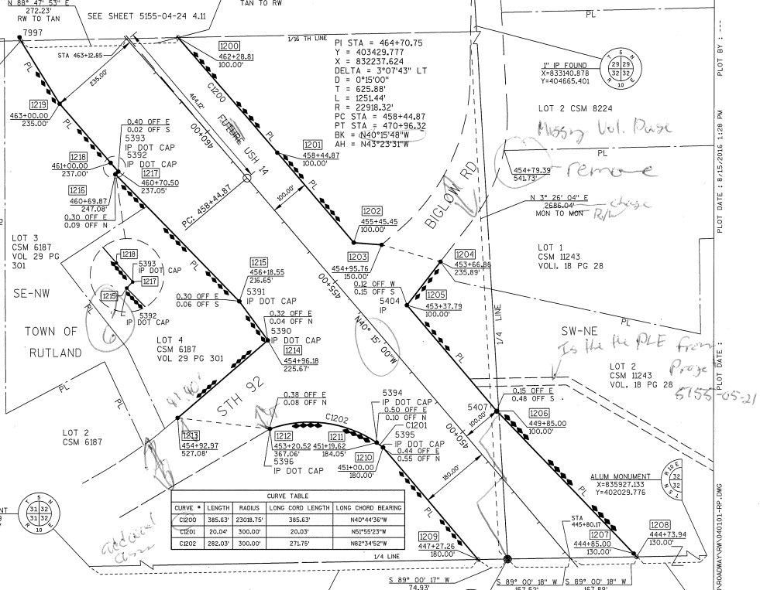
Example: subhead and bullets Select text to edit headline
Click here to edit subhead
Notes:
Many handwritten comments in red pencil and then scanned as a PDF.
A separate document would contain a detailed description of issues to be addressed.
Comments not indexed so updates were often missed.
Resulted in more reviews

Slide 6
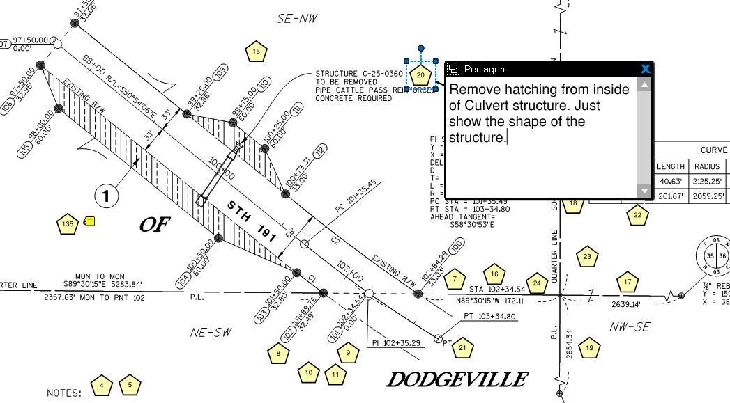
Notes:
Initially placed all text on the page. It was linked but cluttered the image making it hard to read.
Evolved into symbology – Pentagon represents plat related comments
Cleaner look
Too much detail for corrections would clutter page so symbology was used instead.
Linked to comment section.
Increased effectiveness of corrections
Fewer reviews

Slide 7
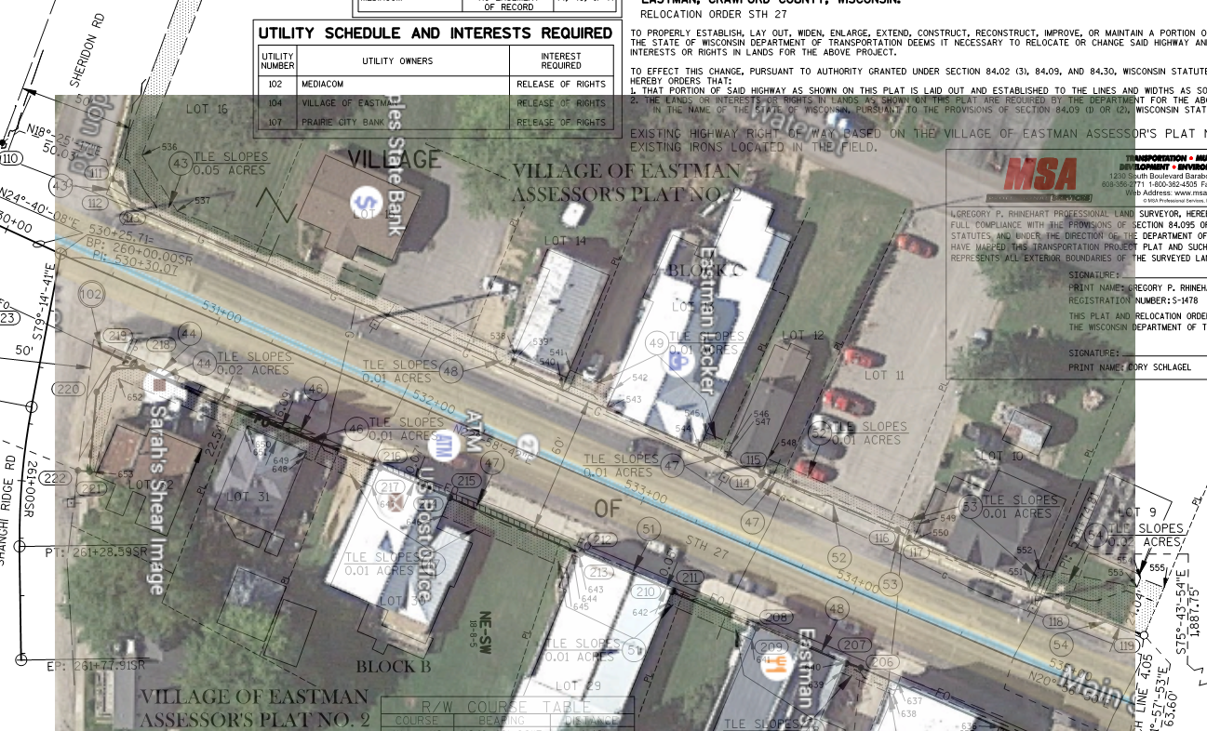
Notes:
Bluebeam allows you to create and manipulate layers.
Can overlay background mapping
Helpful for the public to understand the map/bearing to their property
Can quickly create exhibits that required several tools and multiple hours saved
Overlayed mapping to address access complaint of prosed project.
In the past, we would have sent personnel or survey crews to the field.
Found the field entrance wasn’t part of the project.

Slide 8
Utilizing Large Screen 4K TVs
4K resolution = 3840 x 2160 pixels
A 22” LCD is often 1680 x 1050 pixels in resolution
One 4K TV = ~ 4.5 LCDs in terms of pixels that can be viewed
Piloting 40” consumer TVs & 43” commercial grade TVs
Advantages include:
Viewing more applications concurrently
Better color depth and text/line clarity
One 4K TV = ~ 2 LCDs cost-wise
Less zooming, scrolling, resizing of applications
Less printing
Estimate 1 hour productivity gained per week

Slide 9
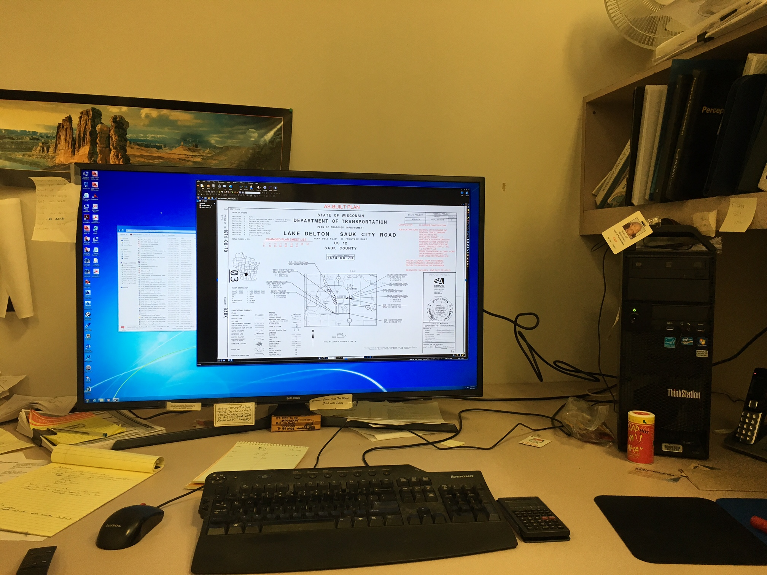
Notes:
Plat review user of Bluebeam, also a pilot user for the 4K TVs

Slide 10
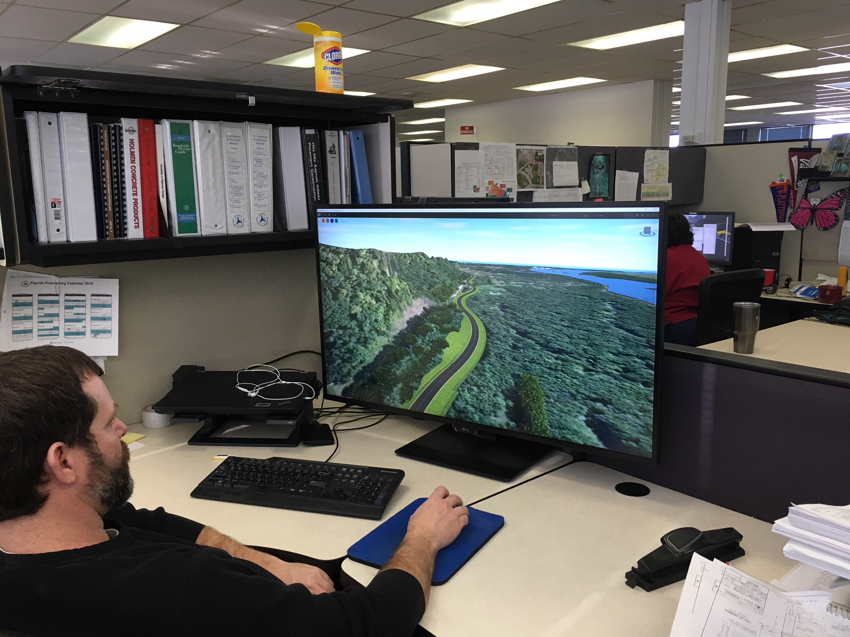
Notes:
Employee using InfraWorks and part of the 4K pilot
Revealed the new for video performance when selecting IT hardware
Timely hardware requirements were applied to replacement hardware models

Slide 11
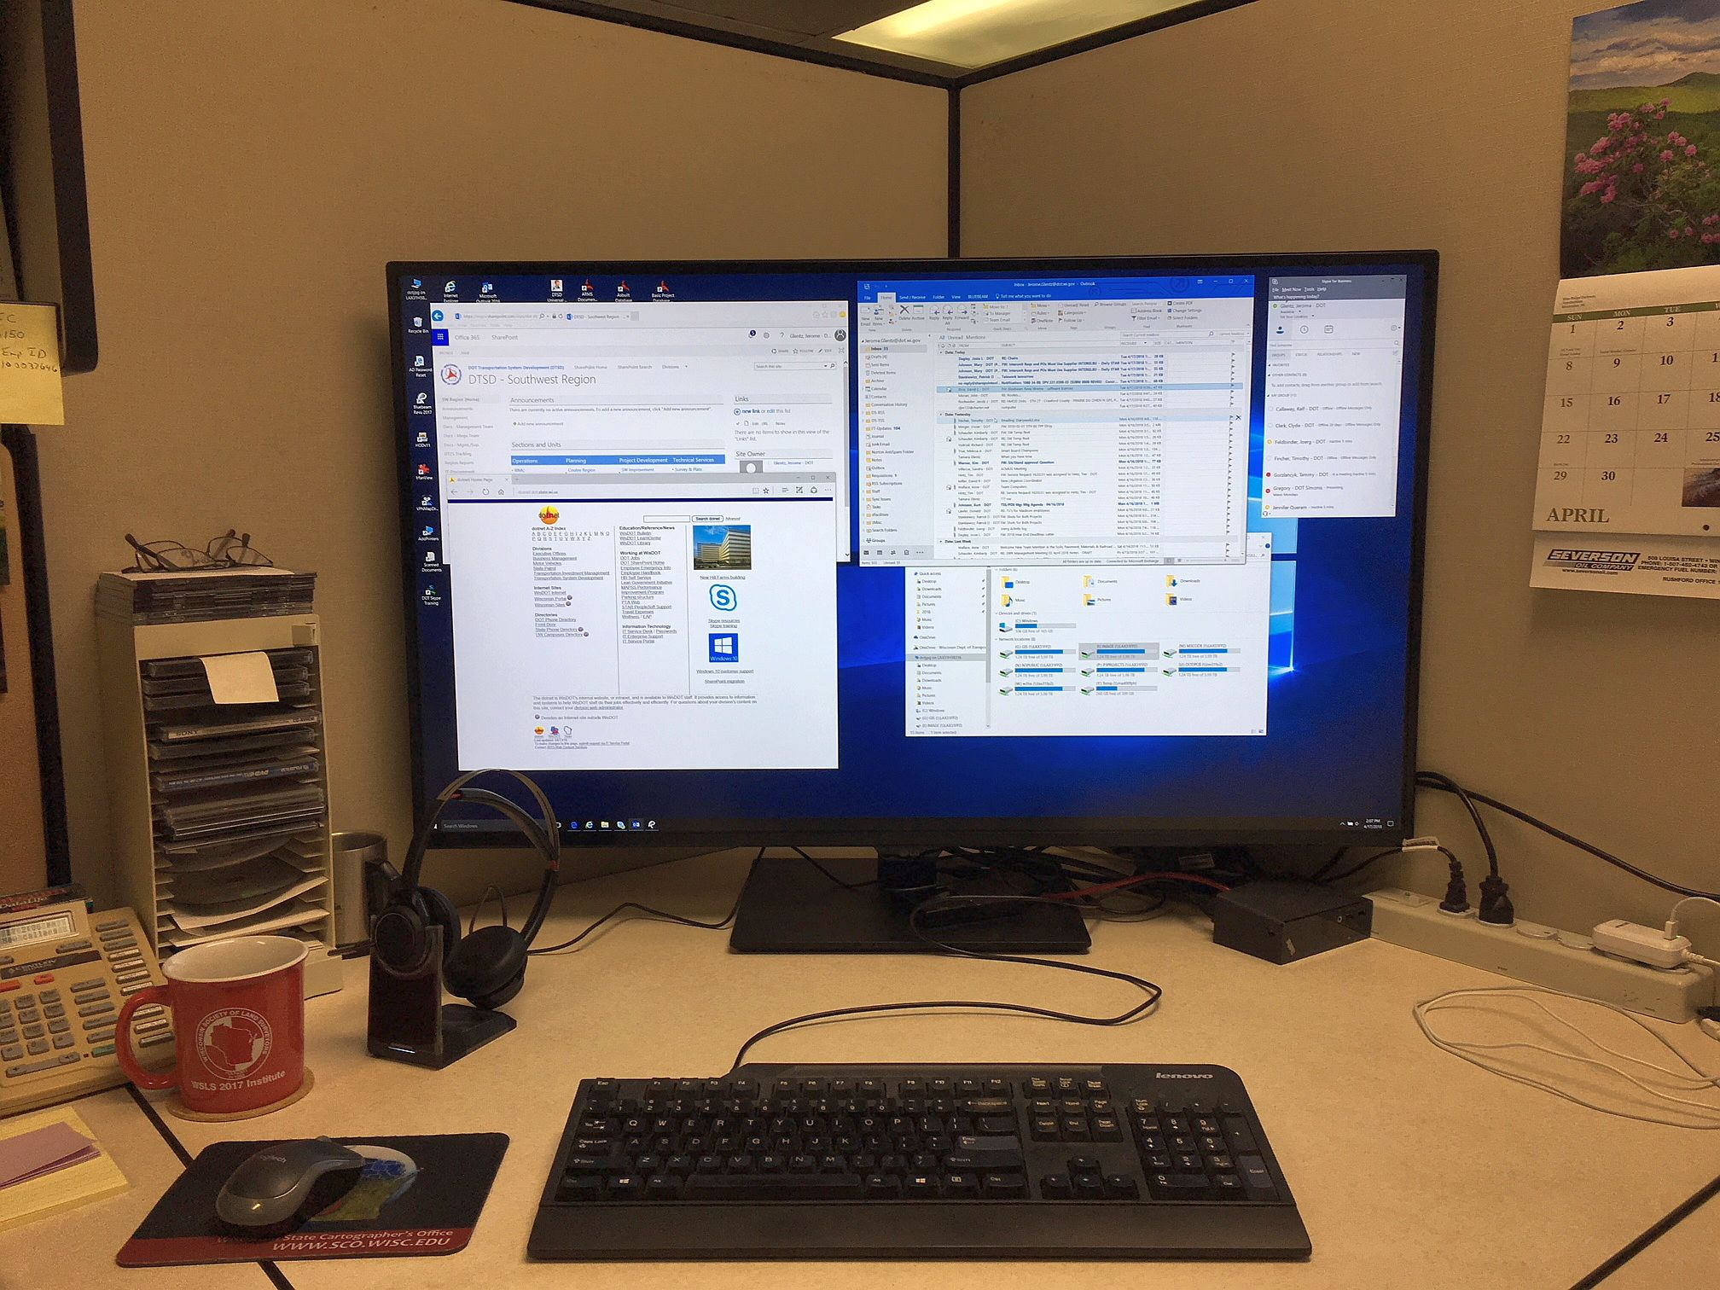
Notes:
My work area and how I often arrange various applications.

Slide 12
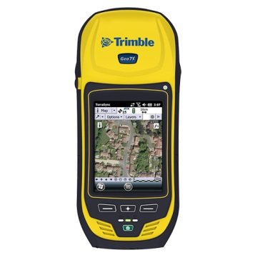
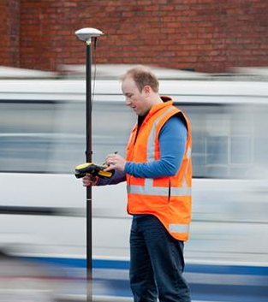
GPS Technology on Construction Projects
Lack of technology for field staff resulted in using wrong tools for the task at hand
No way to verify plan issues, layout or placement of items
Led to increased claims. e.g. items installed in the wrong location
WisDOT initiated a pilot to use 4 Trimble Geo7x handheld GPS units.

Slide 13
GPS Technology on Construction Projects
Pilot in 2016 provided quick successes and efficiencies for field staff
By the end of the 2016 construction season, the pilot concluded and 30 units were deployed state-wide
Staff expanding their use beyond field inspection items
Using the devices to measure quantities
Devices are very accurate, down to 1 cm
Relatively inexpensive - ~$8,000 - $14,000 per device

Slide 14
Bathymetric Survey
The ability to measure the depth of a water body as well as map the underwater features:
Single-beam - SonarMite
Multi-beam
Side-Scan
Integrates fishing technology with survey technology
Notes:
Not many survey firms have underwater survey experience and technology.
Sonar-Mite – relatively inexpensive technology - ~$5,000
Multi-Beam – Very expensive - ~$250,000 considering it needs a larger boat and those related costs.
Side-Scan - ~5,000

Slide 15
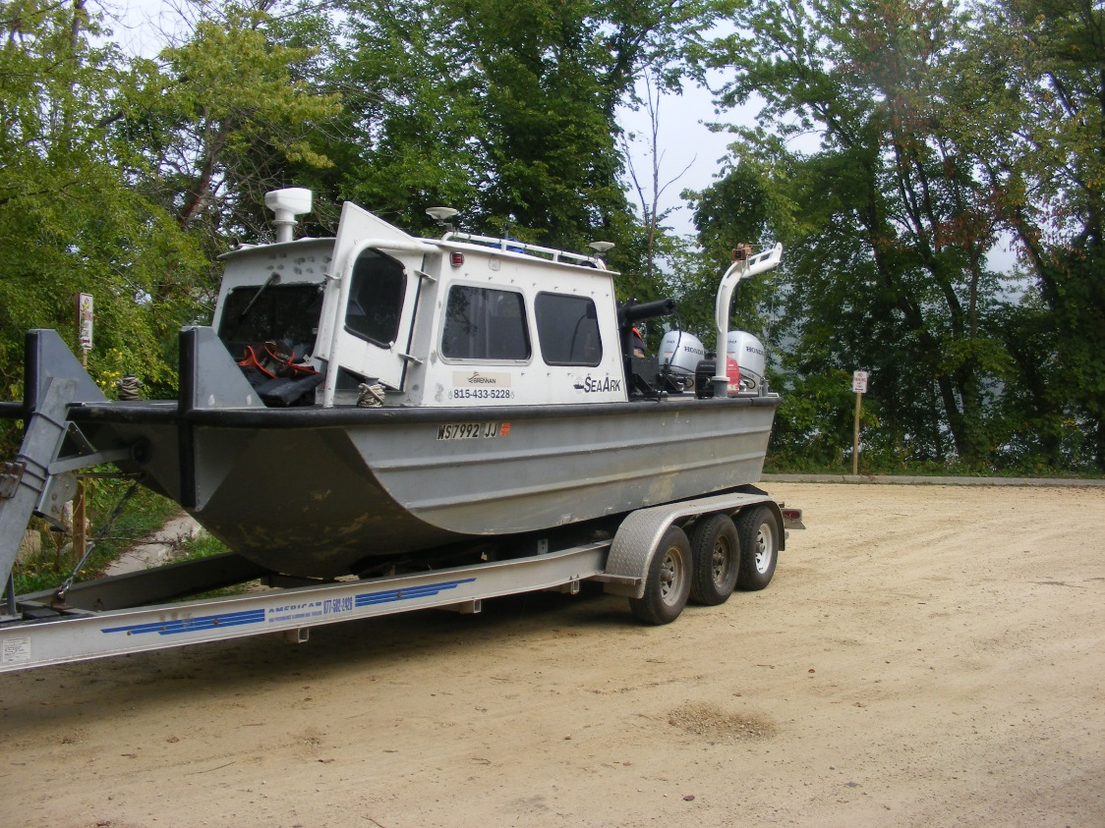
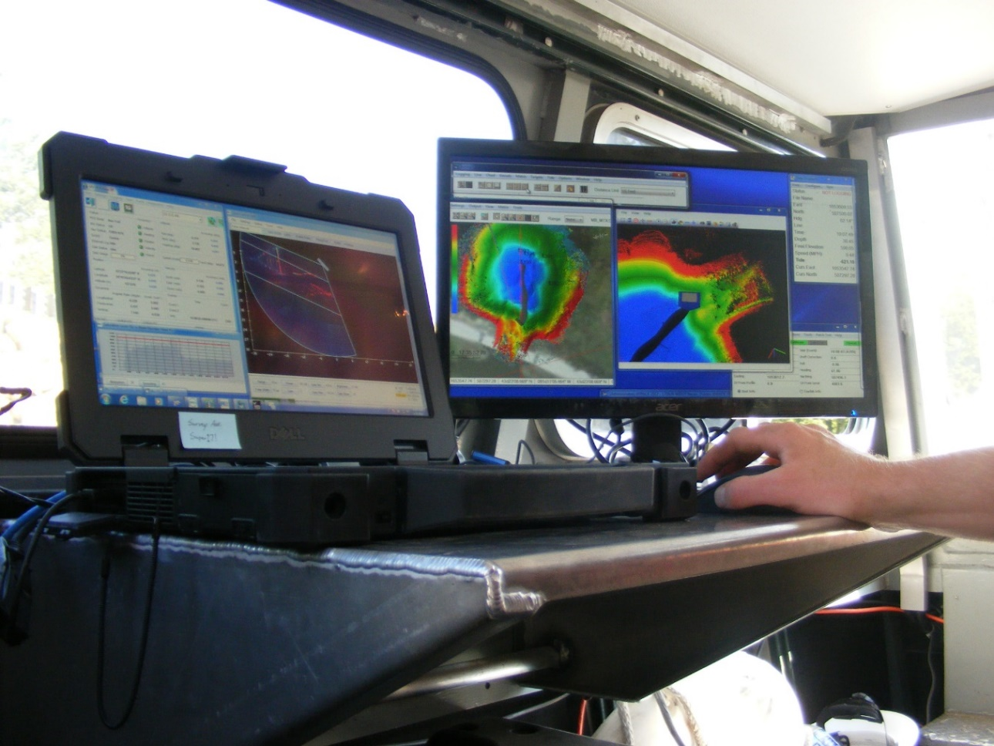
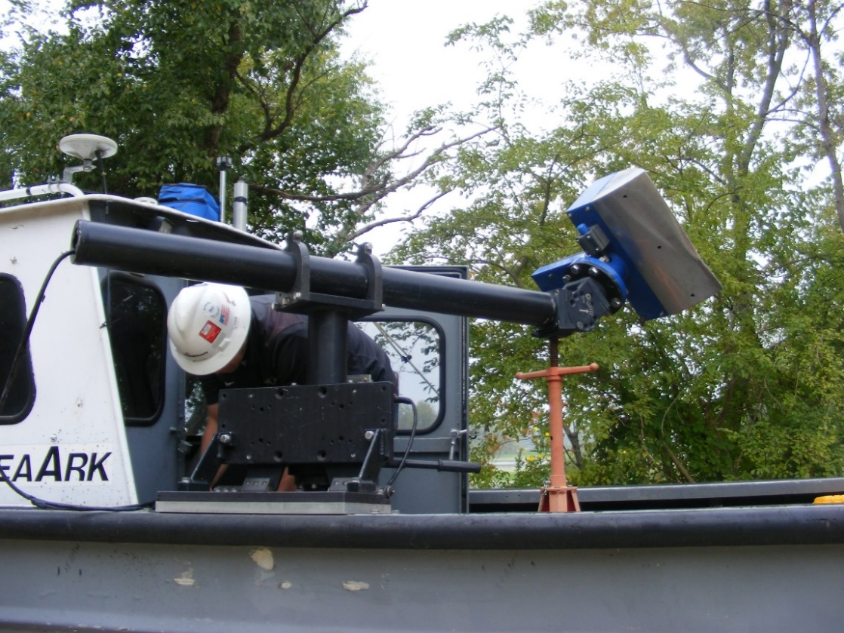
Bathymetric Survey
Multi-Beam

Slide 16
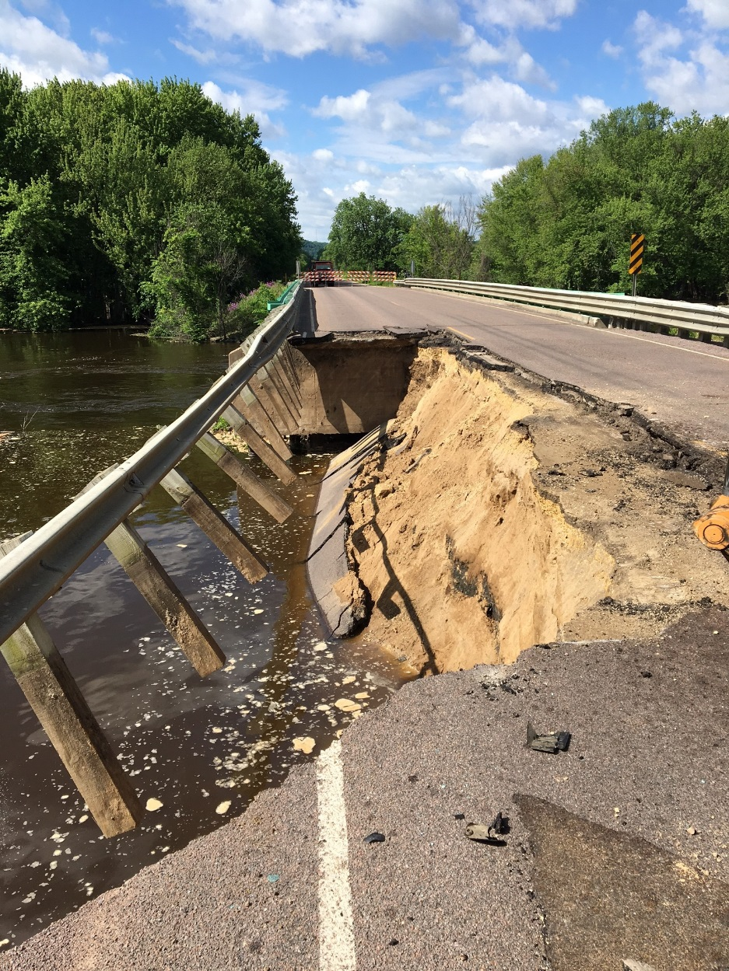
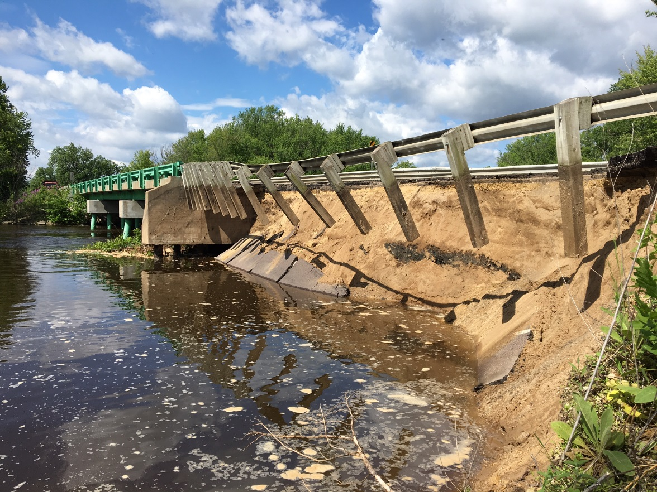
Bathymetric Survey
Technology allowed WisDOT to determine the extent of damage and types of remediation
Notes:
STH 82 – Flooding along the dike-road between Wisconsin and Iowa.
Resulted in a fatality
Continuing to monitor the stability from efforts last spring.

Slide 17
Data model processed in Civil 3D – Revealed 40 deep scours

Slide 18
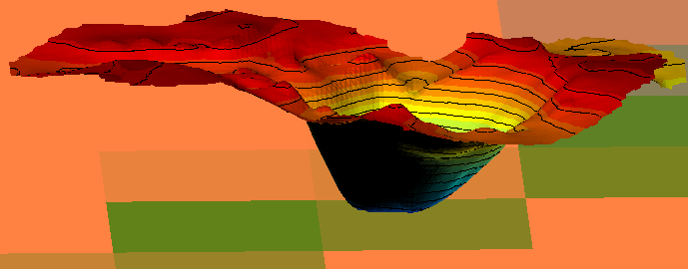
Side-Scan – Creates image to view the underwater relief. However, it does not capture survey information to allow it to be overlayed with collected data.

Slide 19
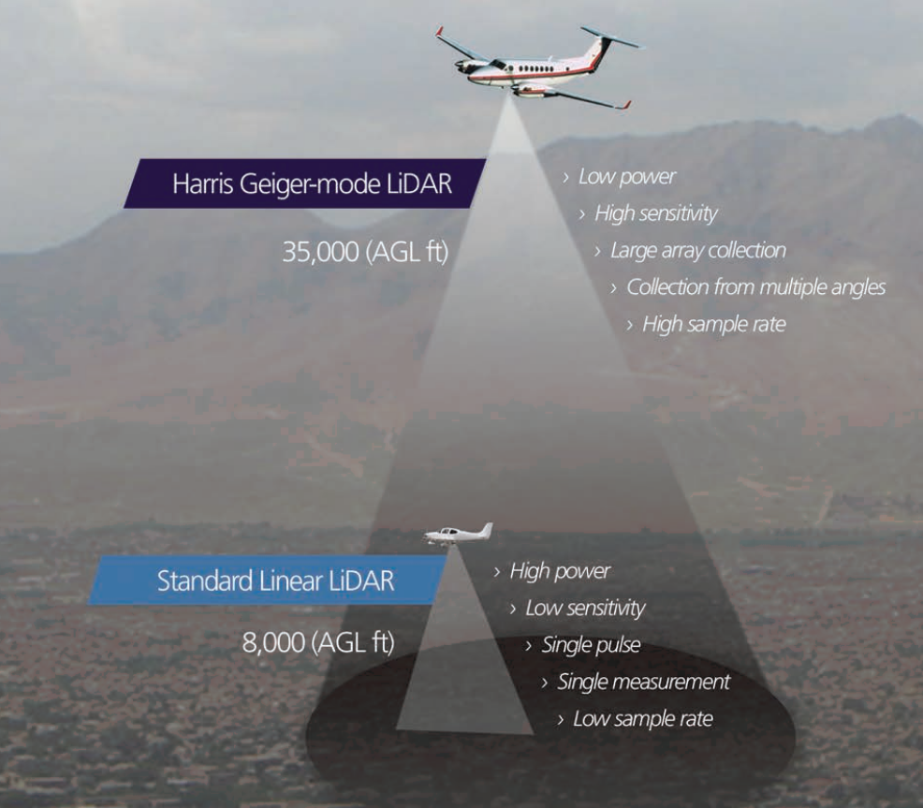
Lidar Technology
Standard Lidar – Linear, single pulse, low level flight paths
Geiger Lidar – Emerging multi-beam, higher level flights, faster collection

Slide 20
Lidar Technology
Looking at WisDOT partnering with counties
Possible county/DOT shared-funding
If we have projects in a county that is being flown, work with vendor to densify control, increase accuracies for planimetric mapping
Data sharing with counties – All16 SW counties provided their lidar data
Savings vs. DOT full service contracted flights
Contracting could be limited to added control surveys and linework

Slide 21
AutoDesk - InfraWorks
Is a planning and design platform that enables engineers to quickly convey preliminary design intent in a real-world, contextual environment, increasing stakeholder buy-in and team decision-making
Integrates Civil 3D and Google Earth mapping data
Creates visualizations of proposed improvement
Bird’s eye view
Vehicle drive-through
Can view project from any viewing angle
Easy to illustrate proposed projects at public information meetings
Can create videos of the project and post them to web sites for public viewing

Slide 23
AutoDesk - InfraWorks
Video of project currently being designed

Slide 24
Public Access to Records
Wisconsin Executive Orders, EO 189 & EO 235 to be more accountable to open records requests
Developed tracking of open records requests
Create a performance dashboard
Identified employee training requirements
Currently identifying records that could be publicly accessible for frequently requested records from State portal:
Recorded Plats
Construction Asbuilts
Other records?

Slide 25
SharePoint
Cloud-based implementation to collaborate and share information internally and externally.
Previous methods of sharing included:
Emailing of files
FTP – one way data sharing
LAN drives but limited external sharing
SharePoint was implemented in January 2014. WisDOT is the main State agency utilizing SharePoint.

Slide 26
SharePoint - Advantages
Increased collaboration
Concurrent editing of documents and spreadsheets
More rapid data entry
Don’t have to deal with first one in and the rest get read-only access
Ability to have versioning of documents
IT backups only provide disaster recovery of the latest version
SharePoint stores as many versions of a document as necessary and allows for users to initiate restoring to previous versions. No delays due to submitting an IT request to recover a file.
Empowers users (Site owner) to manage security and permissions.
Very granular – Entire site, specific libraries or only one document.
First tool to readily share documents with external partners.

Slide 27
SharePoint - Advantages
Developed SharePoint technology champions as a means to provide business/work unit assistance with SharePoint.
Currently no dedicated IT support model for the DTSD’s use and support of SP
Develop work flows
Developing more consistency between regions and state-wide bureaus as specific sites/functional needs evolve.

Slide 28
SharePoint - Disadvantages
Users apply old processes to new technologies
Nesting folders instead of utilizing libraries
Not utilizing Meta data and searching/organizing views
Don’t use this as an opportunity to review existing processes/past practices to modernize their activities
Needs “business analyst” like review of site needs and understanding of each business area
SP support champions often too busy with other duties
Where do I put all these files after my site is done?
Document management
Retention schedules

Slide 29
Questions?

