Slide 1
Lessons Learned
Construction
2019 SW Region Construction Conference
State Office Building, La Crosse, WI
February 28, 2019

Slide 2
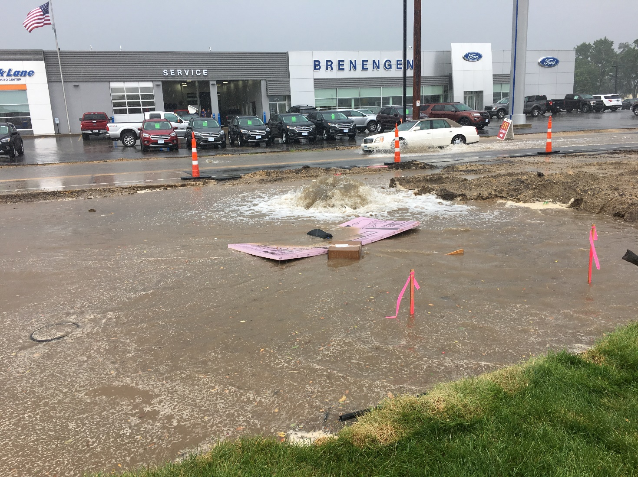
A little Hydraulic Grade Line problem here

Slide 3
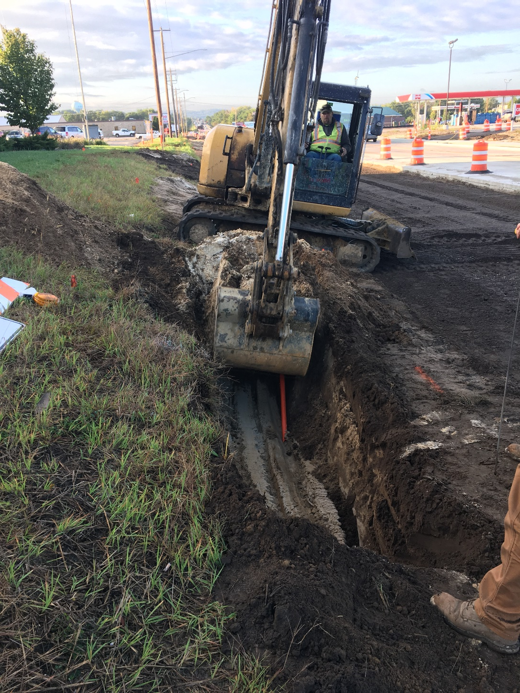
Digging for unmarked, unmapped drain tiles

Slide 4
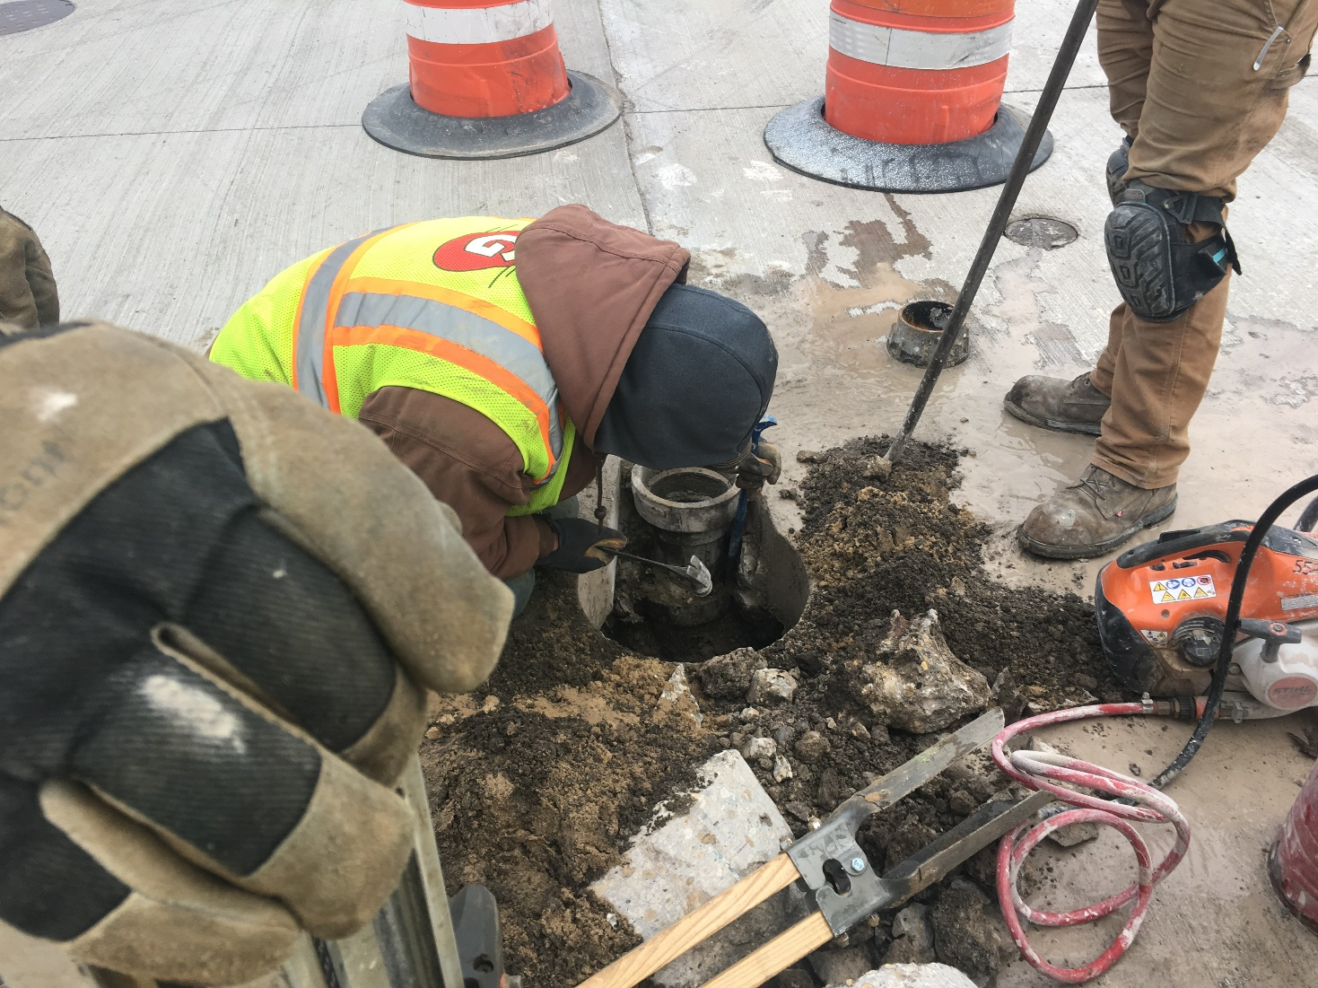
Damage to a valve box by the concrete pour

Slide 5
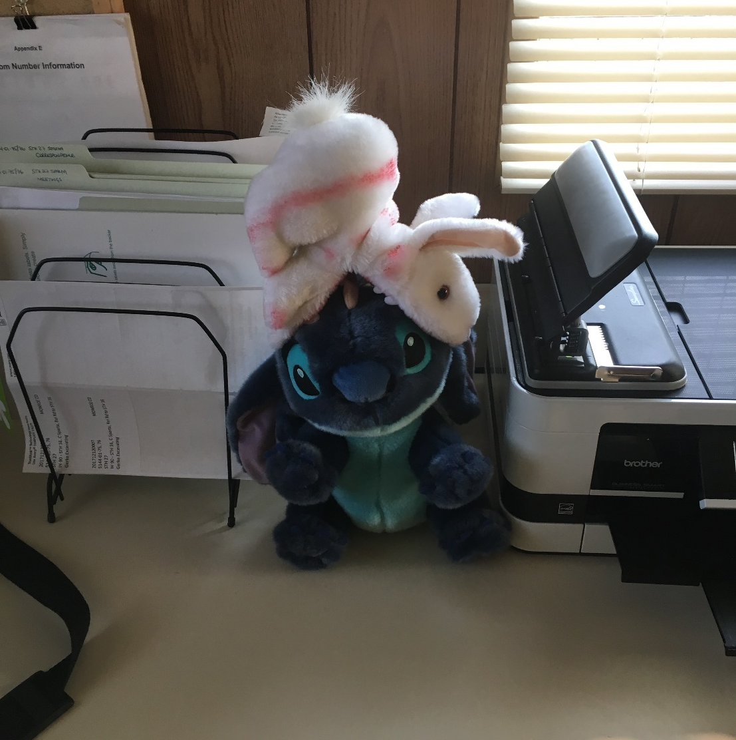
Keep field office mascots separated

Slide 6
Example: bullets only
Select text to edit this headline
Select to edit bullet 1
  Select to edit bullet 2

Slide 7
Example: subhead and bullets
Select text to edit headline
Select text to edit subhead
Select to edit bullet 1
  Select to edit bullet 2

Slide 8
Example: picture or graph only
Select text to edit headline
Select text to edit subhead
Second line optional

Slide 9
Example: subhead and paragraph
Select text to edit headline
Select text to edit subhead
Select text to edit paragraph. Select text to edit paragraph.
Select text to edit paragraph. Select text to edit paragraph.
Select text to edit paragraph. Select text to edit paragraph.
Select text to edit paragraph.

