Slide 1
WisDOT Labor Compliance
Rebecca Porter
Labor Compliance Specialist
2019 Construction Conference
La Crosse, WI
February 28, 2019
Notes:
*Welcome & thanks for having me
*Looking forward to another construction season
*Items being covered today: Who we are, What we do, Where you’ll see us & When to communicate

Slide 2
Who, What, Where & When of labor compliance
Overview
Who are the labor compliance specialists
What does a labor compliance specialist do
Where will you see the labor compliance specialist
When should you communicate with the labor compliance specialist
Notes:
Today we will cover the who, what, where and when of labor compliance

Slide 3
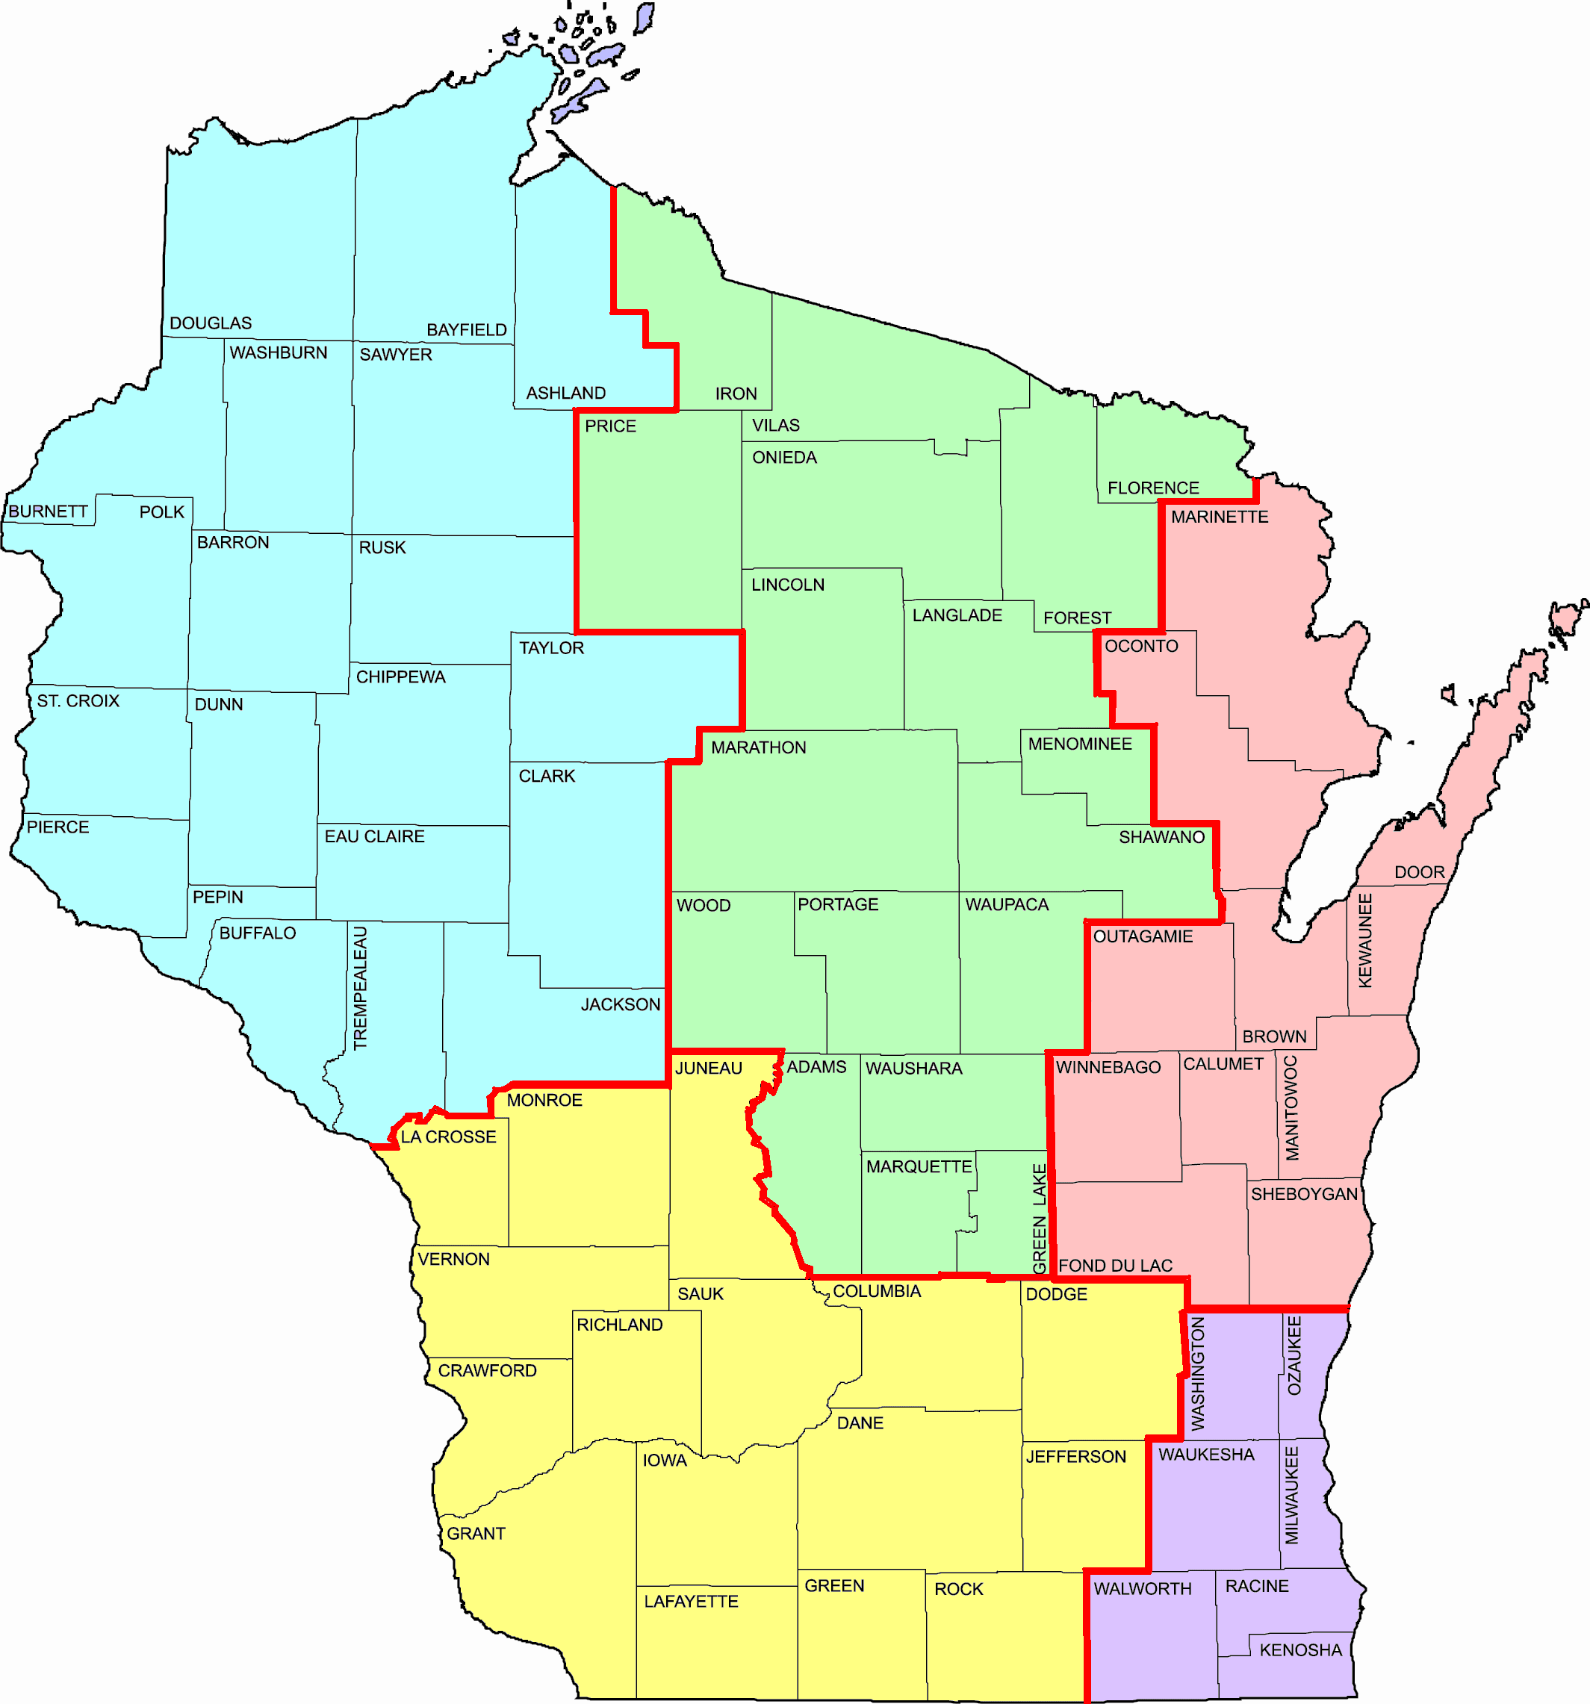
WisDOT Labor Compliance Specialists
Eastern Wisconsin
Lead - Jason Johnson (920) 492-5728 (NE)
Teresa Rademacher (920) 492-5657 (NE Mega)
Jennifer Lubinski (262) 548-5634 (SE)
Margaret Powers (262) 521-5337 (SE Mega)
Janice Sindic (262) 548-5923 (SE Mega)
NW
NC
Western Wisconsin
Lead - Laurie Dolsen (715) 392-7977 (NW)
Stephanie Jaecks (715) 365-5732 (NC)
Tim Alston (608) 242-8040 (SW)
Rebecca Porter (608) 245-2648 (SW)
Deb Henning (608) 884-1178 (SW Mega)
Julie Harkinson (608) 772-5169 (SW Mega)
Diane Zimmer (608) 884-1179 (SW Mega)
Crystal Wilson (608) 264-8700 (SW Mega)
NE
SW
Labor Compliance Investigations (Statewide)
Lead - Natalia Vega (262) 521-5358 (SE)
Teresa Rademacher (920) 492-5657 (NE)
Boula Xiong (608) 267-7354 (SW)
Aeronautics (Statewide)
Shannon Clary (608) 264-7607 (SW)
Crystal Wilson (608) 264-8700 (SW)
SE
04/03/18
Notes:
*Who we are: broadly - OBOEC (Office of Business Opportunity & Equity Compliance) staff throughout regions
*Labor Compliance Specialist – monitor state let construction projects (not locally let)
*Who will be the LCS on work share projects – the region taking on the work share will be the LCS on the project. Example – NCR workshares with NER, LCS will be NER

Slide 4
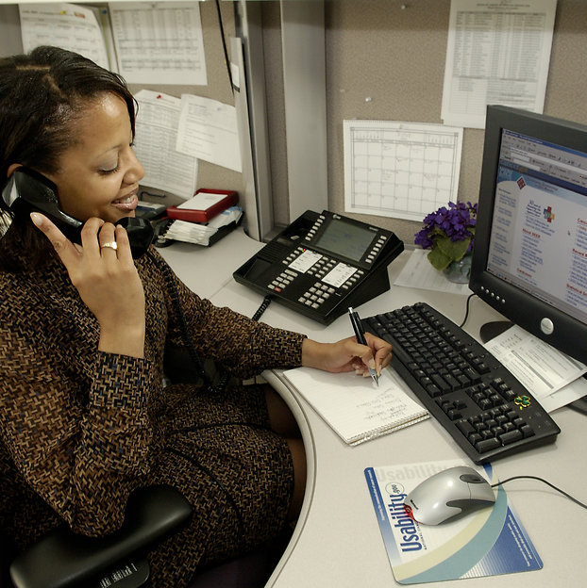
What does a labor compliance specialist monitor
From the office
Additional Special Provisions: TrANS, DBE, payments & payrolls
Sublet requests
Apprentices
Wage rates
Notes:
What we do:
ASP 1 – TrANS
ASP 3- DBE
ASP 4 – Prompt payment- project leaders are responsible to handle any prompt payment issues through the process outlined in the CMM. A lot of times there is confusion since we are in “compliance” the contractors and project leaders/staff feel we are responsible for compliance with ASP4. Our role in labor compliance is to provide assistance to project staff by giving them the payment reports, etc., as they deal with the contractors for resolution.
ASP 7- 1st tier & DBE payment
ASP 9 – Electronic certified payrolls or labor data submission
******NEW THIS YEAR – ASP 9 was revised beginning January 2019 let – may see no cost change order request prior to work starting on projects let end of 2018*********
Sublets – LCS looks @ 30% at this time. Project staff responsible for monitoring from there forward
Apprentices – certified apprentice program
Wage rates – workers getting paid correctly

Slide 5


Where – might you see us
Attending preconstruction conferences
Conducting interviews on site
Tribal Coordination Meetings
Weekly Meetings
Notes:
Precons: Will go over labor compliance at precons, if not available we will get you notes ahead of time
Interviews: even if project is state funded only, we would like to get interviews on all projects
If NAHP (Native American Hiring Provision) – LCS may be at required meetings
Weekly meetings: if there are labor compliance related concerns

Slide 6
When
Should you communicate
Meetings
Job site board
Project schedule
Observations
DBE performance
CAP reviews
Withholding payment
Diaries
Substantially Complete
Dedicated Plants
Pay issues
Notes:
*Meetings: notify LCS ahead of time if NAHP meeting, precon, or if there are labor compliance issues and you’d like us to attend weekly meeting.
*Job site board: (formerly wage board): send completed checklist before sending first estimate
1) required on all projects EVEN state funded only 2) must be maintained life of project 3) wages may be stacked
*Project Schedule: 1) change to project items which will eliminate or increase contractor work 2)overall schedule – carryover to next year
*Observations: 1) contractors approved to work on site 2) Only apprentice without journeyman
*DBE: 1) if DBE commitment has changed 2) if DBE isn’t performing work with own men & equipment
*CAP: if notified by FHWA that project is under Compliance Assessment Program and you need information to answer
*Withholding payment: 1) if you receive just cause for contractor with holding payment to sub – they are required to provide just cause in writing to sub & WisDOT
*Diaries: Please keep diaries up to date. LCS uses to cross check.
*Substantially Complete: Triggers LCS to begin final review for PCD to be issued. PLEASE don’t back date- if you are delaying entry of date PLEASE notify LCS
*Dedicated Plants: helps us in determining trucking prevailing wages
*Pay issues: if construction staff comes to you with a pay issue – let us know or if sub isn’t getting paid from hiring contractor/prime

Slide 7

THANK YOU
For continuing to partner with us to achieve compliance.
Your help is greatly appreciated.

Slide 8
Questions?

