Slide 1
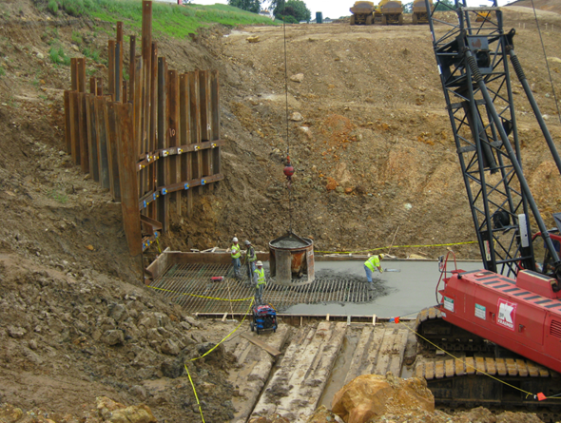
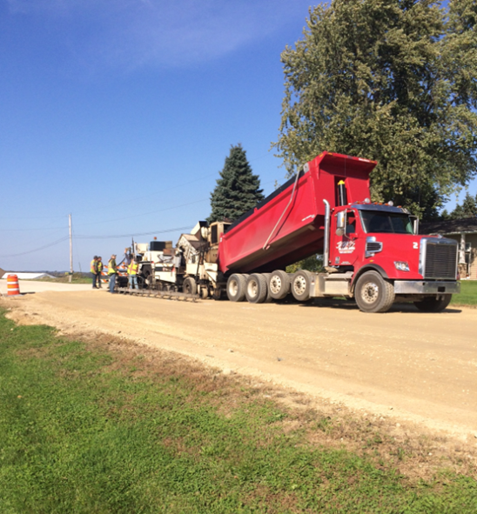
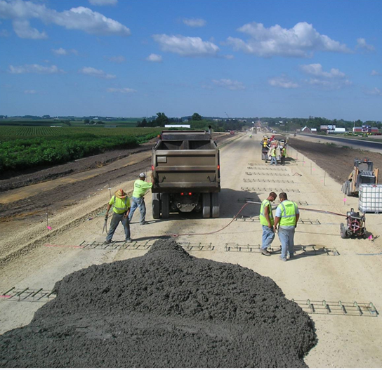
2019 Material Reminders

Slide 2
TSS Contacts
Anne Wallace
Materials Supervisor
Travis Mikshowsky
Soils and Materials Engineer
Jeanette Frazer
IA Specialist
Steve Ames
HMA Specialist
Scott Willinger
Railroad/Materials Specialist
Bill Kobleska
Lab Coordinator

Slide 3
2019 Material Reminders

Slide 4
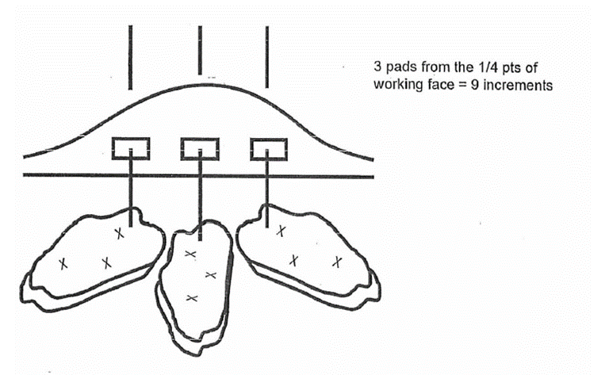
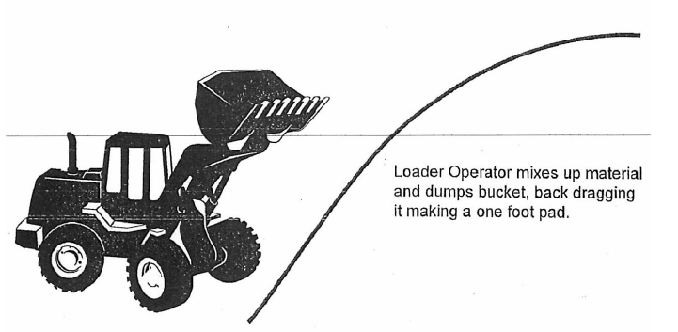
2019 Material Reminders
Passing Stockpile Test for Aggregates Prior to Placement for Both QC and QV
Stockpile sampling should be a coordinated effort between QC and QV (Standard Spec 730)

Slide 5
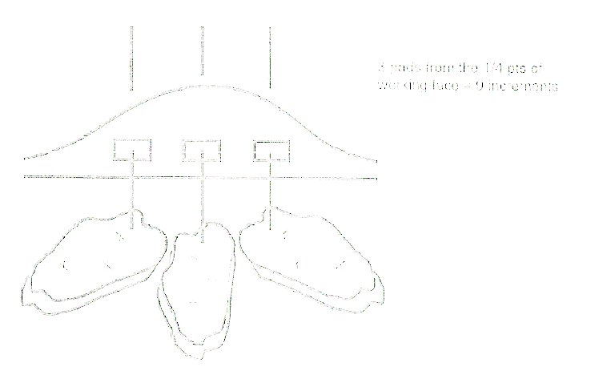
2019 Material Reminders
QMP Base Aggregate is now in the Standard Specs (Section 730)
Passing Stockpile test prior to placement
*If either the QC or QV stockpile test fails, Both the QC and QV will resample side by side and rerun the tests
Pay Reduction Table now in the Spec
Definitions/Extents for Non-Conforming Material
Stockpile tests are valid for multiple projects for up to 60 days from day stockpile test was taken
A lot of other changes
Passing Stockpile Test for Aggregates Prior to Placement for Both QC and QV
Stockpile sampling should be a coordinated effort between QC and QV (Standard Spec 730)

Slide 6
2019 Material Reminders
Passing Stockpile Test for Aggregates Prior to Placement for Both QC and QV
Stockpile sampling should be a coordinated effort between QC and QV (Standard Spec 730)
Check That All the Aggregates Being Used Are From A Source That is Approved For the Aggregate’s Intended Use

Slide 7
2019 Material Reminders
Passing Stockpile Test for Aggregates Prior to Placement for Both QC and QV
Stockpile sampling should be a coordinated effort between QC and QV (Standard Spec 730)
Check That All the Aggregates Being Used Are From A Source That is Approved For the Aggregate’s Intended Use
Notify Materials Section Two days prior to placement of:
HMA
Base Aggregate
Concrete

Slide 8
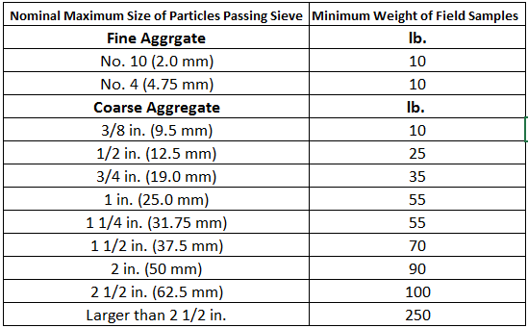
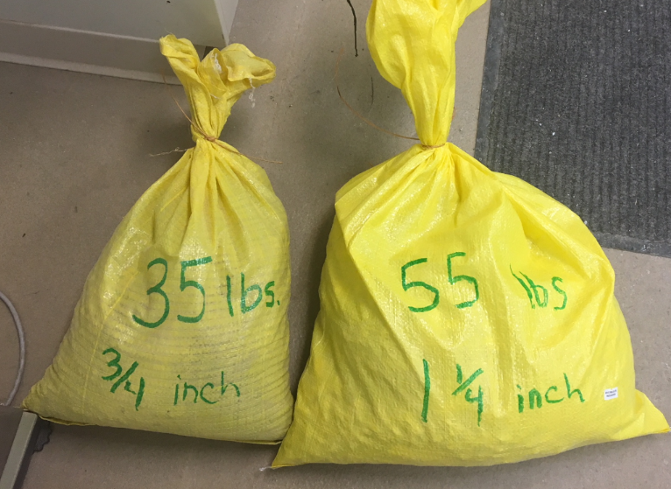
2019 Material Reminders
Passing Stockpile Test for Aggregates Prior to Placement for Both QC and QV
Stockpile sampling should be a coordinated effort between QC and QV (Standard Spec 730)
Check That All the Aggregates Being Used Are From A Source That is Approved For the Aggregate’s Intended Use
Aggregate Minimum Sample Size
Notify Materials Section Two days prior to placement of:
HMA
Base Aggregate
Concrete

Slide 9
2019 Material Reminders
Passing Stockpile Test for Aggregates Prior to Placement for Both QC and QV
Stockpile sampling should be a coordinated effort between QC and QV (Standard Spec 730)
Check That All the Aggregates Being Used Are From A Source That is Approved For the Aggregate’s Intended Use
Fill out Non-Conformance/Non-Performance Spreadsheet as Issues Come Up
Materials Section will Request in October 2019
Aggregate Minimum Sample Size
Notify Materials Section Two days prior to placement of:
HMA
Base Aggregate
Concrete

Slide 10
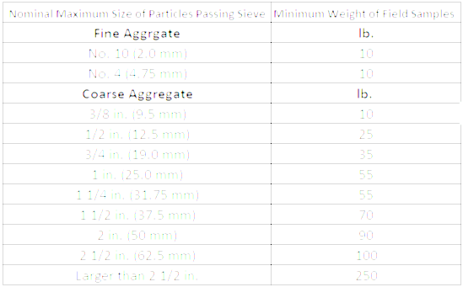
2019 Material Reminders
Passing Stockpile Test for Aggregates Prior to Placement for Both QC and QV
Stockpile sampling should be a coordinated effort between QC and QV (Standard Spec 730)
SWIG 8-45 For Materials Information
Check That All the Aggregates Being Used Are From A Source That is Approved For the Aggregate’s Intended Use
Fill out Non-Conformance/Non-Performance Spreadsheet as Issues Come Up
Materials Section will Request in October 2019
Aggregate Minimum Sample Size
Notify Materials Section Two days prior to placement of:
HMA
Base Aggregate
Concrete

Slide 11
2019 Material Reminders
Passing Stockpile Test for Aggregates Prior to Placement for Both QC and QV
Stockpile sampling should be a coordinated effort between QC and QV (Standard Spec 730)
SWIG 8-45 For Materials Information
Check That All the Aggregates Being Used Are From A Source That is Approved For the Aggregate’s Intended Use
Fill out Non-Conformance/Non-Performance Spreadsheet as Issues Come Up
Materials Section will Request in October 2019
Aggregate Minimum Sample Size
Notify Materials Section Two days prior to placement of:
HMA
Base Aggregate
Concrete
*There are Plenty of Changes to All Materials so Check the Standard Spec, ASP 6, and CMM (Or You Can Always Call a Materials Team Member)

Slide 12
Other Material Reminders
Field Reviews
Notify Materials Staff when
Benchmarks are achieved
Larger Projects
30% Reviews
60% Reviews
Smaller Projects
50% Review

Slide 13
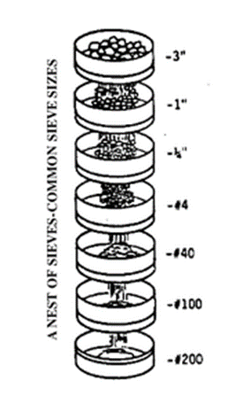
Other Material Reminders Concrete
Optimized Gradation for Concrete Pavements
This SPV should be on every concrete paving project that requires slip form paving
This SPV doesn’t require the use of an optimized gradation but gives contractors the option
Can be added through a No Cost Change Order with no incentives if not in contract this year

Slide 14
Other Material Reminders Concrete
Super Air Meter (SAM)
Now required with concrete pavement through 715.3.1.1 (2)
Exceptions for small quantities, HES, SHES, and approach slabs
Contractor is required to run test and enter it into the MRS for information only

Slide 15
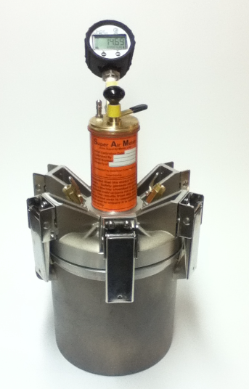
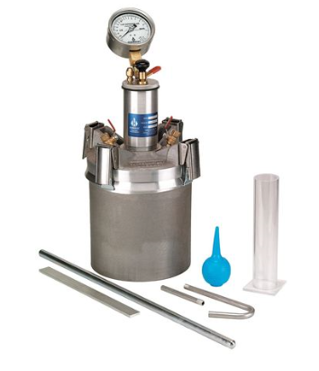
Other Material Reminders Concrete
Super Air Meter Air Meter

Slide 16
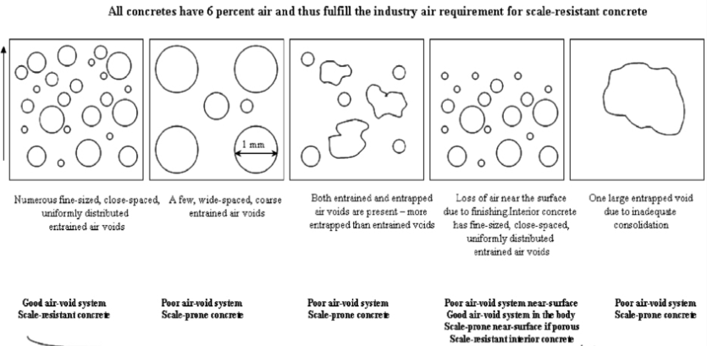
Other Material Reminders Concrete
What is different about the Super Air Meter?

Slide 17
Other Material Reminders Concrete
New QV testing frequency for concrete pavement (715.3.1.3 (1))
1 QV tests for every 5 QC with at least 1 QV test per lot
Example
4 Lots with 8 QC tests/Lot = 32 QC Tests
Will need 7 QV tests with at least one in each lot
Example
6 Lots with 4 QC tests/lot = 24 QC Tests
Will need 6 QV tests to get one in each lot

Slide 18
Upcoming HMA Training
Part 1 – Two Online HMA Training through the LearnCenter
1) Type “AASHTO TC3 HMA Paving Field Inspection” into the search bar
2) Also available April 1st will be an online 2019 PWL Training

Slide 19
Upcoming HMA Training
Part 2 – March 7th in La Crosse
More in depth HMA classroom training that will cover:
Review of the online trainings
HMA Basics
PWL
SMA
Longitudinal Joint Density
Tack Coat
Lab testing
Etc.
*Lab open house after the training for demonstrations on HMA testing practices

Slide 20
Questions?

