Slide 1
WELCOME
Construction Administration Training for Southwest Region
February 28, 2019
Notes:
Debra Howe, La Crosse Contract Specialist Advanced (Design and Construction)

Slide 2
SWR Construction Administration Process
Preconstruction - Project Start
During Construction
Finals Dates & Records
Notes:
Our process is broken into 3 parts: Preconstruction, During construction and Finals Closeout

Slide 3
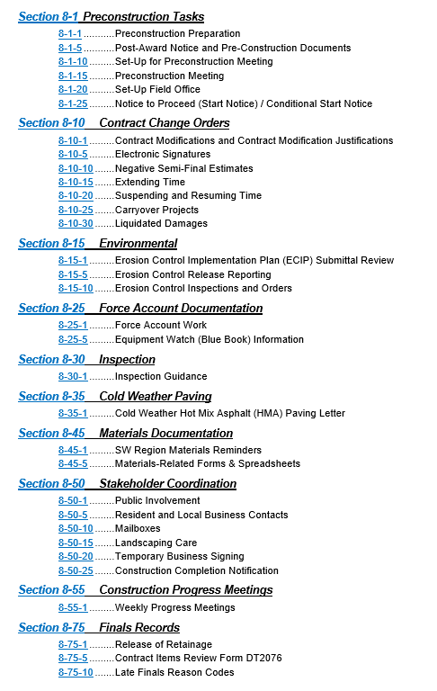

Southwest Improvement Guidance SWIG
Information and procedures typically found in a region pantry are located in the
SWIG Chapter 8: Construction
Notes:
Southwest Region SWIG Information
https://wisconsindot.gov/Documents/doing-bus/eng-consultants/cnslt-rsrces/swig/sw-08-00toc.pdf

Slide 4
AASHTOWare Project Knowledge Base (AWPKB)
Website with resources for design and construction
ACM Updates: Email from me at the beginning of Feb
WisDOT staff: Receive updates automatically via Microsoft SCCM.
Consultants: Go to AWPKB, Construction, Summary of Changes, Downloads
How to Verify? 2018 Pantry was replaced with AWPKB and Field Manager Version 5.3c
---- Future and Current: General information including Help Desk info
---- Construction Summary of Changes: Monthly updates of guides and pantries and downloads for consultants.
---- Pantry
Region Specific Pantries (SWIG link for SW)
Manuals & Guides: Field Software User Guide (FSUG) , FM
Updates: site events/times, mods, L.S. items, delayed contracts, transferring contracts
Statewide Forms, Spreadsheets
Buy America Exemption added to Pantry Forms
Submission of Claim Submittal Form removed from Pantry
Notes:
Click on link to site. Construction
Field Softward User Guide (FSUG)
Updates: site events, site times, mods, lump sum items, delayed contracts, transferring contracts, etc

Slide 5
2019 Field Software Updates
Consultants:
FieldManager 5.3c AND the new ACM Applications installations MUST be updated. FieldBook 5.3c is optional.
Consultant staff are responsible for their own updates.
Administrative rights are be required for most installations.
Instructions will be sent by the region Contract Specialists and instructions will be located on the AWPKB Download page.
Project field staff MUST download and install FIT and MIT updates throughout the field season.
WisDOT Staff:
ALL software updates distributed using Microsoft SCCM including FieldManager 5.3c, FIT, MIT, ACMApplications, and the 2018-FM53c.acp file.
If an update is missing on a WisDOT staff person’s computer, please open a ticket with the DOT IT Service Desk for a BITS L2 ACM Support staff to investigate.
New Software Installations: Call the Help Desk or WisDOT staff open a ticket
All project field staff MUST apply the new ACP file to all FieldManager databases. Instructions can be found page 33 in the Field Software User’s Guide for Construction Staff (FSUG).

Slide 6
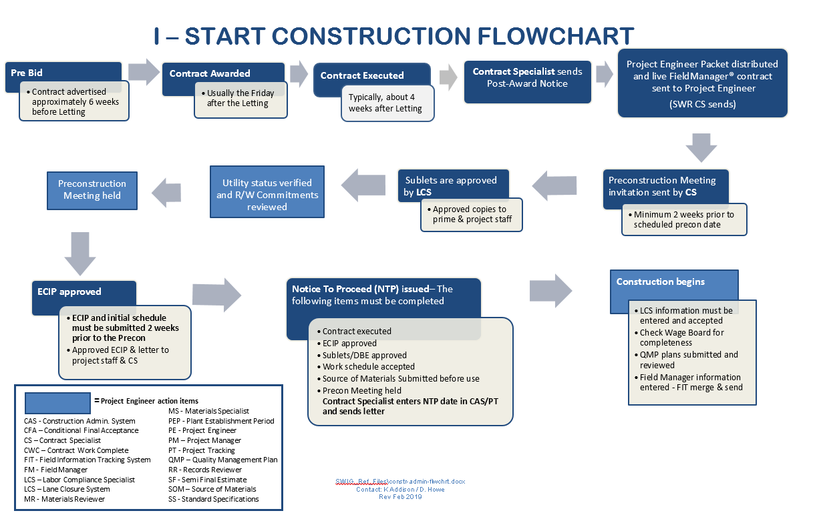
* See SWIG 8-1-20

Slide 7
SWIG 8-1-1 Preconstruction Tasks
Award
Pre-Construction Meeting
ECIP Review, Acceptance, and Approval
Sublet Approval
Execution
Stockpile payment? Notify CS prior to payment. Requires temp NTP and contract refresh.
Lane Closure System (LCS) if req’d
Conditional Start/Notice to Proceed (NTP)
Refer to SWR Constr Admin Guide (CAG) p 2-3 & Flowchart I
Notes:
SWR Constr Admin Guide p 2 & Flowcharts p I
Construction Project startup

Slide 8
PE Packets and Documents
Computer Setup (PE responsible)
PE consultants coordinate w/ PM to pick up Plans, Proposal, PE Packet.
PM sends out Design Doc including Notes to Construction, Real Estate & Environ Commitments, 401/404 & Utility Permits, TMP, IMP, etc.
Obtain electronic documents (CAG) from the SWIG.
* See SWIG 8-1-10

Slide 9
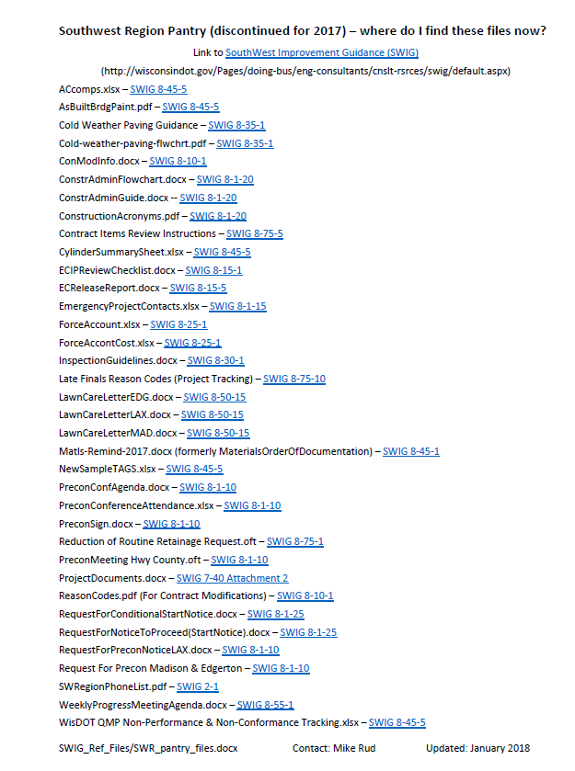
PE Packet Includes
SWIG “Pantry” shortcuts
1 Page of Project Labels
Email me if you need add’l
Emergency Response on Projects document
CURRENT ESTIMATE
WPDES Permit if applicable
Notes:
AWPKB Pantry/Region Specific/SW – Southwest Region/SW – Southwest Region SWIG Information

Slide 10
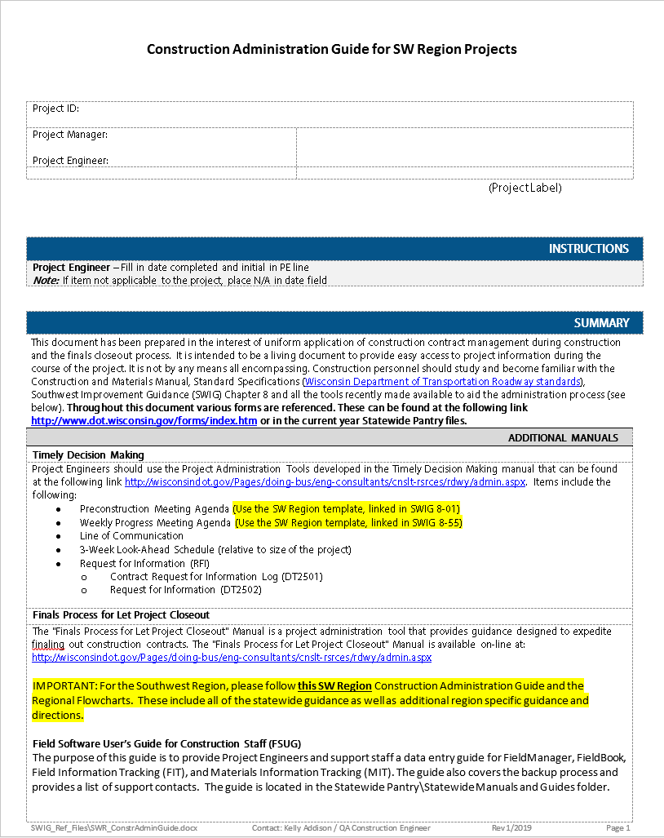
PE Packet Includes:
Construction Administration Guide
UPDATES:
Field Software User’s Guide for Construction Staff (FSUG) page number references updated
Asbuilt instructions updated
Bench Mark Form – Location now Offset (Pat handout, #14 p7 updated)
When emailing CS, please put the lowest project id in your subject line
Email Deb if you want an 11x17 hard copy of the Flow chart.

Slide 11
Field Office Files - Hard Copy Required
Emergency Response to Incidents on Projects
Emergency Project Contacts (email to CS)
ECIP Binder – Environmental Commitments, 401 / 404 Permits (if applicable), ECIP including amendments, etc
Line of Communication Form
WPDES Permit if issued.
Prime: Wage board.
* See SWIG 8-1-20

Slide 12
Design Docs
Plan letter
Environmental Commitments
Time Chart
Notes to Construction Engineer
Real Estate commitments
Wetland Tracking Form / 401 & 404 Permits
Utility Work Plans and Permits
State / Municipal agreements (SMFA / SMMA)
TMP
IMP & who to contact for incidents - ETO plan protocols RIMC / Duty officers
* See SWIG 8-1-1
Notes:
Other important docs to assist you during construction

Slide 13
Preconstruction Meeting
A complete ECIP submittal and initial project schedule is required 2 weeks prior to Precon
PM/PE setup time/date/location with Prime.
Send preconstruction meeting request to CS at least 15 days prior to meeting. Email at a minimum Prime and additional contact emails.
CS has Utilitiy and WisDOT contacts.
Post Preconstruction Meeting:
PE emails minutes to attendees and include CS
PE also emails CS SOM, Schedule, emergency contacts
* See SWIG 8-1-10

Slide 14
Conditional Start Notices
PM decides if a Conditional Start will be issued.
Common reasons are Staking, Traffic Control, PCMS.
Project must be executed.
Sublet request for those performing work must be approved prior to working.
Liability could be huge if we allow any to work w/o this notice!
* See SWIG 8-1-25

Slide 15
Notice to Proceed
(Start Notice)
Contract executed
ECIP approved
Request to Sublet approved
Work schedule accepted/SOM submitted
RR insurance received (if applicable)
PM emails NTP request to CS
CS notifies Prime via email and enters Notice to Proceed (NTP) date in CAS/PT
Prime must have before work begins
PE completes a contract refresh
* See SWIG 8-1-25

Slide 16
Wisconsin Pollutant Discharge Elimination System (WPDES)
If more than 1 acre of disturbance is identified during design, stp-107-056 Information to Bidders, WPDES General Construction Storm Water Discharge Permit will be in the specials.
Design team request permit via Notice of Intent (NOI)
A Notice of Termination (NOT) is required before Final if the DNR issued a WPDES permit.
Form & Instructions: AWPKB, Construction, Pantry, Statewide Forms, Forms Beginning with S-Z
70% Established Vegetation: Construction team submits form and pictures to DNR liaison.
* See SWIG 8-1-25

Slide 17
II - During Construction
FieldManager Entries
Weekly Construction Progress Meetings
Contract Modifications
Claims
Cold Weather Paving
Punch List
Partial Acceptance
*Refer to SWR Constr Admin Guide p 3-8 & Flowchart II

Slide 18
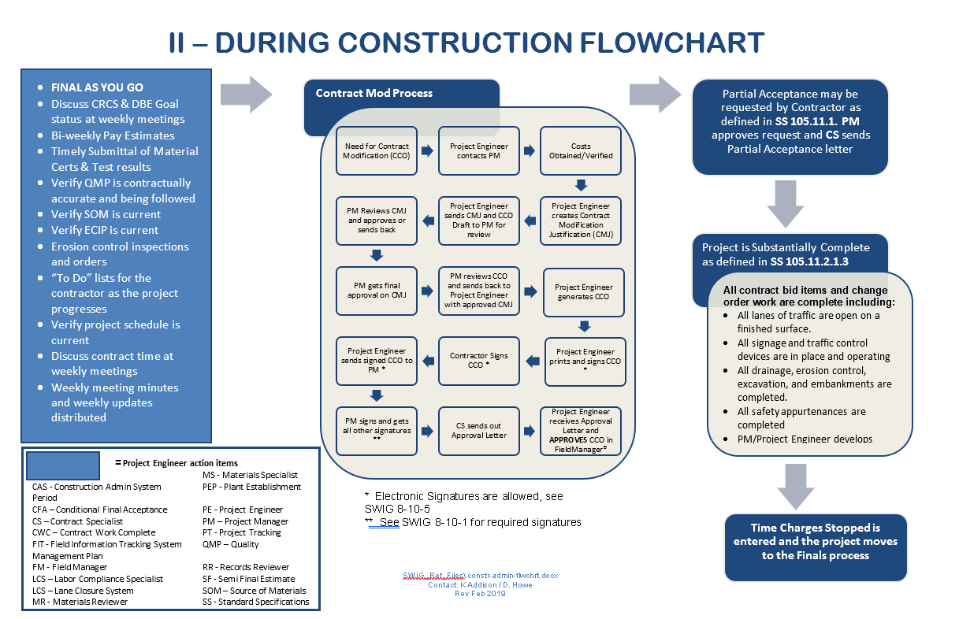
* See SWIG 8-1-20
Notes:
II - During Constr Flowchart
Contract Mods & CMJs
Partial acceptance (rare but seeing more this last year due to weather)
Time charges stopped / substantially complete

Slide 19
Field Manager – Entries
Daily Diaries
  Required for each calendar day, including weekends
Inspector’s Daily Report
  Required for each day the contractor works
Project Engineer is responsible for accuracy of postings
Use caution when printing. Check the FM print to PDF as it cuts off. Might need to print from FIT or Project Tracking.
* See FSUG p8-13, 18, 22, 41-53
Notes:
Daily Diaries are crucial
Inspector Daily Report is key
This is info Used by other sections, primarily Labor Compliance

Slide 20
Field Manager Estimates
Notice to Proceed date MUST appear PRIOR to generating the first estimate. Check Contract Documentation (Docu button/General tab).
IDRs & Daily Diaries MUST be generated prior to creating an estimate
Estimates sent twice a month for pmt due > $1000
Remember to enter “date range” or “FY” on every estimate. FY19 (July 1, 2018 – June 30, 2019)
Discuss negative est with PM prior to sending
Post in Field Office. Email to Prime, if requested.
* See FSUG p 18-21

Slide 21
FieldManager Negative Estimates
If the quantities are incorrect, do not generate the estimate! Close the estimate and make the corrections in the IDRs. Regenerate the IDRs and recreate the estimate.
If the total dollar amount of the estimate is a negative amount, contact your Project Manager or Supervisor prior to generating and sending the estimate. Discuss how to handle this estimate with a negative payment.
  Intermediate Estimates - In most cases, these should not be negative. If possible, do not generate the estimate until there are enough work items to create a positive payment.
  Semi Final Estimates - In most cases, these should not be negative, unless there will be enough retainage to later cover the negative amount with the final estimate.
Notes:
Negative Estimates – things to consider for Intermediate and Semi Final estimates

Slide 22
FieldManager Common Issues
Additional guidance has been added to the Field Software User’s Guide for Construction Staff (FSUG) for these common issues:
Net Change Amount Issues on Contract Modifications: Sometimes when contract revisions are made, the net change dollar amount of the contract modification may not match the total for the item changes for all projects.
Removing Lump Sum Items from a Contract
Guidance for Delayed Contracts: Contracts that cannot be completed until the following spring
Processing Contract Modifications with Site Time Extensions
* See FSUG p 23-26

Slide 23
FieldManager Site Events
WisDOT uses site events to suspend Time and Work on WORKING DAY CONTRACTS ONLY!
  Time Suspended / Time Resumed - Used to temporarily suspend time on carry over contracts and avoid charging liquidated damages
  Work Suspended / Work Resumed - Used to document suspension of work on carry over contracts only. Has no effect on liquidated damages.
The entry of a Suspend event REQUIRES the entry of a Resume event.
Failure to do this will cause issues when the next estimate is sent.
FieldManager site events do not work correctly with Calendar Day or Completion Date contracts in CAS and FieldManager. For these types of contracts, the PL should either:
  Extend time using a contract modification.
  Have your contract specialist enter a maximum liquidated damages rate based on the (number of days to charge) x (liquidated damage rate per day).
* See FSUG p 6-7, 18, 22 & 24
Notes:
Site Events
Only use Time Suspend events with Working Day Contracts
Controls LDs
Time Suspend event must have a corresponding Time Resume event
Time exceeded – check with PM or CS to see if you should create a cont mod

Slide 24
FieldManager Site Times
Before sending an estimate, review all contract sites to ensure that the number of days or completion dates are not exceeded on the site.
If time is exceeded, a time extension contract modification may be required to reduce or eliminate liquidated damages.
If the time charges stop date is entered incorrectly or the number of days charged to date is incorrect, contact your Project Manager and Contract Specialist for assistance.
If you have a contract with mixed sites (a completion date contract with interim working day or calendar day sites), work with your Project Manager and Contract Specialist throughout the life of the contract to ensure liquidated damages are calculated correctly.
* See FSUG p6, 10,12, 14, 16, 18, 19 & 26
Notes:
Site Times
Before sending an estimate (to manage LDs)
Review all sites
Make sure the number of days or completion date have not been exceeded
Monitor contracts with mixed sites closely

Slide 25
Weekly Progress Meeting
Agenda in SWIG 8-55-1
  Modify to fit project
Minutes & attendance taken by Project Engineer
Contractor to provide 3 week look ahead
Always discuss materials documentation and running ‘to-do’ list
PE to distribute minutes weekly (Prime & all attendees)
Attach Weekly Statement of Working Days to Minutes
Completion Day Contracts
  Discuss schedule at Weekly Meeting
  Compare with contractors schedule
  Review of adverse weather days monthly
* See SWIG 8-55-1
Notes:
Every project needs to have weekly progress meetings
Continue to communicate with the Prime after the completion of the work thru the finals process.

Slide 26
FieldManager Contract Modifications
Contract modifications are used to add new items to a project, move items from one project or category to another, increase/decrease items quantities, or add time to a contract.
Contact your region Contract Specialist if you need to add a new project with categories, contract site, change a contract site time, or change the retainer. Categories cannot be added to existing projects.
Merge and send FIT data each time you change the status of a contract modification to keep CAS and Project Tracking up-to-date.
Approval process is based on region specific guidelines.
When generated, item quantity changes can be included on IDRs but will not be included on an estimate until the contract modification is approved.
* See FSUG p6-8, 14-18 & 22-24
Notes:
Categories cannot be added to existing projects because of PeopleSoft restrictions.
FIT merge and sends
Cannot make payment on items until mod is approved

Slide 27
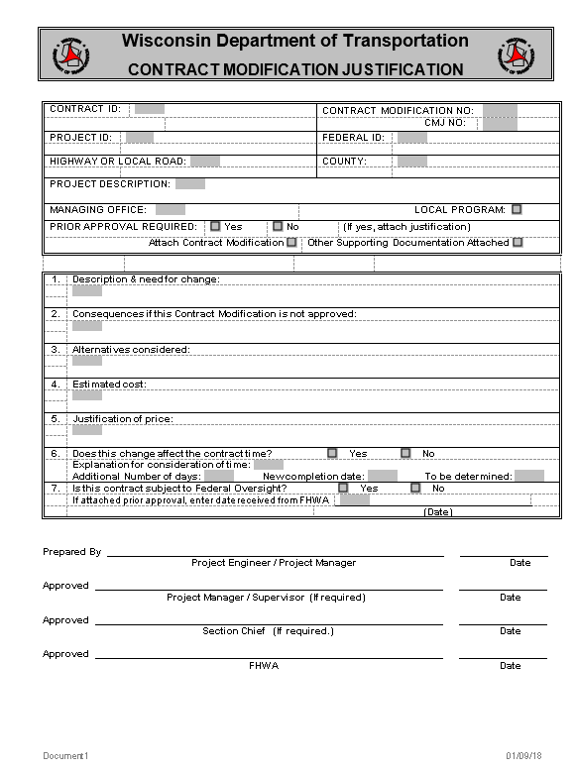
Contract Modification Justification
Use most current version in AWPKB Pantry
Contract Mod Justification (CMJ) is
required for EVERY contract mod
CMJ is an internal document
and is not distributed to the contractor
Follows same signature authority as
Con Mods
Multiple CMJ’s for one Mod
  Ex 1.1, 1.2 or 1-1, 1-2 or 1a, 1b
* See SWIG 8-10-1
Notes:
Each item needs a CMJ, even when multiple items are in the same con mod. Number them to correspond to the Con Mod.

Slide 28
Contract Mods
Use 800 Admin Items if applicable
All Mods require a CMJ
CS can assist in obtaining Prime signature
Required Signatures for approval (+/-)
  $0-$25,000 – PM approves
  $25,000 - $50,000 – Supervisor approves
  $50,000 or more – Chief approves
  Alert local prior to approval. Local signatures are not req’d. CS will send a courtesy copy.
* See SWIG 8-10-1
Notes:
Signature dollar levels are positive OR negative
The CMM says that 800 items are not considered cco’s to be approved by the contractor – IN THE SWR we want mods & CMJs for these, and we want to go through the normal signature and approval process to minimize disputes about these during the finals process. If the contractor refuses to sign, follow the SWIG guidance.

Slide 29
Reason Codes
Reason codes are needed for accurate data in analyzing for performance measures
Each bid item will only accept one reason code
Reason code must be first 2 characters in the “Reason”text box.
Use one of the 7 reason codes found in
SWIG 8-10-1
See Field Software User Guide - p 14
* See SWIG 8-10-1
Notes:
Use the most appropriate reason code for each item in the mod. Don’t use PC (plan change) for everything. These are used in reports by management for tracking the reasons for our Change Orders, so this info is important to them.
RO – Request by Others is for those requests OUTSIDE of DOT, such as a county, municipality, DNR, etc.
If SAFETY mentioned throughout your mod, you probably should be using reason code SE (Safety Enhancement)
If Mod is for a CRI – you must use the CR (Cost Reduction) reason code, as well as the 800.0150 admin item.

Slide 30
FieldManager Contract Modification Approval Process
Draft - Cont Mod is in this status during the initial creation and editing mode
  <Save> or <Save/Close>
  No files in the FieldManager Outbox
  FIT Merge and Send will create cont mod record in Project Tracking
Pending Approval - Ready to print and obtain signatures
  <Generate>
  Respond NO to “Does this require supervisor approval?”
  Note: If YES is selected tell the PM. The PM will have to go into FieldNet and approve.
  Confirm there are 2 messages in FM outbox. Send outbox.
Approved - Change to approval status after all signatures are obtained (and region procedures completed – Wait for email back from CS)
  <Approve>
  Confirm there is 1 message in FieldManager outbox. Send outbox.
Notes:
Contract Mod process
PEs will not have PMs approved cont mods in FieldNet
ALWAYS RESPOND “NO” to “Does this need your supervisor’s approval?”
Staff with version 5.3c, should not encounter the outbox issue.

Slide 31
Claims
What is a claim?
  A dispute between Contractor and Department regarding a change to the work
  The step taken after the process of SS 104.2 when that does not resolve the issue
Follow the process in SS 105.13.1
Prime Contractor must certify the dispute as a claim in writing
PE is required to enter the date the claim is submitted in FIT, Acceptance Tab, FSUG p 44
Notes:
Cc Doak Christenson, CO Construction Oversight Engineer on any correspondence regarding potential or submitted claims – communication is important early on

Slide 32
Partial Acceptance
Contractor needs to request Partial Acceptance per SS 105.11.1
PA may be granted when a substantial portion of the contract work has been acceptably completed
PA should be granted only for areas that are fully operational and (1) all lanes open on a finished surface, (2) all traffic control devices operational, (3) all drainage/erosion control affecting area are complete and (4) all safety appurtenances complete
Be very specific describing what work is accepted
PA should not be granted for individual items.
PE work with PM and Supervisor on all PA requests
Notes:
Due to late painting and staining, erosion control issues, late seeding, etc. some projects need to grant PA to accept finished work, but allow the contractor to finish incomplete work the following spring.
If needed, a Mod should be written to extend time for the remaining work.

Slide 33
Partial Acceptance (cont’d)
PA relieves the contractor of maintenance responsibility for the designated portion of the work and moves the maintenance responsibility for the accepted portion of the work to the owner of road
PA does not relieve contractor of responsibility for defective work or damages caused by the contractor’s operations
Can exclude items that have a proving period (signs, permanent pavement marking, plantings) or that are not accepted yet
Notes:
PA relieves contractor of maint

Slide 34
III-IV – Finals Dates & Records
Substantially Complete
Punch List Complete
All Contract Work Complete
Regional Records Submitted
Payroll Clear Date
Retainage
Semi-Final Estimate
Final Estimate
*Refer to SWR Constr Admin Guide p 8-13 & Flowcharts III & IV

Slide 35
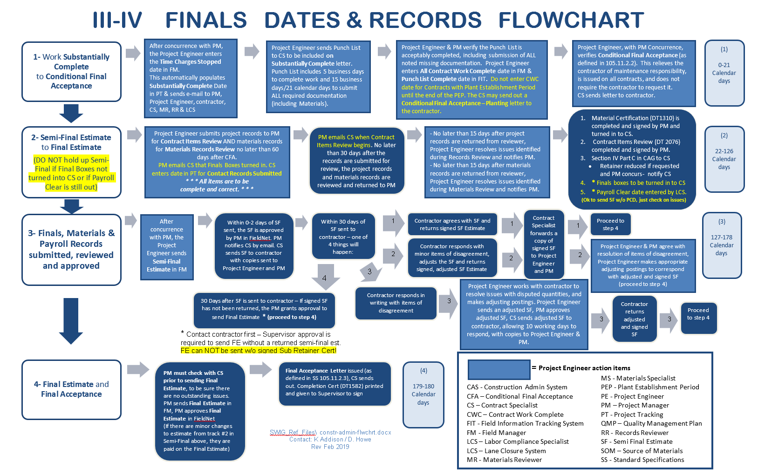
* See SWIG 8-1-10
Notes:
III-IV – Finals Flowchart (TCS/Substantially Complete - Final Estimate)
We don’t have to have PCD in to send SF. CS checks with Labor Compliance. If there are issues, the PM can determine to wait on SF or send the SF to keep the process moving forward.
DT2076 Contract Item Review is completed in La Crosse before the SF every since a Prime had to pay us back due to a quantity error.

Slide 36
Punch List (Ongoing work)
Ongoing “To Do List.”
Discuss at weekly meetings.
Complete corrective work as contract progresses
Contractor indicates work is (substantially) complete:
PE/PM identify contract work that is unacceptable or not complete.
Notify the contractor in writing and continue assessing contract time until the work is corrected and complete.
If no contract time remains, but the PE/PM do not assess Liquidated Damages, a Con Mod must be written.
Notes:
We typically don’t do suspend events -- either use a con mod to extend time, or if a working day contract, just don’t charge days.
There may be a rare circumstance where you’d want to, so if in doubt, ask me, your PM, your CS before you do it.
Keep an ongoing “To Do List” during project, discuss at weekly meetings, do corrective work as you go – get subs to clean up their issues before they leave for other projects and are hard to get back.

Slide 37
Substantially Complete
(Std Spec 105.11.2.1.3)
Grant Substantially Complete when all contract bid items and change order work are complete
  Excludes punch list and plant establishment
This means…
  All lanes of traffic are open on a finished surface
  All signage & traffic control devices are in place and operating
  All drainage, erosion control, excavation and embankments are completed
  All safety appurtenances are completed

Slide 38
Substantially Complete (Stop Time)
PE enters Time Charges Stop date in FM
  Send Outbox.
  Do a FIT merge & send!
  Automatically populates the Substantially Complete date in Project Tracking.
  Stop time begins the start of the 180 days to final. (Labor Compliance has 60 days from Stop Time point)
  Send punchlist to CS and PM
  DO NOT ENTER “PUNCHLIST COMPLETE” AND “ALL CONTRACT WORK COMPLETE” DATES UNTIL ALL PHYSICAL WORK IS FINISHED AND YOU HAVE EVERY DOCUMENT FROM THE CONTRACTORS
2019 : You will be asked to remove and enter 00/00/00

Slide 39
Punch List (work is done)
Prime, PE & PM (local and maintenance if applicable) conduct an Inspection of contract work.
ONLY Punch List Items can remain:
  Minor Corrective Work
  Clean Up
  Remaining Contractual (certs) Documents
PE creates the Punch List.
PE emails punchlist to CS & PM.
CS emails the Substantially Complete letter and the Punch List to the Prime
If no PL (PE MUST have all documents) email CS.
Notes:
If you give the Contractor a PL, then be sure to email that to the CS the same day
Do NOT enter Time Charges Stopped if all work is NOT complete and acceptable – If you’re going to write a mod to extend time, it must be done before time is stopped or LD’s will be charged. Also, do not send an estimate after time is expired without the mod extending time, or LDs will be charged.
It’s a lot of work to fix this after-the-fact, better to do things in the right order in the first place.

Slide 40
Substantially Complete (cont’d)
Substantially Complete Applies:
  Silt fence to be removed in spring
  Proving period for signs and pavement marking
  Clean up of contractor storage area
  Contract documents missing (material testing, etc.)
  Potential areas to re-seed in the spring
Notes:
DON’T FORGET to email Punch List to CS, Substantially Complete Letter will then be sent out

Slide 41
Punch List Complete
(SS 105.11.2.1.4 )
Punch List Work
  Contractor should complete Punch List work within 5 business days, and submit required documentation within 15 business days (21 calendar days)
  The Engineer MAY re-start time if the work is not completed within the allowed time, or MAY agree to extend the 5/15 day requirements
Punch List complete:
  PE enters Punch List Complete date into FIT, Acceptance tab
  Email CS that you have entered Punch List Complete
  Do a FIT merge & send!!!!
FSUG p 44 & 46

Slide 42
All Contract Work Complete
All Punch List items (including all documents), contract, and change order work are completed in the field AND|
Punch list complete entered was in FIT.
PE enters date in FieldManager All Contract Work Complete, Acceptance tab.
PE sends Outbox.
PE completes FIT Send. PE EMAILS PM and CS
All Contract Work Complete is not entered until Plant Establishment is complete for Contracts with Plant Establishment. PE must enter the initial planting date and Establishment Period (1 or 2 years) in FIT (FSUG p 44)
FSUG p 5
Notes:
Punch List complete and All Contract Work Complete should ideally be the same
Plant establishment is ONLY for project that have PLANT ESTABLISHMENT – do not enter a date if you don’t have this, it is NOT for planting grass.
If you enter a date, you must also fill in the Establishment Period.

Slide 43
Conditional Final Acceptance
  Conditional Final Acceptance is granted when:
    All Contract Work Complete Date is entered in FM
    EMAIL CS
Conditional Final Acceptance relieves the contractor of maintenance responsibility for the work
PM may wish to include silt fence removal, if it will need to be done at a later time.
CS adds 70% establishment if NOT req’d as condition of final and not met
PE/PM notifies CS when to issue CFA and any conditions to include
Notes:
Conditional Final Acceptance should closely follow the date for Punch List Complete & All Contract Work Complete
Email CS. I do not get notified about punch list or All Contract work complete unless you tell me or I happen to see it in project tracking. Thanks.

Slide 44

Regional Records Review
PE submits project records to PM for Regional Records Review
PE submits materials records to PM for Materials Review
PM coordinates Contract Items Review (DT2076) and emails Contract Specialist to enter date in PT when the review of the final boxes begins
When the reviewer completes the Contract Items Review (DT2076) and the PM accepts the project records as complete and accurate, CS enters this date in PT
When the records review is complete, PM hands in/emails items 1-13 (SWR Const Admin Guide p 11-12) to CS for entry of dates in PT and distribution/filing of various records
  Thumbdrive file structure if E-Finals
  Be sure Report of Contractor Performance’s are signed before handing into CS
  Asbuilts – Please follow instructions #13 of CAG page 12
  Bench Marks Common Issues (Pat Stankiewicz)
* See SWIG 8-75-5
Notes:
See Flowchart III-IV – PL bring in required docs no later than 81 days from SC (PM please email CS this date)
PM please email CS date when Contract Items Review (DT2076) begins
Both of these are highlighted in yellow in your Flowcharts
CS prefers to get items 1-11 in before SF is sent, multiple dates are entered (realize PM’s prefer to hang onto Finals Boxes – so compromise, just turn in those 11 items)
Ideally, once SF comes back then hopefully we can send the FE (cannot send FE if payroll clear is not completed or WPDES/NOT outstanding. )

Slide 45
Materials Reminders
PE submits materials records to PM for Materials Review
  Materials crew logs in the project in their matls binder, not PDS Staff
  Travis in Lax is signing for us in Madison till position is filled. If Matt says Matls looks good and it is going up to Lax for signature, we can accept his email and move forward with the Semi Final
Why is it important to have Matls approved before sending SF?
  To review required materials certifications for compliance
  To verify testing has been completed with passing results
  If there are material exceptions (failing tests or missing certs), this is documented on the DT1310 and addressed consistently with the contractor (remove and replace, left in place with credit to DOT, etc)
  Harder to get the money back from the Prime after SF is signed

Slide 46
Reducing Retainer
ASP 4 - provides guidance on when and how much additional retainage MAY be released to the contractor
Substantial Completion – PM MAY reduce retainage to 75% of the original amount retained only if requested by Prime Contractor and certain conditions are met.
Semi-Final Estimate – PM MAY reduce retainage to 10% of the original amount retained, or $5000, whichever is greater
Final Estimate – retainage is reduced to zero when the final estimate is sent
* See SWIG 8-75-1
Notes:
Kelly
We don’t want to reduce if there are outstanding issues that need to be addressed – payroll, materials, quantities, etc.
Retainer is for the WHOLE contract, not per project ID.
CS will only reduce retainer at the request of a PM

Slide 47
Liquidated Damages
Time Charges Stop Date in the FieldManager Site Times tab controls Liquidated Damages
Avoid negative Semi-Finals! Should be looking at potential LD’s, any deficient materials credits and any quantities still to be paid before submitting and approving Semi-Final Estimate
Prefer to have all issues resolved before Semi-Final is sent!

Slide 48
Semi-Final Estimate
All Contract Work Complete, Conditional Final Acceptance, Materials Review dates must be completed prior to sending SF.
An estimate indicating the engineer has measured and reported all final contract quantities and materials requirements
DT2076 Contract Item Review must be completed prior to sending SF.
DT2510 Certification of Materials completed.
CS checks with Labor Compliance to determine if payment or LC issues should hold up SF. (Payroll clear is not req’d for SF)

Slide 49
Semi-Final Estimate (cont’d)
PM must Notify Contract Specialist when SF has been approved.
CS sends SF to Contractor via email / pdf, along with Performance Eval (DT2509), Subcontractor’s Final Payment and Retainage Certificate (DT1340).
CS entering date sent to Prime begins the 30 day review period for contractor to return Semi-Final.

Slide 50
Semi-Final Estimate (cont’d)
The contractor has 30 days to review and submit a written statement of agreement or disagreement with the final quantities
15 day auto-email reminder is sent – PM/PE should contact Prime to check if issues.
10 days if a 2nd SF is needed.
CS notifies PM/PE when SF is returned and places in Finals.

Slide 51
Final Estimate
If applicable, WPDES NOT must be received prior to final estimate.
CS checks with Labor Compliance
All bid items must be marked complete in FieldManager prior to generating the final estimate. CMM 2.36.1.4
Retainer will be automatically released when the final payment is approved.
PM notifies CS final estimate was approved.
PM must sign completion certificate.

Slide 52
Transferring your Contracts
Regardless if PE sending contract to another PE, PE to PM or PE to CS…
THESE STEPS MUST BE FOLLOWED TO ENSURE FIT CONTRACT DATA IS NOT LOST:
    Send and receive FieldManager mail.
    Backup FieldManager and FIT databases.
    Transfer FIT contract. (if miss this, we lose data!)
    Transfer FieldManager contract.
    Import FieldManager contract.
    Import FIT contract.
    Email Kelly Addison (all SWR projects) when contracts have been sent to FMGR050 to be archived. (FSUG p 34-36)
                *See FSUG p 34-36
Notes:
Losing data because staff are missing the FIT transfer (export) and import steps affects Project Tracking

Slide 53
As-Built Plans (example - title)

Slide 54
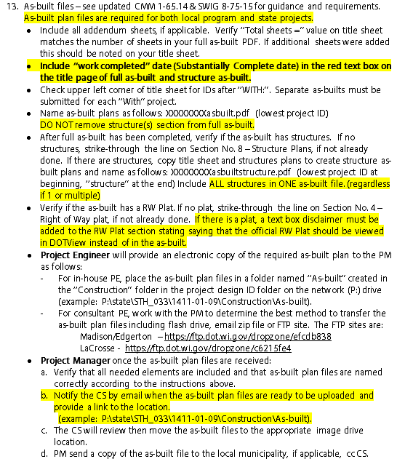
IV. Finals Records
Preparing your asbuilt for submittal – Please refer to checklist before submitting to make sure all have been met!
CS, PE, or PM can send asbuilt to the local. Let CS know so can document in PT.
Notes:
Project ID No dashes ex: 10100271asbuilt
Page numbers agree
ROW disclaimer
With project
Keep complete asbuilt including structures throughout entire project, only copy out structures when submitting asbuilt so have 2 pdfs

Slide 55
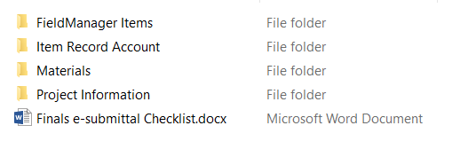
Electronic Files
La Crosse accepts electronic files using the 2018 e-file structure
CAG
Few things hard copy are acceptable
Tickets
Field books Materials
Labels
GREAT JOB ON 2018 FOR THE FIRST YEAR OF E-FILES!

Slide 56
Sneak Peak into next week’s Construction Training
David Castleberg/Annette Czerneski
2018 Field Software User’s Guide (FSUG) updates (handout/Pantry March 5th)
Changes and process clarification for Project Engineers & Contract Specialists
Mobile Inspector
AASHTOWare Project (AWP) Construction
  David will be spending some time going over the proposed implementation, improvements and schedule changes for the Construction module during his construction training

Slide 57
AWP Construction
Web Based with external access for consultants and contractors
Project Status
  Configuration changes - Currently
  Test and Pilot Spring/Summer 2019
  Training Fall/Winter 2019
  Proposed Production date – Spring 2020
Benefits:
  Web Bases with external access for consultants and contractors
  Replaces CAS, FieldManager, FieldBook, FieldNet, Field Information Tracking (FIT) merge/send will be obsolete! and Project Tracking
  Connects to Mobile Inspector app for Daily Work Reports (IDRs)

Slide 58
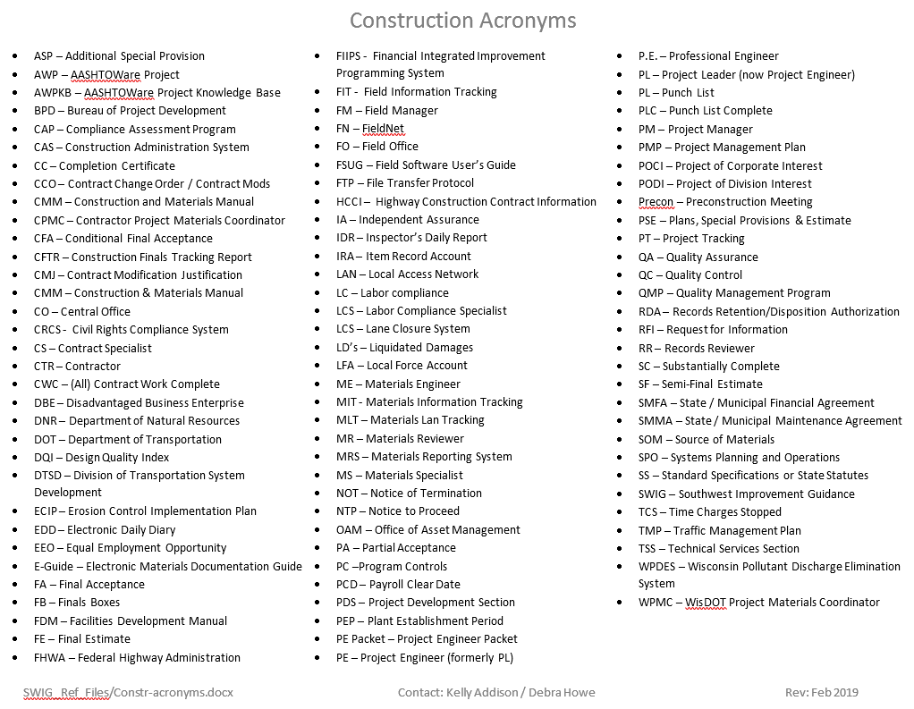
Construction Acronyms
* See SWIG 8-1-20
Notes:
We use a LOT of acronyms in our PP, CAG, Flowcharts and emails.
Recently added AWP, AWPKB, BPD, DTSD, WPDES & NOT (DNR Permit), FN, SWIG etc
https://awpkb.dot.wi.gov/Content/constr/Pantry/ConstrAdminAcronyms.htm

Slide 59

Notes:
Kelly
Just a friendly reminder to Please fill out the training evaluation sheet for each presentation before you leave so we know how to improve the training for next year.
Thank you and good luck on your projects this year.

