Slide 1
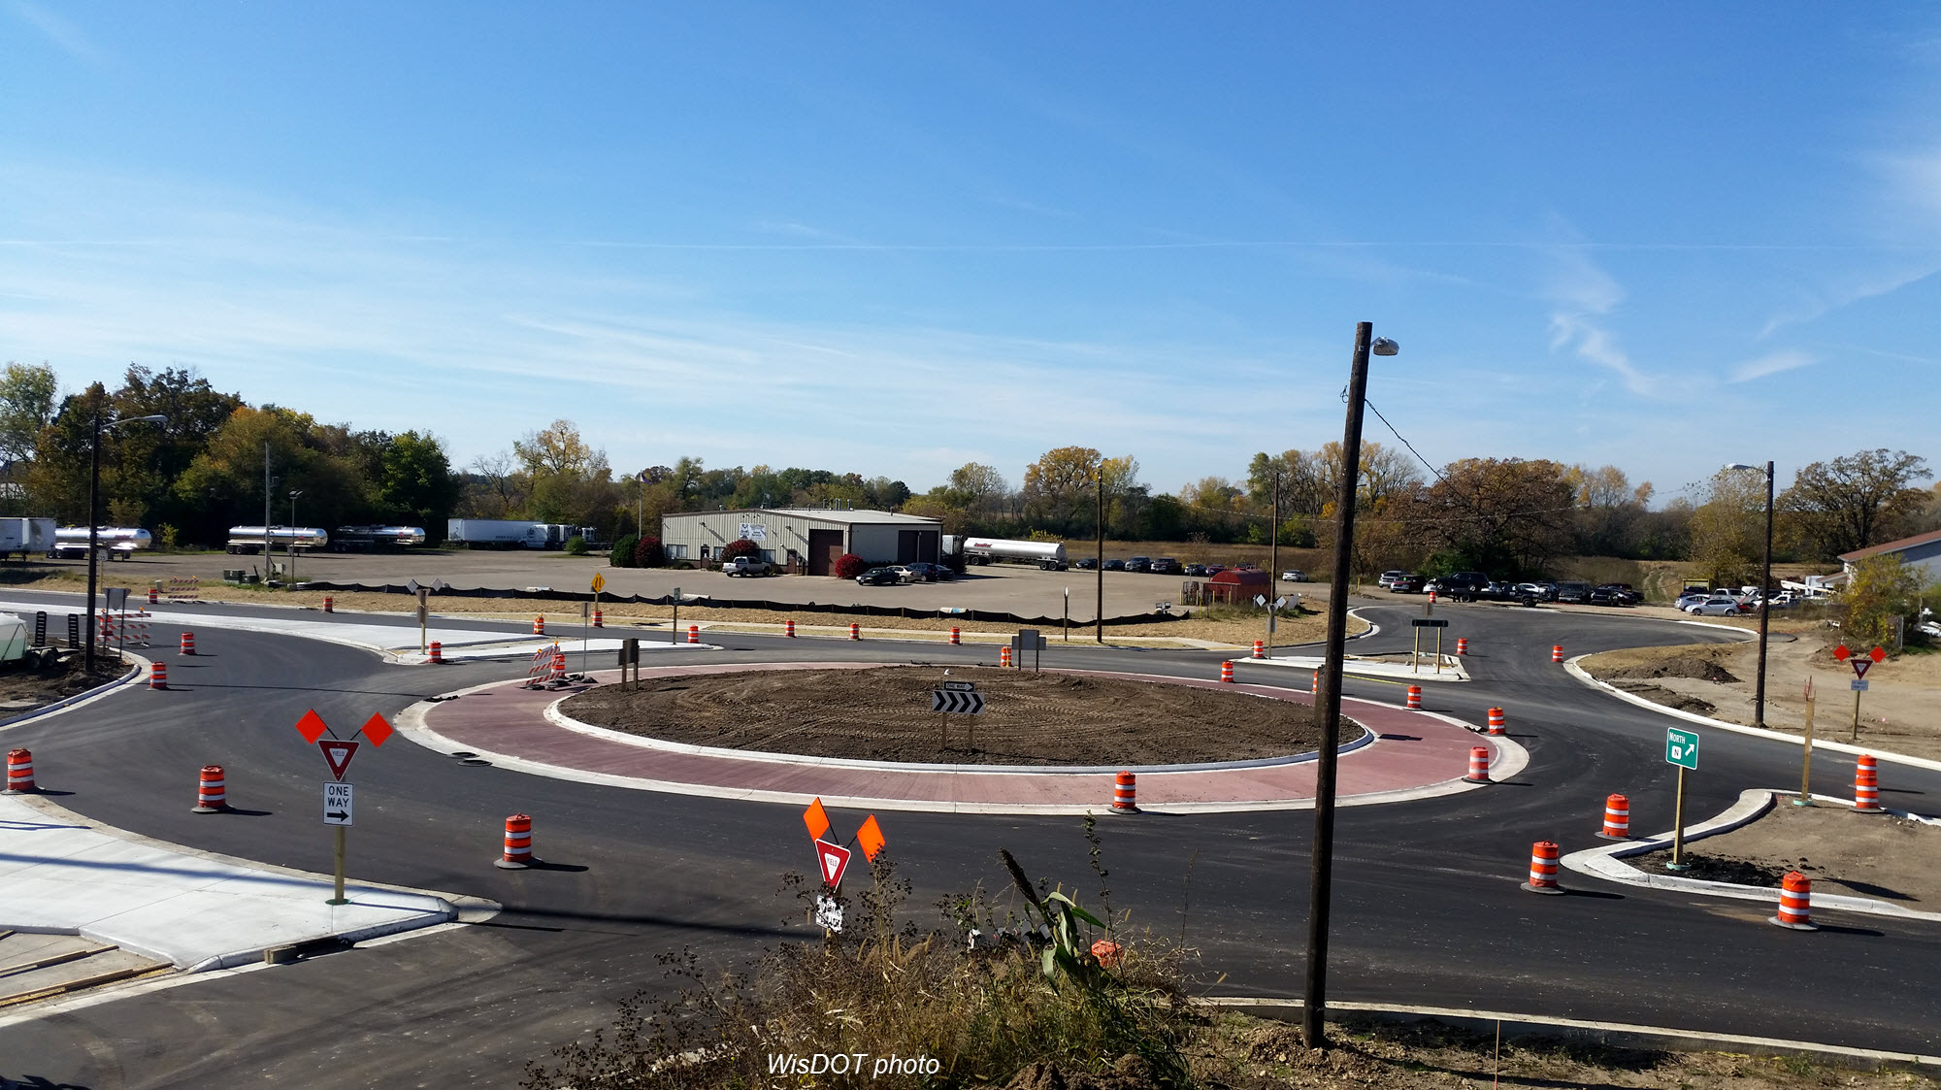
I-39/90 and County N interchange
Open House
Stoughton Senior Center
December 6, 2017

Slide 2
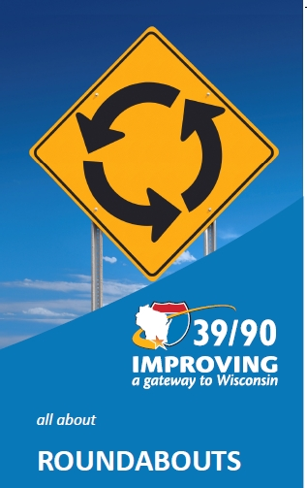
Outline of topics
I-39/90 construction schedule in 2017
County N interchange schedule
Interstate expansion near interchange
What is a modern roundabout?
Why roundabouts?
County N interchange roundabouts
Public education
Questions

Slide 3
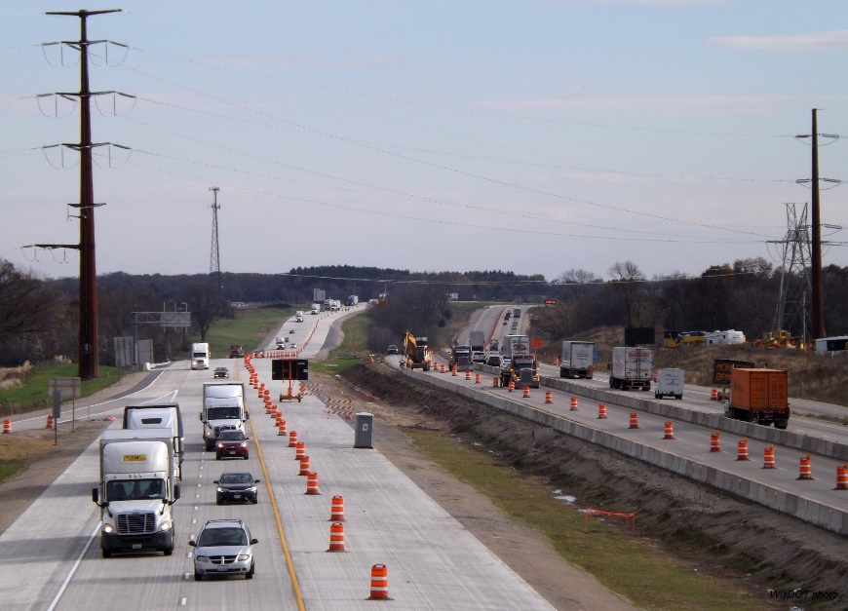
2017 construction schedule
Three bridge replacements over I-39/90:
County AB bridge, south of Madison
Manogue Road bridge, near the rest area north of Janesville
Stateline Road bridge, near Beloit
Reconstruction of the I-39/90 and County N interchange (Exit 147), and Interstate expansion in this area.
Temporary widening of I-39/90 southbound:
Between County AB and East Church Road, north of the US 51 interchange (Exit 156).
From the I-39/90 and County S (Shopiere Road) interchange (Exit 183) to the Illinois state line.
Reconstruction and expansion of I-39/90 northbound:
From the Dane/Rock County line to East Church Road, northeast of Stoughton.
From Hart Road near Beloit north to the I-39/90 and US 14 interchange in Janesville.
I-39/90 northbound near the WIS 73/US 51 interchange in Edgerton

Slide 4
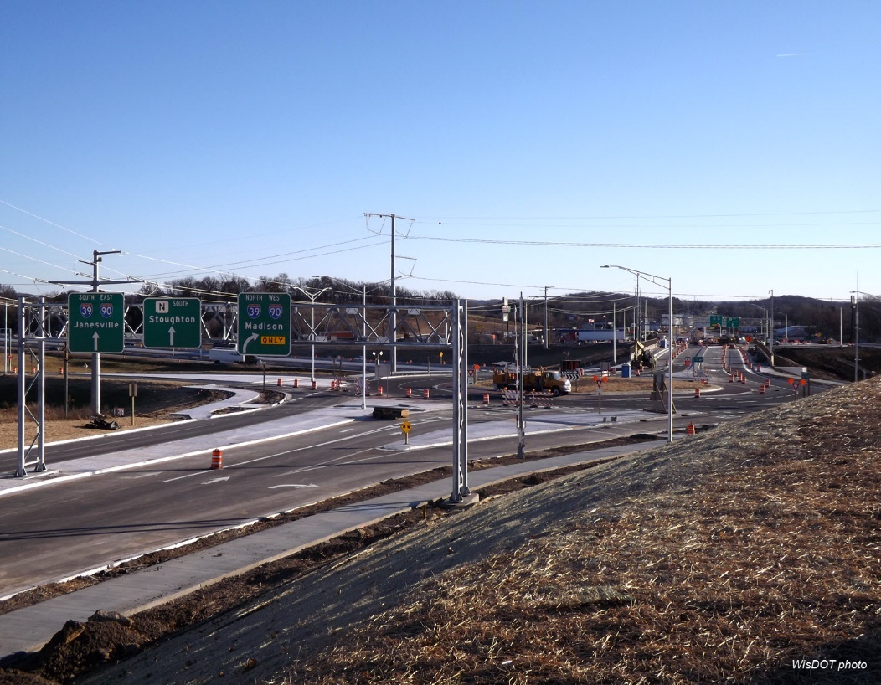
County N interchange schedule
Began construction in late April 2017.
Interchange ramps to remain open during construction, besides periodic nighttime ramp closures.
County N, between I-39/90 and Rinden Road, closed from early May to Friday (December 8, 2017).
Signed detour: I-39/90, US 12/18 and County N.
Interchange roundabouts to opened in early November 2017.
Interchange complete on Dec. 12, 2017.
Note: Dates are weather dependent and subject to change.

Slide 5
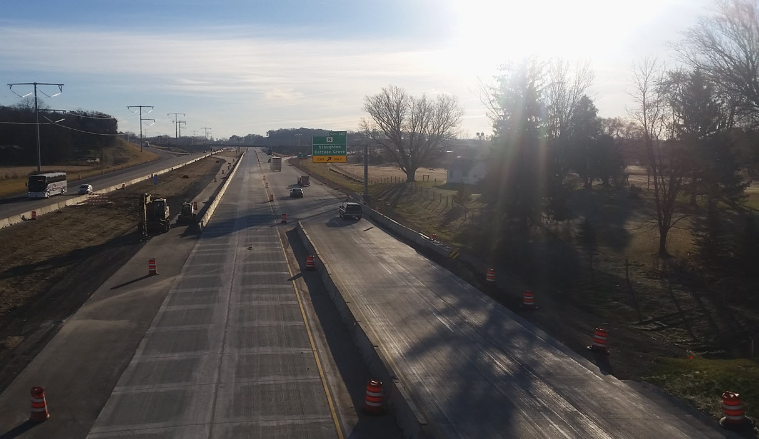
Interstate expansion near County N
Construction: fall 2017 – fall 2018
Two lanes to remain open on I-39/90, especially during peak travel times.
Nighttime lane closures expected 8 p.m. to 5 a.m. M-F.
Be alert for traffic shifts and crossovers in this area.
Interchange ramps to remain open during construction, besides periodic nighttime ramp closures.
Note: Dates are weather dependent and subject to change.

Slide 6
What is a modern roundabout?

Slide 7
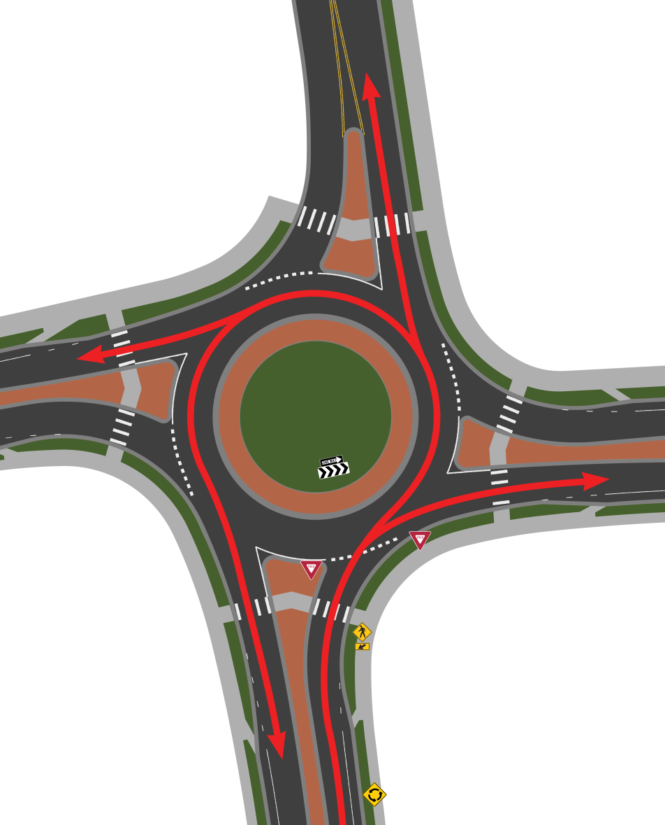
What is a modern roundabout?
Compact circular intersection
Traffic flows counter-clockwise around a center island
Entering traffic yields
Channelized approaches to deflect traffic and reduce entry speeds

Slide 8
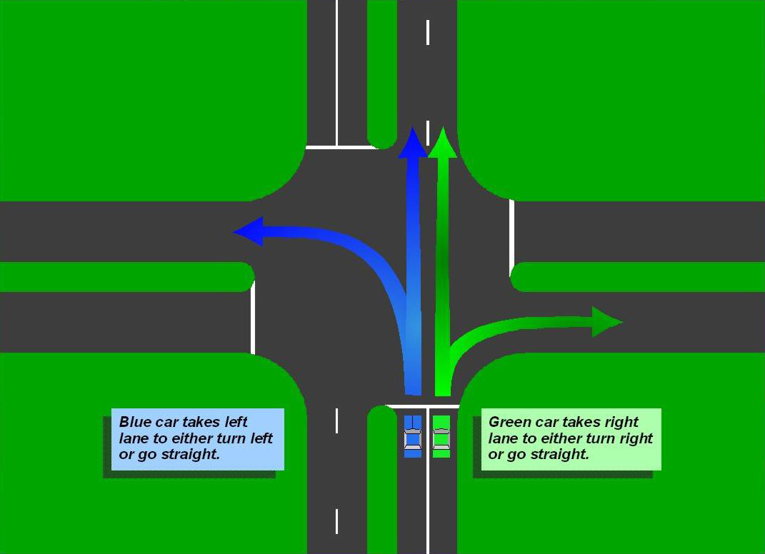
“Typical” 4 way intersection

Slide 9
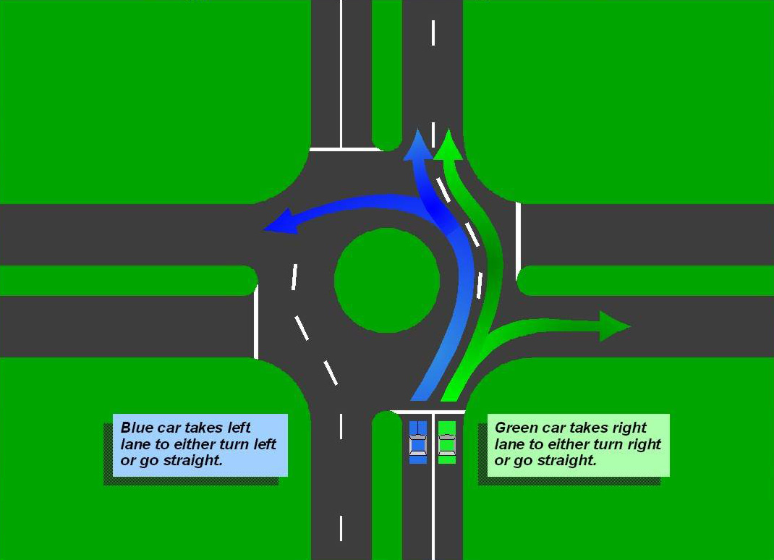
Slight circular movement

Slide 10
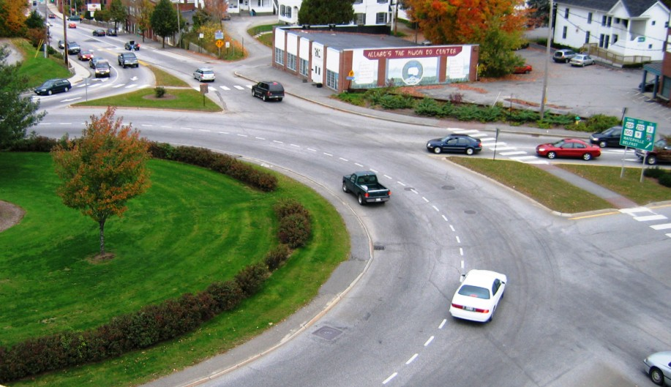
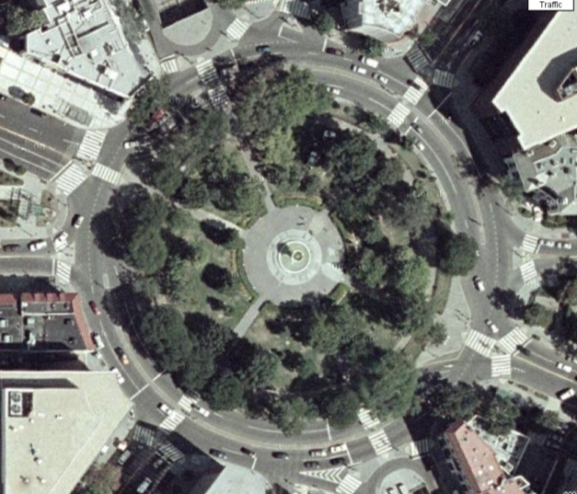
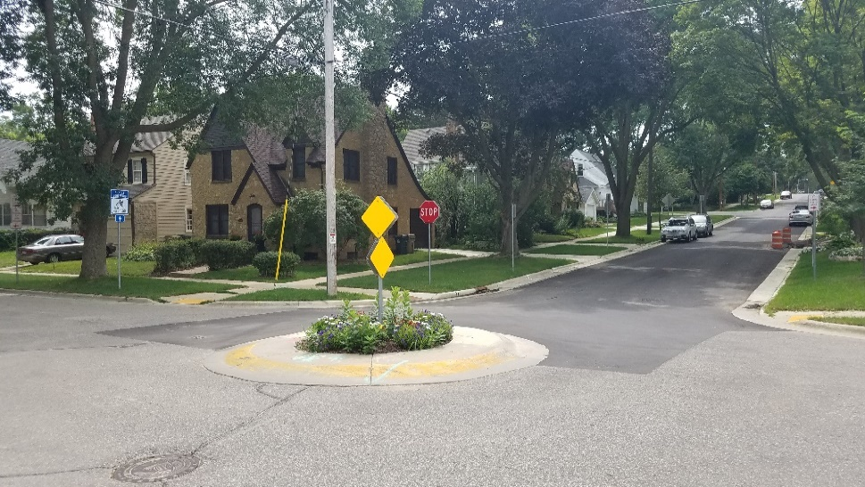
Not to be confused with…
Rotary
Traffic Circle
Traffic Calming Circle

Slide 11
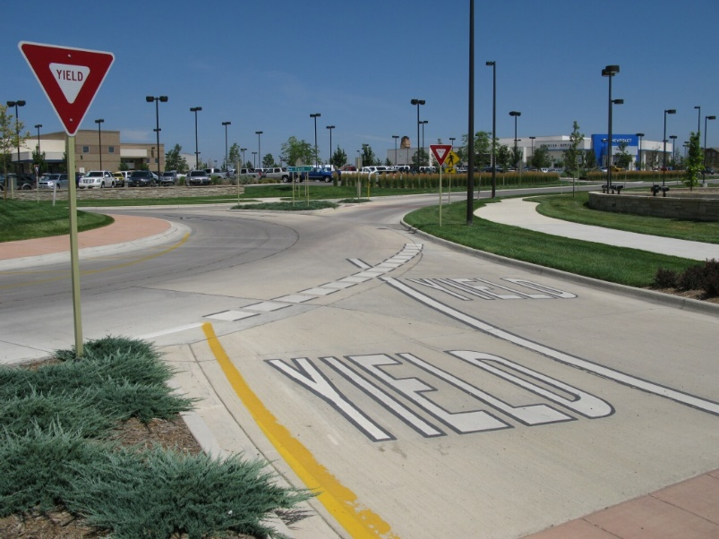
Signing & Marking
Proper signing and marking help drivers anticipate the roundabout

Slide 12
Why roundabouts?

Slide 13
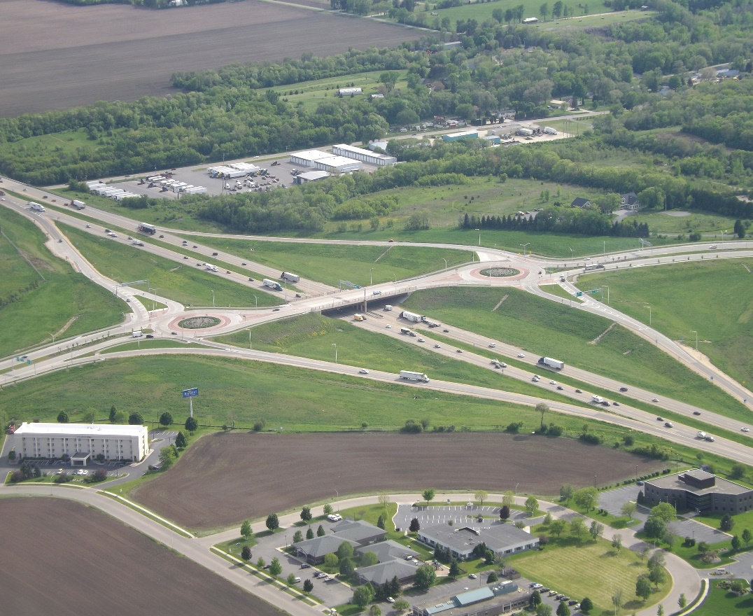
Roundabout benefits
Higher-capacity
Suitable for high and low-flow intersections
Aesthetics – landscaping/civic feature
Safest type of at-grade intersection
Angle of conflict
Slower speeds
Simplified decision-making

Slide 14
Safety comparison
Conventional intersection vs. roundabout
Crossing conflicts eliminated with roundabout

Slide 15
Safety comparison
Traffic signal vs. roundabout
Traffic Signal | Roundabout
High speeds | Low speed
Wide visual scans | Narrow visual scans
Less time to react | More time to react
High severity crashes | Low severity crashes

Slide 16
National studies
Convert two-way stop intersection to roundabout
32%
71%
Total crashes
Fatal/injury crashes
Convert signalized intersection to roundabout
21%
66%
Total crashes
Fatal/injury crashes
Notes:
New HSM data

Slide 17
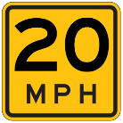
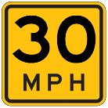
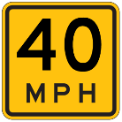
Pedestrian injury probability
Pedestrian’s chance of death if hit by a motor vehicle
Source: Oregon DOT, Dept. of Transport (UK)

Slide 18
Wisconsin Roundabout Crash Study
Studied 56 Wisconsin roundabouts to their ‘no build’ intersection control:
Yield, Stop, Signalized
Results:
Increase in total number of crashes—mostly ‘fender benders’
40% reduction in fatal and serious injury crashes
Consistent trends with several other states

Slide 19
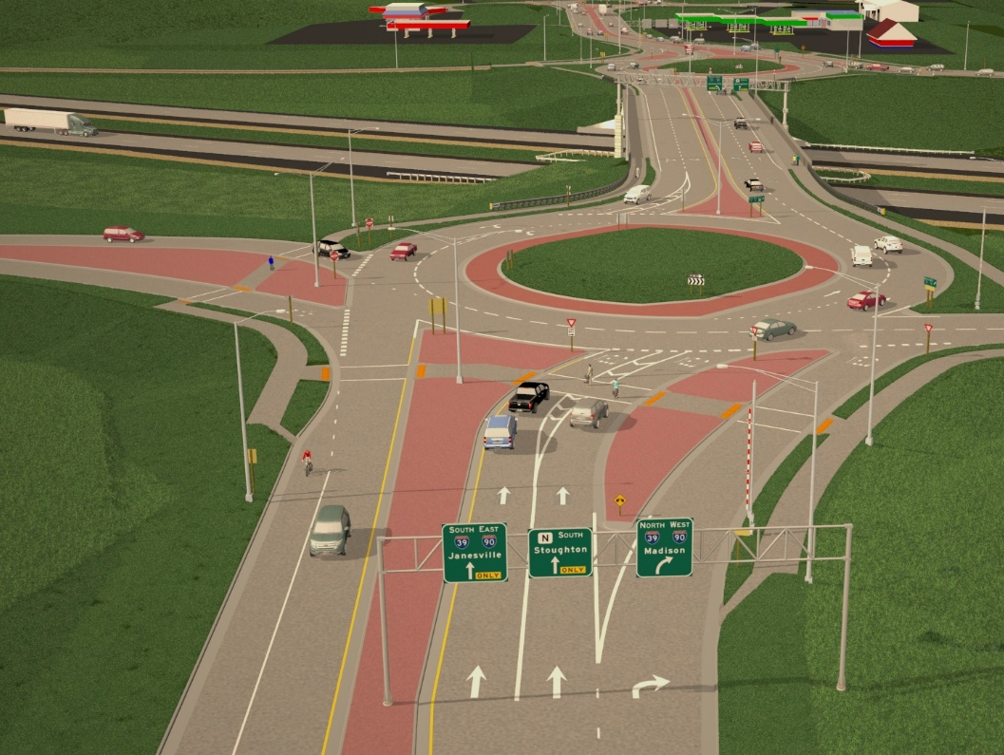
I-39/90 & County N interchange
Notes:
View looking south

Slide 20
Why roundabouts at the County N interchange?
Intersection Control Evaluation
Control options evaluated
Stop, conventional diamond
Traffic signal:
Conventional diamond
Diverging diamond
Roundabout, conventional diamond
Similar impacts, costs, operations
Traffic Signals
Not expected to meet warrants (southbound ramp)
Roundabouts
Safety advantage, better operations
Roundabouts were ultimately chosen
Notes:
Costs w/in 6% of each other (740K between high and low: DDI>roundabout>signal>stop)
SB ramp meets warrants in 2031 (outside of 5 yr construction window)

Slide 21
How to drive roundabouts

Slide 22
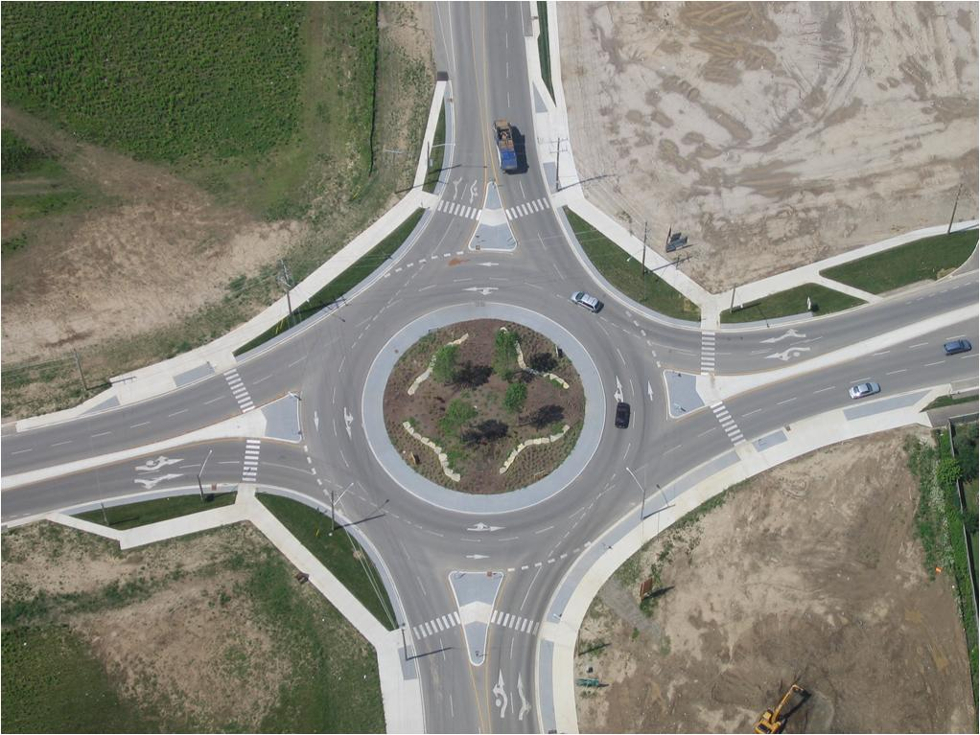
What should I NOT do?

Slide 23
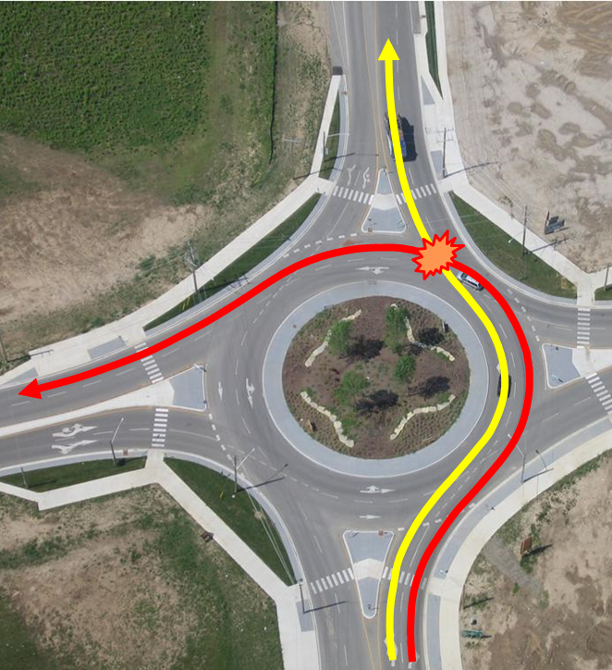
What should I NOT do?
Failure to yield, improper lane changes

Slide 24
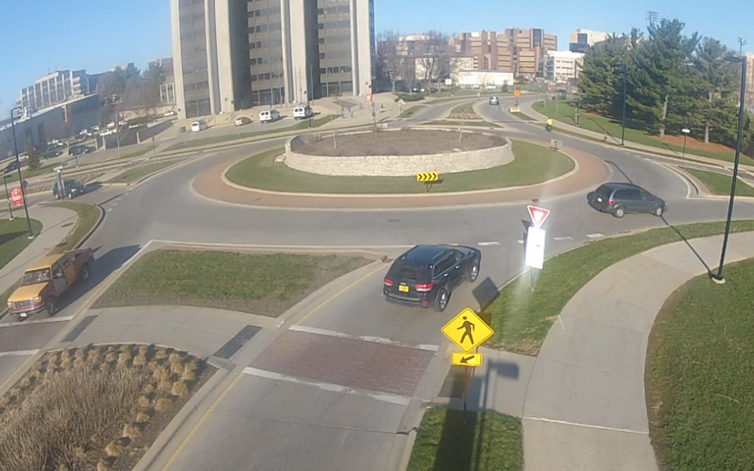
Yielding
OK to enter the roundabout

Slide 25
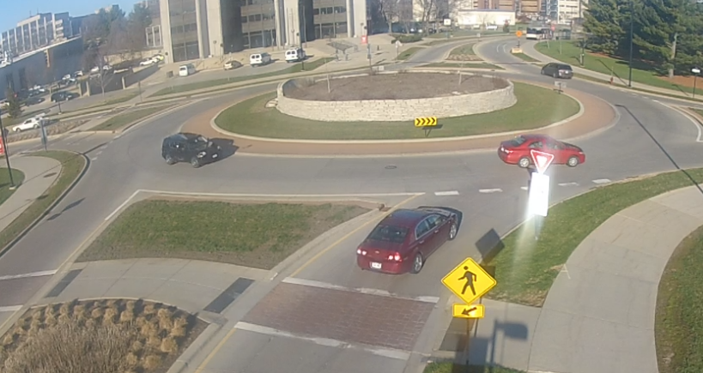
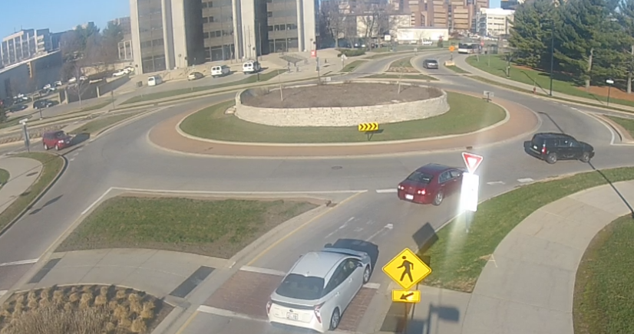
Yielding
✗
Not OK to enter
Waited for a safe gap
✓

Slide 26
Large vehicles – Truck apron
Where trucks are common, a properly designed apron may be necessary

Slide 27
Large vehicles
2015 WI law requires motorists to yield the right-of-way to larger vehicles:
40-ft (or more) in total length
10-ft wide
When in doubt, give ‘em room

Slide 28
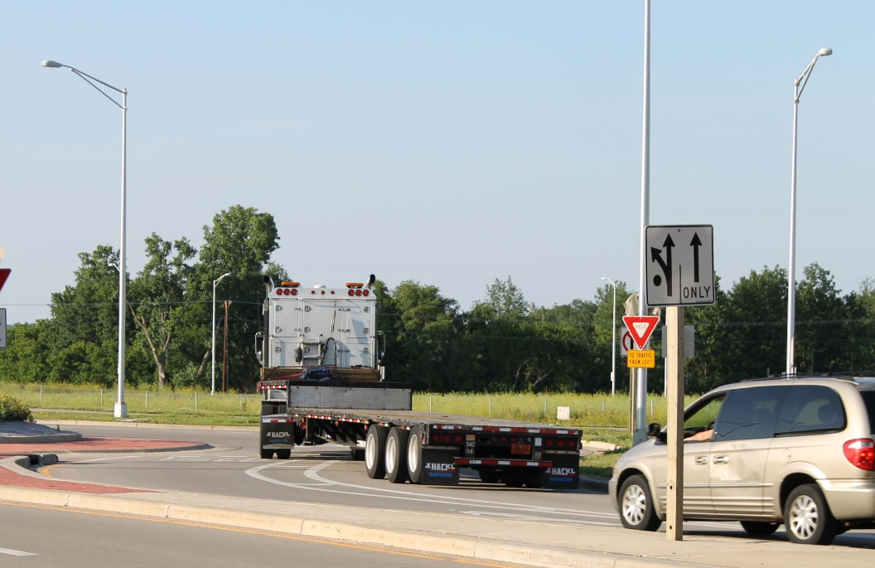
Large vehicles
Entered in right lane…
…trailer drifts into left lane when circulating
Notes:
Truck will switch lanes entering to circulating

Slide 29
Entering
✗
✓
Notes:
Stay out of the “no zone”
https://youtu.be/p0rp7szsgfw

Slide 30
Circulating
✗
✓
Notes:
Stay out of the “no zone”

Slide 31
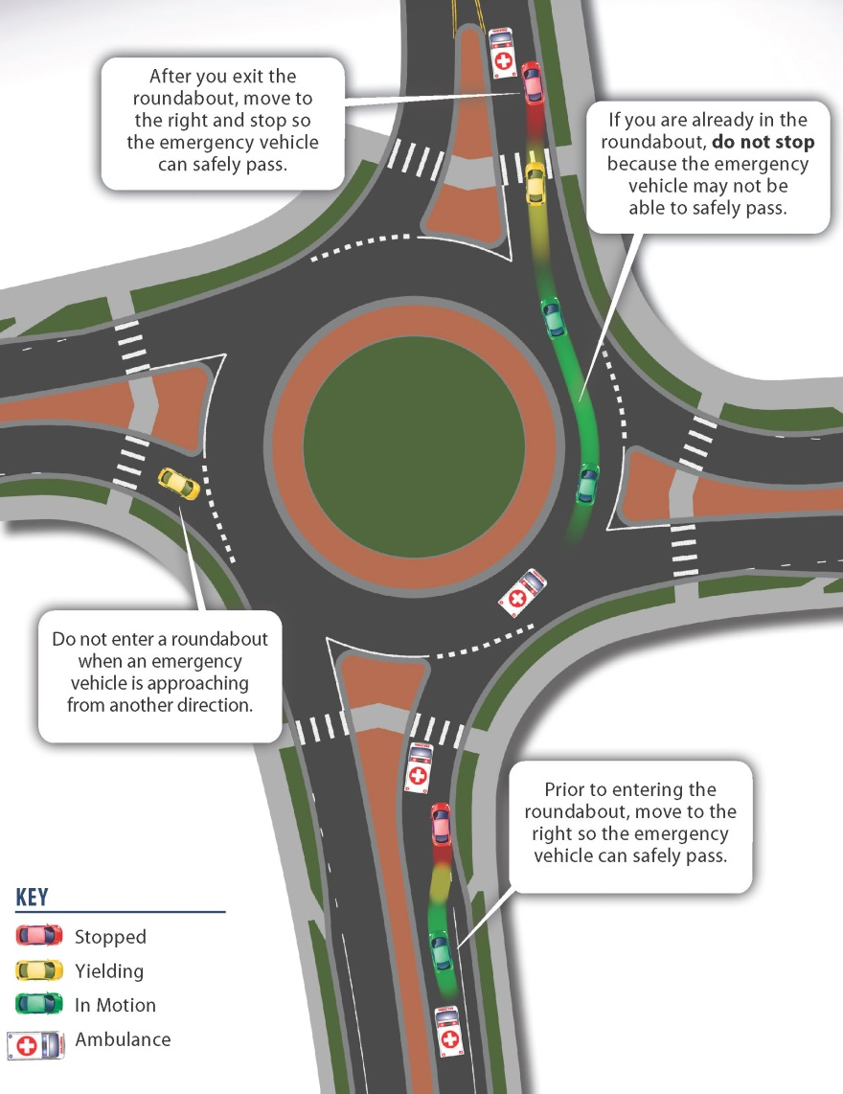
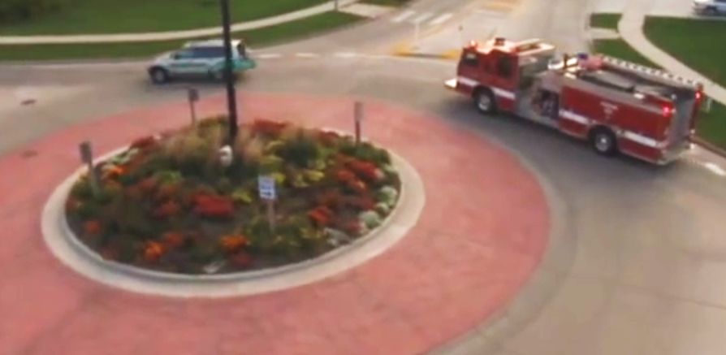
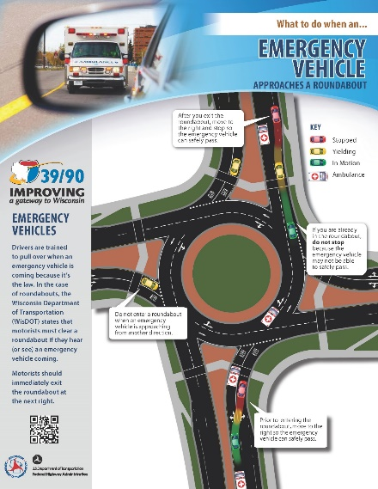
Emergency vehicles

Slide 32
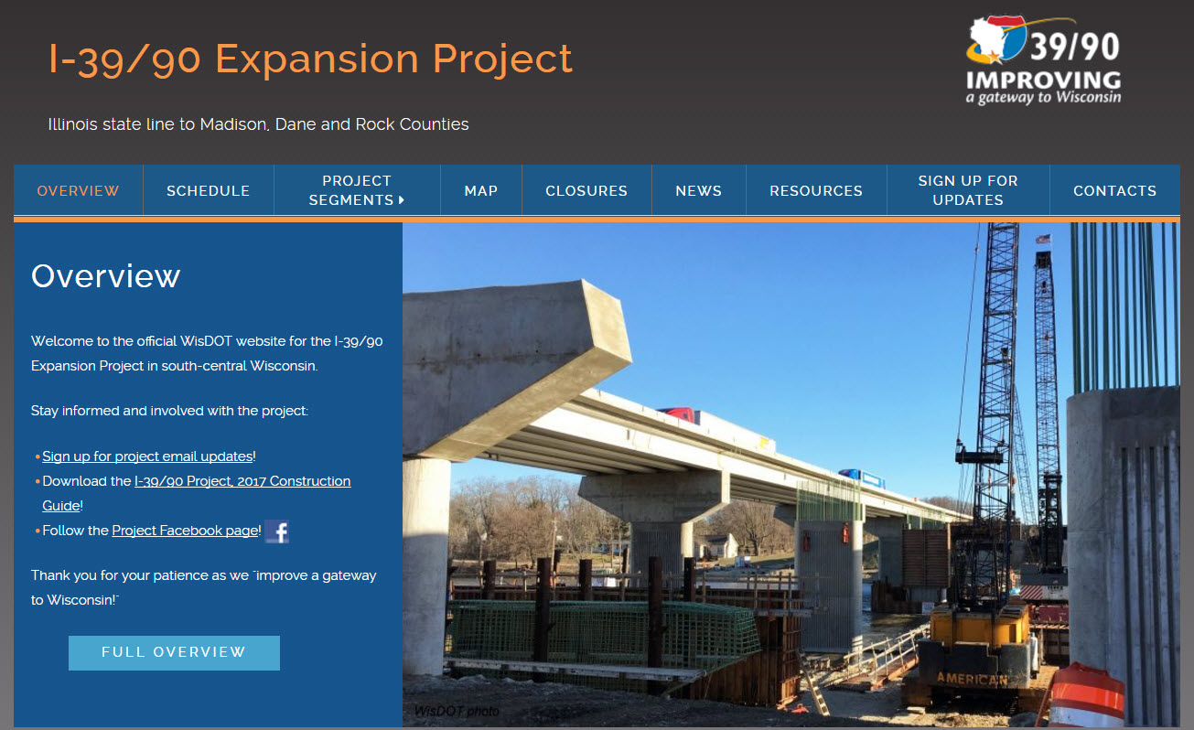
Stay informed and involved!
Register for project email updates at www.i39-90.wi.gov.

Slide 33
Questions?
www.i39-90.wi.gov
i39-90Project@dot.wi.gov
Facebook.com/WisconsinI3990Project
(608) 884-1234

Slide 35
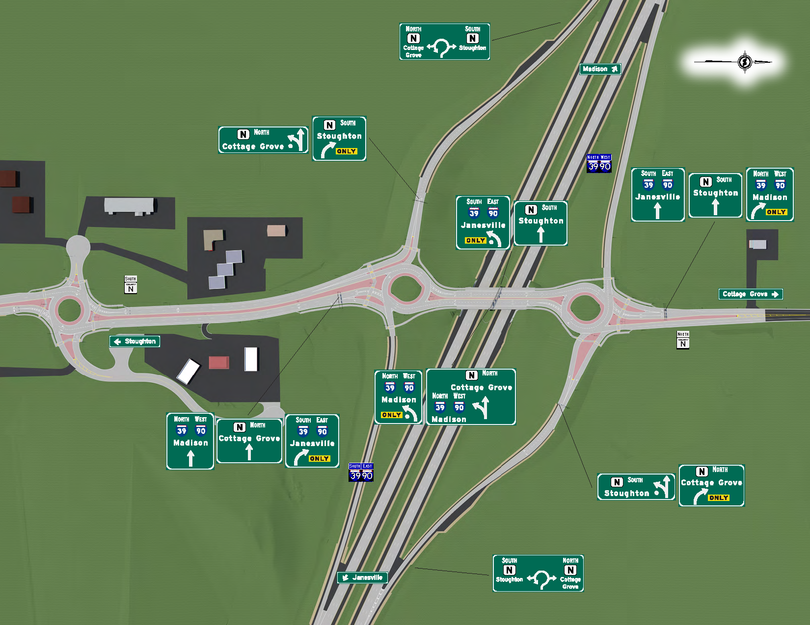
BP
Road Ranger

Slide 36
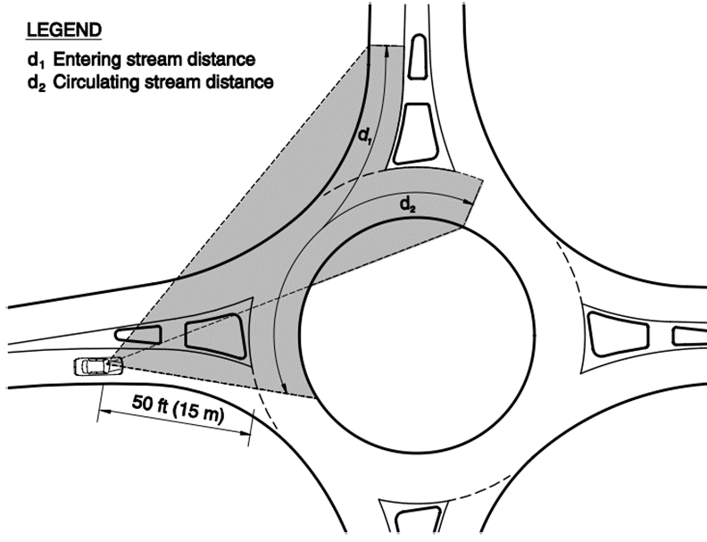
Landscaping
Not just for aesthetic purposes
Speeds are slower, yield rates are higher when sight is restricted
Notes:
Old IIHS data

Slide 37
National Study
Convert two-way stop intersection to roundabout
44%
All crashes
87%
Fatal/injury crashes in rural area
78%
72%
Fatal/injury crashes in urban area
1-lane
2-lane
Notes:
Old IIHS data

Slide 38
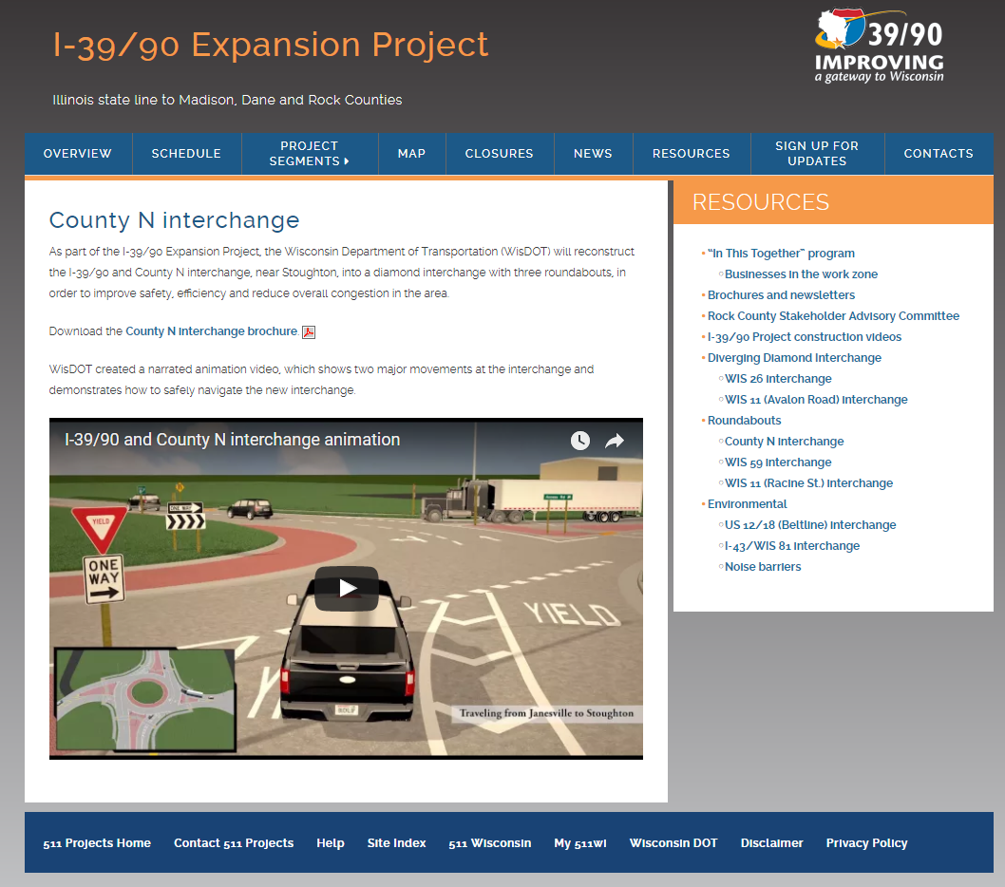
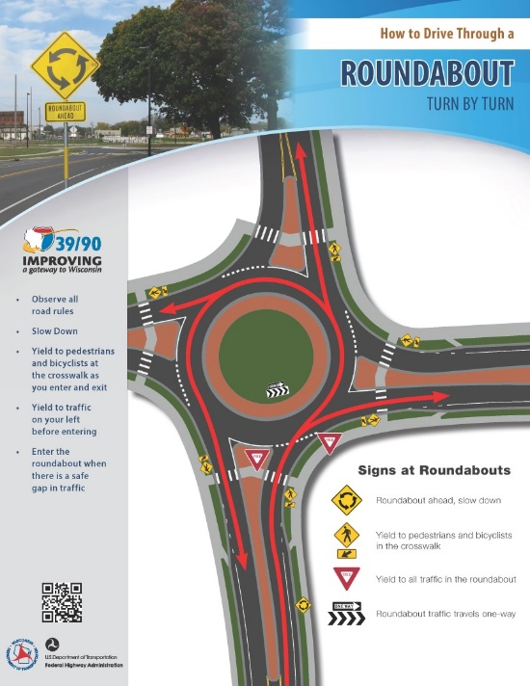
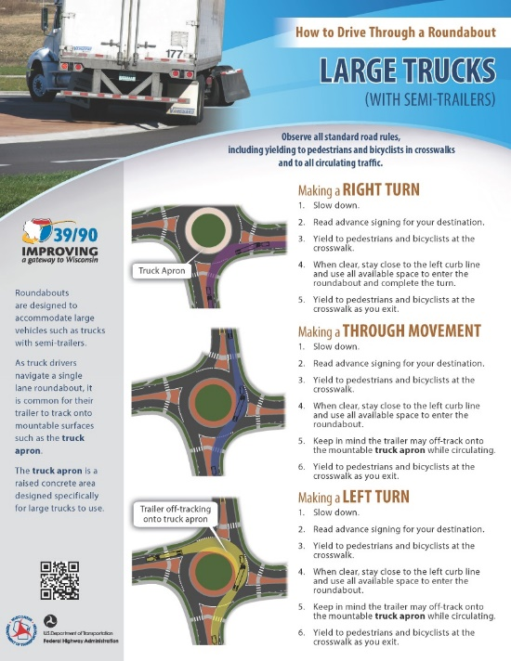
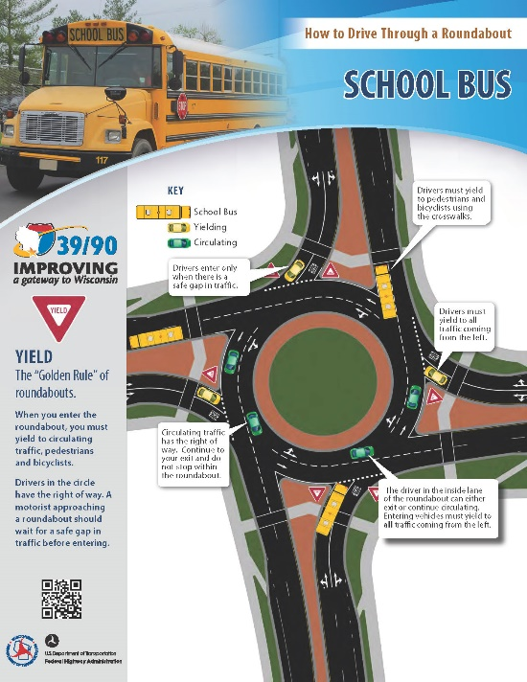
Public education

