Slide 1
Value of social media for state transportation
2020 Transportation Improvement Conference
American Council of Engineering Companies of Wisconsin
John DesRivieres, WisDOT Office of Public Affairs
Steve Theisen, WisDOT Division of Transportation System Development
March 4, 2020
Notes:
Hello, I’m John DesRivieres, social media manager for the Wisconsin Department of Transportation – Among other things, I manage the day-to-day operations for all of WisDOT’s main social media accounts which include Twitter, Facebook, LinkedIn, and soon to be Instagram. Today I’m going to talk the importance of social media and the different ways we use it.
Hello. My name is Steve Theisen, I’m a communications manager in the Wisconsin DOT Southwest Region. I’ve been with the department for nearly 10 years. I oversee communications for two major highway projects – I-39/90 between Beloit and Madison and the Verona Road project in Dane County. I also handle the Facebook pages for those two projects as well as the region Twitter page.

Slide 2
Learning objectives
Learn why and how WisDOT uses social media
Define expectations of social media use to provide consistent voice and message
Explain social media messaging for outreach/engagement during a highway study, design and construction project
Notes:
STEVE
Transportation connects us and real-time communication about transportation is vital. WisDOT communication professionals will talk about the department's social media initiatives and share examples of successful social media efforts.

Slide 3
Before we get started…
Who has Facebook; Twitter or LinkedIn?
Does your company have a social media presence?
Can social media influence public perception?
How about as it relates to government, state agencies or transportation?
Is social media an integral communication piece of the transportation world?
Notes:
JOHN
Everyone in this room should be on LinkedIn.
We hope to influence you to change your mind.

Slide 4
Background on social media channels
WisDOT corporate accounts
Facebook
Twitter
YouTube
Podcast
LinkedIn
WisDOT region accounts
Twitter
Facebook for mega projects
Notes:
JOHN

Slide 5
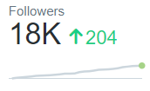
Who is our audience?
Facebook – 38,000
Twitter – 18,000
LinkedIn – 5,000
Notes:
JOHN
A lot of people follow us for a lot of reasons – get info to help keep them safe, help make travel decisions, stay informed on transportation issues that impact them, industry professionals who want to stay up to date on industry standards
No matter the reason, we have a responsibility to give them accurate information, engaging topics and a reason to keep following us – social media is the quickest way to do this and it’s a valuable tool to show the public the value of our agency

Slide 6
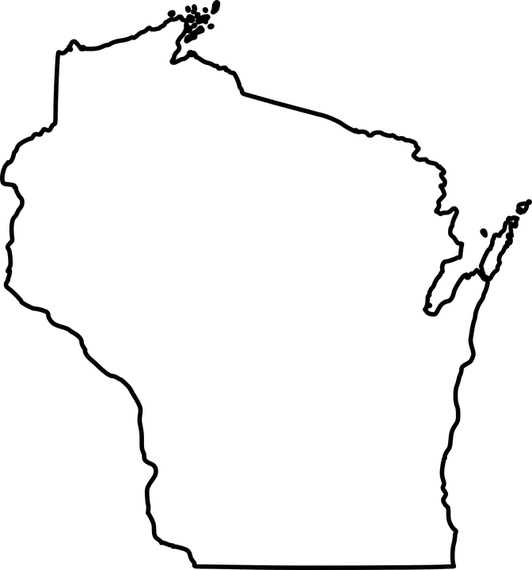
Strategy: telling our story
Statewide "Corporate" Accounts
Six divisions – agency representation
High-level – priority messaging
Big picture initiatives
Good news – show value, humanize
Agency partners – connect the dots
Notes:
JOHN

Slide 7
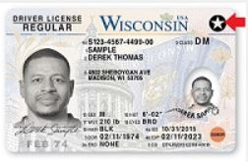
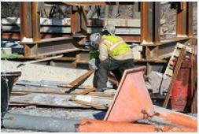
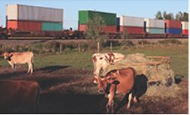
Six divisions in WisDOT Focus on priority messaging
Motor Vehicles
Real ID, Voter ID, Online Services
Transportation System Development
Construction projects, work zone safety
State Patrol
Zero in WI, Click it or Ticket, Drive Sober
Transportation Investment Management
Rail (Amtrak), Harbors, Aviation
Budget and Strategic Initiatives
Budget, legislative policies
Business Management
Notes:
JOHN

Slide 8
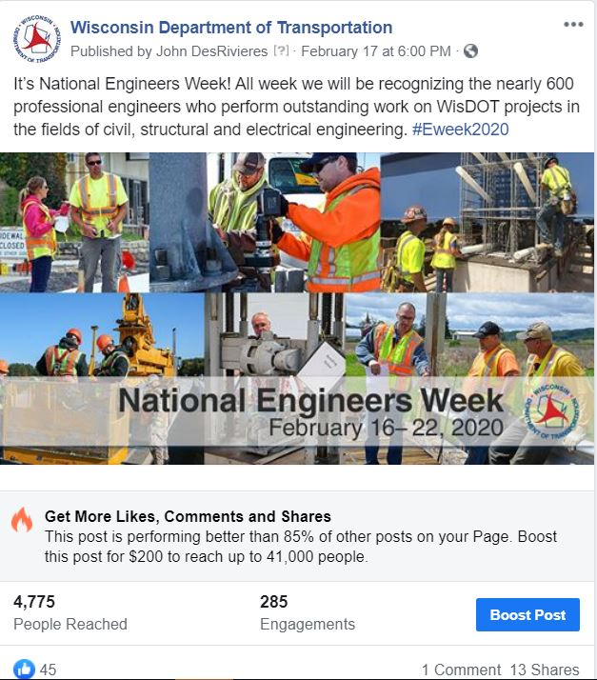
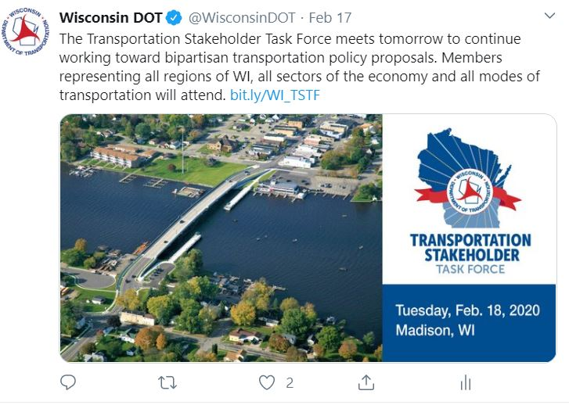
Big picture initiatives
Notes:
JOHN

Slide 9
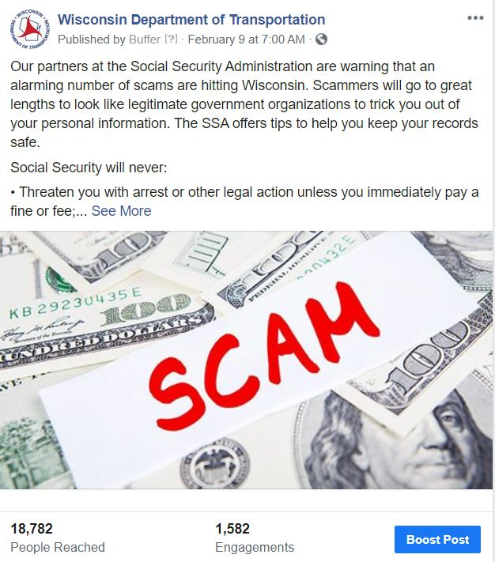
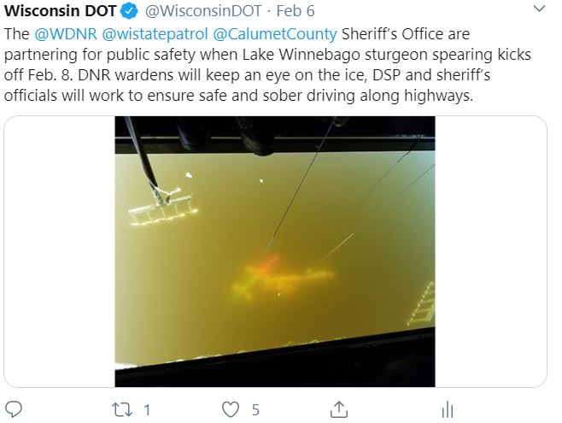
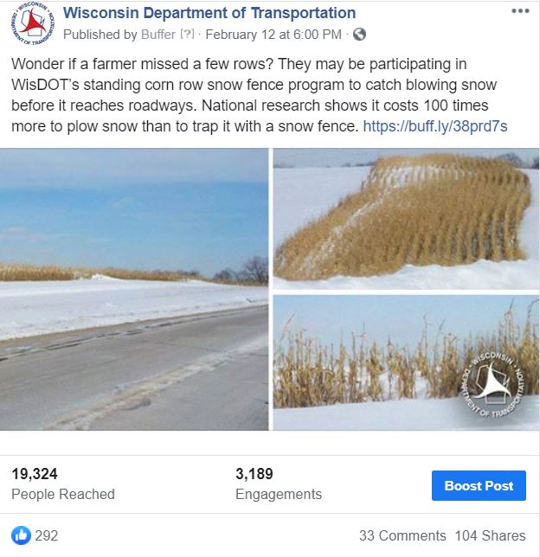
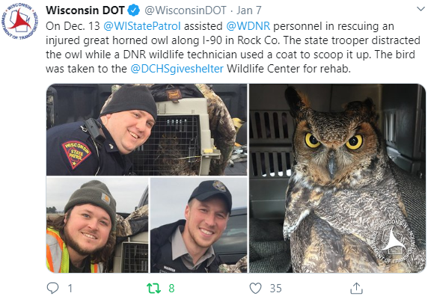
Good news and agency partnerships
Notes:
JOHN

Slide 10
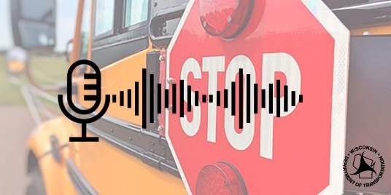
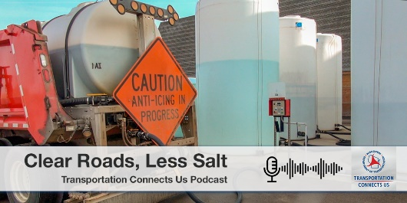
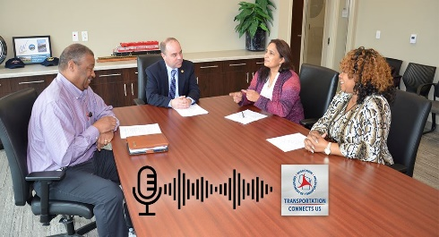
WisDOT Podcast Transportation Connects Us
Monthly podcasts available at wisdot.libsyn.com.
Transportation Budget
School Bus Safety
Countdown to REAL ID
WisDOT Maximizes Your Tax Dollars
Innovative Grant Program for Local Transportation Projects
Helping Disadvantaged Businesses Succeed
Clear Roads, Less Salt – Wisconsin Winter Road Maintenance
Notes:
JOHN

Slide 11
State and Regional Accounts Partners in story-telling
State accounts
Macro-view: reach broad audience
Full agency scope: All six divisions represented
Big picture of transportation initiatives
Regional accounts
Micro-view: reach specific, targeted audience
Smaller scope: one division represented
Detailed focus on area transportation and real-time travel information
Notes:
JOHN, TRANSITION TO STEVE DURING THIS SLIDE
-DOT has 6 divisions – each division has priority messages that are important to the public
-DMV – REAL ID, Voter ID, vehicle registration, etc.
-DTSD – work zone safety, big picture construction messaging
-DSP – Driver safety, buckle up, drunk driving, zero in WI
-DTIM – Rail (Amtrak), harbors, aeronautics
-DBSI and DBM – legislative policies and technical support
***Show examples of posts on each and show analytics to show the value

Slide 12
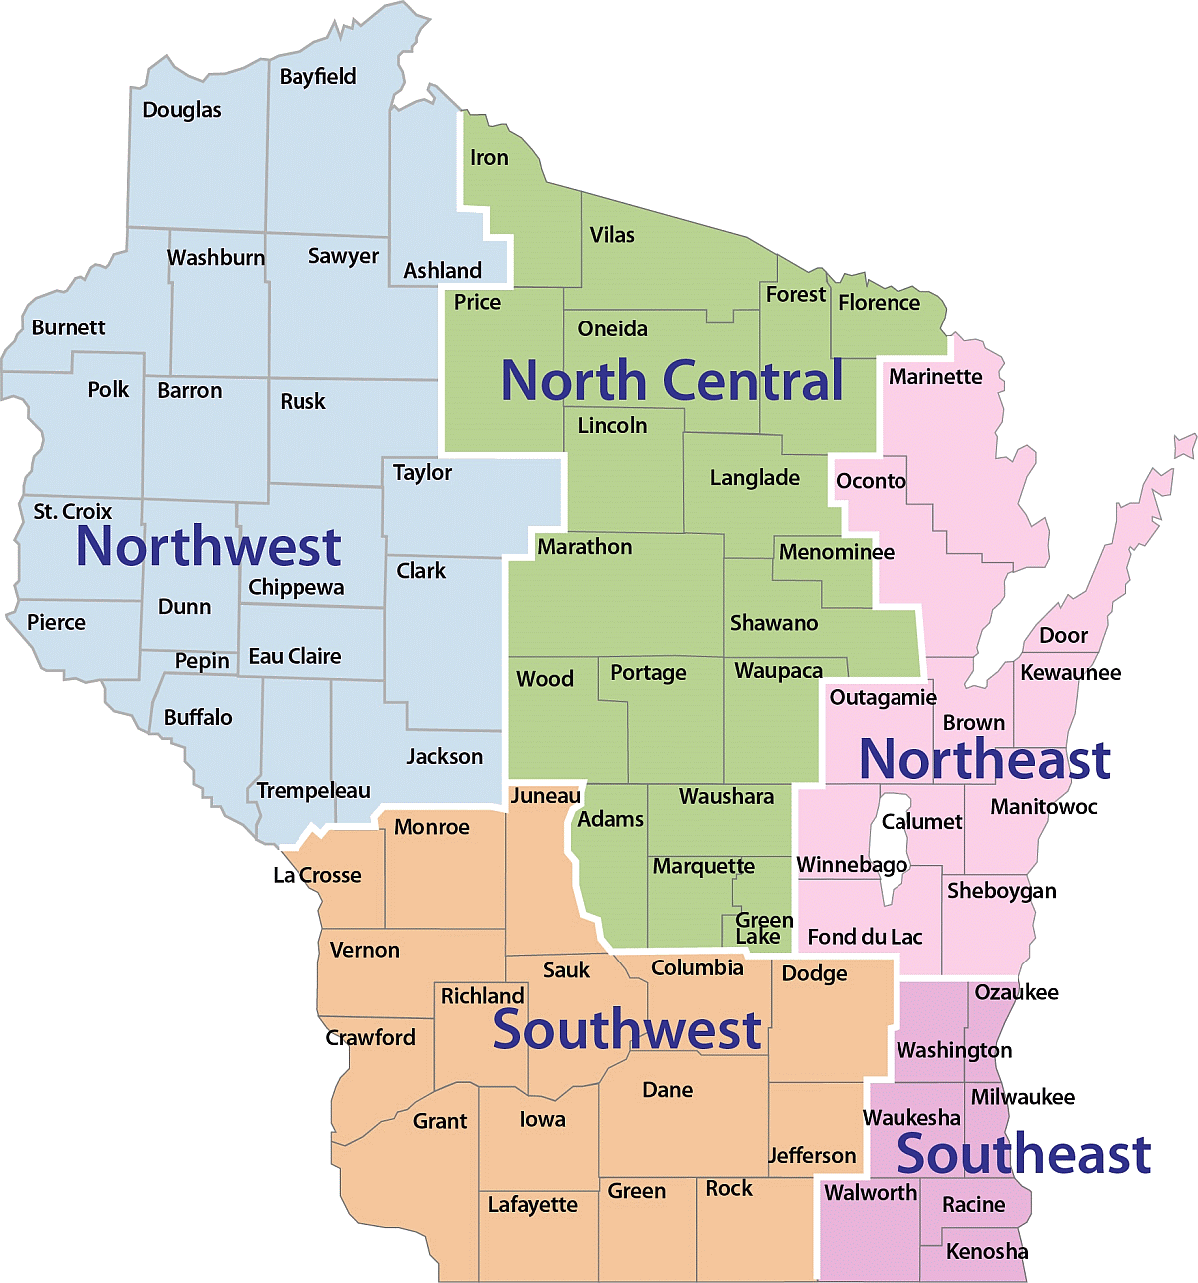
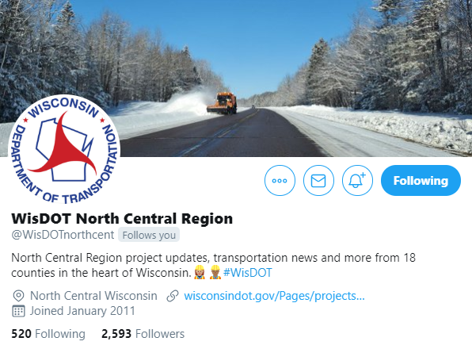
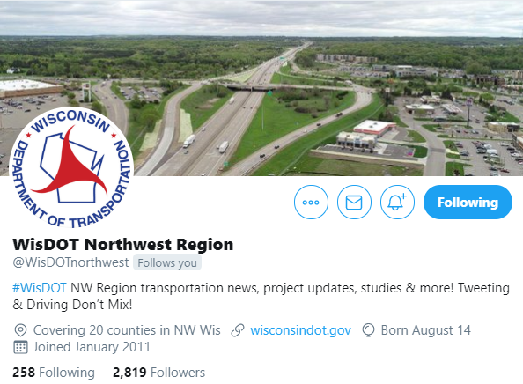
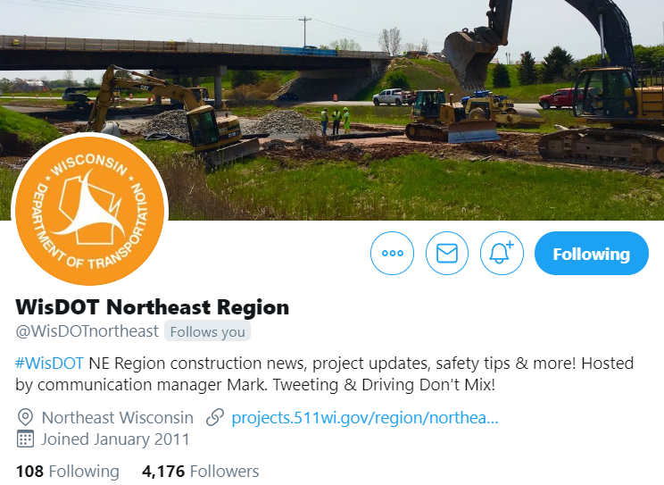
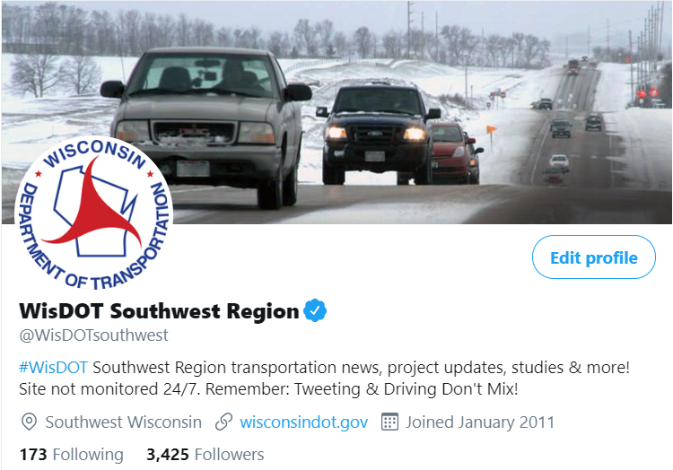
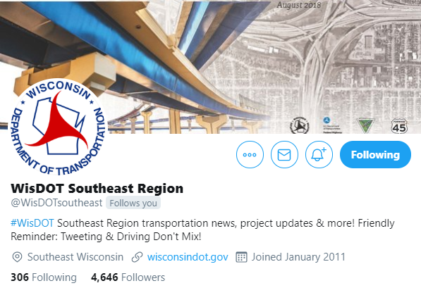
Division of Transportation System Development (DTSD)
Five region Twitter accounts
Outreach tool to communicate with the public about:
Region transportation news, project updates, studies and more!
Humanize our regions on social media
Emojis, names of construction staff, etc.
Notes:
STEVE
In a world of acronyms, I work in the Division of Transportation System Development (DTSD). I explain it to my grandma as the division who builds the roads and bridges.
Region – real time updates, incident notifications, state messages and break down to a regional message
Each of the five DTSD regions has a Twitter account. Initially, the Twitter accounts shared incident alerts from 511 Wisconsin.
In 2015, we made a push to personalize each Twitter page with region updates on projects, studies, etc.
Since then, each region has humanized the page and shared insightful updates.
Many of us have smartphones with us wherever we go. Some even turn around if they left it at home or work. These devices are constantly with us and we want to make sure people have the right information to choose the route to work, attend public meetings, etc.
Increase our reach through multiple platforms to quickly provide information to the public on all transportation topics in Wisconsin.
Twitter is more effective for region accounts to provide timely, concise details on transportation news.
Facebook pages are used for mega projects (i.e., I-39/90, Verona Road, I-94 N/S, Zoo Interchange, US 41, etc.) due to the magnitude and ability to share photos and videos of the progress.
Regional accounts also working to push messaging from the divisions – DMV, DSP posts – maximizing accounts, and reach.

Slide 13
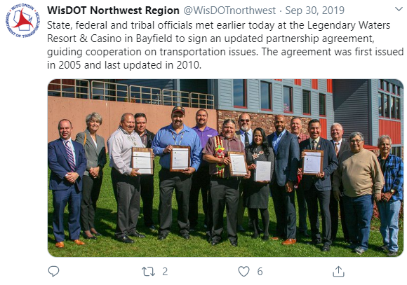
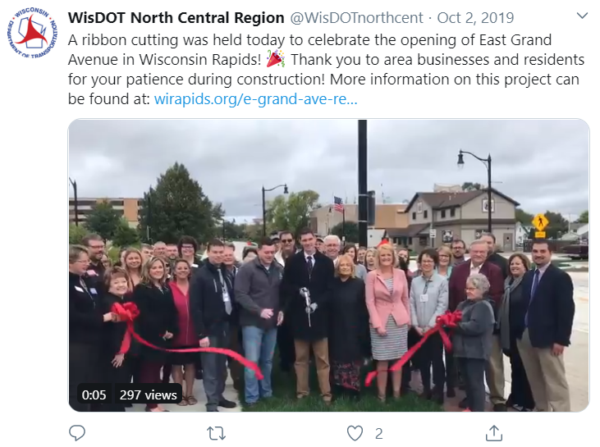
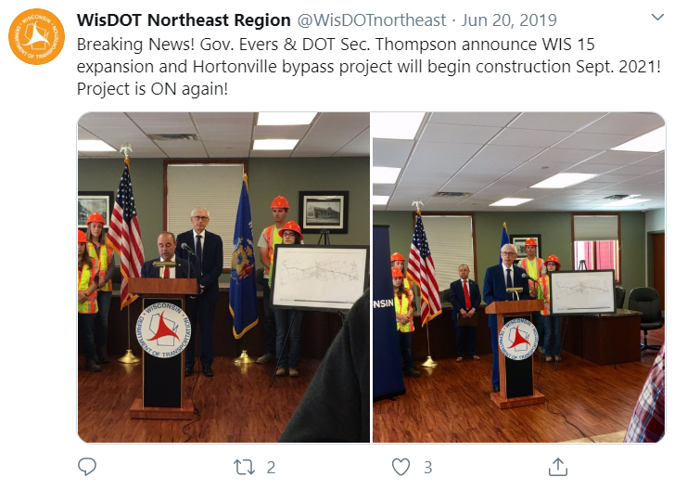
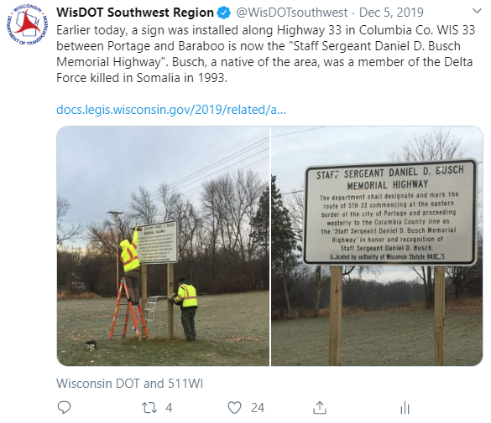
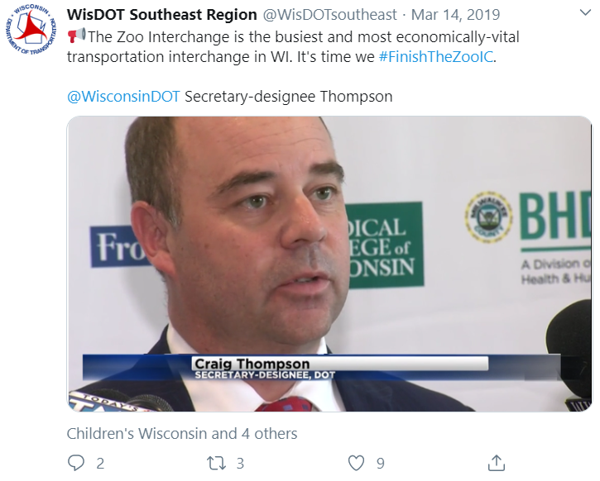
Region news
Notes:
STEVE
The Twitter accounts also provide a great platform to share transportation news happening in the region. Highway designation near Portage, advancing construction on WIS 15 in northeast Wisconsin, finishing the Zoo Interchange, or the partnership agreement with state, federal and tribal officials in northwest Wisconsin.

Slide 14
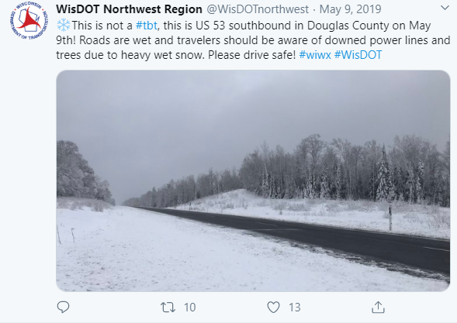
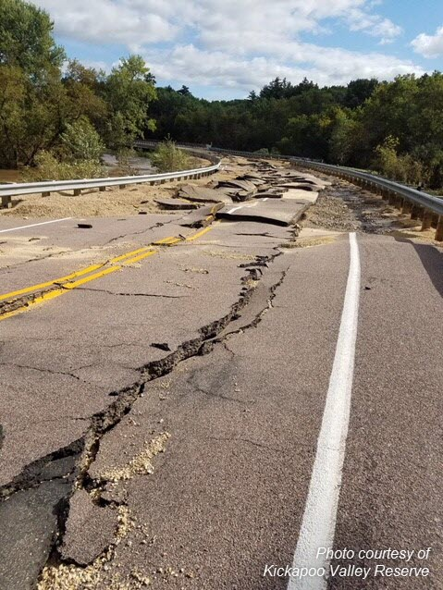
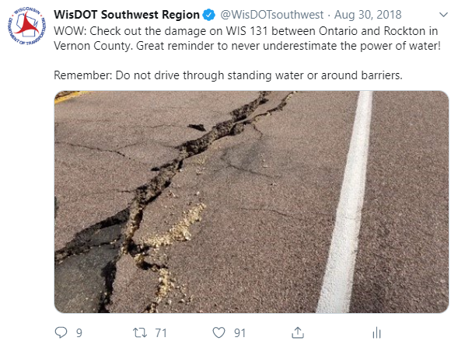
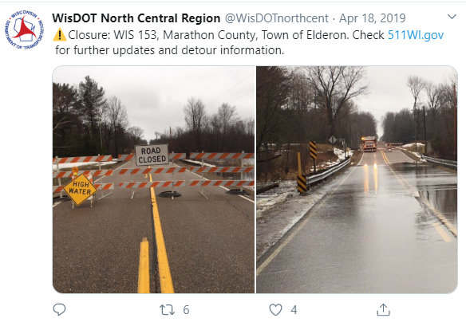
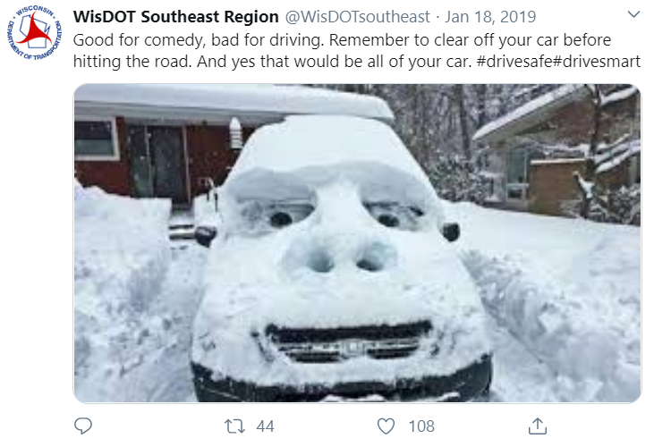
Real-time info about weather
Notes:
STEVE
No matter the season, weather often impacts transportation. Whether it’s a snowstorm or major flooding, the Twitter accounts have been a successful tool to communicate real-time updates to the public. The reach and engagement from these photos help engage drivers of current conditions and keeps us as the source of information.

Slide 15
Humanize and talk about “who”
Notes:
STEVE
We always talk about the where, what, why and how. Rarely do we talk about the who… We want to showcase the men and women who improve our transportation system day in and out.

Slide 16
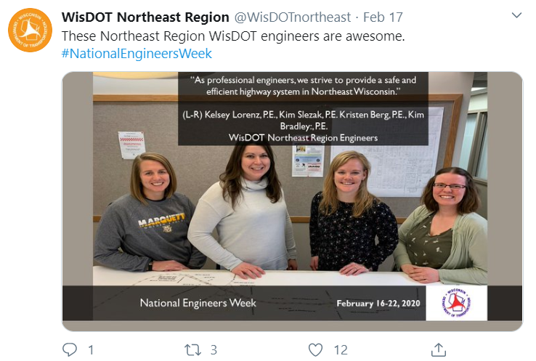
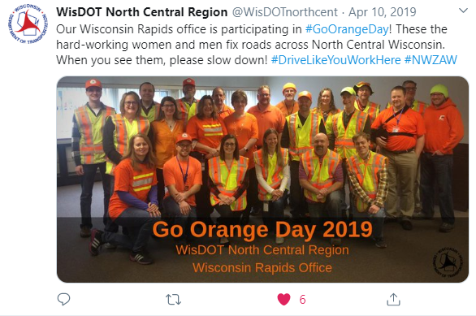
#NationalEngineersWeek
#WorkZoneSafety
Notes:
STEVE, TRANSITION TO JOHN IN THIS SLIDE
We want to remind drivers why they should slow down in work zones! Recognition of work zone safety is one week. Awareness needs to happen 24/7/365.

Slide 17
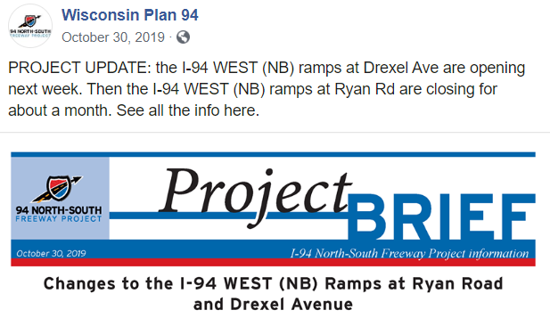
Expectations for social media use
General overview
Primary voice
Team of professional communicators
Provide all communication for project updates, alerts, etc.
Establish consistency
No parallel communications
Consistent wording, tone and voice
Notes:
JOHN
-Overview - Consistent voice/message – WisDOT is primary communicator on projects, do it to become trusted/reliable source of information – very important for Social media
-As state agency expectation for us to provide accurate information every time
– using regional stories to tell broader state-wide messages – regional updates don’t make sense from state account given the audience

Slide 18
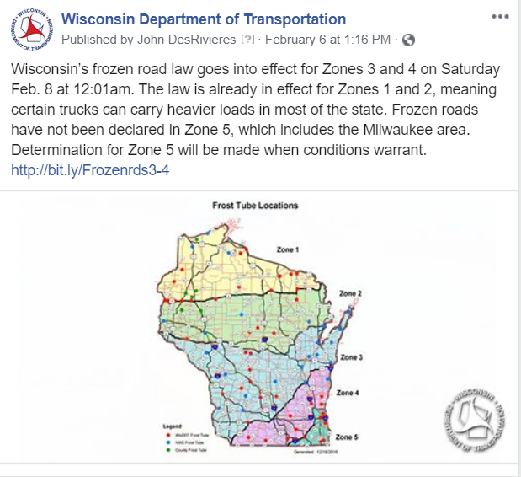
Expectations for social media use
General overview
Information authority
Official information source for media, public, work crews, etc.
Accuracy is paramount
Message credibility
Transparency – what we know, when we know it
Trusted, reliable information source
Notes:
JOHN
WisDOT delivers the program with the assistance of consultant engineering firms and construction companies. In doing so, WisDOT is the main source for information on these projects.
We expect that anyone working on a project follows the line of communication and redirects others to WisDOT websites and social media pages for additional information.

Slide 19
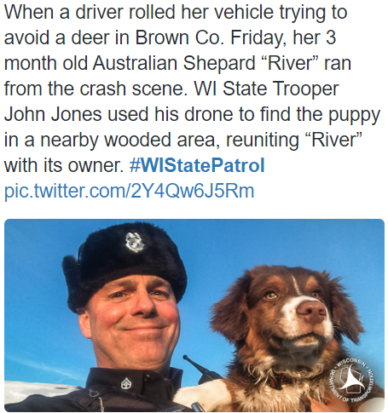
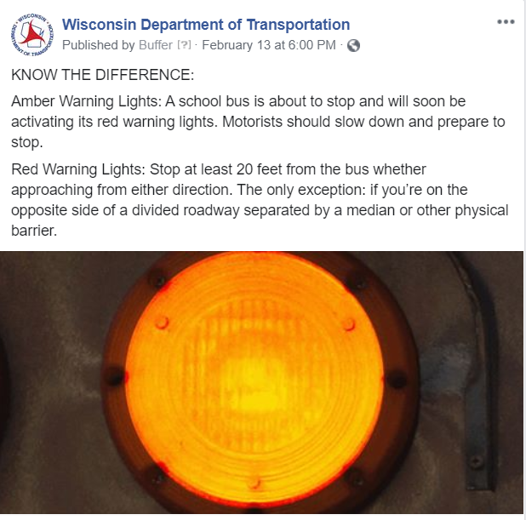
Expectations and analytics
Posts
Engaging, informative, accurate
Audience
Growth rate and engagement rate
Analytics
Measure if we meet our goals
Success
Reach surpasses core audience equals value
Notes:
JOHN

Slide 20
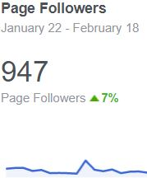
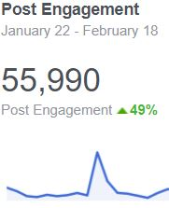
Expectations and analytics
Notes:
JOHN, TRANSITION TO STEVE

Slide 21
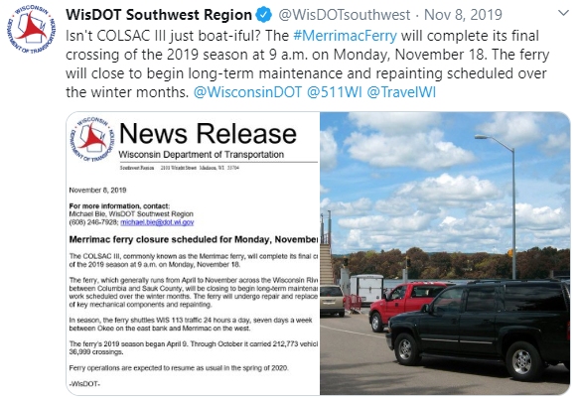
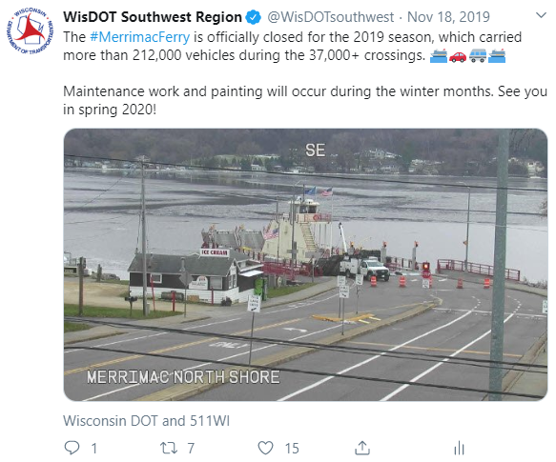
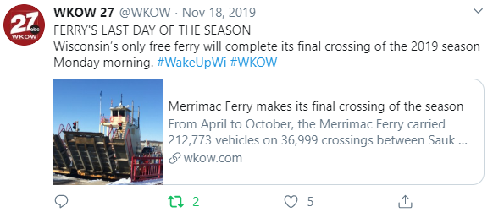
Social media impacting traditional media
Notes:
STEVE, TRANSITION BACK TO JOHN
Another way to maximize our reach is using social media to impact traditional media. One good example is the Merrimac Ferry.
Instead of the traditional news release and media attention, we opted to post a news release only on the region Twitter page. The ferry was closing earlier than usual in the season for long-term maintenance. We decided to post the closure announcement on Twitter to see if our followers would engage with us. Sure enough! We had thousands of impression and Madison-based TV stations ran the story.

Slide 22
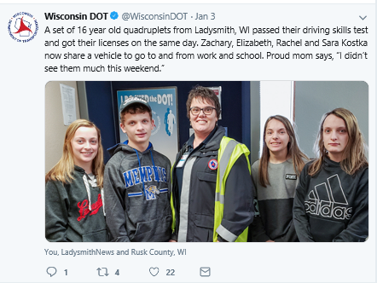
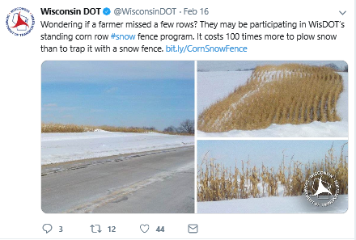
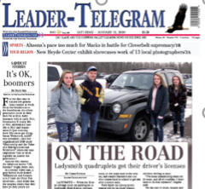
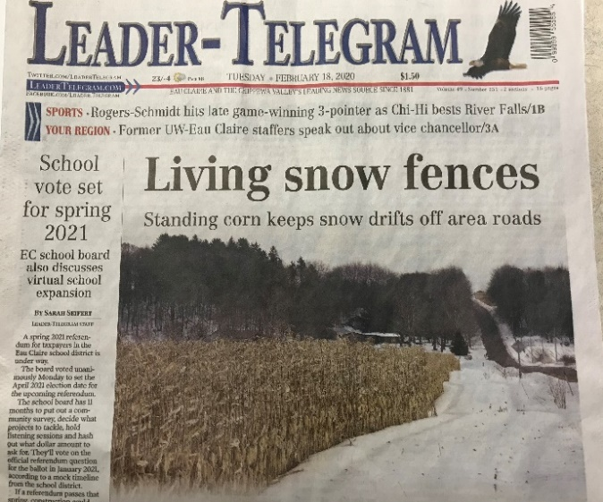
Social media impacting traditional media
Notes:
JOHN
One of the ultimate ways of showing value is when our social media posts influence the media and turn into media stories
-Give examples of times social media posts led to news stories- this shows the value of social media
-state patrol dog rescue/owl rescue – jan 7 2020
-logging partnership video
-quadruplets at dmv
-Crash data – community maps
-Once again here’s where social media shows value when your social post goes beyond your accounts and followers and is now in the masses

Slide 23
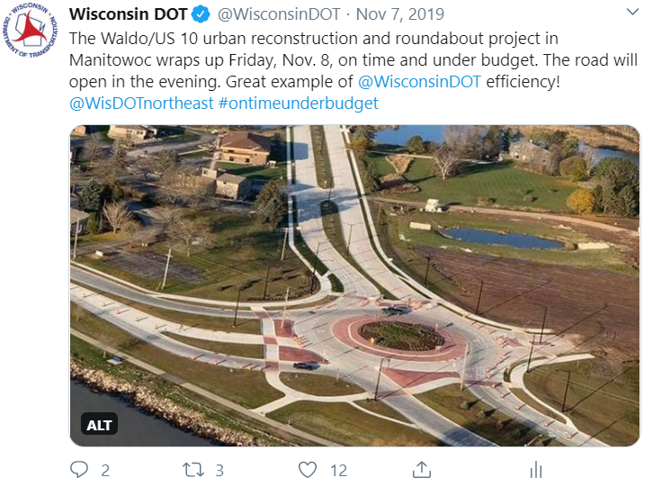
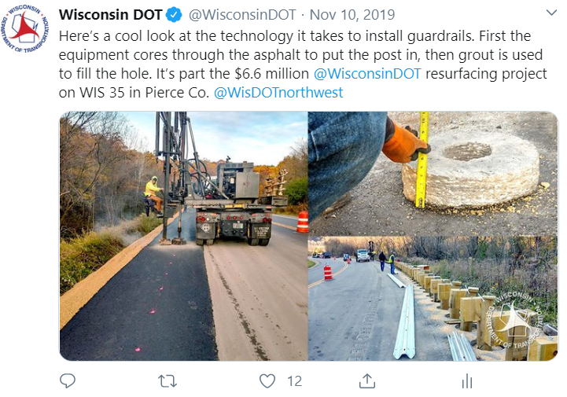
Statewide outreach during highway projects
Major highway construction projects
Impact multiple regions
High-traffic volume
Holiday traffic impacts
Work zone safety
Regional stories to push statewide messages
Notes:
JOHN, TRANSITION TO STEVE
-State – broad message – work zone awareness, drive like you work here, phones down, men/women working day and NIGHT – work zone awareness week – behind the barrels, construction kick off in spring, summer holidays – traveling home, be safe in work zone – statewide stats of work zone crashes – go orange day – photos of people wearing orange

Slide 24
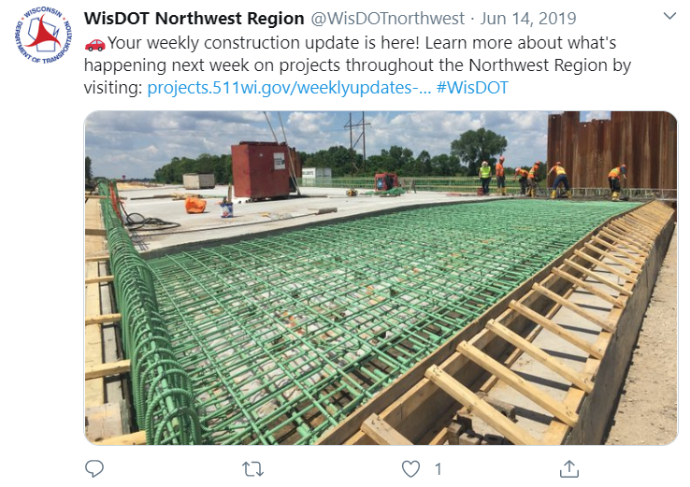
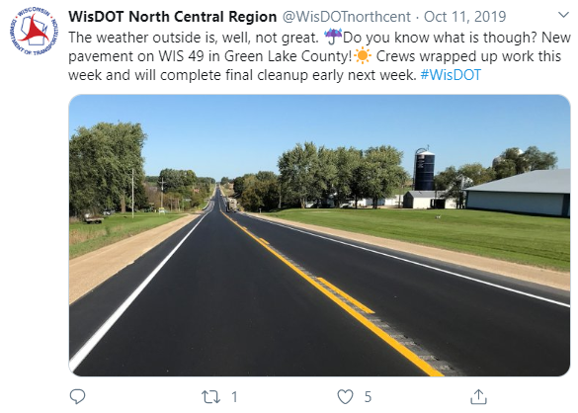
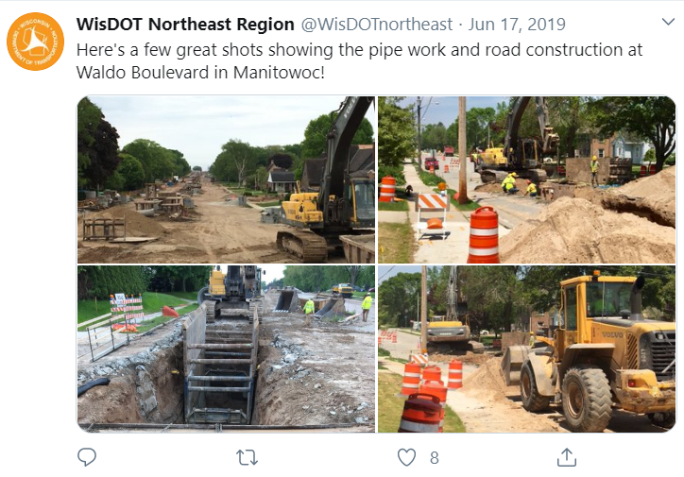
Region outreach during highway projects
Notes:
STEVE
Through the region Twitter accounts, we can share information about construction projects including pictures of the current status, staging changes and completion!
Pictures often do well for engagement, but videos do even better. For instance, a time-lapse of a bridge built in three months…condensed into two minutes!

Slide 25
Region outreach during highway projects
Facebook is a best practice for mega/major projects across the state.
Notes:
STEVE
Many people are visual learners, so finding a social media platform to share that information was crucial for the major construction project.
Compared to Twitter and a limited number of characters, Facebook allows more dialogue about why and how were improving Wisconsin highways.
For each major project in the state, there is a Facebook page. I-39/90, Verona Road, I-94 North/South, WIS 441 and I-41.
Social media plays a supporting role in communicating to the public, including informing the traveling public about construction updates, lane closures, accidents, alternate routes and other important corridor updates.
All social media activities must follow established WisDOT social media best practices criteria.
The page allows us to share timely details about the roadwork, but also factual information.
Through the Facebook page, we have gained a reputation for being responsive, transparent and helpful during the project.
In addition to social media, we have a website and email distribution list. Through effective outreach tools, we are better able to communicate with the business owners, residents, commuters and the general public.

Slide 26
Verona Road opens to full capacity!
Notes:
STEVE
As you may know, social media can often open you up to public comments – negative and positive. We’ve received some negative comments, but I wanted to share this positive post and its power to reach and engage thousands of people. One person was so excited that Joey Tempest from Europe made the page.

Slide 27
Slower speed, faster engagement
Notes:
STEVE
In 2018, we reduced the speed limit to 55 mph within work zones on I-39/90 between Beloit and Madison. We reached more than 134,000 people over three days. To put that in comparison, our page only had 4,300 followers – 29% increase.

Slide 28
Multiple reactions on Facebook
Notes:
STEVE
On Facebook, there are many reactions beyond the typical “Like”. You can react with Love, Ha-ha, Wow, Sad or Angry. Social media can often open you up to many different viewpoints and opinions.
Similar to what John mentioned about rules of engagement, we only respond to questions that necessitate a response and not “why didn’t you improve this sooner?!”

Slide 29
Safety first
Please keep your head up and phone down when driving – especially in work zones!
Notes:
STEVE
Social media helps bridge the gap and tell our story. Despite all of this information about social media, we need to be cognizant of our surroundings when driving – especially in work zones. Do your part and encourage others to do the same – keep your head up and phone down!

Slide 30
Going back to the questions…
Can social media influence public perception?
How about as it relates to government, state agencies or transportation?
Is social media an integral communication piece of the transportation world?
For your next highway project, will you make sure the WisDOT communication manager is involved?
Notes:
STEVE
-Going back to our original questions – now that you’ve gotten some insight into how and why we use social media for transportation – for those who aren’t on social media – or thought social media was a waste of time and only good for cat videos - who has changed their minds, who is thinking about maybe joining social media?
-For those who didn’t think there was value for transportation in social media – who has changed their mind?
**LinkedIn – talk about value of LinkedIn and at a bare minimum everyone in this room should have a LinkedIn page – why?
Don’t forget to involve the WisDOT communication manager. They can assist with news release and updates to the community, but also share the great work happening in the field directly on Twitter.

Slide 31
Questions?
Don’t forget to follow us!
Notes:
JOHN
Are there any questions? Also, don’t forget to follow us on our various platforms.

Slide 32
Contact information
John DesRivieres
WisDOT Social Media Manager
(608) 266-2614
john.desrivieres@dot.wi.gov
Steve Theisen
WisDOT Communications Manager
(608) 884-1230
steven.theisen@dot.wi.gov
Notes:
JOHN
Here is our contact information, so feel free to get in touch with us. Thank you for your time!

