Slide 1
Electronic Submittal of Finals Records
Karla Knorr
February 22nd, 2018
Notes:
Before
Be well prepared with content. Know facts and figures and your audience.
Everyone should be able to read the slides but if NOT, read it to them. Otherwise don’t include it.
Do a final check on microphone and other equipment well before the start time.
Practice the presentation aloud several times. Feel comfortable.
Drink fluids and do something to relax you.
During presentation
Smile and be confident.
Introduce yourself and the organization.
Speak with energy, clearly, and in a reasonable volume so everyone can hear you.
Do not read each line on the slide show – use your own wording and add in examples or additional information which will aid in comprehension.
Talk “friendly” and with the attitude that you are here to provide information and assistance. Have a “win/win” attitude.
If you make an error, politely clarify or correct it. Move on quickly and don’t dwell on it.
If you can’t answer a question, politely indicate you don’t have the information available. Indicate that you will follow-up individually with the requestor.
After presentation
Be available for follow up.
Be prepared for additional comments, questions or clarifications.
Maintain composure.
If you make a promise, be sure to follow up quickly or reassign if appropriate.

Slide 2
Electronic Submittal of Finals Records
Optional for this year
File Structure
Submittal Process
Notes:
Overview should be specific such as listing the goals of the presentation and items to be covered. For example: “Explain Hwy 51 project alternatives.”
Use a verb followed by a brief phase or sentence.
Overview should include time for Q&A or indicate if you intend to take questions during the presentation or prefer that they wait until the end of the presentation.

Slide 3
Electronic Submittal of Finals Records
Optional for this year. Next year, potentially mandatory.
Select one way, electronic or paper, for this year. Please don’t do a combination.
Signatures can be electronic on the forms that need signatures.
Notes:
Provide facts, figures and objective data will help to keep the audience focused.
Review political, financial or other information.
Dispel misinformation.

Slide 4
Electronic Submittal of Finals Records
File Format
The file structure follows the Admin Guide for this year.
Next year, it may change if AASHTOWARE is rolled out
Please follow the structure that is provided. Deviations will not be allowed.

Slide 5
File Structure

Slide 6
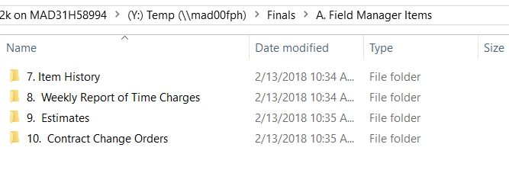
File Structure
Notes:
Provide data, facts and figures.
Photos or graphics will enhance retention and understanding.
Consider grouping key periods such as the past 6-12 months and the next 6-12 months.
Be sure to link to hot topics and accurately address those concerns.

Slide 7
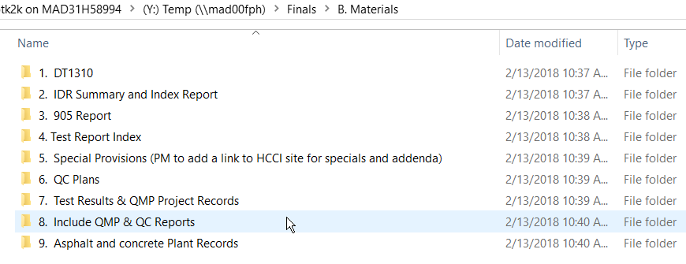
File Structure

Slide 8
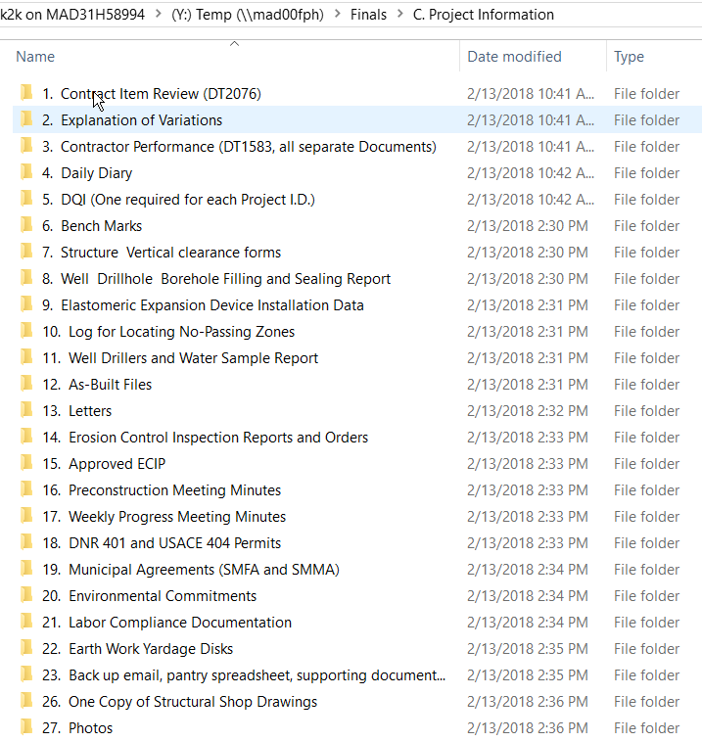
File Structure

Slide 9
Submittal
Flash Drive given to the Project Manager or place it on the FTP site
Finals Box
Even with electronic submittal, there will be a final box to submit
Copies of aggregate and asphalt tickets, seed tickets, hard diaries, etc.
Notes:
Clarify issues or answer anticipated questions.
Often the audience does not clearly understand the benefits of the project and may therefore make up their own assumptions which can be inaccurate.
Use the benefits to refute contentious issues. Use factual information on “hot topics” to divert anger and lessen the chance for misunderstanding.

Slide 10
Project Manager’s Responsibility
On the P Drive, Under the Construction Folder, Create a Folder called Finals
Copy the Finals into this Folder
Send a link to the Materials Section
Check the finals
Send a link to Kelly Addison after the finals have been checked

Slide 11
Electronic File Submittal
One Page Handout for Reference
Questions?
Notes:
List contact and resources to help get answers.
Refer to WisDOT project web site for detailed and ongoing information.
Include name and phone number/email for lead staff.
Take Q&A if time allows.
End the presentation on a positive note. Thank the audience for their time and attention.

