Slide 1
Critical Inspection
Karla Knorr
February 22nd, 2018
Notes:
Before
Be well prepared with content. Know facts and figures and your audience.
Everyone should be able to read the slides but if NOT, read it to them. Otherwise don’t include it.
Do a final check on microphone and other equipment well before the start time.
Practice the presentation aloud several times. Feel comfortable.
Drink fluids and do something to relax you.
During presentation
Smile and be confident.
Introduce yourself and the organization.
Speak with energy, clearly, and in a reasonable volume so everyone can hear you.
Do not read each line on the slide show – use your own wording and add in examples or additional information which will aid in comprehension.
Talk “friendly” and with the attitude that you are here to provide information and assistance. Have a “win/win” attitude.
If you make an error, politely clarify or correct it. Move on quickly and don’t dwell on it.
If you can’t answer a question, politely indicate you don’t have the information available. Indicate that you will follow-up individually with the requestor.
After presentation
Be available for follow up.
Be prepared for additional comments, questions or clarifications.
Maintain composure.
If you make a promise, be sure to follow up quickly or reassign if appropriate.

Slide 2
Critical Inspection
Guide can be found on www.wisconsindot.gov
  Under Doing Business/Engineers and Consultants/Structure and Road Resources
Guide was recently revised and has a slightly different format.

Slide 3
Critical Inspection
Minimum Inspection based on preventing high risk consequences of failure.
Expectation is that cost savings and efficiencies will be realized by using the appropriate level of inspectors as well as combining several tasks to be administered by an individual inspector.

Slide 4
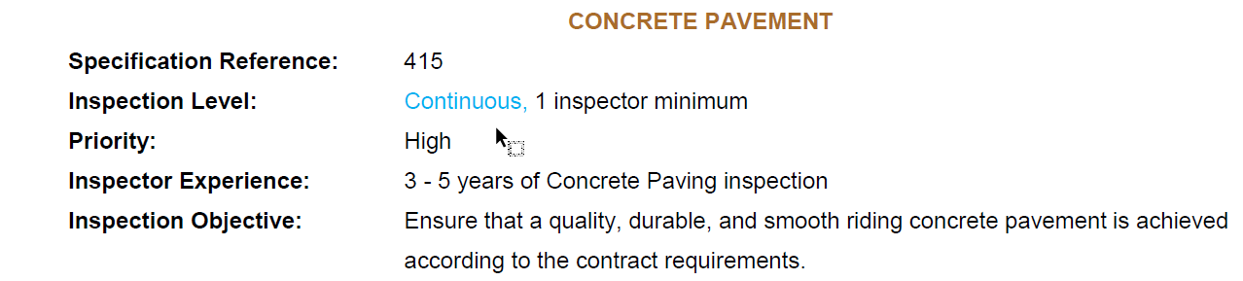
Inspection Definitions
Continuous Inspection = Requires inspection during the entire operation.
  Example: Concrete Paving

Slide 5
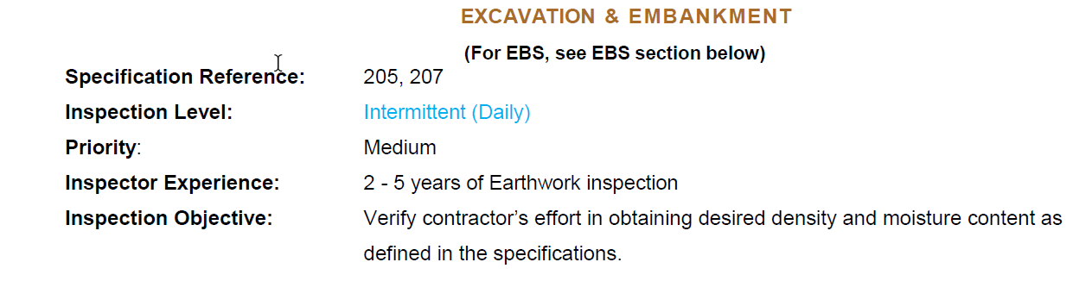
Inspection Definitions
Intermittent Inspection = Requires inspection at critical times in the operation.
  Example: Excavation

Slide 6
Inspection Definitions
End of Product = Requires inspection only after completion of the operation and during the construction operation when time permits.
  Currently, no items are designated as end of product inspection.

Slide 7
Critical Inspection
Staffing Guidelines are listed
  Trying to find the right balance between inspector experience and what is needed for projects
  Evaluated on a project by project basis
    Consider other factors such as job conditions and contractors performance on past projects
Priority
  Level of associated risk resulting from insufficient inspection

Slide 8
Critical Inspection
Guide provides minimum inspection requirements based on preventing high risk consequences of failure
Looking for efficiencies during inspection

Slide 9
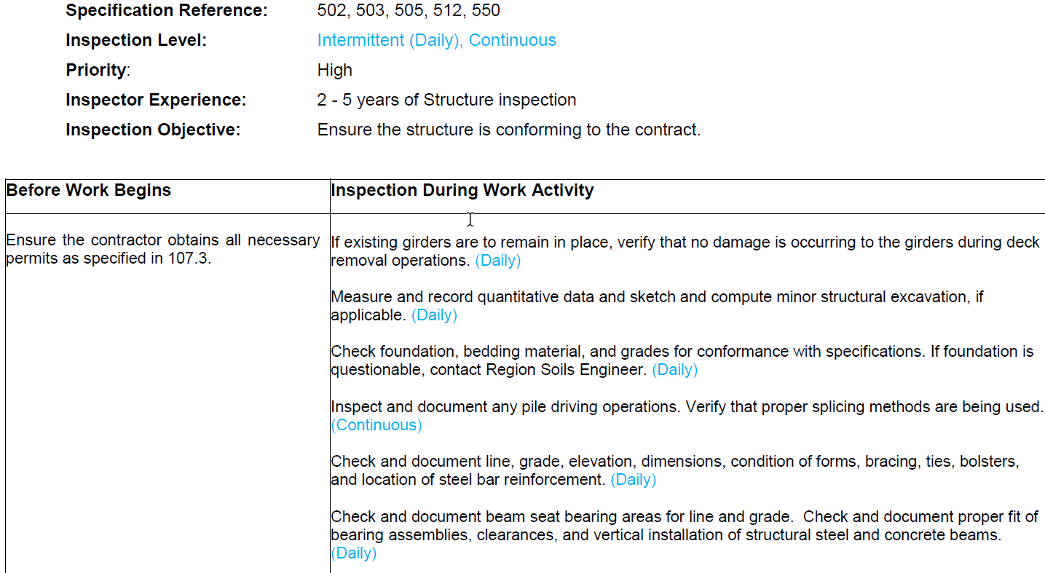
Structures

Slide 10
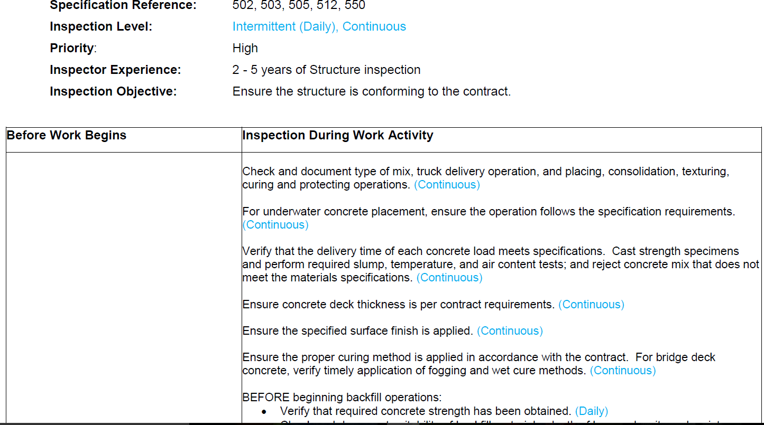
Structures

