Slide 1
WELCOME
Construction Administration Training for Southwest Region
February 19, 2018
Notes:
Kelly Addison, SW Region – Madison Contract Specialist Advanced (Construction)

Slide 2
SWR Construction Administration Process
Construction Project Start-Up
During Construction
Finals Dates & Records
Notes:
Kelly
Our process is broken into 3 parts: Start-up, During construction and project Finals Closeout
Please refer to Constr Admin Guide p 2, 4 & 8 and also the Flowcharts I, II & III-IV

Slide 3
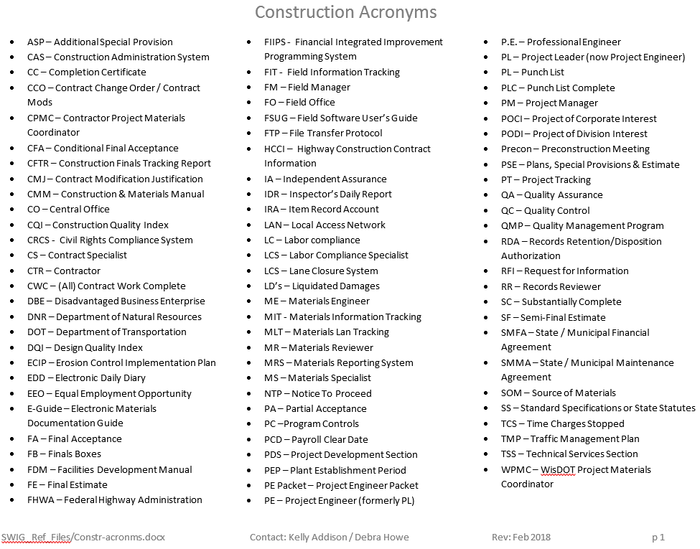
Construction Acronyms
* See SWIG 8-1-20
Notes:
Kelly
We use a LOT of acronyms in our PP, Constr Admin Guide, Flowcharts and emails.
FSUG, RDA, PE now PL

Slide 4
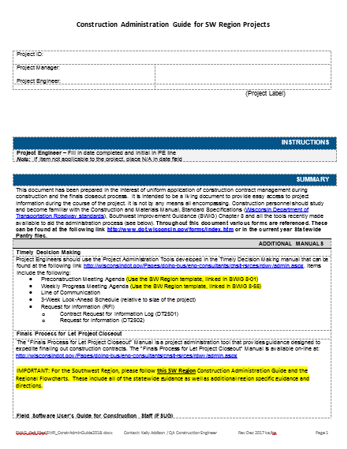
Construction Administration Guide
2018 FSUG pgs updated
Asbuilt changes –
  1 or 2 pdfs only
  CMM updates
* See SWIG 8-1-20
Notes:
Kelly
Please follow our SWR construction administration guide for all (non-local) projects. The Local Program has their own similar guide.
This guide includes all of the statewide guidance, as well as additional region specific guidance and directions
Expl of Variation FSUG 10%10% do better in using CAG 5%10%

Slide 5
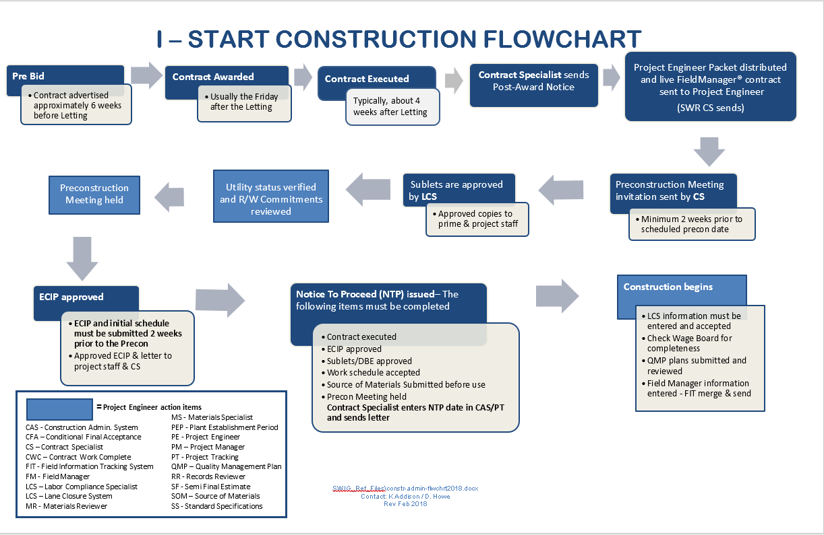
* See SWIG 8-1-20
Notes:
Kelly
SWR Flowcharts are attached to the back of your SWR Constr Admin Guide.
Your PE Packets will also include 11 x 17 color copies of these
First flowchart maps out start of process from prebid to beginning of construction

Slide 6
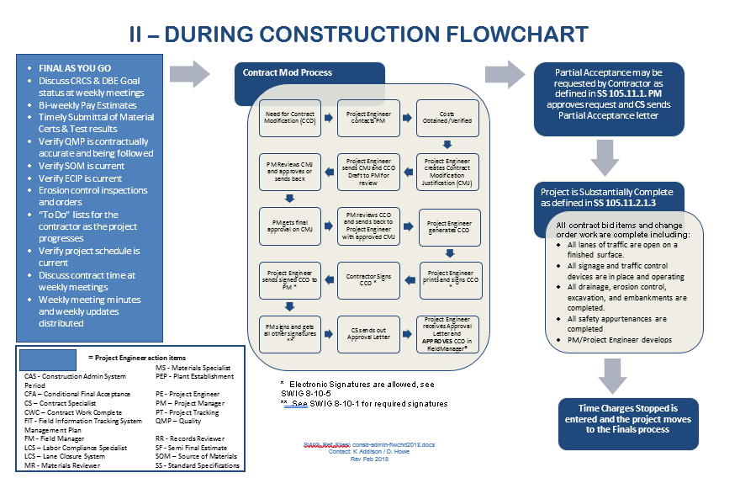
* See SWIG 8-1-20
Notes:
Kelly
Second flowchart maps out during construction activities
Contract Mods & CMJs
Partial acceptance (rare)
Time charges stopped / substantially complete

Slide 7
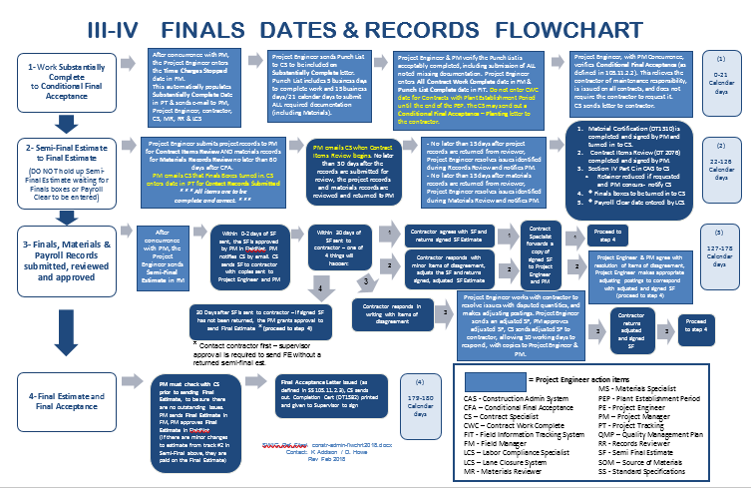
* See SWIG 8-1-10
Notes:
Kelly
Third flowchart maps out our finals process, from substantially complete thru final estimate.

Slide 8
I – Construction Project Start-up
Dplans, Specials, Addendums, PE Packets
Pre-Construction Meeting
Sublet Approval
ECIP Approval
LCS
Conditional Start
Start Notice
Pantry / SWIG / Field Manager / FIT / Project Tracking
*Refer to SWR Constr Admin Guide (CAG) p 2-3 & Flowchart I
Notes:
SWR Constr Admin Guide p 2 & Flowcharts p I
Construction Project startup

Slide 9
PE Packets and Documents
PSE New for 2018, please order 20 Dplans/Specials, not 25
Local projects are coming in with 35, please only 20
PM & PE will coordinate to pick up PE Packet, Plans, Specials and Addenda
PM & PE will coordinate to ensure the PE has access to the Design Documents, such as the Notes to Engineer, Real Estate & Environmental Commitments, 401 / 404 & Utility Permits, TMP, IMP, etc
FIT/MIT email sent out 2/20/18 to PE/PM’s regarding updates for this year, instructions different if DOT vs consultant. Please see handout if you did not receive this email.
Future emails will be sent to download and install Pantry 2018 and the FieldManager ACP file (March)
* See SWIG 8-1-1
Notes:
Kelly
Dplans/Spls – New for 2018, please only order 20 of ea unless a big project & you want more
Locals coming in with 35, way too many
PM coordinates with PE to get access to their project resources, including the PE Packet, design documents,

Slide 10
Preconstruction Meeting
Preconstruction Meeting Invitation – at least 2 weeks prior to meeting
Email Contract Specialist (CS) requests for Precon Invitation
A complete ECIP submittal and initial project schedule is required 2 weeks prior to Precon
* See SWIG 8-1-10
Notes:
Kelly
Send notice no later than 2 wks prior to mtg
ECIP and Initial project schedule must be submitted 2 wks prior as well

Slide 11
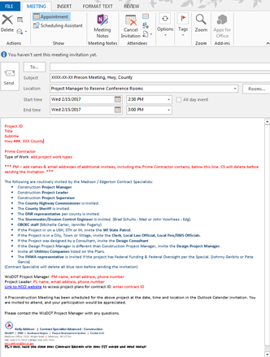
Request for Precon Notice
Email Template for Madison/Edgerton
PM’s:
Please follow SWIG, no expectations
Enter PM/PE & phone #, CS brings in the rest of data with cut/paste
Additional contacts (Ex)
* See SWIG 8-1-10
Notes:
Kelly
Please refer to SWIG 8-1-10 for the template and guidance

Slide 12
Conditional Start Notices
SWR uses these more than any other region for:
  Accelerated work schedules
  Delayed project starts where prep work may be needed
    Staking
    Traffic control / message boards
    Tree removal for Northern Long Eared Bats
Sublets of those performing this work must be approved
Project must be executed
* See SWIG 8-1-25
Notes:
Kelly
For guidance for a request for a Cond Start Notice Refer to SWIG 8-1-25.
Be specific regarding what work you are asking for – Survey, Staking, Traffic control, etc.
We don’t want LC coming to ask us CS’s if there was a Start Notice because payrolls are coming in w/o a Cond Start…this is how we get caught doing work w/o a Cond Start.
If we know they are out there, we have to pay for the work. If we aren’t aware, then the Prime is responsible.

Slide 13
Notice to Proceed
(Start Notice)
Contract executed
ECIP approved
Sublets / DBE approved
Work schedule accepted
RR insurance received (if applicable)
Precon meeting held
Source of Materials submitted
CS enters Notice to Proceed (NTP) date in CAS/PT and sends letter
* See SWIG 8-1-25
Notes:
Kelly
These items must be complete before a NTP/Start can be sent

Slide 14
Request for Notice to Proceed / Start
Email CS a Request for Notice to Proceed / Start (Email subj line lowest project id and date you want to start, that’s it)
Start notice letter – typically 1 week lead time and sent before starting work
Contractor must have this letter BEFORE any work starts
Contractor is liable for any accident without this letter
* See SWIG 8-1-25
Notes:
Kelly
Refer to SWIG 8-1-25 - submit to CS via email.
As CS, if we don’t see the Executed date in PT, we can use the email from CO in place of.
ECIP – PM forwards email approving ECIP to Prime and cc’s CS (this is our green light)
Sublets – CS Must have email from LCS

Slide 15
Field Office Files - Hard Copy Required
ECIP Binder – Environmental Commitments, 401 / 404 Permits (if applicable), ECIP including amendments, etc
Materials documentation / QMP Plans
Contract Modifications
Line of Communication Form (DOT & Contractor Contacts)
Wage board & all required documents
Site Health form with emergency contact info
SWR Construction Administration Guide & Flowcharts
* See SWIG 8-1-20
Notes:
Barb

Slide 16
Field Office Files – Electronic Files
Plan letter
Environmental Commitments
Time Chart
Notes to Construction Engineer
Real Estate commitments
Wetland Tracking Form / 401 & 404 Permits
Utility Work Plans and Permits
State / Municipal agreements (SMFA / SMMA)
TMP
IMP & who to contact for incidents - ETO plan protocols RIMC / Duty officers
* See SWIG 8-1-1
Notes:
Barb
For the Design Documents, if you don’t have access to the Design project files on the network, or can’t find what you are looking for, contact your Project Manager to get those documents for you.
Electronic files are fine for these, they don’t have to be hard copies.

Slide 17
Pantry / SWIG
Field Manager / Project Tracking
N:\PDS\Pantry 2018\SWR (All SW Region specific files now in SWIG) – around March 5th
2018 Pantry and Field Manager – loaded by IT support staff prior to construction start
  Contact BIT L2 ACM Support Staff (FSUG p 53)
2018 Field Software User’s Guide (FSUG) - In Statewide Pantry Manuals & Guides – March 5, 2018
Kelly Addison transfers & archives all contracts for all SWR offices including local program
Pantry – use ONLY 2018 files!
Delete old CAG, Flowcharts, FSUG, etc from C drive, desktop, etc and replace with NEW
* See SWIG 8-1-1
Notes:
Barb
Unless you have a carry-over project and you already have documents started from last year, PLEASE delete your old Pantry Files and ONLY use the current ones for 2017. (Statewide Pantry & SWIG)
If a request comes in dated 2014…we are likely to decline and ask you to submit the current request that has been updated in Statewide Pantry 2017 or SWIG.

Slide 18
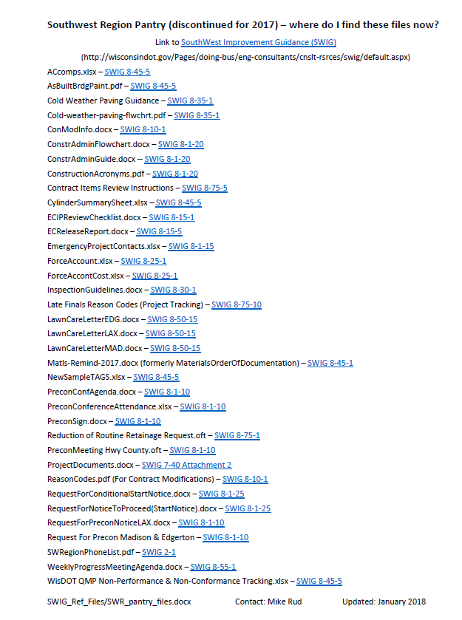
SWIG reference doc
This file is included in your PE Packet, and is the only document that remains in Pantry SW Region Specific
* See SWIG 8-1-1
Notes:
Barb
There will be a quick tour of Chapter 8 of the SWIG - for Construction topics, in a later presentation today.
This will help you find all of the info that you used to find in the SWR Pantry, with links to the section dealing with each topic or document

Slide 19
II - During Construction
FieldManager Entries
Weekly Construction Progress Meetings
Contract Modifications
Claims
Cold Weather Paving
Punch List
Partial Acceptance
*Refer to SWR Constr Admin Guide p 3-8 & Flowchart II
Notes:
Kelly
SWR Constr Admin Guide bottom of p 3 – top of p 8 & Flowchart II

Slide 20
Field Manager – Entries
Daily Diaries
  Required for each calendar day, including weekends
Inspector’s Daily Report
  Required for each day the contractor works
Project Engineer is responsible for accuracy of postings
FN to pdf, cuts off data – PT to pdf, diary complete. If print, print from PT
Notes:
Kelly
Daily Diaries are crucial
Inspector Daily Report is key
This is info Used by other sections, primarily Labor Compliance

Slide 21
Field Manager Estimates
Estimates typically sent every two weeks ($1000 minimum)
Remember to enter “Date to Date” or “FY” on ALL estimates (Intermediate, SF & FE) – FSUG p 18
Project Engineers please double-check estimates before generating and sending for approval / need to reduce denials (rollbacks)
DO NOT send negative estimates without PM approval!
Post in Field Office, email to Prime if requested
Field Software User’s Guide (FSUG) p 18-20
Notes:
Kelly

Slide 22
Weekly Progress Meeting
Agenda in SWIG 8-55-1
  Modify to fit project
Minutes & attendance taken by Project Engineer
Contractor to provide 3 week look ahead
Always discuss materials documentation and running ‘to-do’ list
PE to distribute minutes weekly (Prime & all attendees)
Attach Weekly Statement of Working Days to Minutes
Completion Day Contracts
  Discuss schedule at Weekly Meeting
  Compare with contractors schedule
  Review of adverse weather days monthly
* See SWIG 8-55-1
Notes:
Barb
Every project needs to have weekly progress meetings
Continue to communicate with the Prime after the completion of the work thru the finals process.

Slide 23
Contract Mods
Use 800 Admin Items if applicable
Goal – Complete Contract Mod prior to work, all Mods require a CMJ
Required Signatures for approval (+/-)
  $0-$25,000 – PM approves
  $25,000 - $50,000 – Supervisor approves
  $50,000 or more – Chief approves
* See SWIG 8-10-1
Notes:
Barb
Signature dollar levels are positive OR negative
The CMM says that 800 items are not considered cco’s to be approved by the contractor – IN THE SWR we want mods & CMJs for these, and we want to go through the normal signature and approval process to minimize disputes about these during the finals process. If the contractor refuses to sign, follow the SWIG guidance.
For any Con Mods of $50,000 or more, please send a draft to Barb Gassen as soon as possible.

Slide 24
Reason Codes
Reason codes are needed for accurate data in analyzing for performance measures
Each bid item will only accept one reason code
Reason code must be first 2 characters in the text box “Reason”
Only use the 7 reason codes found in SWIG 8-10-1, follow the guidance on what each is used for
See Field Software User Guide - p 14
* See SWIG 8-10-1
Notes:
Barb
Use the most appropriate Reason Code for each item in the Con Mod. Don’t just use PC (plan change) for everything. These are used in reports by management for tracking the reasons for our Change Orders, so this info is important to them.
RO – request by others is for those requests OUTSIDE of DOT, such as a county, municipality, DNR, etc.
If I see you use the word SAFETY a bunch of times in your con mod, you probably should be using the SE (Safety Enhancement) reason code.
If the Mod is for a CRI – you must use the CR (Cost Reduction) reason code, as well as the 800.0150 admin item.

Slide 25
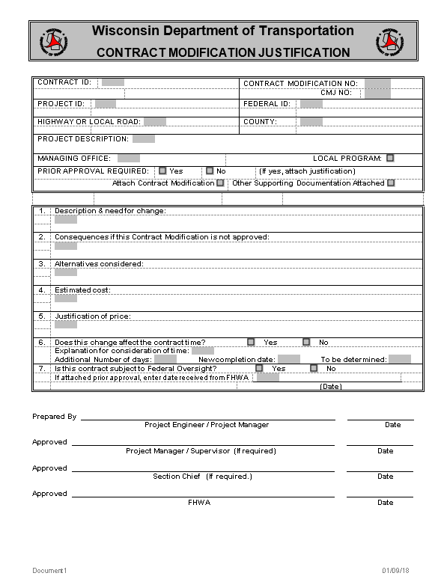
Contract Modification Justification
Use most current version in Statewide Pantry
Contract Mod Justification (CMJ) is
required for EVERY contract mod
Stand alone document
CMJ is an internal document
and is not distributed to the contractor
Follows same signature authority as
Con Mods
Multiple CMJ’s for one Mod
  Ex 1.1, 1.2 or 1-1, 1-2 or 1a, 1b)
* See SWIG 8-10-1
Notes:
Barb
Each item needs a CMJ, even when multiple items are in the same con mod. Number them to correspond to the Con Mod.

Slide 26
Claims
What is a claim?
  A dispute between Contractor and Department regarding a change to the work
  The step taken after the process of SS 104.2 when that does not resolve the issue
Follow the process in SS 105.13.1
Prime Contractor must certify the dispute as a claim in writing
PE is required to enter the date the claim is submitted in FIT, Acceptance Tab, FSUG p 44
Notes:
Barb
Please copy me and CO Construction Oversight Engineer Doak Christenson on any correspondence regarding potential or submitted claims.

Slide 27
Cold Weather HMA Paving
Std Spec 450
  Requires Cold Weather Paving Plan be submitted at Precon
  Plan must be approved by the engineer, and the contractor must follow the plan when paving in temperatures less than 40 degrees. Changes to plan need to be in writing and approved.
  Minimum measures include additional rollers and warm mix additive from the department approved products list
  Once Cold Weather Paving is begun, it is for the entire work-day
  Bid item 450.4000 – HMA Cold Weather Paving
  Cold Weather Paving letters for paving below minimum temps allowed in SS 450.3.2.1 - PM emails CS to send Allow or Direct letters if needed
  PE required to enter in FIT, Acceptance Tab, FSUG p 44
* See SWIG 8-35-1
Notes:
Barb
PL should review the plan to see if possibility of paving in cold weather
If so, have the contractor submit a cold weather paving plan at the Precon
Cold Weather Paving is allowed by the Specs if following a Cold Weather Paving Plan approved by the Engineer -- below 40 deg, down to 32 deg (lower) or 36 deg (upper).
If paving below the minimums, and written approval is needed, work with PM and email CS – follow SWIG 8-35-1 guidance on what needs to be included in the letter. Email the needed info to the CS who will send the letter.
Once Cold Weather Paving is begun, it is for the entire work shift

Slide 28
Partial Acceptance
Contractor needs to request partial acceptance per SS 105.11.1
Partial Acceptance may be granted when a portion of the work under the contract has been completed, inspected and accepted
PA should be granted only for sections that are in fully operable condition
Examples: Staged Construction, Winter carryover, Structure on large project, Electrical items
PA should not be granted for individual items. PE should work with their PM and Supervisor before requesting CS to send a partial acceptance
Notes:
Barb
Due to late painting and staining, erosion control issues, late seeding, etc. some projects need to grant PA to accept finished work, but allow the contractor to finish incomplete work the following spring.
If needed, a Mod should be written to extend time for the remaining work.

Slide 29
Partial Acceptance (cont’d)
PA relieves the contractor of maintenance responsibility for the designated portion of the work and moves the maintenance responsibility for the accepted portion of the work to the owner of road
PA does not relieve contractor of responsibility for defective work or damages caused by the contractor’s operations
Can exclude items that have a proving period (signs, permanent pavement marking, plantings) or that are not accepted yet
Notes:
Barb
PA relieves contractor of maint
PA does not relieve contractor of responsibility for defective work or damages caused by the contractor’s operations

Slide 30
We are here to help, if you get stuck, please reach out to experienced staff for help before entering data you are not sure about or before contacting CO. If we don’t know the answer, we most likely know who to contact.
SS 107.14 Contractor Responsible for Work 1007-10-79 IL State Line, I39 Dane
Khader Abu Al Eis/Tom Wickus, Daar 7/5/2016

Slide 31
Punch List
Keep an ongoing “To Do List” during project, discuss at weekly meetings, do corrective work as you go
When contractor says the project is Substantially Complete, PE / PM identify contract work that is unacceptable or not complete, notify the contractor in writing and continue assessing contract time until the work is corrected and complete
If no contract time remains, but the PE / PM do not choose to assess Liquidated Damages, a Con Mod must be written to extend the time
We typically do not use Suspend Events
DO NOT enter Time Charges Stopped date until all work is acceptable and complete
Notes:
Barb
We typically don’t do suspend events -- either use a con mod to extend time, or if a working day contract, just don’t charge days.
There may be a rare circumstance where you’d want to, so if in doubt, ask me, your PM, your CS before you do it.
Keep an ongoing “To Do List” during project, discuss at weekly meetings, do corrective work as you go – get subs to clean up their issues before they leave for other projects and are hard to get back.

Slide 32
Punch List (cont’d)
When all contract work is complete and acceptable, the PE & PM conduct an Inspection of Contract Work and create the Punch List
ONLY Punch List Items can remain
  Minor Corrective Work
  Clean Up
  Missing Contractual Documents
PE emails Punch List to CS when Punch List is given to contractor.
The Punch List is sent to the Contractor with the Substantially Complete Letter (start of Finals Process)
If no PL, still let the CS know as still need to issue SC ltr
Notes:
Barb
TCS (automatically populates SC) and final punch list must be the same day
If you give the Contractor a PL, then be sure to email that to the CS the same day
Do NOT enter Time Charges Stopped if all work is NOT complete and acceptable – If you’re going to write a mod to extend time, it must be done before time is stopped or LD’s will be charged. Also, do not send an estimate after time is expired without the mod extending time, or LDs will be charged.
It’s a lot of work to fix this after-the-fact, better to do things in the right order in the first place.

Slide 33
III-IV – Finals Dates & Records
Substantially Complete
Punch List Complete
All Contract Work Complete
Regional Records Submitted
Payroll Clear Date
Retainage
Semi-Final Estimate
Final Estimate
*Refer to SWR Constr Admin Guide p 8-13 & Flowcharts III & IV
Notes:
Barb
*Refer to SWR Constr Admin Guide p 8-13 & Flowcharts III & IV

Slide 34
Substantially Complete
(Std Spec 105.11.2.1.3)
Grant Substantially Complete when all contract bid items and change order work are complete
  Excludes punch list and plant establishment
This means…
  All lanes of traffic are open on a finished surface
  All signage & traffic control devices are in place and operating
  All drainage, erosion control, excavation and embankments are completed
  All safety appurtenances are completed
Notes:
Subst Complete means the contractor has completed all contract bit items and change order work
Again, want to remind everyone Punch List items should only be:
1- Minor corrective work
2- Clean up work
3- Missing documentation
PL enters Time Charges Stop date in FM
TCS entry automatically populates the Substantially complete date, and this begins the Finals Process for Let Project Closeout
Do a FIT merge & send!
DON’T FORGET to email Punch List to CS, Substantially Complete Letter will then be sent out

Slide 35
Substantially Complete (cont’d)
PE enters Time Charges Stop date in FM
  Automatically populates Substantially Complete date in Project Tracking
  Do a FIT merge & send!
  This begins the start of the Finals Process for Let Project Closeout
REMEMBER to email Punch List to CS to be included in Substantially Complete letter

Slide 36
Substantially Complete (cont’d)
Examples where Substantially Complete Applies:
  Silt fence to be removed in spring
  Proving period for signs and pavement marking
  Clean up of contractor storage area
  Contract documents missing (material testing, etc.)
  Potential areas to re-seed in the spring
Notes:
Subst Complete means the contractor has completed all contract bit items and change order work
Again, want to remind everyone Punch List items should only be:
1- Minor corrective work
2- Clean up work
3- Missing documentation
PL enters Time Charges Stop date in FM
TCS entry automatically populates the Substantially complete date, and this begins the Finals Process for Let Project Closeout
Do a FIT merge & send!
DON’T FORGET to email Punch List to CS, Substantially Complete Letter will then be sent out

Slide 37
Punch List Complete
(Std Spec 105.11.2.1.4 / Complete)
Punch List Work
  Contractor should complete Punch List work within 5 business days, and submit required documentation within 15 business days (21 calendar days)
  The Engineer MAY re-start time if the work is not completed within the allowed time, or MAY agree to extend the 5 / 15 day requirements
When Punch List is complete:
  PE enters Punch List Complete date into FIT (under acceptance tab – see FSUG p 44 & 46)
  Email CS that you have entered Punch List Complete
  Do a FIT merge & send!!!!
Notes:
BARB
This is the next step in the Finals Process after your project is Substantially Complete

Slide 38
All Contract Work Complete
PE enters this date in FieldManager (acceptance tab) when all Punch List items, contract, and change order work are completed in the field, the last Inspection is passed and all required documentation is submitted (FSUG p 5)
All Contract Work Completed (CWC) date and Time Charges Stopped date (in FM) are NOT the same - Time Charges Stopped date is the field that controls the penalties for liquidated damages
All Contract Work Complete is not entered until Plant Establishment is complete for Contracts with Plant Establishment. PE must enter the initial planting date and Establishment Period (1 or 2 years) in FIT (FSUG p 44)
Notes:
Kelly
Punch List complete and All Contract Work Complete should ideally be the same date
Barb
Plant establishment is ONLY for project that have PLANT ESTABLISHMENT – do not enter a date if you don’t have this, it is NOT for planting grass.
If you enter a date, you must also fill in the Establishment Period.

Slide 39
Conditional Final Acceptance
  Conditional Final Acceptance is granted when:
    All Contract Items & Con Mod work are completed
    Engineer verifies the Punch List is complete, including all Punch List work and all missing documentation
Conditional Final Acceptance relieves the contractor of maintenance responsibility for the work
PM may wish to include silt fence removal, etc. that will need to be done at a later time in this letter, but is not considered remaining work
PM notifies CS when to issue this letter & any conditions to include - CS sends letter and enters date in PT
Notes:
Kelly
Conditional Final Acceptance should closely follow the date for Punch List Complete & All Contract Work Complete
As a CS, I will often remind you once the CWC is in – are you ready to issue Conditional Final Acceptance?

Slide 40
Regional Records Review
PE submits project records to PM for Regional Records Review
PE submits materials records to PM for Materials Review
PM coordinates Contract Items Review (DT2076) and emails Contract Specialist to enter date in PT when the review of the final boxes begins
When the reviewer completes the Contract Items Review (DT2076) and the PM accepts the project records as complete and accurate, CS enters this date in PT
When the records review is complete, PM hands in items 1-12 (SWR Const Admin Guide p 11-12) to CS for entry of dates in PT, and distribution of records
* See SWIG 8-75-5
Notes:
Kelly
See Flowchart III-IV – PL bring in required docs no later than 81 days from SC (PM please email CS this date)
PM please email CS date when Contract Items Review (DT2076) begins
Both of these are highlighted in yellow in your Flowcharts
CS prefers to get items 1-11 in before SF is sent, multiple dates are entered (realize PM’s prefer to hang onto Finals Boxes – so compromise, just turn in those 11 items)
Ideally, once SF comes back then hopefully we can send the FE (cannot send FE if payrolls is out yet)

Slide 41
Materials Reminders
PE submits materials records to PM for Materials Review
  Materials crew logs in the project in their matls binder, not PDS Staff
  Travis in Lax is signing for us in Madison till position is filled. If Matt says Matls looks good and it is going up to Lax for signature, we can accept his email and move forward with the Semi Final
Why is it important to have Matls approved before sending SF?
  To review required materials certifications for compliance
  To verify testing has been completed with passing results
  If there are material exceptions (failing tests or missing certs), this is documented on the DT1310 and addressed consistently with the contractor (remove and replace, left in place with credit to DOT, etc)
  Harder to get the money back from the Prime after SF is signed
Notes:
Kelly - See Flowchart III-IV – PL bring in required docs no later than 81 days from SC (PM pls email CS this date)
PM pls email CS date when Contract Items Review begins
Both of these are highlighted in yellow in your Flowcharts
CS prefers to get items 1-12 in after SF is sent, mult dates are entered (realize PM’s prefer to hang onto FB’s – so compromise, just turn in those 12 items)
Once SF comes back then hopefully send the FE

Slide 42
Payroll Clear Date
The Labor Compliance Specialist (LCS) will issue a Payroll Clear Date AFTER:
  All contractor payrolls have been entered in to and approved by the CRCS
  All labor compliance issues have been resolved
  All Prime Contractor progress payments to 1st tier subcontractors and DBE firms have been reported and confirmed in the CRCS
  All eligible ASP1 – TrANS participant training hours have been reimbursed by PE
Notes:
Kelly
This includes formal wage complaints being investigated by the other regions / LCS’s that involves SWR projects.
LCS’s – Labor Compliance Specialists -- don’t confuse this LCS with Lane Closure System – think Context!

Slide 43
Reducing Retainer
ASP 4 - provides guidance on when and how much additional retainage MAY be released to the contractor
Substantial Completion – PM MAY reduce retainage to 75% of the original amount retained only if requested by Prime Contractor and certain conditions are met.
Semi-Final Estimate – PM MAY reduce retainage to 10% of the original amount retained, or $5000, whichever is greater
Final Estimate – retainage is reduced to zero when the final estimate is sent
* See SWIG 8-75-1
Notes:
Kelly
We don’t want to reduce if there are outstanding issues that need to be addressed – payroll, materials, quantities, etc.
Retainer is for the WHOLE contract, not per project ID.
Never reduce to less than $5000 before the final estimate
CS will only reduce retainer at the request of a PM

Slide 44
Liquidated Damages
Time Charges Stop Date in the FieldManager Site Times tab controls Liquidated Damages
Avoid negative Semi-Finals! Should be looking at potential LD’s, any deficient materials credits and any quantities still to be paid before submitting and approving Semi-Final Estimate
Prefer to have all issues resolved before Semi-Final is sent!
Notes:
Kelly

Slide 45
Semi-Final Estimate
An estimate indicating the engineer has measured and reported all final contract quantities and materials requirements
All Contract Work Complete, Conditional Final Acceptance, Payroll Clear and Materials Review dates must be shown in Project Tracking prior to sending SF
CS will check with PM / PE if there are any quantity concerns with the Contract Item Review if this is still out
If Payroll Clear date is not issued, CS will check with LCS if there are any outstanding payroll issues
Notes:
Kelly

Slide 46
Semi-Final Estimate (cont’d)
PM must Notify Contract Specialist when SF has been approved
CS sends SF to Contractor via email / pdf, along with Performance Eval (DT2509), Subcontractor’s Final Payment and Retainage Certificate, if PCD or Mods are outstanding, this is noted in the letter
Sent email begins the 30 day review period for contractor to return Semi-Final
Notes:
Kelly

Slide 47
Semi-Final Estimate (cont’d)
The contractor has 30 days to review and submit a written statement of agreement or disagreement with the final quantities
15 day auto-email reminder is sent – PM/PE should contact Contractor to see how the review is going
10 days if 2nd SF
Notes:
Kelly

Slide 48
Semi-Final Estimate (cont’d)
When the SF comes back signed, CS emails PM / PE
Any outstanding documents are requested before the PE / PM can send / approve the final estimate -- If nothing is outstanding, CS will direct the PE / PM to send the Final Estimate
Notes:
Kelly

Slide 49
Transferring the Semi-Final Estimate
Project Engineers, before transferring the contract to the Project Manager after sending the semi-final, please be sure to follow FSUG p 28-30 (FSUG 2018 updates), especially step 3 for exporting a contract.
We are losing data between semi-final and final estimate. I am seeing this when contracts are sent to FMGR050 (to archive).
These steps cannot be completed until the finals process is done including the creation and approval of the final estimate and the appropriate records are archived with contract administration staff
Notes:
Kelly

Slide 50
Final Estimate
When the final payment made between the department and the contractor, this releases all remaining Retainer
CMM 2.36.1.4 - All bid items must be marked complete in FieldManager prior to generating the final estimate
Notes:
Kelly – The completion of the Final Process for Let Project Close-out

Slide 51
Final Estimate (cont’d)
PE / PM emails CS & cc LCS that Final Estimate has been sent & approved, these dates are auto populated in Project Tracking
  Check with CS that these dates are in PT before transferring the contract to fmgr050
Email Kelly Addison (all SWR projects) when contracts have been sent to FMGR050 to be archived. (FSUG p 28-30)
Notes:
Kelly
It is a good idea to check with your CS to make sure everything is in before you send your FE (PCD, Sub/retainer cert could still be out)
Be sure to email your CS when FE has been approved

Slide 52
As-Built Plans
PE will record all changes to the as-let plan in RED using Adobe software
Insert any addendum sheets into the as-built file
Note changes as the project progresses
Refer to CMM 1-65.14 for specific requirements and directions (updates coming soon!)
PE will provide completed as-built plan(s) to PM by placing in dropzone file with the correct naming convention, and then notify PM by email. (CAG p 12)
PM will check as-builts to be sure all needed elements are included and files are named correctly, and then email CS they are ready in the ftp dropzone
Notes:
Kelly
New process for providing As-Built Plans this year.
Follow CMM 1-65.14 directions!

Slide 53
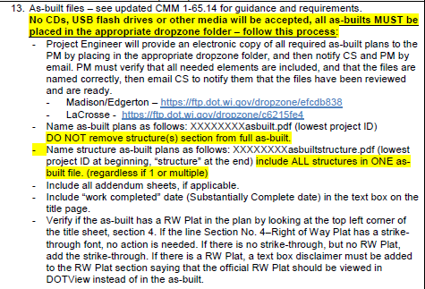
As-Built Plans (cont’d)

Slide 54
As-Built Plans (example - title)
Notes:
Kelly

Slide 55
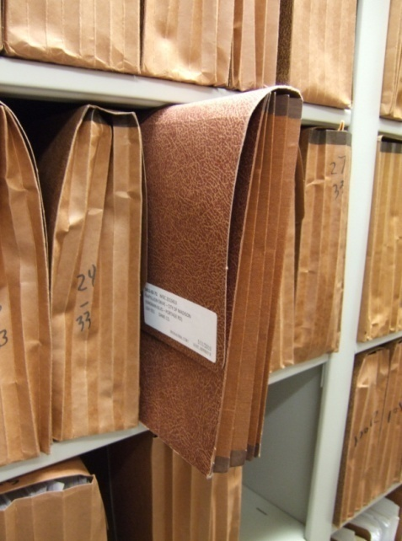
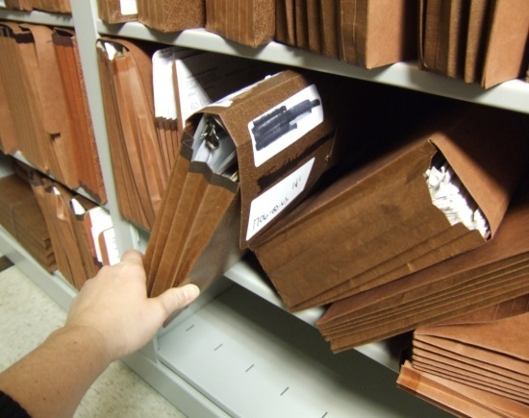
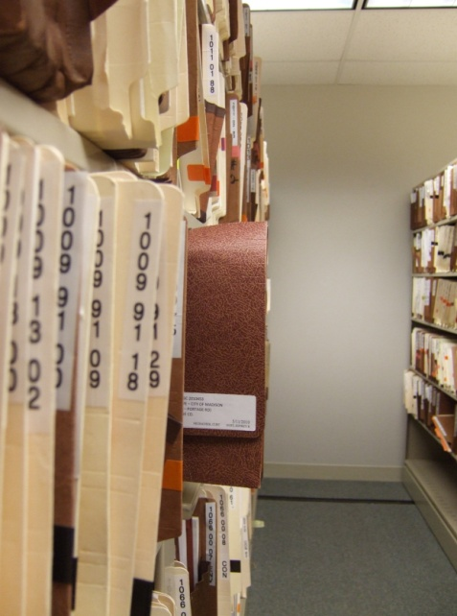
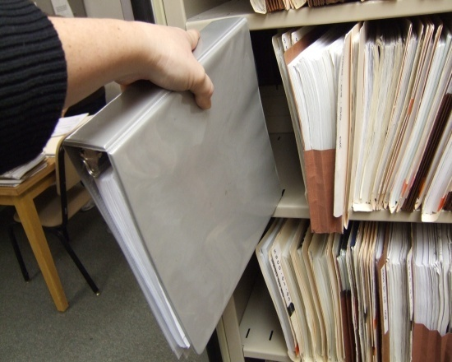
Materials Reminder for Madison/Edgerton
Please no binders or legal size wallets for any final records including materials! They will NOT FIT in our storage areas on the Dock and in the Records Room.
Notes:
Kelly
Pictures show both Dock and Records Room
Doesn’t allow shelving unit to close flush & eats up space due to leaning files vs vertical
Once Mega is done, all files will come to Madison, so Edgerton needs to be filed the same now

Slide 56
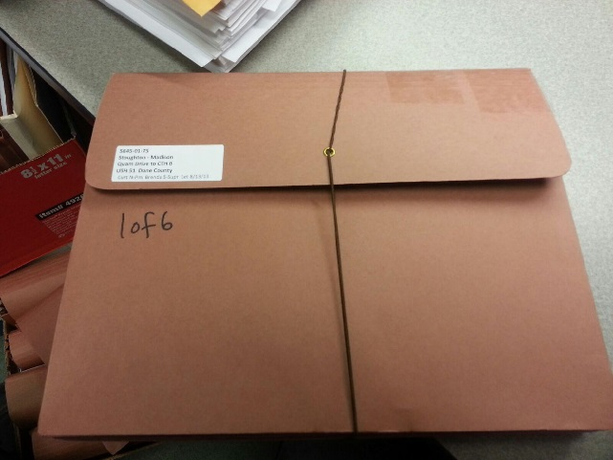
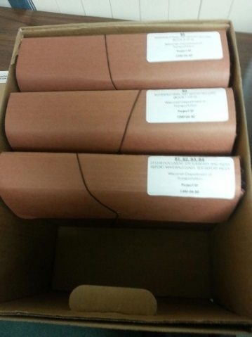
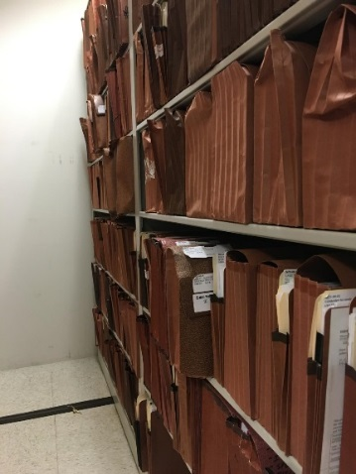
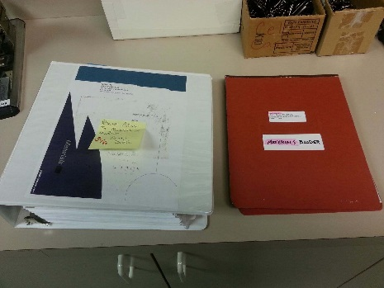
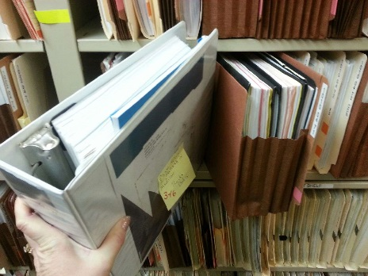
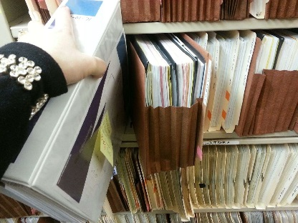
Final Documents (Boxes / Wallets) Reminder
Finals must be in LETTER redrope wallets only if turning in paper! If you need more, see your CS. Place your labeled multiple final wallets in a box when dropping them off.
Thank you for your cooperation in advance!!
Notes:
Kelly
Items 1-11, CAG / Project Info p 11-12, please don’t number this wallet because it’s turned into CS.
This wallet is found in your PE Pkt (for Madison/Edgerton)
I understand why you label on top, but when on dock / records, we can’t see the ID if its on top. So also please label your wallets – Lower Lt corner of Tab / flap and also number multiple wallets
You may be done with the files, but we still have to wait for the FCS date / starts our 3yr countdown before boxing up for last 3 yrs at SRC
Binders do not work in either dock or records

Slide 57
SWR Recap
Project is awarded
Project is executed
Post-Award notice sent
Contract Transferred in PE in FM and PM setup in FN
Documents received from Contractor
Preconstruction Meeting
Conditional Start Notice / Notice to Proceed
Project is constructed
Submit Punch List / Time Charges Stopped / Substantially Complete
All Contract Work Complete (punch list work & documentation complete)
Conditional Final Acceptance
Materials Review & Certification
Finals Boxes / Contract Items Review
Payroll Clear Date (before/after SF)
Semi-Final Estimate sent / approved
Final Estimate sent / approved
Final Acceptance sent
Send the contract to FMGR050 to be archived.
Notes:
Kelly

Slide 58
SWR Recap
SWR Constr Admin Guide & Flowcharts – SWIG 8-1-1
Field Software User Guide – Statewide Pantry
Precons use SWIG templates and only fill in PM/PE info, CS does the rest
Remember your FIT Merge & Send – FSUG p 44-46
Lowest project ID in subject line of all emails
Cc CS for PT entry when sending out Precon Minutes
Remember to enter “Date to Date” or “FY” on ALL estimates (Intermediate, SF & FE) – FSUG p 18
Final Boxes: email CS when PE brings them in for the PM, and when PM starts the review
SWR send contracts to FMGR050 to be archived – FSUG p 28-30, 34
Prior to mods being handed in: FIT merge/send, please make sure $ on mod matches $ in PT and in Pending Approval Status
Notes:
Kelly
Just a friendly reminder to Please fill out the training evaluation sheet for each presentation before you leave so we know how to improve the training for next year.
Thank you and good luck on your projects this year.

Slide 59
Sneak Peak into next weeks Construction Training
David Castleberg/Annette Czerneski
2018 Field Software User’s Guide (FSUG) updates (handout/Pantry March 5th)
Changes and process clarification for Project Engineers & Contract Specialists
Mobile Inspector
AWP Construction (AASHTOWare Project) David will be spending some time going over the proposed process implementation, improvements and schedule changes for the Construction module during his construction training
Notes:
Kelly
Just a friendly reminder to Please fill out the training evaluation sheet for each presentation before you leave so we know how to improve the training for next year.
Thank you and good luck on your projects this year.

Slide 60
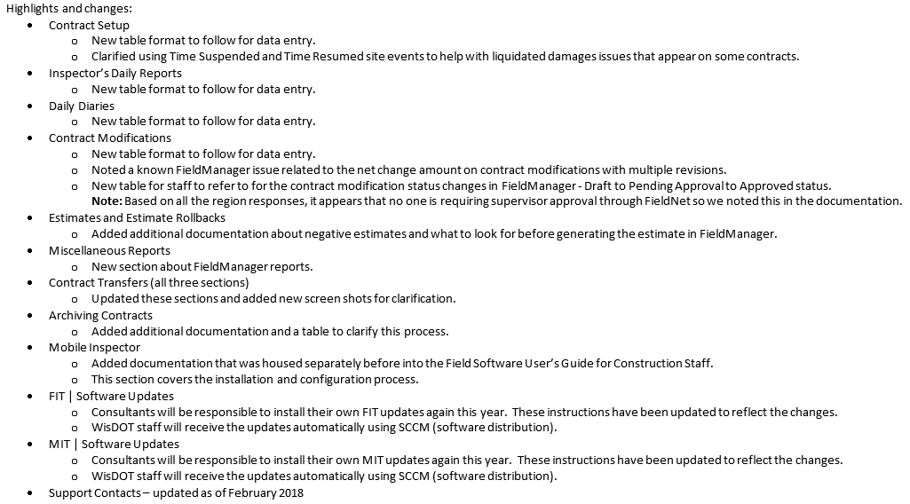
2018 Field Software User’s Guide for Constr Staff

Slide 61
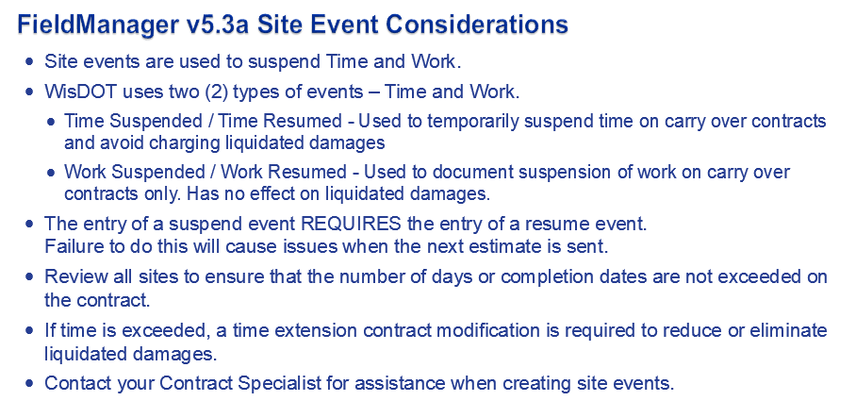

Slide 62
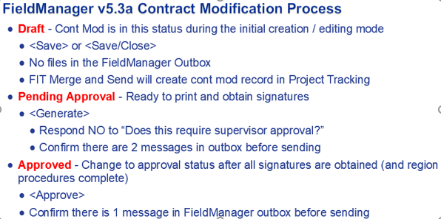
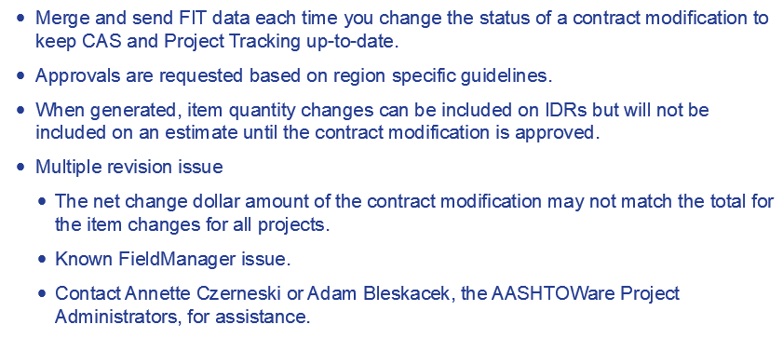

Slide 63
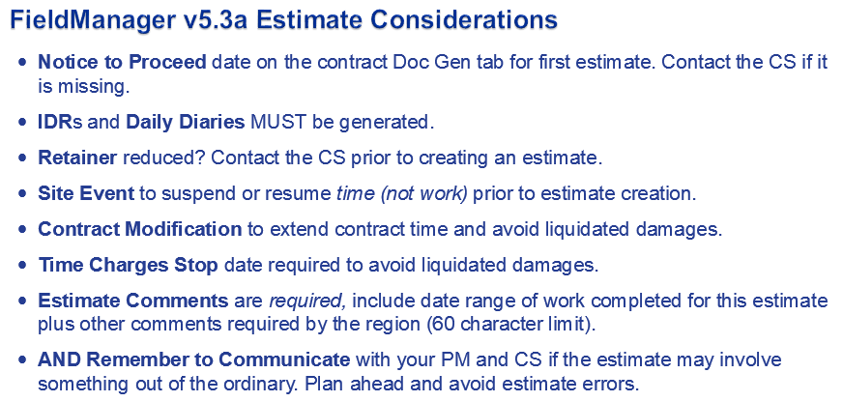
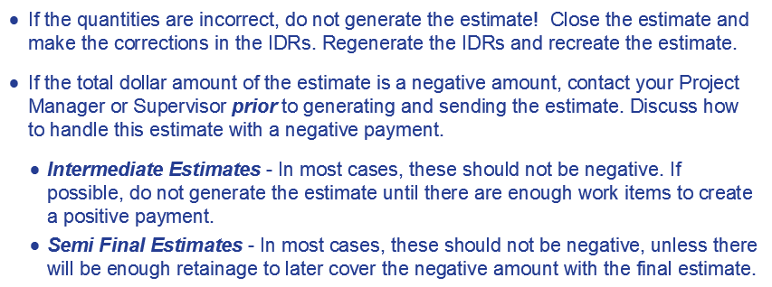

Slide 64
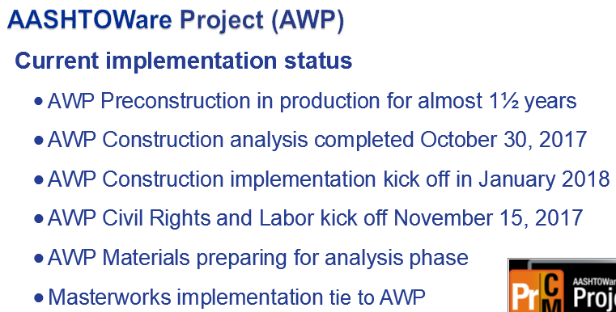
February 2018
Benefits:
Web Bases with external access for consultants and contractors
Replaces CAS, FieldManager, FieldBook, FieldNet, Field Information Tracking (FIT) merge/send will be obsolete! and Project Tracking
Mobile Inspector app for Inspector Daily Reports will still be available
Schedule:
Identify emerging needs to incorporate in AWP Construction - Currently
Configure application – Spring/Summer 2018
Test and pilot new configurations – Summer/Fall 2018
Summer/Fall roll out

