Slide 1
Traffic Control Devices
Changes to section 643 of the Standard Specifications

Slide 2
2018 Traffic Control Changes
ASP 6 for the December 2017 letting
  Section 643.3.1 General
    Revise 643.3.1(1) to require removing devices from the project or storing devices away from traffic when not in use.
      INTENT -Remove all Traffic Control Devices that are not scheduled to be used in a 14 day period, and all traffic control shall be removed within 5 days of substantial completion.
      Additionally - Devices shall be moved off the shoulder when not in use.
Add by Change Order language to the November 2017 Let projects

Slide 3
ASP6 December 2017 Letting
643.3.1 General Replace paragraph one with the following effective with the December 2017 letting: (1) Provide and maintain traffic control devices located where the plans show or engineer directs to maintain a safe work zone throughout the contract duration. Relocate as required to accommodate changing work operations. When not in use, place devices away from traffic outside of paved and gravel shoulder surfaces. Where there is barrier on the shoulder, the contractor may place devices not in use on the shoulder as close as possible to the barrier and delineated with drums. Lay signs and supports flat on the grade with uprights oriented parallel to and downstream from traffic. Do not stack devices or equipment. Promptly remove temporary devices from within the project limits as follows: - That will not be used within 14 consecutive calendar days. - Within 5 business days of substantial completion unless the engineer allows otherwise

Slide 4
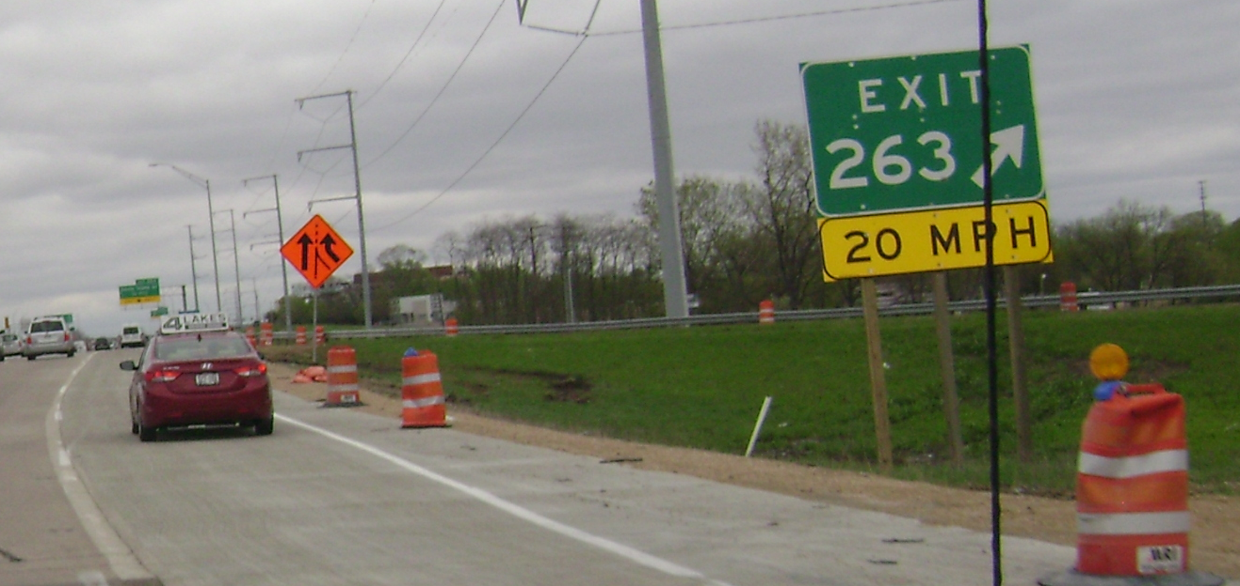
Remove devices from shoulder when not in use
Drivers can’t use shoulders with devices not in use left in the way.
Direct contractors to move drums off the useable paved and gravel shoulders where possible.
Allow as much shoulder space as possible while still protecting hazards.

Slide 5
Remove Traffic Control Devices
When not in use for more than 14 calendar days
Within 5 business days of substantial completion

Slide 6
CMM update Nov 2017
Emphasis on Engineer inspection of traffic control, especially items left on site when construction is inactive.
During the daily inspection, the project engineer should look for signage and barriers that are within the right-of way that could cause a safety problem for the traveling public. Such things as signage or barrels that are not needed, not properly anchored or not properly stored should be removed from the right-of-way to prevent potential hazards for the public. Consult Standard spec 643 for each project regarding allowable timeframes for signage and barriers use when construction is inactive.
Chapter 1 General Provisions
Section 45 Traffic Control

