Slide 1
SWR Local Program
Who/Where We Are…
Project Info…
Differences…

Slide 2
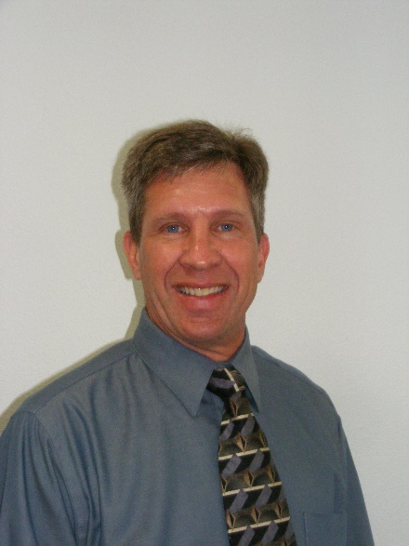
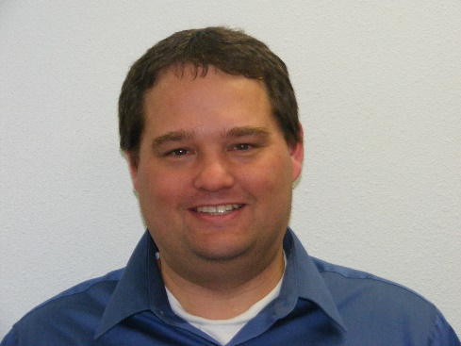
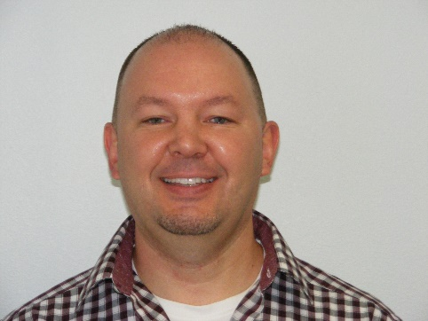
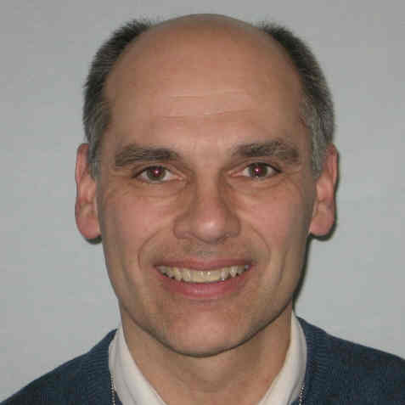
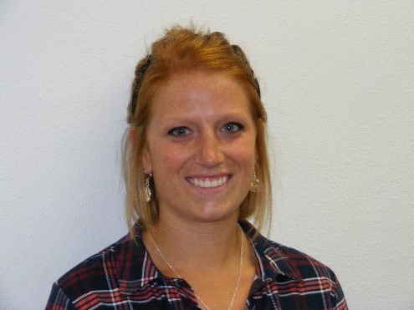
SWR Local Program
Who We Are…

Slide 3
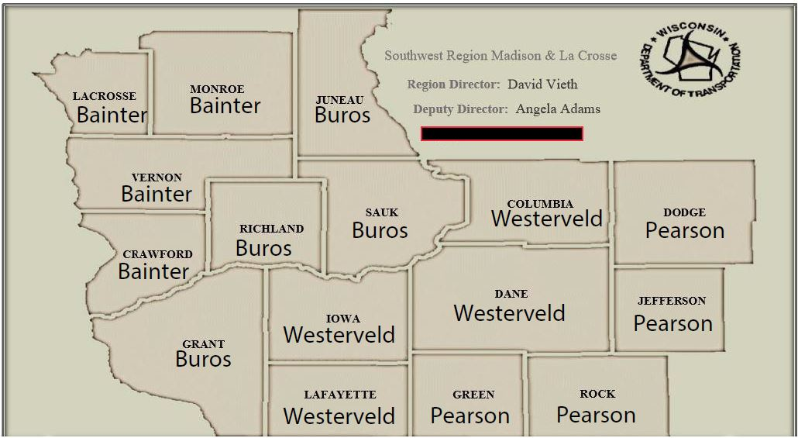
SWR Local Program
Where We Are…

Slide 4
SWR Local Program
Project Info… electronic

Slide 5
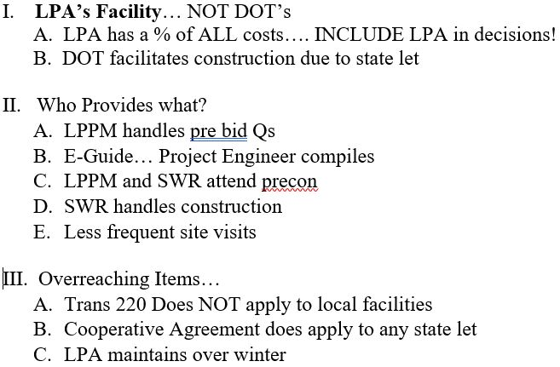
Local Prog. Differences….

