Slide 1
WisDOT Southwest
Region Labor Compliance
2018 Construction Conference

Slide 2
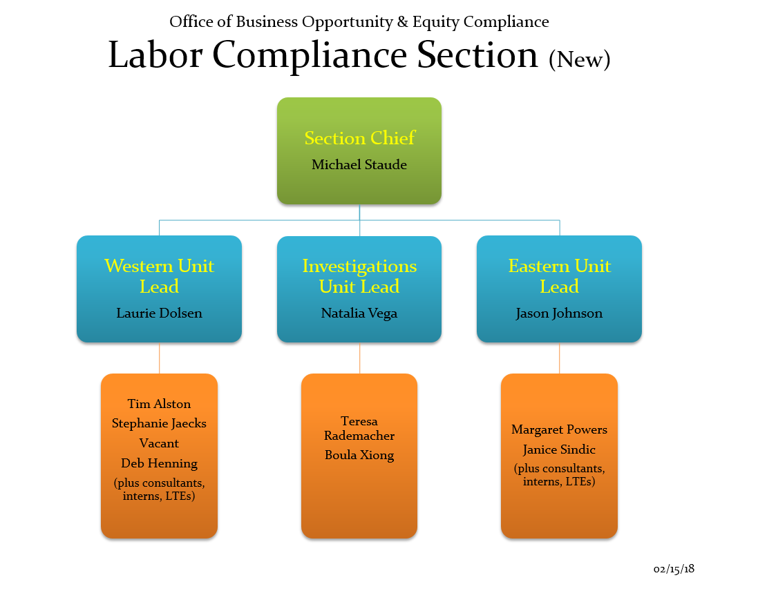

Slide 3
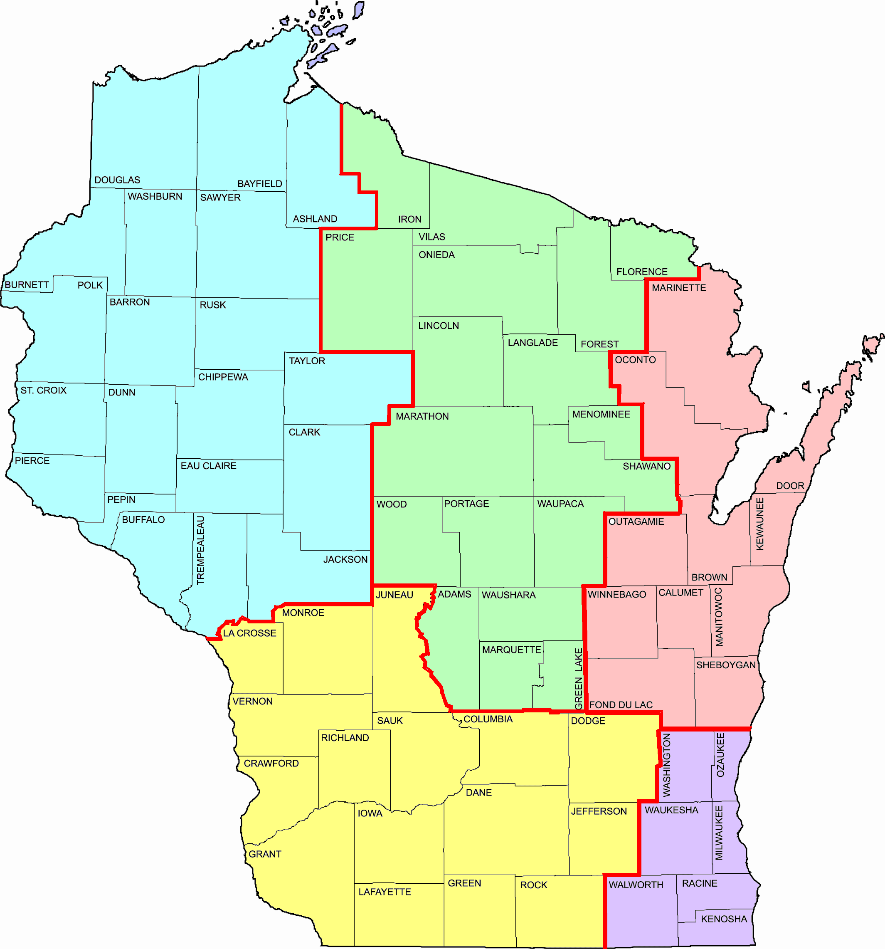
WisDOT Labor Compliance Specialists
Eastern Wisconsin
Lead - Jason Johnson (920) 492-5728 (NE)
Teresa Rademacher (920) 492-5657 (NE Mega)
Jennifer Lubinski (262) 548-5634 (SE)
Margaret Powers (262) 521-5337 (SE Mega)
Janice Sindic (262) 548-5923 (SE Mega)
NW
Western Wisconsin
Lead - Laurie Dolsen (715) 392-7977 (NW)
Stephanie Jaecks (715) 365-5732 (NC)
Tim Alston (608) 242-8040 (SW)
Vacant (608) 785-9051 (SW)
Rebecca Porter (608) 245-2648 (SW)
Deb Henning (608) 884-1178 (SW Mega)
Julie Harkinson (608) 772-5169 (SW Mega)
Diane Zimmer (608) 884-1179 (SW Mega)
Crystal Wilson (608) 264-8700 (SW Mega)
NC
NE
Labor Compliance Investigations (Statewide)
Lead - Natalia Vega (262) 521-5358 (SE)
Teresa Rademacher (920) 492-5657 (NE)
Boula Xiong (608) 267-7354 (SW)
Aeronautics (Statewide)
Shannon Clary (608) 264-7607 (SW)
Crystal Wilson (608) 264-8700 (SW)
SW
SE
2/02/17

Slide 4
Substantially Complete Process
  Substantially complete triggers automated emails to your LCS to start the finals process
  Very important to enter the correct dates
    DO not back date dates… this is not helpful
    Do a FITS upload right after the Substantially Complete date is entered in Field Manager
      Email Notification is NOT generated until this step is completed.

Slide 5
Support between Project Leader and LCS: Making a difference
Daily Diaries- Information correlates with what is reported into CRCS; cross-checking
  Details and accuracy are valuable- essential resource
  Please enter name of the trucking company and number on the truck ☺
  Hours, work, equipment, # of employees
  Let us know
    If you’re notified employees have issues with pay
    Dedicated batch plant or if there are materials being recycled and reused.
    Update on project schedule
      Will this be a carry-over project? Does this have work throughout next season?

Slide 6
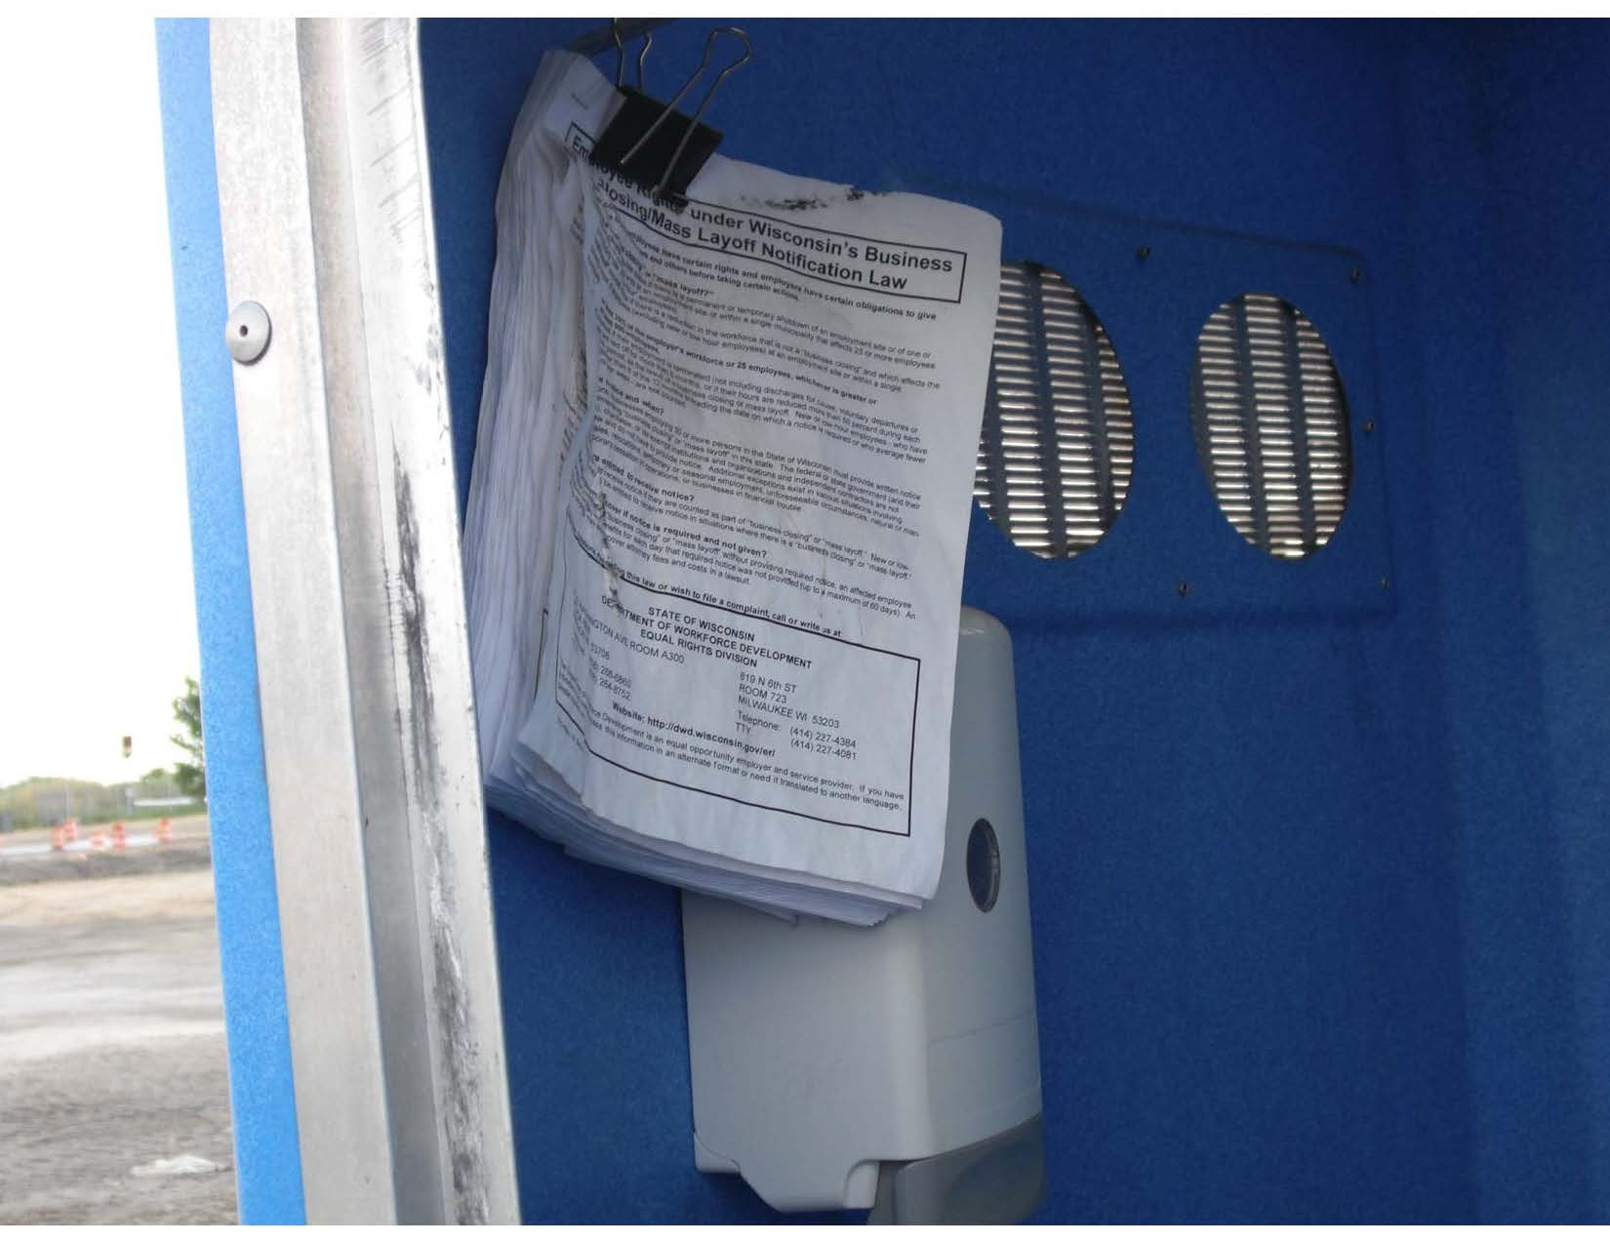
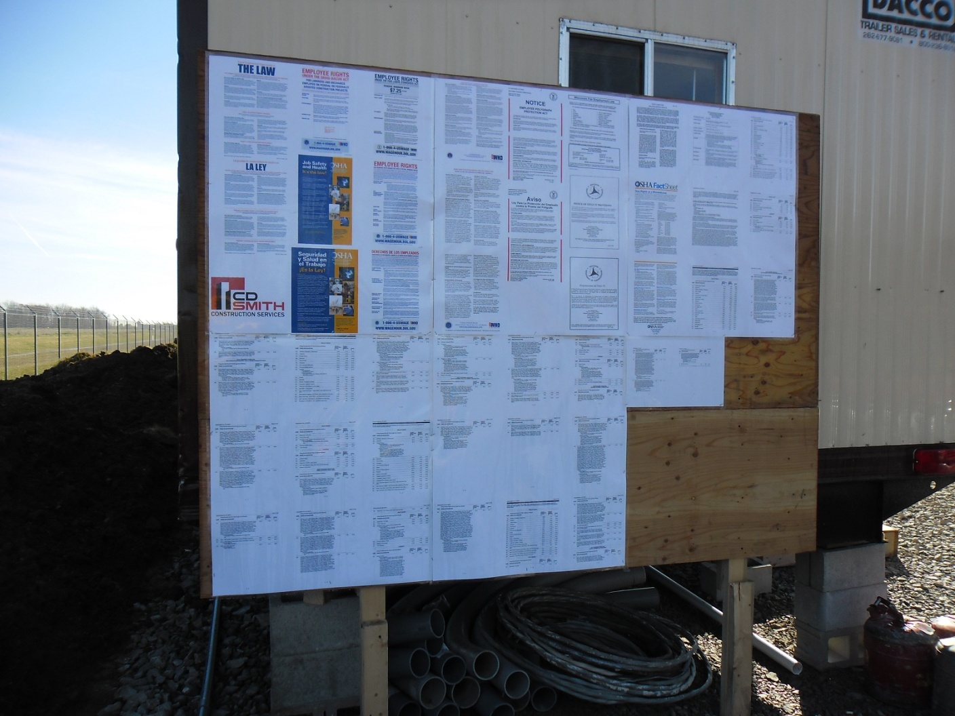
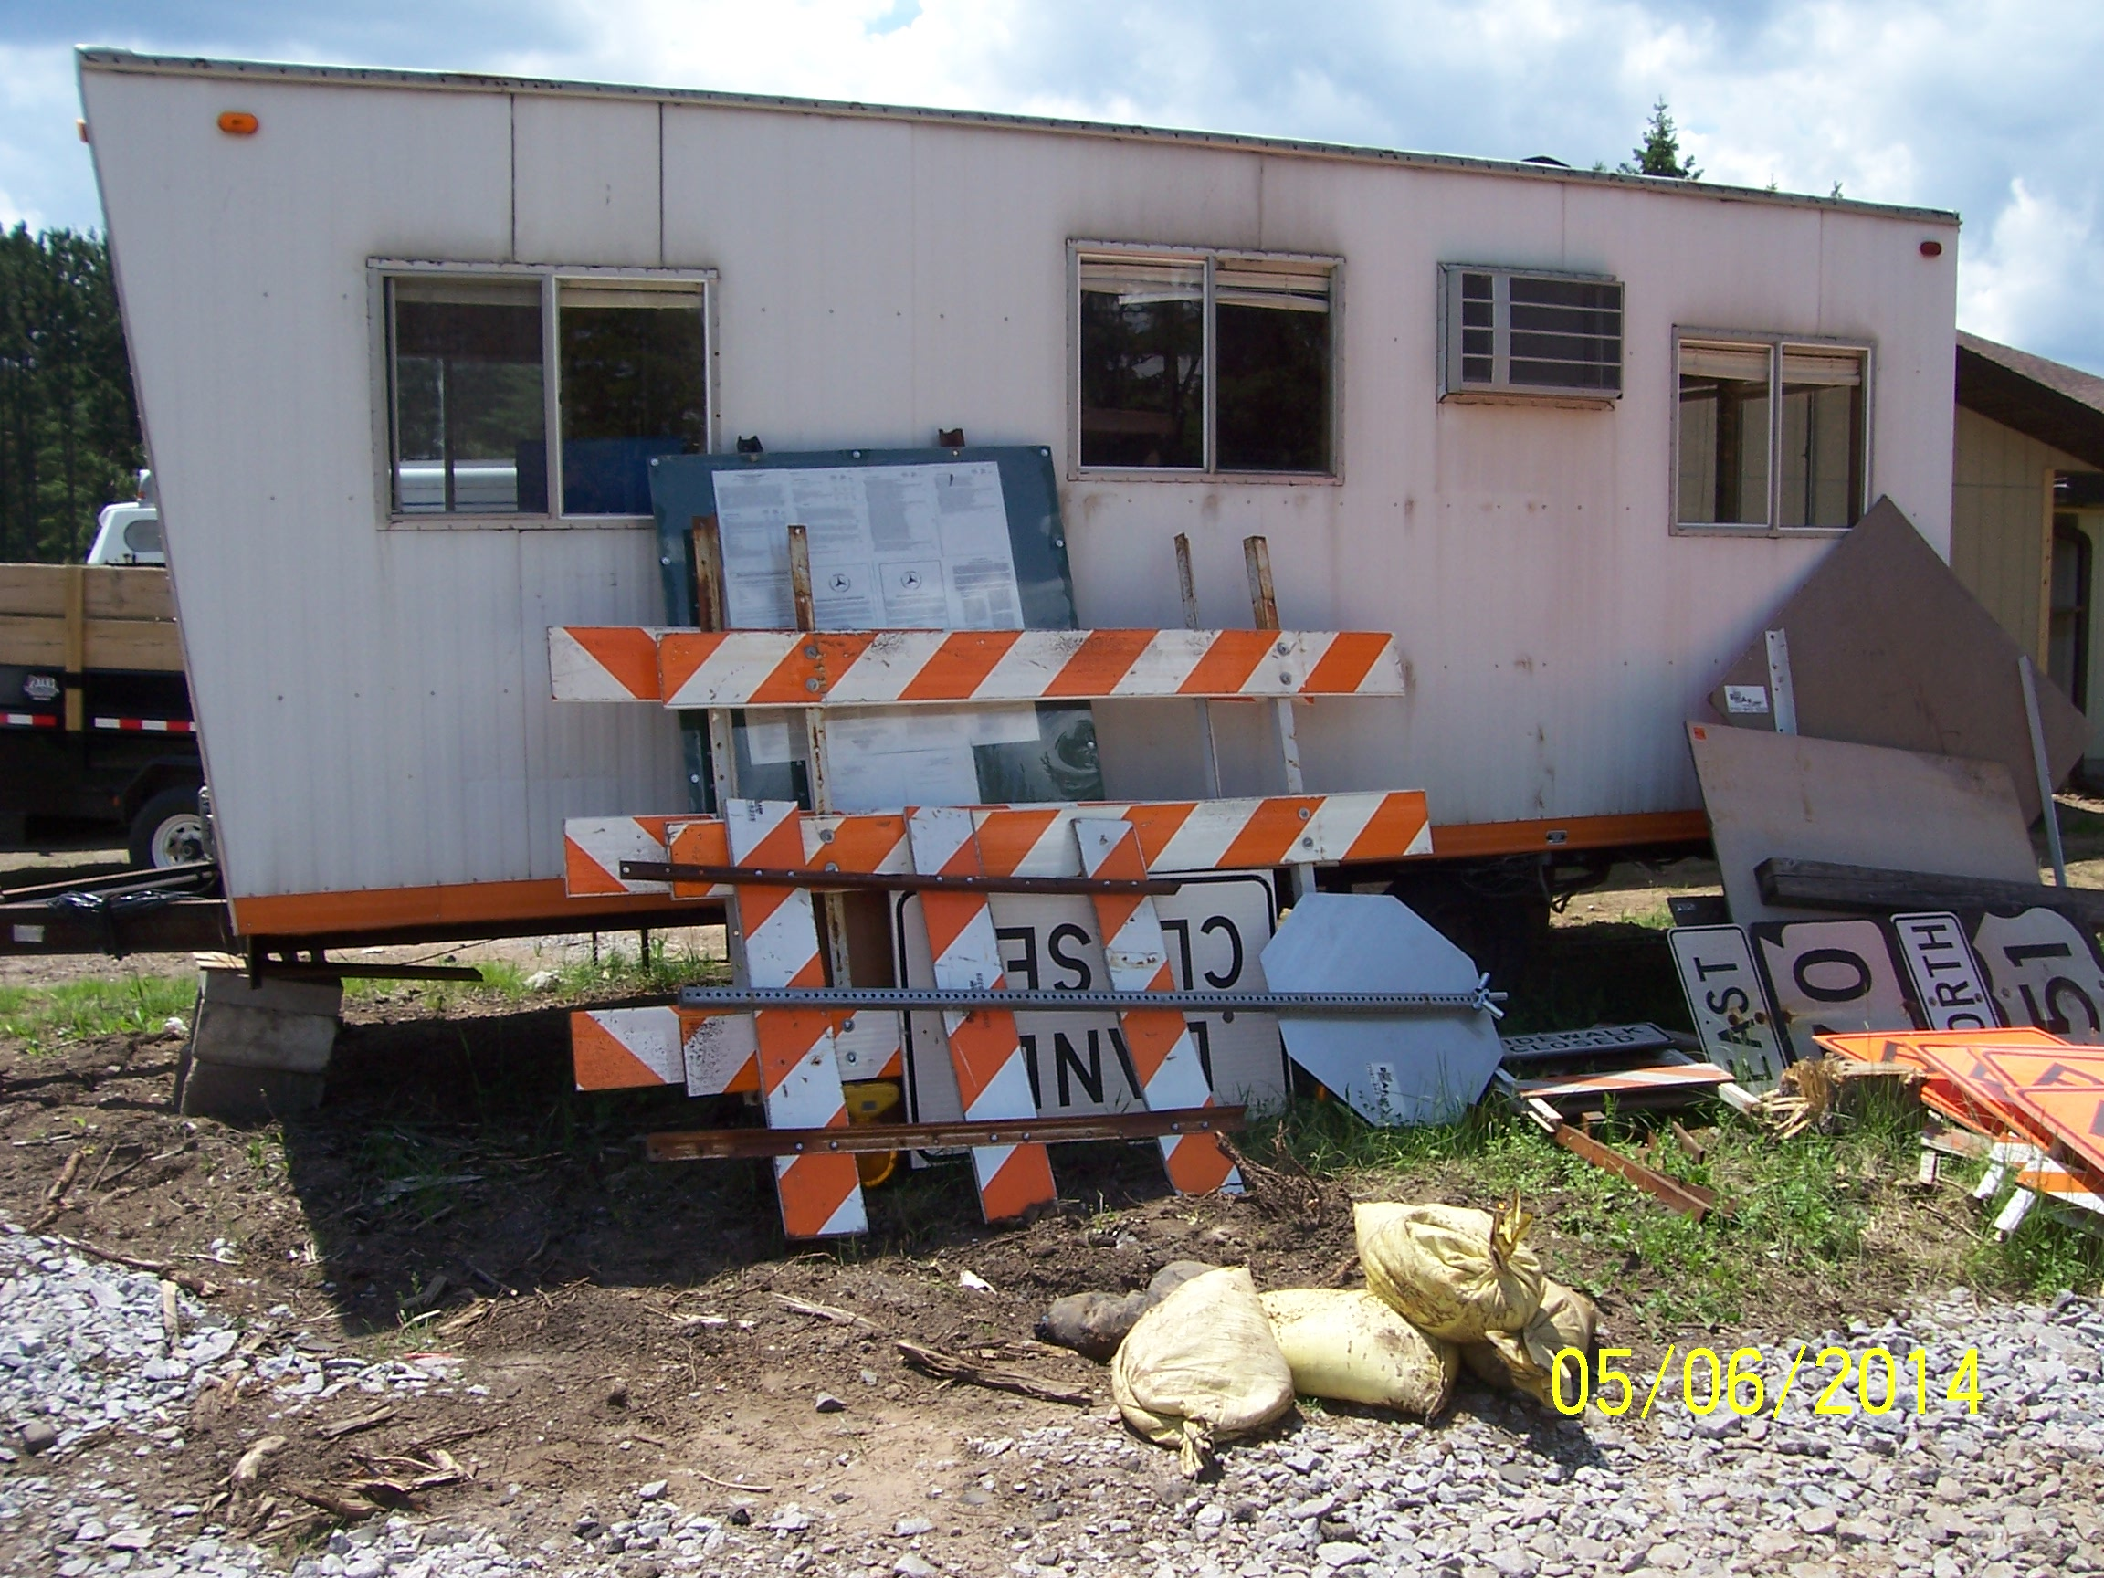
Construction Bulletin Board
Not Acceptable
PERFECT!!!!
Not Acceptable

Slide 7
Field Observations on Wage Boards
Wage boards must be maintained for the life of the project—please monitor them periodically and request they be repaired or corrected if damage occurs. The law requires these postings on the project.
Checklist is provided at precon- please complete and return prior to 1st estimate.
Posters must be readable at all times:
  If print is too small due to the poster being reduced from a larger size to fit on the board—this must be corrected.
  If print is covered up by bolts used to affix the board to the field office or supports—this must be corrected.
  If posters are faded or damaged—replacements need to be requested.
Binders by themselves are not acceptable
Wages can be stacked if they are laminated and hung below a sign saying “Wage Rates”

Slide 8
Investigations Unit: and How project Staff Can Assist with Resolution
Project Staff Assistance with Holding Prime Accountable
  Withholding payments – required to hold final payment.
  Discuss LC issues at weekly meetings
Communications from Investigators
  Copied on written notifications to contractors
  Updates at PM meetings (some regions)
Complexity and Time Frame
  Varies by projects involved, timeframe, and violations
  Other government agency involvement
WisDOT Recourse
  Referral for suspension/debarment – case by case basis
  Referral of case to other government agencies
Notes:
Communication from Project staff is crucial at this point.

Slide 9
DBE’s and Why it Matters
If a DBE is not able to complete their contractor work- the contractor must make an effort to replace the DBE; with a DBE contractor.
ASP 7 requires we monitor the payments entered to DBE’s in the Civil Rights Compliance System
  Payments are verified during the closeout process and you will be asked about this if there are little to no payments made to the DBE firms
  If work is reduced- regional LCS’ need to know about it! Along with the DBE office
  Compliance Assessment Program Review or CAP Review by FHWA monitors the DBE program throughout the project to ensure the goals and requirements are being met and enforced. To ensure nothing is missed; please work with each regional LCS to maintain the DBE portion of each of your contracts as this could possibly impact the federal funding on our projects.

Slide 10
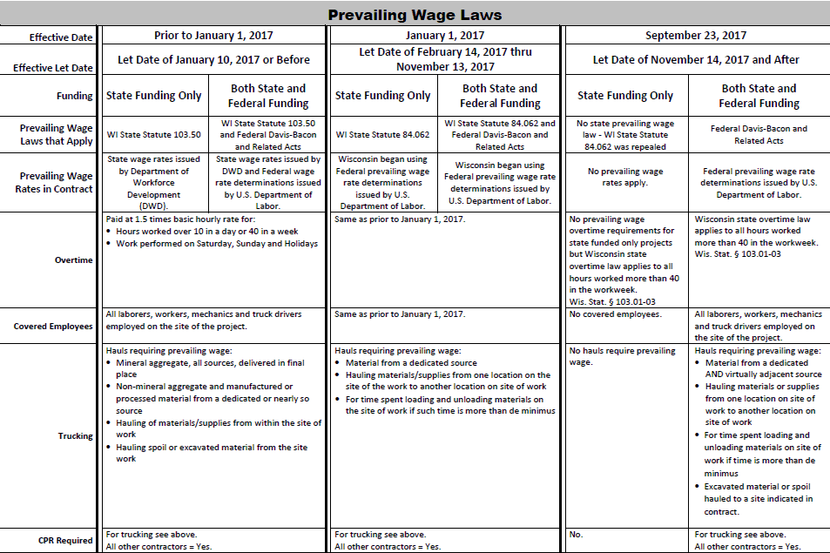
Prevailing Wage Laws
Notes:
**Hint Hint.. Know when your projects are let- the letting date determines what rules are enforced for your contract

Slide 11
Act 59- Repeal of Wisconsin’s Prevailing Wage Law
Repeal applies to all WisDOT projects let on or after September 23, 2017
State funded only projects will no longer include any prevailing wage requirements.
Does not affect enforcement of Federal Davis-Bacon Act by USDOL or FHWA on projects with federal funds.
  Projects with Federal Dollars will still have Prevailing Wages

Slide 12
ASP 9- S- Electronic Labor Data Submittal for State Funded Only Projects
    Labor Data no longer entered/collected via CRCS
    Labor Data will now be collected via Workforce Utilization Report
      Microsoft Excel Spread Sheet or Compatible Spread Sheet
        Details can be found on HCCI site (Labor, Wages, and EEO Info.)
  http://wisconsindot.gov/hcciDocs/contracting-info/asp-9-s.pdf
  http://wisconsindot.gov/Pages/doing-bus/civil-rights/labornwage/default.aspx
  Subs electronically submit labor data to prime via Excel spreadsheet within 14 calendar days of the end of each quarter
  Prime electronically submits all collected labor data to regional LCS within 21 calendar days of the end of each quarter

Slide 13
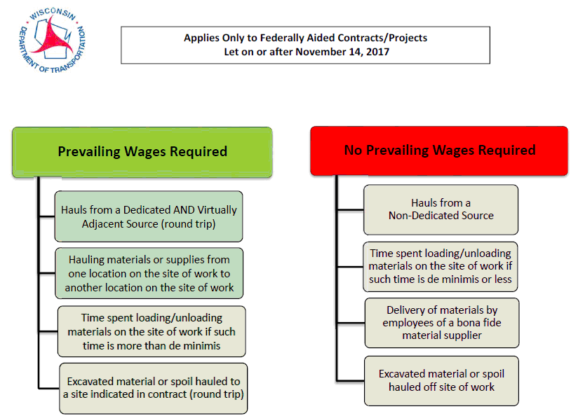
NEW TRUCKING!!

Slide 14
What has changed….
  84.062 was repealed- State funded projects will not be required to have prevailing wage rates
  ASP 9-S requires State funded projects send spreadsheets via electronically to the regional LCS
  Supplemental Required Contact Revisions (Revised)
    Repealed law language was removed
    Duplicate info contained in FHWA 1273 has been removed
    Trucking was added
    Resource list was added
  Trucking (Federally Funded)
    Covered hauls must be from a dedicated AND virtually adjacent source (round trip)
    Excavated material or spoil hauled to a site specifically indicated in the contract (round trip)
    Delivery of material by employee of a bona fide material supplier are not covered

Slide 15
What hasn’t Changed….
  Projects let in Jan. 2017 being carried over- requires State wages issued by DWD and Federal Wage rate determinations issued by U.S. DOL
  Projects let in Feb. 2017 through Nov. 2017 need to follow state statue 84.062 (Heavy 15, Highway 10 or Sewer and Water 8). These were issued by US DOL
  Federally funded projects require prevailing wages issued by US DOL
  All Federally funded projects require payrolls in CRCS
  Hourly basic rate of pay remains the same
  Fringe benefits and statutory minimum wage rates remain the same

Slide 16
Continued….
  List of defined Navigable waters provided by the US Coast Guard and US DOL, regarding work over Navigable waters
  Trucking-(Federally Funded)
    Covered:
      Materials hauled from one point of work to another point of work are covered
      De minimis is still covered
      Non-Covered:
        Non-dedicated source
        Excavated material or spoil

Slide 17
QUESTIONS?
Notes:
-Thank you for continuing to partner with us to achieve compliance. It is greatly appreciated!!

