Slide 1
SW Region - Madison Office
Construction Conference
Maintenance Section
Brian J Rice
February 22, 2018
Notes:
Before
Be well prepared with content. Know facts and figures and your audience.
Everyone should be able to read the slides but if NOT, read it to them. Otherwise don’t include it.
Do a final check on microphone and other equipment well before the start time.
Practice the presentation aloud several times. Feel comfortable.
Drink fluids and do something to relax you.
During presentation
Smile and be confident.
Introduce yourself and the organization.
Speak with energy, clearly, and in a reasonable volume so everyone can hear you.
Do not read each line on the slide show – use your own wording and add in examples or additional information which will aid in comprehension.
Talk “friendly” and with the attitude that you are here to provide information and assistance. Have a “win/win” attitude.
If you make an error, politely clarify or correct it. Move on quickly and don’t dwell on it.
If you can’t answer a question, politely indicate you don’t have the information available. Indicate that you will follow-up individually with the requestor.
After presentation
Be available for follow up.
Be prepared for additional comments, questions or clarifications.
Maintain composure.
If you make a promise, be sure to follow up quickly or reassign if appropriate.

Slide 2
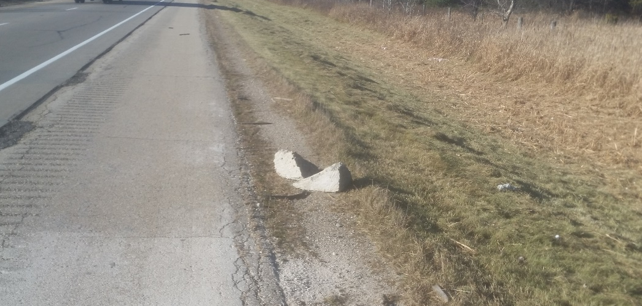
Excess Concrete Disposal
Excess concrete must be removed completely from the jobsite.
It shall not be:
  Left on the shoulder because it was deemed not a hazard
  Thrown into the ditch
  Crushed up and left as shoulder aggregate
Notes:
Overview should be specific such as listing the goals of the presentation and items to be covered. For example: “Explain Hwy 51 project alternatives.”
Use a verb followed by a brief phase or sentence.
Overview should include time for Q&A or indicate if you intend to take questions during the presentation or prefer that they wait until the end of the presentation.

Slide 3
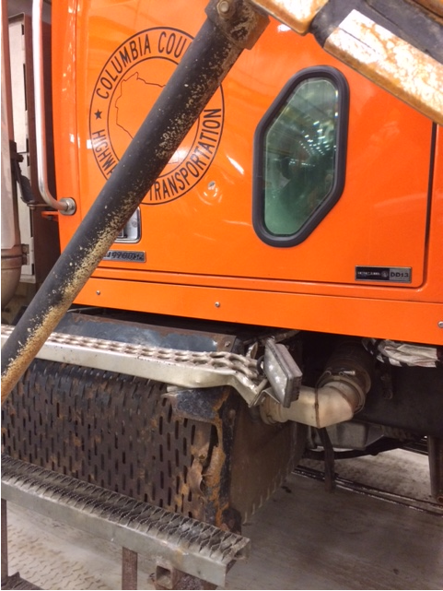
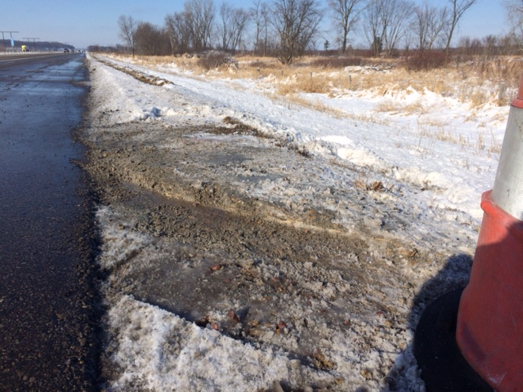
Excess Concrete Disposal
This has been causing:
  Plowing issues
  Mowing issues
Notes:
Provide facts, figures and objective data will help to keep the audience focused.
Review political, financial or other information.
Dispel misinformation.

Slide 4
Punchlist Workflow
Contact Maintenance Roadway Engineer, Roadway Assistant, and Bridge Unit 2 weeks before punchlist is distributed (or any bridge is opened to traffic) so we can assist with the development of the punchlist.
  Sign post height/depth and locations
  Cable guard and guardrail installation issue
  Shoulder gravel compaction
Contact Maintenance Unit before the final punchlist is distributed so we can confirm nothing has changed since our initial inspection.
Contact Maintenance Unit before punchlist is accepted so we can confirm that nothing is being left behind.
  Temporary construction signs
  Erosion control measures
Notes:
Provide facts, figures and objective data will help to keep the audience focused.
Review political, financial or other information.
Dispel misinformation.

Slide 5
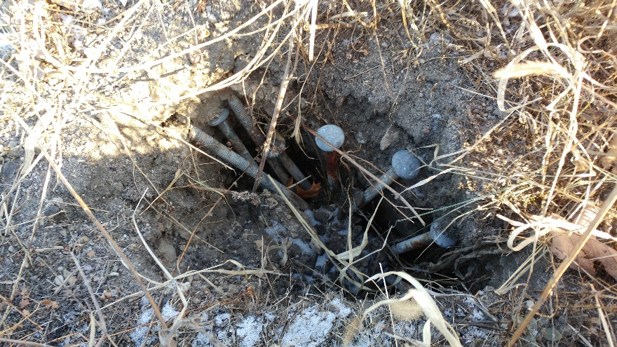
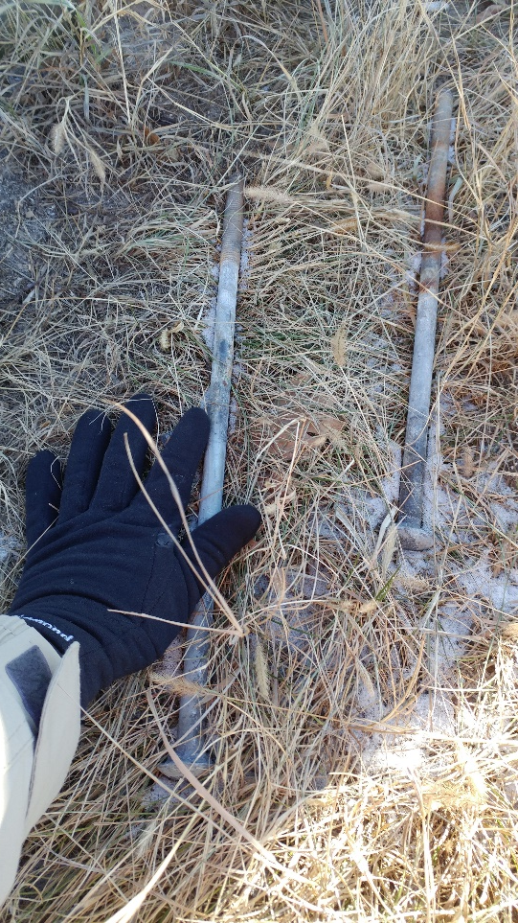
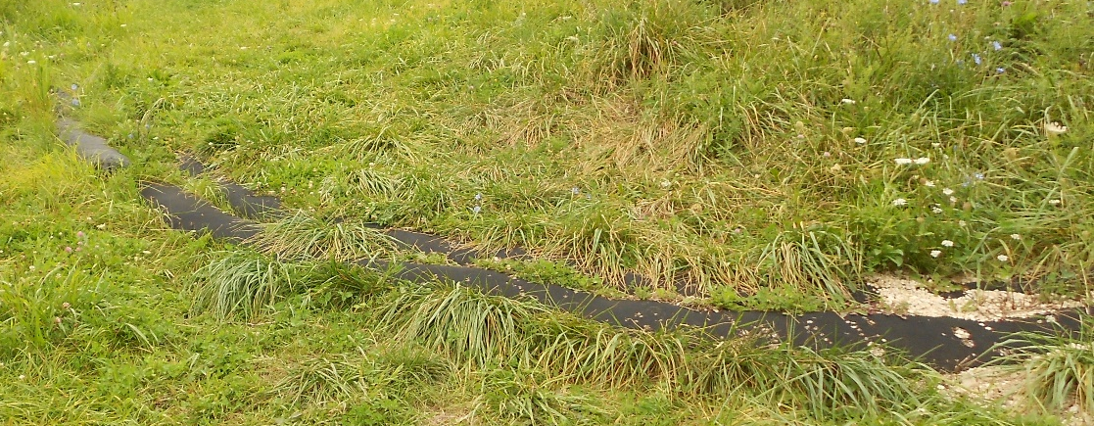
Punchlist / Clean up
Notes:
Provide facts, figures and objective data will help to keep the audience focused.
Review political, financial or other information.
Dispel misinformation.

Slide 6
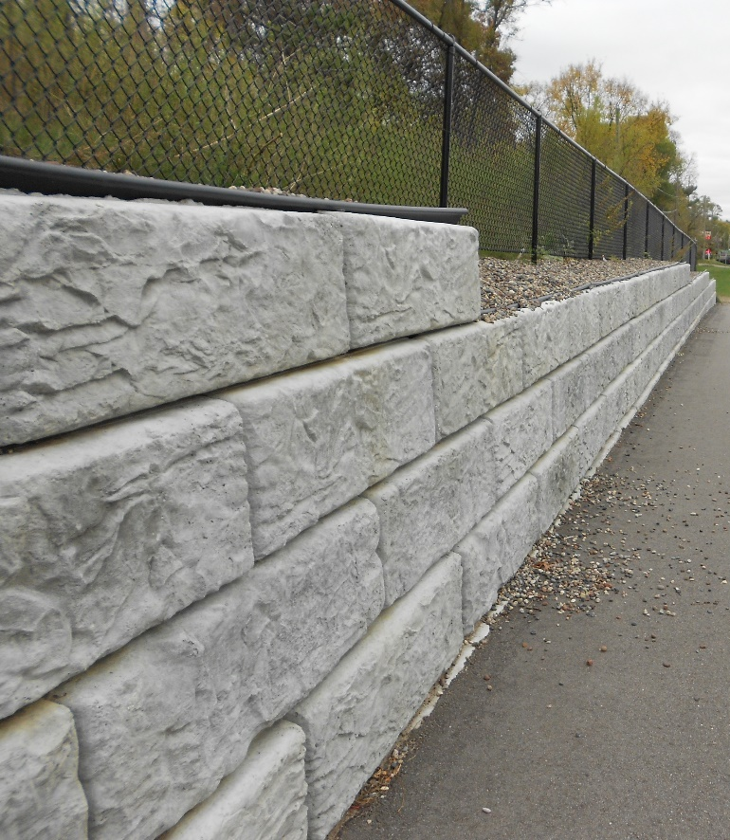
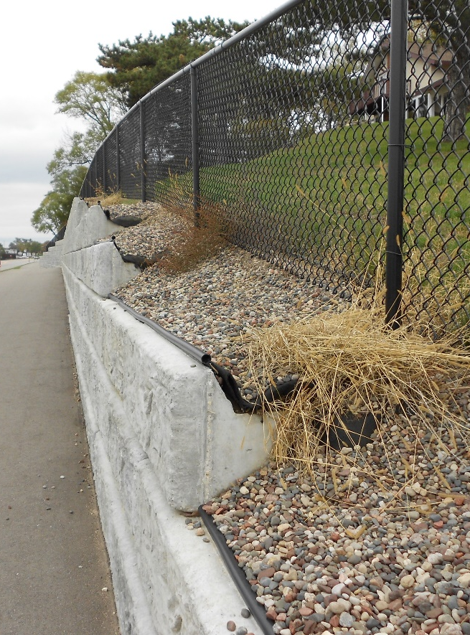
Retaining Wall Backslopes
Notes:
Provide facts, figures and objective data will help to keep the audience focused.
Review political, financial or other information.
Dispel misinformation.

Slide 7
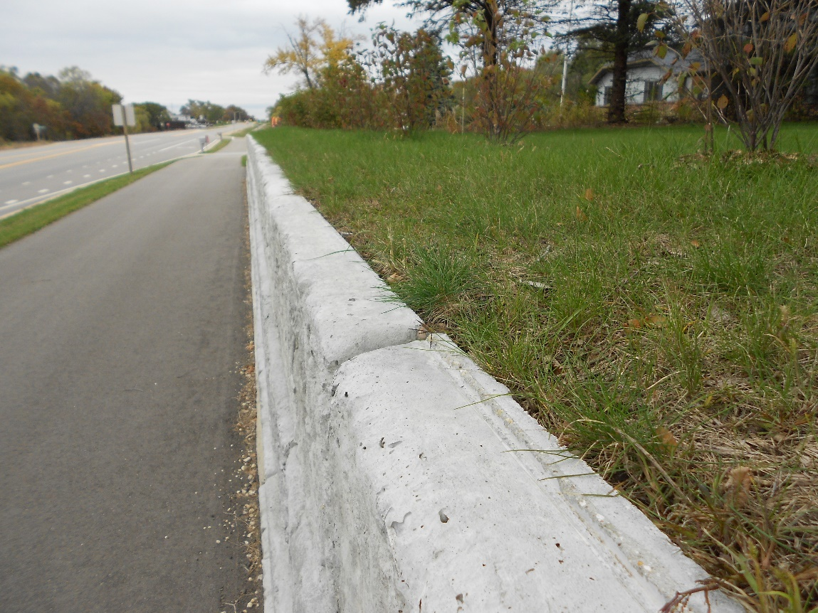
Retaining Wall Backslopes
Notes:
Provide facts, figures and objective data will help to keep the audience focused.
Review political, financial or other information.
Dispel misinformation.

Slide 8
Bridge Unit Concerns
Keep bridge Unit informed of project progress
Make sure forms are cleaned before the concrete pour (we have found hammers, wood etc.)
Make sure the Honeycombing gets filled in
Make sure the contractor doesn’t flame cut any rebar.
Make sure that the rip rap comes to the tip of the wings as shown in the detail.
  If the details don’t show the rip rap coming to the wing tips, try and stabilize the shoulder and along the wing with a flume, stabilized base, breaker, etc.
  This should be done on ALL 4 corners, we do have a lot of erosion problems even on the high side of the bridges
Notes:
Provide facts, figures and objective data will help to keep the audience focused.
Review political, financial or other information.
Dispel misinformation.

Slide 9
Bridge Unit Concerns
Expansion Joints
  If the shop drawings show more than one field splice, make sure that it follows the special detail provided by Central Office.
  When setting the joint, make sure that it is ¼ inch below the finished grade.
Ancillary Bolting Forms
  Make sure the contractor is completing the forms while doing the work.
  Turn the form in to the correct person as soon as it is completed.
  The structures have to be inspected before being opened, and the inspector needs these forms to do the inspection.
Notes:
Provide facts, figures and objective data will help to keep the audience focused.
Review political, financial or other information.
Dispel misinformation.

Slide 10
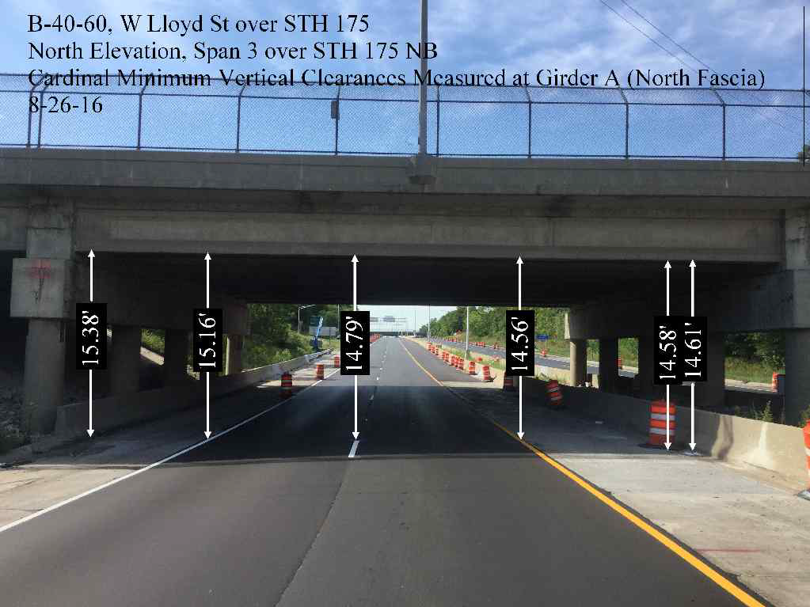
Vertical Clearance Documentation
Record the critical vertical clearance between edges of paved shoulders.
Document using a photograph of the bridge showing vertical clearance measurements.
  Possible app to use is Skitch
  Provide information to Dave Bohnsack, Mike Olson, or Steve Katzner (Sauk County) as soon as possible
Notes:
Provide facts, figures and objective data will help to keep the audience focused.
Review political, financial or other information.
Dispel misinformation.

Slide 11
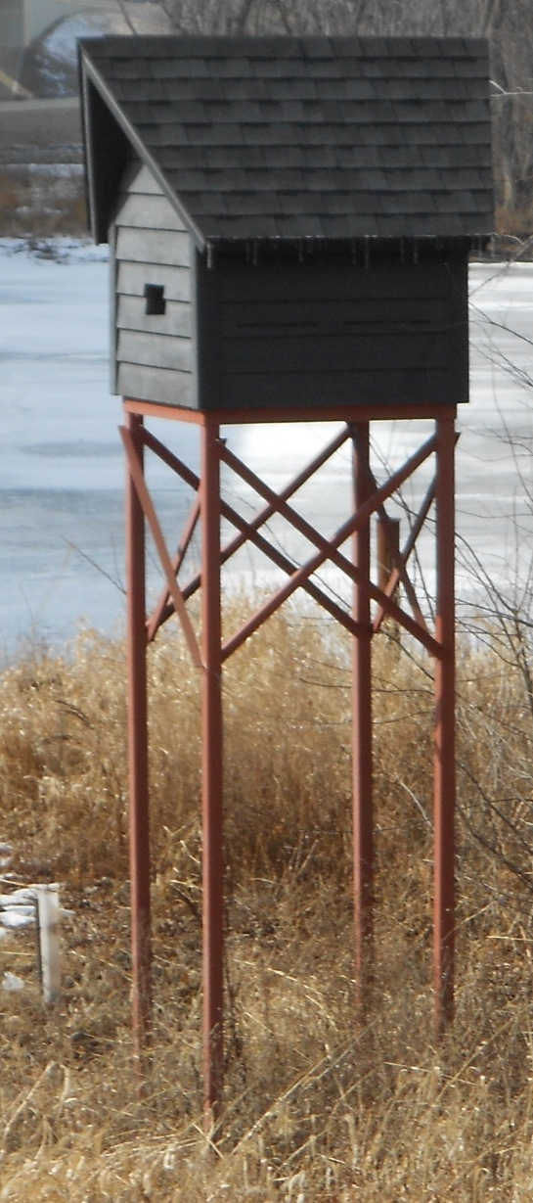
Additional Issues
Construction Staff should not directly contact the county to request services
  All correspondence shall go though Maintenance Staff
No future maintenance agreements shall be made during construction without the Maintenance section being involved
Have a discussion during the Preconstruction Meeting about 24 traffic control
  Direct/personal 24 hour contact
  Not a 24 hour dispatch if possible
Notes:
Provide facts, figures and objective data will help to keep the audience focused.
Review political, financial or other information.
Dispel misinformation.

Slide 12
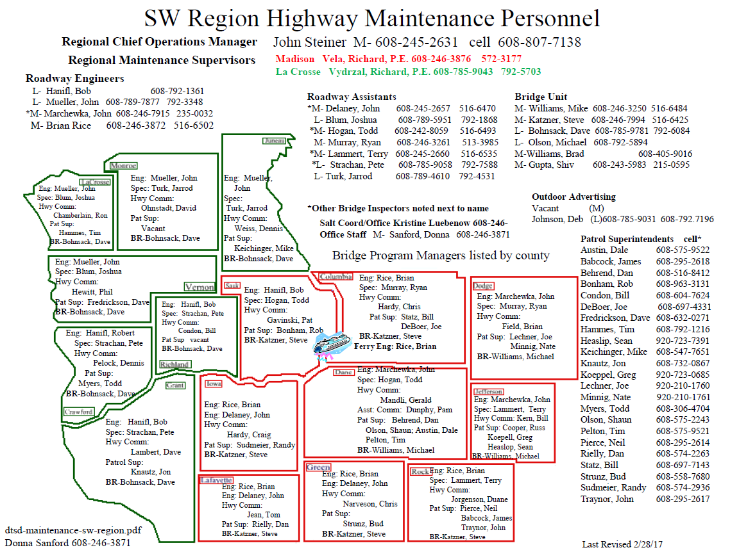
QUESTIONS
Notes:
Provide facts, figures and objective data will help to keep the audience focused.
Review political, financial or other information.
Dispel misinformation.

