Slide 1
Erosion Control 2018
Construction Conference
Christine Krall
(La Crosse)
Notes:
Before
Be well prepared with content. Know facts and figures and your audience.
Everyone should be able to read the slides but if NOT, read it to them. Otherwise don’t include it.
Do a final check on microphone and other equipment well before the start time.
Practice the presentation aloud several times. Feel comfortable.
Drink fluids and do something to relax you.
During presentation
Smile and be confident.
Introduce yourself and the organization.
Speak with energy, clearly, and in a reasonable volume so everyone can hear you.
Do not read each line on the slide show – use your own wording and add in examples or additional information which will aid in comprehension.
Talk “friendly” and with the attitude that you are here to provide information and assistance. Have a “win/win” attitude.
If you make an error, politely clarify or correct it. Move on quickly and don’t dwell on it.
If you can’t answer a question, politely indicate you don’t have the information available. Indicate that you will follow-up individually with the requestor.
After presentation
Be available for follow up.
Be prepared for additional comments, questions or clarifications.
Maintain composure.
If you make a promise, be sure to follow up quickly or reassign if appropriate.

Slide 2
Topics
Binders
Orders
Releases
Select sites
Erosion Mat
Plus – Participation opportunities
Notes:
Before
Be well prepared with content. Know facts and figures and your audience.
Everyone should be able to read the slides but if NOT, read it to them. Otherwise don’t include it.
Do a final check on microphone and other equipment well before the start time.
Practice the presentation aloud several times. Feel comfortable.
Drink fluids and do something to relax you.
During presentation
Smile and be confident.
Introduce yourself and the organization.
Speak with energy, clearly, and in a reasonable volume so everyone can hear you.
Do not read each line on the slide show – use your own wording and add in examples or additional information which will aid in comprehension.
Talk “friendly” and with the attitude that you are here to provide information and assistance. Have a “win/win” attitude.
If you make an error, politely clarify or correct it. Move on quickly and don’t dwell on it.
If you can’t answer a question, politely indicate you don’t have the information available. Indicate that you will follow-up individually with the requestor.
After presentation
Be available for follow up.
Be prepared for additional comments, questions or clarifications.
Maintain composure.
If you make a promise, be sure to follow up quickly or reassign if appropriate.

Slide 3
Binders
Keep hard copies of erosion control documents available on-site

Slide 4
Orders, Releases, & Inspections They’re all important

Slide 5
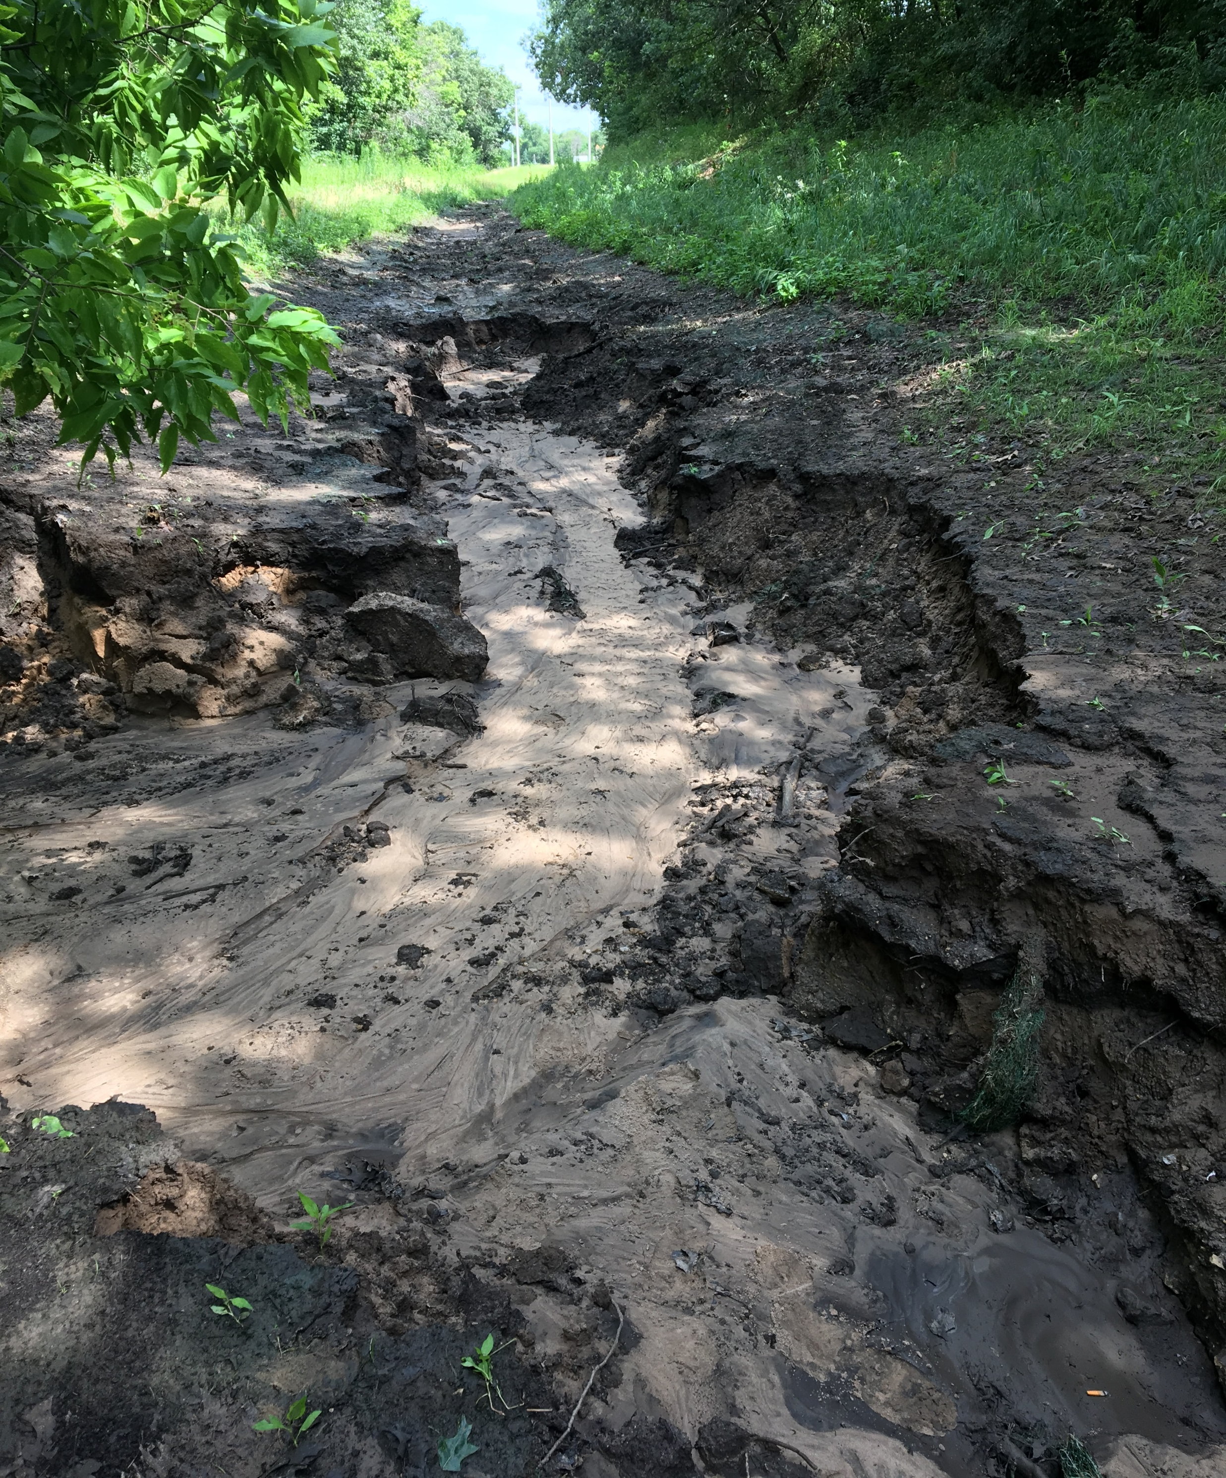
Orders
Order Form
When and How to Pay
Deductions
Guidance and Current Usage
Notes:
Before
Be well prepared with content. Know facts and figures and your audience.
Everyone should be able to read the slides but if NOT, read it to them. Otherwise don’t include it.
Do a final check on microphone and other equipment well before the start time.
Practice the presentation aloud several times. Feel comfortable.
Drink fluids and do something to relax you.
During presentation
Smile and be confident.
Introduce yourself and the organization.
Speak with energy, clearly, and in a reasonable volume so everyone can hear you.
Do not read each line on the slide show – use your own wording and add in examples or additional information which will aid in comprehension.
Talk “friendly” and with the attitude that you are here to provide information and assistance. Have a “win/win” attitude.
If you make an error, politely clarify or correct it. Move on quickly and don’t dwell on it.
If you can’t answer a question, politely indicate you don’t have the information available. Indicate that you will follow-up individually with the requestor.
After presentation
Be available for follow up.
Be prepared for additional comments, questions or clarifications.
Maintain composure.
If you make a promise, be sure to follow up quickly or reassign if appropriate.

Slide 6
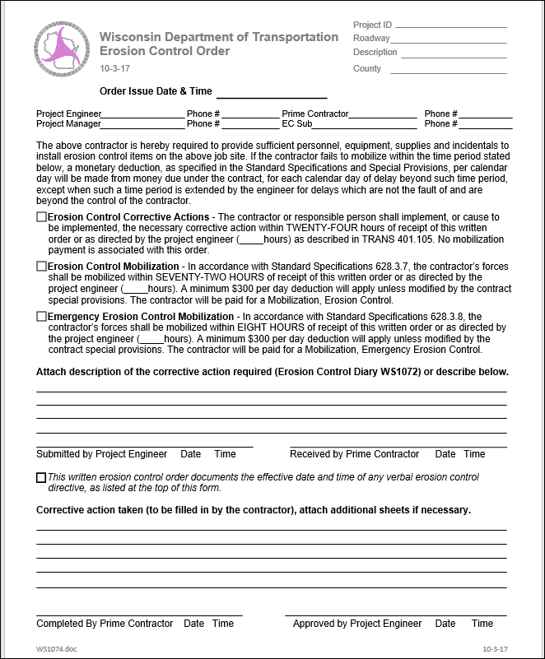
Orders
Notes:
Before
Be well prepared with content. Know facts and figures and your audience.
Everyone should be able to read the slides but if NOT, read it to them. Otherwise don’t include it.
Do a final check on microphone and other equipment well before the start time.
Practice the presentation aloud several times. Feel comfortable.
Drink fluids and do something to relax you.
During presentation
Smile and be confident.
Introduce yourself and the organization.
Speak with energy, clearly, and in a reasonable volume so everyone can hear you.
Do not read each line on the slide show – use your own wording and add in examples or additional information which will aid in comprehension.
Talk “friendly” and with the attitude that you are here to provide information and assistance. Have a “win/win” attitude.
If you make an error, politely clarify or correct it. Move on quickly and don’t dwell on it.
If you can’t answer a question, politely indicate you don’t have the information available. Indicate that you will follow-up individually with the requestor.
After presentation
Be available for follow up.
Be prepared for additional comments, questions or clarifications.
Maintain composure.
If you make a promise, be sure to follow up quickly or reassign if appropriate.

Slide 7
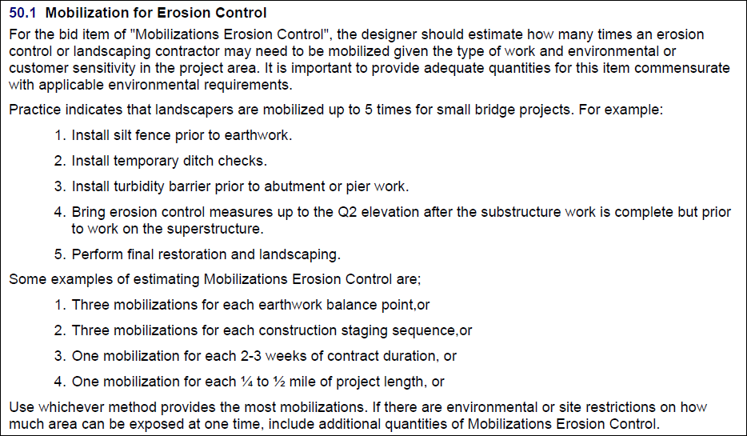
FDM guidelines for Erosion Control Mobilization
Notes:
Before
Be well prepared with content. Know facts and figures and your audience.
Everyone should be able to read the slides but if NOT, read it to them. Otherwise don’t include it.
Do a final check on microphone and other equipment well before the start time.
Practice the presentation aloud several times. Feel comfortable.
Drink fluids and do something to relax you.
During presentation
Smile and be confident.
Introduce yourself and the organization.
Speak with energy, clearly, and in a reasonable volume so everyone can hear you.
Do not read each line on the slide show – use your own wording and add in examples or additional information which will aid in comprehension.
Talk “friendly” and with the attitude that you are here to provide information and assistance. Have a “win/win” attitude.
If you make an error, politely clarify or correct it. Move on quickly and don’t dwell on it.
If you can’t answer a question, politely indicate you don’t have the information available. Indicate that you will follow-up individually with the requestor.
After presentation
Be available for follow up.
Be prepared for additional comments, questions or clarifications.
Maintain composure.
If you make a promise, be sure to follow up quickly or reassign if appropriate.

Slide 8
Mobilization, Erosion Control
SW Region | Plan Quantity | Paid Quantity | Change
State Projects | 506 | 369 | -27%
Local Projects | 211 | 174 | -18%
La Crosse Only | Plan Quantity | Paid Quantity | Change
State Projects | 149 | 116 | -22%
Local Projects | 95 | 67 | -29%
Data:
SW Region Only
Finalized proposals
Let between January 2014 and December 2016
Notes:
Before
Be well prepared with content. Know facts and figures and your audience.
Everyone should be able to read the slides but if NOT, read it to them. Otherwise don’t include it.
Do a final check on microphone and other equipment well before the start time.
Practice the presentation aloud several times. Feel comfortable.
Drink fluids and do something to relax you.
During presentation
Smile and be confident.
Introduce yourself and the organization.
Speak with energy, clearly, and in a reasonable volume so everyone can hear you.
Do not read each line on the slide show – use your own wording and add in examples or additional information which will aid in comprehension.
Talk “friendly” and with the attitude that you are here to provide information and assistance. Have a “win/win” attitude.
If you make an error, politely clarify or correct it. Move on quickly and don’t dwell on it.
If you can’t answer a question, politely indicate you don’t have the information available. Indicate that you will follow-up individually with the requestor.
After presentation
Be available for follow up.
Be prepared for additional comments, questions or clarifications.
Maintain composure.
If you make a promise, be sure to follow up quickly or reassign if appropriate.

Slide 9
FDM guidelines for Emergency Erosion Control Mobilization
Notes:
Before
Be well prepared with content. Know facts and figures and your audience.
Everyone should be able to read the slides but if NOT, read it to them. Otherwise don’t include it.
Do a final check on microphone and other equipment well before the start time.
Practice the presentation aloud several times. Feel comfortable.
Drink fluids and do something to relax you.
During presentation
Smile and be confident.
Introduce yourself and the organization.
Speak with energy, clearly, and in a reasonable volume so everyone can hear you.
Do not read each line on the slide show – use your own wording and add in examples or additional information which will aid in comprehension.
Talk “friendly” and with the attitude that you are here to provide information and assistance. Have a “win/win” attitude.
If you make an error, politely clarify or correct it. Move on quickly and don’t dwell on it.
If you can’t answer a question, politely indicate you don’t have the information available. Indicate that you will follow-up individually with the requestor.
After presentation
Be available for follow up.
Be prepared for additional comments, questions or clarifications.
Maintain composure.
If you make a promise, be sure to follow up quickly or reassign if appropriate.

Slide 10
Mobilization, Emergency Erosion Control
SW Region | Plan Quantity | Paid Quantity | Change
State Projects | 359 | 21 | -94%
Local Projects | 71 | 11 | -90%
La Crosse Only | Plan Quantity | Paid Quantity | Change
State Projects | 108 | 7 | -94%
Local Projects | 165 | 17 | -85%
Data:
SW Region Only
Finalized proposals
Let between January 2014 and December 2016
Notes:
Before
Be well prepared with content. Know facts and figures and your audience.
Everyone should be able to read the slides but if NOT, read it to them. Otherwise don’t include it.
Do a final check on microphone and other equipment well before the start time.
Practice the presentation aloud several times. Feel comfortable.
Drink fluids and do something to relax you.
During presentation
Smile and be confident.
Introduce yourself and the organization.
Speak with energy, clearly, and in a reasonable volume so everyone can hear you.
Do not read each line on the slide show – use your own wording and add in examples or additional information which will aid in comprehension.
Talk “friendly” and with the attitude that you are here to provide information and assistance. Have a “win/win” attitude.
If you make an error, politely clarify or correct it. Move on quickly and don’t dwell on it.
If you can’t answer a question, politely indicate you don’t have the information available. Indicate that you will follow-up individually with the requestor.
After presentation
Be available for follow up.
Be prepared for additional comments, questions or clarifications.
Maintain composure.
If you make a promise, be sure to follow up quickly or reassign if appropriate.

Slide 11
EC Order Considerations
Is the order form issued at the correct time?
Is the form signed and returned after the work is being completed?
How do you administer the $300 deductions?
Why are emergency mobilizations not used?

Slide 12
Releases

Slide 13
Releases
Call the SWEC, DNR, and Army Corps of Engineers (if applicable)
Process for releases is defined on the release report form… copy included in the ECIP binder
Fill out the release form and send to SWEC

Slide 14
Select Sites
Private sites take time to review during ECIP approval
Inspect every week and after 1/2” rain
Please ensure the contractor is submitting site design and erosion control plans for each site

Slide 15
Erosion Mat
STAPLE, STAPLE, STAPLE
PAL lists minimum number of staples required for each mat type

Slide 16
Erosion Mat Usage SW La Crosse Office Counties
Q in SY
 | Awarded | Paid | Change
Class I Type A | 15,000 | 29,224 | 95%
Class I Type B | 123,067 | 291,315 | 137%
Urban Class I Type A | 16,291 | 18,474 | 13%
Urban Class I Type B | 29,843 | 33,061 | 11%
Class II Type A | 670 | - | -100%
Class II Type B | 61,115 | 41,856 | -32%
Class II Type C | 9,268 | 510 | -94%
Class III Type A or Type B | - | -
Class III Type C | 6,900 | 91 | -99%
Class III Type D | 100 | - | -100%

Slide 17
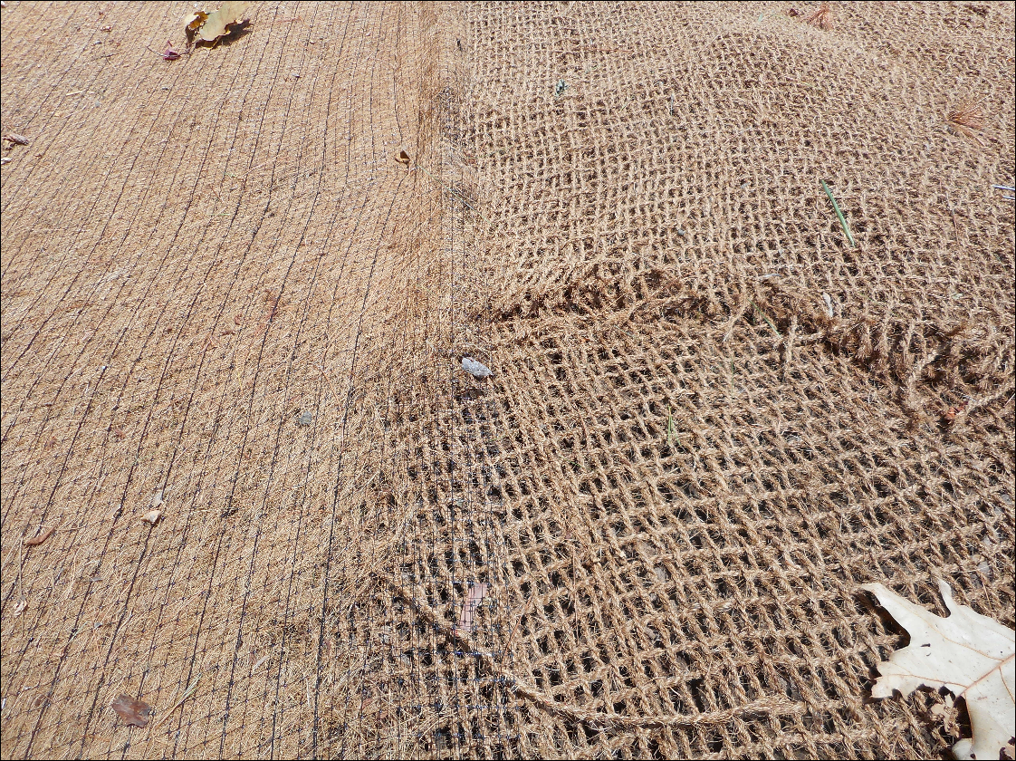
Erosion Mat
Mat is selected in design to withstand Q_{(2, 24)} rain event
Selecting a lesser mat may expose us to more risk – not compliant with EPA standards
Critter passage

Slide 18
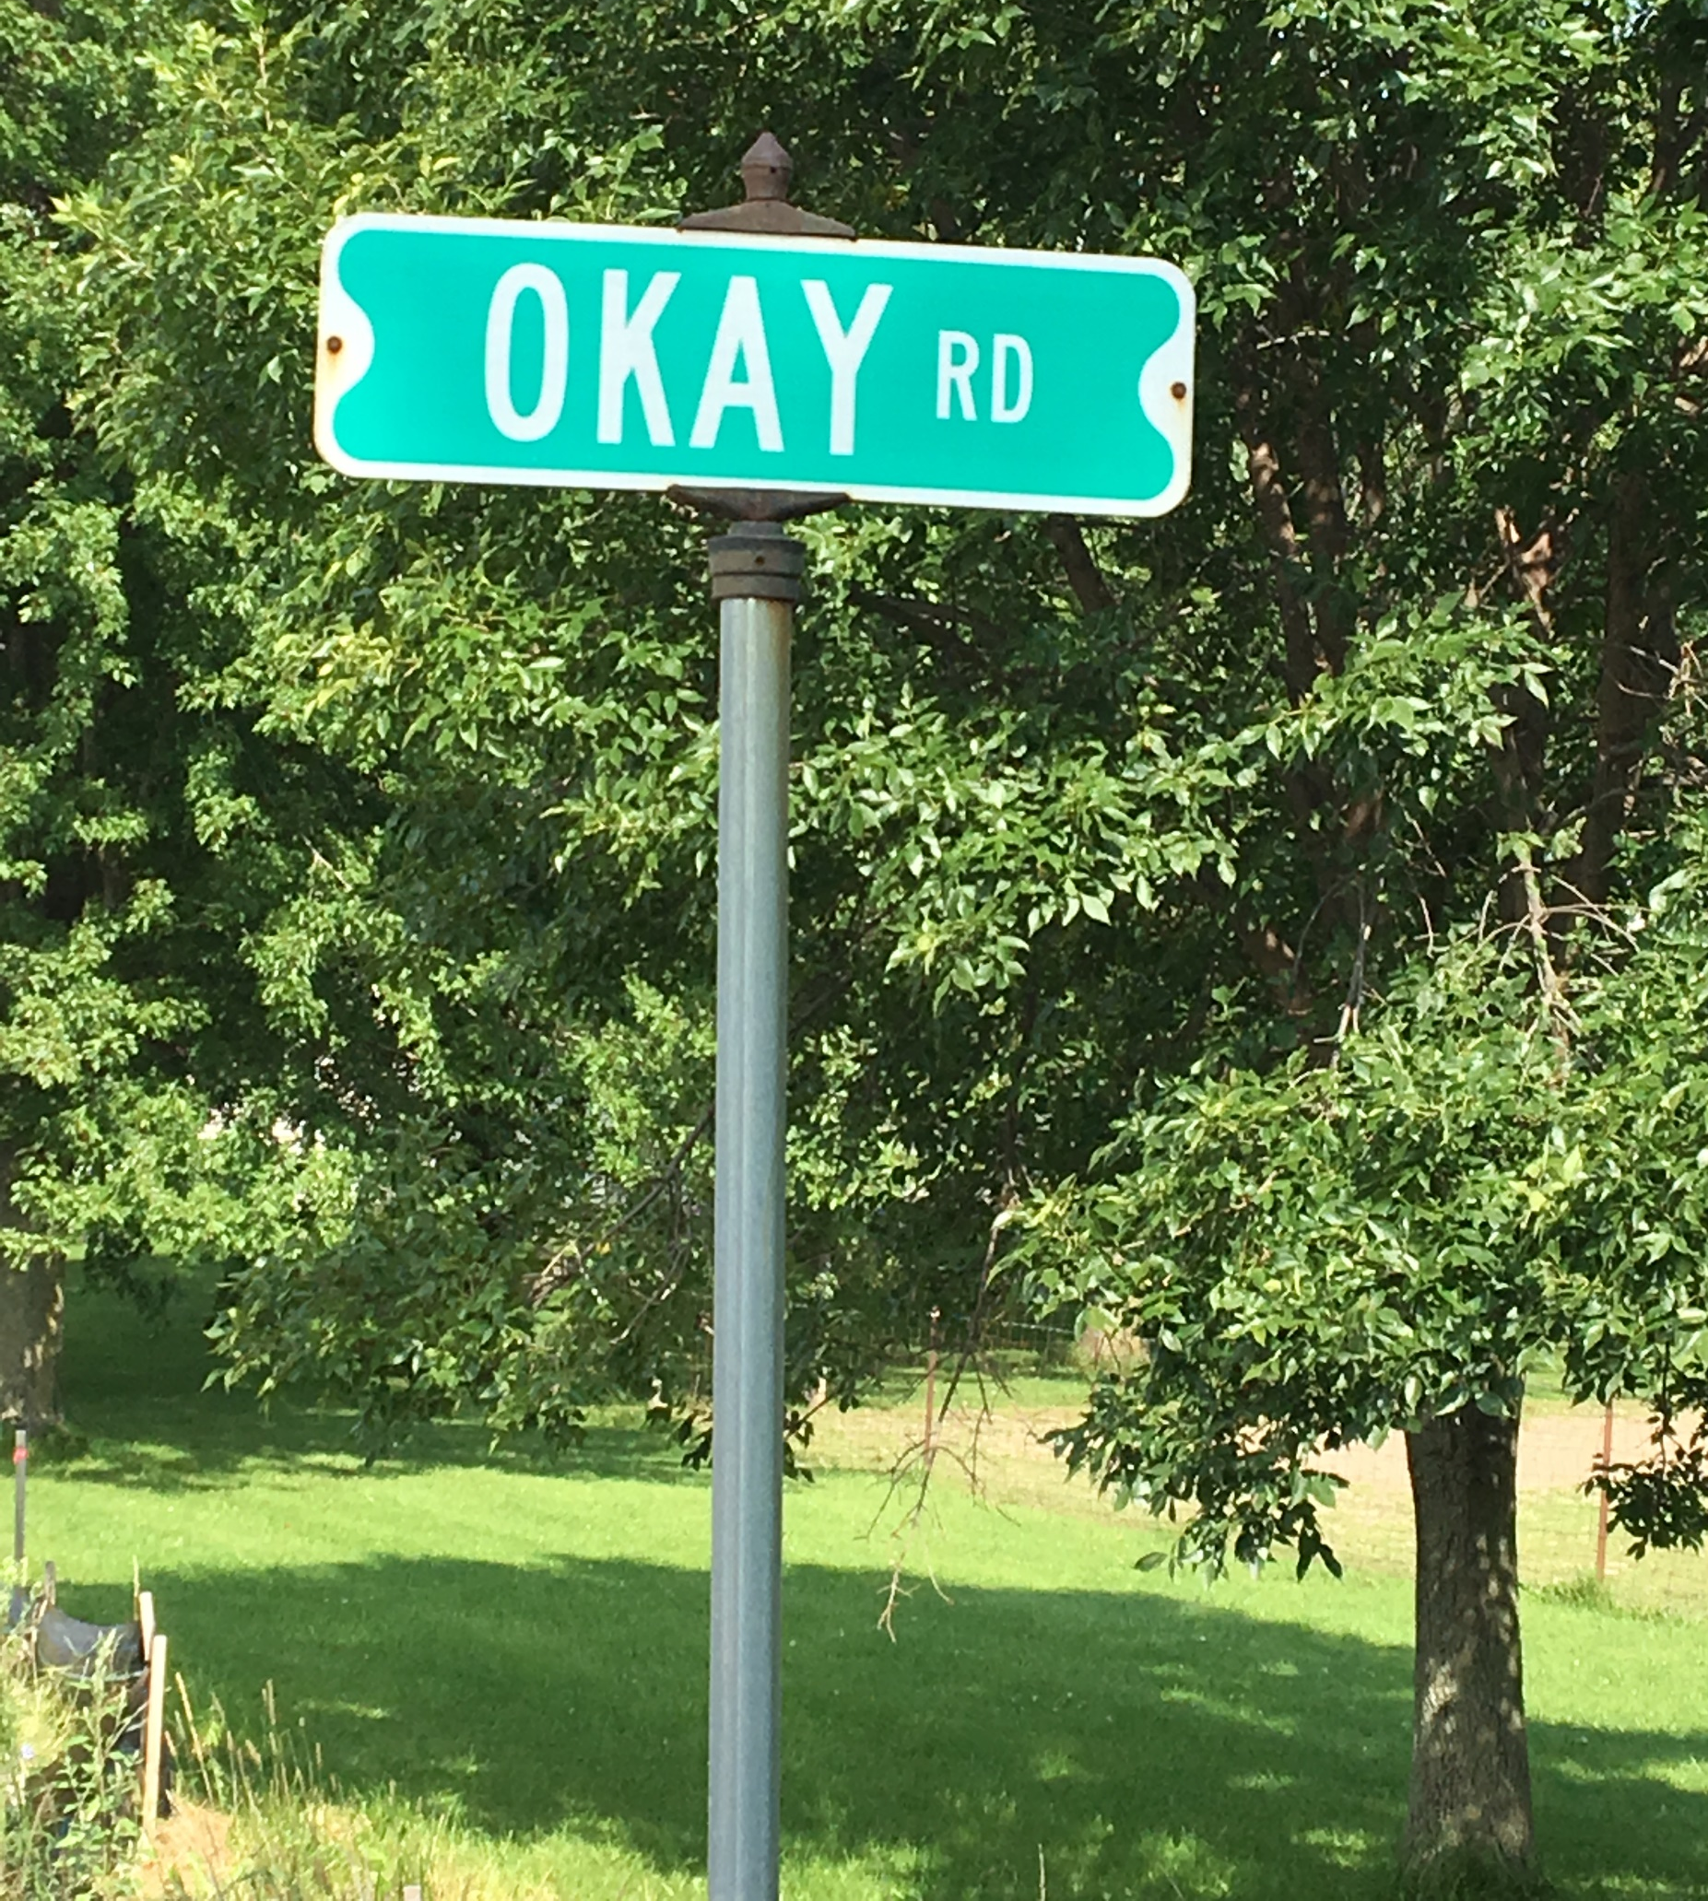
Questions?
How can we help you?
Comments?
PS – there’s a new permit coming!
(June 2018)

