Slide 2
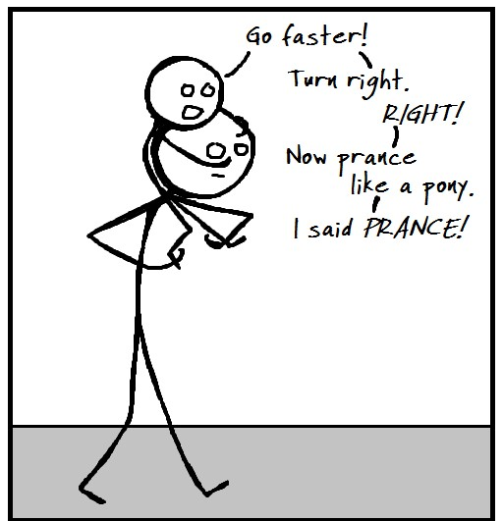

Slide 3
Schedule EC mobs

Slide 4
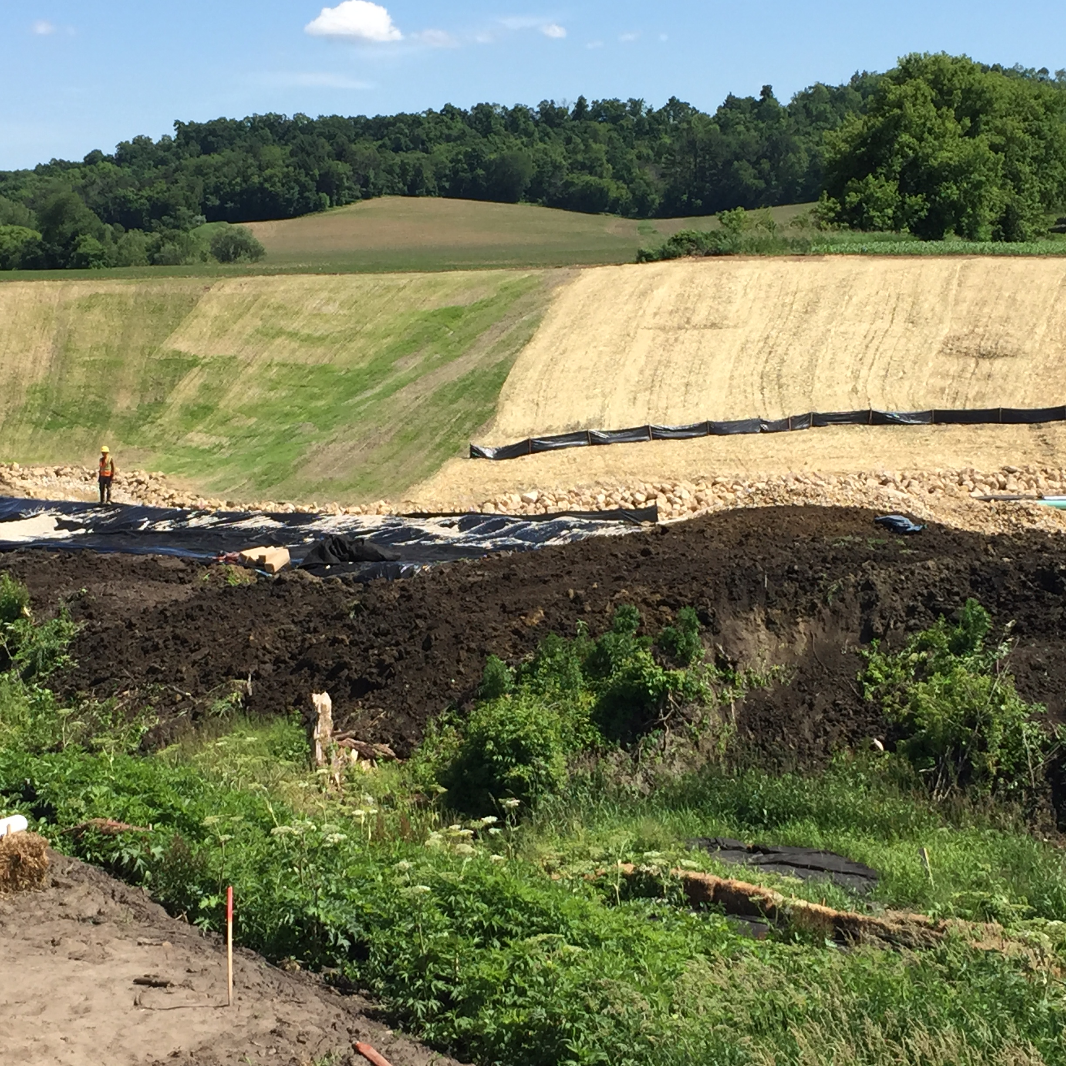
Proper Sequencing
ECIP language
Each section must have proper erosion control measures in place before any existing
ground is disturbed.

Slide 5
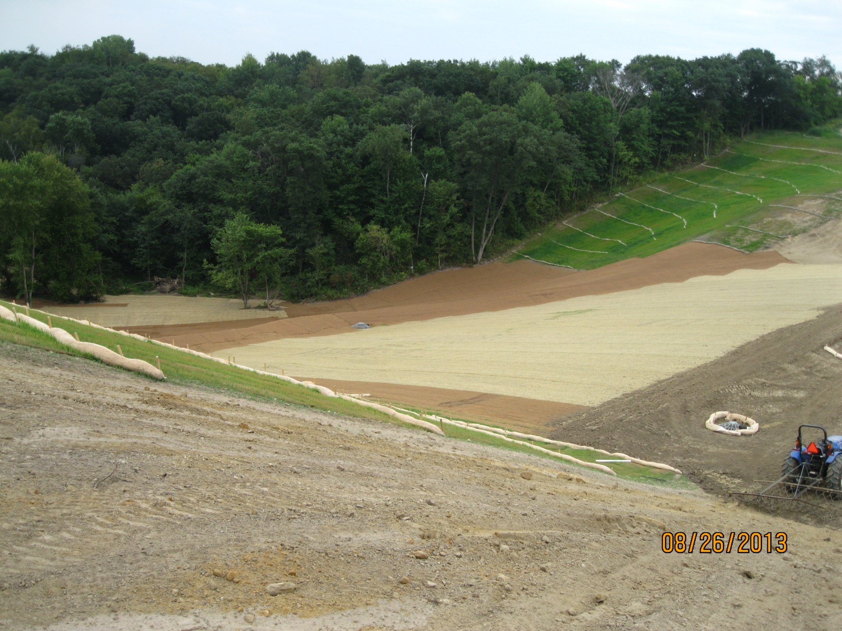
Proper Sequencing

Slide 7
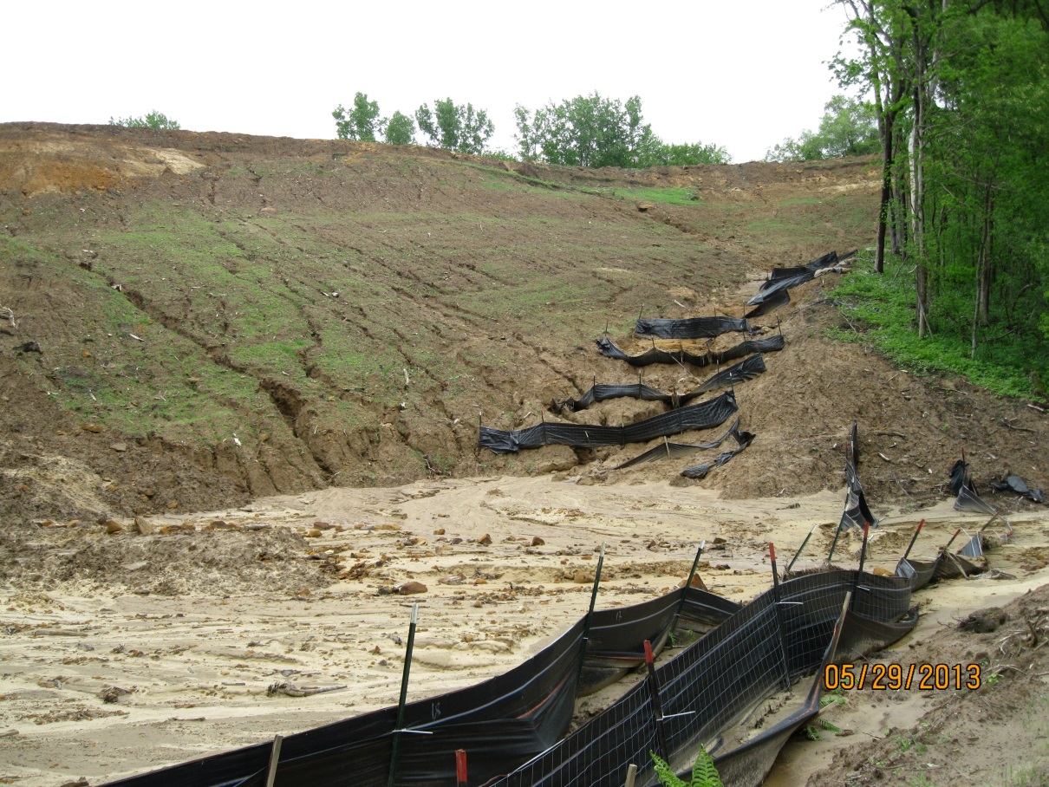
At what point is it time to try something new?

Slide 8
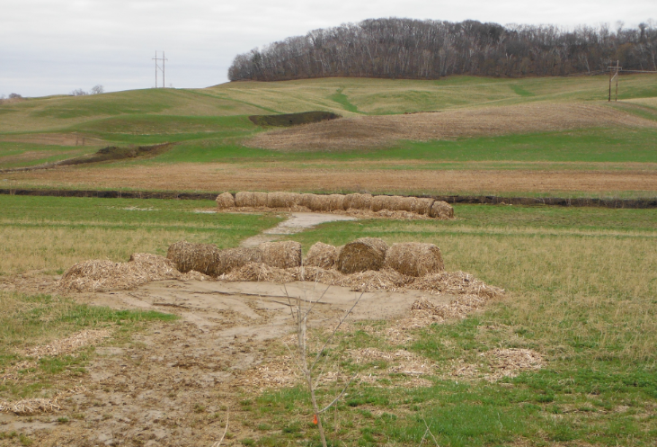

Slide 9
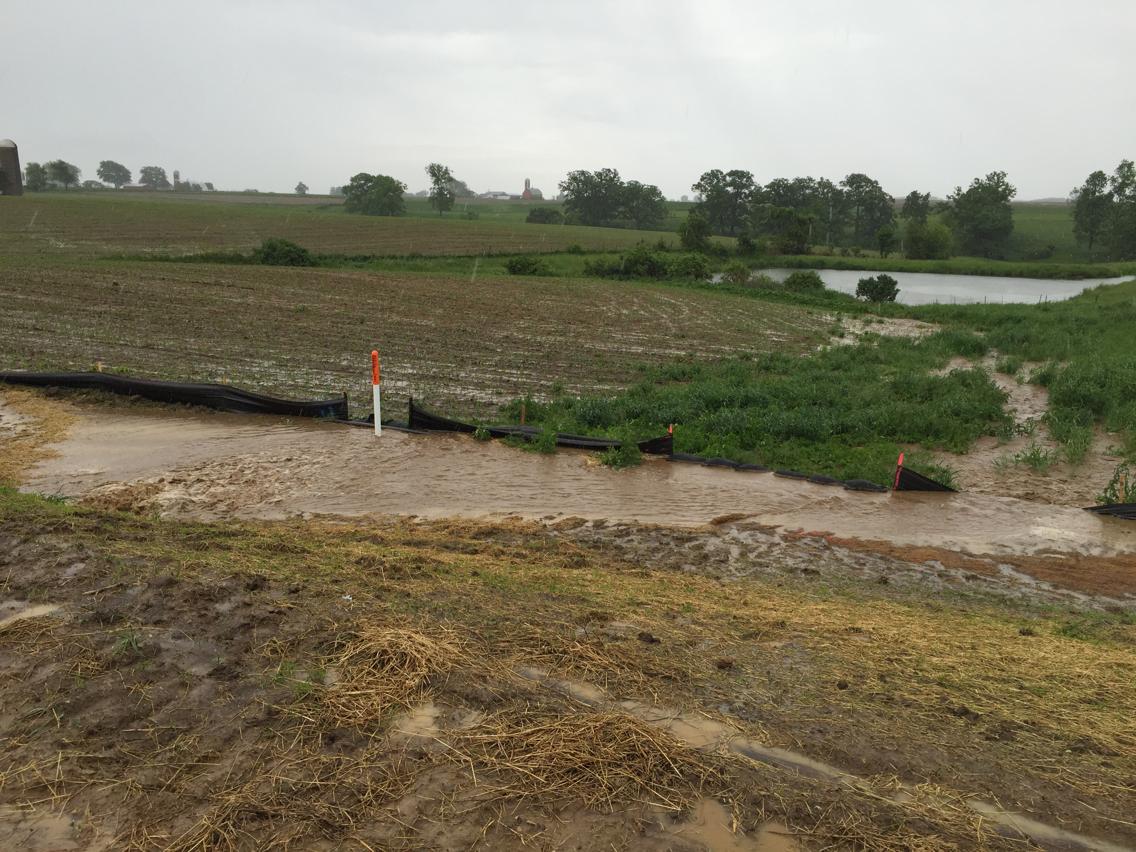

Slide 10
Get it done

