Slide 1
2018 Field Application Updates
David Castleberg, P.E.
Design & Construction Technologies Supervisor
david.castleberg@dot.wi.gov
(608) 264-7606

Slide 2
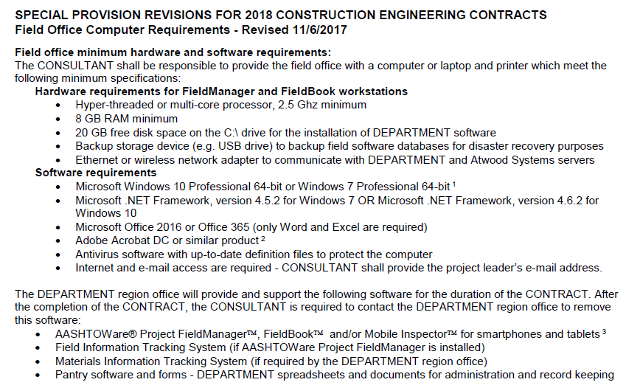
2018 PC Special Provisions – Construction
No hardware changes
No software changes
Removed Local Program requirements
Computers must meet
the minimum specifications
Notes:
Special Provisions are included with your contract.
Computers must meet minimum hardware and software requirements or the construction software cannot be installed.
No hardware changes
No software changes
Removed Local Program requirements
Computers must meet the minimum specifications

Slide 3
2018 Construction Software
FieldManager v5.3a
  A new FieldManager Agency Configuration file will be distributed to all project staff to import into the application.
  FieldBook v5.3a (optional)
  Mobile Inspector 1.17 (optional)
Field Information Tracking (FIT) 2017
Remember to watch for updates throughout the season.
Materials Information Tracking (MIT) 2018 (coming soon)
Remember to watch for updates throughout the season.
ACM Applications update – Backup app, Pantry 2018 and WisDOT shortcuts
Notes:
WisDOT Staff
ACM Applications update – will be installed automatically
FIT – Updates will be installed automatically
MIT – Updates will be installed automatically
FieldManager – Project Engineer MUST import ACP file for all databases (instructions will be provided through the Contract Specialists)
Consultant Staff
(Instructions will be provided through the Contract Specialists / local admin rights required)
ACM Applications update – Project Engineer MUST run exe to install updates
FieldManager – Project Engineer MUST import ACP file for all databases
FIT – Project Engineer MUST download and install updates
MIT – Project Engineer MUST run exe to install updates

Slide 4
2018 Field Software Updates
Scheduling full software installation appointments:
  From February 1, 2018 – July 31, 2018
    Project Engineers contact BITS Level 2 ACM Support staff directly to schedule an appointment.
  From August 1, 2018 – January 31, 2019
    Project Engineers contact the IT Service Desk at 800-362-3050 to schedule an appointment.
Software updates – FIT and MIT
    WisDOT staff computers will be updated using an auto installation process (SCCM).
    Consultant staff will be responsible for their own updates. Update instructions appear in the 2018 Field Software User’s Guide for Construction.
Notes:
Who to contact to schedule appointments for NEW installs AND migrations (staff receiving a new PC):
February 1 – July 31, 2018 – Project Engineer calls or emails BITS L2 ACM Support Staff
August 1, 2018 – January 31, 2019 – Project Engineer calls the IT Service Desk to schedule appointments.
Why - BITS project to account for time to complete installs.
Local administrative rights required for ALL software installs.
Contact WisDOT IT Service Desk for all software issues.

Slide 5
2018 Field Software User’s Guide for Construction
Statewide guide for Project Engineers and support staff.
  Data entry guide for FieldManager, FieldBook, FIT, and MIT.
  Installation and configuration steps for Mobile Inspector.
  Support contacts list.
Electronic versions
  Can be found on the region servers and field computers under Pantry2018\StatewideManualsAndGuides.
  Field staff will have a shortcut in their WisDOT Shortcuts folder.
References region specific construction administration guide for further guidance.
Notes:
Updated for 2018
Used in conjunction with the Region Construction Administration Guides
Covers how to enter data into FieldManager, Fieldbook, FIT and MIT.
NEW - How to install and configure Mobile Inspector.
Found under Pantry2018\StatewideManualsAndGuides folder
Shortcut in WisDOT Shortcuts
Bookmarks to locate info quickly
Searchable

Slide 6
Contract support
Region Contract Specialists
  Contract modifications
  Estimates
  Site time and events
  Liquidated damages
  Retainage issues
  Adding projects, categories, or sites to a contract.
Notes:
Reasons to contact Region Contract Specialists

Slide 7
Contract support
AASHTOWare Project Administrators
Annette Czerneski and Adam Bleskacek
  Bad contract transfers
  Missing vendors
  Data sync issues between FieldManager and AWP Project CAS
  Mobile Inspector support
  Contract specialists may elevate issues to the AASHTOWare Project Administrators.
Notes:
Reasons to contact AASHTOWare Project Admins

Slide 8
FieldManager v5.3a Site Event Considerations
Site events are used to suspend Time and Work.
WisDOT uses two (2) types of events – Time and Work.
  Time Suspended / Time Resumed - Used to temporarily suspend time on carry over contracts and avoid charging liquidated damages
  Work Suspended / Work Resumed - Used to document suspension of work on carry over contracts only. Has no effect on liquidated damages.
The entry of a suspend event REQUIRES the entry of a resume event.
Failure to do this will cause issues when the next estimate is sent.
Review all sites to ensure that the number of days or completion dates are not exceeded on the contract.
If time is exceeded, a time extension contract modification is required to reduce or eliminate liquidated damages.
Contact your Contract Specialist for assistance when creating site events.
Notes:
Site Events
Only use Time Suspend events
Controls LDs
Time Suspend event must have a corresponding Time Resume event
Time exceeded – check with CS to see if you should create a cont mod

Slide 9
FieldManager v5.3a Contract Modification Process
Draft - Cont Mod is in this status during the initial creation / editing mode
  <Save> or <Save/Close>
  No files in the FieldManager Outbox
  FIT Merge and Send will create cont mod record in Project Tracking
Pending Approval - Ready to print and obtain signatures
  <Generate>
    Respond NO to “Does this require supervisor approval?”
    Confirm there are 2 messages in outbox before sending
Approved - Change to approval status after all signatures are obtained (and region procedures complete)
  <Approve>
  Confirm there is 1 message in FieldManager outbox before sending
Notes:
Contract Mod process
PEs will not have PMs approved cont mods in FieldNet
ALWAYS RESPOND “NO” to “Does this need your supervisor’s approval?”

Slide 10
FieldManager v5.3a Contract Modification Process
Merge and send FIT data each time you change the status of a contract modification to keep CAS and Project Tracking up-to-date.
Approvals are requested based on region specific guidelines.
When generated, item quantity changes can be included on IDRs but will not be included on an estimate until the contract modification is approved.
Multiple revision issue
  The net change dollar amount of the contract modification may not match the total for the item changes for all projects.
  Known FieldManager issue.
  Contact Annette Czerneski or Adam Bleskacek, the AASHTOWare Project Administrators, for assistance.
Notes:
Contract Modifications
FIT merge and sends
Cannot make payment on items until cont mod is approved
Multiple cont mod revisions could affect the net change dollar amount on the cont mod report. Known FieldMgr issue.

Slide 11
FieldManager v5.3a Estimate Considerations
Notice to Proceed date on the contract Doc Gen tab for first estimate. Contact the CS if it is missing.
IDRs and Daily Diaries MUST be generated.
Retainer reduced? Contact the CS prior to creating an estimate.
Site Event to suspend or resume time (not work) prior to estimate creation.
Contract Modification to extend contract time and avoid liquidated damages.
Time Charges Stop date required to avoid liquidated damages.
Estimate Comments are required, include date range of work completed for this estimate plus other comments required by the region (60 character limit).
AND Remember to Communicate with your PM and CS if the estimate may involve something out of the ordinary. Plan ahead and avoid estimate errors.
Notes:
Estimate Considerations –
Items PEs should consider before generating and sending an estimate.
Please work with your Project Manager and your Contract Specialist to reduce the number of estimate denials that are taking place each day. Communication between all is the key!.
If an estimate denial cannot be avoided, the Project Engineer must follow the steps outlined on pages 20-21 of the Field Software User’s Guide for Construction Staff to roll back / delete the Estimate in FieldManager, make the appropriate changes and create / generate and send the replacement estimate.

Slide 12
FieldManager v5.3a Negative Estimates
If the quantities are incorrect, do not generate the estimate! Close the estimate and make the corrections in the IDRs. Regenerate the IDRs and recreate the estimate.
If the total dollar amount of the estimate is a negative amount, contact your Project Manager or Supervisor prior to generating and sending the estimate. Discuss how to handle this estimate with a negative payment.
  Intermediate Estimates - In most cases, these should not be negative. If possible, do not generate the estimate until there are enough work items to create a positive payment.
  Semi Final Estimates - In most cases, these should not be negative, unless there will be enough retainage to later cover the negative amount with the final estimate.
Notes:
Negative Estimates – things to consider for Intermediate and Semi Final estimates

Slide 13
FieldManager v5.3a Backup
Prompt appears after logging out of FieldManager database 10 times.
This process backs up the FieldManager database only.
First copy stored on local C: drive.
Can save an additional copy on external backup device.
Notes:
It is very important to do backups!
FieldManager database backup after 10 log outs.
The initial backup is stored at C:\ProgramData\FieldManager\database\Backup
An additional backup can be saved on an external USB or hard drive too.

Slide 14
FieldManager, FIT and MIT Database Backup Process
WisDOT RECOMMENDS weekly backups!
This process backs up ALL field application databases.
Steps to setup on an external device appear in the Field Software User’s Guide for Construction Staff.
Store the backup device offsite.
Notes:
It is very important to do backups!
WisDOT RECOMMENDS weekly backups!
This backup process backs up the FM, FIT and MIT databases. Can work with BITS Level 2 ACM Support to setup backups to run from an USB or external hard drive.
Store the backup device offsite.

Slide 15
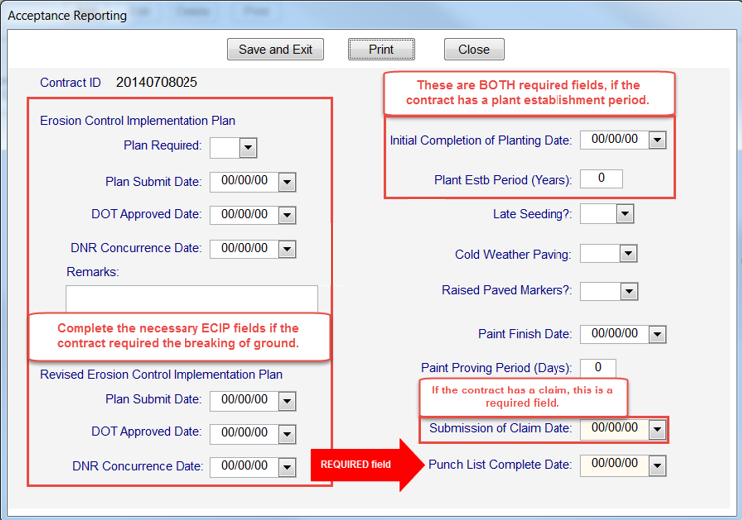
Field Information Tracking (FIT)
Required fields
DQI information for each project
Explanation of Variation report - Item variation entered in FieldManager under the Project Items | Documentation tab
  Notes field - Explanation for the variation between the quantities.
Acceptance Reporting
  Punch List Completed Date
  ECIP Information (if required)
  Plant Establishment Periods (if required)
  If a claim is submitted, Submission of Claim Date
  is required.
  Other fields as required.
Staff / Field Office information
Warranty information, if applicable
Notes:
Required data entry fields for FIT

Slide 16
Field Information Tracking (FIT)
Requirements to merge and send data:
When the ECIP is approved.
When contract time starts.
When a contract modification is created.
When a contract modification is approved.
When work is completed on the contract.
When a DQI report is completed.
When an estimate is submitted.
When claim is submitted.
When the punch list is completed.
When entries are made on the Staff / Field Office tab.
Weekly, at a minimum, for labor compliance reviews.
Notes:
FIT requirements to merge and send data

Slide 17
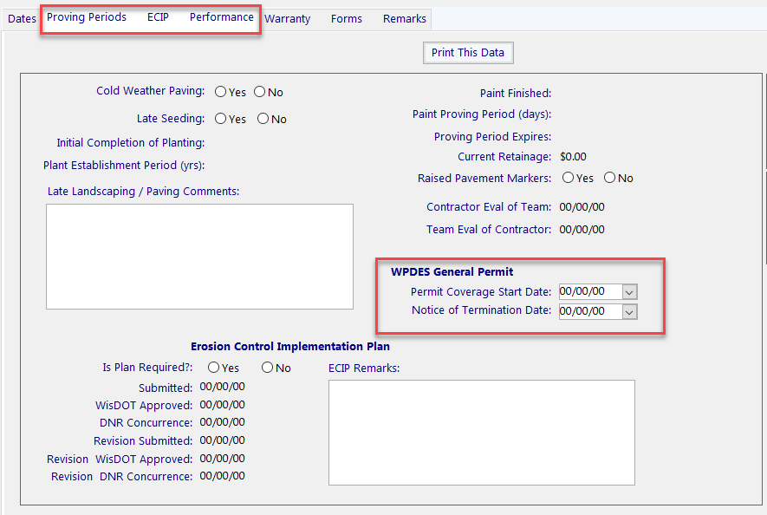
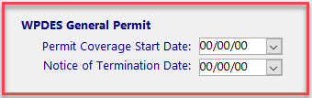
Project Tracking: WPDES General Permit dates- NEW for 2018
Wisconsin Pollutant Discharge Elimination System
General Permit issued by DNR
Only required for projects with an acre or greater of ground disturbance.
NOI is submitted by design team at DNR final concurrence (online e-permitting system).
NOT is submitted by construction team at 70% permanent vegetation establishment (PDF form and instructions are located in pantry).
Project Manager to notify Contract Specialist
  Permit Coverage Start Date (NOI)
  Notice of Termination Date
Dates entered in Project Tracking
Notes:
New WPDES General Permit Dates in Project Tracking

Slide 18
Transferring FieldManager and FIT Contracts
In some regions, Project Engineers may be asked to transfer their FieldManager contract to a Project Manager or a region Finals PC before the semi-final or final estimate has been submitted. THESE STEPS MUST be followed to ensure FIT contract data is not lost:
  Send and receive FieldManager mail.
  Backup FieldManager and FIT databases.
  Transfer FIT contract.
  Transfer FieldManager contract.
  Import FieldManager contract.
  Import FIT contract.
See pages 28-30 of the 2018 Field Software User’s Guide for Construction staff for detailed instructions.
Notes:
If you need to transfer contract to another PL before Semi Final or Final, THESE STEPS MUST BE FOLLOWED.
Losing data because staff are missing the FIT transfer (export) and import steps affects Project Tracking
Refer to Field Software User’s Guide pages 28-30 for details.

Slide 19
Archiving FieldManager Contracts
Each region handles the FieldManager contract archival process differently. Work with your Project Manager and Contract Specialist to ensure you are completing the correct steps.
Regions where the Project Engineer / Project Manager archive contracts:
  Contact your contract specialist to ensure you are ready to archive your FieldManager contract.
  Send and receive FieldManager mail.
  Merge and send FIT contract data.
  Archive FieldManager contract.
Regions that DO NOT have the Project Engineer archive contracts:
  If the Project Engineer DOES NOT archive their FieldManager contracts, follow the Transferring a Contract to Another FieldManager Computer steps on pages 28-30 of the Field Software User’s Guide for Construction Staff.
Notes:
Process varies from region to region.
Contact Contract Specialist to ensure you are following the correct process.
Process outlined on page 34 of the 2018 Field Software User’s Guide for Construction Staff

Slide 20

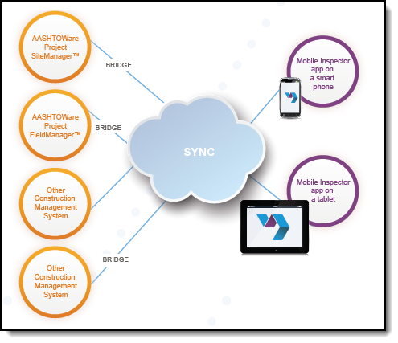
Mobile InspectorTM
Developed by InfoTech Inc.
Purpose
  Field staff use the app to create IDRs.
  Locked IDRs auto sync with the FieldManager contract PC.
  Staff can take photos and attach them to the IDRs.
Notes:
Used create IDR’s in the field on mobile devices.
This is just like using FieldBook on a smart phone or tablet.
Project staff can enter item quantities, labor, equipment and weather on the mobile device at the construction site.

Slide 21
Mobile InspectorTM
Other efficiencies using a mobile device
  Standalone versions of the CMM and Standard Spec are available.
  Access to email
Supported devices
  Apple iOS 8 or higher smartphones and tablets
  Android 5.x or higher smartphones and tablets
  Windows 10 tablets
Notes:
Standalone versions of the CMM and Standard Spec can be download onto the device.
http://wisconsindot.gov/Pages/doing-bus/eng-consultants/cnslt-rsrces/rdwy/mobile.aspx
Staff can access their email on the device too.
Supports all popular smartphone and tablet OS.

Slide 22
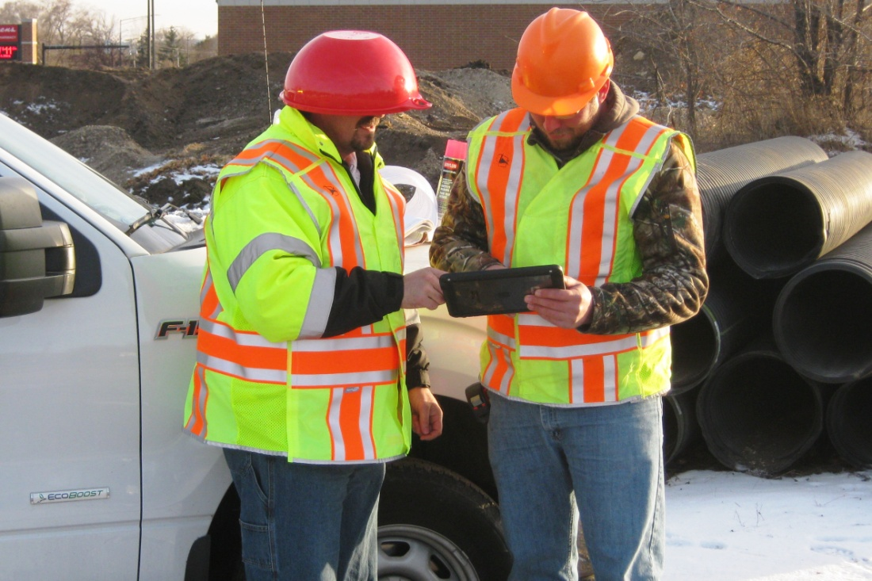

Mobile InspectorTM
Licensing
  Download free app
  WisDOT pays an annual license fee for the AASHTOWare Project
  SYNC Service™ license.
  The installation and configuration steps for Mobile Inspector are in the 2018 Field Software User’s Guide for Construction Staff.
  Contact Adam Bleskacek or
  Annette Czerneski for assistance.
Notes:
Download free app from the App Store, Google Play or the Windows Store
WisDOT pays an annual license fee for the “Bridge” communication software that syncs the app with the FieldManager contract.
Contact Adam Bleskacek or Annette Czerneski for setup and configuration instructions.

Slide 23
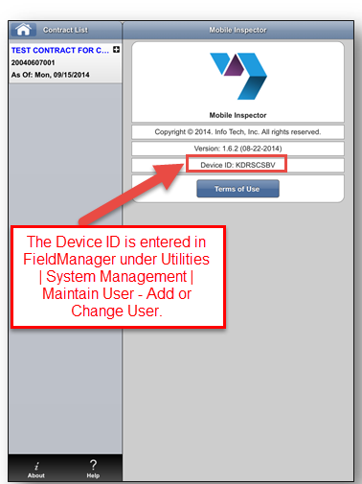
Mobile InspectorTM
Notes:
The next few slides are intended to briefly show screen shots of the Mobile Inspector features
Contract Screen shows contract that was sent automatically from the FieldManager contract computer.

Slide 24
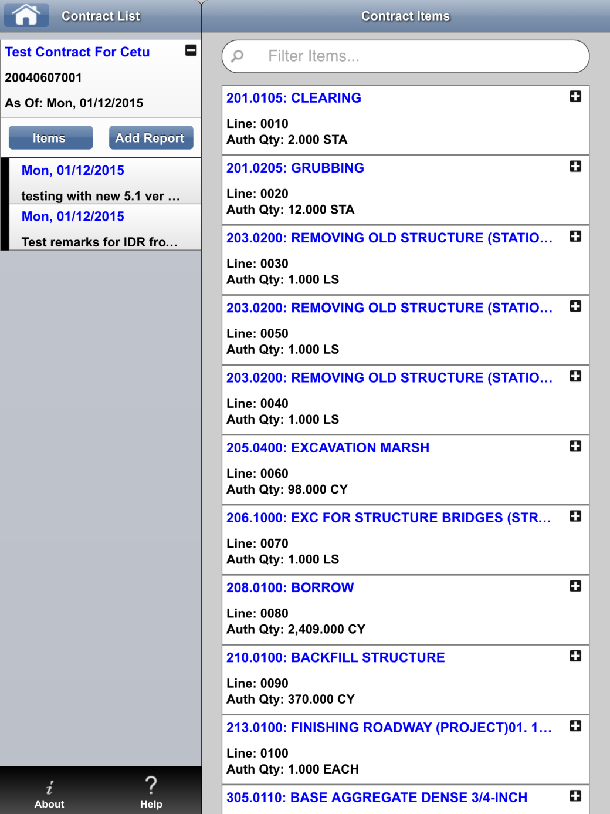
Mobile InspectorTM – Item List
Notes:
Contract Items List

Slide 25
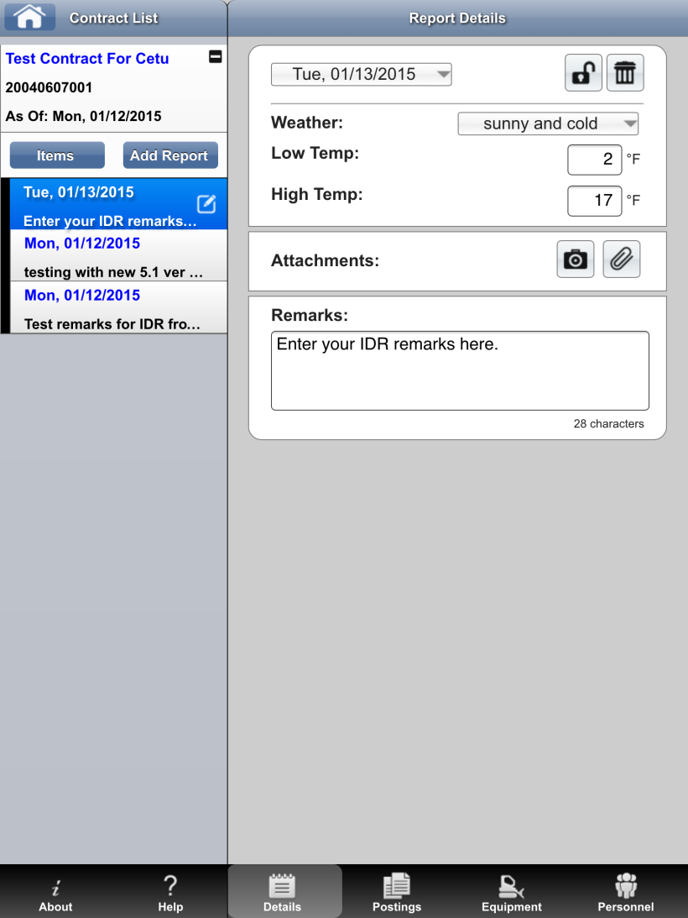
Mobile InspectorTM– Add Report
Notes:
Add a new IDR report

Slide 26
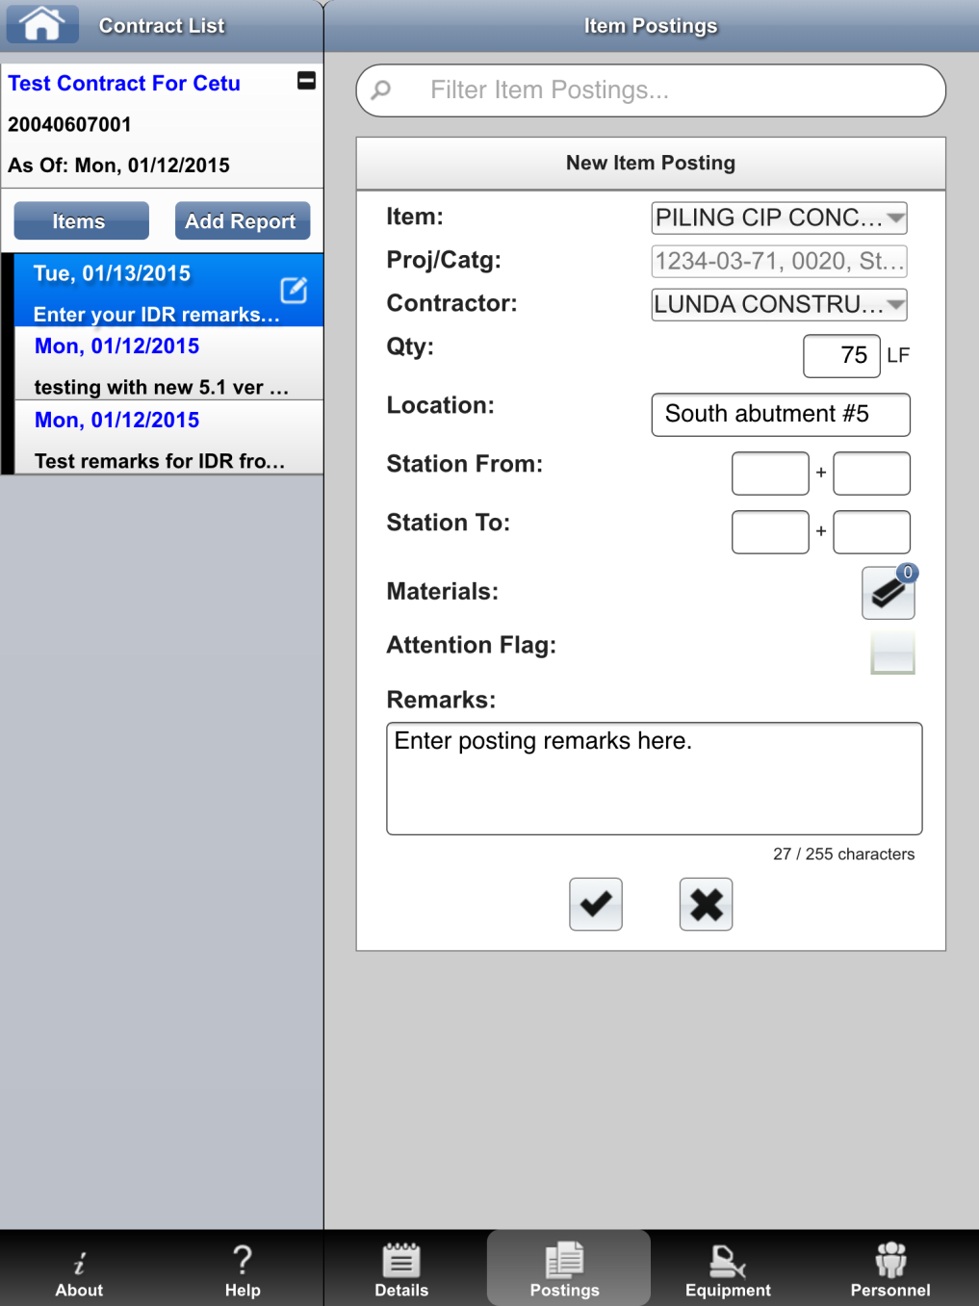
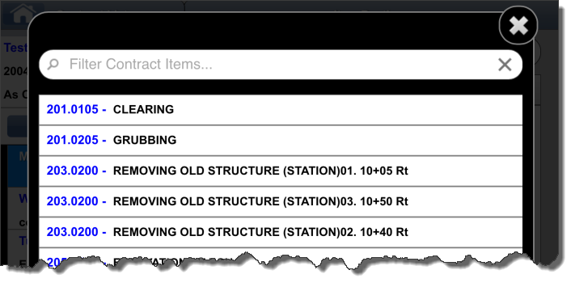
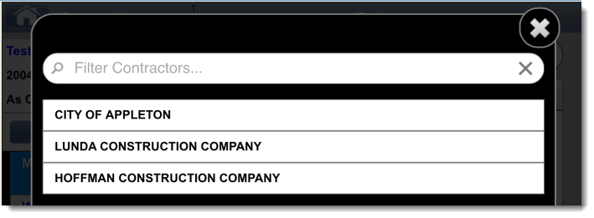
Mobile InspectorTM– Add Postings
Notes:
Add Postings to the IDR

Slide 27
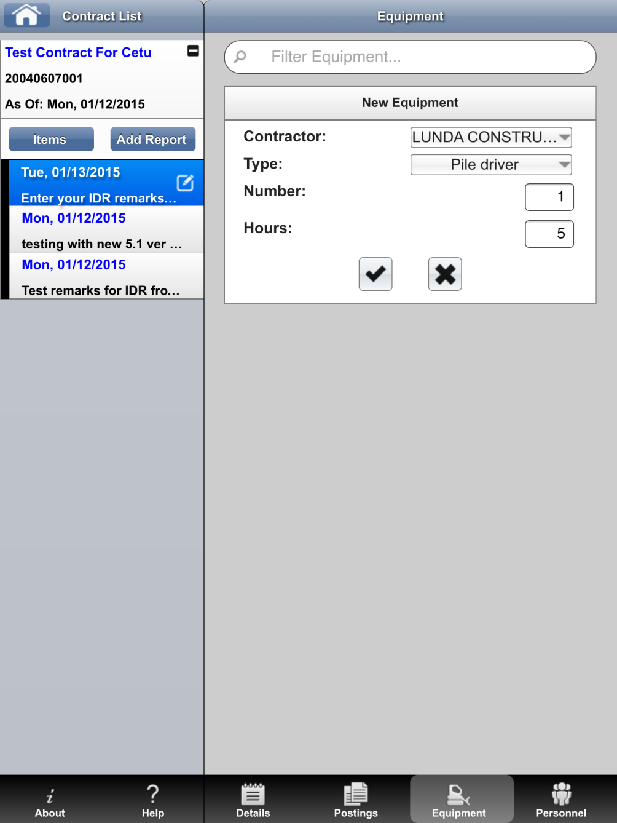
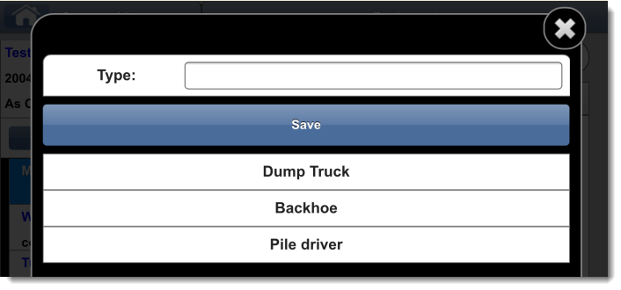
Mobile InspectorTM– Add Equipment
Notes:
Add Equipment to the IDR

Slide 28
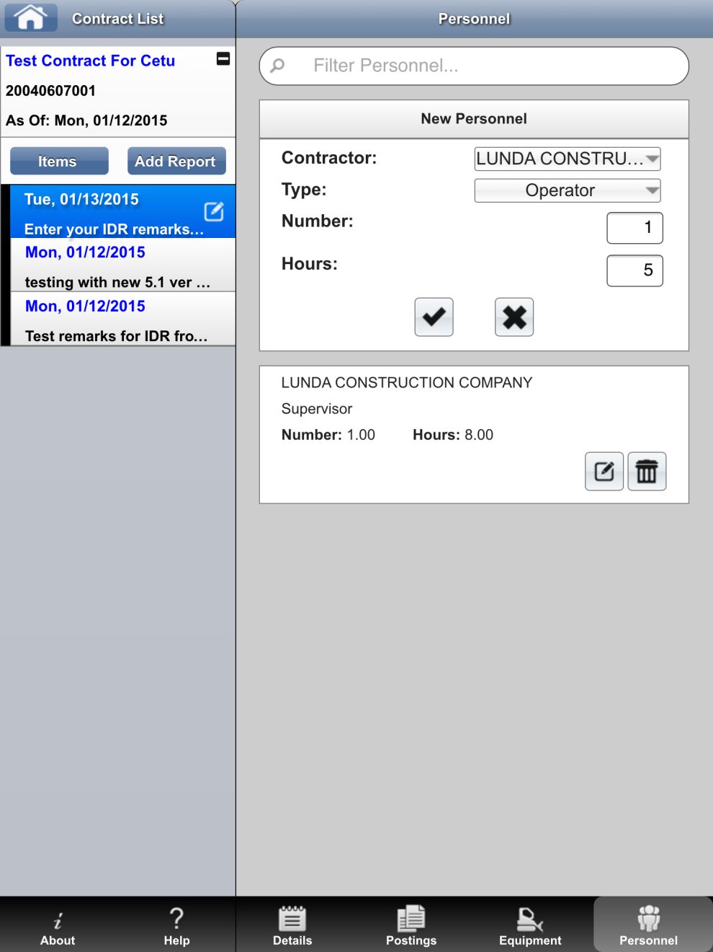
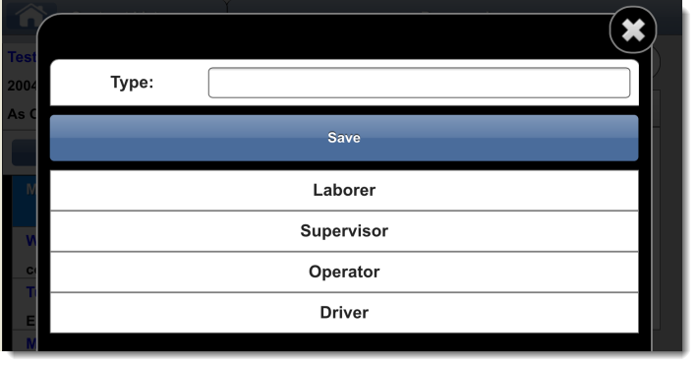
Mobile InspectorTM– Add Personnel
Notes:
Add personnel to the IDR

Slide 29
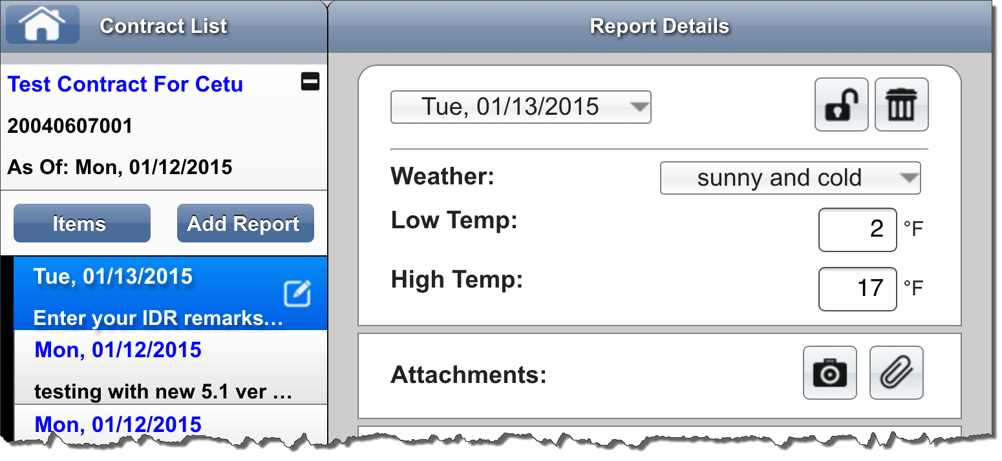
Mobile InspectorTM– Lock Report
Locking report sends it to FieldManager if the mobile device has cellular service or is connected to a wireless network. Once locked, a report cannot be unlocked in Mobile Inspector. Edits are completed in FieldManager.
Notes:
Lock Report to automatically send it to the FieldManager contract computer.

Slide 30
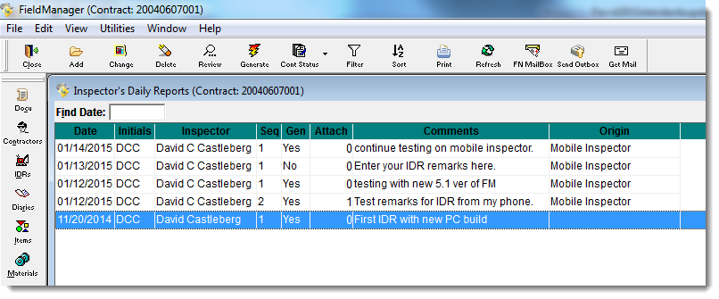
Mobile InspectorTM– FieldManager
IDRs List
Notes:
After being sent to FieldManger through the “Cloud”
Shows list of IDRs in FieldManager.
Note that the “Origin” field will display where the IDR was created.

Slide 31
AASHTOWare Project Implementation
David Castleberg, P.E.
Design & Construction Technologies Supervisor
david.castleberg@dot.wi.gov
(608) 264-7606

Slide 32
AASHTOWare Project (AWP)

Slide 33
WisDOT Contract Management System - Current
Field
Information
Tracking
Materials Information Tracking
Materials
Reporting
System
BAMS/DSS
Bid
Express
Web
Bid
Express
Web
Expedite
FieldManager
Mobile
Inspector
Atwood
Systems, Inc.
FIIPS
AASHTOWare
Project
Preconstruction
Materials
Tracking System
Estimator
LAS
CAS
FieldNet
Project Tracking
PC
File Transfer
PeopleSoft
AASHTOWare
Project Database
AASHTOWare
CAS
Database
Project Tracking
Database
Materials Tracking
Database
CAS - Construction Administration System
BAMS/DSS - Decision Support System
FIIPS - Financial Integrated Improvement Programming
System

Slide 34
WisDOT Contract Management System – Future Phase 1
Materials Information Tracking
Materials
Reporting
System
Bid
Express
Web
Expedite
Mobile
Inspector
BAMS/DSS
Atwood
Systems, Inc.
AASHTOWare
Project
Preconstruction
AASHTOWare
Project
Construction
AASHTOWare
Project
Civil Rights & Labor
Materials
Tracking System
Estimator
Oracle Database
Materials Tracking
Database
AASHTOWare Project Database
FIIPS
Masterworks
PeopleSoft

Slide 35
WisDOT Contract Management System – Future Phase 2
Bid
Express
Web
Expedite
Mobile
Inspector
BAMS/DSS
AASHTOWare
Project
Preconstruction
AASHTOWare
Project
Construction & Materials
AASHTOWare
Project
Civil Rights & Labor
Estimator
Oracle Database
AASHTOWare Project Database
FIIPS
Masterworks
PeopleSoft

Slide 36
AASHTOWare Project (AWP)
Current implementation status
  AWP Preconstruction in production for almost 1½ years
  AWP Construction analysis completed October 30, 2017
  AWP Construction implementation kick off in January 2018
  AWP Civil Rights and Labor kick off November 15, 2017
  AWP Materials preparing for analysis phase
  Masterworks implementation tie to AWP

Slide 37
AASHTOWare Project (AWP)
Civil Rights & Labor
Implementation of AWP Civil Rights & Labor (CRL)
  Web Based with external access for contractors
  Replaces CRCS
  Transition will not be initiated until a successful pilot that includes contractors has been completed.
  Proposed implementation - Fall 2019

Slide 38
AASHTOWare Project (AWP) Construction
Implementation of AWP Construction
  Web Based with external access for consultants and contractors
  Replaces CAS, FieldManager, FieldBook, FieldNet, Field Information Tracking and Project Tracking
  Mobile Inspector app for Inspector Daily Reports will still be available.
  Testing Winter 2018/2019
  Proposed implementation – Spring/Summer 2019

Slide 39
AASHTOWare Project (AWP) Construction
AWP Construction analysis
  Info Tech presented final report on October 30, 2017
  Summary of analysis following
AWP Construction Implementation
  Info Tech to submit Implementation proposal Nov/Dec
  Implementation kick off in January 2018

Slide 40
WisDOT AASHTOWare Project Construction™ Analysis
October 30th, 2017

Slide 41
Analysis Findings
Research analysis offers improved operational efficiencies:
  Unified database and interoperability features tying transactional systems together
Research analysis offers improved customer service:
  Internal gains for improving staff’s satisfaction and buy-in for usability
  External gains offering contractor’s direct participation in real-time decisions and processes
Research analysis provides better information to make policy-based decisions:
  Alignment with goals and objectives for Masterworks, eConstruction, and agency mission and goals: better data means better information for evaluation

Slide 42
Efficiencies Identified
Process | Current Number of Steps | Proposed Number of Steps | # of Steps Reduced | Proposed Efficiency Percentage
Stockpiles | 2 | 2 | 0 | 0%
FIT Merge & Send | 3 | 0 | 3 | 100%
Subcontracts | 4 | 4 | 0 | 0%
Contractor Evaluation | 4 | 2 | 2 | 50%
Design Evaluation | 4 | 2 | 2 | 50%
Planting Inspection | 5 | 5 | 0 | 0%
Contract Execution | 7 | 7 | 0 | 0%
Coordinate Funding with Regional Planning | 8 | 4 | 4 | 50%
Field Documentation & Diary | 9 | 9 | 0 | 0%
Weekly Time Charges | 9 | 9 | 0 | 0%
Force Accounts | 9 | 9 | 0 | 0%
Contract Archival | 10 | 4 | 6 | 60%
Contract Activation | 12 | 10 | 2 | 17%
Stormwater | 20 | 18 | 2 | 10%
Contract Claims | 24 | 24 | 0 | 0%
Contract Award | 25 | 14 | 11 | 44%
Change Orders | 26 | 18 | 8 | 31%
Payment Estimates | 28 | 13 | 15 | 54%
Contract Finalization | 48 | 44 | 4 | 8%
TOTAL | 257 | 198 | 59 | 23%
Note that all processes with “0 number of steps reduced” were actually steps replaced by AASHTOWare Project Construction™

Slide 43
Estimate Process: Current vs. Proposed

Slide 44
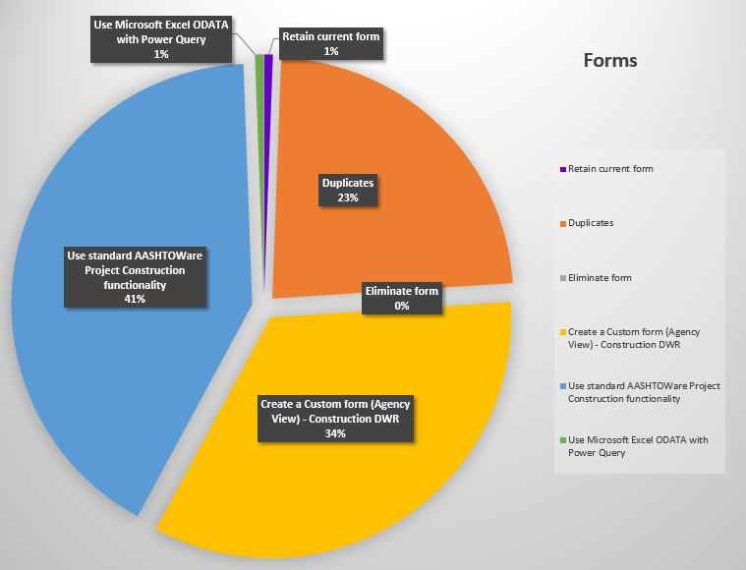
Efficiencies Identified
Forms
  229 current forms
    40 duplicates or variations
  131 proposed forms
  -----------------
  43% reduction

Slide 45
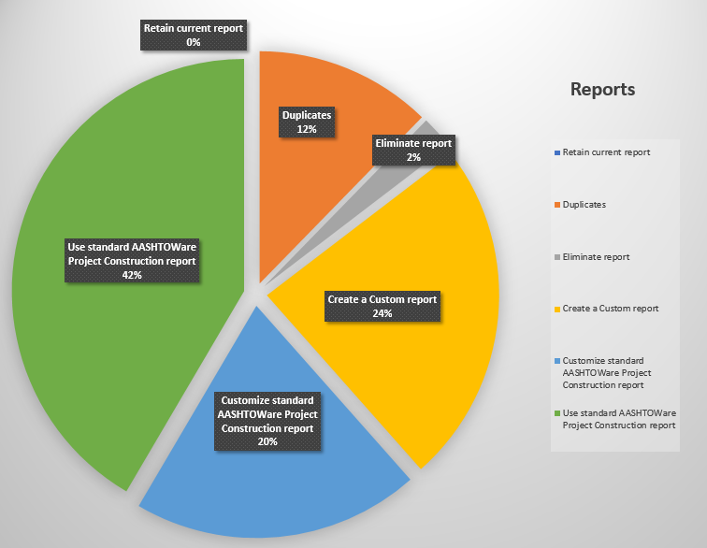
Efficiencies Identified
Reports
  140 current reports
    16 duplicates or variations
  111 proposed reports
  ------------------
  20% reduction

Slide 46
Overarching Benefits
Continuity of a unified database, inclusion of the Preconstruction™ Module, and subsequent Civil Rights & Labor™ and Materials™ modules
Reduction of the number of interfaces, forms, and reports
Streamlined data access to AASHTOWare Project Construction™ and Masterworks

Slide 47
Overarching Benefits
DWR Agency Views for simplifying quantity calculations
Agency Views capacity to extend capturing data and leverage for reporting, computations, workflows, notifications and other conventions
Standardization of WisDOT’s construction and contract administration user-base for best practices and uniformity

Slide 48
Overarching Benefits
External access for contractors to manage tasks, respond to items, and generate their own reports eases the burden for WisDOT
Highly configurable for expansion and growth into the future as new requirements evolve
Integration of Mobile Inspector™ for DWRs

Slide 49
Overarching Benefits
Compliance in WisDOT’s continued eConstruction goals and objectives
Optimal change management opportunity to slowly transition staff into the new software using Construction first, then Materials
Increased IT efficiency in administration and maintenance of fewer systems, interfaces, and peripheral applications

Slide 50
AASHTOWare Project (AWP) Construction
  Schedule
    Identify emerging needs to incorporate in AWP Construction – Currently
    Configure application – Spring/Summer 2018
    Test and pilot new configurations - Summer/Fall 2018
    Be trained as trainers - Fall 2018/Winter 2018
    Help with production roll-out – Spring/Summer 2019

Slide 51
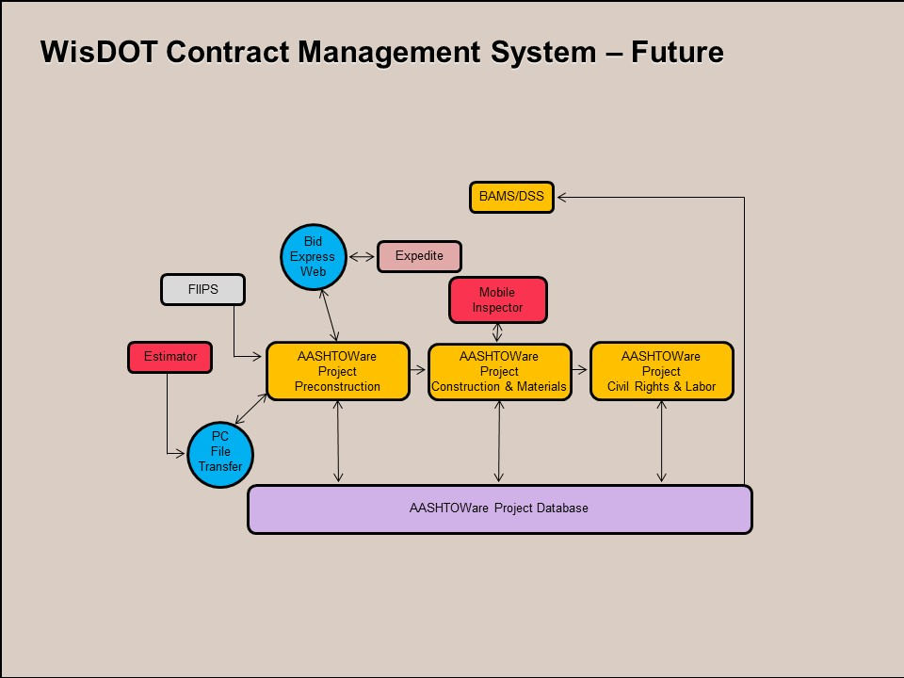

Slide 52
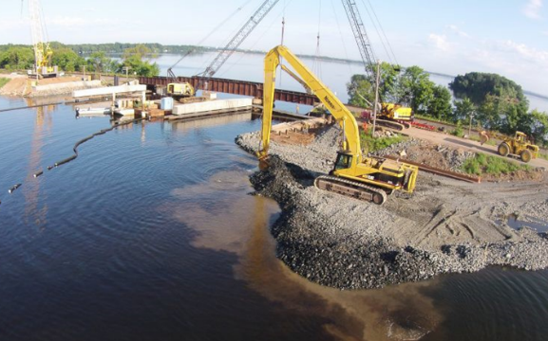

Outstanding Highway Construction Awards
Winner, Grading Category
NW Region Local Program
CTH X, Lake Wissota Bridge, Chippewa County

