Slide 1
Regional Incident Management Coordinator (RIMC) Field Training
Part 1
Section 1: RIMC Program Review
Notes:
Regional Incident Management Coordinator Field Training
Introduction slide to Part 1, Section 1:
Reference Materials List:
Trainer materials:
RIMC Field Training Attendance Record
Training Evaluation Document
Trainer handouts: Page:
RIMC Scenario Matrix 7
(12) – RIMC Scenario Matrix documents 7
Emergency Traffic Control & Scene Management – Quick
Reference (TIMA) 8
RIMC Response Log (Blank) 19
Version 1.2, Revised April 2018

Slide 2
Learning Objectives
At the conclusion of this training, the RIMC will gain practical application and exposure to:
Identifying the 4 key components of a RIMC response:
  Evaluate/Assess
  Respond/Coordinate
  Communicate
  Document
Understand the RIMC’s role in evaluating and sizing up different incident types and response strategies
Understand the importance of communication for situational awareness and verification of significant incident types
The importance of incident response documentation
Notes:
Learning Objectives
Trainers Guidance:
All incident responses are different but have the same key components to a greater or lesser degree
The four key components will be emphasized and discussed in detail throughout the training, including through the three scenarios
Communication is key to a successful or failed incident response
Documentation is critical to reviewing and improving response practices and protocols, as well as recording feedback on lessons learned that can be used for ongoing RIMC training
Transition to next slide: Let’s start with a little background

Slide 3
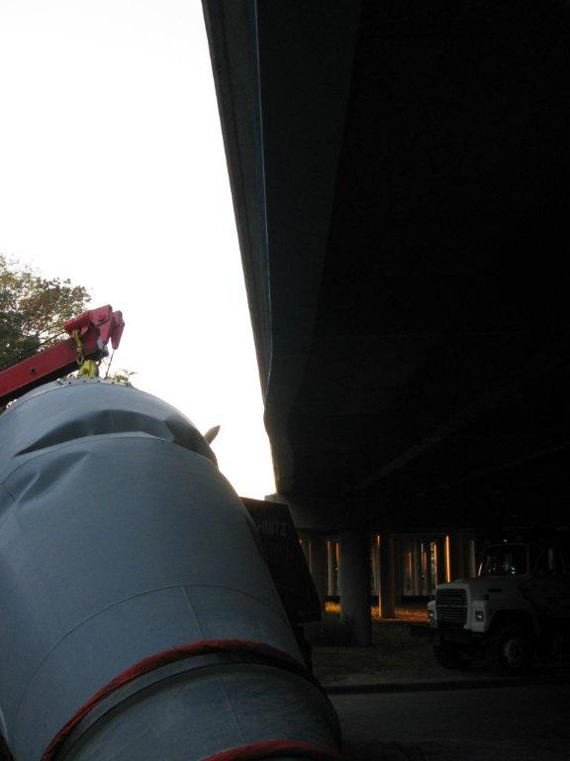
Significant Incident Notification Process (SINP)
History
Implemented May 2006
Established single point of contact through 1-800 number to the Statewide Traffic Operation Center
Ensures 24/7 service
Notes:
SINP HISTORY
Trainer Guidance:
In May of 2006, WisDOT implemented the Statewide Incident Notification Process (SINP)
Established a single point of contact through 1-800 number
Ensures 24/7 service by directing 1-800 calls to the Statewide Traffic Operation Center (TMC)
Transition to next slide: What is the purpose of the SINP?

Slide 4
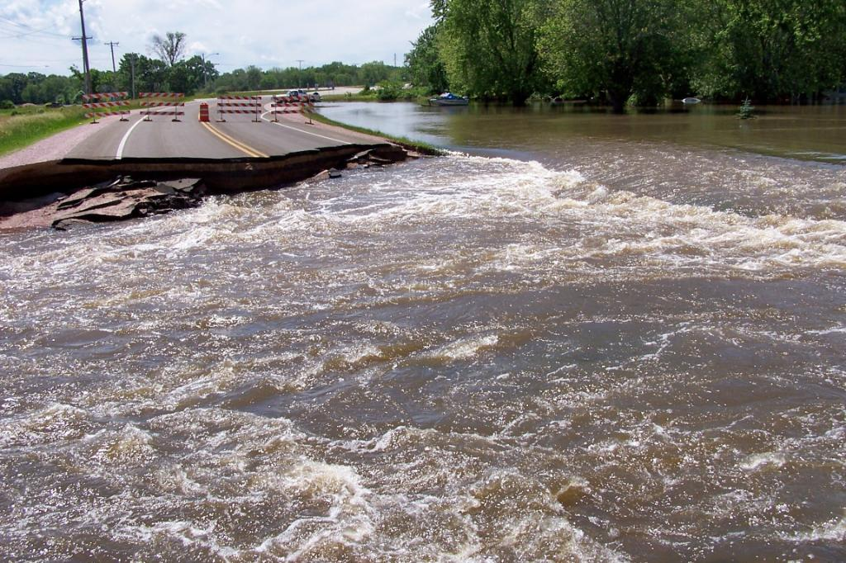
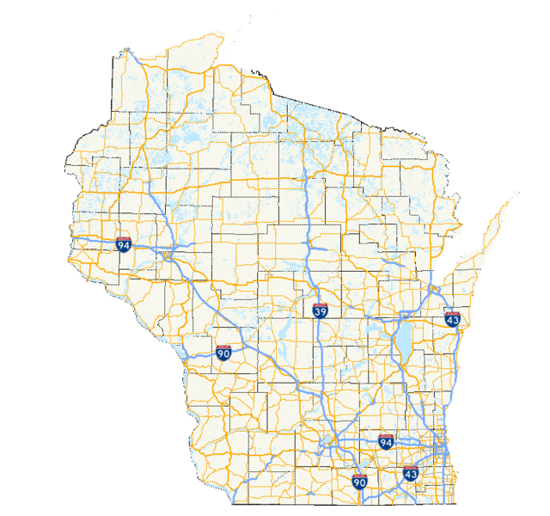
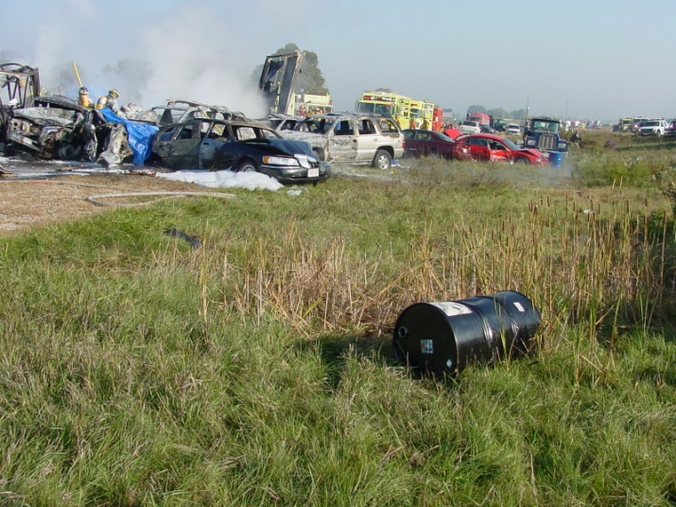
Significant Incident Notification Process (SINP)
Purpose:
To provide law enforcement agencies and highway departments a mechanism for
reporting:
INFRASTRUCTURE PROBLEMS
ON STATE HIGHWAY NETWORK
INCIDENTS
Notes:
SINP Purpose:
Trainer Guidance:
To provide law enforcement agencies and highway departments a mechanism for reporting transportation infrastructure problems and traffic incidents that occur on the state highway network
Connects all 72 counties directly to DTSD
SINP provides consistent notification and response procedures between regions
SINP allows for tracking of incidents and needed resources statewide in one location, which makes the process much easier and streamlined
Reduced work load of DTSD call out duties from Wisconsin State Patrol dispatchers
SINP provides better notification to local transportation stakeholders
Transition to next slide: SINP required that a WisDOT responder be available any time, night or day

Slide 5


Significant Incident Notification Process (SINP)
SINP created the on-call Regional Incident Management Coordinator (RIMC) position to provide 24/7 response capabilities to incoming calls
Notes:
SINP Process
Trainer Guidance:
One such example: Pre-SINP, each State Patrol dispatch center was provided an on-call list of electricians so dispatch could make 24/7 call outs for service. This process made documentation and accountability difficult for DTSD.
Now, because of the SINP, we can capture the type of incidents electricians respond to.
We can also capture the duration and type of incidents RIMCs respond to, which allows for after action reviews and documentation of best practices.
Transition to next slide: Let’s look at the RIMC’s role in the SINP

Slide 6

Overview of RIMC Role
RIMCs serve as WisDOT’s first responder
and agency representative involving
incidents on the state highway network,
from beginning to end.
Notes:
Overview of RIMC Role
Trainer Guidance:
RIMCs serve as WisDOT’s first responder and point of contact for incidents
RIMC is a backup contact for on-call electrician
RIMCs provide on-scene response support to public safety first responders
The traffic operations goal is to maintain a safe and efficient flow of traffic for the traveling public
Transition to next slide: To fulfill this role, RIMCs are expected to evaluate, respond, coordinate resources, communicate and document to perform scene incident management. A matrix has been developed to assist the RIMC in responding to incidents.

Slide 7
RIMC Scenario Matrix
Bridge Issues
  Strike, Collapse, Lift Bridge
Miscellaneous Incidents
  Fire/Smoke Over Roadway
  Maintenance/Work Zone Incidents
  Severe Traffic Backups (3 miles or more)
Responding to Incidents Caused by Weather Impacts
  Flooding
    Bridge Issue, Roadway Collapse or Washout, Water Over Roadway
  Tornado, Straight-line Wind Damage
Roadway Damage/Incident
  Crash
  Culvert Failure
  Pavement Buckling/Pavement Failure
Type I Signs
  Guide Sign (Big Green) Specific Information Sign (SIS) – Knockdown or Damage
Notes:
RIMC Scenario Matrix
Trainers Guidance:
Review RIMC Scenario Matrix in RIMC Field Guide
Matrix is broken down into 12 scenarios within 5 categories and 4 Key components:
Evaluate/Assess
Response/Coordinate
Communicate
Document
Each of the 4 key components provides suggested guidance for each of the 12 scenarios
Not all of the suggestions listed are relevant to each scenario (Explain the “X”s in the matrix)
Transition to next slide: Next we are going to talk in depth on the 4 key components of the matrix and how they fit into RIMC response expectations
Trainer handouts:
RIMC Scenario Matrix
(12) – RIMC Scenario Matrix Documents

Slide 8
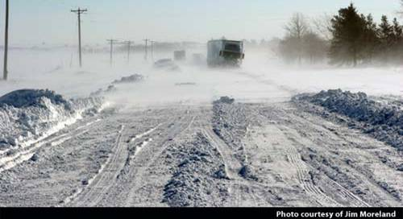
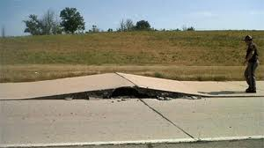
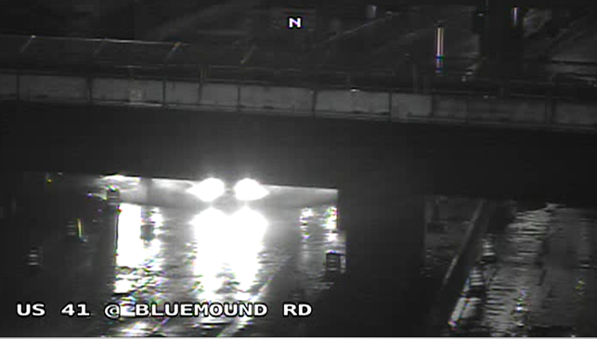
RIMC Response Expectations
Evaluate/Assess
Impacts to infrastructure
Existing traffic control measures
Incident duration
Need for RDO notification - Significant Incident
Availability of county highway resources
Weather conditions
Notes:
RIMC Response Expectations: Evaluate/Assess
Trainer Guidance:
Evaluate incident response scope and needs
Ensures proper traffic control measures and Traffic Incident Management Area (TIMA) are in place
The Evaluate/Assess suggestions list in the RIMC Scenario Matrix is not all inclusive
Transition to next slide: RIMCs must utilize the information they have gathered to determine proper response and needed coordination efforts
Trainer handout:
Emergency Traffic Control and Scene Management Guidelines – (TIMA)

Slide 9


RIMC Response Expectations
Respond/Coordinate
To provide DTSD response support to public safety first responders
Remain involved until the incident is completely resolved
Coordinate with Incident Commander (IC) traffic control strategies
  TIMA, detours, lane closures, alternate routes
Coordinate with county highway department
  Infrastructure repairs, flagging operations, clean up, traffic control equipment
Deploy Intelligent Transportation System (ITS) equipment
  Portable Changeable Message Signs (PCMS), Closed Circuit TV (CCTV)
Coordinate contractor response and resources if needed
Contractor
Notes:
RIMC Response Expectations: Respond/Coordinate
Trainer Guidance:
RIMC is expected to provide response support and coordination of any needed resources for all the incidents they are called for
Discuss the Response/Coordinate list in the RIMC Scenario Matrix
This list of suggestions is not all inclusive
Transition to next slide: Just as important as coordinating resources and helping to manage a scene is making sure to communicate and document what is happening at the scene

Slide 10
RIMC Response Expectations
Communicate and Document
Communicate with the Incident Commander (IC) frequently throughout the incident
Communicate timely and accurate incident status/updates to RDO, TMC, DSP and others as needed
Monitor Traffic Incident Alerts (TIAs), public communications and other incident information
Provide public information as directed
Document incident response and all communications throughout the duration of the incident
Notes:
RIMC Response Expectations: Communicate and Document
Trainer Guidance:
RIMC’s incident status updates create situational awareness on all levels, internal and external
Monitor Traffic Incident Alerts (TIAs) issued by DSP and TMC, public communications and other incident information for accuracy and additional situational awareness
RIMCs provide real time and accurate traffic information to TMC operators for 511 travel information, TIAs, OSOW, LCS, etc.
Document an accurate log/timeline to reflect all response and communications that transpire throughout the incident from beginning to end
Transition to next slide: The RIMCs role in evaluating, responding, communicating and documenting are important not only in every-day incidents, the role may become even more important when a large-scale event occurs. These infrequent large scale incidents are also known as Emergency Transportation Operation (ETO) events, which escalate the RIMC role above the normal RIMC response.

Slide 11
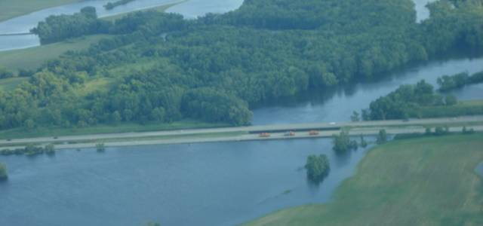
Emergency Transportation Operations (ETO) Plan
Notes:
Emergency Transportation Operations (ETO) Plan
Trainer Guidance:
The ETO Plan:
Provides a framework that supports training and programs for response to incidents and emergency events
Provides guidance and support to DOT initial responders
Engages multiple disciplines
Aids transportation of commerce
Supports ICS principles

Slide 12
What is Emergency Transportation Operations (ETO) Plan?
2016 Administrative Approved Terminology
(ETO) Plan is a formal, coordinated, integrated and performance-oriented approach to managing transportation system resources during incidents and emergency events. Emergency transportation operations constitutes a continuum of efforts that are defined in WisDOT’s ETO Plan. The Plan provides a comprehensive framework of guidelines, procedures, and processes in support of incident response strategies to maintain a safe and efficient flow of traffic, preserve infrastructure integrity, facilitate communication and coordination and provide on-scene response support to public safety first responders and the traveling public during incidents and emergency events.
Notes:
What is Emergency Transportation Operations (ETO)?
Trainers Guidance:
Read or summarize slide
Transition to next slide: Let’s look how the ETO Plan fits into the ETO and TIME Programs

Slide 13
Emergency Transportation Operations (ETO) Plan
Under the ETO Plan:
  Consists of the ETO Program
  Consists of the Traffic Incident Management Enhancement (TIME) Program

Slide 14
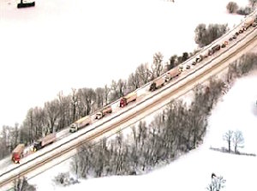
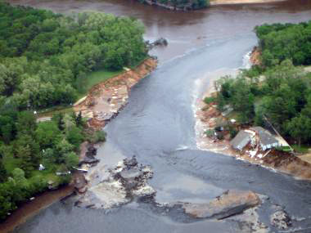
Emergency Event Program History
An emergency transportation operations
program began in 2008 as an
enhancement to WisDOT’s emergency
response capabilities:
Proactive planning for emergencies and inclement weather
The program created three on-call positions:
  WisDOT Highway Emergency Liaison Personnel (WisHELPer)
  Statewide Bureau Duty Officer (SWBDO) – retired in March 2018
  Regional Duty Office (RDO)
Notes:
Emergency Event Program History
Trainer Guidance:
WisDOT Highway Emergency Liaison Personnel (WisHELPer)
Staff position serves at the State Emergency Operations Center (ECO) when activated
Statewide Bureau Duty Officer (SWBDO) – retired in March 2018
On-call staff that are responsible for serving as a single point of contact for DTSD Statewide Bureaus in an emergency
Responsible for deploying Statewide Bureau resources during an emergency
SWBDO is the supervisor for the on-call WisHELPer
Regional Duty Officer (RDO)
The position of the RDO is staffed by Regional Directors and Section Chiefs
On-call, 24/7 management point of contact
Transition to next slide: In the next slides we are going to talk about the dual roles, responsibilities and expectations the RDO has in incident management
.

Slide 15
Emergency Transportation Operations
15
Notes:
Emergency Transportation Operations
Trainers Guidance:
Minor Incident duration under 30 minutes
Examples include: Disabled vehicles, minor crashes and roadway debris
Intermediate Incident duration between 30 minutes and 2 hours
Examples include: Rollover or multi-vehicle crashes, crashes involving personal injury and truck or tractor-trailer crashes
Major Incident duration over 2 hours
Fatal crashes or incidents that require a crash investigation, incidents involving a hazardous materials spill, overturned truck or tractor-trailer and infrastructure damage
Major incidents can become Emergency Events
Transition to next slide: The ETO definition of an Emergency Event is…(click to next slide)

Slide 16
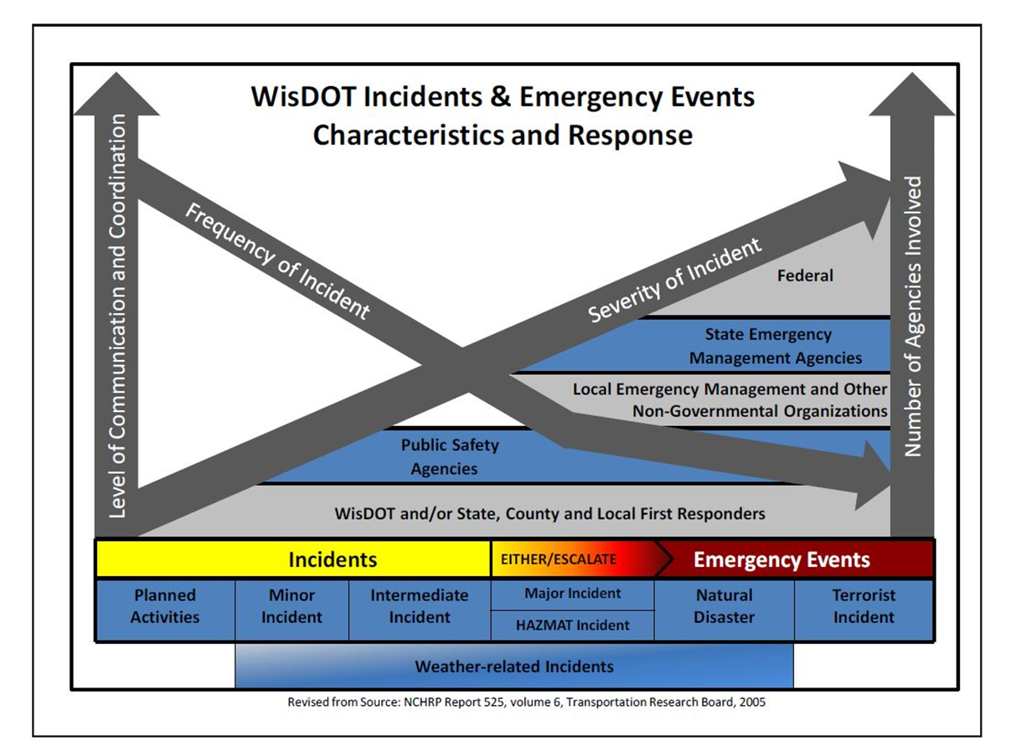
What is the ETO program?
Management of low frequency-high risk “emergency events” that impact our transportation system.

Slide 17
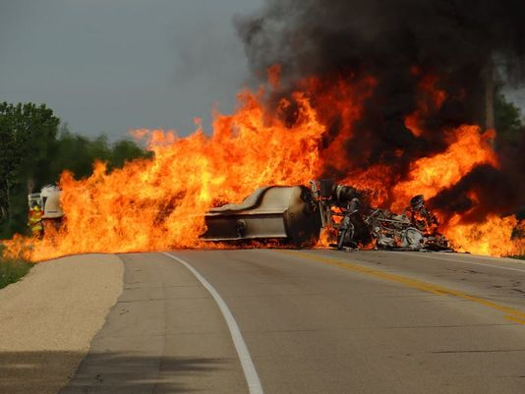
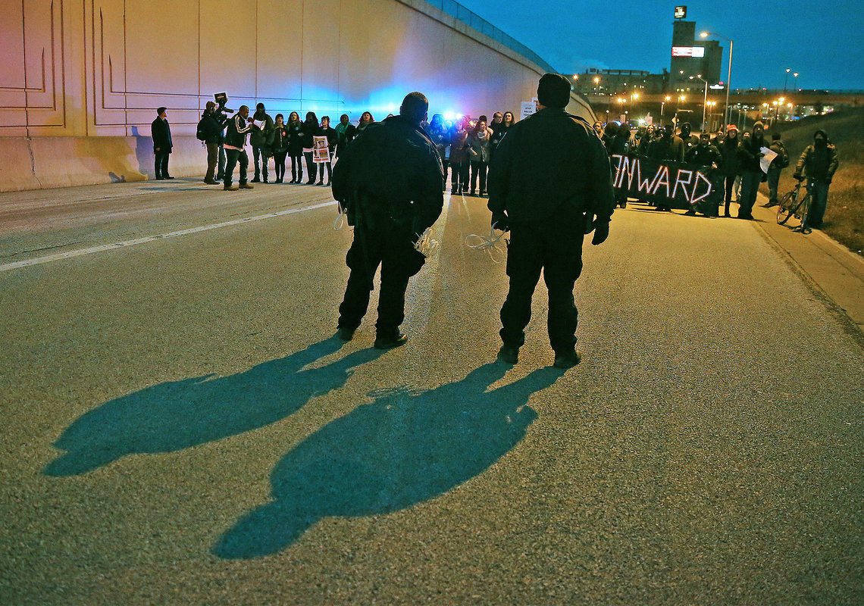
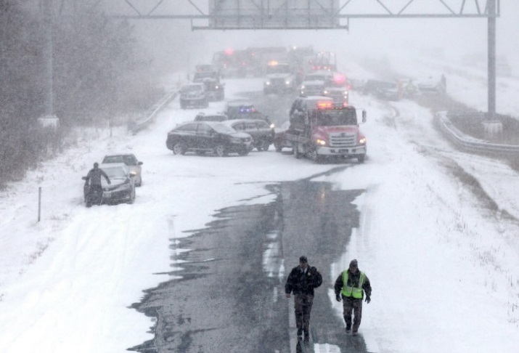
What is an Emergency Event?
An Emergency Event is an escalated incident that disrupts the normal flow of traffic on the Interstate system or state highway network that requires an extreme response beyond normal daily operating procedures/capabilities or an event that disrupts normal operations/capabilities of a WisDOT business facility.
Notes:
Emergency Event
Trainer Guidance:
Read definition
Transition to next slide: Some examples of Emergency Events are…(click to next slide)

Slide 18
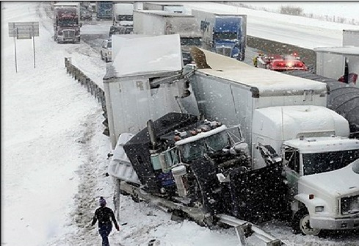
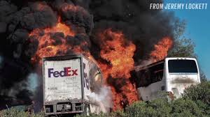
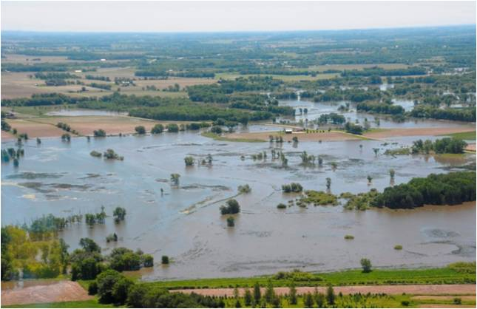
Emergency Event Examples
Traffic incident, e.g. crash, spill or major highway closure/blockage
Mass evacuation
Infrastructure-related incidents and failures
Natural disasters, e.g. severe weather event, tornado, flooding, fire, etc.
Facility or IT failure that disrupts operations and requires a response, potentially including activation of the Continuity of Operations Plan (COOP)
Notes:
Emergency Event Examples
Trainer Guidance:
February 5-6, 2008, I-39/90 Snowstorm
June 2008, WI Spring Flooding
2010 Zoo Interchange Structural Issue
2011 Groundhog Day Blizzard
December 19-21, 2012 Blizzard
July 2016 NCR and NWR and September 2016 SWR Flooding
Resource pictures: top = Ohio turnpike 3.12.2014, 3 killed, State Trooper seriously injured, 50 vehciles stretched over 10.2 miles in both directions, blowing snow and whiteout conditions
Middle = Orland, CA 4.10.2014, 10 killed, FedEx tractor trailer crossed median and struck tour bus, CHP and NTSB investigating
Bottom = Overview of Jefferson County 2008 flood

Slide 19
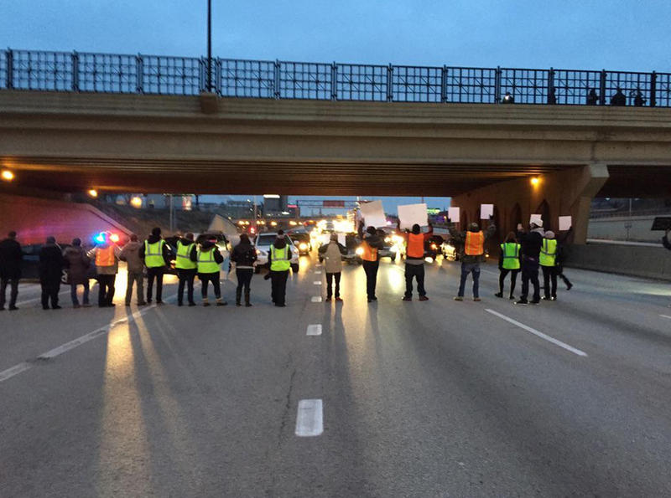
Emergency Event Examples (cont.)
Potential threat to safety of WisDOT employees
Act of terrorism or violence against employees or the transportation infrastructure
Pandemic or other public health crisis
Event requiring multi-division, inter- regional or statewide WisDOT response
Event is anticipated to last longer than one operational period
An Incident commander requests WisDOT involvement
Notes:
Emergency Event Examples Cont.
Trainer Guidance:
Emergency Events are not only weather, they can be events such as the blocking of traffic above, which occurred Friday December 9, 2014 at 4:30 PM (rush hour) in Milwaukee

Slide 20
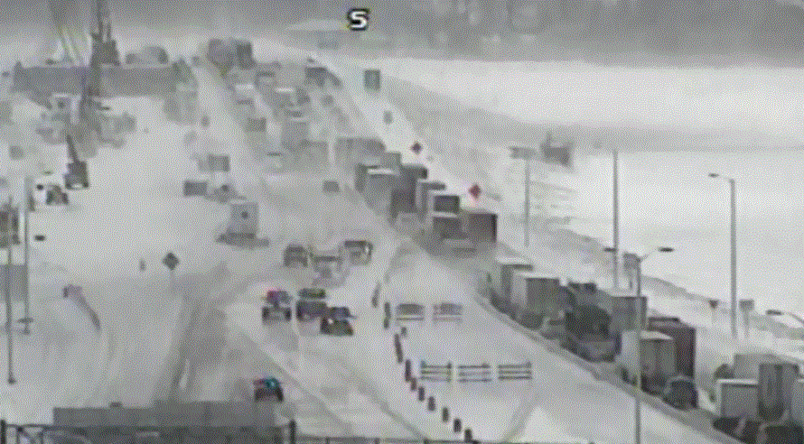
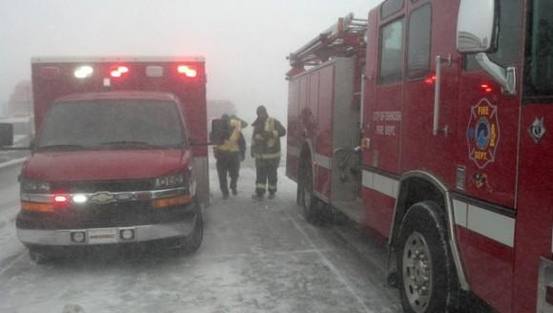
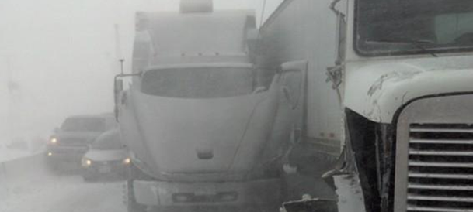
Emergency Event
Emergency Event response is required when:
An exceptional event disrupts the normal flow of traffic on the Interstate system or state highway network
An extreme response is necessary beyond normal daily operating procedures/ capabilities
  OR
An event disrupts normal operations/capabilities of a WisDOT business facility
Notes:
Emergency Event
Trainer Guidance:
Examples of past ETO events:
Iowa & Pennsylvania, Winter 2006/07
February 5-6, 2008, I-39/90 Snowstorm
June 2008, WI Spring Flooding
2010 Zoo Interchange Structural Issue
2011 Groundhog Day Blizzard
December 19-21, 2012 Blizzard
Transition to next slide: As you may know, events of this scale are infrequent. So why did WisDOT create the ETO program?

Slide 21
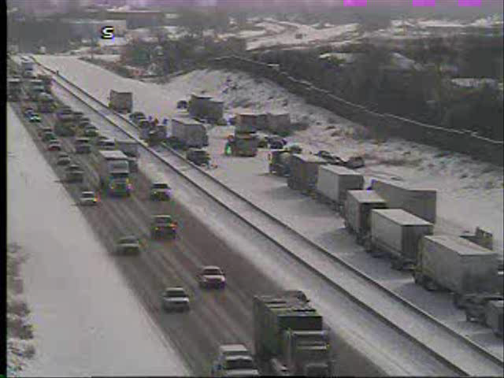
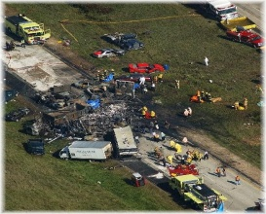
Emergency Event Activation Response
ICS based
Cross-divisional
Accountability through a continuous performance-based improvement process
Redundant communication procedures
Three general levels of Incident Command response: Local, Regional, Area/Statewide
Notes:
ETO Activation Response
Trainer Guidance:
Reference: Handout 6
Events requiring state level escalation, while in the minority, have the strongest potential to significantly impact safety, drain resources, and have the highest “visibility” in the eyes of the public
Transition to next slide: Now lets look at the Traffic Incident Management Enhancement (TIME) Program

Slide 22
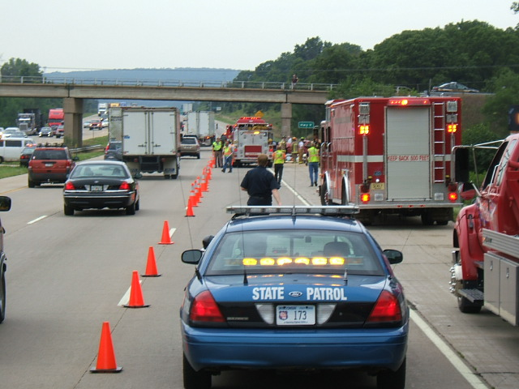
Wisconsin’s
Traffic Incident
Management Enhancement
(TIME) Program
National TIM Responder Training

Slide 23
What is the TIME program?
Management of high frequency-high risk “incidents” that impact our transportation system.

Slide 24
What is an Incident?
“Any non-recurring incident that causes a reduction of roadway capacity or an abnormal increase in demand."

Slide 25

Wisconsin TIME Program
What is TIME?
  Comprehensive multi-agency, multi-discipline program enacted by WisDOT
What is the Purpose of TIME
  Effectively and efficiently manage the response to traffic incidents to improve responder and motorist safety
  Minimize traffic and community impacts

Slide 26
Traffic Incident Management Enhancement (TIME) Program
TIME meetings are intended to provide public safety and transportation partners a regular forum for discussing TIM-related issues.
TIME meetings are conducted in each of the five WisDOT Regions to facilitate discussion, build relationships and promote a consistent program statewide.
Typical meeting topics
  TIME Program initiatives
  Special events/construction updates
  Incident debriefings
  Practical applications of WisDOT’s Emergency Traffic Control and Scene Management Guidelines: Good Practice or Lesson Learned
  What’s new in Traffic Incident Management?
Notes:
Traffic Incident Management Enhancement (TIME) Program
Trainer Guidance:
What TIME is:
TIM Coalition
Traffic Control Scene Management Guidelines
Regional TIM meetings, 20 meetings in the five DOT regions for 2018
AARs
Legislation:
Move Over law
Steer It Clear it

Slide 27

Overview: RDO/RIMC/Operational Supervisor Roles
RDOs serve as the on-call DTSD management point of contact for each region and supervise, advise and support the on-call RIMC
  Regional Duty Officer position staffed by: Regional Directors and Section Chiefs
RIMCs serve as WisDOT’s initial responder and agency representative involving incidents on the state highway network, from beginning to end
  RIMCs position is staffed by: maintenance, traffic and bridge personnel
Operational Supervisor provide backup and perform on-call duties on behalf of the RDO and review, debrief and approve the RIMC eLogs
Notes:
Overview of RDO/RIMC/Operational Supervisor Roles
Trainer Guidance:
Regional Duty Officer (RDO) Role
RDO is responsible for providing situational awareness to upper management in the Region, Bureaus and Executive Office
Being readily available to provide direct incident oversight, supervision and guidance for RIMCs
Provide Significant Notification to the Administrator’s Office
Understand available resources and allocation of resources as needed
The RDO will also work with appropriate field staff to jointly evaluate the need to activate the ETO Plan and corresponding Department response
RIMCs Role
RIMCs serve as WisDOT’s initial responder and point of contact for incidents
RIMC is a backup contact for on-call electrician
RIMCs provide on-scene response support to public safety first responders
Maintain a safe and efficient flow of traffic for the traveling public
Operational Supervisor Role
Transition to next slide: Let’s look at each role further

Slide 28
Regional Duty Officer (RDO)
RDO’s Role and Responsibilities are:
To serve as the on-call DTSD management point of contact for each region
To supervise, advise and support the on-call RIMC
Notes:
Regional Duty Officer (RDO) Role
Trainer Guidance:
RDO is responsible for:
Providing situational awareness to upper management in the Region, Bureaus and Executive Office
Being readily available to provide direct incident oversight, supervision and guidance for RIMCs
Providing significant incident notification to the Administrator’s Office
Understanding available resources and allocation of resources as needed
The RDO will also work with appropriate field staff to jointly evaluate the need to activate the ETO Plan and corresponding Department response
Transition to next slide: An RDO may request assistance from another Operations staff position to perform their duties when necessary

Slide 29
RDO Response Responsibilities
Serves as supervisory support, 24/7, for on-call RIMC
  Must call RIMC back within 15 minutes
Serves as TMC communication backup for RIMC
  When TMC can’t reach the on-call RIMC
Ensures WisDOT/DTSD response
Maintains situation awareness of incident
Provides required Administrator’s Office notification for Significant Incidents that meet trigger points
Authorizes and secures additional resources
Elevates an incident to a higher response level when warranted
Notes:
RDO Response Expectations
Trainer Guidance:
Reference: RIMC Response Guidelines page 17
Transition to next slide: An RDO may request assistance from another Operations staff position to perform their duties when necessary

Slide 30
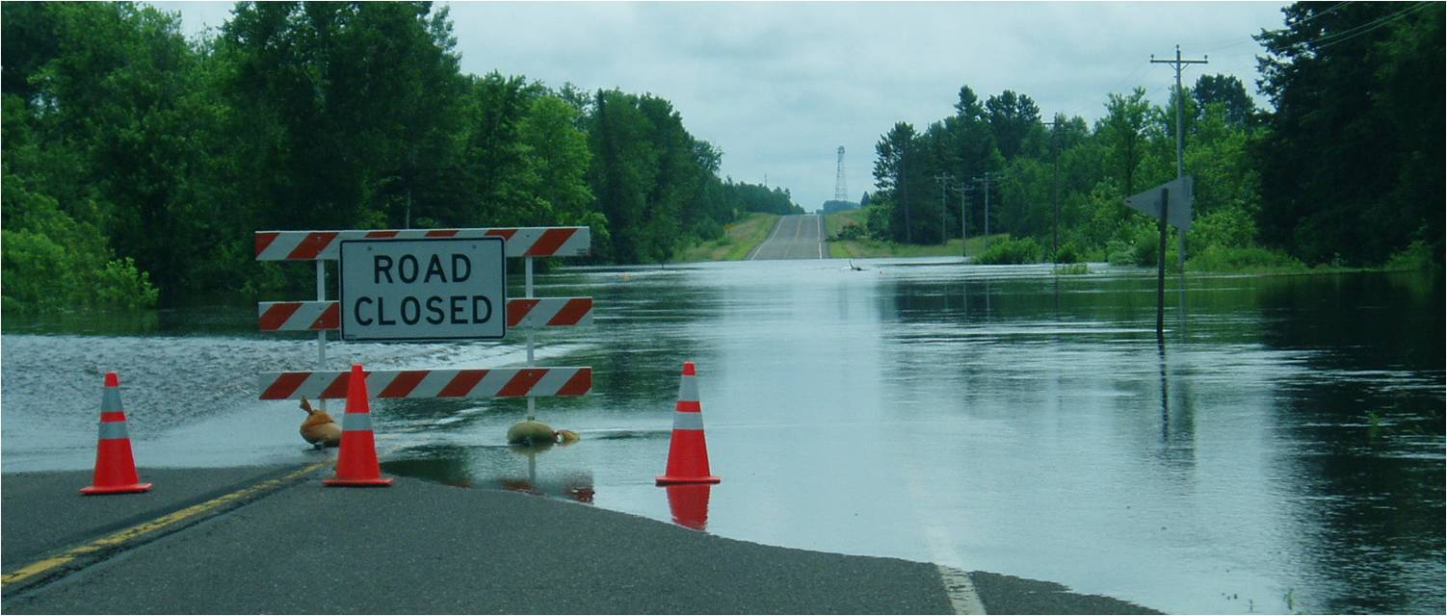
RDO Responsibilities for Emergency Events
Establish unified command with DSP
Coordinate development of a WisDOT Event Plan (201)
Facilitate planning and operational briefings
Coordinate with the Emergency Event Program Manager to ensure an after-action review is conducted
Notes:
RDO Responsibilities For Emergency Events
Transition to next slide: That’s a comprehensive list of what the RDO does – here’s a look at their overall response expectations

Slide 31

Operations Supervisor Roles and Responsibilities
  Provide backup and perform on-call RDO tasks on behalf of the RDO
  During business hours
  At times of critical need
  Stay in communication with the on-call RDO to provide situational awareness
Review/debrief and approve the RIMC logs
Schedule RIMC rotational on-call duties
  For regional offices
  Managing schedule conflicts for on-call availability
Schedule and facilitate TIME After Action Reviews (AARs)
Notes:
Operations Supervisor Roles and Responsibilities
Trainer Guidance:
Some, not all, operational supervisors in the Regions are specifically assigned the additional tasks of reviewing and approving RIMC logs and on-call schedules
The on-call RDO may designate a RIMC Supervisor to assist in the incident management process
The RIMC log review and approval process will:
Provide on-going real world training for both the experienced and new RIMC
Evaluate and document opportunities for improvements and best practices involved in the incident response
The review/debrief of RIMC log, with the RIMC, should include critical incident stress awareness and resources as needed
Review/debrief results can be shared in the weekly incident management teleconferences held with the DTSD and DSP management teams
Supervisor is responsible for reviewing and approval of the RIMC log and for supporting and providing guidance to the mentoring/shadowing program, which we will talk about later
Transition to next slide: The Operational Supervisors expectations are…

Slide 32
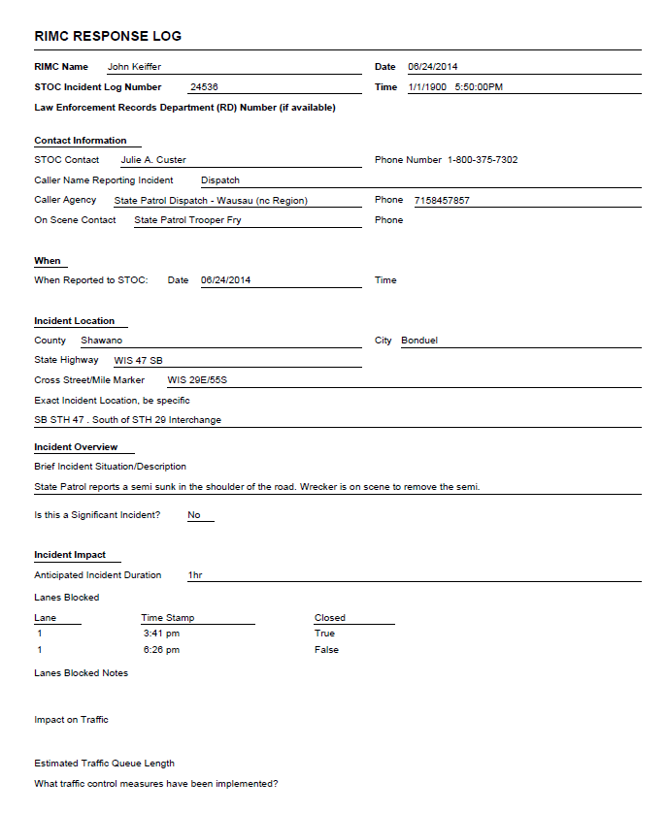
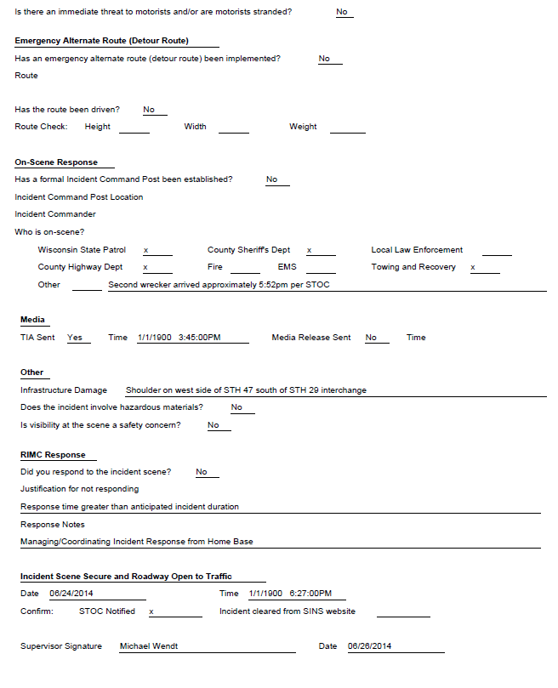
Operations Supervisor Expectations
Attend RIMC/RDO Basic Training, ICS and other required training
Attend Monday morning teleconferences with TMC and DSP
  Designee may be assigned
Review and approve RIMC E-Log or paper log with the RIMC in a timely manner
  Review should take place in the beginning of the week following the RIMC log submission
Notes:
Operations Supervisor Expectations
Trainer Guidance:
All Regional supervisor’s roles are different, depending on the size and makeup of each individual region
Transition to next slide: Here are some basic roles of other responders
Trainer Handout:
RIMC Response Log

Slide 33
Roles of Other Responders
Incident Commander
  Person in overall charge of an incident
  May be the first person on scene
  Usually law enforcement or fire
County Highway Department
  Traffic control setup and traffic control device deployment
    Highway closure authority
  Plowing efforts
  Flagging
  Incident clean up and maintenance
  Infrastructure repair
Law Enforcement
  Life safety and scene stabilization
  Evidence preservation
  Crash reconstruction
  Hazmat (DNR warden)
  Initial traffic control setup
    Highway closure authority
Fire and Rescue
  Life safety and scene stabilization
  Preservation of property
  Emergency rescue response
    Extrication
  Hazmat response
  Evacuation
Notes:
Roles of Other Responders
Trainer Guidance:
In most incidents there is no identified incident commander, but rather the incident is managed through a coordinated effort or unified command:
Fire and law enforcement
RIMC and law enforcement
RIMC and fire
RIMC and county highway
Law enforcement and county highway
Fire, law enforcement, RIMC
County’s primary role is a support role for law enforcement and RIMCs
Law enforcement role is primarily life safety and scene stabilization
Fire tends to be more ICS oriented and focuses most on life safety, property preservation and hazmat
Transition to next slide: Now that we’ve defined the expectations of RIMCs, RDOs, Supervisors and others, we’ll discuss how the RIMC program is structured and the tools RIMC’s have at their disposal

Slide 34
Regional Incident Management Coordinator (RIMC) Field Training
Part 1
Section 2: Regional Structure and Tools
Notes:
Introduction slide to RIMC Field Training Part 1, Section 2:
Reference Materials List:
Trainer handouts: Page
DTSD Call Back and Standby Policy 23
WisDOT/DTSD RIMC Team Structure Document 24
Contact References 29
iPad Overview Document 30
Emergency Hazardous Response – Quick Reference 32
Incident Response Reference Guide 32
Ramp Gate Utilization – Quick Reference 32
Cisco VPN Client User Guide 33

Slide 35
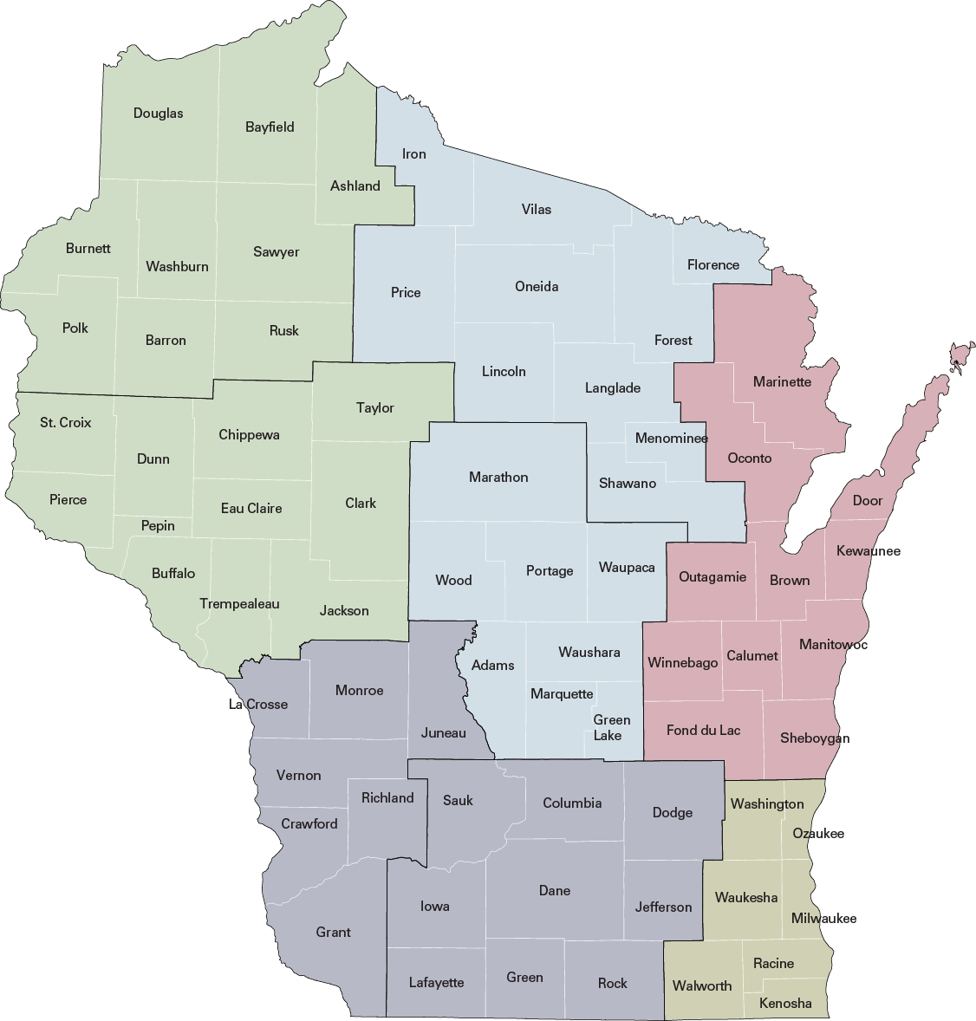
Regional RIMC Teams
  Each of the (8) WisDOT regional offices has its own RIMC Team
  Each regional office has a RIMC on-call 24/7
NC Region
Rhinelander
Wisconsin Rapids
NW Region
Superior
Eau Claire
NE Region
Green Bay
SW Region
La Crosse
Madison
SE Region
Waukesha
Notes:
Regional RIMC Teams
Trainer Guidance:
WisDOT has five regions, eight regional offices
Each regional office has its own RIMC Team made up of 8 to 10, possibly more, RIMCs
RIMC Teams share the responsibility of providing 24/7 response capabilities

Slide 36

Regional RIMC Teams
  RIMCs serve on-call for one full week on a rotational basis
  Frequency of on-call rotation varies by region
  DTSD Standby and on-call policies apply:
  *http://dotnet/dtsd/policies/standby.htm
Notes:
Regional RIMC Teams
Trainer Guidance:
RIMC serves on-call for one full week on a rotational basis with other RIMCs in the regional office
Frequency of rotation varies region to region depending on how many RIMCs there are, i.e. 8 RIMCs in a regional office would serve once every 2 months
RIMCs are compensated for being on-call and follow the DTSD policy
Refer RIMCs to the DTSD Standby and On-call Policy
Last updated May 8, 2014
NOTE:
Standby pay will be paid strictly on an hourly basis at a rate of $2.25/hr when
the appointing authority requires an employee be available for work and be able to report to work in less than one hour or have the ability to work from any location (i.e., computer login access), are covering as an “on-call” expert without the necessity of returning to a specific job site or DOT location
Employees are not eligible for standby pay during the time they are back in “work status”
Transition to next slide: Lets look at team structure, schedules, protocols, resources and responsibilities as this varies by region
Trainer Handout:
DTSD Call Back and Standby Policy

Slide 37
Team Structure and Schedule Protocols
Team Structure
Regional RIMC teams may consist of staff from different sections of the Operations Units:
  Bridge
  Maintenance/roadway
  Traffic
Schedule Protocols
Frequency of rotation
Schedule changes
Updating schedule on ETO repository
Time off
Rotational Hand-off Protocol
When/where do you hand-off RIMC communication equipment and resources
The time that hand-off is expected
Notes:
Team Structure and Schedule Protocols
Trainer Guidance:
The information for Team Structure should be provided as a handout
Handout content should include: (See “Team Structure” form in Reference Section, Trainer to populate with region specific information)
The names of the specific region/office RIMCs
Their corresponding unit, i.e. maintenance, traffic
DOT email address and phone numbers if available
Discuss the regional protocols for scheduling:
How often a RIMC will be on-call, i.e. once every 6 weeks
What the protocol is for the RIMC to request an on-call schedule change
What the RIMC should do if there is a conflict or an emergency need that is preventing the RIMC from performing the on-call duties
Does the RIMC need to contact someone in particular if switching with another RIMC
What is the procedure if the RIMC is scheduled at a time when he/she needs time off
Who updates the regional schedule on the ETO Repository
Discuss the regional protocol or expectations for turning over all RIMC response equipment and information to the next on-call RIMC
Transition to the next slide: Now that we have talked about region structure and scheduling, let’s look at RIMC resources
Trainer handout:
WisDOT/DTSD RIMC Team Structure Document

Slide 38
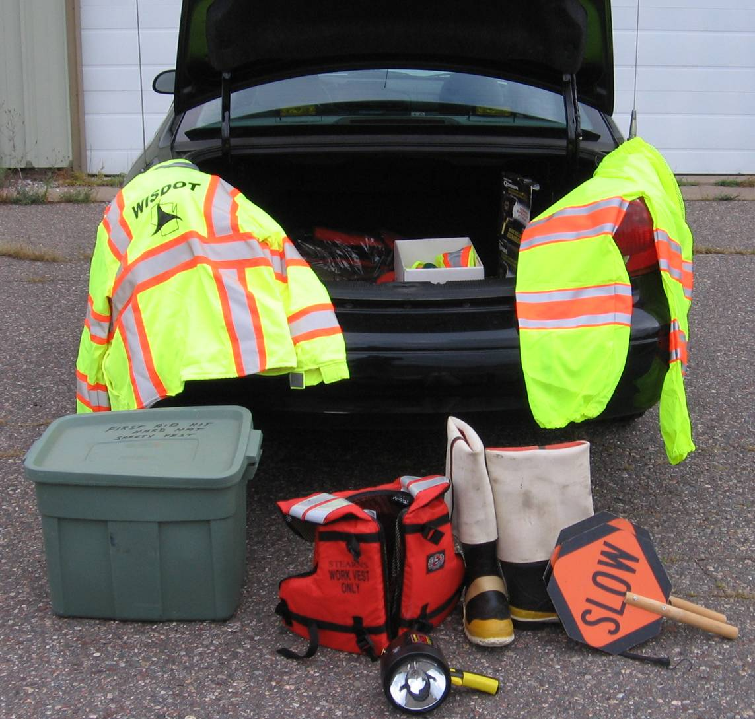
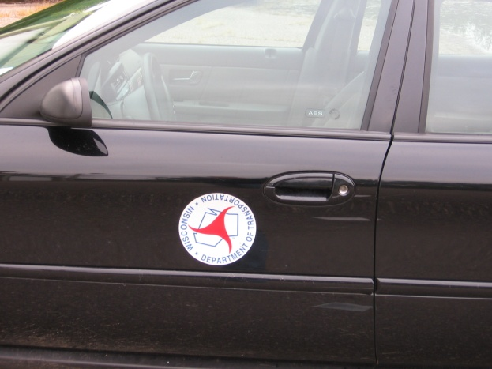
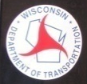
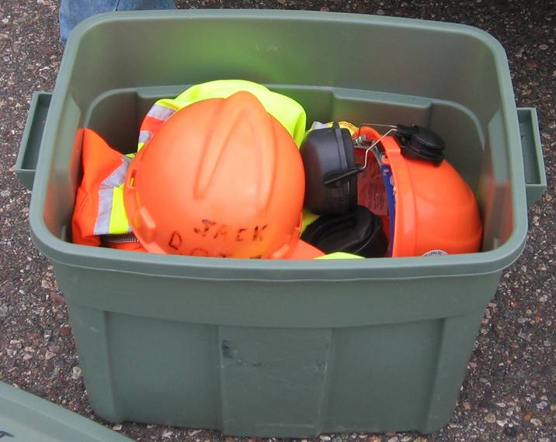
Resource Recommendations: RIMC Vehicle
Notes:
Resource Recommendations: RIMC Vehicle
Trainer Guidance:
Regional specifics should be considered
Review the standard list of equipment and resources a RIMC should have in their response vehicle:
Digital Measuring Instrument
2-way mutual aid radio
Fire extinguisher
Full waders
Hip waders
Life vest
Extra hard hat and high visibility safety apparel, including vests and pants
First aid kit
Flood light
Stop / Slow paddles
Field measuring devices – wheels / tapes
WisDOT Vehicle - Logo magnet
Strobe lights
Caution tape
Transition to next slide: You must also maintain a RIMC Response bag

Slide 39
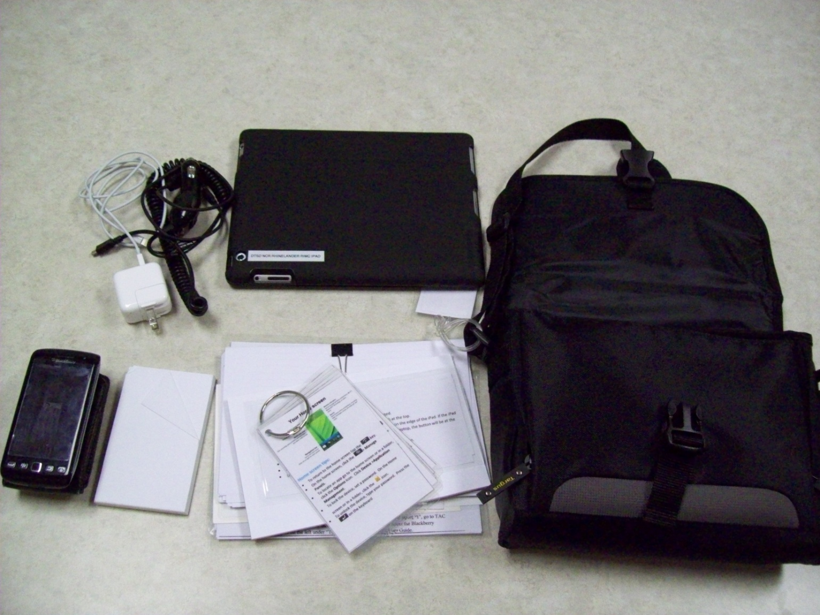
Resource Recommendations: RIMC Bag
Notes:
Resource Recommendations: RIMC Bag
Trainer Guidance:
Trainer should review the RIMC bag explaining its contents
With updated technology, there is less paperwork to carry. However hard copies of some documents are still recommended in case of power failure or no Internet access
This bag will vary region to region, but the basic items should be standard
It is expected that the items identified below be carried by the RIMC at all times:
WisDOT identification
Communication/computer equipment
Laptop and power supply
iPad w/power supplies
Phone w/power supply
RIMC Logs (paper copies)
State Map (paper copy)
Spare batteries for pertinent equipment
Key card to access office
Visor cards
Passwords and trouble shoot documents
RIMC Field Guide
Review region specific items RIMC is required to also have in bag
Trainer handout:
RIMC Field Guide

Slide 40


Electronic Resources
RIMC approved WisDOT devices
Refer to the WisDOT IT Policy and Procedures
  Transportation Administration Manual (TAM 112)
  http://dotnet/tam/docs/it101.docx
New apps or software require supervisor approval
    All iPad activity is monitored and geo-located
Notes:
Electronic Resources
Trainer Guidance:
Supervisory approval is required to download new apps or software to iPad or iPhone
Requests that will require a new cost will need budgetary approval using the Division’s process

Slide 41
RIMC Phone
Functions & Use
Basic protocols
  Lock, password
  E-mail
  Texting
  Pictures
  Downloading
Notes:
RIMC Phone
Trainer Guidance:
Review and demonstrate your region’s phone basic functions
It is important for the RIMC to try the password when the phone is handed off to make sure they are not locked out
Downloading may not be done without supervisory approval
Transition to next slide: Your phone should be pre-loaded with important information

Slide 42
Contacts and Resources
Recommended Contacts
E-mail addresses
  State
  Regional
Phone Numbers
  State
  Regional
Region Contacts
E-mail addresses
  Local
  Phone Numbers
  Local
Technical Support Available
  DOT Help Desk – 800-362-3050
  Hours of operation: 6:00 AM to 5:30 PM, Mon – Fri
  On-call 24/7 with a voice mail
Notes:
Contacts and Resources
Trainer Guidance:
Phone numbers will already be programmed into the RIMC phone, however it is important to look through the contact list to become familiar with what is in the phone
Hand out the recommended statewide contacts document and explain how to add contacts to the phone
Transition to next slide: An iPad is another electronic tool in the RIMC toolbox
Trainer handout:
Contact References document

Slide 43
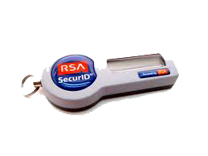

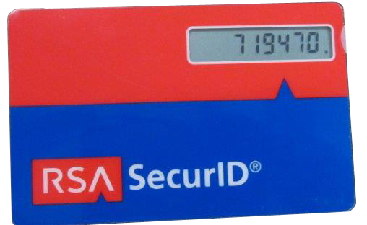
iPad Internet Access
Virtual Private Network (VPN)
Works on WisDOT VPN Client installed equipment anywhere you have Internet, cellular signal or Wi-Fi Hotspot
A secure ID and PIN number are required for access
If you don’t use your VPN within 6 months it is locked out
DOT Mobile
  No more hard tokens, but now a soft token on the desktop
  Used to connect to AD network and the internet
  DOT Mobile will only work in range of DOT offices
Notes:
iPad Internet Access
Trainer Guide:
VPN:
Used if out of range of DOT Mobile to connect to AD network
Cellular signal or Wi-Fi Hotspot can be used
Hand out Cisco VPN Client User Guide
Currently you cannot access Internet websites when you are using your VPN to connect to the WisDOT network
Transition to next slide: During on-call rotational hand-off, here are some reminders in passing along the equipment
Trainer handout:
Cisco VPN Client Use Guide

Slide 44
RIMC Rotational Hand-Off Reminders
Receiving:
  Make sure phone/iPad passwords match
  Log-on once with VPN after iPad is handed off to you to ensure proper operation
Hand-off:
  Make sure equipment is charged and ready for next RIMC
  Clear emails and texts before handing off phone and iPad
Notes:
RIMC Rotational Hand-Off Reminders
Trainer Guidance:
Remember VPN lockout happens after 6 months of no activity
Transition to next slide: Now that we have talked about the tools and resources available for a RIMC to perform incident management, let’s talk about incident response and protocols
Note: Good place to take a break

Slide 45
Regional Incident Management Coordinator (RIMC) Field Training
Part 1
Section 3: RIMC Incident Response
Notes:
Introduction slide for RIMC Field Training Part 1, Section 3:
Reference Materials List:
Trainer handouts: Page:
RDO Notification of Significant Incident (Administrator Office Notification) 44
DTSD Regional Lance Closure system (LCS) Priority Routes 44
RM_1_RIMC_eLog-24536 52
RM_2_SINS_58_24536 52
Trainer Guidance:
This section is about the RIMC’s responsibilities, protocols and expectations for incident response and how they integrate with the 4 key components from the RIMC Scenario Matrix
Transition to next slide: Before we start, lets discuss how and why TMC makes the decision to call out the RIMC, which goes back to the Significant Incident Notification Process

Slide 46
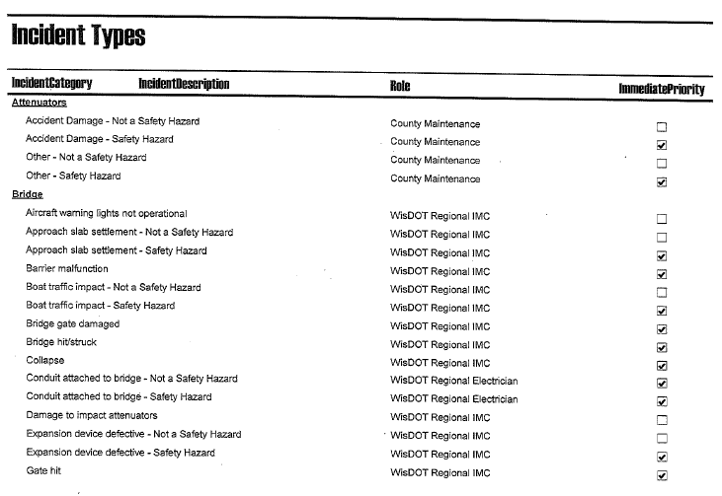
SINP Call-Out
(
(
TMC operators use the SINP incident notification and contact matrix
to properly handle a wide range of calls:
There are 2 incident priority responses:
  Immediate Priority
  Next Day priority
An Immediate Priority Call,
depending on category and
type, will require a call out:
  RIMC
  Electrician
  County Maintenance
Notes:
SINS Call-Out
Trainer Guidance:
The SINP Matrix includes 30 incident categories
i.e. bridges, signals, signing, traffic incidents, etc.
The categories are further broken down into Incident Types
i.e. bridge hit/struck, buckling, system ramp closure – 2 hours or longer, etc.
Each Incident Type has an assigned incident priority – there are 2 priorities:
Immediate Priority Call
Next Day Priority
The TMC operator follows the SINS protocol for calling out the RIMC:
Immediate Priority Calls
This requires the TMC operator to make an immediate call out to the RIMC, electrician or county maintenance
Next day priority
The TMC operator enters this incident in the computer data base, which is forwarded to the region to handle as soon as possible
Transition to next slide: Now we will get into the response protocols and responsibilities starting with the initial call

Slide 47

Initial RIMC Call-Out
(
(
Initial call from TMC to RIMC phone
Incident Occurs
TMC is notified
TMC Calls RIMC
RIMC chooses direct answer vs. voice mail
Be prepared to copy provided information
Ask for information if you don’t receive it
Notes:
Initial RIMC Call-Out
Trainer Guidance:
This is the beginning of the RIMC incident response process and the first of the 4 key components from the RIMC Scenario Matrix
Evaluate/Assess
When an incident occurs, the initial call will come from the TMC to the RIMC phone
The RIMC may choose to pick up right away, or let the call go to voice mail while they prepare to properly respond to the call
Ideally, RIMC would have a blank copy of the RIMC log or pen and paper next to bedside
Direct answer versus voice mail
Direct
Immediately answer phone – be prepared to copy
Be prepared to ask questions about the incident
Refer to a blank RIMC log for needed information
Voice Mail
Let call go to voice mail while you prepare to copy
Call the TMC back within 15 minutes
If TMC does not receive call back within 15 minutes, they will call you again
Be prepared to ask questions about the incident
Refer to a blank RIMC log for needed information
Transition to next slide: The RIMC will initially receive preliminary information from the TMC operators

Slide 48
TMC Initial Preliminary Information
(
(
TMC operators try to provide the RIMC with the following
information on the initial call-out:
SINS number
Incident location and quick synopsis of incident
Road closure and direction
Alternate route if known
Caller and call-back number/handling agency
Remember the TMC phone line is recorded!
The control room operators are a part of our entire team. Courtesy should go
both ways!
Notes:
TMC Initial Preliminary Information to RIMC
Trainer Guidance:
Not all callers/agencies will provide the TMC operator the above information
RIMC may not get all information needed initially from TMC operator, i.e. on-scene contact information
NOTE:
All control room phone lines are recorded
Random quality assurance checks are done regularly
Lines are subject to open record law
Transition to next slide: How to contact the on-scene person?

Slide 49
Establishing On-Scene Contact
(
(
Your first point of contact may be a dispatcher
  Identify yourself
  Ask for additional information
  Ask for the on-scene contact information
The on-scene contact may vary
  Law enforcement, incident commander, county highway department, DNR, etc.
Notes:
Establishing On-Scene Contact
Trainer Guidance:
RIMC will need to make a call to the initial caller, usually dispatch
Refer to a blank RIMC log and cover the needed information
REMINDER:
Do not use acronyms – your contact may not know what a RIMC is
Identify yourself as a Wisconsin Department of Transportation representative, not a RIMC
Transition to next slide: As a special note…

Slide 50
On-Scene Contact: Special Note
(
(
There will be times when the initial caller/agency will not provide you an on-scene number, if this occurs, you should request the initial caller/agency:
Have the on-scene contact call the RIMC back
Patch you through to the on-scene contact
Notes:
On-Scene Contact: Special Note
Trainer Guidance:
Some law enforcement agencies do not provide phones for their officers
Often law enforcement can’t/won’t take a call until they have the scene stable and secure
Transition to next slide: On-scene contact communication

Slide 51
On-Scene Contact Communication
(
(
Get as much information as possible to evaluate and assess:
  Incident scope and severity
  Anticipated incident duration
  Traffic impacts for traffic control strategy
  Infrastructure damage
Why is this important?
  Provide situational awareness
  WisDOT DTSD resource management (County Highway Department)
  Mitigate traffic impacts and queues
Notes:
On-Scene Contact Communication
Trainer Guidance:
RIMC will evaluate and determine how to respond to the incident
If on-scene contact requests field response, RIMC shall go out and coordinate with the on-scene person
Ask where to meet
Ask how to approach the scene
Provide an estimated time of arrival (ETA)
Once the on-scene contact is established and the scope of the incident and needed resources are determined
The RIMC may need to contact the county highway department for additional resources
The RIMC needs to determine if the incident meets the criteria for RDO notification of a Significant Incident
Transition to next slide: Next slides will discuss the contact of the county highway and the RDO Significant Incident Notification criteria
Trainer handouts:
Administrator Office Notification Guidelines (RDO Notification of Significant Incident)

Slide 52
Contacting County Highway Department
(
(
Contacting county highway department on-call personnel
  Sheriff’s departments usually have access to this information
  You can ask the Sheriff’s department dispatch to have the county highway department contact you
  Remember to document your information for the RIMC log
Notes:
Contacting County Highway Department
Trainer Guidance:
To contact the county highway department after hours, use above guidance
Identify and coordinate with county highway for resources such as:
Flagging, signs, county highway department’s resources, plowing, etc.
Transition to next slide: Now let’s look at process and criteria for an RDO notification of a Significant Incident

Slide 53
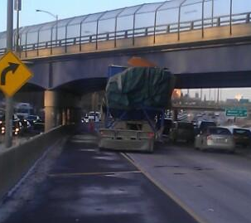
RDO Notification for Significant Incidents
(
(
The RIMC is required to contact the RDO for any incident that meets
the criteria of a significant incident
Significant Incident
Notes:
RDO Notification for Significant Incidents
Trainer Guidance:
Criteria for RDO notification are found in the document called Administrator Office Notification Guidelines
Refer RIMC to Administrator Office Notification Guidelines in RIMC Field Guide and review the criteria
Transition to next slide: Next is a picture of the guidelines, let’s look at the criteria in the notification document in the RIMC Field Guide

Slide 54
Significant Incident Criteria for RDO Notification
Notes:
Significant Incident Criteria for RDO Notification: Administrator Office Notification Guidelines
Trainer Guidance:
The criteria are a list of minimum thresholds and should not be considered all inclusive
RIMCs need to use reasonable judgment and engineering expertise to determine when an incident goes beyond the criteria
When in doubt contact the RDO
Review the expectations and responsibilities on the bottom of the Administrator Office Notification Guidelines
RIMCs need to understand their importance in the notification to the RDO
This document was reviewed and approved by the WisDOT Secretary’s and DTSD Administrator’s Offices July 3, 2014
Transition to next slide: Now let’s look at the ways a RIMC responds to an incident
Trainer handouts:
Administrator Office Notification Guidelines
DTSD Regional Lane Closure System (LCS) Priority Routes

Slide 55

Three Ways To Respond
  Field
  Home
  Office
Notes:
Three Ways To Respond
Transition to next slide: Let’s look at the RIMC expectations for the three ways of responding

Slide 56

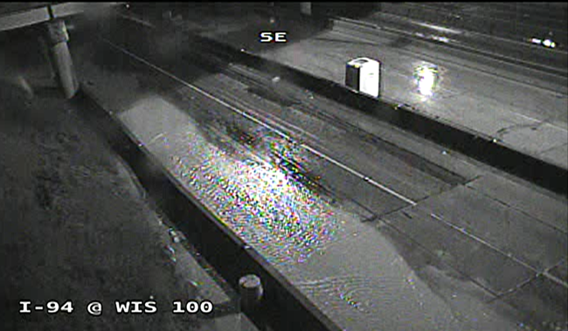
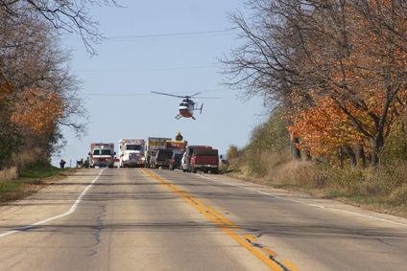
RIMC Response Expectations
RIMC guidance on how to respond to an incident
Notes:
RIMC Response Expectations
Trainer Guidance:
There are three ways to respond to an incident depending on its scope and duration:
Field, Home, Office
RIMCs may use a combination of the three
The RIMC’s decision on the way to respond, field, home, office or combination of the three, is based upon all available information and engineering judgment
When in doubt, go out!
Transition to next slide: The next series of slides will go into detail on RIMC response expectations for each of the three ways

Slide 57
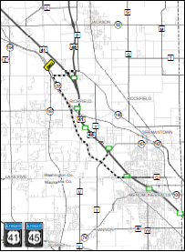
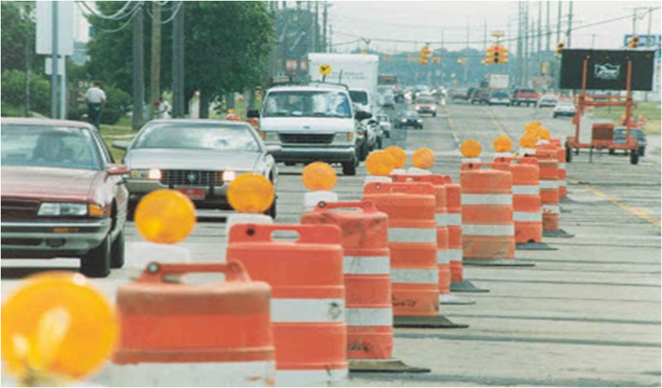
Field Response Expectations
Pre-Arrival
Drive and review the traffic control and/or alternate route before on-scene arrival
Be prepared to offer the on-scene contact:
  Suggestions for a revised alternate route
  Traffic control set up improvements
Notes:
Field Response Expectations
Trainer Guidance:
Obtain situational awareness of:
Alternative route
Traffic Incident Management Area (TIMA)
Traffic queuing
Secondary incidents
Deployment of PCMS, DMS, etc.
Be prepared to advise Incident Commander or on-scene contact from your pre-arrival review as to what resources could be deployed and how you can assist with scene management
Cones, barricades and county highway department flagging resources, etc.

Slide 58
Field Response Expectations Cont.
Scene Arrival
Always respond with proper identification
Report to on-scene contact or Incident Command (IC)
Meet at established location
Ensure you are arriving close to estimated time of arrival (ETA)
Advise the TMC when you are on scene
Notes:
Field Response Expectations Cont.
Trainer Guidance:
When you arrive on scene:
Follow Incident Command System (ICS) principles
Report to Incident Command post or Incident Commander (IC)
Brief IC or designee on pre-arrival assessment and recommendations
If IC is busy or has not been identified, make contact with person in charge of the incident

Slide 59
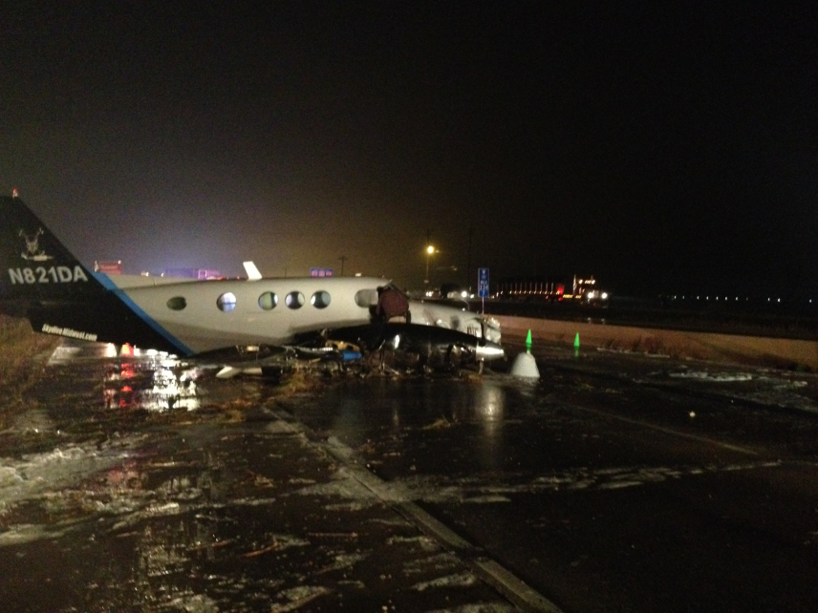
Field Response Expectations Cont.
On-scene Incident Assessment:
Complexity of the incident
Infrastructure integrity and damage
Status of those involved in the incident
Scene stability
Estimated duration of incident
Hazardous materials?
Notes:
Field Response Expectations Cont.
Trainer Guidance:
The RIMC shall complete a full assessment of the incident including the information above
Work with the IC or designee to coordinate/manage to clear the incident and reopen the roadway
NOTE:
Throughout the incident the RIMC needs to frequently re-evaluate and assess whether the incident is escalating
Stay on scene until the incident is cleared and roadway is ready to reopen

Slide 60
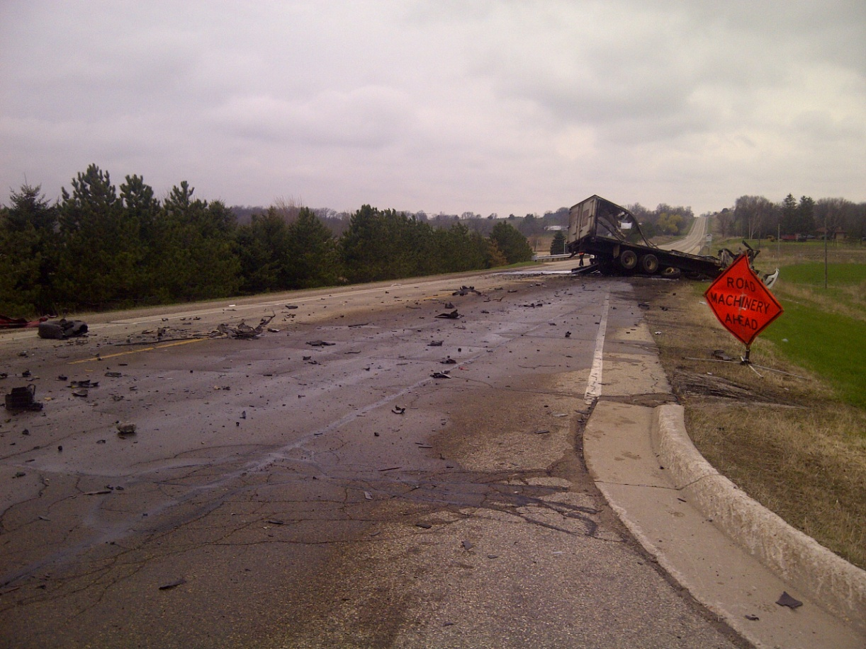
Field Response Expectations Cont.
Communicate and Document
The RIMC will contact and update the TMC and RDO
Document information to the RIMC log and timeline
  Incident pictures and videos
Notes:
Field Response Expectations Cont.
Trainer Guidance:
Throughout the duration of the incident the RIMC will continue to contact and update the TMC and RDO on the status, if warranted
Monitor TIAs for accuracy
Is information output accurate?
Incorrect information in a TIA can have an adverse affect on the public and incident scene
If the media approaches you, refer them to the IC or agency in charge
Inform the TMC when the incident is cleared and you are leaving the scene
Document all communications in the RIMC log and timeline
Take pictures and/or video for situational awareness if possible
Slide picture is from Adams County crash
Transition to next slide: The next slides will be discussing the two other ways of response: office and home

Slide 61
Home and Office Response Expectations
When a field response is not warranted or practical on a call from
the TMC, response shall still take place from either the office or
home
You are still expected to perform the 4 key response components as
if you were actually at the scene:
Evaluate/Assess
Respond/Coordinate
Communicate
Document
Notes:
Home and Office Response Expectations
Trainer Guidance:
Usually after-hours response will be from home, but the RIMC has the discretion of responding from the office where they can utilize the technology/communications and resources that an office environment affords
Regardless if the response is from the home or office, it is expected the RIMC will be actively involved from beginning to end of the incident
Transition to next slide: Let’s review an actual incident that was handled from home

Slide 62
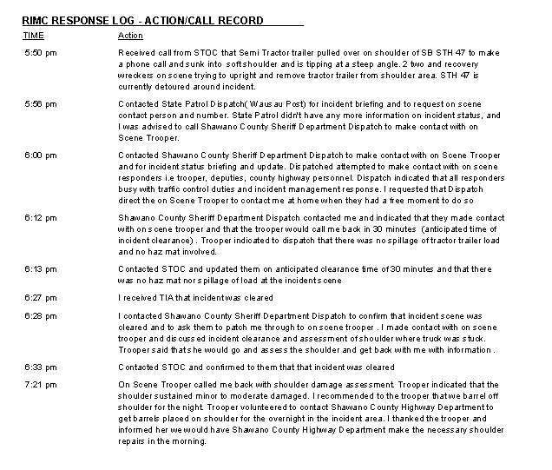
Home Response Example
eLog Discussion
eLog #24536
Disabled semi on shoulder
Notes:
Home Response Example
Trainer Guidance:
Hand out both references: RM_1_RIMC_eLog_24536 and RM_2_SINS_58_24536, which display an example of an incident where the RIMC responded from home
Discuss the response process and documentation
Based on the scope, estimated duration and distance from the scene, it was decided to respond from home
Notice how the scene was cleared, however the scene situation was still not stable even after all vehicles were cleared
RIMC made sure incident area was safe for travel by utilizing a trooper to assess the shoulder integrity
Incident duration is from the time incident occurred until the time the scene was cleared of all vehicles: 2 hours, 51 minutes (1535 to 1826)
Incident duration from the time incident occurred until the RIMC made sure the roadway was safe and incident closed out: 3 hours, 46 minutes (1535 to 1921)

Slide 63
Home and Office Response Expectations Cont.
Key points when responding from office or home
Establish on-scene contacts
RIMC needs to be in communication more often with on-scene contacts to confirm incident status and situational awareness of what is happening at the scene
  Coordination is mostly done through phone calls
  During business hours, the RIMC may ask personnel who are close to the scene to respond as the on-scene contact
Throughout the incident, the RIMC needs to frequently re-evaluate and assess:
  Is the incident escalating?
  Has a field response become warranted?
Notes:
Home and Office Response Expectations Cont.
Trainer Guidance:
Communicate and coordinate with the on-scene contact or others to obtain information for incident management: Usual key contacts, i.e. County Highway Department, Law Enforcement, Incident Commander
Find a different on-scene contact if you’re not confident in the information being provided
Utilize on-scene contact to review traffic control set up and alternate route
Be prepared to offer suggestions for a secondary alternate route or revisions to the traffic control set up
Be prepared to advise what resources could be deployed to assist with scene management
Cones, barricades, flagging, etc.
Maintain awareness of traffic queues
Assess if the queues are getting too long
Utilize on-scene contact to assess and monitor infrastructure integrity
TMC can also utilize the view of on-scene and provide updates on events through CCTV, where available

Slide 64
Home and Office Response Reminders
Maintain frequent communications with on-scene contact, TMC, RDO
Confirm incident status and situational awareness with on-scene contact
Monitor TIAs for accuracy
Confirm with on-scene contact that the roadway is checked before reopening
Stay involved in incident management until the incident is cleared
  Advise TMC incident is cleared
Continuously document information to the RIMC log and timeline
  Complete the RIMC log and timeline within the next business day
Notes:
Home and Office Response Reminders
Trainer Guidance:
You are expected to communicate to the TMC the way you are responding: field, home or office
Reminder: RIMCs still have the same responsibilities when responding from the office or home as they do when responding to the field
Transition to next slide: It’s important to go over the TMC communication/update responsibilities and expectations one more time

Slide 65

TMC Communication Update Reminder
  Provide incident status update to TMC and/or RDO
Notes:
TMC Communication Update Reminder
Trainer Guidance:
This reminder pertains to all three ways of responding to incidents
When calling the TMC operators, remember to identify yourself and provide the incident number
The TMC is statewide and often handles multiple incidents at a time, so identifying yourself and providing the incident number eliminates confusion between the incidents the TMC operators are handling
The updates trigger the TMC operator or DSP dispatch to update TIAs
The TMC should be informed of the way the RIMC is responding to the incident
Keep TMC apprised of any and all changes in incident status, scope, duration and change in traffic control mitigation strategies
Update the TMC as often as you need to, they are your partner in these efforts
Phone communication will continue throughout the duration of the incident
Transition to next slide: Now that we have covered the RIMC responsibility protocols, lets apply what we have learned to three practical scenarios
*Take a break between Section 3 and Section 4, Scenarios

Slide 66
Regional Incident Management Coordinator (RIMC) Field Training
Part 1
Section 4: Incident Response Scenarios
Notes:
Introduction slide to RIMC Field Training Part 1, Section 4:
Incident Response Scenarios
Trainer Guidance:
Section 4 – Incident Response Scenarios will cover three (3) scenarios:
Bridge Strike
Work Zone Incident
Severe Traffic Backups (3 or more miles)

Slide 67
Incident Scenario 1
Bridge Issue
Notes:
Incident Scenario 1: Bridge Issue introduction slide
Trainer Guidance:
Reference Materials used for this scenario include:
RIMC Field Guide
RIMC Scenario Matrix, Bridge Issue
Administrator Office Notification Guidelines
S1_RIMC_Log_49_21294
S1_TIA_49_21294
S1_SINS_49-21294 (For Trainer reference of incident only)

Slide 68
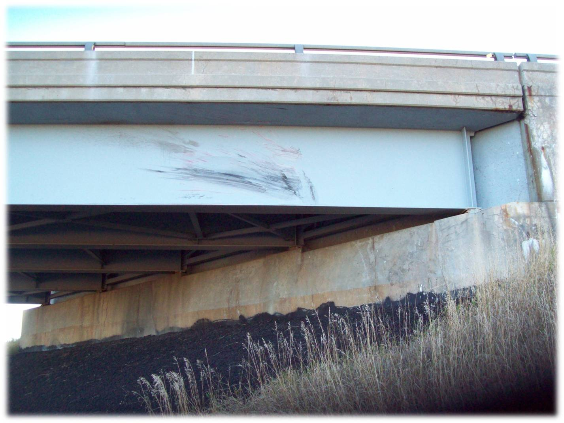
RIMC Incident Scenario: Bridge Issue
A pick up truck, traveling at a high rate of speed, travels up embankment, becomes airborne, and strikes the bridge girder. The vehicle lands on its roof in lane 1 and blocks both NB lanes of traffic.
What information should the RIMC evaluate to assess this incident once he/she is called?
Consult the RIMC Scenario Matrix
  Bridge Issue
Evaluate/Assess
Notes:
Bridge Issue Scenario: Evaluate/Assess
Trainer Guidance:
Engage RIMC in discussion to think about the information he/she would need to gather for evaluation and assessment of this incident using the RIMC Scenario Matrix
What are the impacts to the structure and is there an immediate need for a certified bridge engineer/inspector
What are the considerations to traffic impacts; i.e. time of day, queuing and traffic control set up, adjoining roadways
What would be the needed information to consider for a detour - i.e. safety of infrastructure, detour needed for traffic below/above bridge, short or long term closure of road/lane/shoulder, queuing or delay issues?
Does the information here invoke RDO notification of a Significant Incident?
Transition to next slide: Now we are going to review the RIMC Scenario Matrix for Evaluate/Assess

Slide 69
RIMC Scenario Matrix: Bridge Issue
Evaluate/Assess
Infrastructure damage, i.e. railing, girders, abutment, piers, etc.
  Bridge Engineer/Inspector assistance shall be required
Traffic impacts for queuing and delay, upstream and downstream
  Location of on/off ramps and crossovers for traffic control
  Trapped vehicles
Anticipated duration of incident with law enforcement or Incident Commander
Time of day, peak travel time and/or special events in the area
Estimated time to dissipate queue
Traffic control setup
If incident requires RDO notification of a Significant Incident
Utilize CCTV for monitoring purposes
Continuous incident monitoring (escalation/de-escalation of incident)
Notes:
RIMC Scenario Matrix: Bridge Issue – Evaluate/Assess
Trainer Guidance:
Slide represents statewide considerations for strike, collapse and lift bridge and may not be all inclusive
RIMC will need to use engineering knowledge, expertise and other resources to complete the evaluation/assessment process, i.e. certified bridge engineer/inspector
Verify there are no vehicles trapped anywhere within the closure or queue for longer than 30 minutes
Travelers trapped for any length of time tend to use social media to get or pass along information
Vehicles trapped on the system for any length of time, dependant on weather and other risk factors, may cause reason for incident escalation
Regional specific protocols need to be considered here

Slide 70
RIMC Scenario Matrix: Bridge Issue
Detour
Possible long term detour may be needed if temporary repairs can’t be made or damage is too severe
Review, set up and travel detour route, if necessary, to accommodate traffic
  Emergency alternate route guides may be invoked
Notes:
RIMC Scenario Matrix: Bridge Issue – Detour
Trainer Guidance:
Slide represents statewide considerations for strike, collapse and lift bridge and may not be all inclusive
RIMC will need to use engineering knowledge, expertise and other resources to complete detour evaluation/assessment
Someone in the field may assist in the evaluation and assessment of the detour route
Find a different on-scene contact if you’re not confident in the information being provided
Regional specific protocols need to be considered here

Slide 71
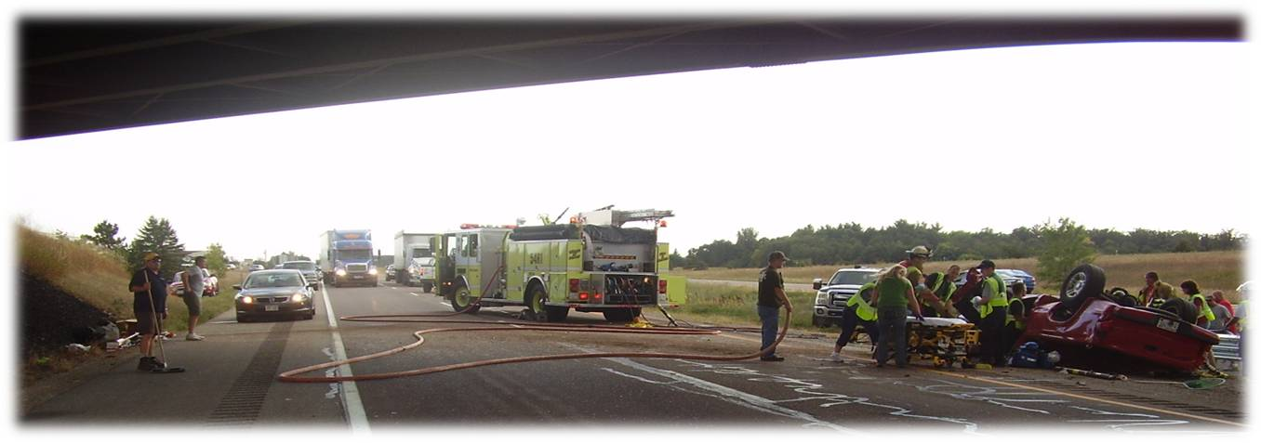
RIMC Incident Scenario: Bridge Issue
Respond/Coordinate
What steps will be involved in responding to this incident?
What are coordination considerations for this incident?
Notes:
Bridge Issue Scenario: Respond/Coordinate
Trainer Guidance:
Engage in discussion to get the RIMC thinking of the different tasks he/she may need to do while coordinating with first responders and highway department personnel
The discussion should include suggestions on what resources can be coordinated or utilized
Discuss the importance of actual response in the field
RIMC is responsible for overall situational awareness and reporting even if bridge engineer/inspector responds
RIMC response will include coordinating resources internally and with various responder i.e. law enforcement, bridge engineer, RDO, and TMC
What traffic control measures might be considered i.e. lane closures, DMS/PCMS for traveler advance warning, ramp gates for closure of on ramps?
Who does the RIMC coordinate response with i.e. bridge engineer, county highway department, project manager, first responders, incident commander on scene?
Regional specific protocols need to be considered here
Transition to next slide: Lets look at the RIMC Scenario Matrix for Response/Coordinate

Slide 72
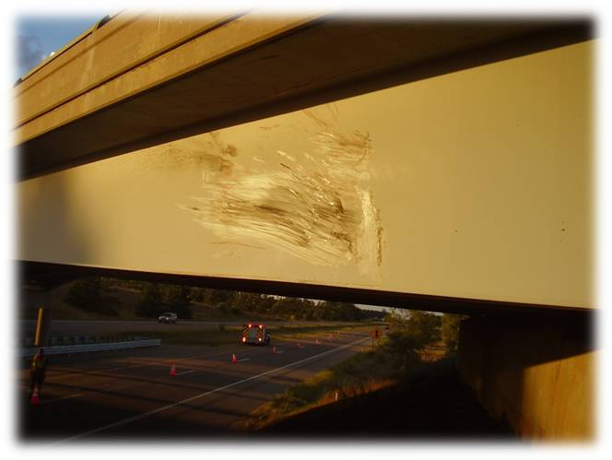
RIMC Scenario Matrix: Bridge Issue
Respond/Coordinate
Field response will be required
Coordinate and set up lane closure
Coordinate with county highway department:
    For traffic control strategies
    To relieve law enforcement from flagging duties if possible
Utilize DMS/PCMS and ramp gates if available and needed
Notes:
RIMC Scenario Matrix: Bridge Issue – Respond/Coordinate
Trainer Guidance:
Discuss regional specific protocols involving bridge issues

Slide 73
RIMC Incident Scenario: Bridge Issue
Communicate
  Continual communication efforts shall be required throughout the incident
RIMC communicating with:
TMC
TIA
511
DTSD
RDO
Bridge Engineer/ Inspector
External Agencies
First responders
DNR and others
Floodgate
County highway department
Maintenance
Notes:
Bridge Issue Scenario: Bridge Issue – Communicate
Trainer Guidance:
Stress importance of communicating from the beginning of the incident until the very end; i.e., incident commander, RDO, TMC, law enforcement/dispatch, county highway department, others
Communication is continual and constant providing situational awareness and assistance for incident management no matter what time of day or night
When in doubt RIMC should contact the RDO
Discuss other possible contacts the RIMC should consider i.e. project manager, maintenance staff
Transition to next slide: Review the RIMC Scenario Matrix: Communicate

Slide 74
RIMC Scenario Matrix: Bridge Issue
Communicate
With the RDO if a Significant Incident Notification is warranted
Provide frequent and timely situational awareness updates to TMC as scene changes
  Provide updates and confirm accuracy with TMC for 511, TIA and floodgate information
With Bridge Engineer/Inspector
  Advise on closure of bridge and/or adjacent roadways
  Consult on reopening bridge/roadway
In the event of a bridge structure emergency requiring central office notification or involvement
  Structure expert on-call: (608) 206-1280
  http://dotnet/dtsd/emergency/index.htm
Notes:
RIMC Scenario Matrix: Bridge Issue - Communicate
Trainer Guidance:
Slide represents the minimum standard for communication during a bridge strike, collapse or lift bridge incident and may not be all inclusive
The bridge engineer/inspector reference can be found on the DOTNET:
DTSD Emergency contacts - WisDOT Emergency Information
http://dotnet/dtsd/emergency/index.htm
It is important to impress upon the RIMCs that they may contact the bridge engineer/inspector if they have any questions or concerns
Major incidents may need the assistance of a Regional Communication Officer (RCM)
Possibly for press release
Possibly for media monitoring
Discuss regional specific protocols for communication, i.e. regional bridge engineer/inspector, RCM, etc.

Slide 75
WisDOT Bridge Structure Emergency
Currently there is no statewide policy on bridge structure emergencies
RIMCS should contact their RDO
RIMCs should contact Bureau Of Structures (BOS) follow on bridge hits Reminder:
A Structure Expert from central office is on-call 24/7 and available to answer questions related to bridge structure emergencies:
  Structure Expert on-call: (608) 206-1280
  http://dotnet/dtsd/emergency/index.htm
The Structure Expert does not respond to the scene when a bridge strike occurs
When a bridge hit occurs and is reported to the TMC, the TMC sends an email to: DOT DL BOS Bridge Hits, where BOS staff is notified
Notes:
WisDOT Bridge Structure Emergency

Slide 76
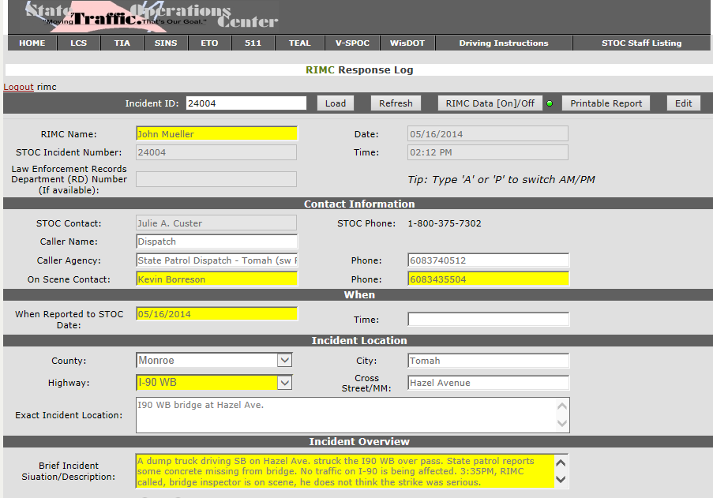
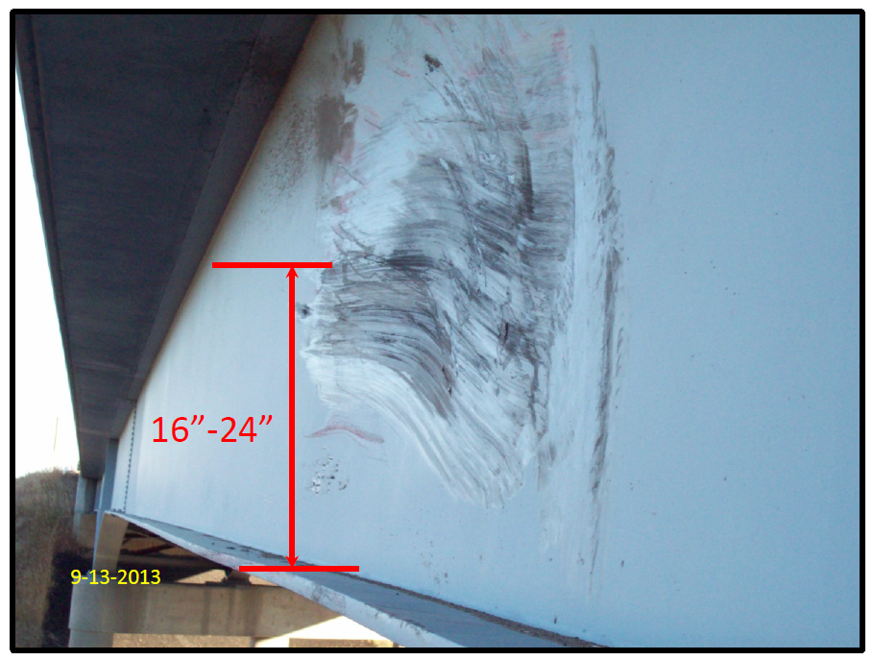
RIMC Incident Scenario: Bridge Issue
Document
What type of information should the RIMC be documenting?
Where can the RIMC obtain information for documenting?
Notes:
Bridge Issue Scenario: Document
Trainer Guidance:
Handout and review RIMC Response Log #49-21294 to encourage awareness of the information the RIMC needs to be gathering and documenting during the entire event
Handout the corresponding TIAs and review the initial notification with second and third updates
TIAs provide information, but this information should also be vetted by the RIMC for accuracy
Re-emphasize the four components
Evaluate/Assess
Response/Coordination
Communication
Documentation
Importance of photo and video documentation
This is for situational awareness: i.e. RDO, central office/bridge staff
Discuss the necessity to document information throughout the incident
Discuss the importance of keeping documentation for the RIMC log timeline
The paper RIMC Response Log can be used as a reminder of needed information
Discuss where the RIMC can obtain information from i.e. TMC/SINS e-log, TIAs, law enforcement dispatch, on-scene responder, incident commander

Slide 77
RIMC Scenario Matrix: Bridge Issue
Document
Maintain RIMC response log
Take photos to document incident as it occurs to provide situational awareness, forward to RDO, Bridge Engineer and RCM if possible
Obtain law enforcement CAD number from incident report to assist with repair reimbursement
Notes:
RIMC Scenario Matrix: Bridge Issue – Document
Trainer Guidance:
Redirect to the RIMC Scenario Matrix

Slide 78
Incident Scenario 2
Work Zone Incident
Notes:
Incident Scenario 2: Work Zone Incident introduction slide
Reference Materials:
Reference Materials used for this scenario include:
RIMC Field Guide
RIMC Scenario Matrix, Maintenance/Work Zone Incident
Administrator Office Notification Guidelines
S2_RIMC_eLog_23982
S2_TIA_23982
S2_SINS_30_23982 (For Trainers reference of incident only)

Slide 79

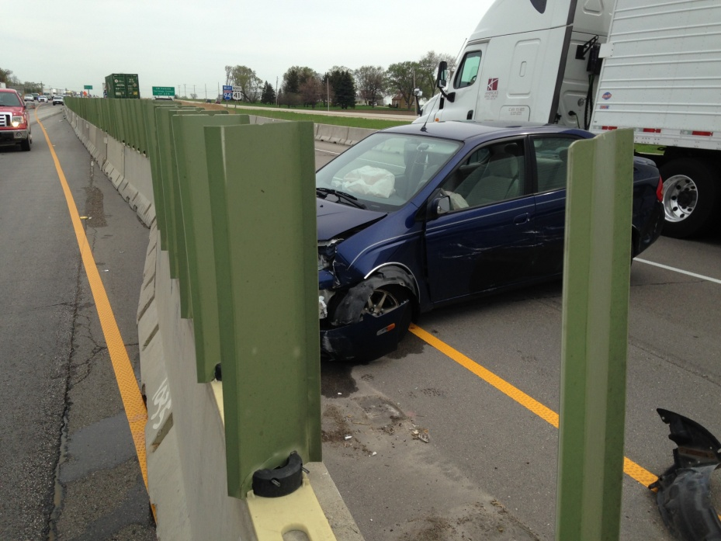
RIMC Incident Scenario: Work Zone Incident
A vehicle crash in the northbound lanes of I-94 hit the temporary work zone median barrier and moved it into the southbound lanes. The temporary median barrier needs to be moved back into place.
Evaluate/Assess
Initial call to TMC
Work Zone Incidents
  RIMC may/may not respond to the scene depending on incident scope and time of day
    Work zone traffic control impacts to devices
    Severe traffic backups
    Crashes
    Temporary roadways
Notes:
Work Zone Incident Scenario: Evaluate/Assess
Trainer Guidance:
Listen to the audio of the initial call to the TMC
This scenario is a crash that impacted a contractor’s temporary traffic control device in a work zone
Transition to next slide: You heard the call come into the TMC, now let’s listen to the call from the TMC to the RIMC

Slide 80



RIMC Incident Scenario: Work Zone Incident
Evaluate/Assess
RIMC Call
What assessment information does
the RIMC need to respond to the call?
Notes:
Work Zone Incident Scenario: Evaluate/Assessment
Trainer Guidance:
RIMC Call
Trainer should play the RIMC work zone assistance call
Determine the scope and impacts of the incident in the work zone:
Contractor’s temporary traffic control devices
Contractor’s temporary roadway
Crash
Severe traffic delays
Water/flooding on the roadway
Other
The RIMC will need to determine who the incident is associated with for the maintenance of the work zone; including, but not limited to, temporary traffic devices or roadways:
Contractor
DOT
County/local agency
Other
Review what other information might be needed to evaluate appropriate response
Traffic Management Plan (Also available at TMC)
Contractor’s contact information (Should be on iPad/iPhone)

Slide 81
Protocol for Project Related Incidents
When the TMC contacts the RIMC regarding project work zone related incidents:
During Work Hours
Contact project leader, if no answer
Contact operations supervisor, if no answer
Contact the RDO
After Work Hours
Traffic control devices:
  Contact the emergency 24-hour traffic control contact
Other project issue not related to traffic control devices
  Contact prime contractor, if no answer
  Contact project leader, if no answer
  Contact the RDO
The county highway department may need to be utilized for emergency situations where the contractor doesn’t answer their phone or if they are unable to resolve the situation in a timely manner.
Notes:
Protocol for Project Related Incidents
Trainer Guidance:
RIMC should not deploy county forces within a project work zone without RDO approval
Transition to next slide: Again, this is the suggested statewide evaluation/assessment recommendations for work zone incidents

Slide 82
RIMC Scenario Matrix: Work Zone Incident
Evaluate/Assess
If incident meets criteria for RDO notification of a Significant Incident
Traffic control setup
Information from Incident Command, DSP, contractor, county highway department or other source:
  Anticipated duration of incident
  If this is a hazmat incident
  Is there infrastructure damage or utility damage (i.e. downed power line)
Time of day, peak travel time and/or special events in the area
Traffic impacts for queuing and delay, upstream and downstream
  Evaluate closing on-ramps and crossovers
  Trapped vehicles
Estimated time to dissipate queue
CCTV to monitor situation
Continually monitor incident from beginning to end
Notes:
RIMC Scenario Matrix: Maintenance/Work Zone Incident
Trainer Guidance:
Slide represents statewide considerations for maintenance/work zone incidents and may not be all inclusive
Provide any regional specific protocols for maintenance/work zone incidents
Verify there are no vehicles trapped anywhere within the closure or queue for longer than 30 minutes
Travelers trapped for any length of time tend to use social media to get or pass along information
Vehicles trapped on the system for any length of time, dependant on weather and other risk factors, may cause reason for incident escalation

Slide 83

RIMC Scenario Matrix: Work Zone Incident
Detour
Review, set up and travel detour route, if necessary, to accommodate appropriate traffic
  Emergency alternate route guides may be invoked
Notes:
RIMC Scenario Matrix: Maintenance/Work Zone Incident
Trainer Guidance:
Consult and evaluate the implementation of project Traffic Management Plans (TMP) (May be available from TMC on request)
Transition to next slide: Let’s listen to the call that came in to the TMC from the county dispatcher

Slide 84

RIMC Incident Scenario: Work Zone Incident
County Dispatch Call
Respond/Coordinate
Field Response
Office Response
Home Response
Notes:
Work Zone Incident Scenario: Respond/Coordinate
Trainer Guidance:
Listen to the County Dispatch Call
Information is often received by the TMC from various responding agencies
Accuracy of information needs to be vetted, i.e. county dispatch says they are handling when DSP is actually handling
When information is unclear during an incident, there is still a need to work together and follow up or provide clarification once the incident is closed
Clarification provides information for future response and after action reviews
RIMC plays an important role in assessing information accuracy and clarifying who is responsible for scene incident command. That information needs to be conveyed back to the TMC
Discuss the response the RIMC might have as a result of responding from the office or home, i.e. project manager, contractor, RDO, etc.
Response in this issue would mean phone call coordination and communication with incident commander
Transition to next slide: In looking at the RIMC Scenario Matrix, response to the field would be probable, but may not be required

Slide 85
RIMC Scenario Matrix: Work Zone Incident
Respond/Coordinate
Field response probable
When traffic control assistance is necessary, call emergency contractor or project manager
RIMC may need to coordinate with RDO for communication efforts with contractor
  If emergency contractor and project manager are unavailable, contact RDO
  When in doubt, call the RDO
With RDO approval and as a last resort, coordinate traffic control strategies with county highway department
Set up lane or shoulder closures
Utilize DMS/PCMS and ramp gates if available and needed
Notes:
RIMC Scenario Matrix: Response/Coordinate

Slide 86


RIMC Incident Scenario: Work Zone Incident
Communicate
Notes:
Work Zone Incident Scenario: Communicate
Trainer Guidance:
Discuss the responsibility of the RIMC to coordinate via communications in this issue, i.e. incident commander, DSP dispatcher, county dispatcher, contractor, contract construction lead, TMC, etc.
Discuss how quality communication is important because it is used as the basis for many other forms of situational awareness:
TIA being sent out to law enforcement, media, trucking industry, etc.
Use of DMS to advise traveling motorists
511, Twitter
Refer to the RIMC Scenario Matrix and discuss Maintenance/Work Zone Incident under the Miscellaneous Incidents category
RIMC Scenario Matrix - Communicate
Provide frequent and timely situational awareness updates to RDO, RCM and TMC as scene changes
Provide updates and confirm accuracy with TMC for 511, TIA and floodgate information
Transition to next slide: Lastly lets look at the documentation for this incident

Slide 87

RIMC Incident Scenario: Work Zone Incident
Document
Maintain RIMC response log
Take photos or video if field response is warranted
Document incident as it occurs to provide situational awareness
Forward to construction staff, RDO and RCM if possible
Note: Timeline is vital in documentation for project construction files
Notes:
Work Zone Scenario: Document
Trainer Guidance:
Handout: RIMC Response Log #30-23982, SINS and TIA
Re-emphasize the four key components
Evaluate/Assess
Respond/Coordinate
Communication
Documentation
Express importance of photo and video documentation
This is for situational awareness, i.e. RDO, RCM and construction staff
Discuss the necessity to document information throughout the incident
An accurate log with timelines is important for project construction files
The paper RIMC Response log can be used as a reminder of needed information
Discuss where the RIMC can obtain information from, i.e. TMC/SINS e-log, TIAs, law enforcement dispatch, on-scene responder
RIMC Scenario Matrix – Document
Maintain RIMC response log
Take photo, video, if possible, to provide situational awareness
Acquire dispatch CAD record number

Slide 88
Incident Scenario 3
Severe Traffic Backups
3 Miles or More
Notes:
Incident Scenario 3: Severe Traffic Backups – 3 Miles or More
Trainer Guidance:
Reference Materials used for this scenario include:
RIMC Field Guide
RIMC Scenario Matrix, Severe Traffic Backups – 3 Miles or More
Reference materials for this scenario include:
S3_RIMC_eLog_24304
S3_SINS_67_24304 (For Trainers reference of incident only)

Slide 89

RIMC Incident Scenario: Severe Traffic Backups
Traffic delays of approximately 4 miles occurred due to a crash, which resulted in eastbound lane closures
TMC Video
Notes:
Severe Traffic Backups Scenario
Trainer Guidance:
Play the video and hand out RIMC log #24304
Video is what TMC verified prior to calling the RIMC
Video timeline (Time does not match log) Information for trainer only
3:56 Normal Traffic Flow
3:57 Vehicle stops inside median lane, pedestrian walks back to scene
3:58 Other vehicles stop in median
4:00 WB traffic visibly slowing (gawkers)
4:02 Eastbound queue

Slide 90

RIMC Scenario Matrix: Severe Traffic Backups
Evaluate/Assess
If incident meets criteria for RDO notification of a Significant Incident
  Criteria for notification of RIMC is 3 miles of backup
Verify/determine the cause of the backup so steps can be taken to eradicate it
Time of day, peak travel time and/or special events in the area
Traffic impacts for queuing and delay, upstream and downstream
  Evaluate closing on ramps and crossovers
  Trapped vehicles
Estimated time to dissipate queue
Traffic control setup
Continually monitor incident from
beginning to end
Notes:
RIMC Scenario Matrix: Evaluate/Assess
Trainer Guidance:
Review the RIMC log to 5:15 PM prior to notification of helicopter request
Discuss the RIMC Scenario Matrix and how each point fits into a traffic backup situation
This is currently not a significant incident notification unless the incident causing the backups requires or meets the RDO notification criteria
3 miles of backup on any state highway is a SINP trigger for RIMC notification only
Verify/determine the cause of the backup so steps can be taken to eradicate it
Verify there are no vehicles trapped anywhere within the closure or queue for longer than 30 minutes
Travelers trapped for any length of time tend to use social media to get or pass along information
Vehicles trapped on the system for any length of time, dependant on weather and other risk factors, may cause reason for incident escalation
Review RIMC Scenario Matrix – Detour below in the event the incident escalates
Assess traffic impacts on alternate routes
Readjust signal timing on alternate routes
RIMC Scenario Matrix - Detour
Possible detour may be needed depending on duration of incident
Review and set up for detour route
Travel or delegate someone to travel the detour route to make sure the route is adequate to accommodate traffic, i.e. pavement quality, volume of traffic
Reassess alternate route periodically, dependant on duration and timing (peak hours) of backups
Emergency alternate route guides may be invoked
Transition to next slide: Let’s watch the next video where the scene escalates to a full closure

Slide 91
RIMC Incident Scenario Matrix: Severe Traffic Backup
Respond/Coordinate
Full closure impacts
    Flight for Life (FFL) (Emergency helicopter)
    Reconstruction
Impacts to on/off ramps, crossovers and ancillary roads
Traffic backups can escalate quickly and dissipate slowly
Notes:
Severe Traffic Backups Scenario: Response/Coordinate
Trainer Guidance:
Review RIMC log at 5:30 PM, point of full closure to 5:45 PM
Video timeline (Time does not match log) Information for trainer only
4:06 TIMA setup
4:08 Reposition of TIMA and delays continues to build
4:22 Eastbound traffic directed off and eastbound closed
4:24 Another ambulance arrives and Flight for Life (FFL) incoming
4:27 FFL arrives
4:29 FFL landing with WB closed, traffic backups on both sides now
Reassess RIMC response throughout entire incident
Field, home or office response will be dependent on incident scope
Reassess a detour due to the full closure
During business hours, the RIMC may ask personnel who are close to the scene to respond as the on-scene contact
When in doubt, go out!
Discuss how an incident can impact both sides of the road and ancillary roads
Utilize DMS, PCMS, ramp gates and advanced notice signs if available and needed
Transition to next slide: Rule of thumb/side note…

Slide 92

Rule of Thumb
Impacts – Congestion and Delay
Non-recurring traffic incidents account for one-fourth of congestion and delay
1 minute of Interstate lane blockage translates into at least 4 minutes of delay
Secondary incidents (crashes)
Decreased quality of life
Poor public image of “us”
Economic impacts
  Freight
  Public
Special Events/
Other (5%)
Poor Signal Timing (5%)
Bad Weather
(15%)
Bottlenecks
(40%)
Work Zones
(10%)
Traffic Incidents (25%)
Notes:
Rule of Thumb
Trainer Guidance:
Congestion and delay are probably the most obvious impacts of a traffic incident
As illustrated by the pie chart on the right, studies have shown that at least ¼ of all congestion and delay is caused by non-recurring events such as traffic incidents
General guidance:
Every minute of lane blockage causes 4 minutes of delay – 4 to 1 ratio
Consider this – if a lane on the Interstate is closed for 15 minutes it will effectively cause 1 hour of delay
Reference:
Traffic Control and Scene Management Guidelines - Traffic Congestion and Reliability Report - 090105.pdf

Slide 93
RIMC Scenario Matrix: Severe Traffic Backups
Respond/Coordinate
Field, home or office response will be dependent on incident scope
  Reassess response throughout incident
  During business hours, RIMC may ask WisDOT personnel who are closer to the scene to respond and operate as the on-scene contact
  When in doubt, go out!
May be working with contractors or traffic control sub-contractors
Determine traffic control actions based on cause, scale and estimated duration of backups
Coordinate traffic control strategies with county highway department
Utilize DMS, PCMS, ramp gates and advanced notice signs if available and needed
Note: This incident is adjacent to a construction zone
Notes:
RIMC Scenario Matrix: Severe Traffic Backups
Trainer Guidance:
Determine traffic control actions based on cause, scale and estimated duration of backups
May be working with contractors or traffic control sub-contractors
(Side note: This incident is adjacent to a construction zone)
Coordinate traffic control strategies with incident commander, county highway department and TMC
Transition to next slide: Lets look at communication efforts

Slide 94
RIMC Incident Scenario: Severe Traffic Backups
Communicate
Communicate with TMC frequently and in a timely manner
RDO triggers
  Road closed in both directions for 30 minutes or more
Notes:
Severe Traffic Backups Scenario: Communicate
Trainer Guidance:
Review video and RIMC log from 5:59 PM until end of log
Video timeline (Time does not match log) information for trainer only
4:41 FFL departs
4:42 Westbound lanes open
4:44 Eastbound lanes open
4:49 Eastbound queue and exit begin to move
5:14 All lanes open and traffic moving
Important to communicate with TMC for 511, TIA and floodgate information accuracy
RIMC Scenario Matrix - Communicate
Contact RDO when incident meets criteria for notification of a Significant Incident
Provide frequent and timely situational awareness updates to TMC as scene changes
Provide updates and confirm accuracy with TMC for 511, TIA and floodgate information

Slide 95
RIMC Incident Scenario: Severe Traffic Backups
Document:
eLog
Paper log
Photos
Video
Notes:
Severe Traffic Backups Scenario: Document
Trainer Guidance:
Talk about the RIMC e-Log #67-24304
Express importance of an accurate timeline
Reiterate the use of the paper log
Log lists the data fields for needed information
As a temporary log until the eLog can be filled out
Pictures and videos can assist with situational awareness when available
RIMC Scenario Matrix - Document
Maintain RIMC response logs
Transition to next slide: This concludes the three specific scenarios let’s look back at our objectives for this training

Slide 96
RIMC Incident Response Scenarios Summary
4 Key components:
  Evaluate/Assess
  Respond/Coordinate
  Communicate
  Document
RIMC’s play an important role in evaluating and sizing up different incident types to determine response strategies
Communication is:
  Key to a successful traffic incident management response
  Continual throughout an incident and provides situational awareness
  Verification of significant incident types
Documentation needs to be detailed to:
  Improve response practices and protocols
  Provide best practices/lessons learned for on-going training
Notes:
RIMC Incident Response Scenarios Summary
Trainer Guidance:
Just went through three out of the 12 scenarios
The RIMC Scenario Matrix is a guide to response
The Matrix may not be all inclusive and RIMCs need to use their judgment and expertise in responding to different incidents
Transition to next slide: Part 2 of this training will discuss the RIMC mentoring process

Slide 97
Regional Incident Management Coordinator (RIMC) Field Training
Part 2
Regional RIMC Mentoring Process
Notes:
Introduction slide to Part 2:
Regional RIMC Mentoring Process

Slide 98
Regional RIMC Mentoring Process
Region selects a method(s) to carry out the task of mentoring and supporting new RIMCs
  Region to place experienced RIMC on-call with new RIMC for first on-call rotational period. Experienced RIMC will respond to all calls with the new RIMC for that rotational period.
  New RIMC will shadow (during working hours) any of the other experienced RIMC team members when they are on-call. The new RIMC will respond accordingly to incidents with them
  Dedicate an experienced RIMC team member to assist the new RIMC when they are on their first on-call rotation. (Day and night) the new RIMC can call the dedicated experienced RIMC for assistance and guidance.
Notes:
Regional RIMC Mentoring Process
Trainer Guidance:
Regional Operations Managers approved, May 2014: For training purposes, 2 RIMCs (1 experienced and 1 new RIMC), can be on-call at the same time for the new RIMC’s first rotational period
It is the Region’s responsibility to identify who the best experienced RIMC is to serve as a mentor for the new RIMC
The RIMC mentor shall assist the new RIMC with filling out the eLog for the first time
Transition to next slide: So, what are the next steps?

Slide 99
Next Steps
Trainers need to train the existing RIMCs, new RIMCs and Operational Supervisors
All future RIMCs will need to be trained using this training tool
Questions?
Thank you!
Notes:
Next Steps
Trainer Guidance:
Trainers need to schedule regional RIMC Field Training for all existing RIMCs and Operations Supervisors to be completed by the end of August 2014
Attendance forms for RIMC Field Training attendees should be emailed back to the TMC (attachment) at: TMC@dot.wi.gov Attention: ETO Program Manager
Future RIMCs coming on board after August 2014 are required to take this training
Note:
Trainers will meet in September to share feedback, comments and suggestions on improvements to the Train-the-Trainer manual and resources

