Slide 1
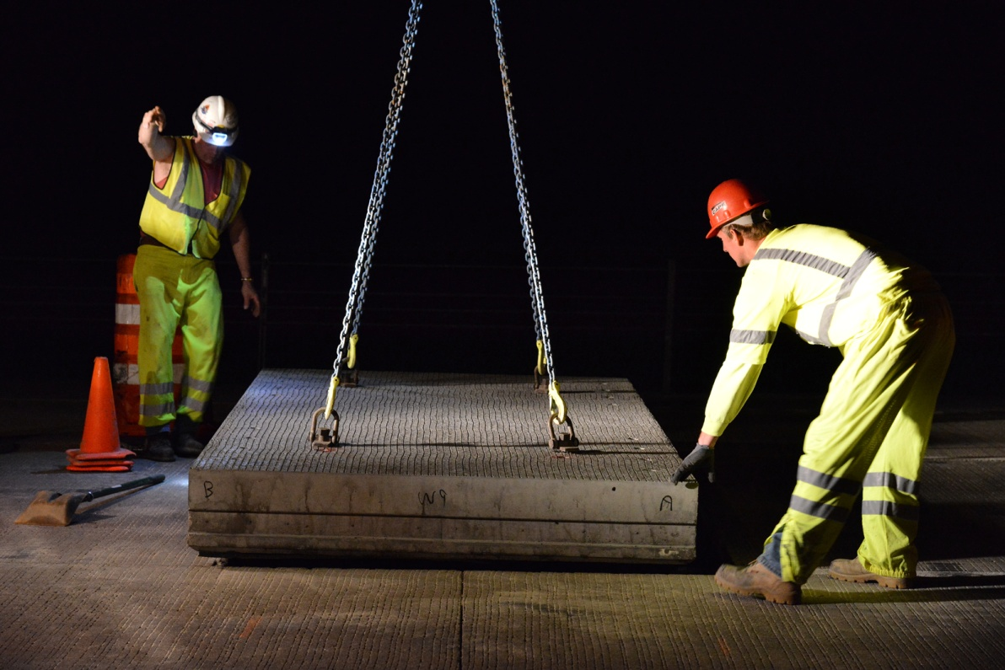
Project 1020-06-61 IH 94 Hudson, WI Precast Panels

Slide 2
Urban Interstate – 4.5 miles

Slide 3
Westbound Hourly Traffic

Slide 4
Eastbound Hourly Traffic

Slide 5
Example Lane Restrictions

Slide 6
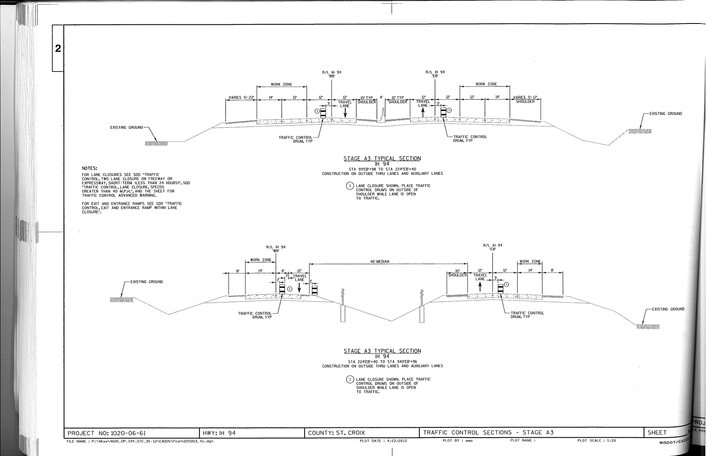
Construction Staging Plan

Slide 7
Patch Layout

Slide 8
Saw

Slide 9
Patch Removal

Slide 10
Dowel Bars

Slide 11
Grading for Panels

Slide 12
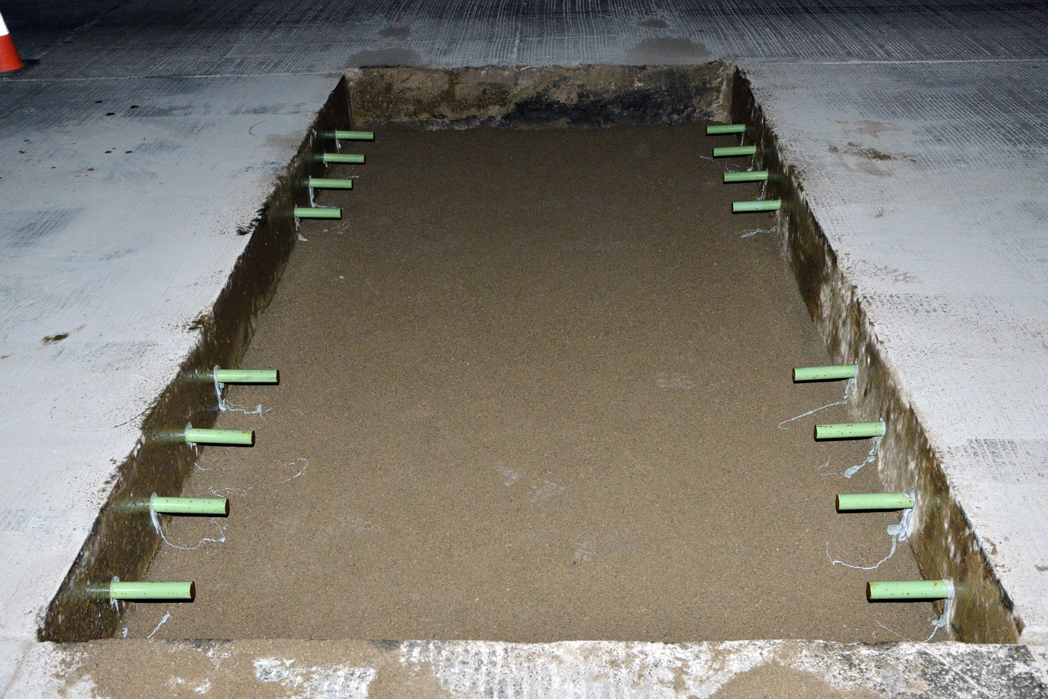
Ready for Panel

Slide 13
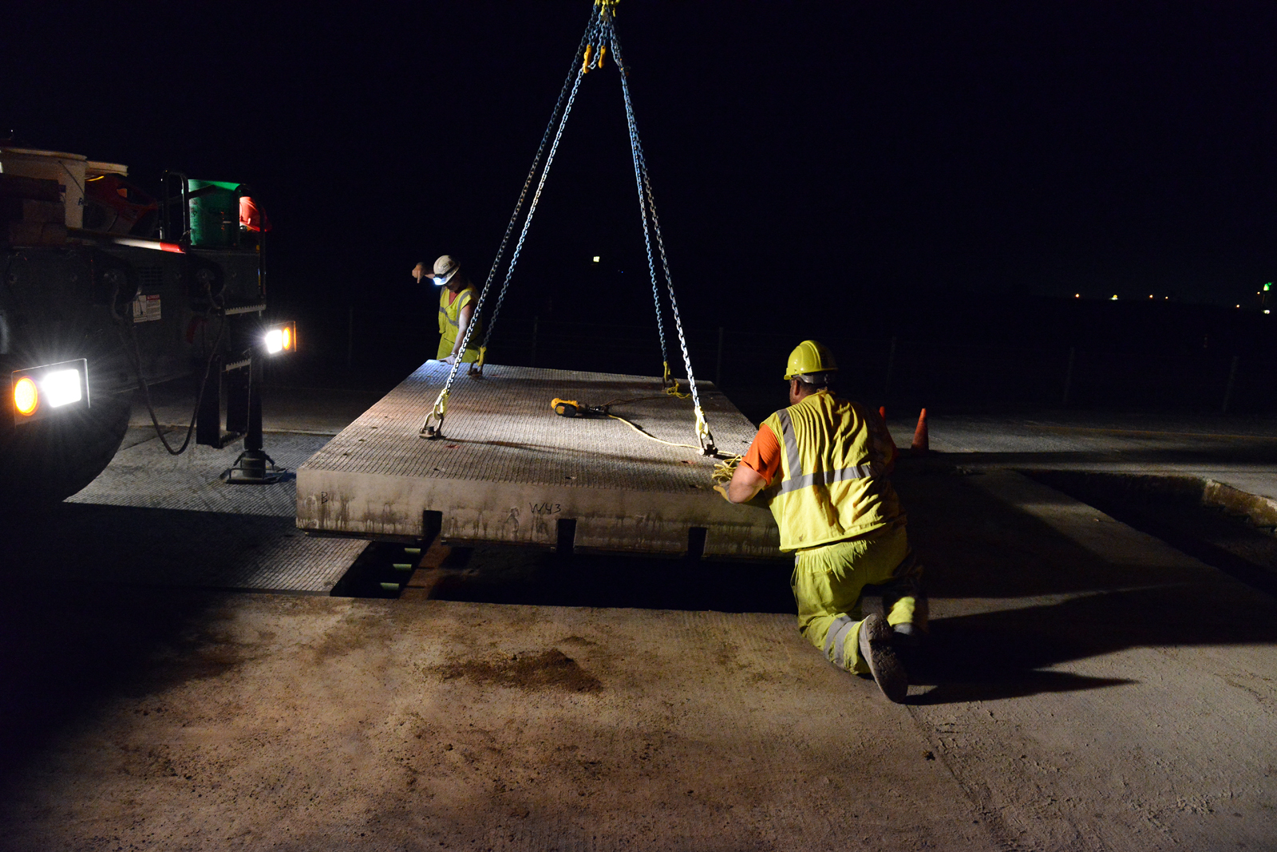
Setting of a Panel

Slide 14
Panel Set

Slide 16
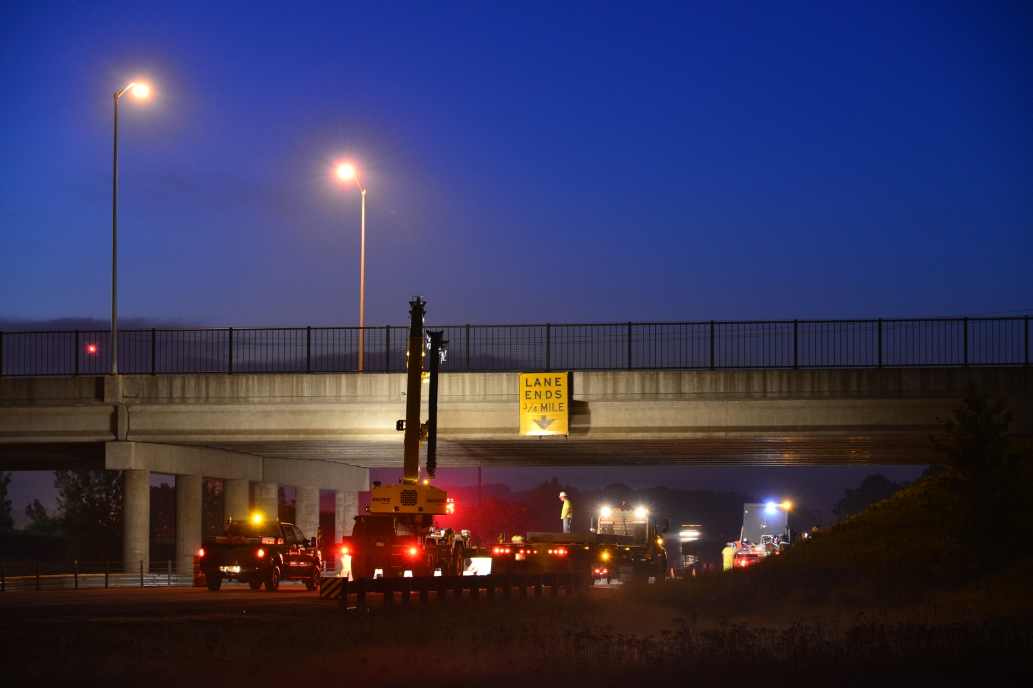
Work Near a Structure

Slide 17
Concrete Joints and Tolerances

Slide 18
Concrete Joints and Tolerances

