Slide 1
Northwest Region Precast Panel Project I-94 in Hudson, Wis.

Slide 2
Project Location
Notes:
Urban Interstate 4.5 miles
Just east of the Twin Cities with high commuter traffic

Slide 3
WisDOT Partners
EMCS
Stephanie Christensen, PE
Ayres Associates
Lisa Fleming, PE
Adam Gaugh, PE
Ryan Erdmann, PE
Cornerstone Pavers USA
Chris Cape
The Fort Miller Co.
Mike Quaid, PE
Wieser Concrete Products
Andy Wieser

Slide 4
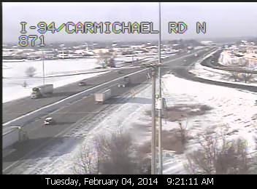
Project Background
Let: November 2012
Bid: $5.36 million
Start: April 1/April 29/May 6, 2013-Winter that never ended!
Complete Target: July 31/August 29, 2013
Complete Actual: August 26, 2013

Slide 5
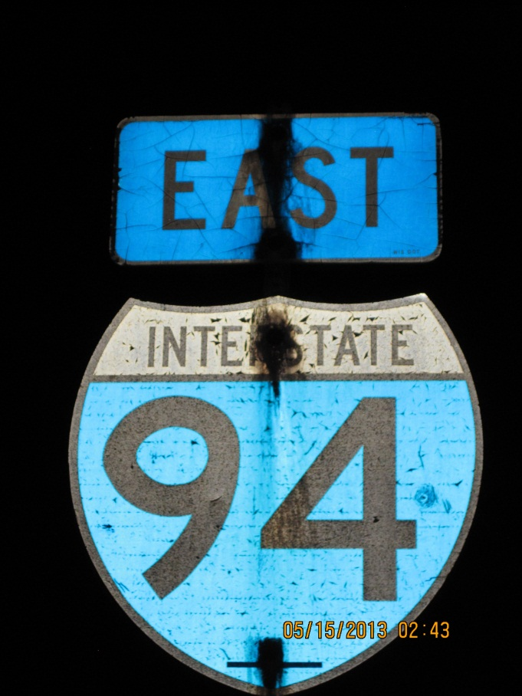
Project Background-Other Work
Passing and driving lanes repairs
Bridge epoxy overlays
Variable message sign for Mn/DOT
ITS items
Carmichael interchange
Notes:
Preventative Maintenance Project
Fix spot failures before deteriorate further
Joints that had opened up and were patched

Slide 6
Design Challenges
High traffic volumes
Short lane closure windows
Center lanes
Border City
Notes:
Largest traffic volumes in NW Region
ADT 87,000 at Bridges to 60,000 USH 12
Between 3200-4300 AHT at peak
Intricate matrix for lane closures

Slide 7
Westbound Hourly Traffic
Notes:
See generally over our thresholds
And shows EB/WB peak times are almost opposite for commuter traffic

Slide 8
Eastbound Hourly Traffic

Slide 9
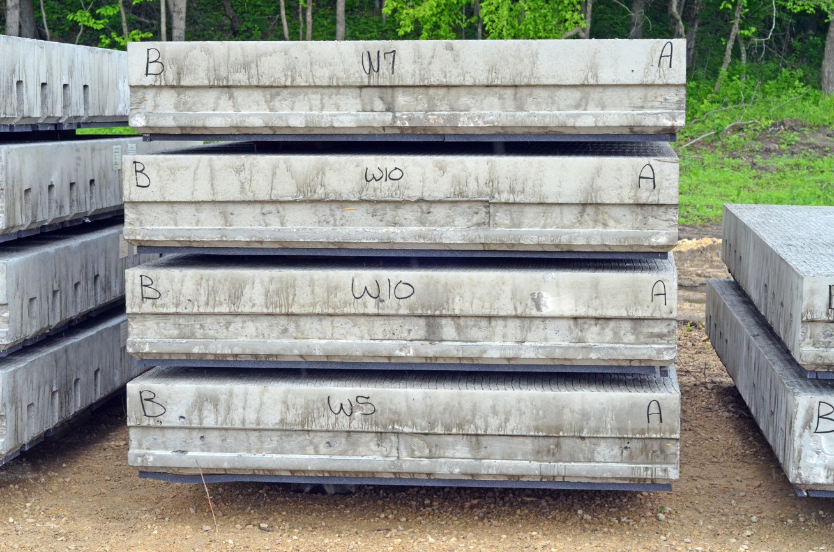
Why Choose Precast Slabs?
Cure time, no wait
Control
Durability
Ride quality
Statewide use (SE, SW)
WisDOT test for speed
“Real world” traffic
Notes:
With traffic challenges:

Slide 10
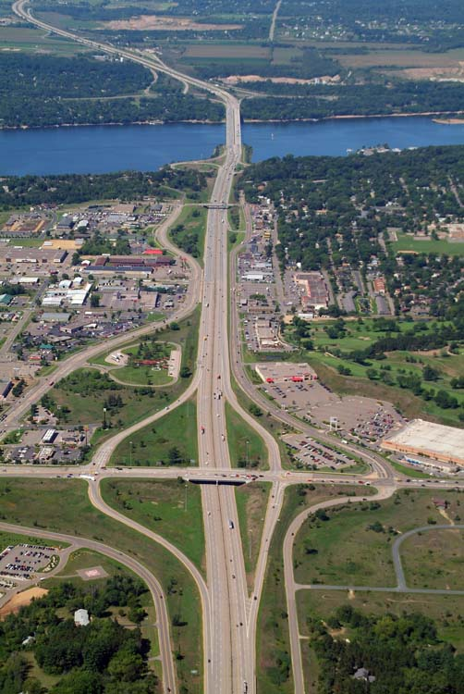
Special Provisions-Test Panels
30 test panels
Driving lane EB – longest time frame to work
Timing for shortest time frame worked out for WB lanes
First night 3 panels, up to 10 at conclusion

Slide 11
Project Budget
Joint selection previous winter
Currently at 95% of contract price
208 precast panels in center lanes
Approximately 408 cast in place

Slide 12
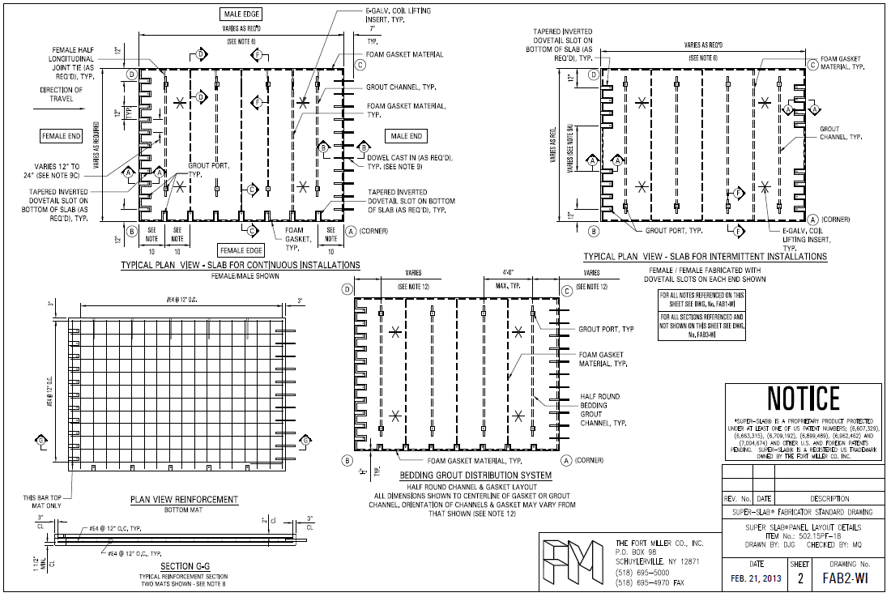
Construction of Precast Panels
The Fort Miller Co., Inc – Schuylerville, NY

Slide 13
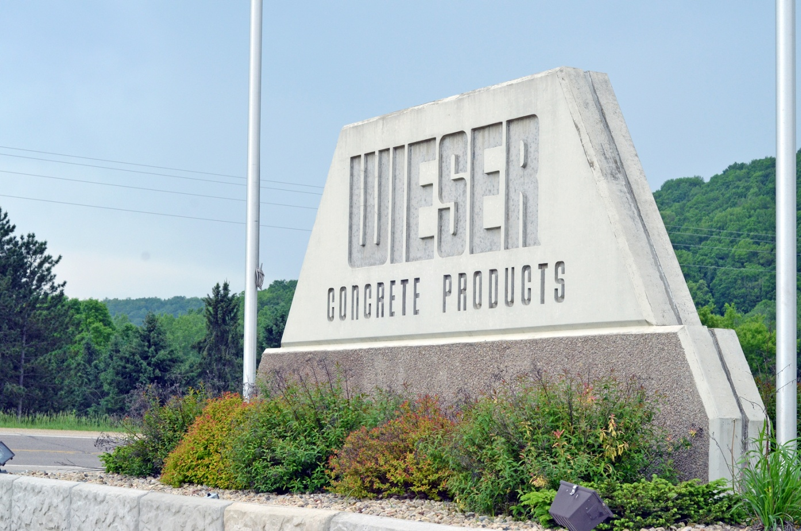
Construction of Precast Panels
Wieser Concrete Products – Maiden Rock Plant

Slide 14
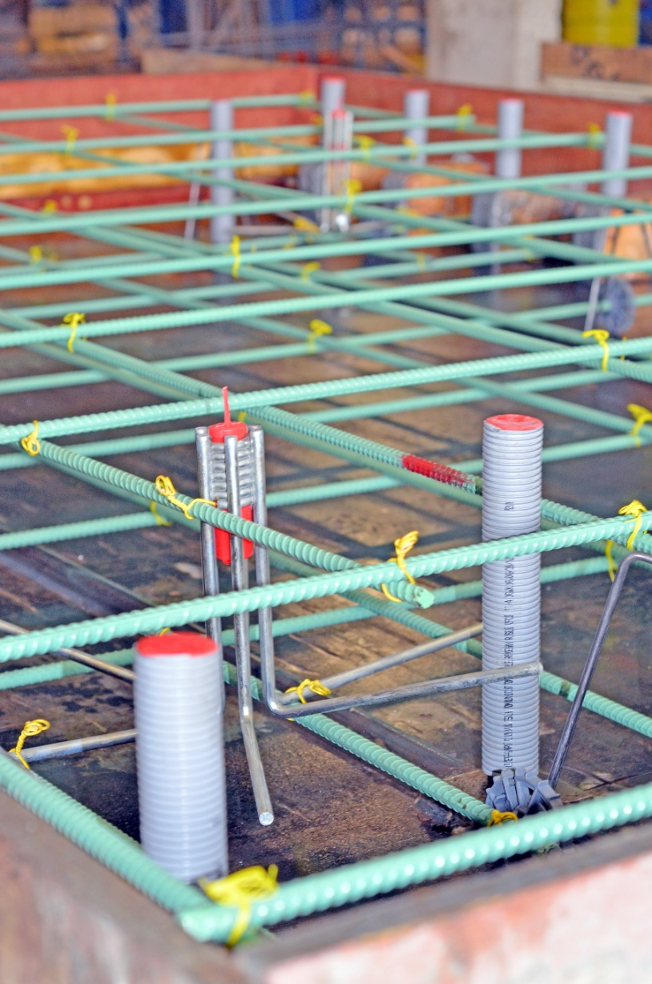
Construction of Precast Panels
Dowel bar grout ports
Bedding grout ports
Coil thread insert
Minimum steel to concrete area of 0.0018
Max bar spacing – 18 inches
No. 4 epoxy-coated steel bars or larger

Slide 15
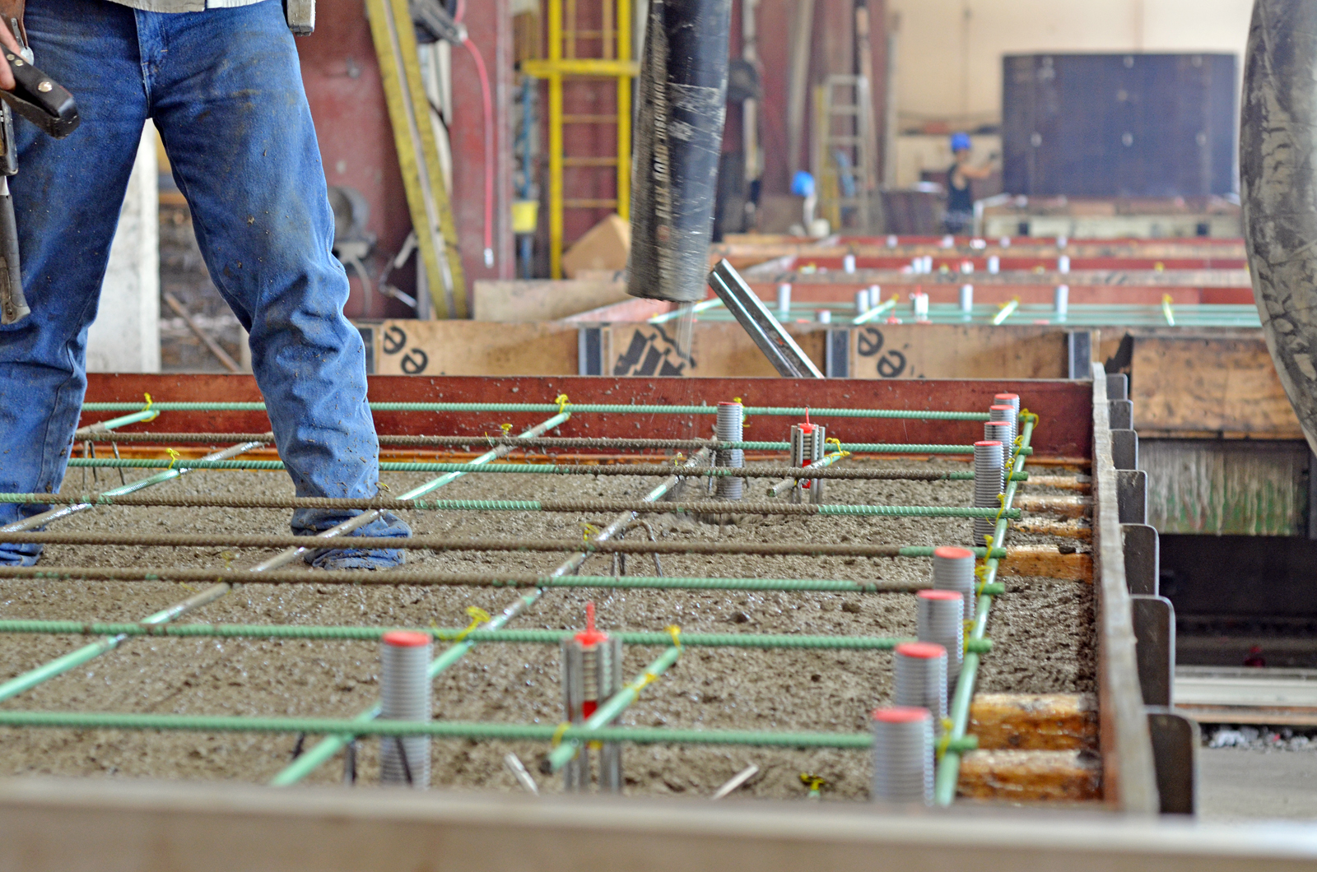
Construction of Precast Panels

Slide 16
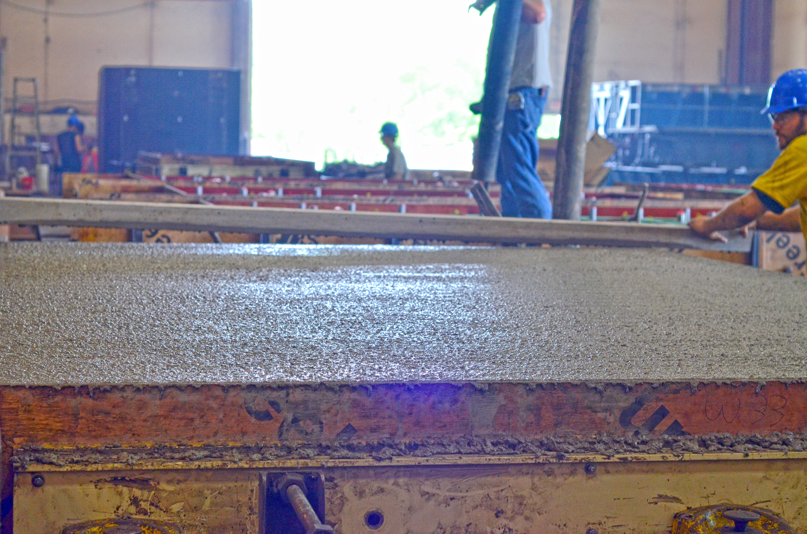
Construction of Precast Panels

Slide 17
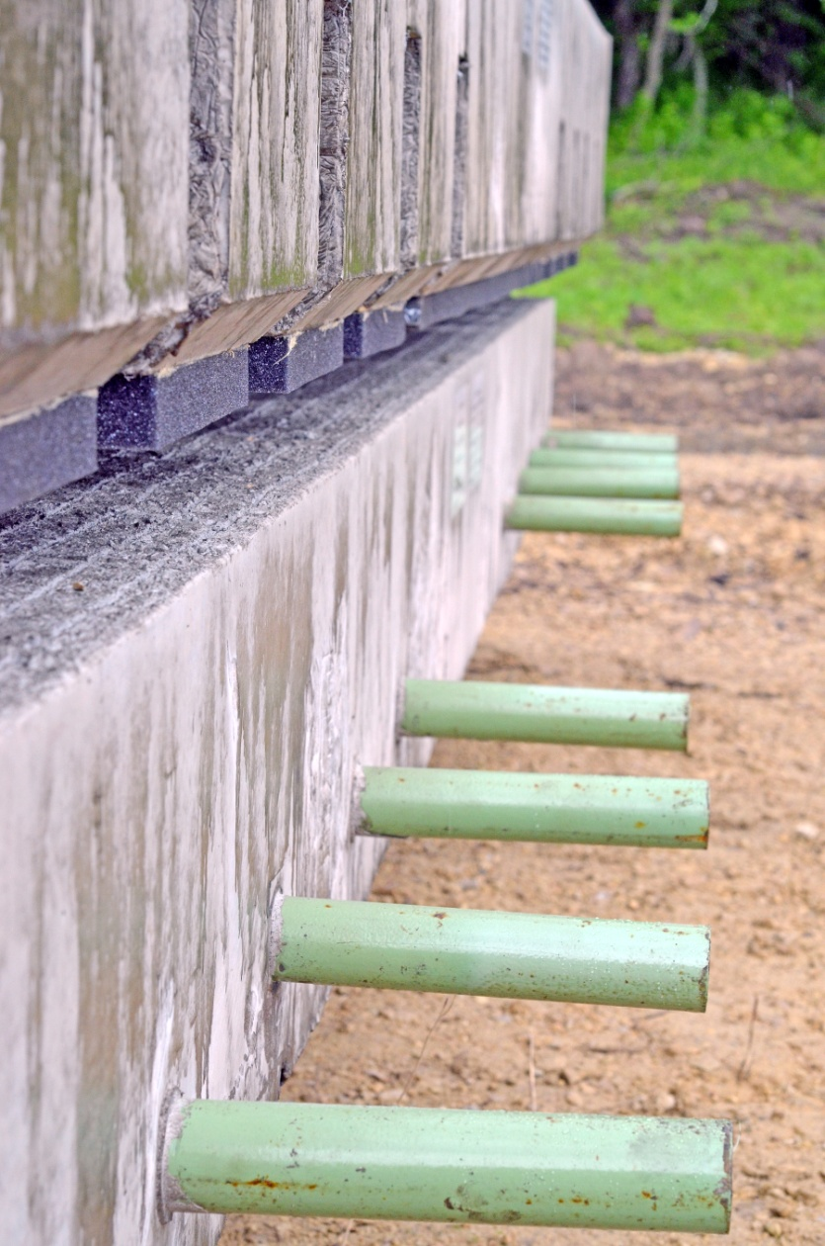
Construction of Precast Panels
Initial minimum compressive strength of 3,000 PSI
Minimum 28-day strength of 5,000 PSI

Slide 18
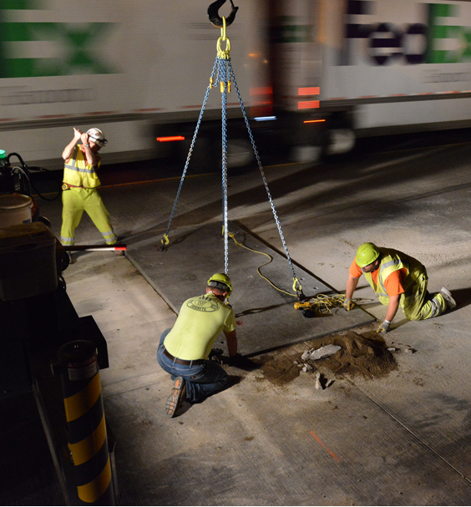
Precast Panel Installation
Vertical – plus or minus ⅛ inch
Transverse joints – ½ inch or less
Longitudinal joints – ¾-inch or less

Slide 19
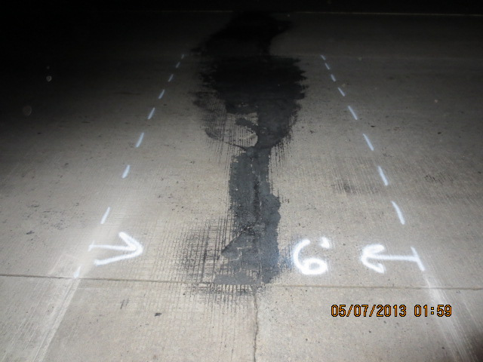
Precast Panel Installation

Slide 20
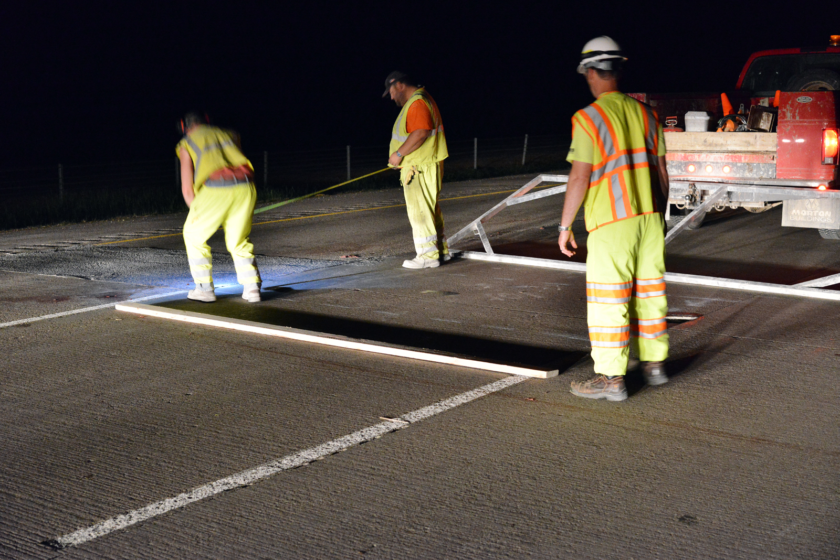
Precast Panel Installation

Slide 21
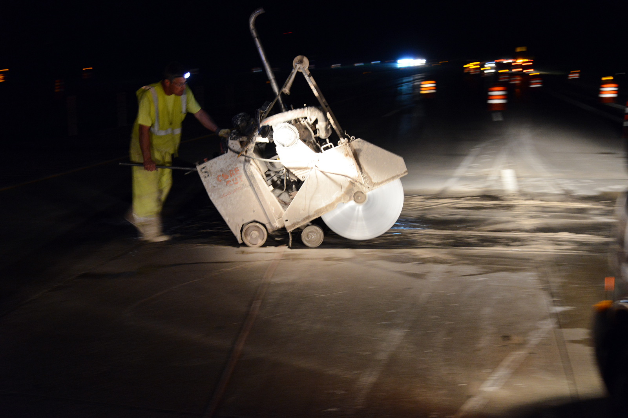
Precast Panel Installation

Slide 22
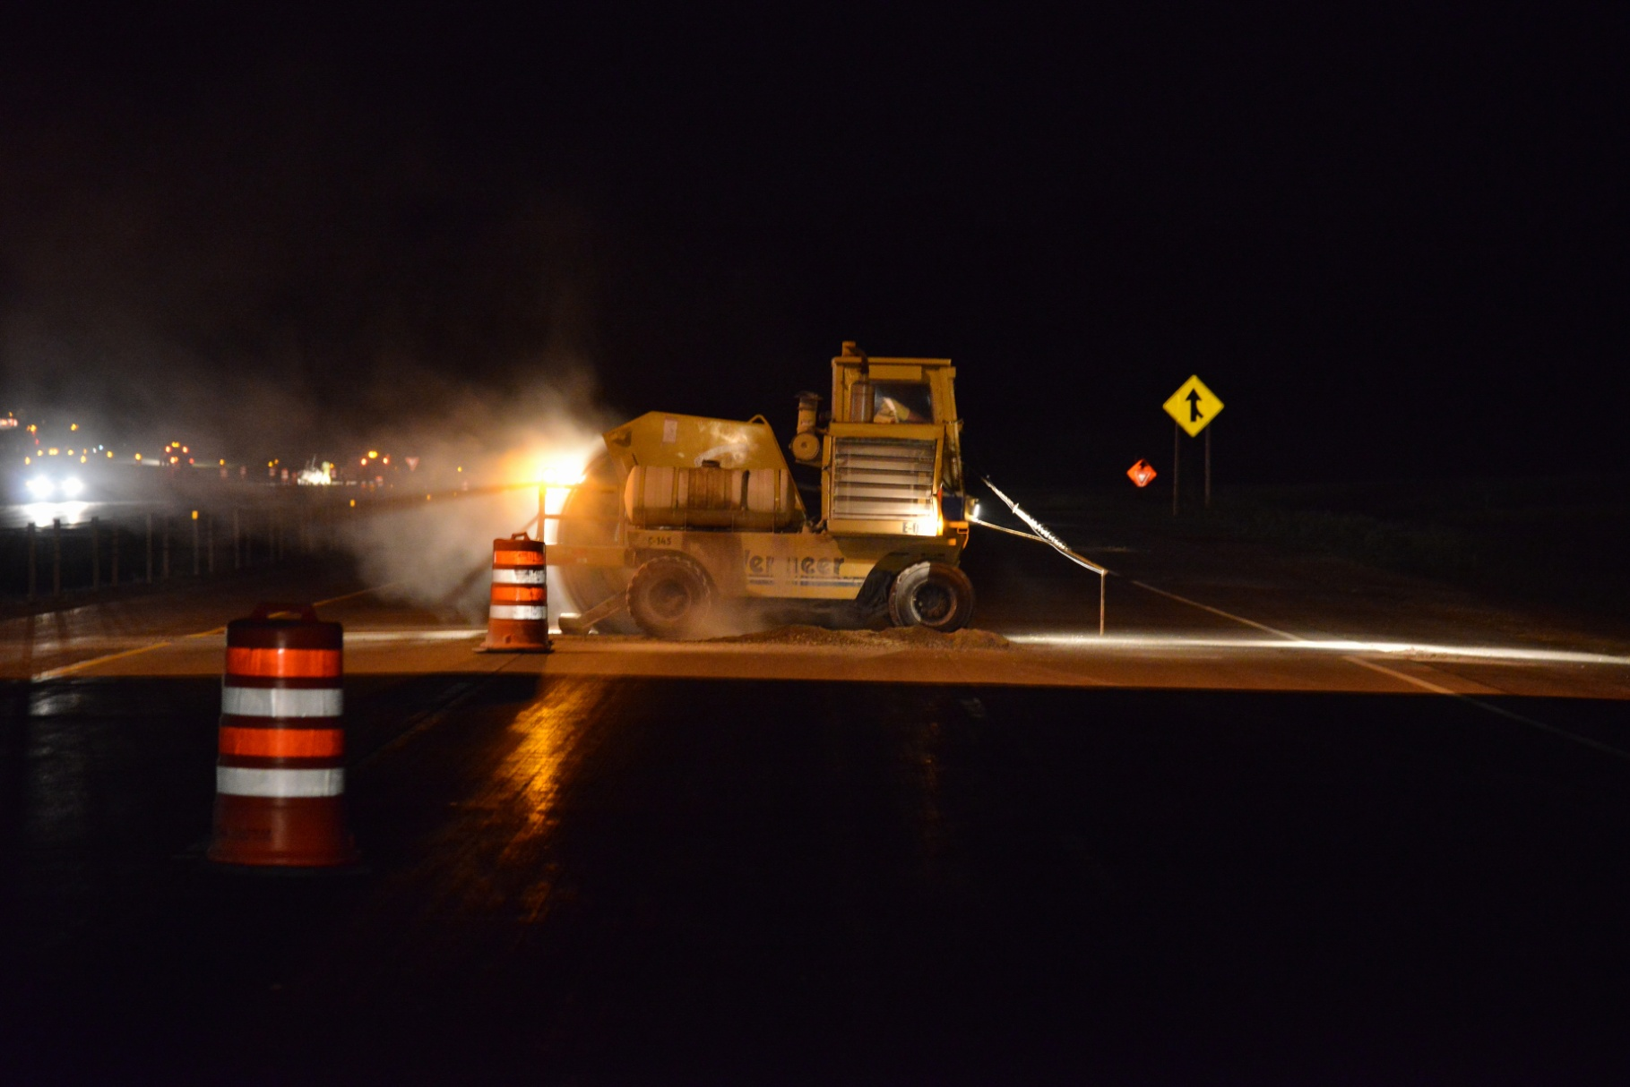
Precast Panel Installation

Slide 23
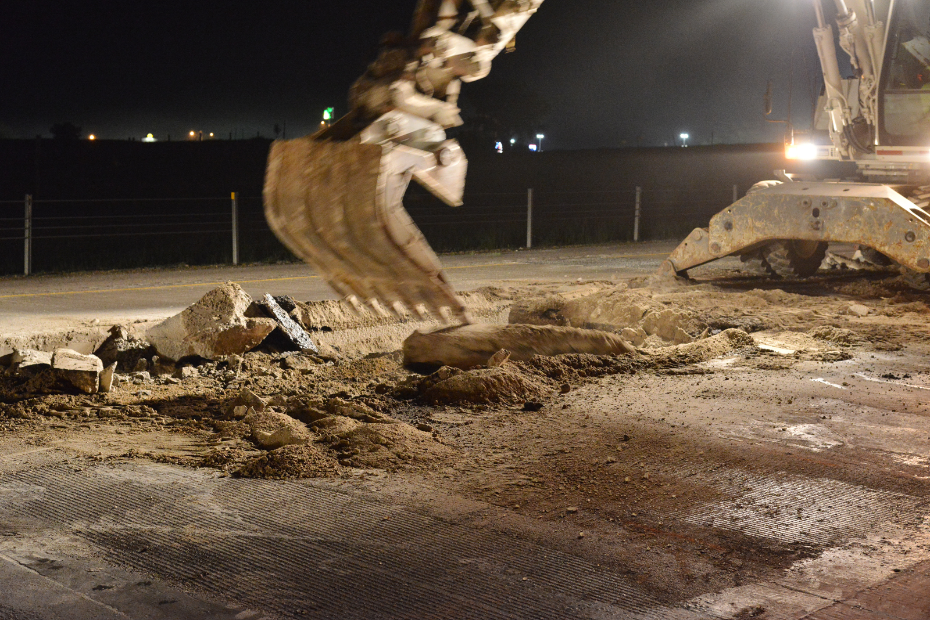
Precast Panel Installation

Slide 24
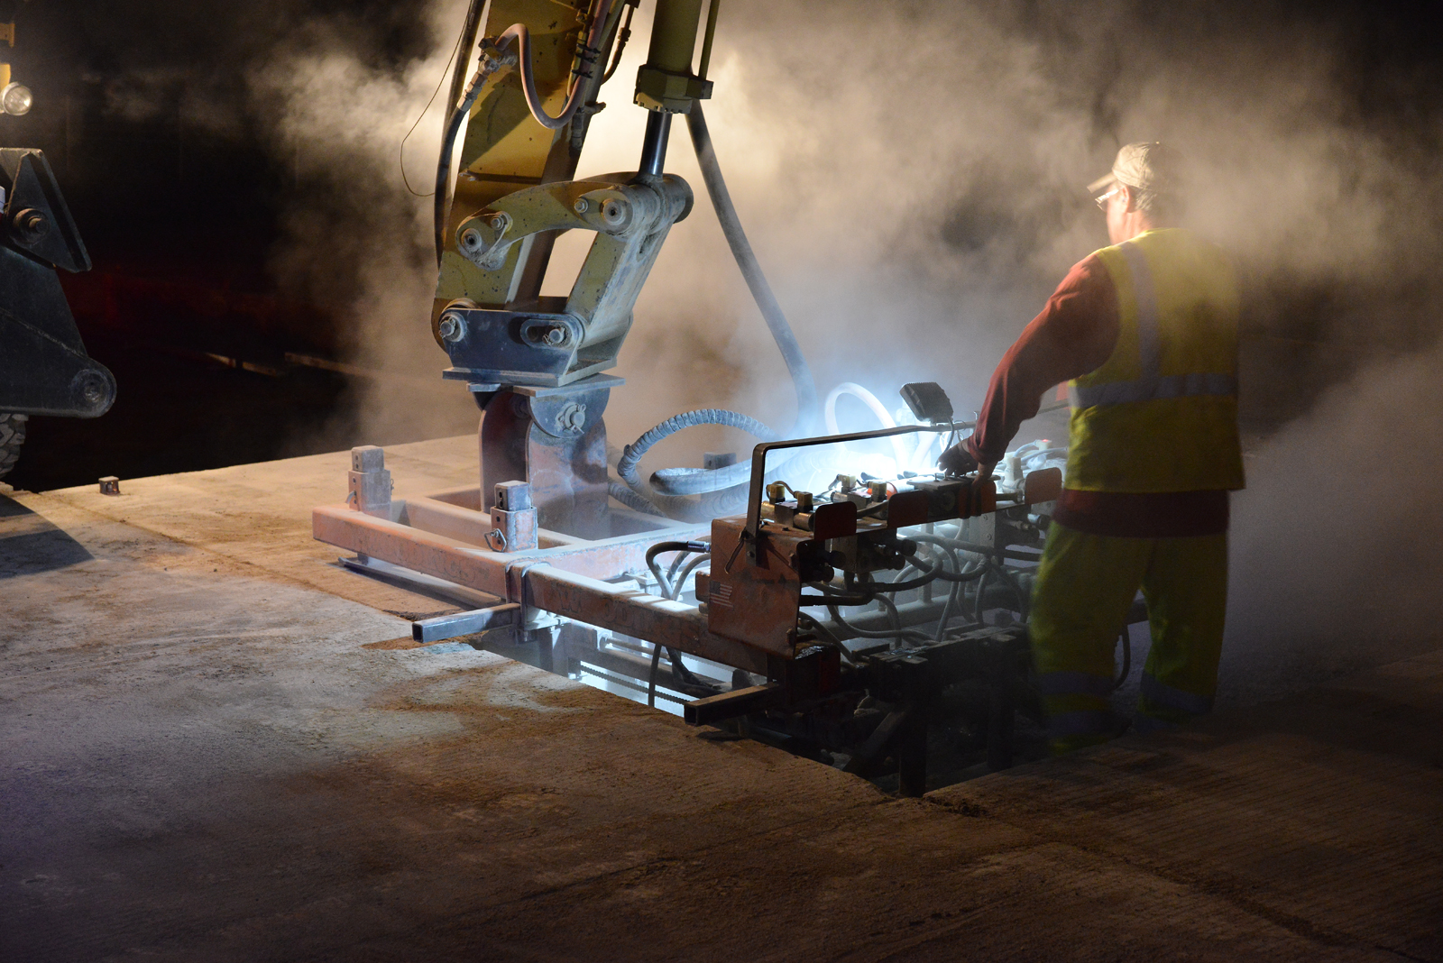
Precast Panel Installation

Slide 25
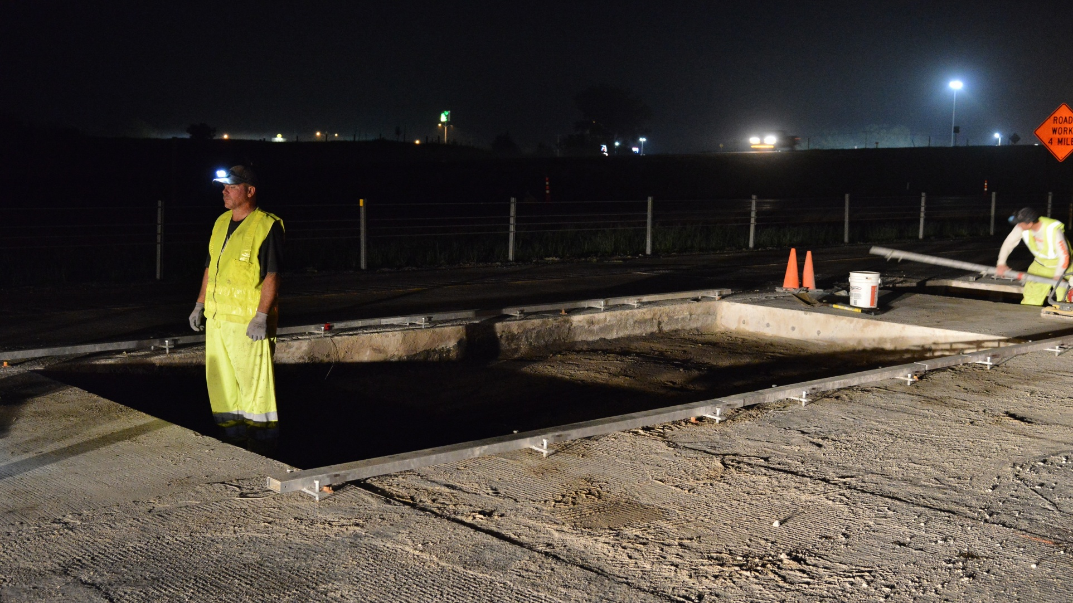
Precast Panel Installation

Slide 26
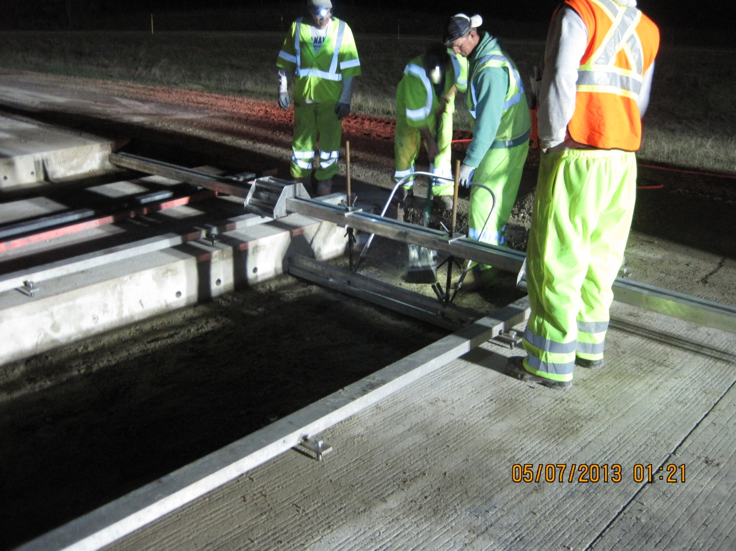
Precast Panel Installation

Slide 27
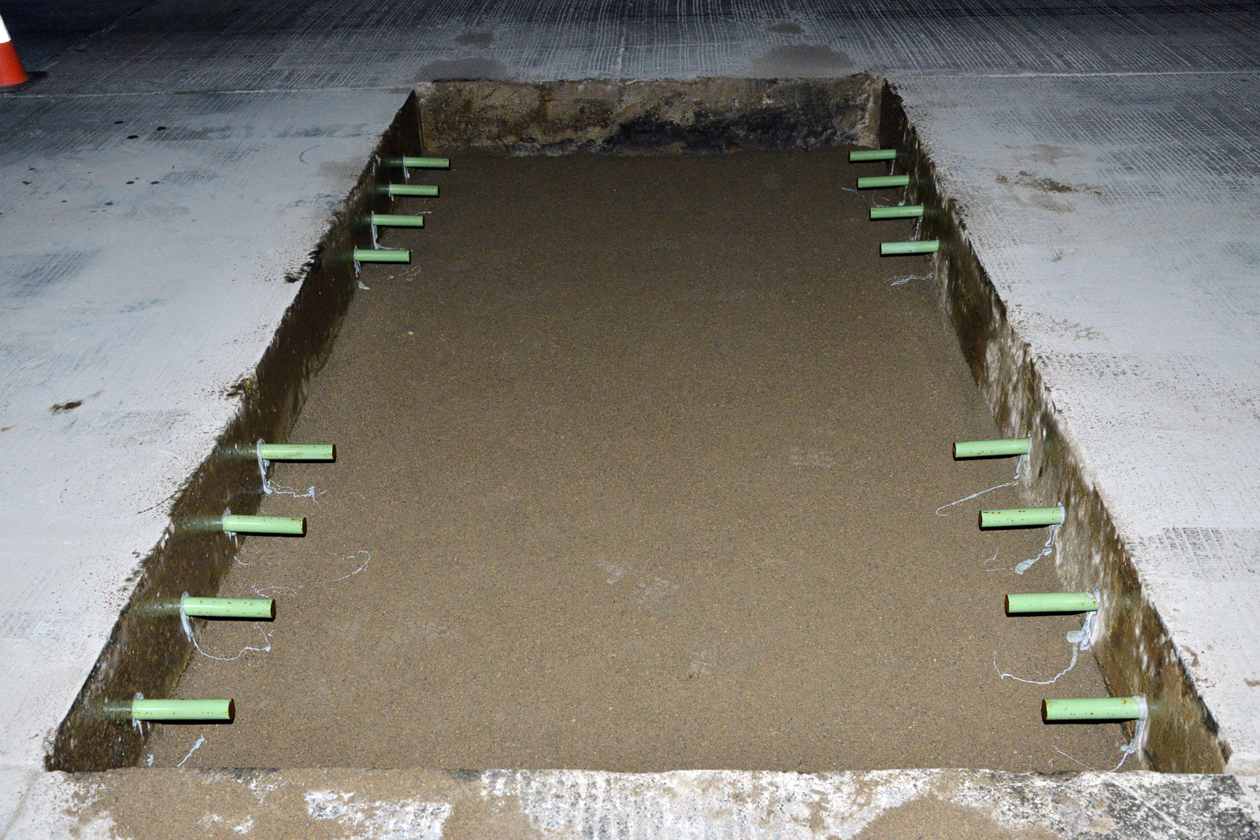
Precast Panel Installation

Slide 28
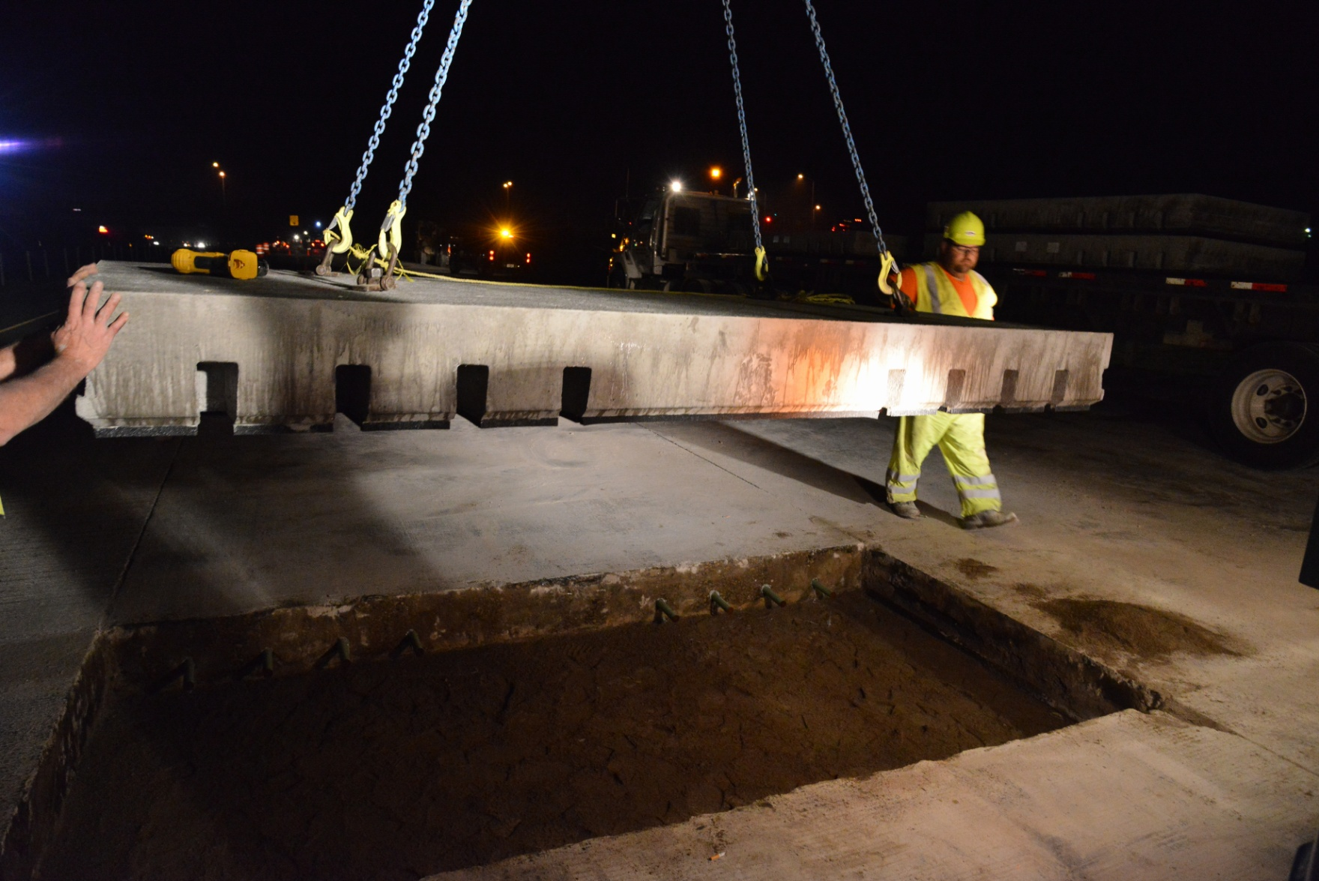
Precast Panel Installation

Slide 29
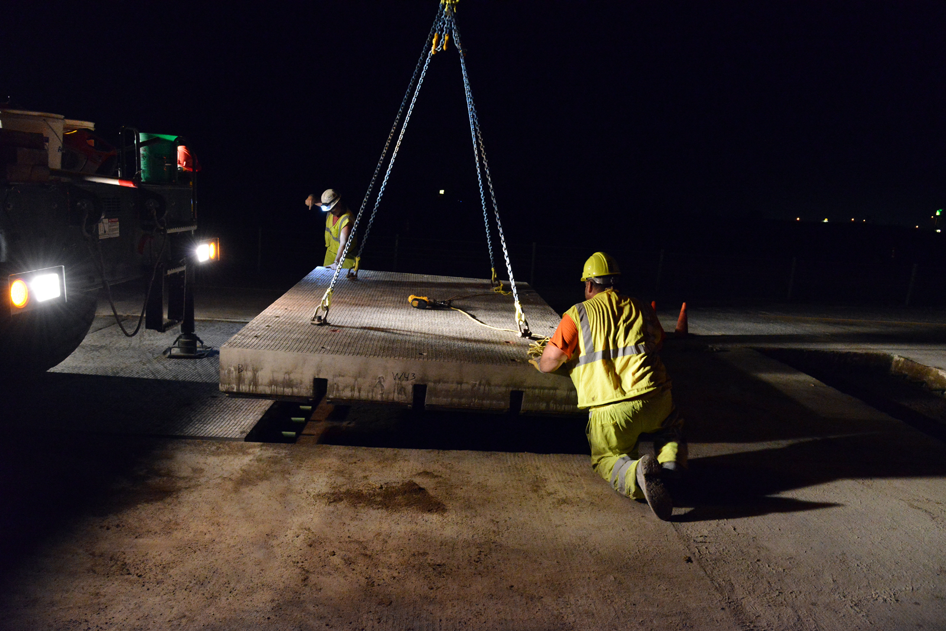
Precast Panel Installation

Slide 30
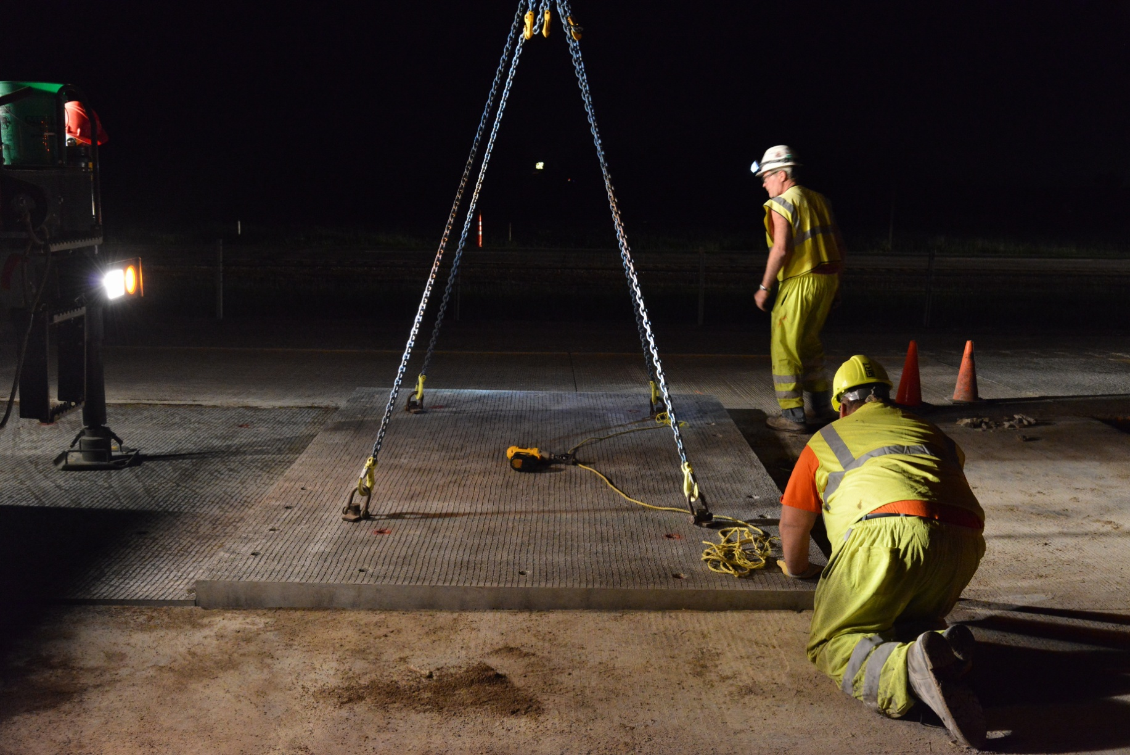
Precast Panel Installation

Slide 31
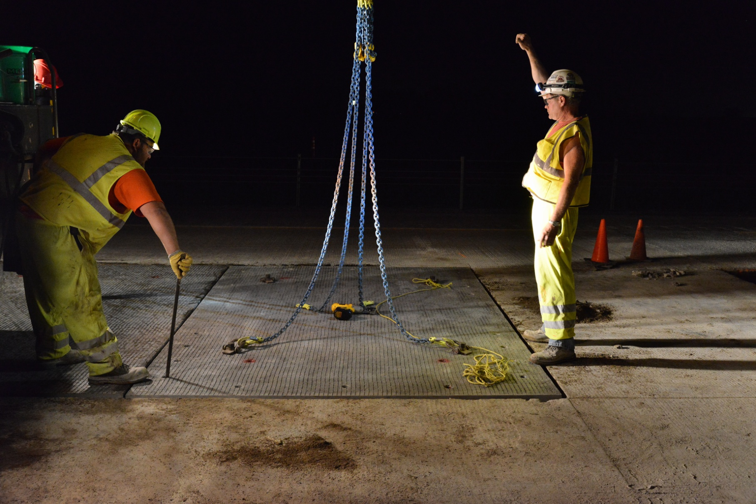
Precast Panel Installation

Slide 32
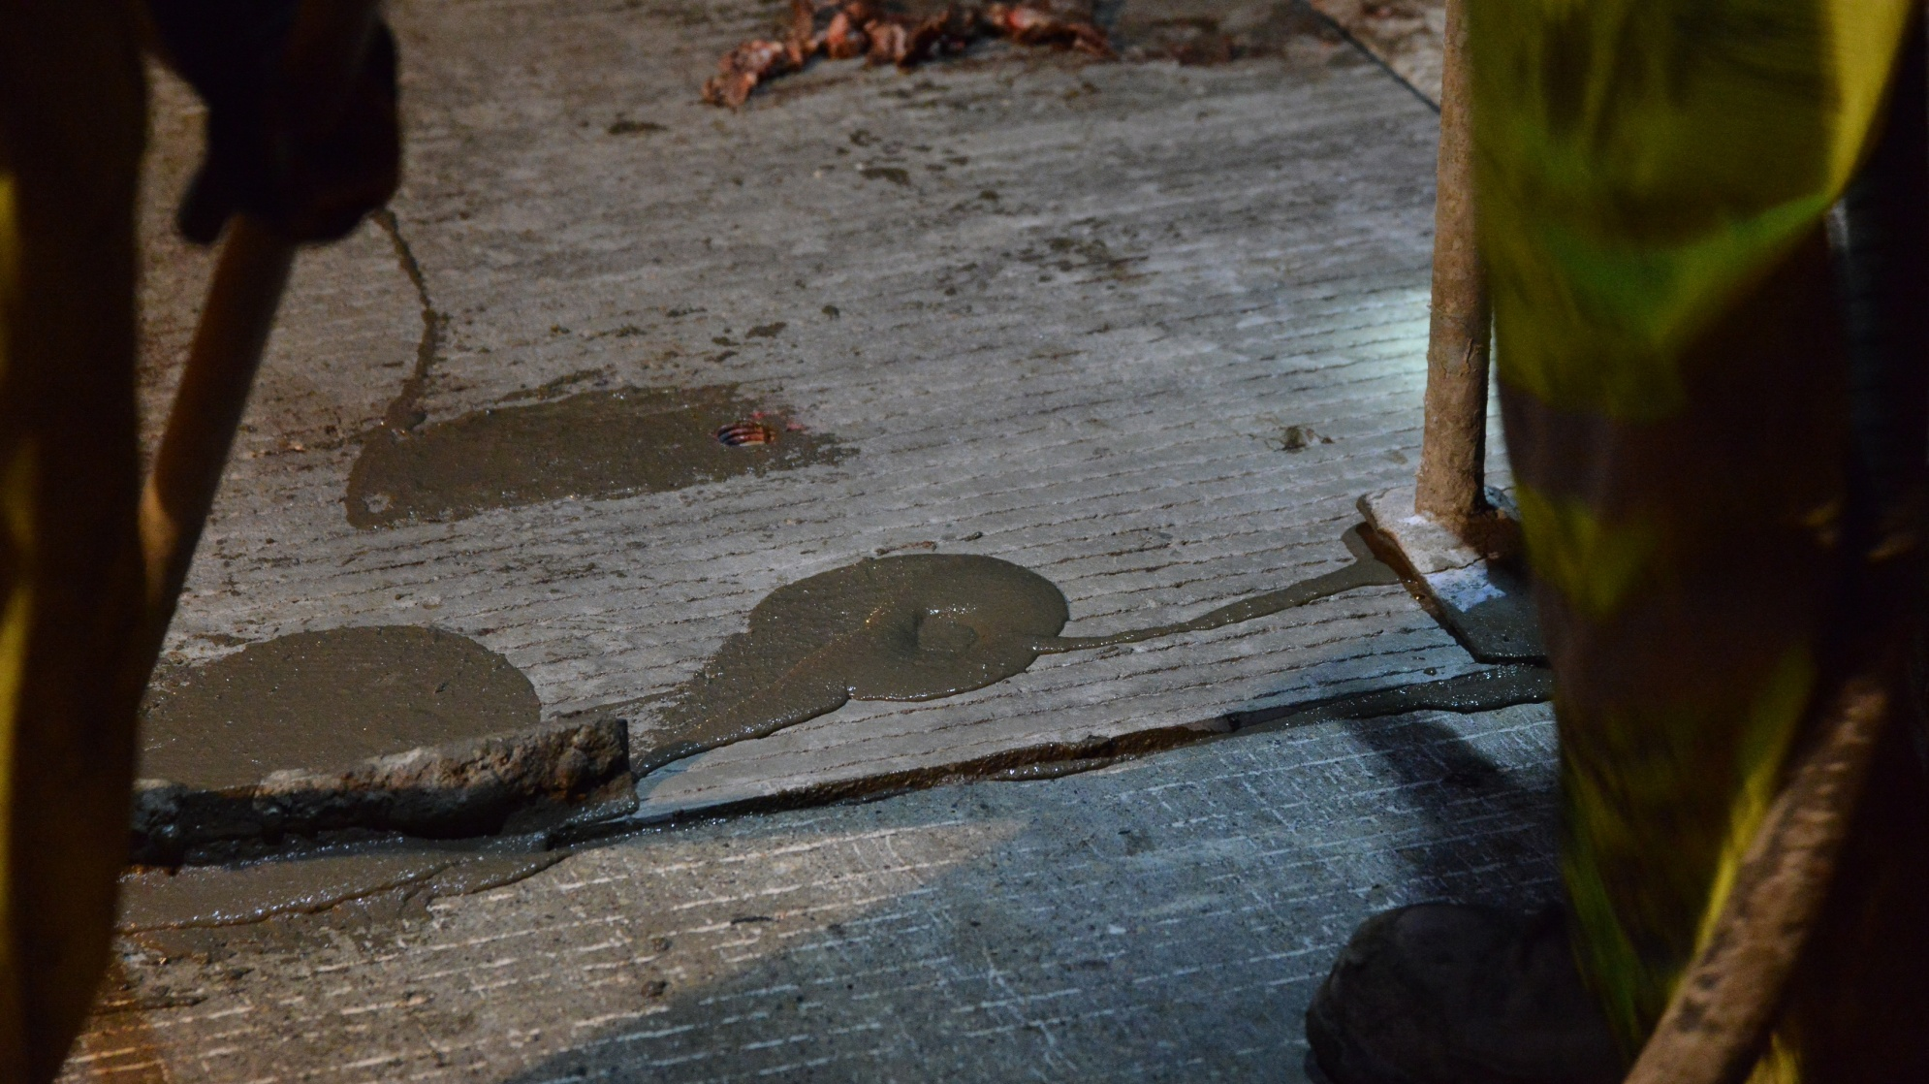
Precast Panel Installation

Slide 33
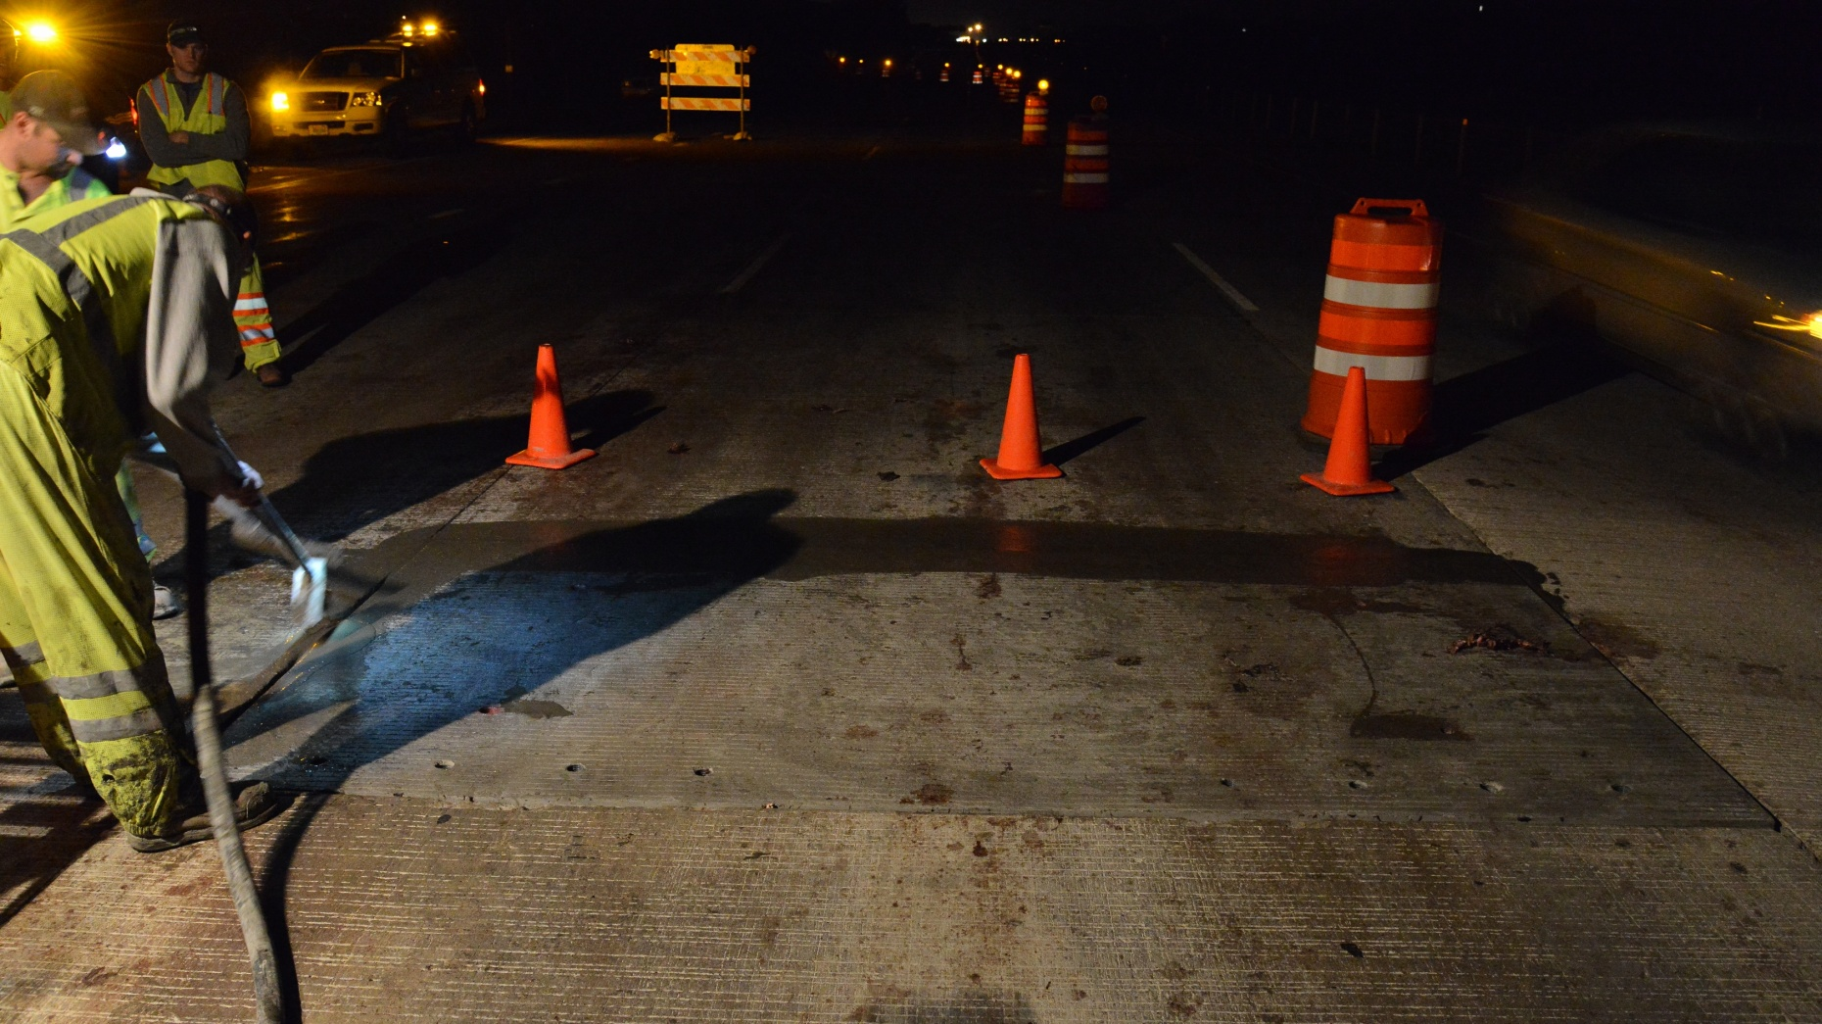
Precast Panel Installation

Slide 34
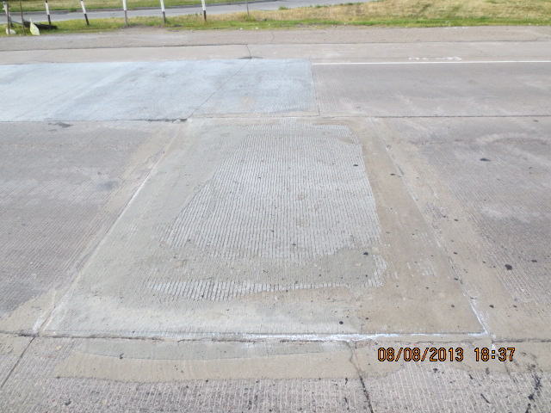
Precast Panel Installation

Slide 35
Lessons Learned
Grout strength vs. temperatures
Grout compressive strength requirement – 3,000 PSI
Sawing
Vertical and precise
Resawing and joint sealing

Slide 36
Precast vs. Cast-in-Place Repairs
Initial cost – 6-by-12-foot repair
Precast – $350 per SY
Cast-in-place – $200 per SY
Ride
Precast better than cast-in-place
Time

Slide 37
Precast Video

Slide 38
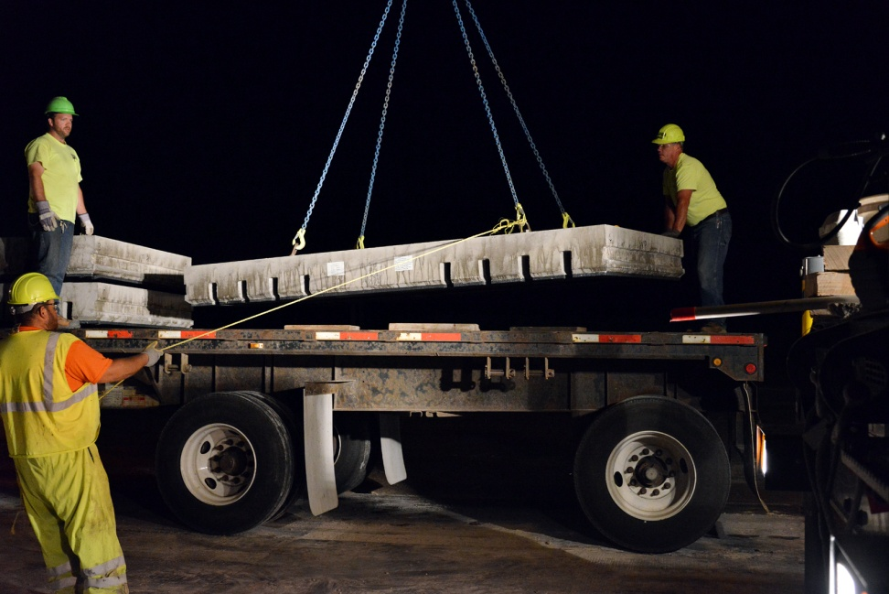
Conclusion
Successful Installation
Quickest method – Multiple nights
Maintenance

Slide 39
Questions?
WisDOT- Tara Weiss, PE – 715.836.2283
tara.weiss@dot.wi.gov

