Slide 1
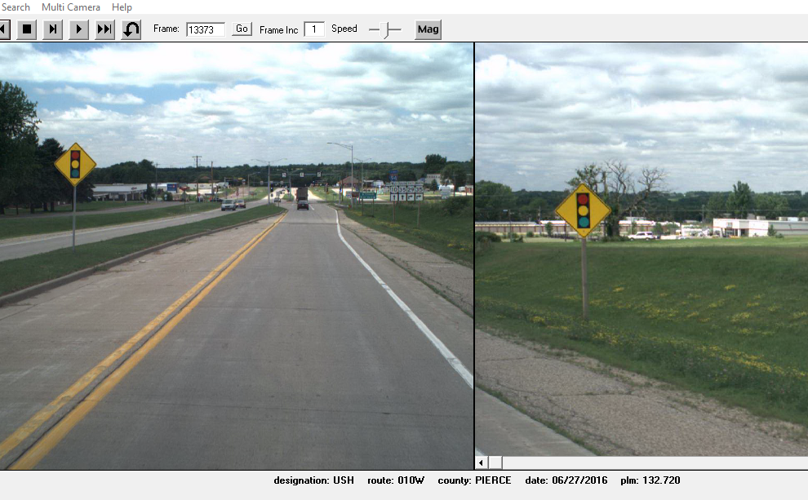
Site 3
Prescott _ Pierce Co _ 2019
USH 10 WB/EB @ 0.12M East of STH 29/35
Black Cat Recorder Mounted on Signal Ahead Sign Post
Black Cat
Recorder

