Slide 1
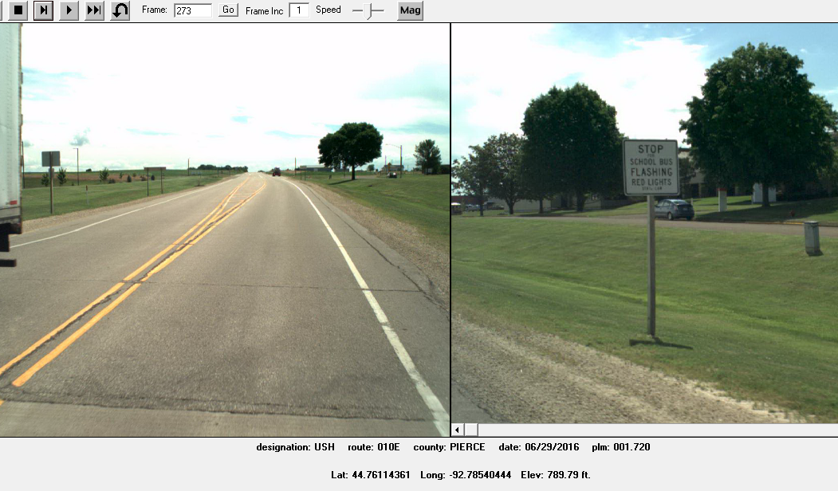
Site 2
Black Cat
Recorder
Prescott _ Pierce Co _ 2019
USH 10 EB @ 0.34M East of STH 29/35
Black Cat Recorder
Mounted on Stop For School Bus Sign Post

