Slide 1
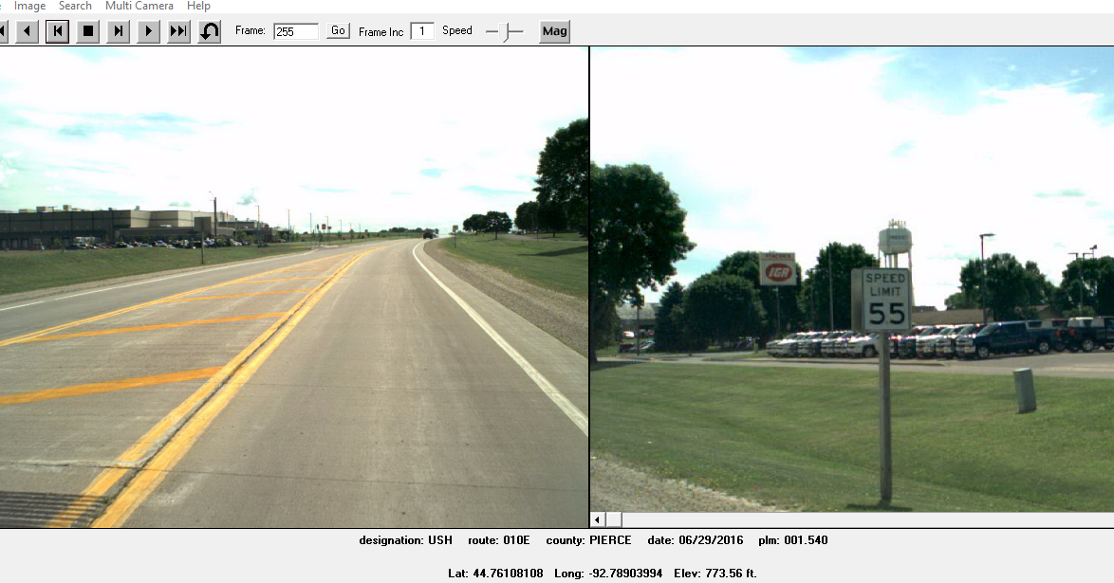
Site 1
Prescott _Pierce Co _ 2019
USH 10 EB/WB @ 0.16M East of STH 29/35
Black Cat Recorder Mounted on 55 MPH Sign
Black Cat
Recorder

