Slide 1
HMA Training
Southeast Region
Waukesha, WI
April 24, 2019
Notes:
Read me notes regarding this WisDOT PowerPoint template: Standard screen size of 1024 by 768, includes either blue or light gray backgrounds
This WisDOT PowerPoint template has a standard (4:3) aspect ratio (1024 x 768).
Use if you will be doing one of the following:
Presenting with a WisDOT projector that displays in standard (4:3) or 1024 x 768.
Presenting at a conference location which uses projectors that display in standard (4:3) or 1024 x 768.
Use the WisDOT PowerPoint template that has the widescreen (16:9) aspect ratio (1920 x 1080) if you will be doing one of the following:
showing your presentation on a large widescreen television.
showing your presentation using a display in widescreen format.
converting your presentation to video in the future.
Title slide
Slide 1 and slide 8 are layouts for the title slide of your WisDOT presentation. The title of your presentation goes at the top in the white text (for the light gray background) or blue text (for the gray background). The title may be one or two lines.
Managing placeholders
If your presentation does not need all the text placeholders, delete the placeholders you do not need and then you may need to lower or adjust the height between lines.
Various slide layouts
Slides 2 through 6 and 9 through 13 are examples of five slide layouts you may use in your presentation. The headline of each example describes which content placeholders are available in its layout. Review the slide layouts and decide which one best suits your content.
Blank slides
Slides 7 and 14 are blank slides for custom layouts in your presentation.
Ways to transfer a PowerPoint presentation from another design to this template.
The recommended way is to copy text line by line, slide by slide, from the other PowerPoint design. Then paste it into Notepad, copy from Notepad, then return to this template, select the text in the desired placeholder and copy. If you would like to get all your text out of the other design at once, choose file, save as .rtf, then copy all text from the .rtf, paste it into Notepad. Then use the Notepad file to copy the text line by line into this template by selecting the desired placeholder and copying. (Notepad will clear styles from the other PowerPoint design.)
How to paste text and keep template’s font styles and color
Select the text in placeholder, then copy. If copying and pasting text into a slide layout does not preserve the template’s font styles, select text in placeholder and right click on the placeholder and select the first paste option: use destination theme. Doing so will keep your pasted text in the font style and color designed for WisDOT template.
How to add more slides with the layout you want
To add a new slide layout to your presentation: in normal view, on the home tab, select new slide. Slide layout options for the WisDOT template will appear. Select the slide layout you want.
Changing a current slide layout on to a different current slide layout is not recommended.
Changing a current slide layout on to a different current slide layout is not recommended, as sometimes this results in additions of unmatched text and placeholders. It’s best to add a new slide layout to your presentation: in normal view, on the home tab, select new slide. Slide layout options for the WisDOT template will appear. Select the slide layout you want and add new text to this slide layout.
When to choose the light gray background
Slides 1 through 7 have a light gray background. Use with its navy and red type styles. Use if you have positive versions of graphics and logos. Some experts say if you're presenting in a small room with most of the lights on, use a lighter gray background, then the background will tend to fade away while the other components will grab attention. Other experts say that if your copy is kept short and sweet, the lightness or darkness of the background is irrelevant, as viewers then have little to read.
When to choose the blue background
Slides 8 through 14 have a dark blue background. Use with its white and gold type styles. Use if you have reverse or negative versions of graphics and logos. Some experts say if you're presenting with most of the lights off in the room or in a darker presentation area, consider using the blue background color, then the background won't intrude on the message and the lighter components will stand out. Other experts say that if your copy is kept short and sweet, the lightness or darkness of the background is irrelevant, as viewers then have little to read.
Use these sizes and colors of fonts for template with LIGHT GRAY background and standard aspect ratio (1024 x 768).
Font sizes may be adjusted either 2 points smaller or 2 points larger from sizes listed.
Slide 1 with GRAY background
Title text = Arial Narrow Bold, 60 point, Color: navy blue R0 G65 B106, Title text may be one or two lines. 3 or more lines are not recommended.
Name of Presenter = Arial Narrow Bold, 47 point, Color: red R164 G40 B76, Keep to 1 line
Title of Presenter = Arial Narrow, 40 point, Color: red R164 G40 B76, Keep to 1 line
Name of conference or event, Location, City, State = Arial Narrow, 28 point, Color: navy blue R0 G65 B106, Keep to 1 or 2 lines
Month, Day, Year = Arial Narrow Bold, 25 point, Color: red R164 G40 B76, Keep to 1 line
Slides 2, 3, 4, 5, 6 with GRAY background
Example heading = Arial Narrow Bold, 45 point, Color: navy blue R0 G65 B106, Heading may be one or two lines. 3 or more lines are not recommended
Red subhead = Arial Narrow Bold, 39 point, Color: red R164 G40 B76, Keep to 1 line
Bullet 1 = Arial Narrow, 35 point, Color: navy blue R0 G65 B106
Bullet 2 = Arial Narrow, 32 point, Color: red R164 G40 B76
Paragraph text = Arial Narrow, 28 point, Color: navy blue R0 G65 B10
Use these sizes and colors of fonts for template with BLUE background and standard aspect ratio (1024 x 768).
Font sizes may be adjusted either 2 points smaller or 2 points larger from sizes listed.
Slide 8 Title slide with BLUE background
Title text = Arial Narrow Bold, 60 point, Color: white R255 G255 B255, Title text may be one or two lines. 3 or more lines are not recommended.
Name of Presenter = Arial Narrow Bold, 47 point, Color: gold R216 G184 B70, Keep to 1 line
Title of Presenter = Arial Narrow, 40 point, Color: gold R216 G184 B70, Keep to 1 line
Name of conference or event, Location, City, State = Arial Narrow, 28 point, Color: white R255 G255 B255, keep to 1 or 2 lines
Month, Day, Year = Arial Narrow Bold, 25 point, Color: gold R216 G184 B70, Keep to 1 line
Slides 9, 10, 11, 12, 13 with BLUE background
Example heading = Arial Narrow Bold, 45 point, Color: white R255 G255 B255, Heading may be one or two lines. 3 or more lines are not recommended
Red subhead = Arial Narrow Bold, 39 point, Color: gold R216 G184 B70, Keep to 1 line
Bullet 1 = Arial Narrow, 35 point, Color: white R255 G255 B255
Bullet 2 = Arial Narrow, 32 point, Color: gold R216 G184 B70
Paragraph text = Arial Narrow, 28 point, Color: white R255 G255 B255
Contact the WisDOT Learn Center for training in PowerPoint. A link to the WisDOT Learn Center may be found on the dotnet home page.

Slide 2

Welcome
Notes:
Chief or supervisor to give welcome.
Kickoff by the department. Briefly discuss the background on why this training is being put on my the department. Options for importance of training (Discuss the large number of dollars that the region spends on HMA pavement, Discuss the number of dollars and hours spent on early distressed pavement, Discuss the number of dollars and hours spent on failing material. The days of make it black and don’t look back are over.
Hand over to Facilitator that is present at training.

Slide 3
Housekeeping Items
Sign-in
Evaluation
Parking lot for questions
Coffee/snacks
Bathrooms
Notes:
- Introduce self
Reminder that there is a sign –in sheet
Grab an evaluation and fill out so we can get some good feedback and possibly tweak the presentation for the upcoming sessions
As we go through the presentation feel free to ask questions but some questions may be answered later in the presentation or better suited for the end. I will park these unanswered questions for us to come back to later.
Coffee and snacks are provided so go ahead and grab something during the break.
Bathroom locations
If you need to take a phone call feel free to step out during the presentation
Please put your phone on silent or vibrate

Slide 4
Introduction
Presenters
  Dan Kopacz, BTS HMA Engineer
  Steve Hefel/James Pforr/Jeff Anderson, BTS
  SE Region, Project Development
  SE Region, Technical Services
Notes:
Introduce the presenters and give brief synopsis of bio.
Dan Kopacz – BTS HMA Engineer – 20 years on WisDOT projects, 5 years Regional Pavement Engineer, 5 years HMA Engineer
Steve Hefel – BTS HMA Supervisor – Years of experience w /HMA or HMA Background or what role plays w/ HMA
James Pforr – BTS Consultant HMA Engineer – Years of experience w /HMA or HMA Background or what role plays w/ HMA
Jeff Anderson – BTS HMA Mix Specialist – Years of experience w /HMA or HMA Background or what role plays w/ HMA
Region Name - Region PDS Title – Years of experience w/ HMA or HMA background
Region Name - Region TSS Title – Years of experience w/ HMA or HMA background

Slide 5

Introduction
Attendees
  Name
  Employer
  2019 construction project
  HMA experience (none, a little, a lot)
Notes:
Go around the room and have the attendees introduce themselves by providing their name, firm, 2019 construction project, and past HMA experience.
Slide note: Change picture to be specific to the state or the region

Slide 6

Training Format
Interactive
  Ask questions
  Share experiences
Notes:
Emphasize that the training is meant to be interactive. We are all on the same team. We tried to keep class sizes smaller so we could discuss some project specifics or questions from individuals.
This training also qualifies for 7 PDHs so we have a handout with questions pertaining to the material in the training.

Slide 7
Overview
HMA Basics (8-33)
Project Setup (34-42)
Paving & Fieldwork (43-118)
Documentation & Closeout (119-129)
Unique Items (130-197)
Region Specific Concerns/Issues (198-207)
Wrap Up (208)
Region Lab Tour
Notes:
Walk thru the schedule.
Hand over to ???? for HMA Basics

Slide 8
HMA Basics

Slide 9
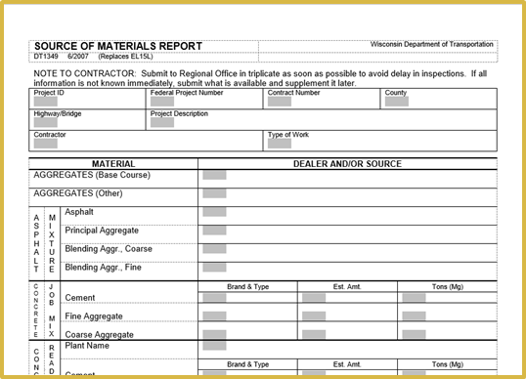
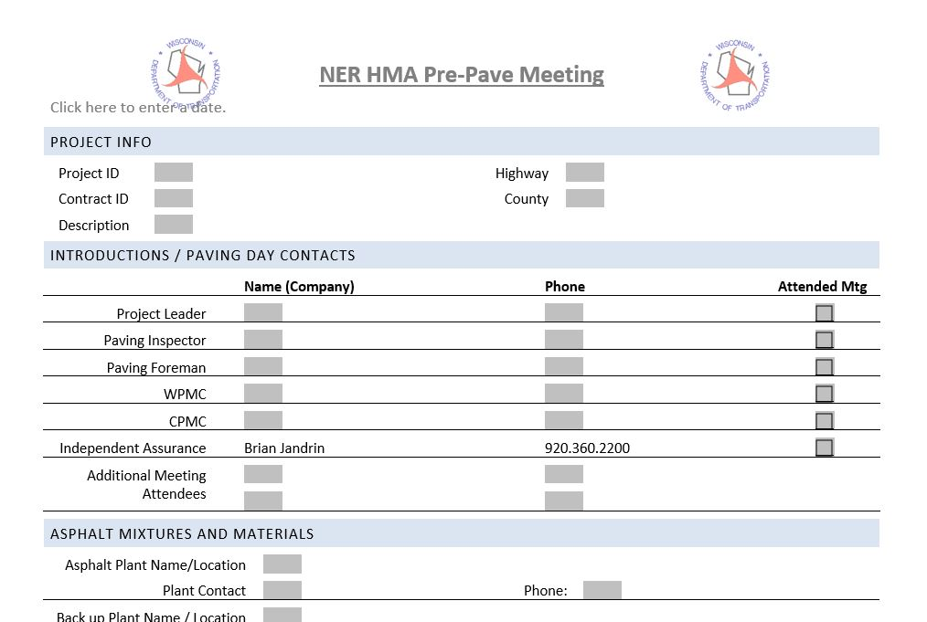
General Outline of a Project
Source of material (DT 1349)
Preconstruction meeting
QMP plan
Pre-pave
  At least 1 week prior to paving
Paving start
Final documentation
  Report w/in 10-days after paving

Slide 10
General Order of Paving Operation
Mill or finish base course
Tack Coat
Delivery of mix
Paving
Breakdown Rolling
Finish Rolling
Test finished product
Documentation
Notes:
This is the general order of paving operations. Details of the process will be discussed in the upcoming slides.

Slide 11
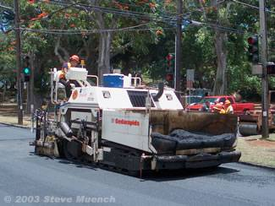
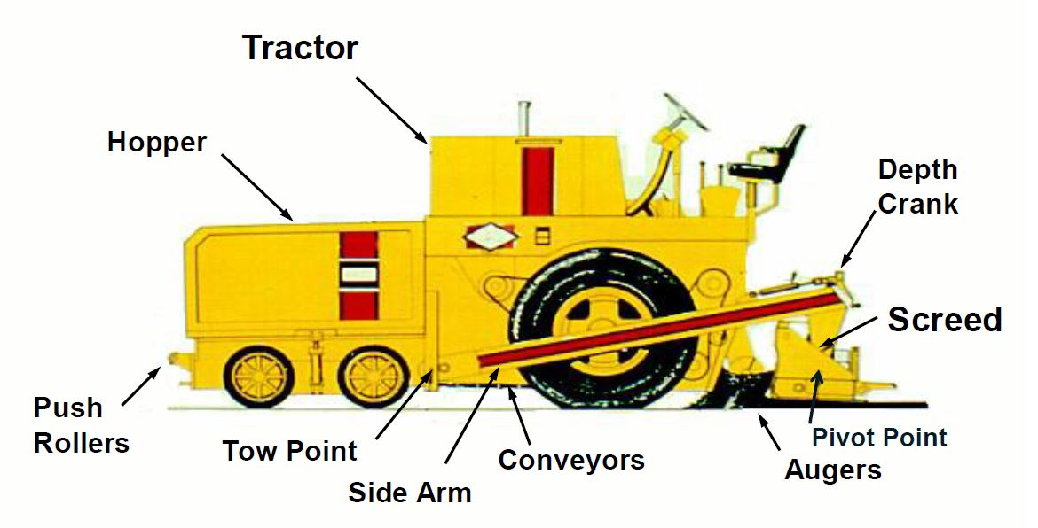
Basic Paving Equipment
Paving Screed
Notes:
First, lets look at some of the basic equipment. Screed. The screed is the first device used to compact the mat and may be operated in the vibratory mode. Approximately 75 to 85 percent of Total Mix Density will be obtained when the mix passes out from under the screed.

Slide 12
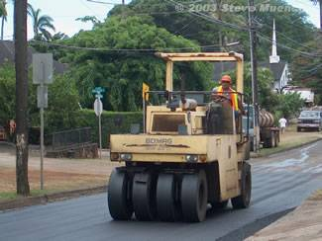
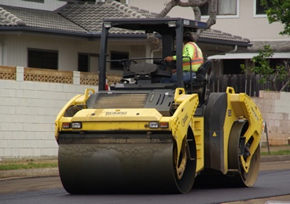
Compaction Sequence
Screed
Breakdown Roller
  Most density gain
Intermediate Roller
  Additional compaction
Finish Roller
  Smooth mat surface
May vary roller type, number, speed, and passes
Notes:
As mentioned earlier, the Screed provides 75-85% compaction of the mix. To achieve the remaining compaction, rollers are necessary.
Generally a series of two or three rollers is used. Contractors can control roller compaction by varying things such as the:
Type of Roller
Number of Rollers
Roller Speed
Number of Passes
Pattern of Passes
Approximately 92 to 95 percent Theoretical Max Density (TMD) will be obtained when all rollers are finished compacting the mat.
Typical roller sequence used in compaction are:
Breakdown Roller. The first roller behind the screed. It generally effects the most density gain of any roller in the paving train.
Breakdown rollers can be of any type but are most often vibratory steel wheel and sometimes pneumatic tire.
Intermediate Roller. Used behind the breakdown roller if additional compaction is needed ***(see Figure 10)***. Pneumatic tire rollers are sometimes used as intermediate rollers because they provide a different type of compaction (kneading action) than a breakdown steel wheel vibratory roller, which can help further compact the mat or at the very least, rearrange the aggregate within the mat to make it receptive to further compaction.
Finish Roller. The last roller in the sequence ***(see Figure 11)***. It is used to provide a smooth mat surface. Although the finish roller does apply compactive effort, by the time it comes in contact with the mat, the mat may have cooled below cessation temperature. Static steel wheel rollers are almost always used as finishing rollers because they can produce the smoothest surface of any roller type.

Slide 13
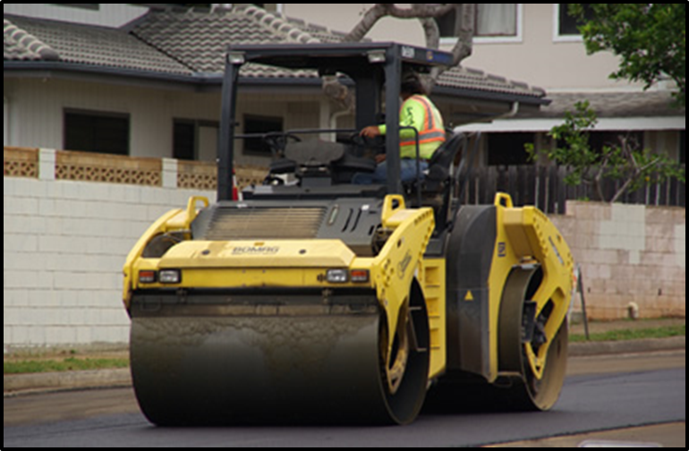
Basic Paving Equipment
Varies in size
Static, Vibratory or Oscillating
Vibratory:
  1,600 – 3,600 Vibrations per minute (10-12 impacts per foot)
  Proper amplitude setting for lift thickness (0.01 – 0.04 Inches)
Steel Wheel Roller
Notes:
Steel Wheeled Roller: They can have one, two or even three drums, although tandem (2 drum) rollers are most often used. The drums can be either static or vibratory and usually range from 35 to 85 inches in width and 20 to 60 inches in diameter.
As a general rule-of-thumb, a combination of speed and frequency that results in 10 – 12 impacts per foot is good. At 3,000 vibrations/minute this results in a speed of 2.8 – 3.4 mph.

Slide 14
Basic Paving Equipment
Varies in size
Static, smooth rubber tires
Uses compressive and kneading action
Proper air pressure is very important
Excellent tool for mix in the tender zone
Pneumatic Tire Roller
Notes:
Pneumatic tire rollers employ a set of smooth tires (no tread) on each axle; typically four or five on one axle and five or six on the other. The tires on the front axle are aligned with the gaps between tires on the rear axle to give complete and uniform compaction coverage over the width of the roller.
In addition to a static compressive force, pneumatic tire rollers also develop a kneading action between the tires that tends to realign aggregate within the HMA.

Slide 15
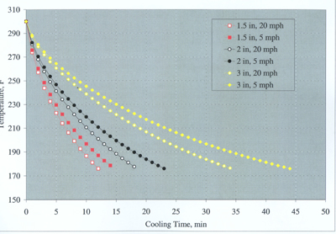
How To Determine Mix Cooling Time
MultiCool
12
44
Notes:
The graph above if from MultiCool (an online/app resource for determining mix temperature). This graph represents that on a 40°F day, the wind speed and the thickness of the paved lift have profound effects on the amount of time available for compaction. On a windy day (20 mph), paving a thin lift (1.5 inches), only about 12 minutes is available before the mix cools to 175°F, whereas paving a 3-inch lift on a calm day will allow for more than 40 minutes to get density in the mat.
Access MultiCool for free:
Online
Mobile Web
Android App
Download for Windows

Slide 16
Production Rates
Plant loading start time
Time to and from project
Number of trucks hauling to job
Average tonnage per truck
Example: 7:00 a.m. load out
1 hour round trip from plant to project
10 Quad axle trucks hauling
Average 22 tons / truck
Approximately 220 tons per hour
Notes:
***Can also be checked using the yield check formula over hour time frame.*** to get the RATE
CMM Yield Formula.

Slide 17
Nuclear Density Gauge Safety
Must be HTCP certified to run tests
Practice ALARA
  As Low As Reasonably Achievable
Radiation Safety Officer (RSO)
WisDOT RSO Michael A Bohn
Work cell: (608) 516-6359
Office: (715) 421-8002
Personal cell: (715) 340-9085
Email: michael.bohn@dot.wi.gov

Slide 18
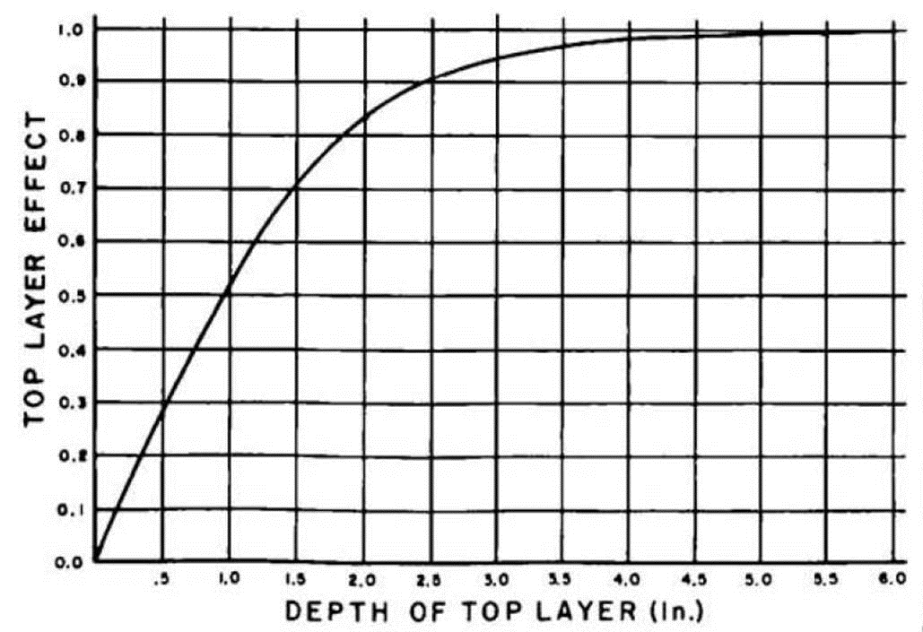
Influence of depth on density gauge

Slide 19
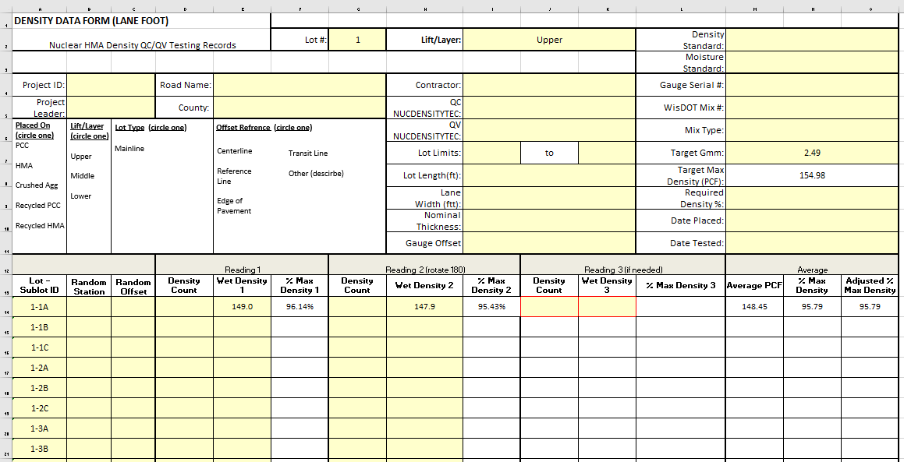
1-Min Nuclear Density Testing Times
Applicable to all projects beginning 2019
3rd reading if necessary
> 1 pcf?

Slide 20
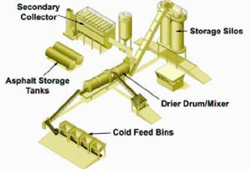
General tour of an Asphalt Plant
General tour of plant
Notes:
To Tour the Plant you may have to change settings in Microsoft Edge. Tour about 2 minutes.
Enable Flash on Edge
Use the following steps to allow Flash content in Microsoft Edge:
On your computer, open Microsoft Edge.
On the top right-hand corner, click the icon.
Click Settings near the bottom of the menu that appears
Click View advanced settings under the Advanced Settings header
Toggle Use Adobe Flash Player to On

Slide 21


Drum Mixer
Inside the Drum
The drum is equipped with longitudinal troughs or “flights”
  Lift the aggregate & drop it in veils through the hot gases
  Drum slope, rotation speed, diameter, length and arrangement & number of flights determine the time the aggregate will need to dry & heat

Slide 22
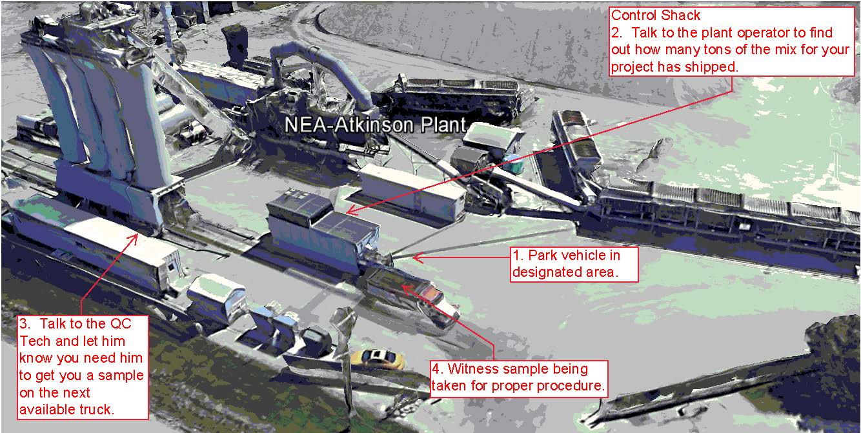
Checking into an Asphalt Plant
Notes:
Talk through notes on slide.
Should not wait for exact random tonnage. Check with project staff on tons placed in the field to get close to the random tonnage.

Slide 23
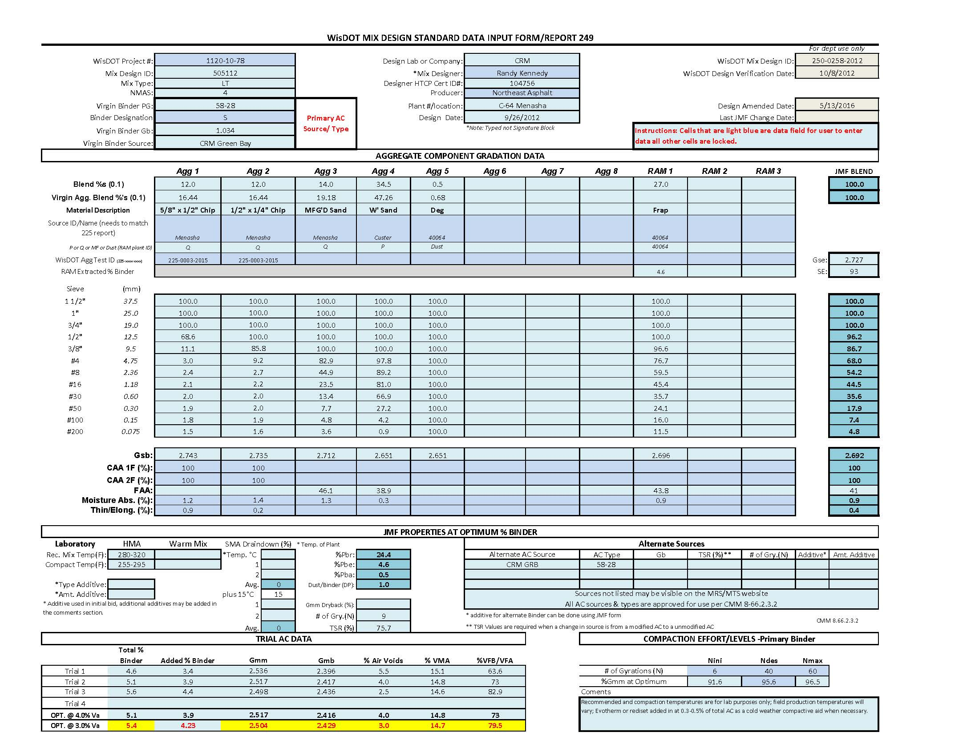
Basic Mix Design
Notes:
MAXIMUM THEORETICAL SPECIFIC GRAVITY (Gmm) Also known as the Rice Test – Ratio of the weight of a unit volume of uncompacted HMA mixture to the weight of an equal volume of water. REGION TESTS
BULK SPECIFIC GRAVITY (Gmb) is a ratio of the weight of a unit volume of compacted HMA mixture to the weight of an equal volume of water. This is determined using the Asphalt pucks made in the lab. REGION TESTS
AIR VOIDS (Va) are small air spaces or pockets of air that occur between the coated aggregate particles in the final compacted mix. A certain percentage of air voids is necessary in all dense-graded highway mixes to allow for some additional pavement compaction under traffic and to provide spaces into which small amounts of asphalt can flow during this subsequent compaction. REGION CALCULATES
VOIDS IN THE MINERAL AGGREGATE (VMA) are the air-void spaces that exist between the aggregate particles in a compacted paving mixture, including spaces filled with asphalt. VMA represents the space that is available to accommodate the asphalt and the volume of air voids necessary in the mixture. The more VMA in the dry aggregate, the more space is available for the film of asphalt. REGION CALCULATES
ASPHALT BINDER CONTENT (Pb) affects HMA mixture performance in the areas of stiffness, strength, durability, fatigue life, raveling, rutting and moisture damage. Aggregate gradation is directly related to optimum asphalt content. The finer the mix gradation, the larger the total surface area of the aggregate and the greater the amount of asphalt required to uniformly coat the particles. REGION WILL BE TESTING FOR INFO ONLY ON PWL currently given from the contractor
BULK SPECIFIC GRAVITY (Gsb) value is used to calculate the amount of asphalt binder absorbed by the aggregate and the VMA of the HMA mixture. REGION IS GIVEN FROM CONTRACTOR

Slide 24
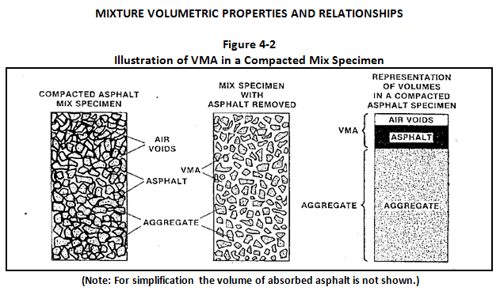
Notes:
Air Content Percentage is determined using the data from both the Rice and Puck tests (Gmm & Gmb)
Voids in the Mineral Aggregate is determined using the Puck (Gmb), Bulk Specific Gravity of the Aggregate (Gsb) from the mix design, and the percent binder in the mix.
Prior to 2019 construction, the asphalt content was determined by using the mix design percentage. With the introduction of the ignition ovens, the state is able to determine the actual asphalt content in the mix.

Slide 25
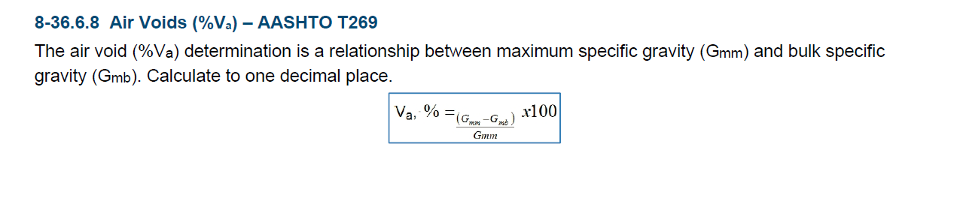
Example Calculation of Air Voids
Notes:
MAXIMUM THEORETICAL SPECIFIC GRAVITY (Gmm) Also known as the Rice Test – Ratio of the weight of a unit volume of uncompacted HMA mixture to the weight of an equal volume of water. REGION TESTS
BULK SPECIFIC GRAVITY (Gmb) is a ratio of the weight of a unit volume of compacted HMA mixture to the weight of an equal volume of water. This is determined using the Asphalt pucks made in the lab. REGION TESTS
AIR VOIDS (Va) are small air spaces or pockets of air that occur between the coated aggregate particles in the final compacted mix. A certain percentage of air voids is necessary in all dense-graded highway mixes to allow for some additional pavement compaction under traffic and to provide spaces into which small amounts of asphalt can flow during this subsequent compaction. REGION CALCULATES
VOIDS IN THE MINERAL AGGREGATE (VMA) are the air-void spaces that exist between the aggregate particles in a compacted paving mixture, including spaces filled with asphalt. VMA represents the space that is available to accommodate the asphalt and the volume of air voids necessary in the mixture. The more VMA in the dry aggregate, the more space is available for the film of asphalt. REGION CALCULATES
ASPHALT BINDER CONTENT (Pb) affects HMA mixture performance in the areas of stiffness, strength, durability, fatigue life, raveling, rutting and moisture damage. Aggregate gradation is directly related to optimum asphalt content. The finer the mix gradation, the larger the total surface area of the aggregate and the greater the amount of asphalt required to uniformly coat the particles. REGION WILL BE TESTING FOR INFO ONLY ON PWL currently given from the contractor
BULK SPECIFIC GRAVITY (Gsb) value is used to calculate the amount of asphalt binder absorbed by the aggregate and the VMA of the HMA mixture. REGION IS GIVEN FROM CONTRACTOR

Slide 26
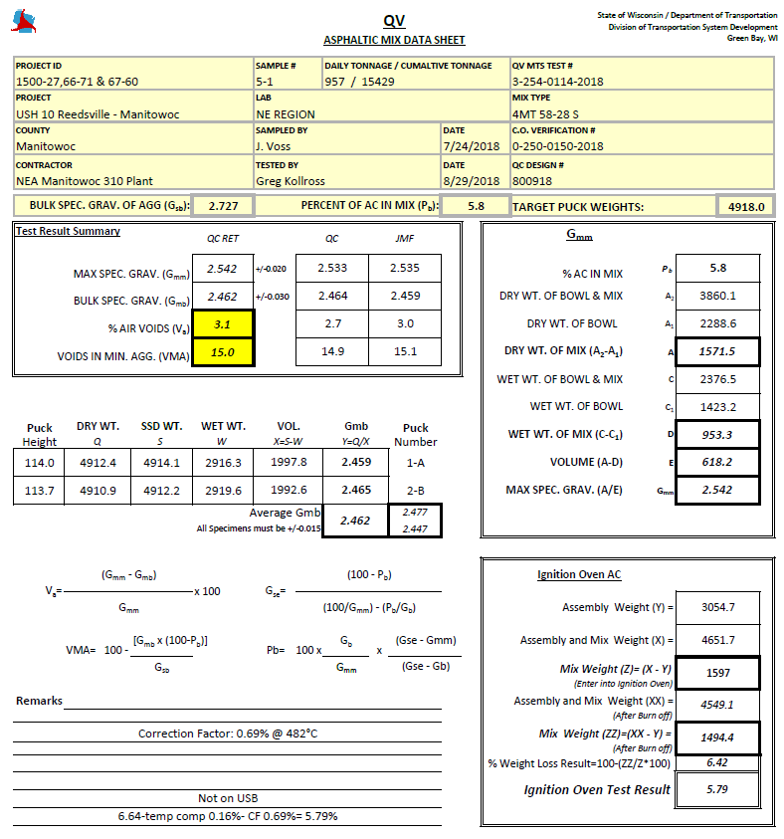
Example Calculation of Air Voids (Con’t)
Notes:
MAXIMUM THEORETICAL SPECIFIC GRAVITY (Gmm) Also known as the Rice Test – Ratio of the weight of a unit volume of uncompacted HMA mixture to the weight of an equal volume of water. REGION TESTS
BULK SPECIFIC GRAVITY (Gmb) is a ratio of the weight of a unit volume of compacted HMA mixture to the weight of an equal volume of water. This is determined using the Asphalt pucks made in the lab. REGION TESTS
AIR VOIDS (Va) are small air spaces or pockets of air that occur between the coated aggregate particles in the final compacted mix. A certain percentage of air voids is necessary in all dense-graded highway mixes to allow for some additional pavement compaction under traffic and to provide spaces into which small amounts of asphalt can flow during this subsequent compaction. REGION CALCULATES
VOIDS IN THE MINERAL AGGREGATE (VMA) are the air-void spaces that exist between the aggregate particles in a compacted paving mixture, including spaces filled with asphalt. VMA represents the space that is available to accommodate the asphalt and the volume of air voids necessary in the mixture. The more VMA in the dry aggregate, the more space is available for the film of asphalt. REGION CALCULATES
ASPHALT BINDER CONTENT (Pb) affects HMA mixture performance in the areas of stiffness, strength, durability, fatigue life, raveling, rutting and moisture damage. Aggregate gradation is directly related to optimum asphalt content. The finer the mix gradation, the larger the total surface area of the aggregate and the greater the amount of asphalt required to uniformly coat the particles. REGION WILL BE TESTING FOR INFO ONLY ON PWL currently given from the contractor
BULK SPECIFIC GRAVITY (Gsb) value is used to calculate the amount of asphalt binder absorbed by the aggregate and the VMA of the HMA mixture. REGION IS GIVEN FROM CONTRACTOR

Slide 27
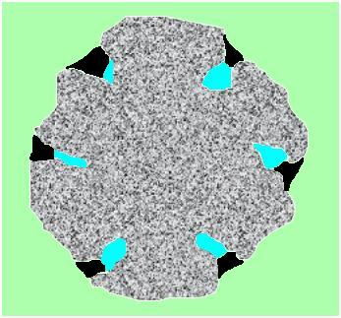

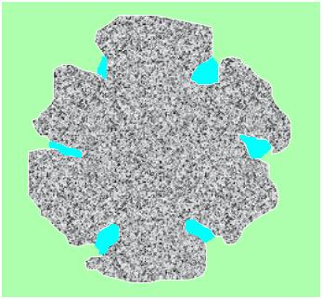
Aggregate Properties
Absorption:
  Capacity to absorb water or Asphalt
Specific Gravity
  Ratio between the weight of a given volume of the aggregate and the weight of an equal volume of water (@23°C).
  Means of expressing a weight – volume relationship
Effective
Apparent
Bulk
Notes:
The higher the specific gravity the lower the percent binder
Gse represents how much binder penetrates into the aggregate pores
Gsa doesn’t account for any porosity
Gsb is weight/bulk volume (includes porosity)

Slide 28
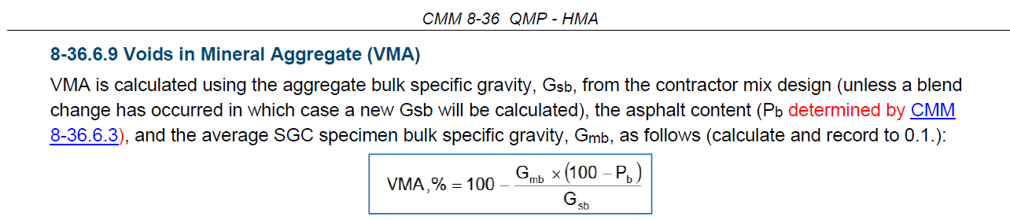
Example Calculation of VMA
Directly affected by Aggregate Bulk Specific Gravity
Notes:
Specific gravity of aggregate determines the amount of VMA or room for AC/air in the mix. Needs to be accurate.

Slide 29
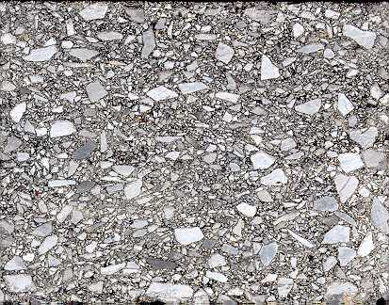
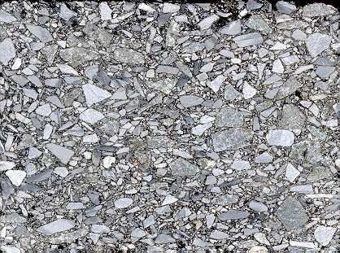
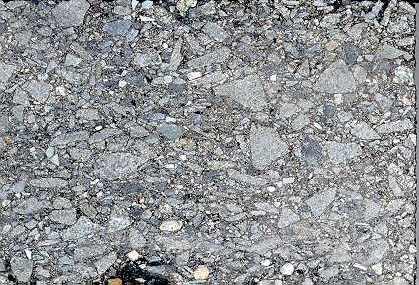
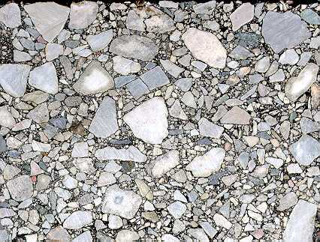
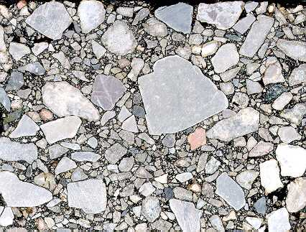
Mix Designations
9.5 mm (#5)
12.5 mm (#4)
19.0 mm (#3)
25.0 mm (#2)
37.5 mm (#1)

Slide 30
WisDOT Mix Designations
LT < 1 Million ESALs
MT 1-8 Million ESALs
HT >8 Million ESALs
SMA >2 Million ESALs
  Applies to surface mixes only
Notes:
Note change from 2 M ESALs to 1 M ESALs for LT and MT mixes.

Slide 31
Mix Relationships
SMA
Durability & Stability
high
Durability
low
Stability
LT
MT
HT
low ESALS high

Slide 32
List of HMA Forms
HMA Pre-Pave Agenda
QMP Nuc Density Spec
PG Binder Sample Tag (DT1352)
Nuclear Density Forms
155 HMA Mix and Density Summary Templates
Other miscellaneous forms can be found in:
  CMM
  Pantry

Slide 33


Slide 34
Project Setup

Slide 35
Contract Documents
Addenda
Construction Notes/ASP 6
Special provisions (includes STSP’s and SPV’s)
Plans/Proposals
Standard Specifications
CMM (may or may not be contractual)

Slide 36
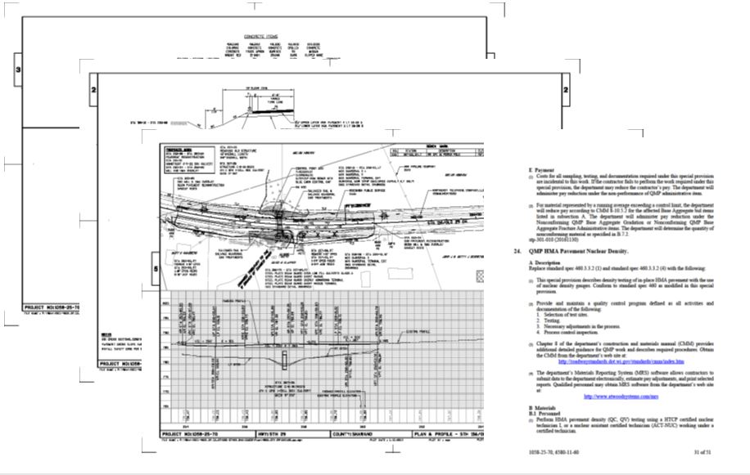
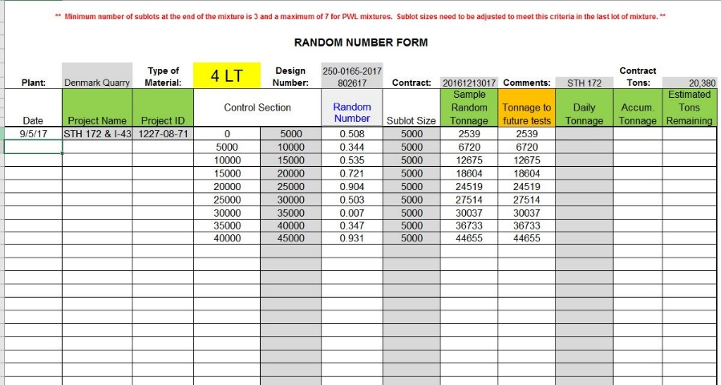
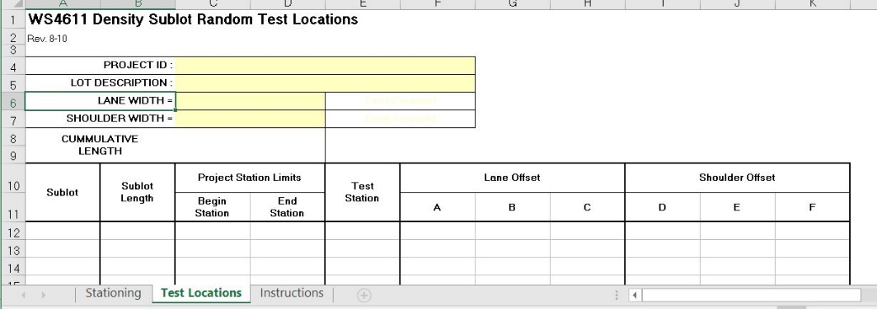
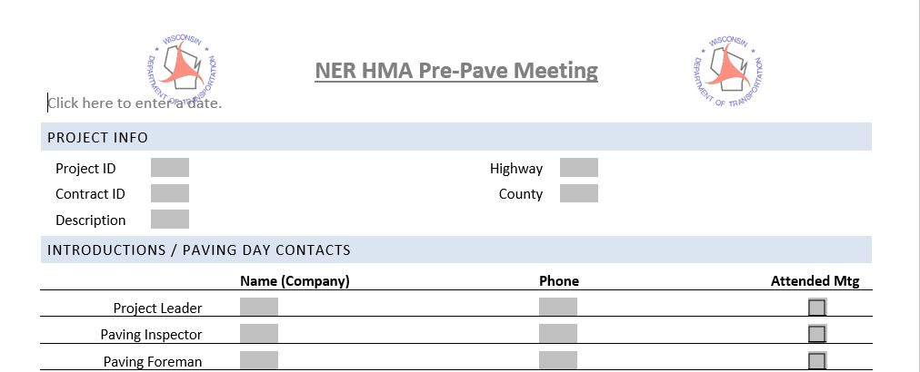
Project Set-up
Review plans & specials
QC
Review QMP
Number of samples
Random numbers for QV
Pre-pave meeting
Post pre-pave meeting
Notes:
List the following subjects we will cover in this section.

Slide 37

Review Plan & Specials
Miscellaneous Quantities
Plan & Profile
Typicals
Specials
Notes:
When preparing for an HMA project, the first item to review are the contract documents. The plans and specials will indicate items such as quantity, location, mix type and special construction details.

Slide 38
Checklist for plan review
Check stationing and quantities
Locating sawcuts and matchpoints
Verifying depth changes within the typicals.
Reviewing bid items and special provisions to know if there are unique requirements.
Notes:
When reviewing the plans and specials, it is important to check the following:
Check stationing and quantities
Locating sawcuts and matchpoints
Verifying depth changes within the typicals.
Reviewing bid items and special provisions to know if there are unique requirements.

Slide 39
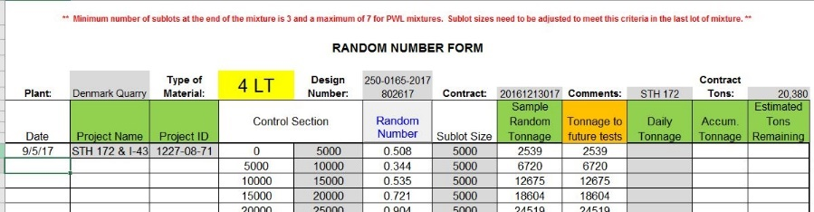
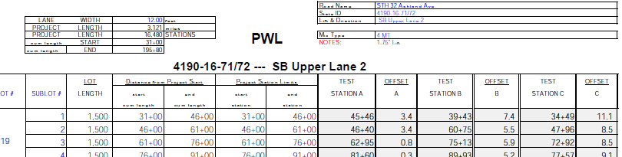
Review QC Plan & Random Numbers
Notes:
Once a good grasp of the paving scope is had then the mix design and QC random numbers are to be reviewed. The number of QV samples and random numbers for the samples can be generated. Most of the planning for the paving project should be done before the PrePave meeting.

Slide 40
Figure out # QV samples needed (Mix & Density)
Mix Testing
QMP Projects
  1 sample per 5000 tons
Binder Testing
  >1,000 tons mix
  1 In-Line 1 quart sample required per 15,000 tons of mix
Density Testing
QMP Projects
  Test 10 % of the sublots tested by the QC Tests (1500 lane feet or 750 tons) and 1 sublot per mix design
QMP HMA Pavement Nuclear Density
Notes:
However, For PWL, SMA and CIR the differences will be talked about later.
QMP The department will perform verification testing at a minimum frequency of 10 percent of the sublots and a minimum of one sublot per mix design.
QMP A lot consists of the tonnage placed each day for each layer and target density specified in standard spec 460.3.3.1. A lot may include partial sublots.
QMP Lane Feet
Divide the roadway into sublots. A sublot is 1500 lane feet for each layer and target density.
QMP Tonnage
If a side road, crossover, turn lane, or ramp is less than 1500 feet long, determine sublots using a maximum of 750 tons per sublot and perform the number of random tests as specified:
Side Roads, Turn Lanes, Crossovers, Ramps, Roundabouts:
Sublot/Layer tonnage Minimum Number of Tests Required
25 to 100 tons 1
101 to 250 tons 3
251 to 500 tons 5
501 to 750 tons 7

Slide 41
Pre-Pave & Post–Pave Meetings
Setup pre-pave before paving
  Time to resolve any issues
Post pre-pave meeting
  Project staff only to discuss any staff concerns involving documentation, inspection, testing, roles and responsibilities, etc.
Location of forms:
  Pantry Files – https://awpkb.dot.wi.gov/Content/constr/Pantry/Pantry.htm

Slide 42



Slide 43
Paving & Fieldwork

Slide 44
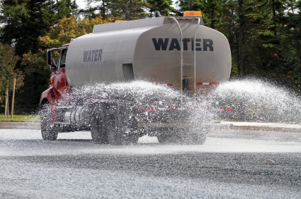

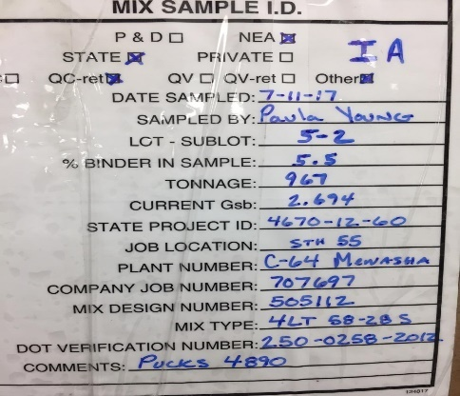
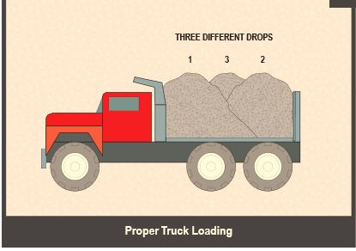
Paving & Inspection
Density
Mix Section
Misc.
Notes:
In the Paving and Field Work section, we will discuss paving & inspection duties, HMA mixes, density testing, and some additional need to be aware of information.

Slide 45
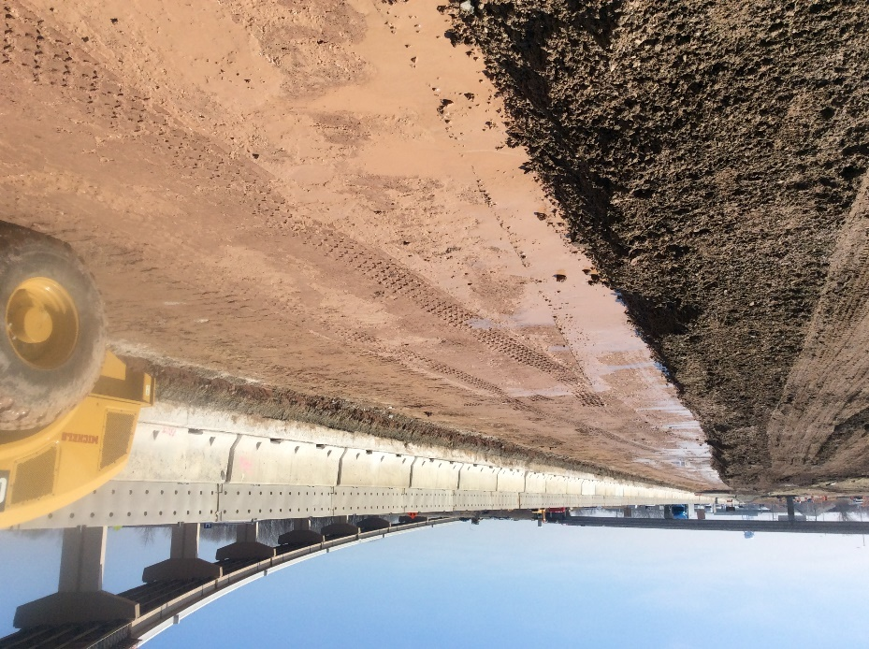
Subgrade Inspection
Cross slope and longitudinal grade check
Check crown and superelevation
Incorrect slope or grade will cause incorrect base thickness
Soft and yielding soil
Proof roll prior to base placement
Failing Subgrade Proof Roll.MOV
Passing Subgrade Proof roll.MOV
Notes:
Checks should be made of both the cross slope and longitudinal grade of the subgrade. A good blade operator can shape
the base to within 1 inch per 100 feet of grade.
The crown should be checked at frequent intervals and should be held to within a close tolerance of the crown shown on the plans. A good blade operator can shape
the base to within 1/4 inch of the crown or superelevation specified (per lane pavement) greater variations should not be permitted.
During inspection of the subgrade, the inspector should look for areas of soft or yielding soil that are too weak to
properly support the paving equipment. This can be accomplished by visual inspection for dark organic soils and also can be accomplished by a proof roll.
The following videos show two different proof roll situations.
Any yielding or soft areas should be corrected before paving.
When in doubt take it out.
This material is covered in further detail in Earthwork training

Slide 46
Base Inspection
Check for crown and transverse slope
Longitudinal slope or smooth profile
Check red tops
Incorrect slope or grade will cause incorrect pavement thickness
Sufficient watering for compaction
Proof roll prior to asphalt paving
Drive the base
Notes:
Again just like for the subgrade the base course must be shaped and compacted to the proper crown or transverse slope and to a smooth, true
profile.
Make sure the base is constructed to the width and section the plans show. Shape, and compact the base surface to
within 0.04 feet (1/2 inch) of the plan elevation.
Make sure you check the base agg placement vs. the red tops to make sure you are within tolerance for the base placement
Check your tight drainage spots or your sags curves or where the roadway is relatively flat. Ideally your paving is going to substantially follow how your base is graded so if you trap water with your base agg you could trap with your paving.
-Generally, the tendency is to use an insufficient amount of water in the shaping and compacting of an aggregate base, but in the case of a layer of aggregate over an old pavement, it is possible to saturate the base material to the extent that it loses stability.
Finally make sure you are proof rolling the base aggregate again to make sure there is no yielding of the base coarse surface. You also can then drive the base and feel for bumps, dips, or other issues, you can find issues just by driving the base.

Slide 47
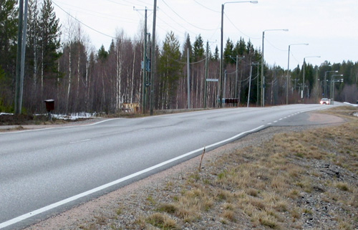
Speed Bump?
Notes:
Another area to consider is Culvert/backfill trenches. Consult soils engineer for guidance.

Slide 48
Importance of Shaping Example
EX: Typical slope = 2% Paving width = 15 feet Depth = 4 inches
  Base incorrectly shaped @ 1.5% (not 2%)
  Slope difference of 0.5% x 15 feet = 0.9 inches difference
  Thickness now varies from 3.1 to 4.0 inches or 4.0 to 4.9 inches
  Thin areas may see load related distresses during pavement life
  Typically, areas are paved thicker and quantities overrun
Notes:
When Asphalt mixes were $20 per ton it was less critical. Now with mixes $70-90 per ton, thickness issues are more critical.

Slide 49

Milling Inspection
Cross slope
Depth of milling
Remove scaling pieces
Crown or slope correction
Sweep
Notes:
Check periodically the cross slope and depth of milling.
If during milling any surface delamination or scaling pieces occur, they should be removed.
Know if the plan has any corrections to the cross slope and whether this should be accomplished in the milling or in the paving operation. You will want to know this so that the milling machine can be set up to change the slope if needed.
Sweeping - ensure the pavement is clean!!! or bonding won't occur - important!!! tracking of other material on top of milled mat. This picture is an example of issues you could come across.

Slide 50
Overlay of Deteriorated Concrete
Concrete dust absorbs water
Causes heaving/tenting when frozen
Expands 10% when frozen
Remove rotten concrete before overlay

Slide 51
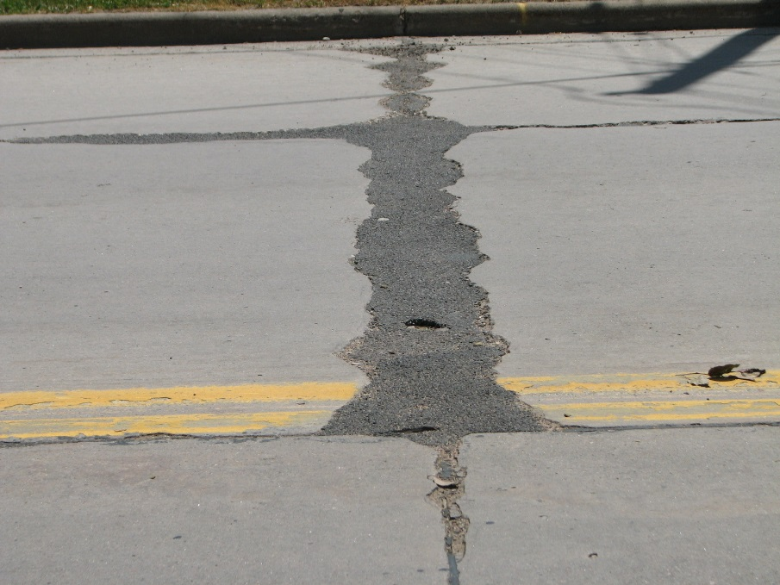
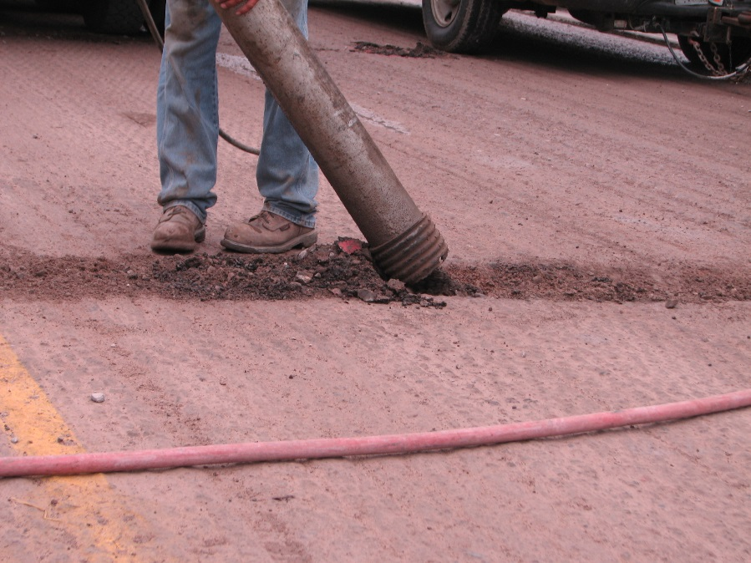
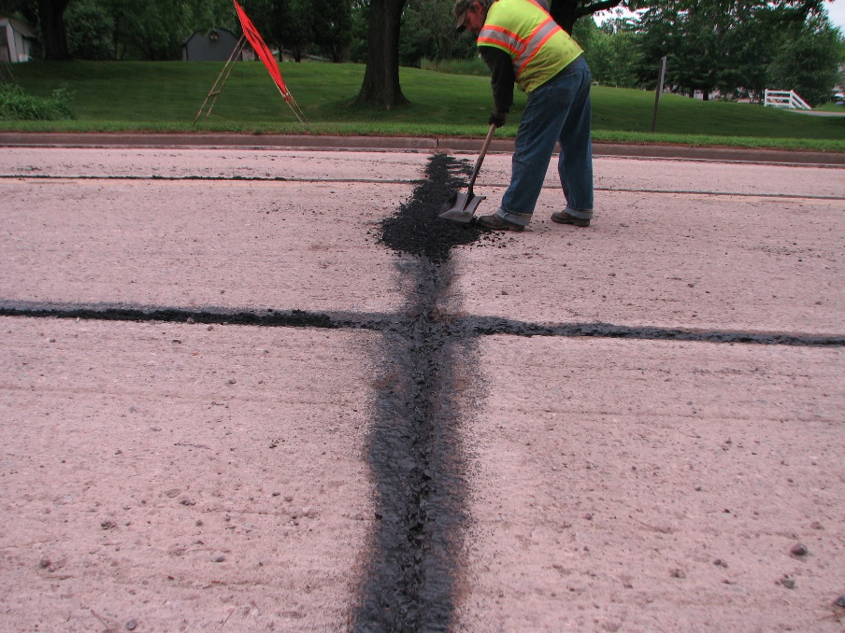
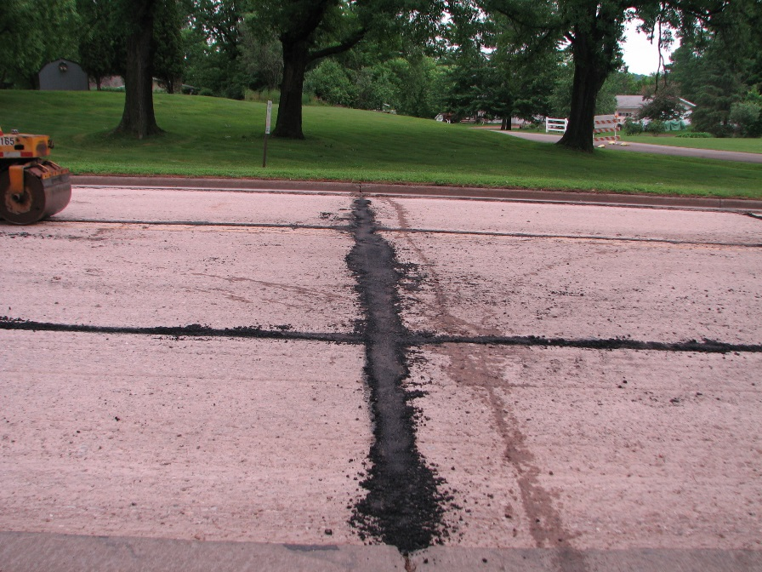
Existing deteriorated material
Mill/Remove patching material
Compact patched areas
Patch with new HMA
Notes:
There are two main groupings of joints. Hot and cold
The only hot joint we will talk about will be with tandem paving
The cold joints we will discuss that are mainly used on WisDOT projects are:
Notched wedge
Longitudinal butt joint
Transverse butt joint
Transverse construction joint (paper joint)

Slide 52
Asphalt Joints
Hot Joints
  Tandem paving
Cold Joints
  Notched wedge longitudinal joint (Michigan Joint)
  Longitudinal butt joint
  Transverse butt joint
  Transverse construction joint
Longitudinal Joint Density SPV
Notes:
There are two main groupings of joints. Hot and cold
The only hot joint we will talk about will be with tandem paving
The cold joints we will discuss that are mainly used on WisDOT projects are:
Notched wedge
Longitudinal butt joint
Transverse butt joint
Transverse construction joint (paper joint)

Slide 53
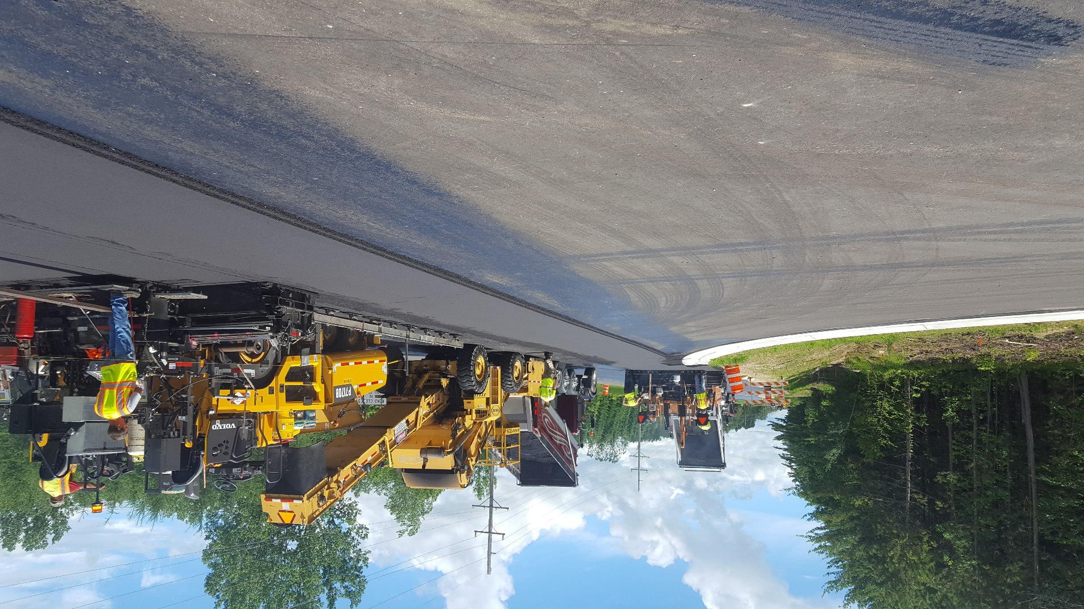
Tandem Paving
Allows you to eliminate a joint
Joint is the weakest part of the pavement
Notes:
A hot joint is the most preferred of all the joints because you achieve the greatest bond between the two mats.
Tandem paving is where you run two pavers and one runs in the next lane right behind the first pavers.
This allows you to basically eliminate a joint. This is great cause usually the joint is the weakest part of the pavement.
This picture is an example of tandem paving

Slide 54
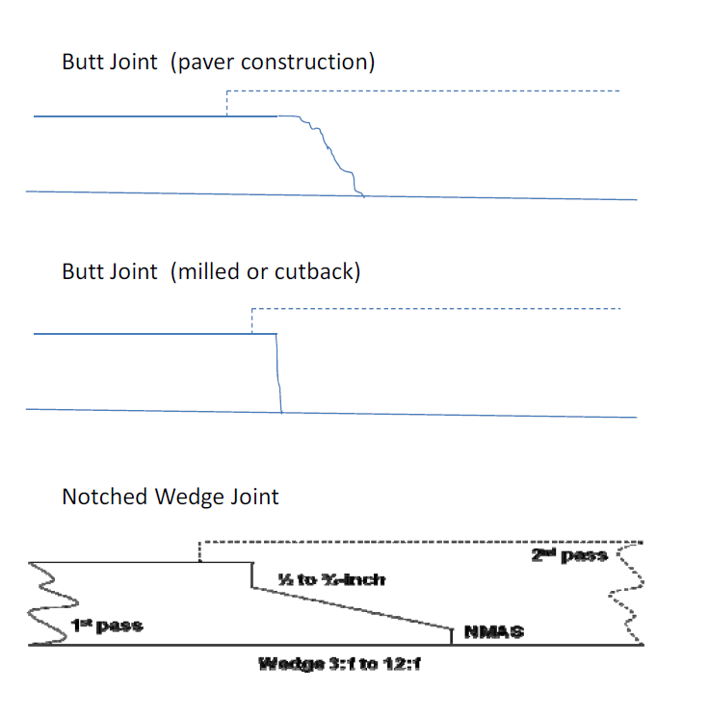
Longitudinal Cold Joints
Longitudinal Joint Types
  Longitudinal Butt Joint
  Notched Wedge (Michigan) Joint

Slide 55
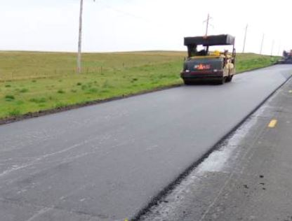
Longitudinal Butt Joint

Slide 56
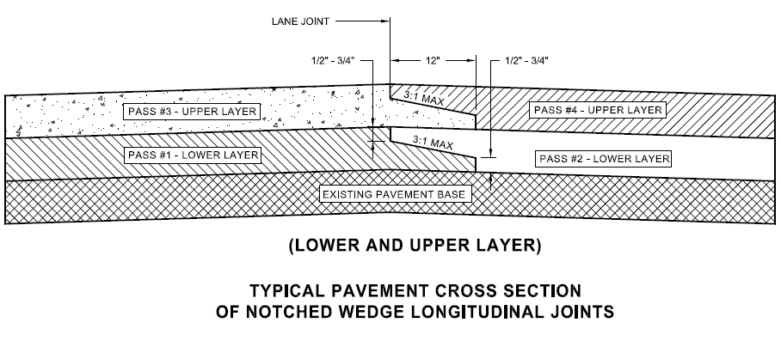
New Specifications for Notched Wedge Joint Construction in 2019
CMM 4-58.5 & FDM 14-10 Attachment 5.5

Slide 57

Notched Wedge Longitudinal Joint (Michigan Joint)
Notes:
This is an example of a Michigan joint on a region project.

Slide 58
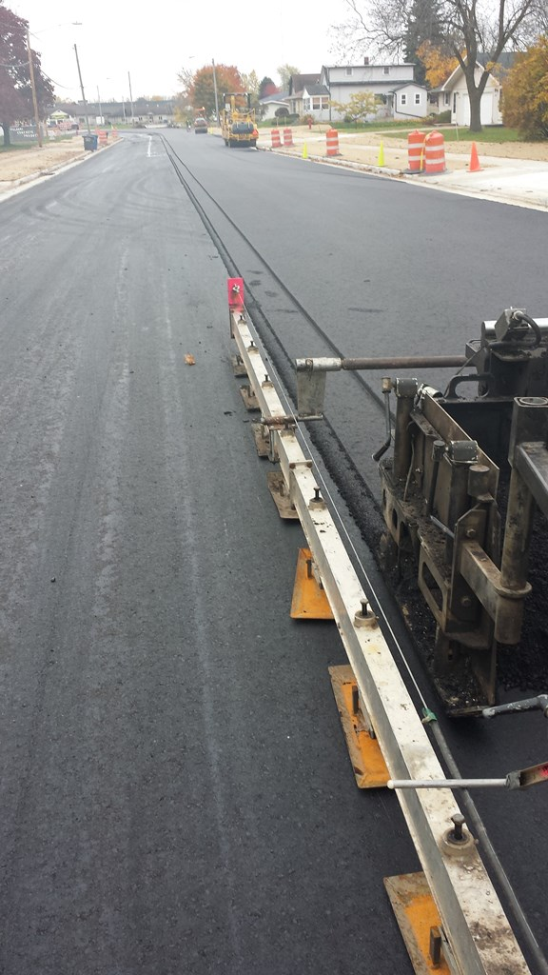
Notched Wedge Longitudinal Joint
(Michigan Joint)
Notes:
This is another example of a Michigan joint just showing it from the vantage point of coming out of the back of the paver. There is a roller behind the screed or in this case I believe a small vibratory compactor that is achieving density on the tapered section of the Michigan joint. Sometime a heavy wheel is used to compact the wedge.

Slide 59
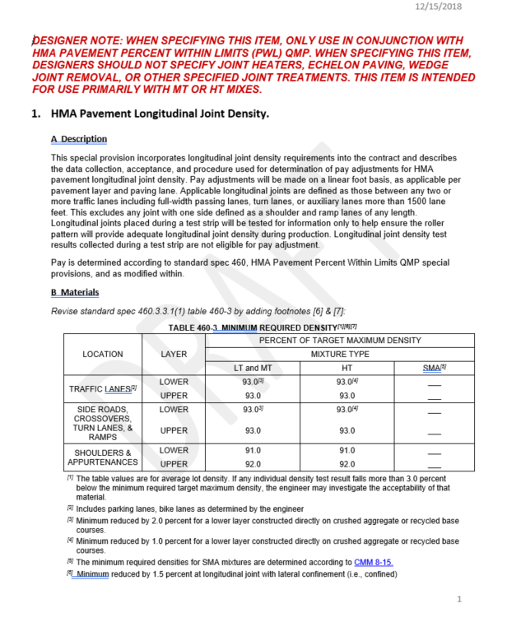
Longitudinal Joint Density SPV
To be used only on PWL projects, some not all
  Region will determine longitudinal joint construction details for non-LJD projects
Currently working with regions towards statewide uniformity

Slide 60
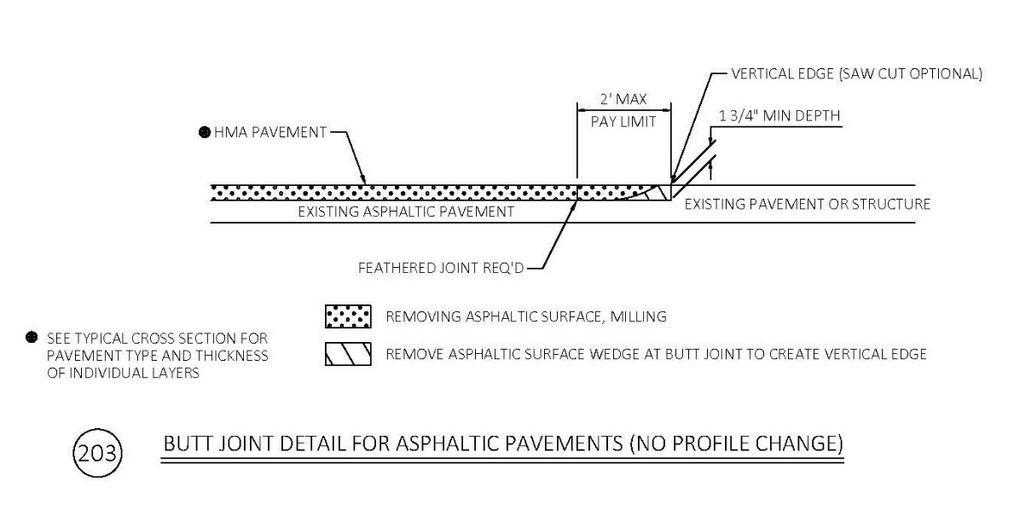
Transverse Butt Joints
Notes:
Here is an example of a region construction detail that we use that shows a transverse butt joint. This detail is specific with when you have a project with know profile change or raising of the roadway for example a simple mill 2” pave 2”. There is another region detail that we have that is for when you do have a profile change or you are raising the roadway. Like a mill 2” pave 4”.
You can see in the detail that the saw cut is optional as you can use a mini mill and turn it sideways and mill out the joint to achieve the vertical face required.

Slide 61
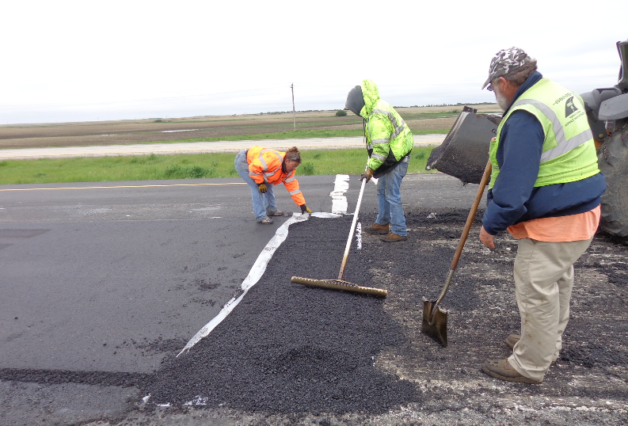
Transverse Construction Joints
Constructed across the pavement when paving is being suspended
Do not allow cold material
Paper Joints
  Cut back joint
  Shim for joint takeoff
Notes:
Transverse construction joints or a Paper joint is constructed across the pavement when paving is halted. This type of joint temporarily places an asphalt taper or ramp that will protect the construction joint edge and allow traffic to easily traverse the joint. It is called a paper joint because they use heavy duty paper to place the hot mix on and this makes it is easy to remove with the paper and have a good clean construction joint to take off from when paving is resumed.
When the paver is placing the last load of the day, it is shifted into low gear as it approaches the location of the
proposed joint.
2. As the hopper empties and the amount of material in the screed chamber decreases below normal operating
level, the paver is stopped.
3. The screed is raised and the paver moved out of the way.
4. Asphalt mix is then shoveled away from the end of the mat to form a clean, vertical end.
5. Heavy wrapping paper is placed along the edge.
6. The material that was shoveled away in Step 4 is replaced and used to form a taper.
When the paver is resuming paving at the transvers construction joint.
1. The taper of material is removed along with the board or paper.
2. A straightedge is used to check the longitudinal grade of the mat. Because the paver was running out of material
as it laid the last few feet of mat, it is possible those last few feet taper slightly (ramp down) from the specified
level of the mat. If this is the case, a new transverse end must be cut behind the point where the ramping down
begins.
3. The vertical face of the mat end is tack-coated.
4. The paver is backed up to the end of the mat and the screed rested on the mat surface.
5. The screed is heated while it rests on the mat. This provides some heat to the material at the end of the mat.
6. The heated screed is raised and shims as thick as the difference between the compacted mat and the
uncompacted mat are positioned under its ends.
7. The truck with the first load of hot mix is backed carefully to the hopper. During discharge of the mix from the truck
bed to the paver, it is essential the truck not bump the paver and cause it to move.
8. The paver starts forward in a low gear.
9. Once the paver has moved away, excess hot mix is cleaned off the surface of the mat and the evenness of the
joint is checked with a straightedge.

Slide 62
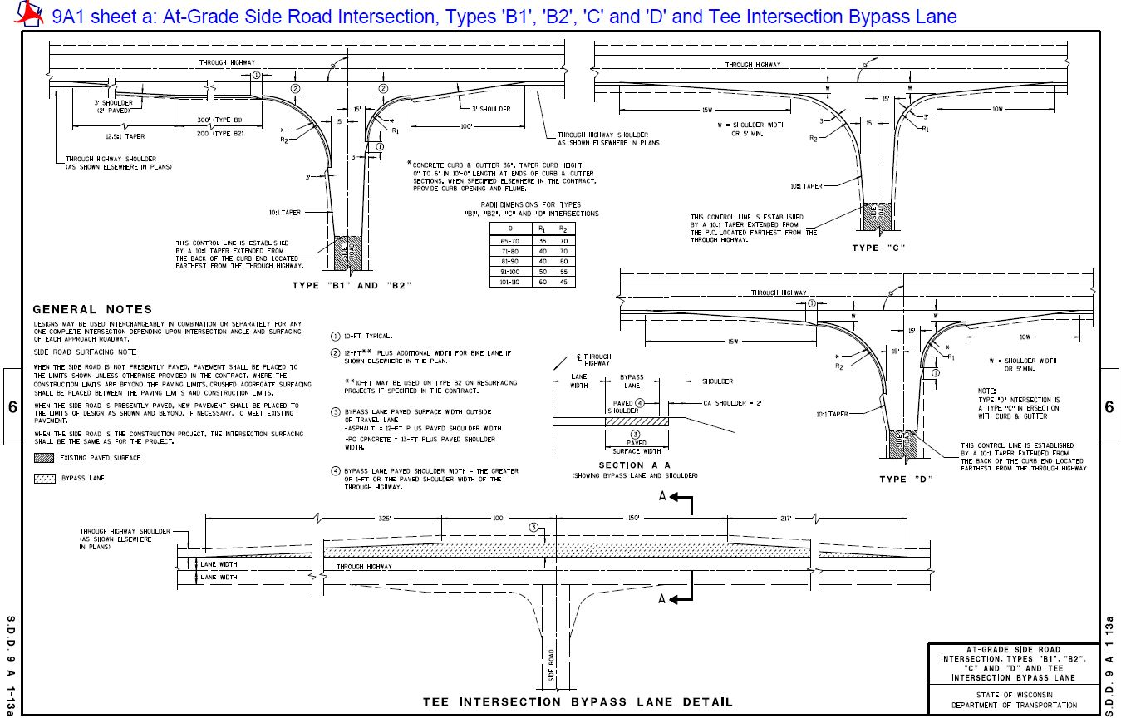
Intersection Paving-SDD 9a1-13a
Check Tapers coming in or off curb and gutter
Notes:
DONT GO INTO GREAT DETAIL ON THIS SLIDE FOR TIME PURPOSE
Make sure you know ahead of time what your plan has for intersections. If information is called out in the plan sheets or if the sideroads just reference you to the intersection sdd and know which intersection type you have and what the tapers are doing.
If I open and zoom in on the SDD you can see the various tapers for your intersection and the tapers coming in and out of the curb and gutter.
You will have a 10ft kicker that matches the asphalt to the back of the curb. The edge of the asphalt coming into the curb and gutter should angle to match the flange line of the curb and gutter so you are not directing the traffic into the curb but then you have the 10ft kicker right before the curb and gutter.
Also look to see if you have turn lanes and what the tapers are of the the turn lane most likely a 12.5:1 or if you don’t have a turn lane then the edge of asphalt would taper out to the sideroad radius at a length equal to 15 times the shoulder width.
Watch when you are matching into beam guard that you know the details in your plans also of how the asphalt will bump out for the EATs

Slide 63
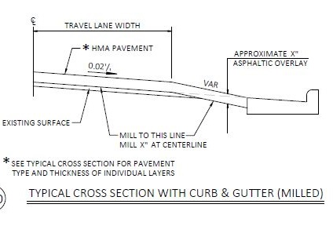
Paving with Curb & Gutter
Know how your paving at curb and gutter sections for existing roadways
If your profile is raising (3 options)
  Fill in curb and gutter
  Adjust milling line like detail to the right
  Mill straight across and asphalt thickness varies
Notes:
This detail is for when you are paving a thicker mat depth than the milling depth.
There are 3 options if you are raising the roadway.
Fill in curb and gutter
Adjust milling line like detail to the right
Mill straight across and asphalt thickness varies

Slide 64
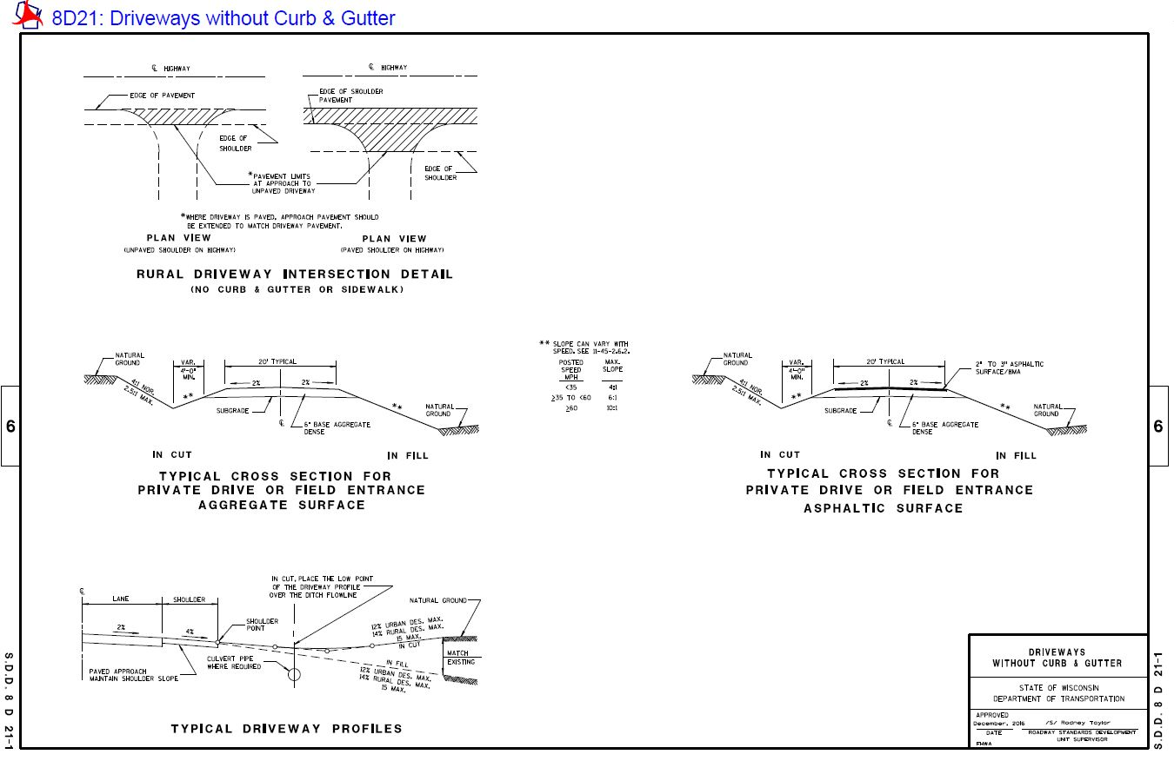
SDD 8D21-1
Notes:
BREEZE THROUGH THIS SLIDE
I just wanted to point out that when you get to driveways on your rural projects do not bump out for driveways when paving mainline. They put the joint line on the edge of the paved shoulder.
There is also some region construction details for driveways. Every project is different as far as where you will match in at your driveways depending on if there is a profile change or not. Know your paving limits on your driveways based on what is shown in your plans and know how thick your driveways are going to be.

Slide 65

Safety Edge S.D.D. 14B 29-1
Notes:
This is a picture of the standard detail drawing for a safety edge. A safety edge is a taper that is placed on the edge of the asphalt so that if the base aggregate settles or is pushed away from the edge of the pavement and there is a pavement drop off, you have a tapered edge that can be used by vehicles to re-enter the roadway.
If I zoom into the detail you can see that the taper is constructed with an allowable slope between 29 to 40°. It can be paved in 1 of two ways as shown here. Just talk with the contractor and see which way they are going to pave it.
Currently this is being used on highways where our shoulders are less than 5’ wide….Check your plans, contact PM for questions.

Slide 66

Safety Edge
Used to mitigate run off the road crashes
Less edge cracking
SDD 14B29-1
Notes:
Here is a picture of what a constructed safety edge looks like. You can check the taper angle using a rod or something similar to the picture. Check the rise over run.
As stated on the previous slide they are used to mitigate run off the road crashes. Since FHWA started advocating for asphalt safety edges they have also noticed that there seems to be less edge cracking because of the extra support that the safety edge is giving to the edge of the asphalt.

Slide 67

Asphalt Ticket
Notes:
BREEZE THROUGH THIS SLIDE
Here is an example NEA ticket. The red callouts show various things to pay attention to on the ticket.

Slide 68

Asphalt Ticket
Notes:
BREEZE THROUGH THIS SLIDE
Typical Mathy Ticket

Slide 69

Pavement Thickness and Yields
Check thickness
  Asphalt probe
  Asphalt measuring stick
Make sure plan thickness = contract quantity
Check yield
  Every few hours, half day, end of day
  Reasons for high or low yield
Make sure paver is set correctly
Paving_area_calc.xls
Yield Calc&Asphalt Paving Diary Example.xlsx
Notes:
-Make sure to check thicknesses. You can ask the contractor to use their probe or watch them as they do their thickness checks every little while. Check thickness at the beginning of paving and periodically throughout the day or when thicknesses or conditions change
-In estimating the quantity of asphaltic mixture required for a project, 112 pounds per square yard per inch of
thickness is normally used for the travel lanes. Some projects allow up to 10% to provide for wedging,
curve correction, and side road approaches. Since the contract quantity is an estimate, ensure that the
contractor provides the plan mat thickness rather than the contract quantity. Consequently, expect some underrun
or over-run.
-The average thickness being placed should be checked periodically based on the total mixture placed over time
(several hours, half day or day), compared with the theoretical, and adjustments made. Compute the amount of
material that theoretically should be used for the desired mat thickness using the density in pounds per cubic
foot being determined from density samples taken from pavement on the job.
-The fluff factor is usually 1/4inch per inch placed but can very based on the type of mix, specifically with the aggregate size of the mix. You can check with the foreman for what he is assuming or check before and after rolling on the pavement edge.
-Yield is the amount of material being used in a set area vs. the amount that should be placed.
-If you have a distance calculated, but the paver doesn’t get that far with its load, you will know there’s a problem. That might mean that your depth is set too high, or some other such problem. You’ll know that something needs to be double-checked and fixed.
-Or, if you have a distance calculated, but the paver goes past that mark with its load, you will know that you’re paving too thin. Again, the depth may be set too low.

Slide 70


Asphalt Mixture Temperature
Mix temp in paver hopper should be within 20°F of temp recommended in mix design
  Notify foreman and project engineer if its not
Most mix design temps are around 280°-320°F
Cover loads in inclement weather or when air temp is below 65°F
Notes:
-The mixture should be delivered to the receiving hopper of the paver within 20 F of the temperature recommended by the asphaltic material supplier.
-If the temperature exceeds +/- 20 F of the temperature recommended by the asphaltic material supplier, both the paving foreman and the project leader should be .notified immediately.
Thermometers: Infrared Temp Gun/Gauge If you can get one then get one but otherwise the contractor has them and you could ask them to check a few readings for you
Intermediate and finish rollers always have them to check the temp for when they can get on pavement
Check the temps of
-pavement surface
-Mixture temp in/out of paver
-Compaction temps.
-All loads shall be covered during inclement weather, or when
the ambient air temperature falls below 65 F (18 C).

Slide 71


Asphalt Mixture Temperature
Consistency is key
Inconsistent temperatures will give variable density
Long hauls cause outside of load to cool (crust)
Material Transfer Vehicle (MTV) remixes material back to uniform temperature
Infrared cameras
Notes:
-Consistency is key.

Slide 72
MTV Benefits
Provides additional surge volume for the paver
  Keeping the paver moving smoother pavement
Serves as a buffer between the paver and the haul trucks
  Avoiding bumps smoother pavement
Provides remixing capability
  Remixing less segregation (temperature and aggregate)
  https://www.pavementinteractive.org/reference-desk/construction/placement/aggregate-segregation/
Notes:
MTVs are used to provide an additional surge volume for the paver (see Figures 7.47, 7.48, 7.49 and 7.50). This surge volume allows for continuous paver operations because with an MTV the paver no longer has to stop while one truck leaves and the next truck backs up. Additionally, the MTV serves as a buffer between the paver and the haul trucks, which eliminates most truck bumping problems. Finally, most MTVs offer some sort of remixing capability that remixes the cool HMA crust formed during transport with the hot interior HMA to produce a more uniform mix entering the paver. This remixing can essentially eliminate aggregate segregation and temperature differentials. Some regions have actually implemented specifications that require a remixing MTV for paving contracts where segregation and temperature differentials are of concern. All SMA mixes require an MTV to be used.

Slide 73

HMA Mix Transport
HMA is usually loaded into a truck at a fairly uniform temperature between 260F to 320F. Several measures that can be taken to minimize HMA cooling during transport are:
  Minimize Haul Distance
  Insulate Truck Boxes
  Place a tarpaulin over the truck bed

Slide 74



Thermal Bars

Slide 75
Placing Mixture
When should you fold the wings?
  To minimize segregation, fold the wings as seldom as possible. Just enough to keep the mix in the wings from getting so cool that it won’t go through the paver.
  How often will depend on delivery rate, mix temperature, and the air temperature.
  Folding the wings should only be done while the hopper is fairly full.

Slide 76
Placing Mixture
What do you do if the next truck is not ready?
  Do not slowly pull it forward and run the hopper empty.
  Wait with a full hopper. This keeps the mix and paver warm, and the screed charged with a full head of material.
  When the truck arrives, have the bed raised and ready to flood the hopper. Start the paver, getting it to paving speed as quickly as possible. When the truck is picked up by the paver, release the gate and flood the hopper.
  If the paver frequently waits, a paver speed adjustment may be necessary.

Slide 77
Factors Affecting Compaction
Environmental Factors |  |  | Mix Property Factors |  |  | Construction Factors
Temperature |  |  | Aggregate |  |  | Rollers
 | Ground Temperature Air temperature Wind speed Solar flux |  |  | Gradation Size Shape Fractured faces Volume |  |  | Type Number Speed and timing Number of passes Lift thickness
 |  |  | Asphalt Binder |  |  | Other
 |  |  |  | Chemical Physical Viscosity Amount |  |  | HMA production temperature Haul distance Haul time Foundation support

Slide 78
Rain During Paving
Occasional light sprinkles ok
Cease paving with downpour
A little more leeway if paving on well drained crushed aggregate versus if you are paving on an milled surface
Notify project engineer if contractor does not stop paving and document in IDR
Rain affects HMA mix/placement
  Bonding of tack coat to mix
  Cools asphalt too fast resulting in poor compaction
  Puddles overlaid with asphalt can cause stripping of binder from aggregates
  Nuclear density gauges should not be used in rain and wet surface can affect density numbers
Notes:
This common question can mean different things to different people because of the wide range of precipitation encompassed by the word “rain.” On one end, occasional light sprinkles should not be cause to shut down operations. However, a steady downpour, either light or heavy, should result in cessation of paving activities. To avoid waste, some states have verbiage in their specifications stating that trucks in route to the project when rain begins can be laid at the contractor’s risk.
-Also keep in mind that the surface on which you are paving may influence your decision. Paving on a firm, stable, well-draining crushed aggregate base might be given more leeway than a thin asphalt overlay. Raining or not, new pavement must be placed on a firm, unyielding base.
-If the contractor decides to continue paving during a rain event. It is important to notify project leader, document all times and operations during paving in the rain.
-
Rain may affect the HMA mix/placement:
-Bonding of the tack coat to the mix, the asphalt lifts must be able to properly bond together and moisture can be a hindrance to that bond
-Cooling of the HMA mix too quickly may result in poor compaction and a change in rolling patterns
-Puddles overlaid with HMA turn to steam, which may cause stripping (separation of the asphalt binder from the aggregate) – never pave over puddles whether it is raining or not
-Nuclear Density gauges should not be used during rain and a wet surface may affect density numbers.

Slide 79

Rain During Paving
Things to do if paving is temporarily stopped for short duration
  Construct proper vertical faced construction joint
  Dispose of left over mix in hopper
  Keep all trucks tarped
  Try not to track mud onto surface
Notes:
If you temporarily suspend paving operations due to rain, don’t forget to:
-Construct a vertical-faced paper construction joint
-Properly dispose of all material left in the hopper
-Keep all trucks tarped and check temps of mix when you resume paving
--Be careful not to track mud and dirt onto the project and if you do make sure you sweep it off if needed
Asphalt pavements are designed to last for many years, so don’t let a sense of urgency to get the job done quickly allow you to make decisions which could strip years away from the pavement life.

Slide 80

Production Rate Tracking
http://wisdot-productivity.engr.wisc.edu/home/projects
Notes:
Here is a screen shot of the WisDOT construction productivity rates online tool.
The link at the top of the page will take you to this site. This should be used by the project leader to document the production rates that were achieved from the paving on your project. It asks you a bunch of questions about the paving and helps calculate the amount of tons that were placed on average in a day. The reason we need all construction projects to enter this data is for helping designers to figure out the proper production rates for designing the project and estimating the project schedule during PS&E.
Production rates can be entered each day to help keep the different operations separate.

Slide 81

Guidance for Field Change?
Joint Type Change
  Contact:
Mix Type Change
  Contact:
PG Binder Change
  Contact:
Thickness Change
  Contact:
Cold Weather Paving Change
  Contact:
Notes:
If you need to make a field change to any of these 5 things you should talk with your Project Manager and let them know why you or the contractor want to make the change. The five field changes are for Joint, Mix, Binder Grade, Thickness, and Cold Weather Paving. Your PM will talk to the listed WisDOT staff to provide guidance on whether the change is warranted or not..
List examples of the impact.
People are listed in the order of contact.

Slide 82
Mat Flaws
Microcracking
  Roller checking-mat deflection during compaction that causes mat to fracture
  Cold mat cracking- compacting of an excessively cool mat which causes the mat to fracture
Segregation
  The course and fine aggregate separating in the mix
Dragging or tearing of mat
  Occurs directly behind the screed
Notes:
These are the 3 most common types of mat flaws that you will see during paving.
-Microcracking
Which consists of
Roller Checking-Mat deflection during compaction that causes mat to fracture
Cold mat cracking- compacting of an excessively cool mat which causes the mat to fracture
-Segregation
the course and fine aggregate separating in the mix
And dragging or tearing of the mat
Occurs directly behind the screed

Slide 83

Roller Checking
3 usual causes
  Pavement deflection
  Mix tenderness
  Mat too hot
If the tension from these 3 causes becomes larger than the cohesive forces of the mix, you will have cracks
Communicate with paving foreman and roller operators
Notes:
Roller Checking occurs from 3 usual causes
-Excessive pavement deflection during compaction. If underlying layers, base, or subgrade deflect then the mat will deflect
-Mix tenderness- tender mixes shove when compacted, means the mix is internally unstable
A tender mix tends to displace laterally and shove rather than compact under roller loads. Internal mix stability is a function of asphalt binder viscosity and aggregate gradation and shape.
- Or rolling the mix while the mat is still too hot
If the tension created from one of these 3 causes is enough to overcome HMA cohesive forces, tiny fissures or cracks will develop on the surface.
-You usually will notice these cracks after the hot roller compacts the HMA
-Communicate with rollers and foreman to get rid of whatever issue you have by figuring out if it is an base or subgrade issue, a mix tenderness issue at the plant, or if it’s a roller issue

Slide 84

Cold Mat Cracking
Occurs from compacting a cold mat
Tiny fissures or cracks develop in the surface
Communicate with rollers
  Watch mat temps if you have a temp gauge/gun!
Notes:
If rollers are operated on a cool mat, the surface can be too stiff and therefore fracture under the compactive force.
If this tension is enough to overcome HMA cohesive forces, tiny fissures or cracks will develop on the surface.
Communicate with rollers to make sure they are getting on the mix at the proper time. Talk with the Hot Roller, Intermediate roller, and the cold roller
-Make sure if you have a temp gauge to watch the mat temps, otherwise talk to the rollers and they can show you the mat temps if there is an issue with cold mat cracking

Slide 85
Segregation
Lack of uniformity in the asphalt mix constituents
Five causes
  Mix design issues
  Stockpile loading issues
  Asphalt plant issues
  Truck loading and unloading
  Asphalt paver
Two types
  Coarse segregation
  Fine segregation
Notes:
-Segregation is the lack of homogeneity in the asphalt mix constituents at a magnitude that there could be accelerated pavement distress.
There are five causes of segregation
Mix design
Stockpiling loading
Asphalt plant
Truck loading and unloading
Asphalt paver issues
We will focus specifically on the asphalt paver and truck loading and unloading segregation issues in the next slides cause that is something as an inspector you can notice easier and tell the paver operator and foreman.
There are two types of segregation either:
Coarse-too much coarse or large aggregates in the mix
Fine-too much fine or small aggregates in the mix

Slide 86


Segregation
Paver Segregation
  Auger not extended fully
  Dumping of the wings
  Longitudinal segregation at the center of the paver
  Keep the hopper close to half full if you have to stop
  Keep auger full but don’t overfill
  Raise truck bed slightly before opening tailgate
  Truckload segregation
Notes:
-Segregation is the lack of homogeneity in the asphalt mix constituents at a magnitude that there could be accelerated pavement distress.
There are five causes of segregation
Mix design
Stockpiling loading
Asphalt plant
Truck loading and unloading
Asphalt paver issues
We will focus specifically on the asphalt paver and truck loading and unloading segregation issues in the next slides cause that is something as an inspector you can notice easier and tell the paver operator and foreman.
There are two types of segregation either:
Coarse-too much coarse or large aggregates in the mix
Fine-too much fine or small aggregates in the mix

Slide 87

Truckloading Segregation
Notes:
This diagram shows the proper ways to load the truck from the mix silos at the asphalt plant.
When you go to the plant to witness any samples being taken you can also check to make sure they are loading the trucks correctly.
Typically fine graded mixes are less prone to segregation. Wisconsin uses mostly fine graded mixes compared to other states.

Slide 88
Other Things to Watch For
Trucks to stop before paver
Limit starting and stopping of the paver
Asphalt chunks
Centerline joint compaction
Mix spilled in front of paver
Maintain uniformity of the mat as this is essential
Minimum variability in the mat
Rolling patterns
Notes:
-Here is a list of other things to watch out for. Trucks should stop before the paver. Bumping the paver with the truck can cause the paving screed to rise and place a bump in the mat at this location. Therefore, make sure the trucks are stopping before the paver and they allow the paver to initiate contact and move the truck forward.
-Segregation and other issues can occur if the paver is starting and stopping a lot. The equipment can cool down, such as the screed, auger, etc on the paver as it is waiting for the next truck. This can lead to segregation and other mat imperfections. If the paver is running empty a lot the paver operator could be tempted to continue to run the paver forward and empty most of the hopper by dumping the wings which can lead to segregation as talked about on two slides previously. If this is happening frequently talk with the foreman about if there are more trucks available that he could add or if the spacing is off on the trucks to try and get them evenly spaced again. You can also limit this by using a shuttle buggy or transfer machine but that will depend on if the contractor has one available and it makes sense for that project. Another option to fix this is to slow down the speed of the paver slightly so that it does not pave out as quickly and the next truck can arrive while the paver still has a half load of mix.
-Sometimes chunks of asphalt can be present do to too much moisture in the mix or maybe it is just a large rock that got into the mix. Make sure to point them out to the laborers or operators if they don’t notice them. Catch them as quickly as possible behind the screed also cause they can get caught under the screed and be pulled along by the paver causing the mat to tear. The longer they are dragged the bigger the area of non uniformity.
-Make sure the hot roller is rolling the centerline joint from the hot side appropriately to achieve good density at the centerline joint. Also make sure the paver is placing a little extra mix over the centerline joint so that it is not starved for mix. If the joint is starved for mix this will cause the roller to bridge the joint and not be able to achieve good density at the joint and you will have longitudinal cracking at the centerline in the future. Having a little extra mix will allow for their to be good compaction at the joint. Rather have a 1/8” higher second mat then first mat then for the second mat to be below the first mat.
-Watch for mix being spilled and leaving piles in front of the paver, this will cause the paver to ride up and leave a bump at this location and possibly cause cohesive issues in the future at this location.
-Anytime there is a decent amount of non-uniformity of the mat you will want to figure out the cause and rectify the situation. Uniformity is so important in asphalt paving because if the mat is uniform it tends to hold together much better and have increased cohesive properties across the mat. Any deformities in the mat will lead to issues immediately or more likely issues down the road with potholes or cracks forming at these points of non-uniformity.
-There are many processes that go into asphalt paving. The mix design, asphalt production of the mix design, truck loading, truck unloading, paving, and rolling. One small thing could go wrong in this process at one given time and cause slight deformities in the mat. A few times is ok but if it is happening consistently then there must be some step in the process that is not being done properly regularly.
-make sure to watch the rolling pattern as there is a proper way to make your rolling passes on the mat. This will be shown on the next slide in more detail.
-

Slide 89

Rolling Pattern
Notes:
This is an example of a rolling pattern. When watching a rolling pattern, you should be looking for the following:
1. Overlap at least 6 inches – minimizes seams
2. Turning roller slightly to the side to reverse or stop - minimizes a perpendicular bump
3. End passes at different points – minimizes a bump
4. Do not roll over the crown – avoids rounding the crown to maintain a tight joint
5. The first roller pass should ~ 0.5 - 1 ft. away from the unconfined joint - this will prevent asphalt spread
6. Compact joints with the roller operating parallel to the joint - avoid pushing the joint out & longer passes give better ride

Slide 90

Visual Inspection for HMA Production Issues
Blue smoke
  Mix is too hot?
Stiff appearance of mix
  Mix temp possibly too cold?
Mix slumped in truck
  Excessive moisture or too much binder?
Lean dull appearance
  Not enough binder in mix?
Notes:
BREEZE THROUGH THIS SLIDE
If any of the signs above are observed the mix may be sent back to the batch plant to be reprocessed.
Like do you see blue smoke? Well then the mix could be too hot possibly?
Or does the mix appear stiff. What I mean by this is does the mix have its normal wormy appearance. When good hot mix settles it has a wormy appearance where the mix settles into place as it is dropped. If the mix is too stiff it could be cause the mix is too cold?
-Is the mix slumped in the truck, this could mean excessive moisture or too much binder?
-Or does the mix have a lean dull appearance not nice and solid black well than there could be not enough binder in the mix.

Slide 91


Visual Inspection for HMA Production Issues
Rising steam or asphalt lumps
  Too much moisture?
Contamination
  Possibly truck beds are not clean?
Bleeding
  Check release agent (no diesel fuel)

Slide 92
Asphalt Mix Sample Tag
CMM 8-36.5
  required box must have dimensions of 10” x 8” x 8” (such as Uline S-19062).
Sample Identification
  Contractor Testing Lab and Certified Technician Name
  QC, QC-ret, QV, QV-ret
  State project ID
  Date
  Sample number
  Type of asphaltic mixture
  State mix design ID (250-XXXX-YR)
  Percent binder
  Daily tonnage sampled
  Current Gsb

Slide 93


Asphalt Mix Sample Tag
Notes:
This is a typical sample tag for a mix sample. When picking up a sample from the plant, ensure the tag is filled out completely. The Region Lab uses the information on the tag for documenting the region tests. All information on this tag is required by the CMM. Any questions?

Slide 94
Sample Security
QC-Retained Samples
Implemented in 2018
Contractor must collect and provide the Department with retained samples on a pallet or rack
Dept. Representative will secure retained samples when they come to the plant to collect a QV sample
Notes:
Do the regions have any feedback on this process?

Slide 95

Sample Security
Sample Security
Notes:
When picking up QV sample all retains need to be securely taped and left on pallet.
When a failed sample occurs department representative need to collect backward and forward retains.

Slide 96

Asphalt Binder Sample
>1,000 tons mix
  1 In-Line 1 quart sample required per 15,000 tons of mix
<1,000 tons mix
  1 In-Line 1 qt. sample at engineers request
For all contracts
  1 non-random truck sample at discretion of the engineer
Notes:
The supplier or contractor personnel will obtain samples, under the
observation of a project engineer, at the HMA plant site.
For contracts greater than 1,000 ton of mix, obtain an In-Line sample at a
rate of one-liter (one-quart) sample per 15,000 tons of mix for each supplier and grade of asphalt binder, or fraction thereof.
For contracts with 1,000 ton of mix or less, one (1) random In-Line sample may be obtained at the discretion of the project engineer.
If you have less than 1000 tons you still need to obtain the Bill of Lading from the contractor for the binder.
For all contracts, one (1) non-random truck transport sample may be obtained at the discretion of the project engineer.
In addition, obtain samples as directed by the project engineer at any time extra samples are deemed necessary.
A list of approved asphalt suppliers and approved sampling methods/locations are shown in the Combined State Binder Group Method of Acceptance for Asphalt Binders at:

Slide 97

Combined State Binder Group Method of Acceptance for Asphalt Binders - Edition 2019

Slide 98

Sample Tag-DT1352
Provide with binder sample
CMM 8-65.2
  DT1352 form
  Example tag
Notes:
This picture is an example of form DT1352. Make sure you fill this out and provide it with the binder sample. A link to this form and a filled out example tag can be found in CMM 8-65.2. Any questions on filling this out?

Slide 99
Job Mix Formula (JMF) Changes
CMM 8-36.6.13.1
The following changes require a new mix design
  Binder content decrease exceeding 0.1%
  Addition of an additive or changing an additives dosage
  Elimination or addition of any aggregate component
  A >20% change in the aggregate component blend percentages
No JMF change requests should occur prior to 3 production tests
When requested to change from LT to MT mix or from MT to HT mix consult the region pavement engineer
Notes:
There are 4 main changes that require a new mix design
-A 0.1% decrease in the binder content of the mix will require a new mix design.
-If you introduce a new additive into the mix or if you adjust the dosage rates of any of the additives then you need a new mix design.
-If any aggregate component is eliminated or added or
-A 20% change in the aggregate component blend percentages. This is the cumulative change so if you increase a certain size aggregate by 10% you would have to consecutively decrease another size aggregate by 10% which would be an absolute value change of 20%.
You need the results of at least 3 production tests before you change a job mix formula.
Data from prior production testing do not have to be from state projects, but must be sampled and tested by HTCP certified personnel. Testing must occur in a WisDOT approved laboratory, following WisDOT approved methods.
-Finally if you are required to change mix type even if you are going up in grade of mix from say an MT to an HT you need to consult the region pavement engineer.

Slide 100

JMF Change Request

Slide 101


What Gmm Number to Use
Notes:
This is a WisDOT Mix design 249 form. The Gmm was mentioned earlier in the HMA Basics. The Gmm is the “Rice Number.” This number is used for calculating the target density for asphalt yield. It is located in the lower left part of the spreadsheet. The Gmm for this mix is 2.504.

Slide 102

Notes:
Mathy mix design for Gmm

Slide 103

What Gmm Number to Use
Notes:
This is a typical control chart that the contractor supplies. On the first day of paving, the mix design Gmm value is entered into the nuclear density gauge. The next day of paving, the average of the test values are used. Once a 4 point running average is established, the 4-pt will be entered in the nuc gauge each morning.

Slide 104

What Gmm Number to Use
Notes:
Typical Mathy production chart

Slide 105
Failed Density Test
CMM 8-15.11
Density test greater than 3.0% below minimum
  Test at 50’ increments ahead and behind failing test
Once limits of unacceptable material is found handle as follows:
  Remove and replace
  Allow to remain in place and pay tonnage at 50%
Notes:
As soon as you know about having a density test greater than 3.0% below the minimum requirement, contact your PM and the Region HMA IA. From there, CMM 8-15.11 outlines the procedure to determine the extent and outcome of the mix that is in place.
8-15.11 Procedure for Determining Limits of Unacceptable Material
For single nuclear density test results greater than 3.0% below specified minimums per standard spec
460.3.3.1, perform the following:
a. Test at 50 foot increments both ahead and behind the unacceptable site, using the same offsets as the original
test.
b. Continue 50 foot incremental testing until the test value indicates conforming material (i.e., within 3.0% less than
minimum required density).
c. Materials within the incremental testing indicating more than 3.0% below minimum required density are defined as
unacceptable, and will be handled as follows:
1. Remove and replace unacceptable materials with the same mix type, unless otherwise approved by the
project engineer, and meeting the required specified density. This will be done to the full lane width as
defined by the density requirements. The shoulder may be considered separately from the mainline.
Unacceptable materials replaced are at contractor cost.
2. If unacceptable materials are allowed by the project engineer to remain in place, tonnages will be paid at
50%.
Note: If the 50’ testing extends into a previously accepted lot, removal of the unacceptable material may be
required or allowed to stay in place at a 50% payment deduct; however, the results of these tests must not be
used to recalculate the previous accepted lot density.

Slide 106

Failed Density Test
Standard Spec 460.3.3.1
Notes:
The previous slide was for if you have one single test that is more than 3.0% below the minimum required density. The table values above are for average lot density. As an FYI, a lot represents the total tonnage placed per layer, per target Gmm, per day. If at the end of the day your entire lot is below the specified minimum in the chart then that lot will also be paid at a percentage of the full unit price.
There can be adjustments to the table and that is what the superscripts 2, 3, and 4 are for. The minimum percent is adjusted down for various reasons.
[2] Includes parking lanes, bike lanes, and park-and-ride lots as defined by the contract plans.
[3] Minimum reduced by 2.0 percent for a lower layer constructed directly on crushed aggregate or recycled base
courses.
[4] Minimum reduced by 1.0 percent for a lower layer constructed directly on crushed aggregate or recycled base
courses.
[5] The minimum required densities for SMA mixtures are determined according to CMM 8-15.

Slide 107

Density Pay Reduction
Standard Spec 460.5.2.2
Notes:
So here is the table from SS 460.5.2.2. It states the pay factor to be applied for a pay adjustment based on how far the target percentage is below the minimum values discussed on the previous slide.
So for example if your lot density is 1.3% below the minimum required, the asphalt for the given quantity will only receive 95% of the pay. (or a 5% credit to the Department)

Slide 108

Failed Mix Test
CMM 8-36.9.3.3
Notes:
If a QV mix test fails, the Region HMA IA will inform the project staff and work with Bureau of Technical Services to test any needed QV-Retains and any forward and backward QC-Retains from the mix. The HMA IA will be providing the PM and project staff with all necessary test results. BTS will advise as to the direction of a pay adjustment or a need for removal. The process for confirming the value of a failed QV test or to proceed with dispute resolution is outlined in CMM 8-36. This process will be handled by the Region, but it is important that you are aware of the details so you can answer questions that contractor will have.

Slide 109

Non Performance of QMP
CMM 8-30.13
Notes:
Non-Performance of QMP is in CMM 8-30.13. The scenarios can range from Non-Random tests to improper documentation/sampling to not performing appropriate number of tests. When filling out the Non-Performance form that is located in pantry, it needs to be written like a police report.

Slide 110


Tack Coat
Uniform coverage
Bonds layers
Residual rate
Application rate
  New surfaces-0.05 gal/SY
  Milled surfaces-0.07 gal/SY
Not enough = slippage, bonding issues
Too much = bleeding
Tack coat pickup
Notes:
-The tack coat is normally placed in a single application at a rate approved by the project engineer. The
emulsified asphaltic material should be applied as a uniform fog spray which leaves a coat about as thick as a
light coat of paint.
-Tack coats are intended to enhance the bond between existing pavements and new asphaltic surfaces and at the interface between layers of asphaltic pavements. Research
has shown that the bond developed between the layers is critical in providing long-term performance of an
asphalt pavement.
A suggested initial application rate after dilution is 0.05 gal/SY on new surfaces and 0.07 gal/SY on older
or milled surfaces. This rate may have to be adjusted after initial application and observation.
Too little tack causes slippage, too much tack causes surface mix bleeding
-Be watching that we don’t have too much tack coat pickup like this picture on the bottom with the truck tires pulling the tack off the surface. Watch to make sure the tack coat is not being tracked off the project onto adjacent roadways.

Slide 111

Tack Tracking Solutions
Spray earlier/previous day if closed
No dust on surface
Different material, CQS
Raise tack temperature
Pre-wetting
Spray paver
Last Resort:
  Consider paving over unbroken emulsion
  Wet paint analogy
Notes:
Tack coat must be placed early enough to allow it to break and cure. If tack is tracking off of the project, stop paving until a solution is determined.
Tack that has broken looks dull in color. The shiny appearance has worn off. Tack needs to be broken before it is paved over. You can also tell if tack has broke by walking on it. If you feel your boots sticking and hear a “Velcro” sound the tack has broken. The time for tack to break is variable. It is dependent on the ambient temperature, wind conditions and sunlight. Ensure the paving crew is prepared to place the tack well in advance of the paving.

Slide 112
Asphalt Binder Content Testing
Required on all HMA Contracts in 2019
QC AC% will determine corrective action.
QV AC% test results will affect pay:
  Minus 0.4%-0.5% of JMF AC content = 75% pay
  More than minus 0.5% of JMF AC content = 50% pay or remove and replace

Slide 113
Asphalt Binder Content Testing
Accepted methods of AC% testing
  Chemical extraction according to AASHTO T 164 Method A or B
  Automated extraction according to ASTM D8159 as modified in CMM 8-36.6.3.1
  Ignition oven according to AASHTO T 308 as modified in CMM 8-36.6.3.6

Slide 114

Ignition Oven and Correction Factors
Required for each mix design/ignition oven combo used on 2019 WisDOT Projects
Department: AC% IOCF
Contractor: AC% and Aggregate IOCF

Slide 115
Asphalt Binder Content Verification by WisDOT BTS
IOCF determination: IOCF split sample sent to BTS
  BTS will verify AC% of all plant-produced mix for IOCF
  BTS reserves the right to verify the AC% of all lab-batched mix for IOCF
If regional lab and contractor labs do not compare when using the optional QC/QV asphalt binder content comparison procedure: Individual split sample sent to BTS for referee test

Slide 116
Optional QC/QV Asphalt Binder Content Comparison Procedure
CMM 8-36.6.3.8: Contractor has option to compare AC% test results with the regional lab at any time during production.
  QC takes one split from a random QV split sample to test for AC% (for comparison to QV only. Not 4-pt running avg)
  QC tests AC% using ignition oven and either chemical extraction or automated extraction
  AC% referee tested by WisDOT BTS if either:
    QC and QV ignition oven AC% differs by > 0.40% from each other
    QC or QV ignition oven AC% differs by > 0.40% from chemical or automated extraction

Slide 117
Ignition Oven Calibration & Maintenance
REQUIRED:
  Calibrate scale and temperature annually or when accuracy is questionable
RECOMMENDED:
  Keep the oven and blower assembly clean!
  Perform lift test at least weekly
  Follow manufacturer’s maintenance recommendations

Slide 118


Slide 119
Documentation & Closeout

Slide 120
Material Documentation
Material diary - 905 report entries
Material testing summary - 155 Report
Test reports
  Project staff
  Contractor
  Region / Bureau
Highway Quality Management System (HQMS)
Certification of Materials - DT1310

Slide 121
Material Diary – 905 Report Entries
Entry needed for each material or manufacturer
  Cold weather paving plan
  Tack coat
    Application rate
  Mix design
    Mix ID’s (contractor and department)
  Aggregates
  Asphalt binder
  Additives

Slide 122

HMA Mix & Density Testing Summary – 155 Report
Notes:
This is the Mix and Density Testing Summary that is required for the material records. The template is located in Pantry.

Slide 123
Test Reports
MIT - Project Staff
Asphaltic Pavement Nuclear Density (262 Prefix Report)
  QV nuclear density testing
  Department acceptance testing

Slide 124
Test Reports
MRS - Contractor
Asphalt Mix Design Submittal (249 Prefix Report)
Asphaltic Pavement Nuclear Density (262 Prefix Report)

Slide 125
Test Reports
MTS – Region / Bureau
Region
Asphalt mix verification (254 Prefix Report)
Asphalt mix field changes (259 Prefix Report)
  JMF change
Asphaltic pavement nuclear density (262 Prefix Report)
  Region TSS staff performs QV or acceptance testing
Bureau
Asphalt Mix Design Approval (250 Prefix Report)
Asphalt Mix Testing (257 Prefix Report)
  1 pt verification to validate older mix design
Notes:
Asphalt Mix Testing (257 Prefix Report)
This is a 1 pt verification test that is used to validate a mix design that was created prior to mix designs having an expiration date. ** is this an easier process?**

Slide 126

Highway Quality Management System (HQMS)

Slide 127
Certification of Materials – DT1310
Material test with non-conforming property
Material documentation not conforming
Contractor non-performance of QMP specification
QV non-performance of QMP specification

Slide 128


Waiving Density Test - SS 460.3.3.3
DT1310 Entry
155 Testing Summary

Slide 129


Slide 130
Unique Project Items

Slide 131





Unique Project Items
PWL
SMA
Performance Testing
CIR
Longitudinal Joint Density

Slide 132
“NEW” Methods
Percent Within Limits (PWL)
  Assure more consistent mixture production and density
Stone Matrix Asphalt (SMA )
  Improved rutting and cracking performance on important routes especially backbone
Performance Testing
  Physical tests to characterize HMA mix properties
Cold In Place Recycling (CIR)
  Utilize existing pavement as base but remove all cracking
Longitudinal Joint Density (LJD)
  Assure density at centerline joint to improve pavement performance

Slide 133
HMA Pavement
Percent within Limits (PWL)

Slide 134
PWL Training
Available thru LearnCenter
All project staff must take PWL training
Training is online
Available April 1th
Contact PWL Region Reps. with questions

Slide 135
2019 PWL Construction
No longer in Pilot Stage
All “contracts” that qualify should be PWL
  See FDM Chapter 19-21 for guidance
  Contact your region PWL rep. with questions
    SWR - Travis Mikshowsky, Scott Syron, Tim McCarthy
    SER - Justin Kutschenreuter, Jim Boggs
    NER - Leslie Ashauer, Brian Jandrin
    NCR - John Brophy, Jeff Michalski, Tom Nelson
    NWR - Amber Bever, Devin Harings

Slide 136
2019 PWL Construction
New SPV articles effective with the Dec. 2018, January, Feb, March, April 2019 lettings
  Available thru Proposal Management Section
SPV moved to STSP as of Dec. 1, 2018
  Same content as SPV’s
  The new STSP articles will be effective beginning with the February 1, 2019 PS&E submittals (May, June, and July 2019 lettings)

Slide 137
TENTATIVE PWL 2019
Reg | Project ID | County | Route
NC | 6580-02-70 | Waupaca | STH 156
NC | 6524-03-70 | Shawano | STH 055
NC | 9215-01-73 | Lincoln | STH 086
NE | 4100-21-71 | Manitowoc | USH 151
NE | 4140-19-71 | Door | STH 042
NE | 9150-29-60 | Oconto | STH 032
NE | 9170-17-60 | Oconto | STH 032
NE | 1430-18-72 | Fond Du Lac | STH 023
NE | 1430-18-73 | Fond Du Lac | STH 023
NE | 4430-10-71 | Door | STH 042
NE | 1500-73-60 | Calumet | USH 010
NE | 4090-07-71 | Fond Du Lac | STH 067
NE | 4100-38-60 | Calumet | USH 151
Reg | Project ID | County | Route
NW | 8090-00-70 | Dunn | STH 025
NW | 7510-02-60 | Jackson | STH 054
NW | 7510-02-62 | Jackson | STH 054
NW | 7650-01-62 | Pierce | STH 035
SE | 2709-03-70 | Washington | STH 164
SE | 1100-36-70 | Waukesha | USH 041
SE | 1100-36-71 | Waukesha | USH 041
SW | 1071-02-71 | Monroe | IH 090
SW | 1111-03-72 | Columbia | USH 151
SW | 1016-05-75 | Juneau | IH 090
SW | 1016-08-79 | Monroe | IH 090
SW | 1670-04-71 | Sauk | USH 012
SW | 5350-01-73 | Rock | USH 051
SW | 1206-06-78 | Dane | USH 012
SW | 5730-07-60 | Vernon | STH 056

Slide 138

HMA PWL Test Strip
Density
Produce approximately 750 tons of HMA.
Test strip testing locations to be laid out by the Engineer
  2 one-minute nuclear density gauge readings for QC & QV team*
  Pavement core
Notes:
The test strip for density is to provide a gauge to core correlation value. This will provide a standard offset number for that specific nuclear gauge for the entire placement of that mix and layer. It is extremely important to ensure the test strip is done properly and is representative to how mainline is paved. If the offset number is incorrectly established there can be cost implications and pavement performance implications.
The test strip will be about 750 tons. This 750 tons is already included in the HMA bid items, it is not a separate quantity. There will be project specific details that will affect the tonnage for the test strip. Some examples include paving between bridges or differing underlying base layers could impact the overall tonnage placed during the test strip.
Consideration needs to be given as to test strip location on the project. For example, paving a test strip in a superelevation area is not recommended for the following reasons:
If the entire pavement is milled and the test strip is placed on the bottom of the super, a rain event could flood out the upper lane in the test strip location if paving schedule / operations are not back to back.
If you pave the upper portion of a super and the lower lane is milled, there is a potential for sliding depending on operations and the joint type of the pavement (Michigan Joint versus vertical joint.)
The test strip testing locations will be determined and marked out by the project staff. These locations are to remain concealed from the contractor.
Test strip testing locations to be laid out by the Engineer
The engineer will identify two zones in which gauge/core correlation is to be performed.
These two zones will be randomly selected within each half of the test strip length. (Note: Density zones shall not overlap and must have a minimum of 100 feet between the two zones; therefore random numbers may be shifted (evenly) in order to meet these criteria.)
Each zone shall consist of five locations across the mat as identified in Appendix A
2 one-minute nuclear density gauge readings for QC team*
2 one-minute nuclear density gauge readings for QV team*
*If the two readings exceed 1.0 lb/ft³ of one another, a third reading shall be conducted in the same orientation as the first reading. [In this event, the engineer will average all three readings, discard the initial of the three readings which falls farthest from the average value and then average the remaining two values to represent the location for the gauge.]
Both QV and QC teams shall have two nuclear density gauges present for correlation at the time the test strip is constructed. The above testing shall be conducted in accordance with Appendix A: Test Methods & Sampling for PWL QMP HMA Pavements.
Pavement core sample

Slide 139

HMA PWL Test Strip
Density
Notes:
Here is a basic layout of a density testing zone of a test strip. The two density testing zones of the test strip are determined by the project engineer using the Project Info & Instructions Worksheet Tab within the HMA PWL Test Strip Spreadsheet Guide.
One zone represents half of the entire test strip quantity. Within each zone a test location (station) will be determined. This will be the center testing location (station) on the mat. This station can be generated within the Project Info & Instructions Worksheet Tab within the HMA PWL Test Strip Spreadsheet Guide. An additional 2 test spots on each side of the center location. In order to operate multiple gauges a minimum of 30’ needs to separate them. It is suggested to use 50’ for calculating ease.
As you can see from Figure 1 of the HMA PWL Appendix, the 5 testing locations are placed at equal offsets throughout the lane. The spacing is to provide cross-sectional data that will check consistency, with focus on the joints and wheelpaths.
One thing to note when determining density testing zones is that zones don’t overlap.

Slide 140



HMA PWL Test Strip
Coring
Core should be full thickness of the layer placed
Thoroughly dry pavement cores
Fill all core holes with non-shrink rapid-hardening grout, mortar, concrete, or with HMA
When using grout, mortar or concrete, remove all water from the core holes prior to filling. Mix the mortar or concrete in a separate container prior to placement in the hole.
Coring PWL Video
Notes:
PWL coring is a crucial step in the PWL process to help us determine what our gauge offset number should be which in turn directly affects the quality of our pavement through density testing. It is equally important to repair our core locations.
Each random core shall be full thickness of the layer placed, in some instances the asphalt core may be difficult to separate from the lower layer of concrete/asphalt. Be sure to recognize the point that fresh layer of asphalt ends and lower layer of existing material begins so you retain the correct core.
Thoroughly dry pavement cores in accordance with ASTM D 7227. Inspectors please be sure to keep a close eye on this in the field as the contractor may have tendency to miss this step as they are in a hurry.
Fill all core holes with non-shrink rapid-hardening grout, mortar or concrete, or with HMA. Ask to see the bags of mortar or grout prior to begin filling the core holes. If it happens to be the incorrect type of mortar or grout the contractor can obtain correct type.
When using grout, mortar or concrete, remove all water from the core holes prior to filling. Mix the mortar or concrete in a separate container prior to placement in the hole. Note the consistency of the grout or mortar mix. The contractor needs to use the right water to grout ratio or the mix will not perform adequately and will affect how the surface will finish.

Slide 141
HMA PWL Test Strip
Core Custody
Contractor is responsible for:
  Coring the pavement
  Drying the cores following testing
  Testing of the cores
QV/Department is responsible for:
  Approving of the coring
  Approving of the filling
  Labeling and transport
  Oversight of the testing
  Possession following testing
Notes:
Core custody is an important part of the coring process so it is important that all precautions are carried out correctly.
The contractors responsibilities include: Coring of the pavement, testing of the asphalt cores, and finally drying of the asphalt cores following the testing of them.
The engineer must approve all the coring and filling operations of the asphalt cores.

Slide 142
HMA PWL Test Strip
Volumetrics
Collect three split samples during production
Split sample to obtain QC, QV and QV retained portion
Perform tests the same day as taking the sample
Notes:
The department will evaluate material acceptance and make pay adjustments based on the PWL value of air voids and density for the test strip.
The QC core densities and QC and QV mix results will be used to determine the PWL values as calculated in accordance with Appendix A.
The PWL values for air voids and density shall be calculated after determining core densities.
An acceptable test strip is defined as the individual PWL value for air voids and density both above 75, and an acceptable gauge-to-core correlation.
If either PWL value for the test strip is below 50, the material is nonconforming and the test strip is unacceptable. Material allowed to remain in place requires another test strip prior to additional paving. If material is removed, a new test strip shall replace the previous one at no additional cost to the department.

Slide 143
HMA PWL Test Strip
Approval
Department evaluates material conformance & make pay adjustments based on PWL value of air voids & density
PWL Value (T.S. Approval > 75)
  Core density
  Air voids
QC & QV mix results within tolerance
  AC%
  VMA
  QC Gradation
Notes:
The department will evaluate material acceptance and make pay adjustments based on the PWL value of air voids and density for the test strip.
The QC core densities and QC and QV mix results will be used to determine the PWL values as calculated in accordance with Appendix A.
The PWL values for air voids and density shall be calculated after determining core densities.
An acceptable test strip is defined as the individual PWL value for air voids and density both above 75, and an acceptable gauge-to-core correlation.

Slide 144
HMA PWL Test Strip
Approval
PWL values for air voids and density shall be calculated after determining core densities
An acceptable test strip is defined as the individual PWL value for air voids and density both above 75, and an acceptable gauge-to-core correlation
Notes:
PWL values for air voids and density shall be calculated after determining core densities.
An acceptable test strip is defined as the individual PWL value for air voids and density both above 75, and an acceptable gauge-to-core correlation.

Slide 146

HMA PWL Mainline
Density
Lots are defined as 7500 lane feet
Sublots broken into 1500 lane feet
QC Mainline testing of 3 randomly selected locations per sublot
QV Mainline testing will consist of one randomly selected location per sublot
Notes:
When beginning a PWL Density Testing job it is critical to know how the basic lots/sublots and testing locations are laid out. This may be beneficial when reviewing contractor submitted lots and sublots or when reviewing test results after paving.
PWL testing lots will be 7500 lane feet. This only includes the single layer of asphalt being placed. It will not include multiple layers of asphalt. Any partial lots that remain on a project that and are 3 sublots or less will be lumped in with the previous lot for acceptance and pay.
PWL testing sublots will be broken into 1500 lane feet sections. If an additional partial sublot is needed that is under 1500 lane feet it can be lumped into the previous sublot.
It is important to recall that any testing locations that may have been randomly placed within the test strip area should be removed from testing as the test strip is already paid for separately.
Furthermore, within each sublot the QC is responsible for 3 random test locations. Each test location will represent a third (outside, middle, inside) of the lane with for that sublot as shown in this figure. The QV is responsible for 1 test location per sublot. This test location will be randomly selected and should include a random lane width offset location as well.

Slide 147

HMA PWL Spreadsheets
Updated PWL spreadsheets to be out soon for the 2019 construction season
Notes:
Updated PWL Spreadsheets are currently being updated for the 2019 Construction Season.

Slide 148


HMA PWL Footprint Testing
Test throughout project duration
Use QC testers random locations
Utilize the two one-minute gauge readings oriented 180 degrees from one another
Note any gauge tendencies or large differences
Document completed footprint tests on daily worksheet
Notes:
**There is no specific guidance at this point on the frequency of footprint testing, the procedure, or how it may be documented** This is a representation of how I did it in the field.
Perform PWL footprint testing throughout the duration of the project.
Footprint tests can be taken within the QC testers random locations.
Utilize the two one-minute gauge readings oriented 180 degrees from one another method for footprint tests.
Note any tendencies of the gauge or large differences between gauges.
Document any footprint tests completed on your daily worksheet, they may need to be analyzed at a later time.

Slide 149
Density Testers (QMP vs PWL)
PWL Project
  Does not include shoulders and appurtenances
  Will not be eligible for density incentive
  Tested by Department for acceptance
QMP Project
  QC tests shoulder and appurtenance areas
  QV responsible for 10% of these areas
Notes:
When performing density testing on a PWL project, the QV/Department has to recognize that PWL does NOT include the testing of Shoulders, Intersections, Turn Lanes, etc…
The testing procedure to be used while performing Shoulder and Appurtenance testing on a PWL Project will not differ from the mainline procedure. Which will include testing each location with 2 one-minute gauge reading oriented 180 degrees from one another in the same footprint, and a third reading if necessary.
The Department is responsible for testing all these areas to the full specification and the contractor will not be eligible to receive density incentive within these areas.
This differs from QMP projects because the contractor will be responsible for the testing of shoulders and appurtenances which means the QV will only be required to test 10% of these areas.

Slide 150
2019 PWL Changes
New Administrative Items for 2019:
  HMA Delayed Test Strip $2000
  HMA Additional Test Strip $2000
  HMA Regional Lab Testing (Production)
  Disincentive HMA Binder Content (Production)
Shoulders & Appurtenances:
  No Incentive/disincentive (Unacceptable material handled according to standard spec 460.3.3.1 and CMM 8-15.11.)
Asphalt Binder Content:
  QV AC% test results will affect pay:
  Minus 0.4%-0.5% of JMF AC content = 75% pay
  More than minus 0.5% of JMF AC content = 50% pay or remove and replace

Slide 151

QMP compared to PWL

Slide 152

QMP compared to PWL

Slide 153

QMP compared to PWL

Slide 154

QMP compared to PWL

Slide 155
Stone Matrix Asphalt
(SMA)

Slide 156

What is SMA?
Gap graded aggregate mixture
Designed to maximize durability & rut resistance
Fibers added to mix
Generally only upper layer
Not more permeable

Slide 157
SMA
Most recent STSP update beginning with Dec. 2018 lets
Consider on important corridor (backbone) routes with heavy truck traffic (HT)
Can be used on new construction or resurfaces
Performs well where reflective cracking is expected
Notes:
Stone matrix asphalt (SMA) is a gap-graded HMA (Figure 1) that is designed to maximize deformation (rutting) resistance and durability by using a structural basis of stone-on-stone contact (Figures 2-6). Because the aggregates are all in contact, rut resistance relies on aggregate properties rather than asphalt binder properties. Since aggregates do not deform as much as asphalt binder under load, this stone-on-stone contact greatly reduces rutting. SMA is generally more expensive than a typical dense-graded HMA (about 20 – 25 percent) because it requires more durable aggregates, higher asphalt content and, typically, a modified asphalt binder and fibers. In the right situations it should be cost-effective because of its increased rut resistance and improved durability. SMA, originally developed in Europe to resist rutting and studded tire wear, has been used in the U.S. since about 1990 (NAPA, 1999^{[1]}).
Because SMA mixes have a high asphalt binder content (on the order of 6 percent), as the mix sits in the HMA storage silos, transport trucks, and after it is placed, the asphalt binder has a tendency to drain off the aggregate and down to the bottom – a phenomenon known as “mix draindown”. Mix draindown is combated by adding cellulose fibers to keep the asphalt binder in place. Cellulose fibers are typically shredded newspapers and magazines. A laboratory test is run during mix design to ensure the mix is not subject to excessive draindown.

Slide 158
SMA
Performance data shows rutting and cracking resistance
Graph showing SMA performance (IFIT & HWT)

Slide 159


Slide 160
2019 SMA Changes
Cellulose fiber stabilizing additive required
Asphalt binder content testing required
SMA minimum density
  93.0% for mainline
  92.0% for shoulders and appurtenances (offsets applied to all)
SMA test strip approval criteria
  Department will test one of the two mixture split samples for volumetrics
  QV test fails Va or QV / QC test results exceed testing tolerances (0.015 for Gmm or Gmb), dispute resolution by BTS

Slide 161

What’s Different?
Available as an STSP
Material transfer vehicle (paid separately)
Test strip required (CMM 8-15.13)
  Correlate gauges to pavement cores
  500 tons – 2 zones
  Layout like HMA PWL
  2 QC tests - 1 QV test
Notes:
STSP 460-030 Updated 20170915

Slide 162
SMA Test Strip
Gauge Correlation
Produce approximately 500 tons of HMA.
Test strip testing locations laid out by the engineer
2 one-minute nuclear density gauge readings for QC team*
2 one-minute nuclear density gauge readings for QV team*
Pavement core sample

Slide 163

SMA Test Strip
Gauge Correlation

Slide 164


SMA
New this year, cellulose fibers are required to prevent:
  Fat spots
  Drain down
Rubber tire roller prohibited

Slide 165
TENTATIVE
2019 SMA Project List
Region | Project ID | County | Route
Southwest | 1071-02-71 | Monroe | IH 090
Southwest | 1016-05-75 | Juneau | IH 090
Northeast | 1221-09-71 | Sheboygan | IH 043

Slide 166

Performance Testing

Slide 167
Performance Testing
Hamburg Wheel Tracker (HWT)
IFIT
DCT
IDEAL CT

Slide 168

Hamburg Wheel Tracker Test (HWT)
Moisture sensitivity and rutting potential
Limits based on high temperature PG grade
Less than 0.5” rut depth @ defined # of passes
  PG 58 – 5,000 passes
  PG 64 – 10,000 passes
Stripping & Inflection Point (SIP) for mix stability

Slide 169

InstroTek Smartracker (BTS HWT Machine)

Slide 170

Semi-Circular Bend Test - Illinois Flexibility Index Test (IFIT)

Slide 171

Disc Shaped Compact Tension Test (DCT)
Low temperature cracking
400 J/m2 the desired minimum
Run at 10C above the design required minimum
  -34 C binder = -24 C Test temperature

Slide 172
DCT Testing

Slide 173

Indirect Tensile Asphalt Cracking Test (IDEAL-CT)
Cracking Test
Simple, Practical
Same sample size as HWT
  No notching, sawing, coring
CT index

Slide 174
Cold In-place Recycling (CIR)

Slide 175

What Is CIR?
A method of recycling existing asphalt pavement in place by:
  Milling the existing pavement 3” to 4”
  Crushing and sieving the reclaimed asphalt
  Adding water and binder to the mixture
  Immediately repaving a new asphaltic surface
Notes:
So what exactly is CIR. How many of you have heard of CIR? CIR stands for cold in placed recycling. It consists of:
Milling the existing pavement 3” to 4” deep
Crushing the reclaimed asphalt milling and then sizing the material using a sieve machine
Then based on the job mix formula or design formula, you have water and oil added to the mixture at certain percentages
Then finally you take this recycled asphalt and you immediately repave it

Slide 176

How Does CIR Work?
WATER SUPPLY TRUCK
MILLING MACHINE
CRUSHING MACHINE /
PUG MILL
BINDER SUPPLY TRAILER
Notes:
Here are the typical pieces of equipment that you will see in a CIR paving train all though as we will talk about in the following slides these machines can come in various forms or orders or some of these pieces of equipment can be combined.

Slide 177


How Does CIR Work?
PAVER with
PICKUP MACHINE
Notes:
Here is the paver with the pickup machine. Watch that you are not getting segregation in the asphalt mat that could be possibly be do to the pickup machine not picking up all the material.

Slide 178
How Does CIR Work?
One type of CIR Paving Train
  Water supply truck
  Milling machine
  Combined pug mill and crusher
  Binder supply trailer
  Paver with pickup machine
CIR 1.MOV
Notes:
This is one CIR train that we have seen in the state. There are currently two types of operations we have seen and the first is as shown here in this order. The video will show this paving train.

Slide 179
How Does CIR Work?
A second type of CIR Paving Train
  Water supply truck
  Binder truck
  Combined milling/pug mill/crusher machine
  Paver
CIR 2.MOV
Notes:
This is the other paving train we have seen. This can be seen visually in this second video also.

Slide 180

CIR Inspection Items
Measure mill depths every few hundred feet
  Watch if milling into base aggregate
Know mix design % for asphalt stabilizing agent and water
  Mix design to be around 2%
  Min to be around 1.5%
  Keep track of percents
Visually inspect the mix
Notes:
If minimal thickness for milling, watch if milling into base agg
Also know the min and max range tolerances for the stabilizing agent and water in the JMF
Contractor will adjust agent and water daily based on weather and conditions of the milled material
Measure mill depths every few hundred feet
Watch if milling into base aggregate
Know mix design % for asphalt stabilizing agent and water
Mix design to be around 2%
Min to be around 1.5%
Keep track of when percents are changed
Visually inspect the mix coming out of pug mill frequently

Slide 181

CIR Inspection Items
Mat segregation
Large chunks
Document rolling pattern
Check depths and cross slopes
Inspect mat behind paving train
  Adjust flagging operation length if needed
Paid for as SY not as TON
Notes:
Watch for segregation of the mat cause there are a lot of moving parts with the milling, crushing, pug mill, and paving direct hopper or pick up machine option that segregation could happen. Talk to foreman about fixing if you see segregation.
CIR mat will be overlay so it is sort of like a glorified base so some small chunks are ok but if there are any large rocks that could form point loads those should then be removed
Make sure you document the rolling pattern and see if the rolling pattern seems to be working to achieve good density and a good looking mat with out defects.
Minimal slope correction can be done with the CIR operation it is difficult to adjust milling auger head slope to correct the slope and have the paver pave a smooth ride with changing slope. Advise slope correction to be done with wedge layer of HMA before paving surface layer of HMA. CIR operation works best with consistent depth milling and paving.
Make sure you check the mat depth and the cross slopes just like with hot mix paving. Ideally there is very little fluff in the CIR process so whatever depth you are milling the mat thickness will only be around slightly thicker
Inspect the mat behind the paving train to make sure traffic is not causing pot holes, blow outs, or pick up of the mat
Just an fyi that CIR is measured by the SY and not tonnage so if you have a CIR job make sure you are measuring it.

Slide 182
Testing of CIR
Quality Control (QC) Testing
  Lot= 4000 LF Sublot= 2000 LF
  Roadway samples 1 per lot
  Roadway sample report the gradation of material
  Report stabilizing agent foaming properties 1 per lot of production
  Conduct density testing 3 random tests per sublot
  Mill depth checks 1 per sublot min.
  Report stabilizing agent temp. & application rate at a min. frequency of 1 per sublot
  Provide Daily Inspection Report to the engineer summarizing
Quality Verification (QV) Testing
  Conduct QV tests at the minimum frequency of 10% of the required QC tests
Notes:
Quality Control (QC) Testing
(1) Roadway production lots will be defined as 4000 lane feet. Each roadway production lot will consist of two- 2000 lane feet sublots.
(2) Roadway samples shall be taken at a minimum frequency of 1 per lot of production.
(3) Samples shall be taken representative of the full recycled depth, immediately prior to application of the stabilizing agent.
(4) For each roadway sample report the gradation of material, determined in accordance with AASTHO T27, for the Number 4 (4.75mm) sieve and larger.
(5) Report stabilizing agent foaming properties, if applicable, (i.e. half-life and expansion ratio) at a minimum frequency of 1 per lot of production.
(6) Conduct and report density testing at a minimum frequency of 3 random tests per sublot.
(7) Conduct and report mill depth checks at a minimum frequency of 1 per sublot.
(8) Report stabilizing agent temperature and application rate at a minimum frequency of 1 per sublot.
(9) The contactor shall provide a Daily Inspection Report to the engineer summarizing the: daily beginning and ending stations, applicable mix design, sublot test (mill depth check, density test, stabilizing agent temperature and application rate) locations and values, lot roadway sample locations, and any adjustments to the application rate of the stabilizing agent or water.
(10) If at any time during production, stabilizing agent adjustments for mixing and placement exceed the allowable limits defined in B.3.(6) or reduce the stabilizing agent application rate below the 1.5% mix design minimum specified in Table B.3, based on a single test or meter adjustment, from the Job Mix Formula (JMF) value, re- evaluation of the entire process must be completed and approved by the engineer before production can resume.

Slide 183

CIR Mat
Notes:
This pictures shows the CIR mat and how much more porous and coarse it is then a standard HMA mat.

Slide 184

What Are The Benefits Of CIR?
Environmentally friendly
Less trucking needed compared mill & overlay
Cost effective
Greatly reduces reflective cracking
Notes:
BREEZE THROUGH THIS SLIDE
First off CIR is environmentally friendly because you are greatly reducing the amount of trucking and the extra production emissions at the asphalt plant.
In comparison there is roughly only 10% of the truck required compared to a standard mill and fill. This trucking is for the water trucks and the oil or asphalt stabilizing agent trucks.
This helps in around an 80% reduction in gas emissions.
There is less waste cause you are not trucking away most of the millings, the original asphalt is incorporated in the C.I.R. almost entirely
Another one of the huge benefits is that it greatly reduces the reflective cracking. It provides an effective buffer between the remaining existing asphalt and the new asphalt
Can be done under traffic with flagging
Similar work zone length as a regular asphalt paving operation

Slide 185

What Are The Benefits Of CIR?
Reflective Crack
Mill/Resurfacing
CIR/Resurfacing

Slide 186
What Are The Limitations Of CIR?
Cure timeframe may cause delay
Not recommended for high traffic volumes
Challenges with thin asphalt
  Anything less than 3” existing is undesirable
Time of year restrictions
  May 15 – Sept 15 only; due to CIR mat drying needs
Notes:
BREEZE THROUGH THIS SLIDE
Cure timeframe may delay application of HMA overlay
May add to overall project timeframe
Not recommended for roads with high traffic volumes If you are on a CIR project and the ADT is a decent number make sure you are watching the movement of traffic around the new CIR mat and that it is not causing any issues with the mat.
There can be Challenges with thin asphalt
Anything less than 3” existing is undesirable
You want to have more inches of existing asphalt then you are milling so that you are preferably not milling up the aggregate base that has no oil in it.

Slide 187
HMA Pavement Longitudinal Joint Density (LJD)

Slide 188

Longitudinal Joint Density
2014 WHRP 15-09
Evaluate HMA longitudinal joint type, method and compaction data
Resulted in 2018 Longitudinal Joint Density SPV

Slide 189
Longitudinal Joint Density SPV
To be used only on some PWL projects
Region will determine other longitudinal joint construction details
Currently working with regions towards statewide uniformity

Slide 190
HMA Pavement Longitudinal Joint
Longitudinal Joint Definition:
  Applicable longitudinal joints are defined as those between any two or more traffic lanes. This excludes ramp lanes, merging zones, medians/center turn lanes and any joint with one side defined as a shoulder.
Longitudinal Joint Test Location:
  Each QC and QV density location must have a companion density location at any applicable joint. This companion location must share longitudinal stationing with each QC or QV density location, and be located transversely with the center of the gauge 6-inches from the final joint edge of the paving area.
Notes:
Be clear on the definitions.

Slide 191

HMA Pavement Longitudinal Joint Density Requirement
Notes:
General overview of the slide.
#6 & 7 added to the Standard Spec.

Slide 192

LJD Test Location Layout
Notes:
Most cases you will only have 1 joint test this illustration shows the middle lane of a 3 lane facility.

Slide 193
Pay Adjustment For HMA Pavement Longitudinal Joint Density
PERCENT SUBLOT DENSITY PAY ADJUSTMENT PER LINEAR FOOT
ABOVE/BELOW SPECIFIED MINIMUM
More than +1.0 confined, +2.0 unconfined $0.40
From 0.0 to +1.0 confined, 0.0 to +2.0 unconfined $0
From -0.1 to -1.0 $(0.20)
From -1.1 to -2.0 $(0.40)
From -2.0 to -3.0 $(0.80)
More than -3.0 REMEDIAL ACTION^{[1]}
[1] Remedial action must be approved by the engineer and agreed upon at the time of the pre-pave meeting, and may include partial sublots as determined and defined in 460.3.3.2(7) of this document
Notes:
Emphasis the Remedial Action must agreed upon at the time of the pre-pave meeting.

Slide 194
Wisconsin Highway Research Program (WHRP)

Slide 195
2019 WHRP Status Update
Recently completed research:
  Critical Factors Affecting Asphalt Concrete Durability - 0092-14-06
  Regressing Air voids for Balanced HMA Mix Design - 0092-16-06
  WisDOT Asphaltic Mixture New Specifications Implementation-Field Compaction and Density Validation - 0092-15-09
  Field Aging and Moisture Sensitivity Study - 0092-17-04
  Asphaltic Binder Extraction Protocol for Determining Amount & PG Characteristics of Asphaltic Mixtures - 0092-16-02
  Evaluation of Quality Management Program (QMP) Activities and Impacts on Pavement Performance - 0092-15-05
  Analysis and Feasibility of Asphalt Pavement Performance-Based Testing Specifications for WisDOT - 0092-15-04

Slide 196
2019 WHRP Status Update
Ongoing research:
  Investigation of Tack Coat Materials on Tracking Performance 0092-17-06, completion est. Spring 2019
  Investigation of In-Service Pavement Performance 0092-18-05, completion est. Summer 2019
  Enhanced Moisture Sensitivity 0092-18-06, completion est. Summer 2019
  Recycled Asphalt Binder 0092-19-04, completion est. Winter 2020
  Rubber Modified Asphalt 0092-19-05, completion est. Winter 2020

Slide 197
2019 WHRP Status Update
Upcoming research:
  Balanced Mixture Design Implementation Support
  Expansion of AASHTOWare Mechanistic-Empirical (ME) Design Inputs

Slide 198
Region Specific Concerns/Issues

Slide 199
Region Specific Concerns/Issues
What can regions share? Spreadsheets/Forms?
BMP’s
SOP’s

Slide 200
Region Specific Concerns/Issues
Regional Special Projects:
Interlayer
Texas Underseal

Slide 201
Region Specific Concerns/Issues
Regional Contacts for specific issues?
Past issues?
Additional Topics – “I’d like to see counter measures used to correct issues with HMA for common problems i.e. rutting, bleeding, reflective cracking
Paving over milled PCC that may have been too deteriorated at joints to warrant placing asphalt over the top.”

Slide 202
Information Sharing
Quick links of useful inspection info.
Historical Weather: Wunderground.com
Contract payments: HCCI website, Need WAMS ID, available after award for a list of contract items https://trust.dot.state.wi.us/ccpvs/default.jsp
Bid Express https://www.bidx.com/

Slide 203
Information Sharing
DOTview: DOT only? Access to photolog, asbuilts/aslet plans, pavement surface type/year, bridge info, aerial photos, traffic data and much more http://dotnet/dotview/launch-dotview.htm
HQMS https://www.atwoodsystems.com/
Roadway Standards
PS&E report
Google Earth – Plant/Aggregate sites

Slide 204
SWR Specific
Typical PWL Test Strip Day
Week prior to paving – Project Leader fills out and PWL spreadsheet Cover Page and sends random numbers to TSS Staff
30 minutes prior to loadout - TSS Materials/Project Staff sends three people from TSS Staff to the HMA plant site prior to mix production
  An additional TSS Materials member is located at the test strip paving location
Loadout (7:00 AM) – First Load of HMA mixed and sent out from plant

Slide 205
SWR Specific
Typical PWL Test Strip Day
7:00 AM – 11:00 AM – 750 tons of HMA mix is produced
  During this time, the three TSS/Project Staff members at the plant are collecting and running the three hot HMA samples back to the DOT lab for testing
~ 10:00 AM – 11:00 AM – First density zone is laid out, tested, and cored
~ 2:00 PM – 3:00 PM – Second density zone is laid out, tested, and cored
Project or TSS Staff takes cores to HMA plant to be tested (has to be done by department representative)

Slide 206
SWR Specific
Typical PWL Test Strip Day
~ 5:00 PM - 6:00 PM – Core testing is completed. Results from DOT lab mix testing, Contractor mix testing, and Core testing are entered in PWL spreadsheet. The spreadsheet is shared with Department and Contractor staff. If everything is acceptable, Materials Engineer will send out a PWL Test Strip Acceptance Letter

Slide 207
SWR Specific
HMA Verification Sampling
HMA Verification Sampling during mainline production will occur by either TMS Certified Project Staff, HMA Specialist, or combination of both
Steve Ames/Scott Syron will coordinate this with project staff to ensure all verification frequencies are met

Slide 208

Wrap-Up
Q & A
Test questions
Evaluation form
Travel to Regional Lab for tour
Notes:
Wrap-up presentation and go through any other questions the group has.
Discuss the evaluation form and process for completing these.

