Slide 1

2012 FHWA
ROW Excellence Award
Tribal Partnership Award
by Mary Jo Nash
September 11, 2013

Slide 2
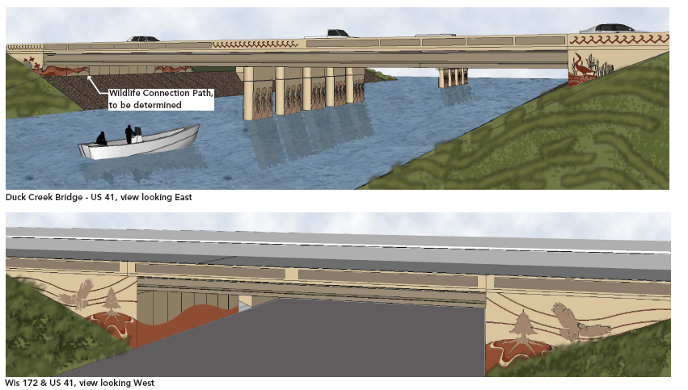

Slide 3
WISCONSIN DEPARMENT OF TRANSPORTATION and
ONEIDA TRIBE OF INDIANS

Slide 4
SELF GOVERNANCE TRIBES
Oneida Tribe of Indians of Wisconsin (1997)
Forest County Potawatomi Community (2005)
Stockbridge-Munsee Community (2011)

Slide 5
1887 The General Allotment Act of 1887 which was approved by the Oneida Tribe required the US government to parcel the tribal land into individual tracts called allotments. Approximately 1,530 allotments were assigned to tribal members now referred to as the Original Allottee. Many of the individual allotments were lost through taxation, liens, foreclosures, land speculators and questionable land transactions.

Slide 6
1838 Oneida Tribe establishes the Oneida Reservation, composed of 65,428 acres.

Slide 7
1937 The Indian Reorganization Act was passed and the Oneida Tribe bought 1400 acres of land and established the Land Committee to work with the Business Committee.

Slide 8
1977 The General Tribal Council approved the establishment of a Tribal Land Office in order to maintain all tribal lands records and to reacquire ownership of lands on the Oneida Reservation. This is the office which I was hired to handle all the Real Estate, Commercial Leases, Residential and Rental Leases for the Oneida Tribe in 1995.

Slide 9
In 2004, there was a partnership developed with the WDOT/FHWA and all 11 tribes in the State of Wisconsin. At the time, Wisconsin Governor James Doyle issued an Executive Order 39 that recognized the sovereignty of Wisconsin’s 11 Tribal Nations and directs his Cabinet to enter into a government-to-government relationship with the Tribes.

Slide 10
We, the Oneida Tribe of Indians of Wisconsin, were also allowed to partake in the CSD. This is the Community Sensitive Design. There were groups from the Oneida Community including artists that met with the WDOT to give the WDOT suggestions and explain the heritage.

Slide 11
Another project tells a story of the “Three Sisters” which are the bean, the corn and the squash. This can be seen along Hwy 41 in Green Bay, WI.

Slide 12
Our community is very strong. The Business Committee and the Land Commission strive to have the community involved with the decisions. Some of these groups are our Children, our Elders, our Veterans and we have community meetings and include the WDOT.

Slide 13
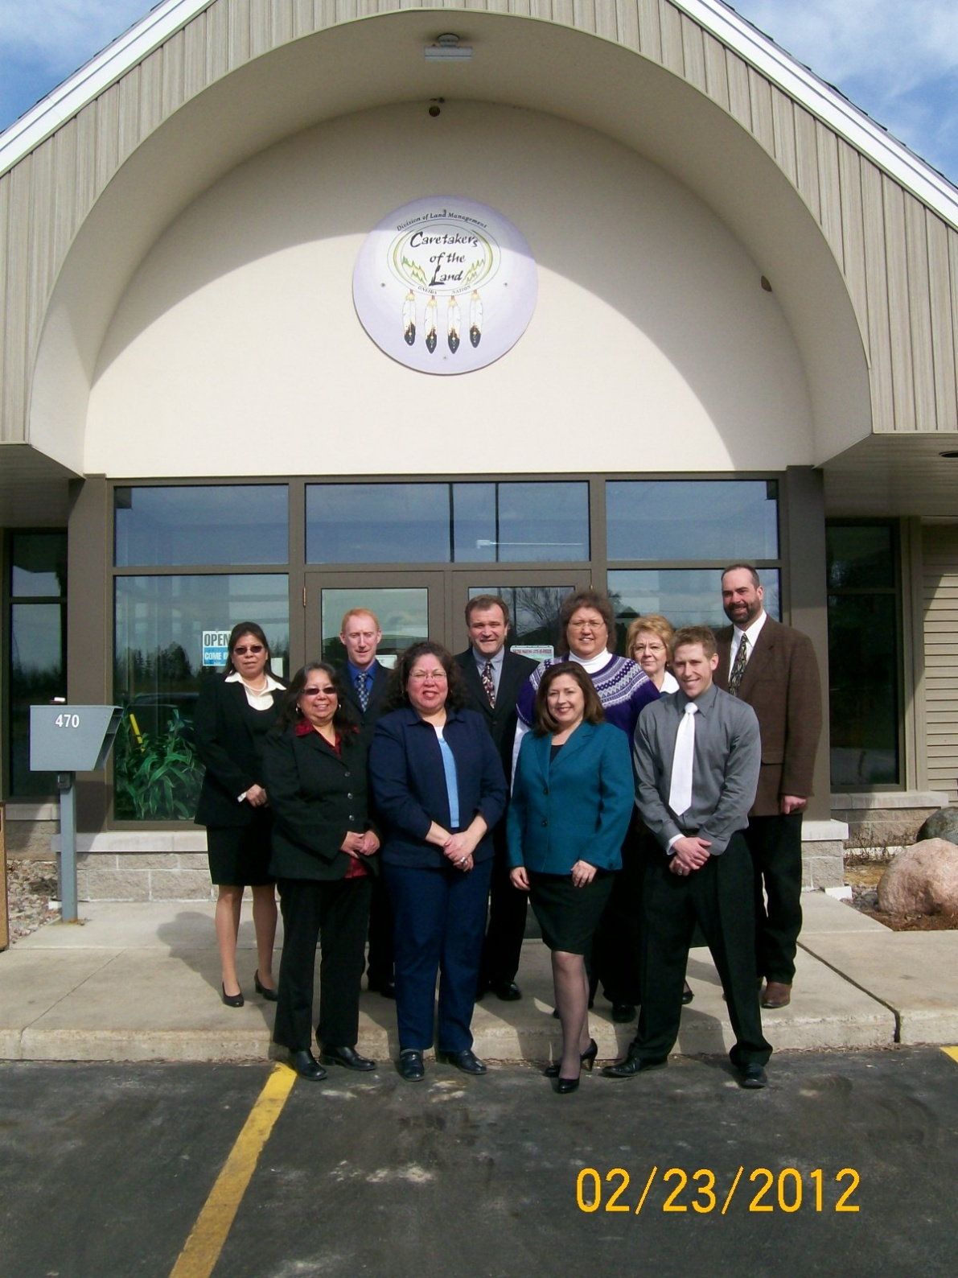

Slide 14
ROW Tribal Partnership Award
Tribal employees that are part of these meetings include representatives from the following departments
  Real Estate
  Legal
  Title & Trust
The WisDOT NE Region employees that are part of these meetings include representatives from the following sections
  Technical Services
  Planning
  Project Development

Slide 15
ROW Tribal Partnership Award
Information exchanged at the meetings generally include
  right of way parcel acquisition updates
  information on real estate acquisition procedures
  tribal land ownership verification discussions
  current project design issues
  future project concerns.

Slide 16
ROW Tribal Partnership Award
working together
to reach a common goal
WisDOT has been able to provide information to the Oneida Tribe about highway projects in their area
WisDOT has received input from the Oneida Tribe that has helped DOT design and construct the most effective highway projects possible.

Slide 17

What is a clan?
Oneida is a Matrilineal society, which
means they follow the mother’s family line.
Your clan is inherited from your mother’s
clan.
Your clan is your family and a part of your
identity.

Slide 18
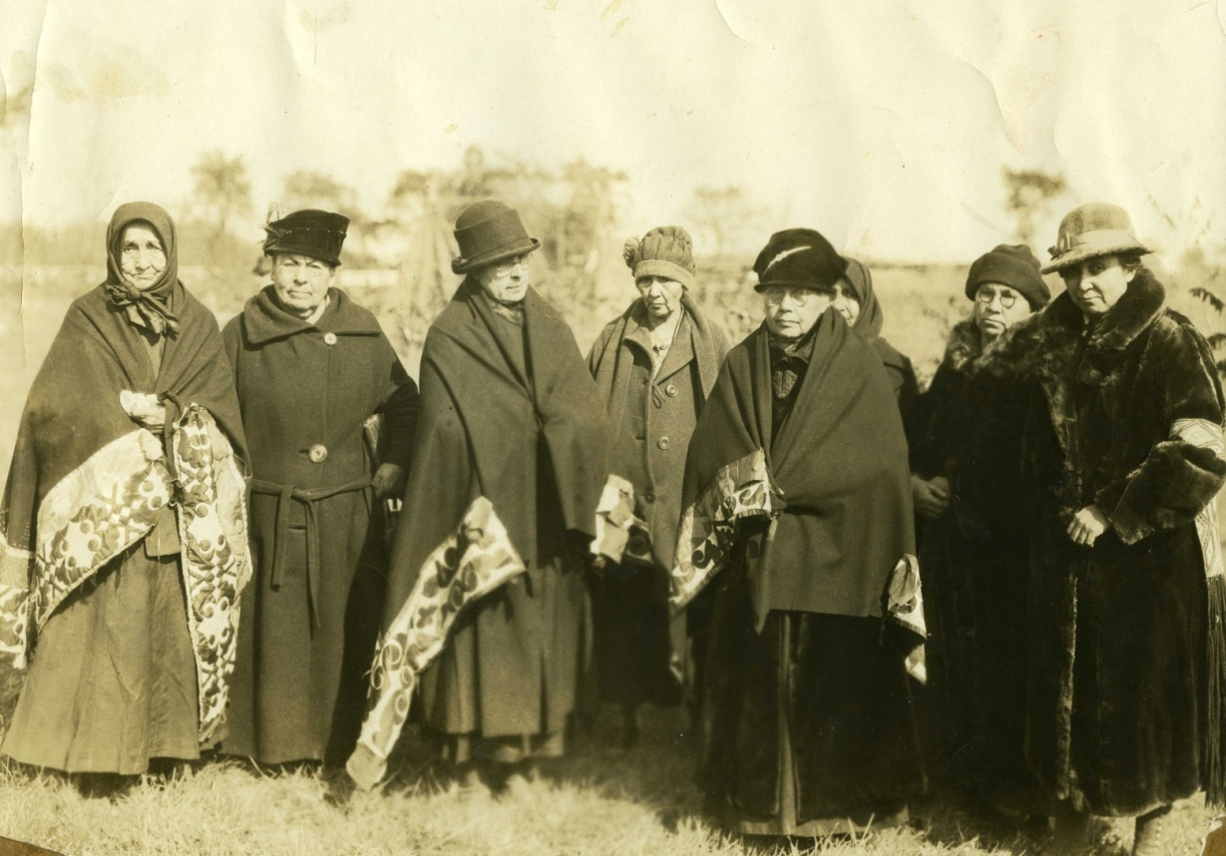
Clan Mothers - 1925
Role:
Hereditary
Usually the eldest woman in the clan
Appoints/dethrones Chief
Facilitate decisions for the clan and send the decision to the chiefs
Live by the Great Law
Responsibilities:
Observes the actions of the Chiefs
Ensure the duties follow the Great Law
Responsible to everyone in her clan
Settles disagreements within extended family
Ensures family is living in proper manner
Keeper of clan names
Approves marriages
Left to Right: Dina Schuyler, Christine Skenandore, Alice Cornelius, Margaret Summer Cooper, Jane Hill Elm, Celisa Adams, Ida Skenandore, Laura Cornelius Kellogg

Slide 19
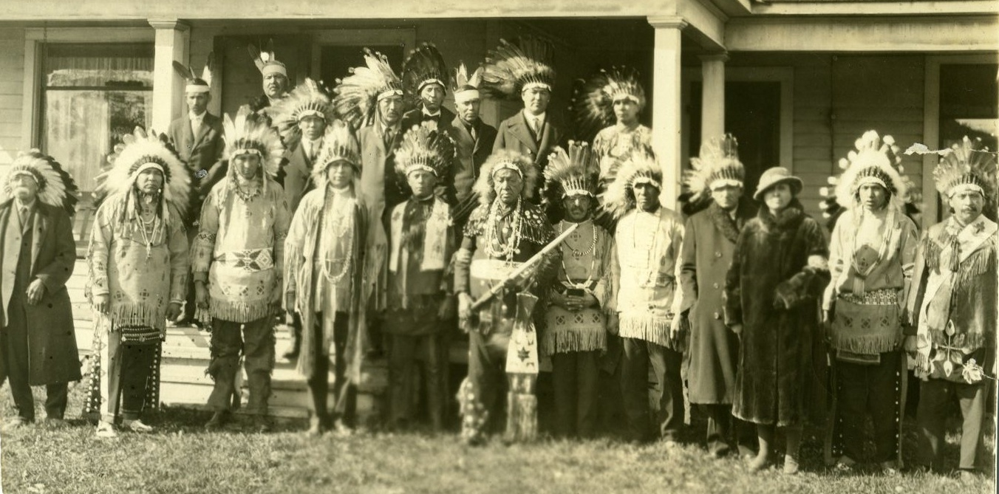
Chiefs – 1925 Onondagas help install Oneidas Chiefs
Wolf: John Pawlas, Phillip Cornelius, Alfred Pewles
Turtle: Cluster Poe Cornelius, Eli Skenandoah, Emerson Metoxan
Bear: Nelson Metoxen, Richard Summers, Gilbert Parkhurst
Nine sub chiefs: Henry Smith, Peter Danforth, Mackenzie Skenandoah, Nicholas Elm, Wallace Cooper, Solomon Skenandoah, Jonas Schuyler, Fred Cornelius, Alfred Powlas
Green Bay Press Gazette October 9, 1925

Slide 20
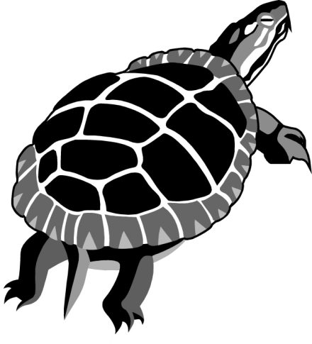


The three On<yote > a=ka (Oneida) Clans.
Wolf Turtle Bear

Slide 21
Oneida Clan Roles & Responsibilities
Role:
- Makes a path on this earth
- Give direction in the way we should go on the pathways of life
Responsibility:
- Facilitator of clan meetings
- Opening/closing a meeting
(Thanksgiving Address)
- Setting the agenda for a clan meeting
Wolf Clan: The Pathfinders
Relationship: Cousin to the Turtle clan and uncle to the Bear clan
Attributes
*Intelligent
*Listens
*Watchful
*Sense of family
*Cunning

Slide 22
Oneida Clan Roles & Responsibilities
Role:
- Mother earth is created on the back of the turtle
- Represents a calendar for the cycles of the moon and ceremonies
Responsibility:
- Acquire information for an issue brought up
- Caretaker of earth (environment)
Turtle Clan: Environment
Relationship: The older brother to the Bear Clan
Attributes
*Patient
*Never gives up
*Wise
*Respected

Slide 23
Oneida Clan Roles & Responsibilities
Role:
- Knowledge of the sacred medicines
- Knowledge of Medicine societies
Responsibility:
- Keeps the best interest of the clan and the nation
Bear Clan: Environment
Keepers of the Medicine
Attributes
*Gentle
*Strong

Slide 24
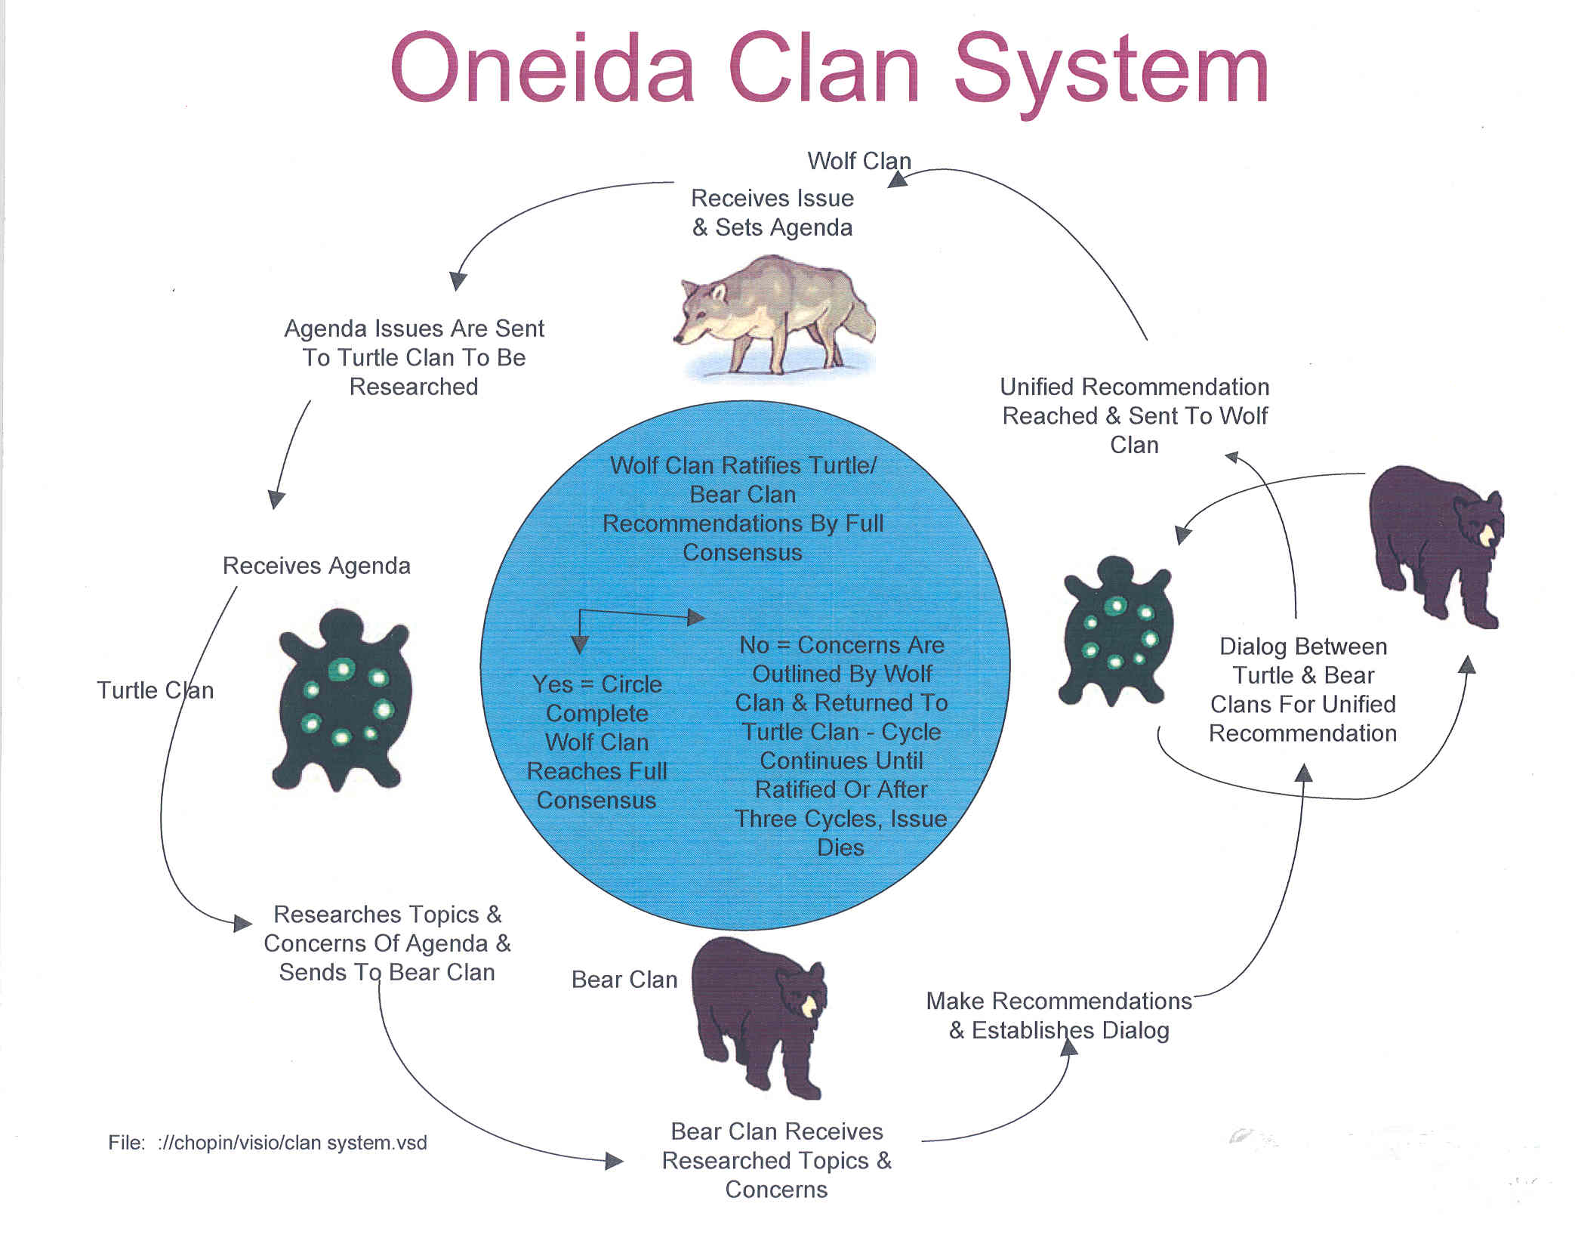

Slide 25
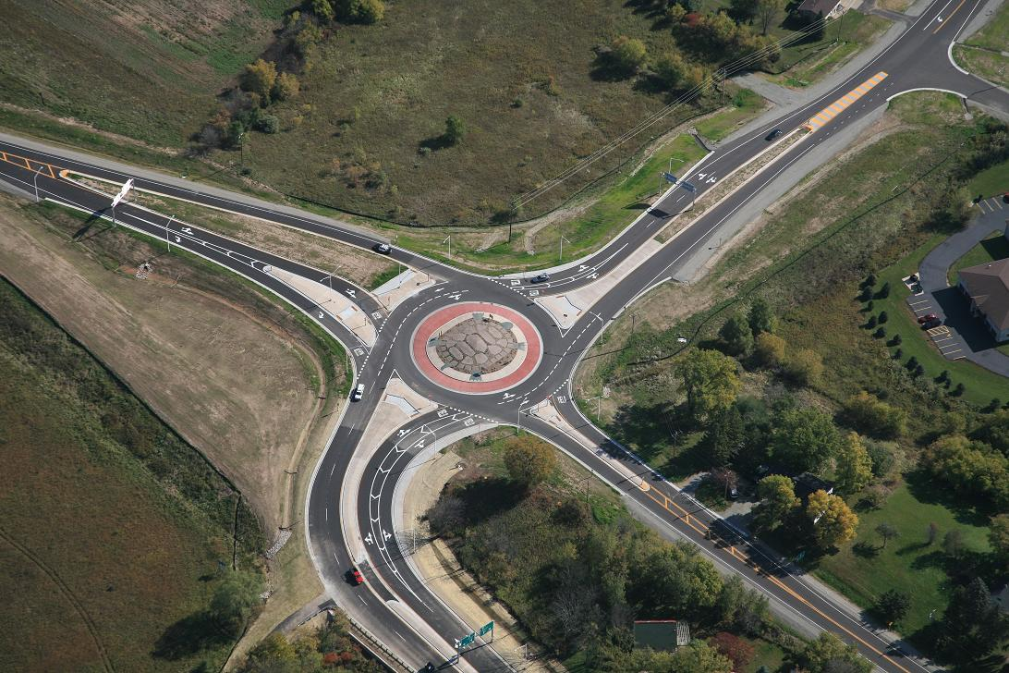

Slide 26
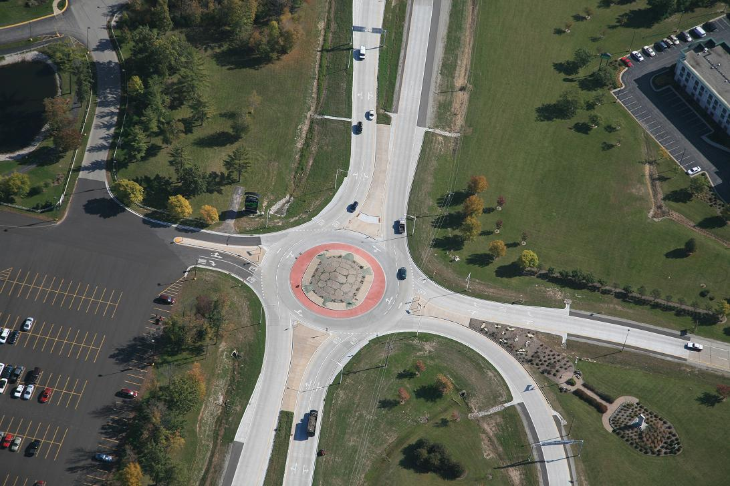

Slide 27
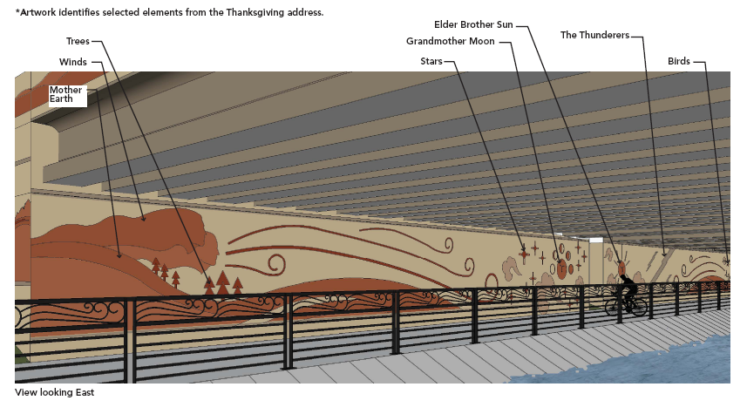

Slide 28
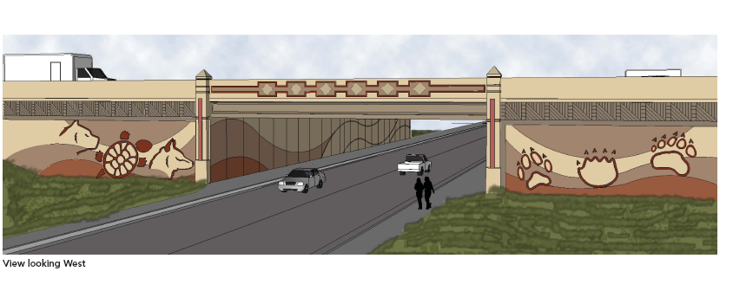

Slide 30
INTRODUCING KATHY CURREN WISDOT

