Slide 1
MATERIAL important • essential • relevant
Leslie Ashauer, PE
NE Region Materials Engineer
2020 Northeast Region Construction Training
NWTC, Green Bay, WI
March 12, 2020

Slide 2
9 to 5: Organizational Structure
Jamie Cynor
Base Aggregate
Concrete
Brian Jandrin
Hot Mix Asphalt
Nuclear Density
Kim Heise
IRI Ride
MIT Scan
Jason Tucker
Lab Testing
Beam Guard
Equipment / Supplies
Tony Allard
Pavement Thickness
Neil Michaelson
Retaining Walls
Soils
Leslie Ashauer
Material Requirements
Nonconforming Materials
Non-Performance QMP
Testing Requirements
Pavement Changes (MTL or construction methods)
Notes:
9 to 5: Dolly Parton
Jamie Cynor
Concrete & Aggregate IA/QMP Coordinator
WisDOT NE Region
jamie.cynor@dot.wi.gov
Office: (920) 492-7719
Mobile: (920) 366-8096
Brian Jandrin
HMA IA/QMP Coordinator
WisDOT NE Region
brian.jandrin@dot.wi.gov
Mobile: (920) 360-2200
Kim Heise
Soils, Pavement and Materials Assistant
WisDOT NE Region
kim.heise@dot.wi.gov
Office: (920) 492-5985
Mobile: (920) 362-6360
Jason Tucker
NE Region Lab Coordinator
WisDOT NE Region
jason.tucker@dot.wi.gov
Office: (920) 492-5677
Anthony P. Allard, P.E.
Pavement Engineer
WisDOT NE Region
anthony.allard@dot.wi.gov
Phone: (920) 366-9659
Neil Michaelson, P.E.
Soils Engineer
WisDOT NE Region
neil.michaelson@dot.wi.gov
Mobile: (920) 362-2811
Leslie E. Ashauer, P.E. Materials Engineer
WisDOT NE Region
leslie.ashauer@dot.wi.gov
Mobile: (920) 362-1502

Slide 3
ROCK THIS TOWN
Notes:
Rock This Town: Stray Cats

Slide 4
FOR THOSE ABOUT TO ROCK: BAD Stockpile
QC & QV Passing Results
USE SOURCE
QC & QV Sample Stockpile
One or Both Samples Fail
QC & QV Perform Side by Side Sampling
QC & QV Passing Results
USE SOURCE
Contractor Submits Written Corrective Action Plan & Passing PC Test
QV Takes Sample & PASSES
USE SOURCE
One or Both Samples Fail
QV Takes Sample & FAILS
SOURCE NOT ALLOWED
Notes:
For Those About to Rock: AC/DC
SS 730.3.1(2) Stockpile Tests
Ensure that both QC and QV stockpile test results conform to the specifications before placing material. If either the QC or the QV test fails, both the QC and QV technicians will resample the stockpile side-by-side and rerun the tests. If either side-by-side test fails, submit a written description of corrective action taken. If the corrective action results in a passing process control test, the department will retest to confirm that the resulting material is conforming.
************************************************************************************************************************************************************************************************************
For those that are taking stockpile tests, there is a new procedure outlined in the spec for what to do when a QC or QV stockpile sample fails.
If QC and QV take their stockpile samples and both results are passing, the source is allowed to be used on the project.
However, if either of those initial samples fails (QC or QV) then the next step is to take a side-by-side test. In this region, we encourage the QV and QC to do a side by side sample for the first sample taken. That may or may not happen, so regardless, the second sample is required to be a side-by-side. If you did not have an IA present at the first sampling, include the IA for this test. The IA can be a fresh set of eyes to know if there are some sampling discrepancies and just ensure that sampling is not the issue with the test results failing.
If the second set of samples are satisfactory, then the source is allowed to be used on the project.
Now if either the second QC or QV test fails, here is where the spec gets more definitive on the process. The Contractor is then required to submit a written corrective action plan, implement the plan, take a process control test and submit it to the project staff. The process control test needs to be passing. If the contractor does not have a passing process control test and they followed their corrective action, they could go back and do alternate corrective action. The department (QV) will not take another sample until there is a passing PC test on the material. If/when a passing PC test is presented after the corrective action, then the QV (just the QV) will take a 3rd sample. The QC essentially provided a 3rd sample with the PC test.
If that third QV test passes, the source is allowed to be used and the project keeps moving.
If that third QV test fails, it’s a three strikes – you're out and that source is not allowed on that project.

Slide 5
ROCK AND ROLL NEVER FORGETS: BAD Stockpile Test
120 DAYS
Notes:
Rock and Roll Never Forgets: Bob Seger
SS 730.3.1(3) Stockpile Tests (ASP 6, Dec 2019 LET)
Stockpile tests^{[1]} can be used for multiple projects. If placement on a project does not begin within 120 calendar days after the date the stockpile sample was obtained, retest the stockpile before placement begins.
^{[1]} Replace the stockpile test with an in-place production test for concrete pavement recycled and reprocessed on-site; test on the first day of production.
************************************************************************************************************************************************************************************************************
This is mentioned at every preconstruction meeting. It is the responsibility of the contractor to bring forward the project ID of the project that the stockpile tests are being used from. Contractor will need to supply the QC stockpile test. The QV test can be looked up in Atwood systems.

Slide 6
ROCK ON: QC BAD Small Quantity
>500 but ≤ 6,000 TONS
1 Stockpile
Before Placement
2 Production
OR
1 Loadout
QTY overruns 6,000 Ton
Additional Sample(s)
≤ 500 TONS
2 Production Tests
Valid for 3 Years
1 Stockpile Test
and
OR
Notes:
Rock On: David Essex
SS 730.3.4 Small Quantity BAD Testing
SS 730.3.4.1 Contractor QC Testing (ASP 6, Dec 2019 LET)
For small quantity contracts with ≤ 500 tons, submit 2 production tests or 1 stockpile test. Production tests are valid for 3 years from the date the production sample was obtained. Begin placement within 3 years of the sate sampled.
For small quantity contracts with ≤ 6000 tons and > 500 tons, do the following:
Conduct one QC stockpile test before placement.
Submit 2 production tests or conduct 1 loadout test instead of placement tests. Production tests are valid for 3 years from the date the production sample was obtained; the first day of placement must be within 3 years of the date sampled.
If the actual quantity placed is more than 6000 tons, on the next day of placement perform one additional random QC test for each 3000 tons of overrun, or fraction thereof.
************************************************************************************************************************************************************************************************************
If the contract quantity is 500 tons or less, the contractor needs to provide only an abbreviated QC plan and then 2 production tests OR 1 stockpile test. Those tests should be submitted with the abbreviated QC plan. QV does not have to perform a stockpile test or a random QV test for contract quantities under 500 tons; that testing can be waived per SS 730.3.4.2.
If the contract quantity is over 500 tons, but less than or equal to 6,000 tons, a stockpile test before placement is required. In addition, the contractor will have to provide 2 production tests OR 1 loadout test for the material. If the quantity exceeds 6,000 tons, an additional sample may be needed. It depends on when the quantity over 6,000 tons is placed.
So for example:
The contact quantity is 5,800 tons. The last day of placement the contractor starts the day with a cumulative total of 5,600 tons and proceeds to place 700 tons that day. The end of day total is 6,300 tons. QC would not need an additional sample because the quantity over the 6,000 tons was placed in the same day. Project staff is provided tickets at the end of the day, so it makes it difficult to track when the contractor will overrun the quantity.
Contract quantity is 4,700 tons. At the end of Tuesday, the contractor has placed 4,600 tons. On Wednesday, the contractor places a cumulative total of 5,500 tons. Then they come back on Thursday and place 300 tons for a cumulative total of 5,800 tons. The contractor does not need an additional QC test because the 6,000 threshold was not exceeded. **However, if the contractor comes back on Friday and places 500 tons, for a cumulative total of 6,300 tons, this would provide for some anticipation of exceeding the 6,000 tons. It is recommended that they provide a QC test. At a minimum, if the contractor came back yet another day a QC sample would be absolutely required..
Contract quantity is 5,600 tons. Monday started a cumulative tonnage of 5,400 tons. Contractor placed 700 tons on Monday, ending the day at 6,100 tons. Tuesday the contractor placed 500 tons. A QC sample is required on Tuesday because it is the next day after the quantity exceed 6,000 tons.

Slide 7
I WANNA ROCK: Production Tests
HTCP Certified
Random Numbers Req’d
Notes:
I Wanna Rock: Twisted Sister
SS 701 General QMP Requirements
701.1.2.4 Personnel Certification
Have personnel that are HTCP-certified at or above the minimum levels specified in table 701-1 perform sampling, testing, and documentation.
701.3 Testing
701.3.1 General
Perform contract required QC tests for samples randomly located according to CMM 8-30. Use the test methods specified in table 701-1.
************************************************************************************************************************************************************************************************************
All production tests need to be performed by a certified person with the Highway Technician Certification Program. The production tests also need to be random. The random number can be used to determine a random tonnage, time, etc, but the test needs to be random. Make sure to pay attention to the production records that contractors are submitting and ensure all the required information is on the test results (person performing the test, random number etc.)

Slide 8
BLACKTOP
Notes:
Blacktop: Alan Jackson

Slide 9
WALK THE LINE: HMA Joints
ASP 6 (Dec ‘19 LET) - SS 450.3.2.8(3)
Layer of 1.75” or Greater → Notched Wedge Req’d
Do not remove notched wedge joint for rumbles.
Notes:
Walk The Line: Johnny Cash
450.3.2.8 Jointing
Replace paragraph three with the following effective with the December 2019 letting:
(3) Construct notched wedge longitudinal joints for mainline paving of HMA layers 1.75 inches or greater. Extend the wedge beyond the normal lane width as the plans show or as the engineer directs.
Replace paragraph five with the following effective with the December 2019 letting:
(5) Construct the wedge for each layer using an engineer-approved strike-off device that will provide a uniform slope and will not restrict the main screed. Shape and compact the wedge with a weighted steel side roller wheel or vibratory plate compactor the same width as the wedge. Apply a tack coat to the wedge surface and both notches before placing the adjacent lane.
6) Clean longitudinal and transverse joints coated with dust and, if necessary, paint with hot asphaltic material, a cutback, or emulsified asphalt to ensure a tightly bonded, sealed joint.
************************************************************************************************************************************************************************************************************
A notched wedge longitudinal joint is required on all layers of 1 ¾” or greater. This is effective with December 2019 LET’s (2020 construction contracts).
Also, there was guidance about removing the notched wedge joint when installing centerline rumble strips. The new guidance is to NOT REMOVE THE NOTCHED WEDGE JOINT when installing rumble strips.
Starting with May 2020 LET’s, the special/STSP to remove the notched wedge joint will ONLY be on SMA projects. This directive came from BTS, with region consensus. However, if you have it on a project that was LET prior to May 2020, please contact Region Materials to discuss removing the item from the contract.

Slide 10
JOINT 2 JOINT: HMA Joint Heater
JOINT HEATER
Notes:
Joint 2 Joint: Prince
Starting with May 2020 LET’s, the joint heater STSP will no longer be on construction projects. This directive came from BTS, with region consensus. If the contractor proposes to have the joint heater removed on a project, discuss with your Project Manager (PM)

Slide 11
PAINT IT BLACK: Tack
ASP 6 (Dec ‘19 LET) - SS 455.2.5: Only “h” suffix tacks allowed
Nonconforming Tack SS 455.3.2.6
Nonconforming Work
Tracked offsite
Puddling
Nonconforming Material
Insufficient residual AC
Failing test results
Notes:
Paint It Black: The Rolling Stones
455.2.5 Tack Coat
Replace paragraph one with the following effective with the December 2019 letting:
Under the Tack Coat bid item, furnish type SS-1h, CSS-1h, QS-1h, CQS-1h, or modified emulsified asphalt with an “h” suffix, unless the contract specifies otherwise.
455.3.2.6 Nonconforming Tack Coat
Tack coat is nonconforming as follows:
- Where applied tack coat is tracked either offsite or to other areas of the construction site.
- Where excess tack coat accumulates in puddles.
- In areas with insufficient residual asphalt content.
(2) Remove tracked tack and correct nonconforming tack coat.
*********************************************************************************************************************************************************************************************
For all of 2020 construction, only the “h” suffix tack coats are allowed. The “h” at the end indicates a harder asphaltic base which is determined necessary in the state’s climate.
The SS now also states different types of “nonconforming” tack. Tack tracking and tack puddles are considered nonconforming work and should be discussed with your PM and the Region Construction Quality Assurance Engineer (Krissy). Insufficient residual rate is a nonconforming material issue and should be discussed with your PM and the Region Materials Engineer (Leslie).

Slide 12
BLACK BETTY: Ignition Oven
1st Day of Production Sample
Mix Designs Prior to 12/1/2019
Provide to Region, Tested by BTS
Lab Batched Mix Sample
Mix Designs after 12/1/2019
Provide to Region 10 days prior to production
Notes:
Black Betty: Ram Jam
CMM 8-36.6.3.6 Asphalt Content by Ignition Oven WisDOT-Modified AASHTO T308
All ignition ovens used for AC determination should be installed, operated, and maintained according to AASHTO R96. Mix designs with AC determined by ignition oven must have appropriate ignition oven correction factors (IOCF). Either lab-batched or plant-produced material must be provided to the department according to CMM 8-36.6.3.7. For mix designs using lab-batched material, mix designers must collect sufficient material (at 3.0% air voids for HMA or 4.5% air voids for SMA) to provide the region with ten individually-packaged IOCF split samples of appropriate weight according to CMM 8-36.6.3.7 at least 10 days before producing the mix design on a WisDOT contract. Regional labs will send three individually-packaged IOCF split samples to BTS within one day of receiving the sample for possible AC verification.
CMM 8-36.6.3.7 Ignition Oven Correction Factor
Ignition oven asphalt binder content and aggregate correction factors are specific to each mix design and oven and are not transferable.
CMM 8-36.6.3.7.1 Ignition Oven Correction Factor Using Plant-Produced Material
The contractor must determine an ignition oven asphalt binder content and aggregate correction factor before the first day of production on a WisDOT project. The regional lab ignition oven correction factor may be determined using material obtained at the plant on the first day of production or using lab-batched material. Regardless of the type of material used for IOCF determination, ten individually-packaged IOCF samples of the appropriate weight according to CMM 8-36.6.3.7 must be submitted to the regional lab. If using plant-produced material for the IOCF, the contractor must notify the regional lab at least 24 hours before the first day of production for the mix being sampled. The department has the option to witness collection of the IOCF samples at the plant. If the department does not witness sampling at the plant, the contractor is responsible for delivering the IOCF samples to the regional lab within one day of collecting them. The regional lab will send three individually-packaged IOCF samples to BTS for AC content verification within one day of receiving them.
*********************************************************************************************************************************************************************************************
If a project is using a mix design that was created prior to 12/1/2019, a 1st day of production sample needs to be supplied to the region so the ignition oven correction factor can be established.
If the project is using a mix design created after 12/1/2019, the contractor needs to supply the material for the IOCF to the region 10 days prior to production.
Project staff should be talking with the contractor and the Region HMA IA to determine what is needed for the project.

Slide 13
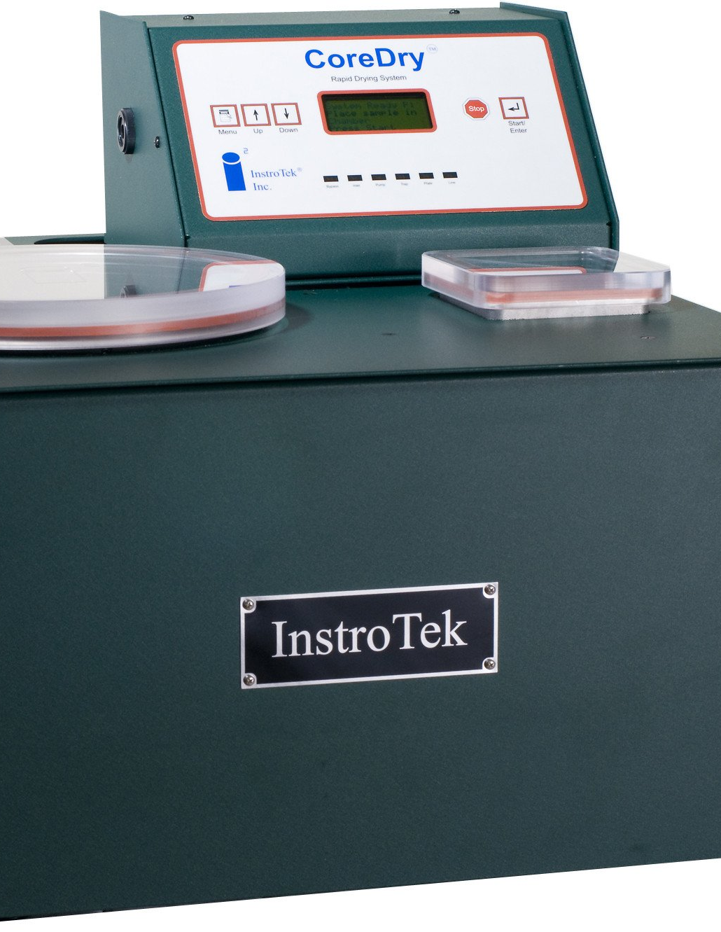
BONE DRY: HMA PWL Cores
Prior to QC Testing
Dry Cores in CoreDry
Dry Cores in CoreDry
After QC Testing
Notes:
Bone Dry: George Jones
Stp-460-055 Appendix A: WisDOT Procedure for Nuclear Gague/Core Correlation – Test Strip
(7) The contractor is responsible for thoroughly drying cores obtained from the mat in accordance with ASTM D 7227 prior to using the specimens for in-place density determination in accordance with AASHTO T166 as modified in CMM 8-36.6.5
(6) The contractor is responsible for drying the cores following testing. The department will take possession of cores following initial testing and is responsible for any verification testing.
************************************************************************************************************************************************************************************************************
New for 2020 PWL projects, the PWL cores that are taken from the roadway need to be put into the CoreDry prior to doing the weighing and testing of the cores. Then after all the testing is completed, the cores need to be put back into the CoreDry before they are transported back to the region. The cores need to arrive at the region completely dry.

Slide 14
BACK IN BLACK: HMA
TSR Samples
#4 & #5 Mixes
Contractor Samples
HMA / PWL Training
HMA Training on Learn Center
Region PWL Training April 9
Stone Matrix Asphalt (SMA)
LOTS of changes
Talk to Region Materials
Interlayers #6 Mix
Reduce reflective cracking
Notes:
Back In Black: AC/DC
TSR Samples:
The contractor is required to submit samples of #4 and #5 mixes for tensile strength ratio (TSR) testing. The test will tell us how susceptible the mix is to moisture. This submittal should happen directly between the contractor and Region/Central Office staff, however, on a rare occasion project staff might be requested to deliver the sample to the Region. If staff is asked to deliver samples, please coordinate with Region HMA IA (Brian Jandrin).
If the TSR results of your project mix are not satisfactory, Region HMA IA will coordinate with you if there are actions to be taken on your project.
------------------------------------------------------------------------------------------------------------------------------------------------------------------------------------------------------------------------
HMA/PWL Training:
PWL Training is on the Learn Center:
2019 HMA PWL Training Series – Yes, it is still says 2019, but the training is still valid. If you are on a PWL job and have not completed this training, please do so. There are 5 modules.
HMA PWL 01: Introduction and Background 2019This is the first module in a 5-module series. Complete all 5 modules here in this series. To receive 3 PDH's for the series, please go back into the LearnCenter and request the HMA PWL Assessment. Complete it with a score of 80% or greater to receive the 3 PDH's.
HMA PWL 02: Pre-Production 2019This is the second module in a 5-module series. Complete all 5 modules here in this series. To receive 3 PDH's for the series, please go back into the LearnCenter and request the HMA PWL Assessment. Complete it with a score of 80% or greater to receive the 3 PDH's.
HMA PWL 03: Test Strip 2019This is the third module in a 5-module series. Complete all 5 modules here in this series. To receive 3 PDH's for the series, please go back into the LearnCenter and request the HMA PWL Assessment. Complete it with a score of 80% or greater to receive the 3 PDH's.
HMA PWL 04: Main Production 2019This is the fourth module in a 5-module series. Complete all 5 modules here in this series. To receive 3 PDH's for the series, please go back into the LearnCenter and request the HMA PWL Assessment. Complete it with a score of 80% or greater to receive the 3 PDH's.
HMA PWL 05: Analysis and Best Practices 2019This is the fifth module in a 5-module series. Complete all 5 modules here in this series. To receive 3 PDH's for the series, please go back into the LearnCenter and request the HMA PWL Assessment. Complete it with a score of 80% or greater to receive the 3 PDH's.
PWL Guide:
https://awpkb.dot.wi.gov/Content/constr/PantryFiles/StatewideManualsAndGuides/wisdot-pwl-guide.pdf
HMA Paving Field Inspection Training:
It is recommended that this course be taken prior the PWL training.
For consultants:
https://store.transportation.org/Item/TrainingDetail/2473
For DOT Staff:
https://wisconsindot.csod.com/LMS/LoDetails/DetailsLo.aspx?loid=f40e26f7-dea9-460c-8520-485338c16e5a&query=%3fq%3dHMA+Paving+Field+Inspection#t=1
------------------------------------------------------------------------------------------------------------------------------------------------------------------------------------------------------------------------
Stone Matrix Asphalt:
There have been a TON of changes to SMA in the SS. The region does not have any SMA projects this year in the program, so I’m not going to go thru the information. However, if you find yourself on an SMA project, please reach out to Region Materials for assistance.
------------------------------------------------------------------------------------------------------------------------------------------------------------------------------------------------------------------------
Interlayers (#6 Mix):
A #6 mix has been added for use on projects. This mix is to help reduce the amount of reflective cracking that is seen in the upper layers of the asphaltic pavement. Currently the NE Region does not have any projects designed with the #6 mix, however, watch for it in the future.

Slide 15
CONCRETE JUNGLE
Notes:
Concrete Jungle: Bob Marley

Slide 16
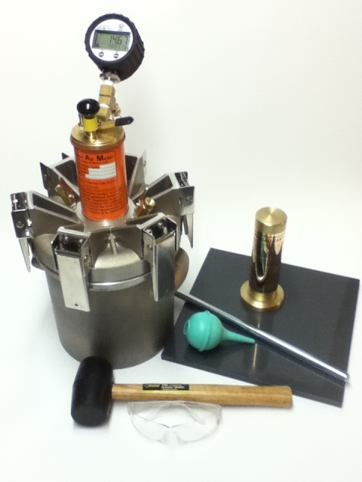
TINY BUBBLES: Super Air Meter
10 Min test
SAM = 0.2
14.5, 30, 45 PSI
Air Void Size
Freeze-Thaw Durability of Concrete
Notes:
Tiny Bubbles: Don Ho
The super air meter (SAM) is testing to see the size of the air bubbles in the concrete. Tyler Ley from Oklahoma State University developed the SAM. He has a number of YouTube videos on his channel (plus a ton about concrete in general.)
Introduction to the Super Air Meter:
https://www.youtube.com/watch?v=xabCt_CibJY
Secrets of the Super Air Meter:
Https://www.youtube.com/watch?v=90iahpAwqRE
The SAM is a device that can perform the standard Type B air meter test (must use aggregate correction factor) and also perform the SAM test (no aggregate correction factor.) The SAM test is performed at 3 different pressures: 14.5 PSI, 30 PSI and 45 PSI. The test takes about 10 -15 minutes to perform. The test is looking at the air void size. The SAM number that is desired is 0.2. This number is the difference between the result of the 45 PSI test and the 30 PSI test.
Smaller air bubbles provide concrete that has better durability to freeze-thaw, which is very important in our Wisconsin climate.
It is suggested that when a tester is due to recertify in PCCTEC-1, that you repeat the class at the reduced rate so that the hands on portion of the SAM is taught to the tester.

Slide 17
THE AIR BETWEEN US: SAM Testing Requirements
QC TESTING
Class I Concrete
1 QC / Lot
QV TESTING
Class I Concrete
1 QV / 5 QC (or portion of)
Notes:
The Air Between Us: Hammock
QC Testing:
Contractor is required to perform SAM testing on all Class I concrete (unless listed as an exception in SS 715.) The contractor is required to perform 1 QC SAM test per lot of concrete.
QV Testing:
QV is required to perform 1 SAM test for every 5 QC SAM tests, or portion thereof. So, if the contractor only has to perform 1 QC SAM test, the QV needs to perform 1 QV SAM test.
If the project meets the following criteria, contact Region Materials (Concrete IA) for potential solutions:
Project is small – meaning only 1-2 QV SAM tests are required
Staff does not own a SAM
Staff has not been instructed on how to run a SAM

Slide 18
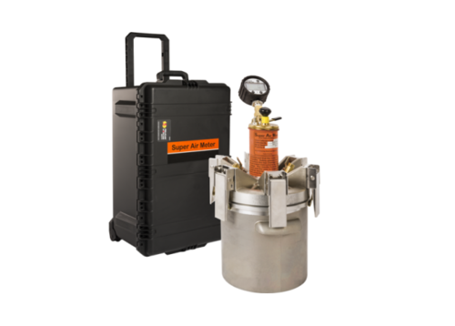
PRICE YOU GOTTA PAY: Super Air Meter / Air Compressor
AMAZON
Super Air Meter
Humboldt
Gilson
Forney
$3,200
$80
Notes:
Price You Gotta Pay: Mr. Big
Super Air Meters can be purchased at the following locations:
www.superairmeter.com
Humboldt
Gilson
Forney
The cost of the equipment and case is approx. $3,200.
There is a CAPE available from Super Air Meter for approx. $600. This is a set of gauges and an air compressor. This equipment is big and clunky. It is recommended to NOT PURCHASE the CAPE.
Instead, it is recommended to purchase a handheld air compressor that looks like a handheld drill. These can be found on Amazon for approx. $80. There may need to be an adapter purchased and that is around $20.
SAM testing is not going away. This year QV is for information only, however, going forward that will change at some point. Companies are strongly encouraged to budget and purchase the SAM. As a reminder, the SAM equipment can be used to perform both the SAM test and the traditional Type B air test. Two separate pieces of equipment are not needed.

Slide 19
GREAT BIG WHITE WORLD: Concrete
Agg Testing: QV 1 / 5 QC
Concrete Barrier – Class I
Aggregate Testing 1 in 5
Recycled Concrete on project – extra samples for Freeze/thaw testing
Optimized Gradation – STSP
Fly Ash Shortage – take out – new mix/new randoms: substitute Fly Ash for Fly ash same class-same mix.
Concrete Barrier
Recycled Concrete
Concrete
Fly Ash Shortage
Optimized Gradation STSP
Notes:
Great Big White World: Marilyn Manson
Concrete Aggregate Testing:
SS 701.3.3.2 QV Testing
The department will conduct a minimum of 1 verification test for each 5 contractor QC tests unless specific QMP provisions specify otherwise.
Concrete Aggregate Testing: 1 QV per 5 QC
Contractor tests aggregate during aggregate production
QV will test aggregate during concrete production
------------------------------------------------------------------------------------------------------------------------------------------------------------------------------------------------------------------
Recycled Concrete:
IF your project has concrete that is being recycled ON-SITE, notify Region Concrete IA.
Extra aggregate samples are requested by BTS for Freeze/Thaw testing.
------------------------------------------------------------------------------------------------------------------------------------------------------------------------------------------------------------------
Optimized Aggregate Gradation STSP:
If your contract does not have the Optimized Gradation STSP and contactor wants to use OAG, contact Region Materials.
No Cost CCO will be required for your project.
------------------------------------------------------------------------------------------------------------------------------------------------------------------------------------------------------------------
Fly Ash Shortage:
SS 715.3.1.2.1(1)
For paving and barrier mixes, a source change under item 1 of 710.4(5) for fly ash of the same class that does not require a modification under items 2 through 4 of 710.4(5) does not constitute a mix design change.
------------------------------------------------------------------------------------------------------------------------------------------------------------------------------------------------------------------
Concrete Barrier:
2020 Concrete Barrier is Class I Concrete.
Eligible for incentive / disincentive

Slide 20
I NEED TO KNOW
Notes:
I Need to Know: Tom Petty and the Heartbreakers

Slide 21
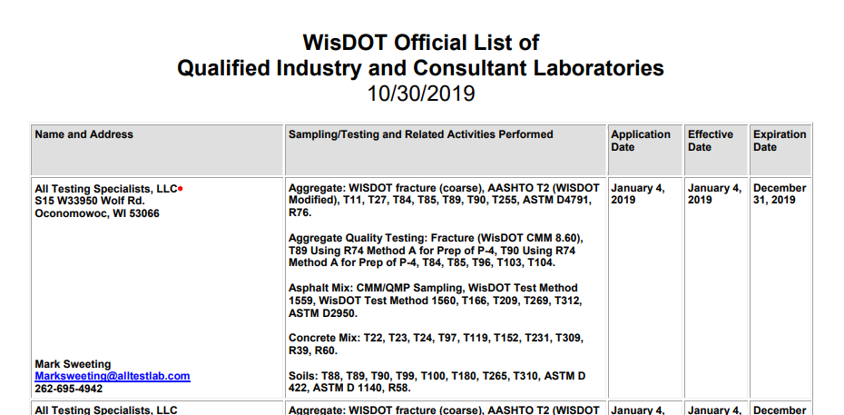
I FOUGHT THE LAW: Lab Qualifications
Doing Business → Engineers & Consultants → Structure & Roadway Resources → Tools → Qualified Laboratories
Notes:
I Fought the Law: The Clash
https://wisconsindot.gov/Pages/doing-bus/eng-consultants/cnslt-rsrces/tools/appr-prod/qual-lab-req.aspx
All laboratories doing testing on WisDOT projects need to be Qualified. A listing of the qualified laboratories is found at the above link . Please check that the laboratories doing testing on your projects are certified for the tests that they are performing. If you have any concerns with a lab not be on the list, please contact Region Materials.
It is suggested that you shortcut the link as it is a bit cumbersome to find.

Slide 22
TEST OF TIME: Nuclear Density (CMM8-15)
Test TIme
1 Minute
(all material types)
Gauge Rotation
Some require 180° rotation
Discrepancies
Notify Region Materials if contract states 4 min test
Notes:
Test of Time: Judy Collins
For any nuclear density test, the test time is 1-minute. CMM 8-15 has been updated to reflect this.
Some materials will require the 180° rotation; the spec will need to be reviewed for the given material being tested.
There are a few specials/STSP’s that may still reference a 4 minute test time for random QC/QV tests. Notify Region Materials if there is a special/STSP on the project with the longer test time so a no cost CCO can be applied to the project. **NOTE: The reference site tests and gauge comparison tests (being clarified in Spring 2020 CMM update) are still 4 minutes. This test time did not change.**

Slide 23
IF I COULD JUST GET IT DOWN ON PAPER
Notes:
If I Could Just Get It Down On Paper: Jimmy Buffett

Slide 24
THE RULES OF THE ROAD: Nonconforming / Non-Performance
NC/NP
Notify Contractor
Notify PM
Notify ME
Complete Form
Region Approval
BPD / BTS Approval (≥ $5,000)
CMJ / ConMod
File with DT1310
Notes:
The Rules of the Road: Nat King Cole
This is the flowchart for how Nonconforming Material or Non-Performance of QMP progress. Once the NC/NP is discovered on the project, it needs to be addressed with the contractor AND the PM needs to be notified. The contractor should have an opportunity to rectify the NC/NP it if at all possible. The region material engineer needs to be brought into the loop early on also. Early involvement by all affected (PCL, Liable Contractor, Prime Contractor, PM, ME) can help reduce the severity of the NC/NP in many cases. The PM and/or ME will being in the Region Construction QA Engineer as needed.
If a nonconformance/non-performance credit needs to be taken, the form in pantry needs to be completed: Nonconformance_NonPerformance Concurrence_20200114.docx (As of 3/17/2020 the form has not been uploaded yet – so contact Region Materials (ME) until pantry is updated with the statewide form.)
The form needs to have an uber amount of detail. Any amount of detail you can provide regarding the situation is helpful. These documents are used by individuals that do not have intimate knowledge of your project. The more detail provided, the faster the approval process and the easier it will be for project staff when drafting CMJ’s/ConMods and DT1310 entries. Once project staff has completed the form, send the PM & ME for approval. It is very likely that the ME will review what has been written and make comments for corrections, so please do not be shocked if there are a few revisions to the document. The ME is responsible to ensure that all the necessary information is provided so that if the credit is >$5,000, the Chief of the Bureau of Project Development and the Chief of the Bureau of Technical Services has all the justification documentation to concur on the issue.
The region will sign the document. If the credit is less that $5,000, the staff can proceed with writing the CMJ/ConMod and DT1310 entries.
If the credit is >$5,000 as mentioned abouve, the ME will send to the BPD/BTS chiefs for concurrence or recommendation. Once concurrence/resolution is received, the project staff can proceed with writing the CMJ/ConMod and DT1310 entries.
A signed copy of the Nonconformance/Non-Performance Concurrence Form needs to be placed in the material records behind the WS4567 form/documentation.
Also, the verbiage in the form is the same verbiage to use for the CMJ/ConMod and DT1310 entries. It is not intended to have you reinvent the wheel when composing those documents.

Slide 25
PANTRY: Statewide
HMA
Yield Calc & Asphalt Paving Diary Example
HMA Density Field Worksheet 1 min
HMA Long Joint Density V2.0
HMA PWL Production V2.0
HMA PWL Test Strip V2.0
Nonconforming / Non-Performance
Nonconformance / Non-Performance
Nonconformance / Non-Performance Addendum
QMP Templates
NE Region Templates moving to Statewide
Agendas
Concrete PrePours – Coming
Asphalt PrePaves (PWL & QMP) - Coming
Notes:
Pantry: Lyle Lovett
These are the documents that are submitted to be in Statewide Pantry this year. If you are unable to find the information, please contact Region Materials and we will get you the documents that you need.

Slide 26
HELP ME: Region Pantry
E-Guides for Standard NE Region SPV’s
Coded with NER SPV Code
Sample Truck Delivery Schedule
Nonconforming / Non-Performance Form
DT1310 Examples
Disincentives
Stockpile Failure
Buy America
more to keep coming . . .
Notes:
Help Me: Elvis Presley
These are the documents that are submitted to be in Region Pantry this year. If you are unable to find the information, please contact Region Materials and we will get you the documents that you need.
Region E-Guides to the Standard Region SPV’s should be a huge help to all of staff. This will eliminate the questioning of what is required and should provided reduced work load for many.
If you find that you have a lot of municipal items on your project, please reach out to Region ME as there may be an E-Guide that is in the arsenal that was used on another project in the past. It may not be the 100% accurate for your special, but it would be a huge head start.
Region Materials will keep expanding on the DT1310 examples for more standard types of items that are seen.
If you have a suggestion for something that you would like available, please contact Region ME.

Slide 27
Notes:
Box: Izzy Stradlin

Slide 28
PANDORA’S BOX: File Structure
Notes:
Pandora’s Box: Aerosmith
Box is talked about in a previous presentation, however, this will just highlight the areas where material documentation will be stored in Box for each project.
There is the FINALS folder and the MATERIALS folder. The details of each are on the following slides.

Slide 29
JUKE BOX HERO: Material Final Structure
Project Material Records (PMR)
No defined structure
Material Archive
Organize similar to hard copy
DT1310
Temp Storage for Staff
Dept will put final documents in folder
Notes:
Juke Box Hero: Foreigner
Finals> Materials Finals > Project Material Records:
This folder does not have any defined structure. This is for staff to keep documents pertaining to PMR requirements (CMM 8-45 / Region Pantry for PMR Checklist.) Use this folder to house any PMR information. Region Materials will not be reviewing this folder. These are documents that project staff needs while the project is being constructed.
Finals> Materials Finals > Material Archives:
This folder should be organized similar to how the hard copy Material Archive records are turned in for review. Please make this folder easy to follow and understand. As of this time, the Region/State are not dictating how this folder is to be used/organized.
Finals> Materials Finals > DT1310:
This folder can be for temporary storage during the construction project. Drafts of NC/NP, tracking sheet of DT1310 entries, WS4567 form and documentation etc. However, once the material final is completely reviewed by Region Materials, anything in this folder WILL BE DELETED and the final copies of the DT1310, WS4567 form/documentation and SIGNED NC/NP concurrence will be put into the folder by Region ME (or designee.)

Slide 30
TRAPPED IN A BOX: Material Folder
QC Plan
Be Descriptive
Whose QC Plan or Type of MTL
SOM
By Revision Date
By Contractor
Contractor
Emails
Documentation
Pictures
Email links for:
Source of Materials (SOM)
QMP Plan Review
Notes:
Trapped In A Box: No Doubt
Materials > Submittals:
Use this folder to organize QC Plans, SOM’s, or things that are submitted and others will need to review. When asking individuals to review items, please email a link to the Box location. DO NOT EMAIL THE DOCUMENTS to individuals. Region Materials will provide comments to the document in Box and everyone will be able to see the comments in ONE document.
Materials > ????? (Created by Project Staff):
Organize this to fit the needs of the project. Please do your best to keep things organized so that individuals not familiar with your project can find information as needed.

Slide 31
(and I won’t tell you no lies)
DON’T ASK ME NO QUESTIONS
Notes:
Don’t Ask Me No Questions: Lynyrd Skynyrd
NE Region Material Section is here to help the project run successfully. Please reach out with questions as they arise. We are here to support you.
We are looking forward to a great 2020 Construction Season!

