Slide 1
Contract Administration
NER Construction Training
March 12, 2020

Slide 2
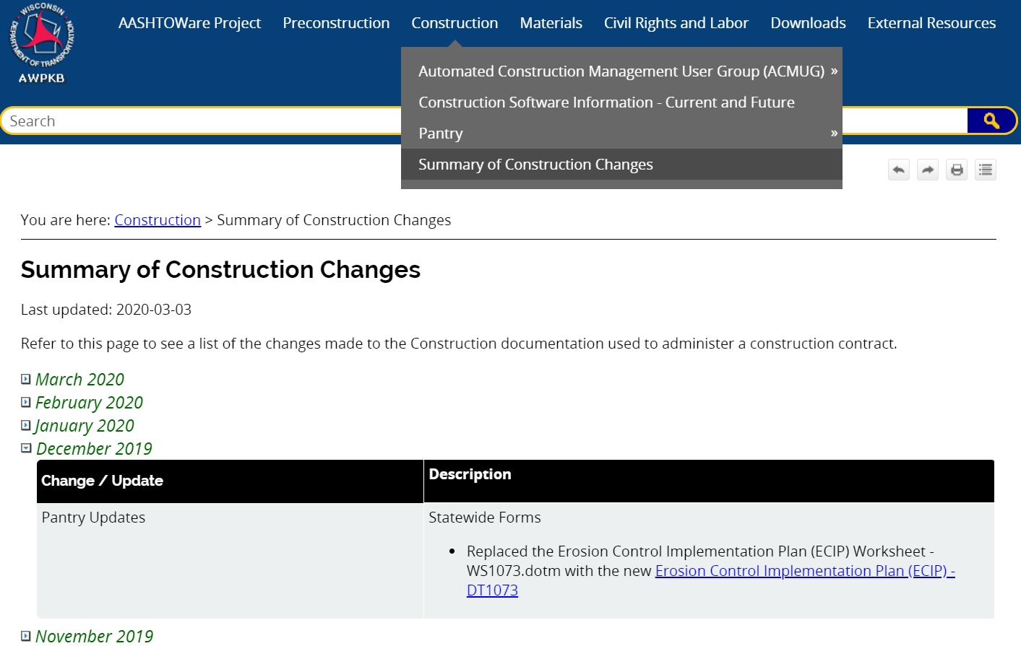
AWPKB
Notes:
Hopefully by now everyone is comfortable using the AASHTOWare Project Knowledge Base website to access Pantry. Please make sure to check the Summary of Construction Changes often to see updates made to Pantry.
Several revisions have been posted to the Pantry Statewide Forms. A couple to note are:
The ECIP, Erosion Control Inspection/Order, and CMJ documents are now DT forms.
Many of the materials QMP templates will be moving to statewide forms.
Revisions to several Region Specific forms and spreadsheets will be posted in the next week or so.
Don’t use old templates from previous projects!

Slide 3
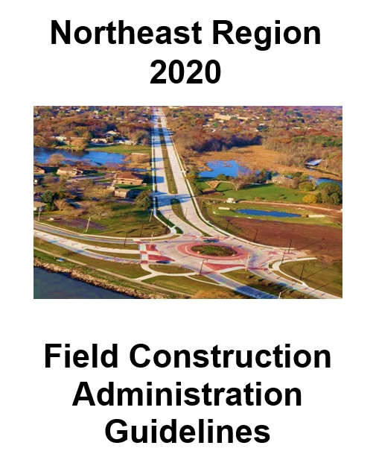
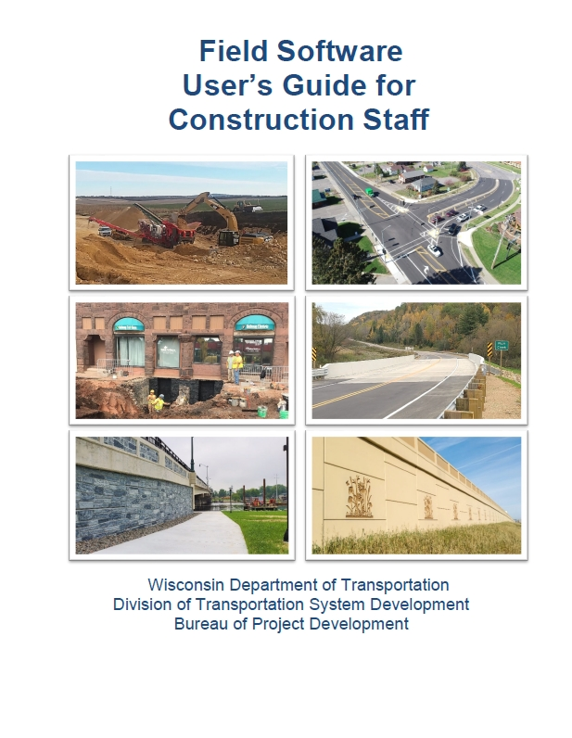
2020 NER Field Construction Administration and Field Software User’s Guide available in Pantry
Notes:
Only one regional guide for all projects (including Local Program and Workshare). 2020 is currently available in Pantry. The statewide Field Software User’s Guide is also available in Pantry.
Please refer to these for procedural guidance before contacting Bill or Krissy for assistance.

Slide 4
Local Program
Contract administration managed in-house
Most processes are same as state projects
Differences include:
LP Weekly Construction Update form (in Pantry)
Utility coordination and conflict
Municipality notification within CMJ
Change Management
Notes:
We’re on our third year now of Local Program projects being administered in-house. For the most part, the goal is to streamline local program projects and administer them the same as state projects. There are a few key differences to mention.
There is a Local Program Weekly Construction Update form in the NE Region specific folder in Pantry.
Utility coordination, conflict resolution and costs are the responsibility of the sponsor/municipality.
The CMJ has a place to enter the name/title of the local official and notification date.
There is a Change Management process where PMs can talk to our Programming section to apply for additional funding for locals if costs overrun.

Slide 5
Workshare Projects
NE Region is administering several projects for NC and SW Region
Follow all NE Region processes
LCS and Weekly Construction Updates go through the NC or SW Regions.
PM will coordinate/communicate issues with the other regions as necessary
Notes:
LCS – system is assigned to send data by home region. Each region has its own procedures. NC has a form to fill out weekly.
Construction Updates – Home region likes to have this update. Each region has its own procedures and forms.
Project issues go through NER PM.

Slide 6
Start of Your Projects
Project Binders
Pick up your plans, proposals, and labels from the PM’s
Project leader prints off Binder materials (including instructions) located in Pantry
All binder materials are in one document called 2020 NER Construction Binder
Empty 3-ring binders available at NE Region office
Notes:
Plans, proposals and labels can be picked up anytime from our regional office. You can get them from your PM. You can also wait until the pre-construction conference to pick up your items, too. Like last year, print off the binder materials from Pantry.
We have 3-ring binders and you’re welcome to take as many as you need!

Slide 7
Preconstruction Conference
Updated invite and agenda templates
Fill in pertinent project info on agenda
Helpful to have project overview or online mapping available for discussions
Send minutes (w/all attachments) to attendees and original distribution list
Attachments: Attendance List, Line of Communication, Schedule, MTL & EEO/LC talking points
Notes:
Updated precon invitation and agenda templates are located in the NE Region specific folder in Pantry.

Slide 8
Contract Transfer to PCL
DOT IT Service Desk will load programs
Bill Bartz will transfer the contract
No more Field Files folder
Notes:
Do not contact Steve Nies directly. Don’t need the computer software request form.

Slide 9
Box
Use on all new 2020 construction projects
Box Drive and Box.com
Online training videos
Statewide file structure
Security and permissions
Records retention
Notes:
Box is a cloud based storage system that allows us to manage and share documents in one secure location.
Box will be used on all new 2020 construction projects as the primary location for data and file storage of construction related documents that are not part of other database applications (in other words anything that is not part of AASHTOWare/FieldManager type applications). That means no more Field Files folder or files on the N:/ drive. Do not keep copies on local drives to be moved to Box later. Store them on Box throughout the project.
Box Drive is the desktop application for accessing Box content in Windows File Explorer. This can be useful if you’re experiencing internet connectivity issues, but there are limitations with collaboration when using Box Drive. Box.com is the web-based application for accessing files in Box that everyone can use at the same time. Box.com is the preferred application and works best with Chrome as the web browser.
There are training videos available through the LearnCenter and Box Support (online help) is very useful and easy to search.
WisDOT has developed a statewide uniform file structure to be used for all construction projects using Box. <<File Structure on next slide>>
WisDOT Box structure includes various built in security features. Users can share links or invite others to folders and we’ll show that during the upcoming demo.
Part of the benefit to using Box and the uniform file structure is to streamline the records retention process. This is why its important to store files according to the guidance shown in the file structure. This also benefit when it comes to open records requests.
[[Side notes]]
Cloud-based, unlimited storage of files upto 15GB; no VPN needed; accessed via email credentials; free accounts for external users connecting to WisDOT shared info; reduces file storage costs

Slide 10
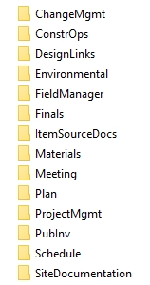
Box File Structure
Don’t make changes to first tier of file structure
Folders may be added under any of the first tier folders
Don’t rename any folders that are part of the statewide folder structure
Notes:
The statewide file structure will be used for all projects in Box.
The first tier or top level folders that show up under any construction project ID are shown on the right. There are additional second and third tier folders within those.
Do not make changes to the first tier folders. Folders can be added under any of the first tier folders. Do not rename any of the folders that are part of the statewide file structure.
When in Box.com folders have information notations describing what should be included in those folders.

Slide 11
Box.com Demo
https://wisdot.account.box.com/login?redirect_url=%2Ffolder%2F0
Notes:
Login: WisDOT click on blue box to continue. Consultants click below on “Not a part of WisDOT?”
Collaborators: All WisDOT NE Region staff are Co-owners to all NE Region projects. Consultants will be invited as Editors to their project. WisDOT staff will see all the projects and consultants will see only the ones they are invited to.
Favorites: Can drag a project folder under Favorites on the left to make access easier.
*open project folder to show tier 1 folders* By default folders are arranged by the most recently updated. Click on Name^ to keep folders in alphabetical order.
*open ProjectMgmt/ConsultantContracts* There are some confidential folders that are shielded as DOT Only so none of the contents will be visible to consultants.
*open ProjectMgmt* Hover over the (i) to see guidance on what is to be stored in a folder or the same folder description is shown at the top when you’re in the folder. For example, ContractCorr is where Bill will save letters to the contractor and the project leader will save the punchlist and emails at the end of the project. Our region manual has a complete overview of the file structure with the guidance which may be helpful as you get used to where things should be saved.
*open DesignLinks* The bookmark will take you to design folder in Box where you can access the environmental document, TMP, utility workplans & permits, RE commitments, etc. Do not save these into the construction folder.
Sharing Links: Slide over the button to enable the shared link. Make sure the settings below are appropriate.
The default is “People in your company” so the link only works for people with the email domain @dot.wi.gov. “Invited people only” allows the link to work for anyone that is an invited collaborator. This is an easy way to direct one another to a specific file/folder. “People with the link” allows anyone with the link to access the item and no Box account is required. This would be necessary if sharing something with a contractor or public. It’s the least restrictive since the link will work for anyone it is forwarded to. Also have the option of “Can view and download” or “Can view only.” Then click on the Copy button and paste it into your Outlook email. Those are live settings which can be changed if need be, but if someone already has the link, their accessibility will change.

Slide 12
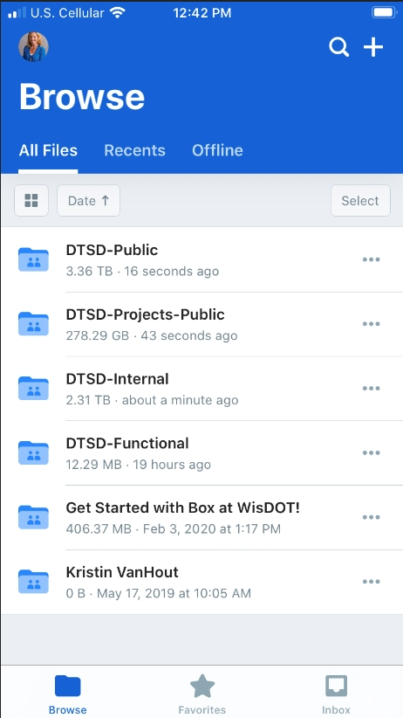
Box App
Access Box content directly from mobile device
Upload photos, videos and other files
Download content to device

Slide 13
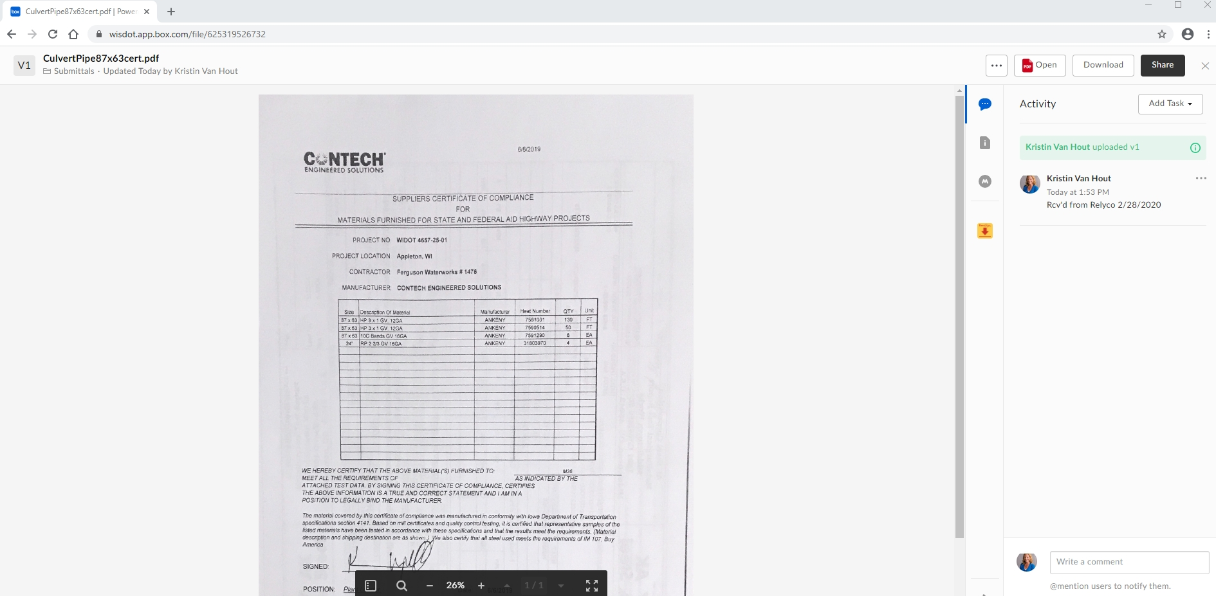
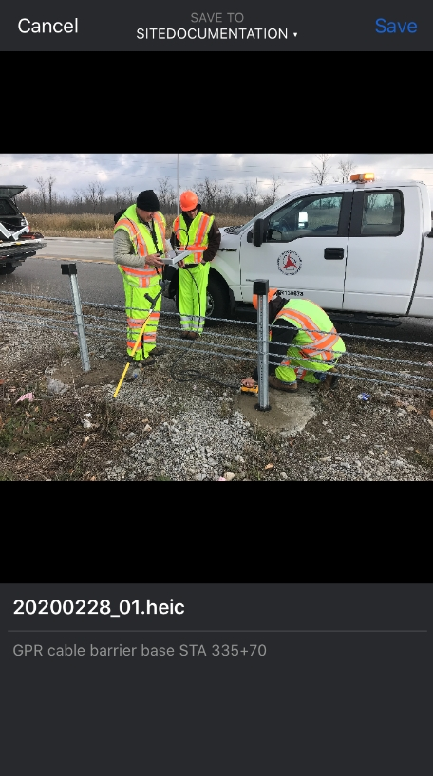
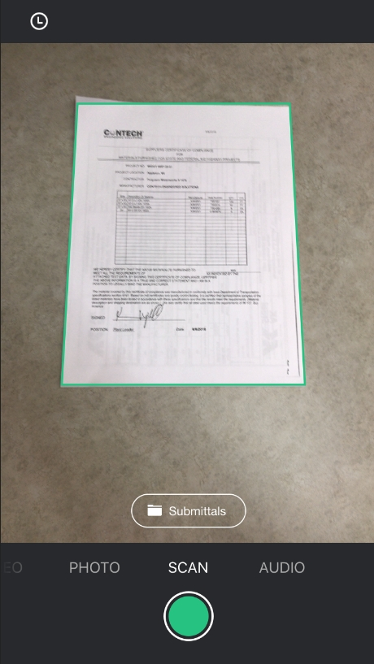
Box Capture (currently only available for iOS)
Use mobile device to upload directly to Box
Photos, videos, audio, document scans
Notes:
Box Capture app allows your mobile device to upload directly to Box. You can take photos, videos, audio recordings, and document scans on the go and instantly save them to the cloud.
Can select the location where photos will be stored within Box. Site Documentation folder is where project photos are typically stored.
Can name photos and add comments.
Can preset metadata tags for easier data collection, storage and searching.
Location needs to be turned on on the mobile device.
Can set to save to device photo library and Box, or just Box.
Currently the Capture app is only available for iOS. For Android users, photos can be uploaded into the Box app.

Slide 14
Box Implementation
Folders will be created at start of season
Contact Contract Specialist for access
Contact PM with any procedural questions
Contact IT support with technical issues
Notes:
Contract Specialist will create folders for all 2020 construction projects and invite the appropriate consultant staff to the folders prior to start of the project.
Contact Contract Specialist if you cannot access construction files or folders you think you should have access to.
Contact your Project Manager if you have questions about storing files in Box – where certain files need to go, etc.
Contact IT support for technical issues (That would be IT Portal for WisDOT – follow internal company support procedures for consultants).

Slide 15
Naming Conventions
Files/Folders
Minimize length with common abbreviations
Upper Case/Lower Case with no spaces
No hyphens, spaces or special characters $, %, &, #, ()
Underscore may be used if needed
Examples:
64301271_CCO3Draft1.pdf
628.2008EMatUrbanClassITypeB.xlsx
15003776>Materials>Submittals>QMPBaseAgg>03052020
Notes:
File paths limited to 256 characters total which includes all folder names and the file name.
Example C:\Users\DOTKXV\Box\DTSD-Projects-Public\NER-Projects-State\Construction\ProjectID\......
If the file path exceeds that it may be visible in Box.com but will not appear in Box Drive.
Don’t need to create a folder to store a single document or even a couple documents if they are named properly.

Slide 16
Naming Conventions
Email Subject Line
Always include Project ID, Route and subject
Include other descriptive info as necessary
Town/Village/City/County, Project Limits, etc.
Examples:
4987-02-65 Webster Ave; Nonconforming Conc Pavt Thickness
9029-02-71 CTH G, Marinette County; CCO 4 for review
9190-26-73 STH 32, Pensaukee River Bridge; revised deck grades
Notes:
Also make sure the subject line still applies when forwarding emails!

Slide 17
Contract Modifications
PCL saves draft CMJ/CCO as PDF in Box and tells PM they’re ready for review
PM adds comments and emails Box link to CS, CQA, ME for review by COB XX/XX/XX
PCL makes revisions and gets contractor signature
CS obtains WisDOT signature(s) and processes executed CCO

Slide 18
Cost to Complete Reports
Main data comes from FieldManager
Engineer inputs projected over/under for each bid item
Monthly updates April - November
Email reminders from Bill Bartz
SharePoint site same as last year
Notes:
PM will notify you if your project needs to report.

Slide 19
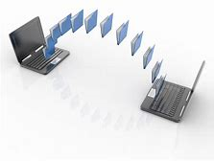
Contract Transfer to WisDOT
Must transfer contract before submitting final records
All mail messages must be processed before transferring the contract
Follow FSUG pg. 35-37
Notes:
We will not start your review until we get your contract.
Major issues if mail messages are not processed before transferring the contract. Make sure all 3 messages for Estimate Approval, Estimate Records and Contract Refresh are received and processed (may take up to 30 minutes after estimate approval).
Make arrangements to turn in your final records with Bill Bartz. Do not contact Steve Nies to transfer contract off your computer. Follow the instructions on pages 35-37 of the Field Software Users Guide.
Thumb drives shouldn’t be needed for the Finals process since those files will now be in Box.

Slide 20
Finals Process Reminders
No need to print NTP, acceptance letters, CMJ/CCO, etc.
Emails/correspondence saved to a combined PDF. No hardcopies.
Reduce paper when practical
Notes:
Saved in electronic files.
Do not print out emails. Save them to a combined PDF.
Be smart and stay organized.

Slide 21
Finals Process Reminders
Timely entering of Time Charges Stop date
Generates automatic Substantially Complete email and starts clock for LCS payroll review
Turn in your records as early as you can but with minimal outstanding issues
Discuss with PM when small issues remain but are ready to turn in
Reviews can occur even with a few outstanding items
Notes:
We have issues with the Time Charges Stop Date being entered in FM weeks or months after it actually occurred.
-looks bad to our external partners, and denies Labor Compliance the appropriate time to review records and enter payroll clear.
Don’t wait day 81 for all projects.
-Most projects should not take more than 30 days to turn in.
-Discuss with PM to turn in records with outstanding issues. PM can discuss with Krissy and Eric if questions.
- Idea is not to fall behind on the process for small issues or paper work.
Examples: CCO negotiations, material credits, claims

Slide 22
Finals Process Updates
Pavement Marking Proving Periods
2020 SS 646 Updates
Epoxy Markings are accepted within 60 days or first snow fall
Grooved-in Markings have 180 day proving period or April 15, whichever is longer
Notes:
Be aware of the spec change for proving periods……

Slide 23
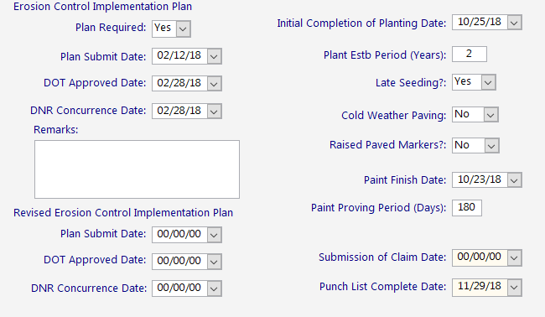
Finals Process Updates
Pavement Marking Proving Periods
CHANGE: DO NOT need to fill pavement marking information into FIT.
Notes:
We will no longer need to fill in the fields for pavement markings in FIT.

Slide 24
Finals Process Updates
Conditional Final Acceptance
2020 SS 105.11.2.1.3 Change
Substantial Complete Date/Time Charges Stop Date now relieves the ‘contractor of maintenance responsibility for completed work’
CFA removed = no letter to be sent
Punch List Complete Date still needs to be entered in FIT when complete.
Email the contractor when complete
Notes:
Another big change in the spec……..

Slide 25
Finals Issues
READ the Construction Guide!!
It is updated each year.
Notes:
Please READ the guide!!
Even the seasoned vets should reread. Updated with new guidance each year.

Slide 26
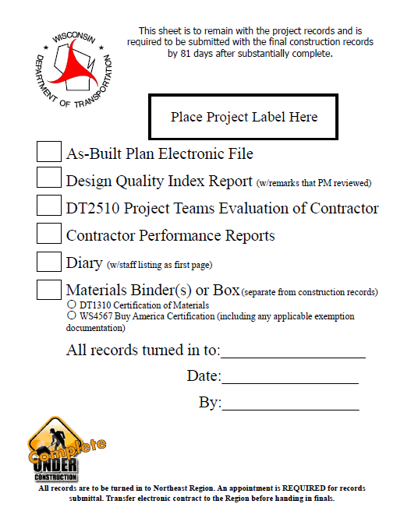
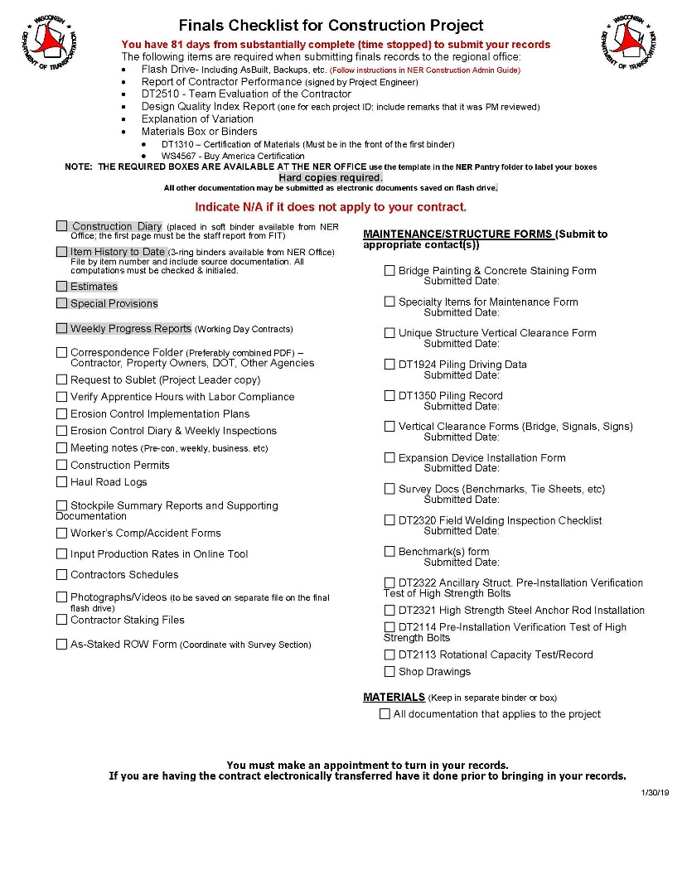
Finals Issues
NER Finals Checklist
Notes:
These documents need to be turned in with your final records. Fill out the finals checklist. These are included in the 2020 NE Construction Binder material in Pantry under NE region, Field Resources.
Do not fill out the finals checklist that is under the statewide forms in Pantry. NE region is more specific.
This specifically tells you what needs to be printed and what needs to be in your project files.

Slide 27
Finals Issues
Estimate Only – Need Justification
100+00
102+00
Estimate only. Paid plan quantity between STA 100+00 – 102+00.
Posted by ESG 6/18/2019
STH 57 NB
Notes:
When entering an ‘estimate only’ posting, justification is needed to show how you came up with the payment amount.
Give as much detail as you can.
In this example the PCL paid plan quantity between stations. Other examples could be a % of plan quantity, or based off truck tickets until measurement can be made later.
Estimate only guidance is in the Field Guide under the Making the Right Remarks

Slide 28
Finals Issues
Mobile inspector entry consistency between staff
Makes it easier to navigate your records
Location field is limited in characters. No measurements.
Notes:
Discuss with staff how to post items. Try to keep fields and entries consistent between all your staff members.
- Easier to navigate your records and check for errors or possible double measurements.
The issue most likely stems from inspectors who in the past were not responsible for posting items and are now being asked to post.
-May have to show expectations up front.
-In the past one or two people might have done it on each project and consistency of the postings was easier.

Slide 29
Finals Issues
Posting Error Corrections
Correct the error with a new posting
DO NOT go back and edit or update the original posting in FM or the source documents computations
Comments must be added to the new posting or original source document to show/state the error, and any applicable math, and reasoning for the error
If new sheets are created the original source document must be referenced
Notes:
Guidance was added to the Making the Right Remarks section of the Field Guide.

Slide 30
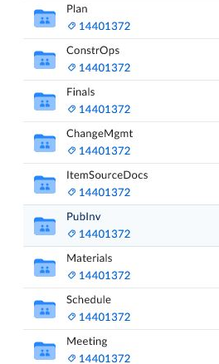
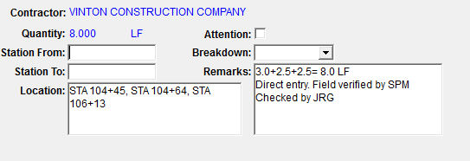
Finals Issues
Electronic Source Docs
See Electronic ItemSourceDoc/Spreadsheets Folder
Notes:
With BOX now your referencing of electronic files will change a bit from when it was in the field files.

Slide 31
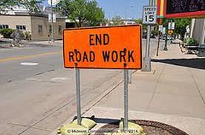
Finals Issues
Working Day Contracts
Each day from Construction Start Date to Time Charges Stopped Date
Site times: Working Yes/No, controlling item, hours worked/available
Clearly explain when no time/half day is charged in ‘Reason for Delay’ field (Not ‘Comments’ Field)
Include ‘No Work – Contractors Choice’ in the delay field
Completion Date Contracts
Same as above except No Weekly
Report of Time Charges needed
Helps with delay claims
Notes:
Fill out all the information in the site times as possible for all types of projects.

Slide 32
Finals Issues
Notes:
Don’t place important info or delay reason in the Comments field – does show up in any reports
This example is also missing controlling items on all days.
The site tab should be filled out for all project types (working day or completion day)

Slide 33
Finals Issues
Notes:
Reason for Delay field should state why time was charged or not charged for each day.
Holidays or Work Restrictions or Adverse weather should be shown, even if it is weekend.
This information is also displayed in the Daily Diary print out which is important for future records retention.
- This is also the reason why it should be filled out for completion date contracts.

Slide 34
Finals Issues
Daily Diary
Bring IDR comments into Diary before generating
Don’t change IDR within the Diary. Change IDR and merge back with Diary.
‘Environmental Commitments Reviewed’ statement
NOTE: Approved Enviro. Document, TMP, Bid Inquires can be found in the Design Files linked through Box.
Notes:
Don’t delete comments once brought in. Change IDR and merge back with Diary.
‘Enviro’ statement needs to be in your diary. Usually your environmental document will require that you review all the commitments before accepting the ECIP….

Slide 35
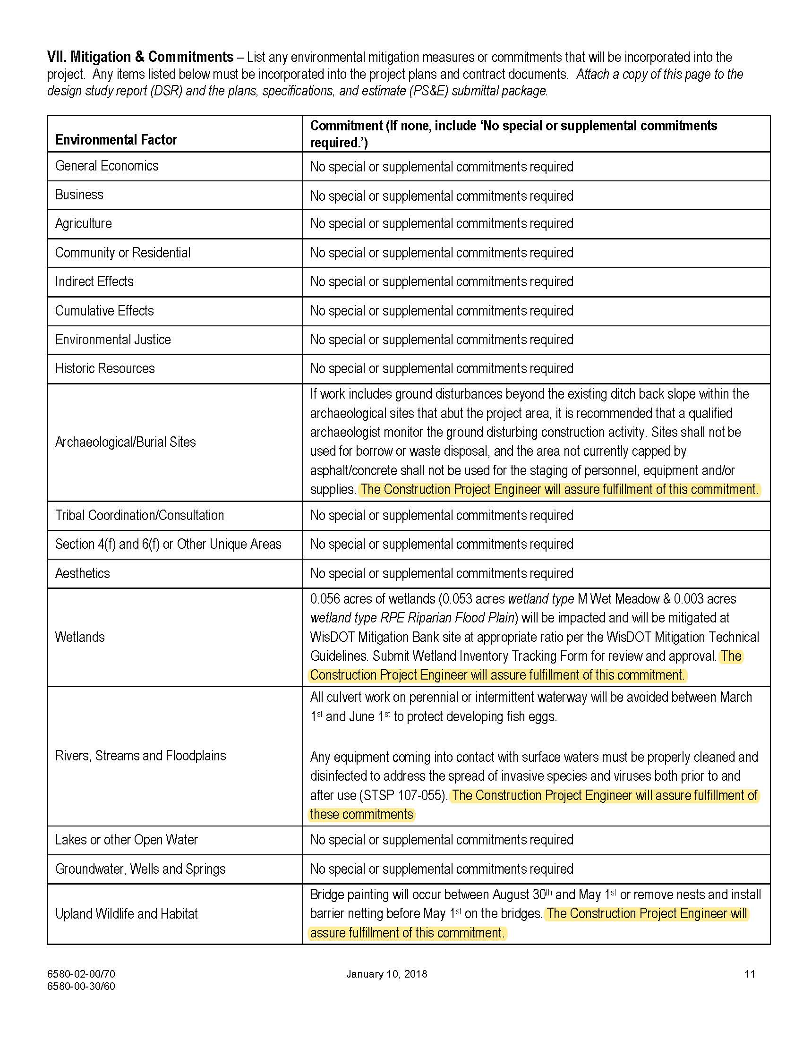
Finals Issues
Daily Diary
Bring IDR comments into Diary before generating
Don’t change IDR within the Diary. Change IDR and merge back with Diary.
‘Environmental Commitments Reviewed’ statement
NOTE: Approved Enviro. Document, TMP, Bid Inquires should be in placed in field files by PM.
Notes:
This is an environmental document example….
This document should be linked in your BOX construction folder.

Slide 36
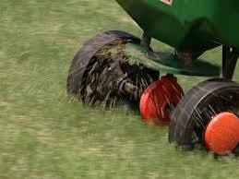
Finals Issues
Seed (LBS)
Check Seed Rates – Do Not Just Pay Submitted Tickets
Sowing rates in SS 630
Example: 50,000 SF would get 100 lbs of No 20 Seed
Contractor submits 120 lbs worth of seed tickets
Document your check/approval in your IHTD or source document
Notes:
….You can pay more than the seed rate but that needs to be agreed upon before hand and have justification documented.

Slide 37
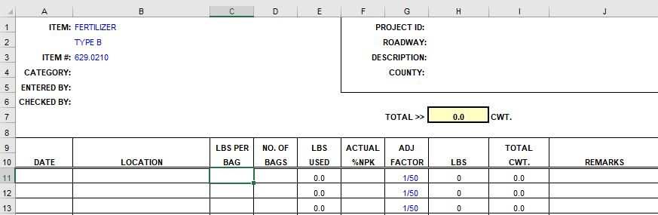
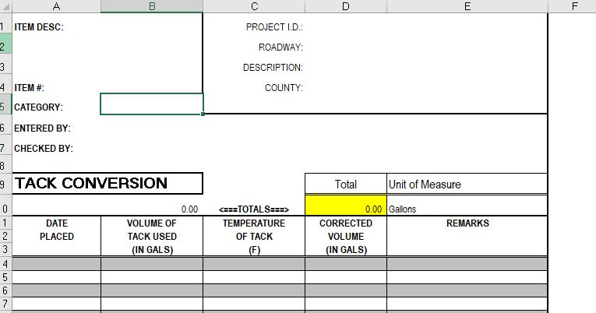
Finals Issues
Conversion Spreadsheets
Notes:
Fertilizer – application rate by conversion factor. Also make sure you are not paying for overapplications.
Tack – needs to be adjusted for temperature
Both are required per the spec book and both have pantry sheets.

Slide 38
Finals Issues
Water or Seed Water (MGAL)
SS requires the payment is from engineer- approved meters or by the volume of tanks of known capacity.
Pantry has sheet for measuring a tank
Document quantity check/acceptance on your calc sheet/ source document
Notes:
A straight water ticket is not acceptance.
Need to document tank capacity or if meter is calibrated.
Document your justification for acceptance

Slide 39
Finals Issues
Concrete Masonry (CY)
Check plan quantity for accuracy
If check is reasonably close = pay plan quantity
If not reasonable = talk with designer and rectify quantity
Collect concrete truck tickets for materials records & testing
Not for payment
Document quantity check/acceptance on your calc sheet/ source document
Notes:
Since PPQ went away these items have had a few issues.
Reasonably close does not have a definition, it will depend on the size of the structure. Within a few cubic yards of plan quantity is probably reasonable.

Slide 40
Finals Issues
Structure Backfill (Tons, CY)
Check plan quantity for accuracy
Max pay is to that quantity by truck ticket or final position measurement (per SS)
Collect truck tickets for materials records & testing purposes
Document quantity check/acceptance on your calc sheet/ source document
Notes:
Another item is structure backfill. Can either be paid in Tons or CY.
Materials testing still needs to be done for the entire quantity placed.

Slide 41
Finals Evaluation
Finals Process Improvement
Project Records and Materials Records will be evaluated
To provide feedback to the staff
Shared with PCL at end of project finals process
Will see more feedback from the PM in consultant evaluation in CARS
Starting 2020 Construction Season
Read Field Guide, Understand Project Expectations,
Ask Questions!!
Notes:
We are implementing a process improvement to help provide DOT and Consultant Staff with feedback on their finals records and materials records.
The goal is to help staff see where they are ok and where they need to improve. Hopefully this will reduce repeated records issues. Over time we will see if staff are improving or digressing.
PM’s will be providing more feedback on CARS evaluations.
This will begin for the 2020 season. So nothing new will be seen until later this fall.

