Slide 1
WisDOT NE Region Labor Compliance
Jason Johnson, Labor Compliance Lead, Eastern Wisconsin
jason.johnson@dot.wi.gov
920-492-5728
2020 Construction Conference

Slide 2
CUF Monitoring Commercial Useful Function
DBE must be responsible for performing its own work on the project.
The DBE is utilizing its own equipment.
CUF pilots are occurring on selected projects and are discussed with the regions ahead of time.
LCS’s will present CUF info at the precon.
Notes:
Tell audience that Madalena Maestri, DBE Chief will cover this in more detail.
FOR SLIDES 2 and 3 REGARDING DBE/CUF, ASSURE THE AUDIENCE THAT MORE INFORMATION IS COMING AND COMMUNICATION IS AN ESSENTIAL ELEMENT IN THIS PROCESS

Slide 3
Modification of DBE Subcontracting-DBE Replacement Policy
It is a Contractual Requirement
Contractor Considerations:
Any modification to approved DBE commitment will be treated as a contract modification requiring a change order beginning in April, 2020.
Prime cannot modify the DBE commitment through reduction in participation, termination and/or replacement without prior written consent of the DBE office.
Primes that reduce DBE participation are required to provide documentation supporting just cause for reduction.
Prime is required to demonstrate efforts to find another DBE to perform at least the same amount of work under that contract.
Notes:
Again, tell audience that Madalena will go more in depth about the Modification and DBE Replacement Policy
Important!!!!! Please tell audience about emergency situations….”A contractor has the ability to move forward in emergency situations without first getting permission from the DBE office. However, they must follow the policy after the situation is dealt with.” Example) If a DBE traffic control subcontractor does not show up or does not have enough equipment to complete the job, the prime can step in to get the work done rather than compromise public safety.

Slide 4
WisDOT Labor Compliance Specialists
Eastern Wisconsin
Lead - Jason Johnson (920) 492-5728 (NE)
Teresa Rademacher (920) 492-5657 (NE Mega)
Alec Smith (608) 785-9039 (SE)
Margaret Powers (262) 521-5337 (SE)
Laurie Nelson (262) 548-5938 (SE)
NW
Western Wisconsin
Lead - Laurie Dolsen (715) 392-7977 (NW)
Stephanie Jaecks (715) 365-5732 (NC)
Tim Alston (608) 242-8040 (SW)
Rebecca Porter (608) 245-2648 (SW)
Julie Harkinson (608) 772-5169 (SW Mega)
Diane Zimmer (608) 884-1179 (SW Mega)
Crystal Wilson (608) 264-8700 (SW Mega)
NC
NE
Labor Compliance Investigations (Statewide)
Lead - Natalia Vega (262) 521-5358 (SE)
Teresa Rademacher (920) 492-5657 (NE)
Aeronautics (Statewide)
Shannon Clary (608) 264-7607 (SW)
Crystal Wilson (608) 264-8700 (SW)
SW
SE
2/02/17

Slide 5
Lower Tier Subs
WisDOT needs to know who is on the projects
Project Leaders need to communicate to their LCS if additional subs come out to project that were not initially on the Request to Sublet Packet
LCS’s check contractors against the Suspension/Debarment List
Expectations of Standard Specs
LCS’s can make certain that ASP.4, 7,& 9 is monitored for those lower tiered subcontractors

Slide 6
Keeping Communication Lines Open Between LCS and PL
It is important to have clear communication during the course of the project.
If you see a contractor on site and do not have a Request to Sublet or email from LCS stating approval, please contact your LCS immediately.
If you receive questions, comments and/or concerns from employees, direct them to your LCS.
If the LCS has a question regarding classifications, equipment and/or time and day, it is important to keep your diary up to date and accurate as possible including truck numbers so any potential issues can be resolved.
If you have any concerns, please contact your LCS right away as you are our eyes and ears on the project.

Slide 7
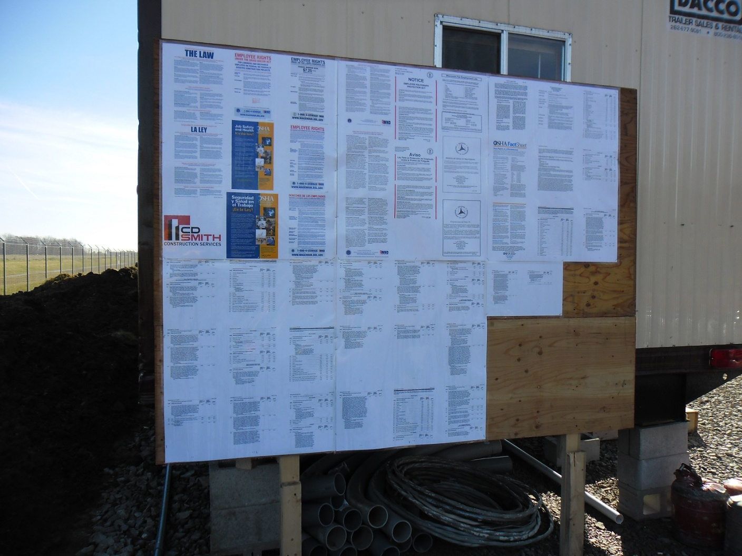
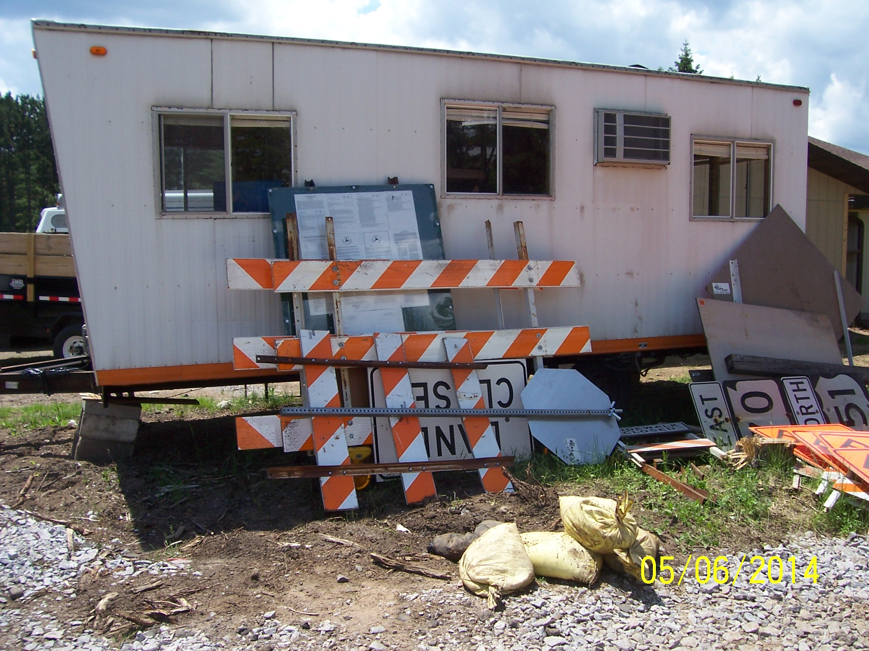
Construction Bulletin Board
Not Acceptable
PERFECT!!!!
Not Acceptable

Slide 8
Field Observations on Job Boards
Job boards must be maintained for the life of the project—please monitor them periodically and request they be repaired or corrected if damage occurs. The law requires these postings on the project.
Checklist is provided at precon- please complete and return prior to 1st estimate.
Posters must be readable at all times:
If print is too small due to the poster being reduced from a larger size to fit on the board—this must be corrected.
If print is covered up by bolts used to affix the board to the field office or supports—this must be corrected.
If posters are faded or damaged—replacements need to be requested.
Posters must be accessible to all employees and the traveling public.
Binders by themselves are not acceptable
Wages can be stacked if they are laminated and hung below a sign saying “Wage Rates”

Slide 9
Change/Elimination of Project Work
If WisDOT changes or eliminates project work during the course of the contract, please contact your LCS as soon as the change or elimination is approved by WisDOT.
If a portion of DBE work is eliminated such as replacing sod with seed, that will affect the DBE general payroll and payments made.
The LCS will then contact the DBE office to make them aware of what and how much DBE work was changed or eliminated.
LCS’s need to be contacted for non DBE contractors as this will also affect their general payroll and payments made.

Slide 10
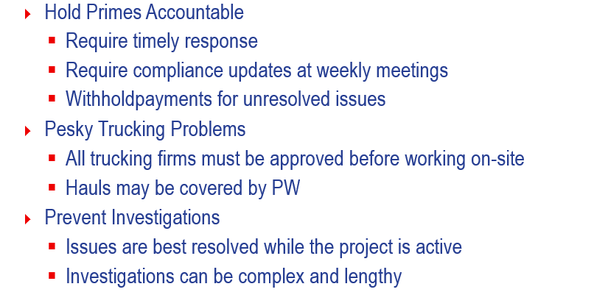
Project Staff and Issue Resolution
Notes:
The prime contractor is responsible for all compliance by all subcontractors. Don’t ignore our emails – follow up with the prime. At the weekly meetings, discuss open issues and require updates on the status of their compliance – certified payrolls, sub assignments, payment reporting, DBE utilization. If a prime contractor is not able to inform you with a status and updates on these requirements, then that is a red flag; they are unaware and your project is a risk for non-compliance.
Trucking companies are subcontractors for compliance purposes and all trucking firms must be approved before performing work on your project. Hauls may be subject to Federal PW requirements. The prime contractor must clearly communicate to their subcontractors and to the Dept. which hauls are being paid PW and which are not.
Investigations can be avoided with your active participation in monitoring and resolving compliance issues.

Slide 11
TRUCKING REMINDER

Slide 12
