Slide 1
Utility Conflict
Documentation Report
Michael Baumann
Statewide Utility Engineer
Northeast Region Construction Conferences
Green Bay, WI
March 12, 2020

Slide 2
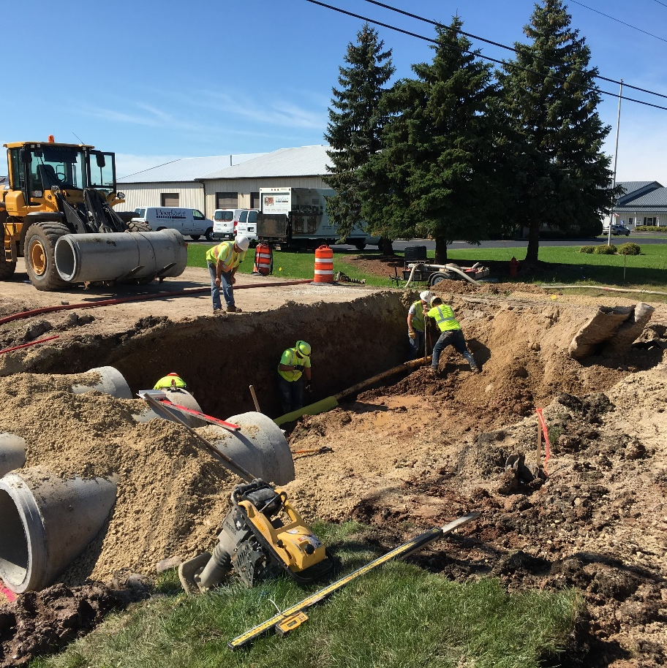
Overview of Presentation
Background
Purpose
2019 Report
2020 Report
2021 and Beyond
Questions

Slide 3
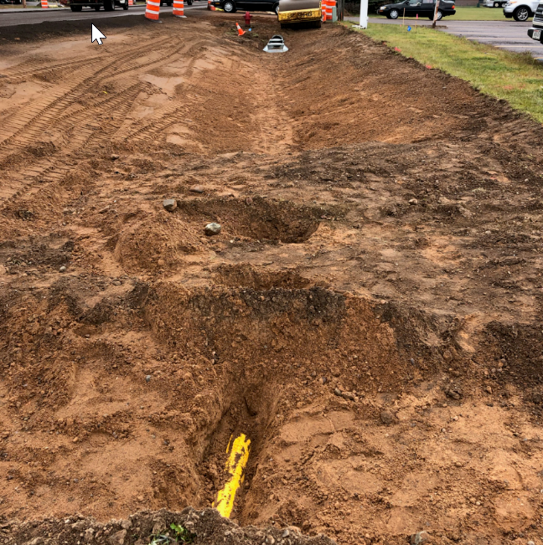
Background
3D Utility Survey Data
FHWA National Utility Program Review
FHWA/WisDOT Contract Risk Assessment
WisDOT/WTBA Trans 220

Slide 4
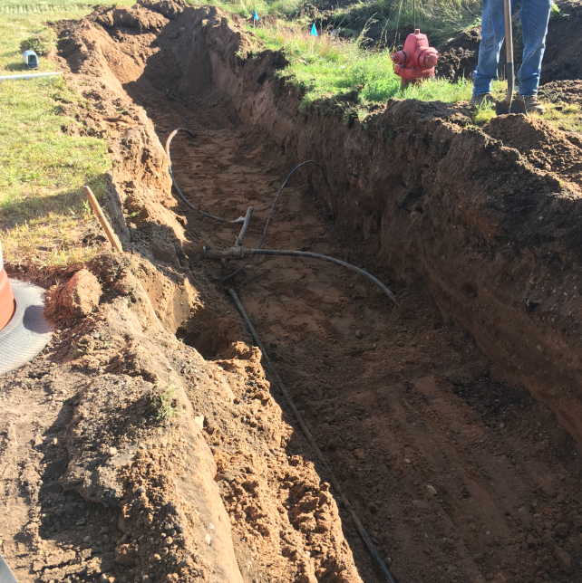
Purpose
WisDOT construction staff and WTBA
Utility delays not documented
Anecdotal evidence
Tool to document utility delays

Slide 5
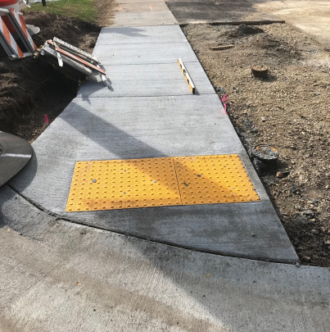
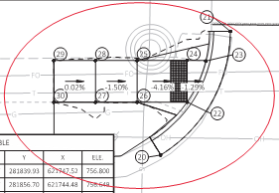
2019 Report
4 regions on 7 projects
Various project types
All delays documented
General synopsis:
  Two main causes
  Two facility types
  Two main resolutions
  Affected controlling item
  All utility delays less than 5 hours

Slide 6
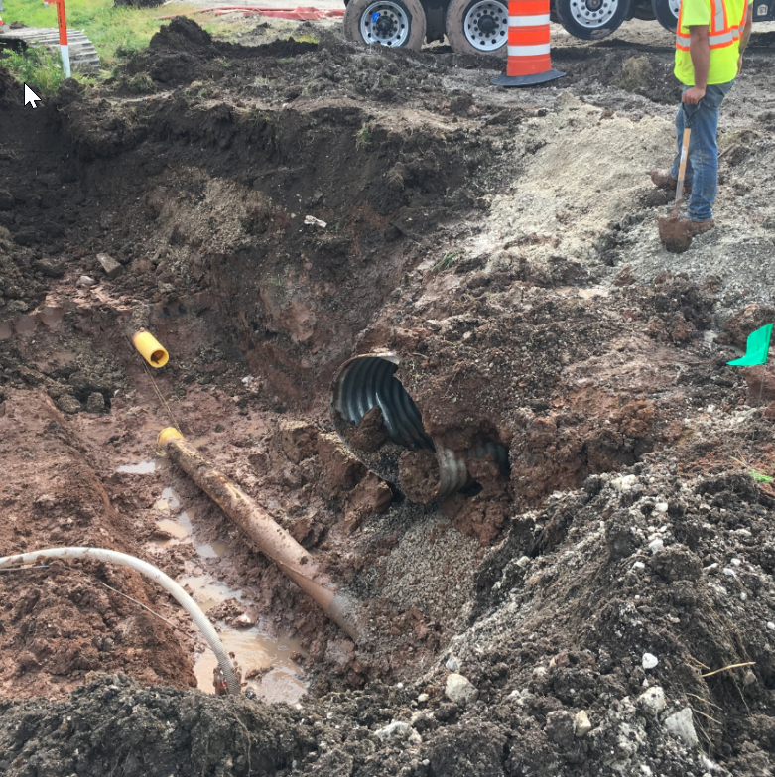
2020 Report
Revised the report
All contract modifications with “UC” reason code
30 to 40 projects
Various project types

Slide 7
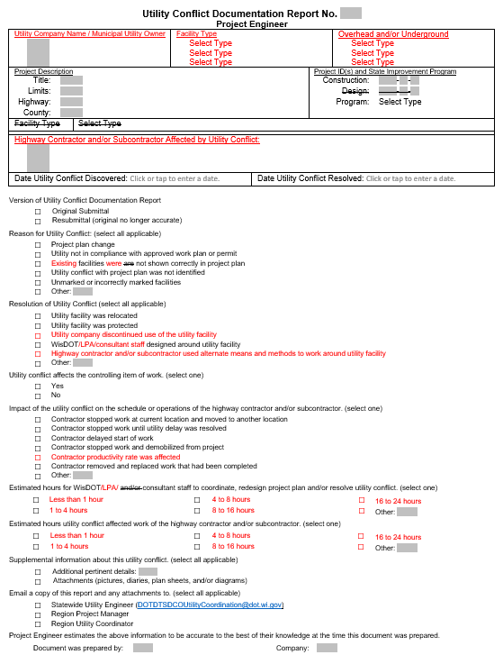
2020 Report

Slide 8
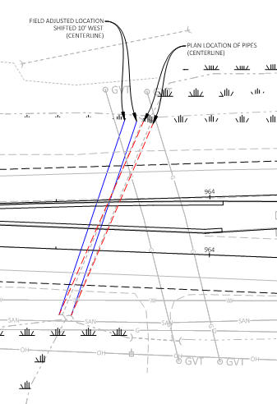
2021 and Beyond
AASHTOWare
Evaluate which project types will be required to utilize
Analyze data
Evaluate potential solutions

Slide 9
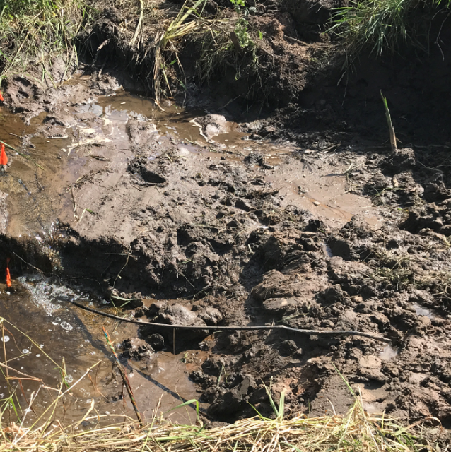
Questions
Michael Baumann
Statewide Utility Engineer
michael.baumann@ dot.wi.gov
(608) 219-5109

