Slide 1
WisDOT NE Region 2020 Construction Conference
Tim Borowski
NE Region Liaison / Consultant Review Engineer
Northeast Wisconsin Technical College
March 12, 2020

Slide 2
Structures Agenda
Contacting BOS – When & Why
Specification and Manual Updates & Reminders
Structures Construction Issues
Ancillary (Wind Loaded) Structure Issues

Slide 3
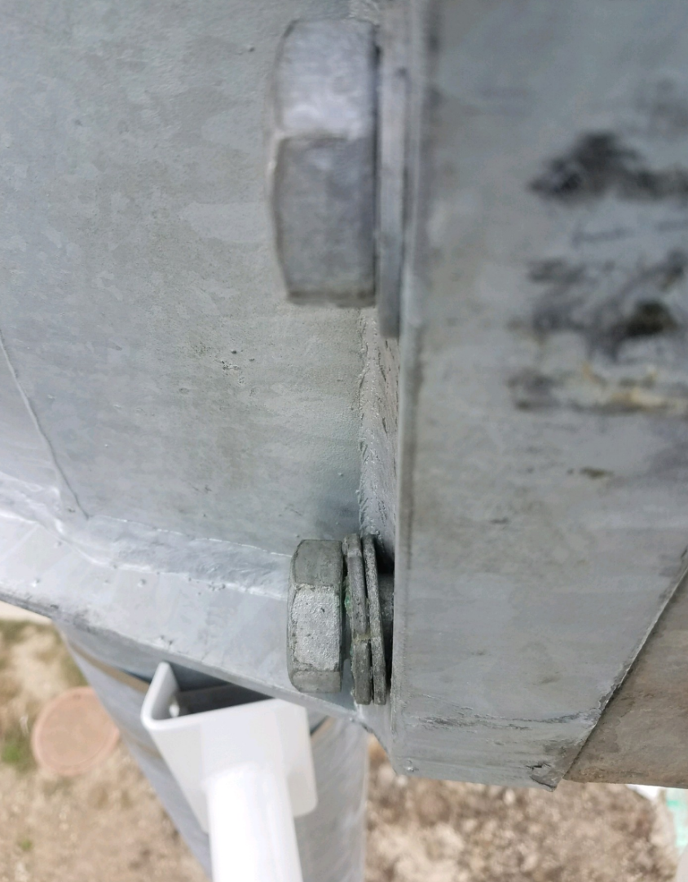
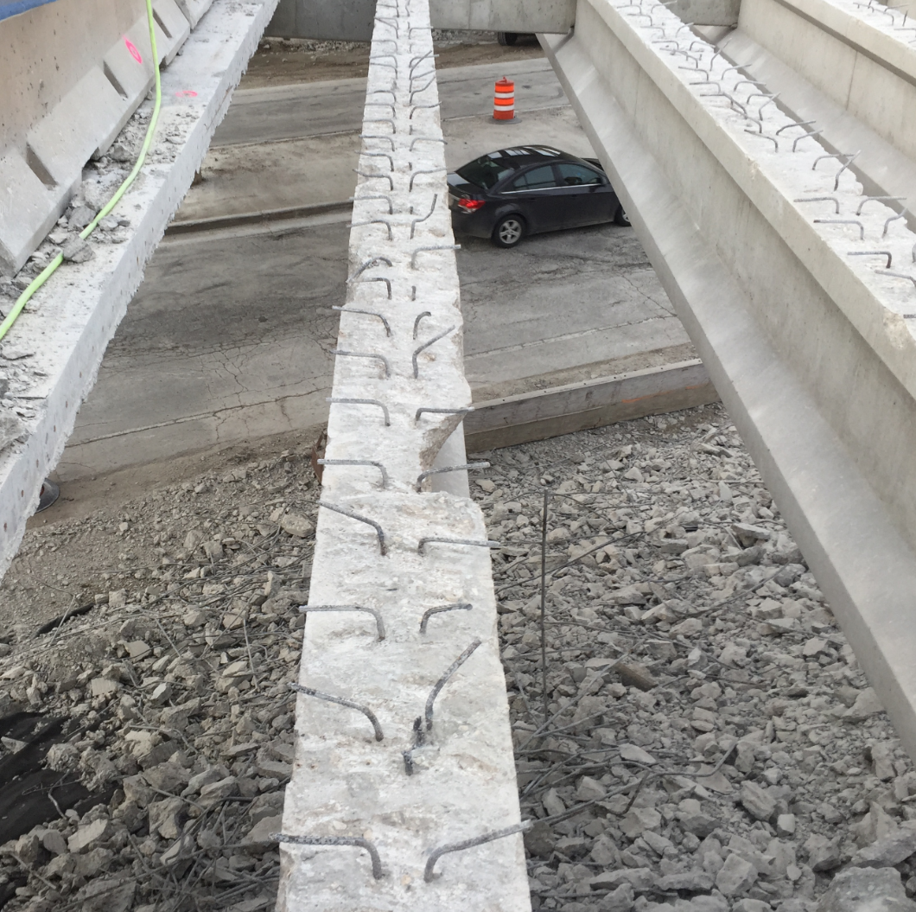
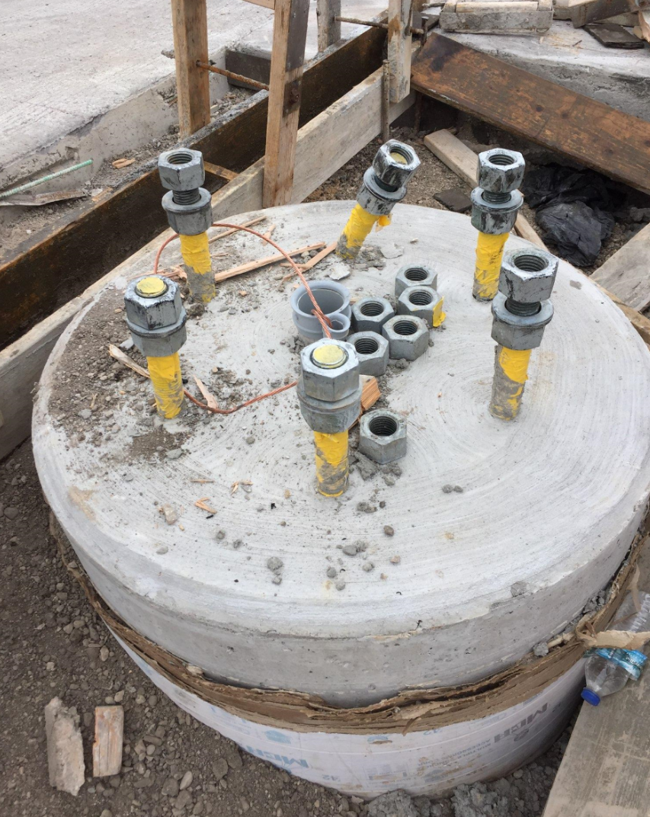
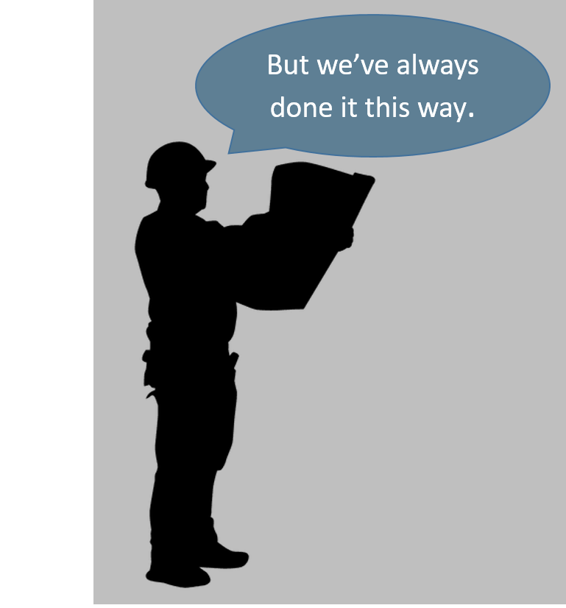
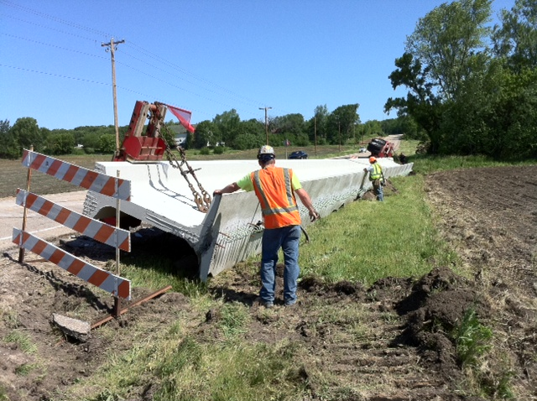
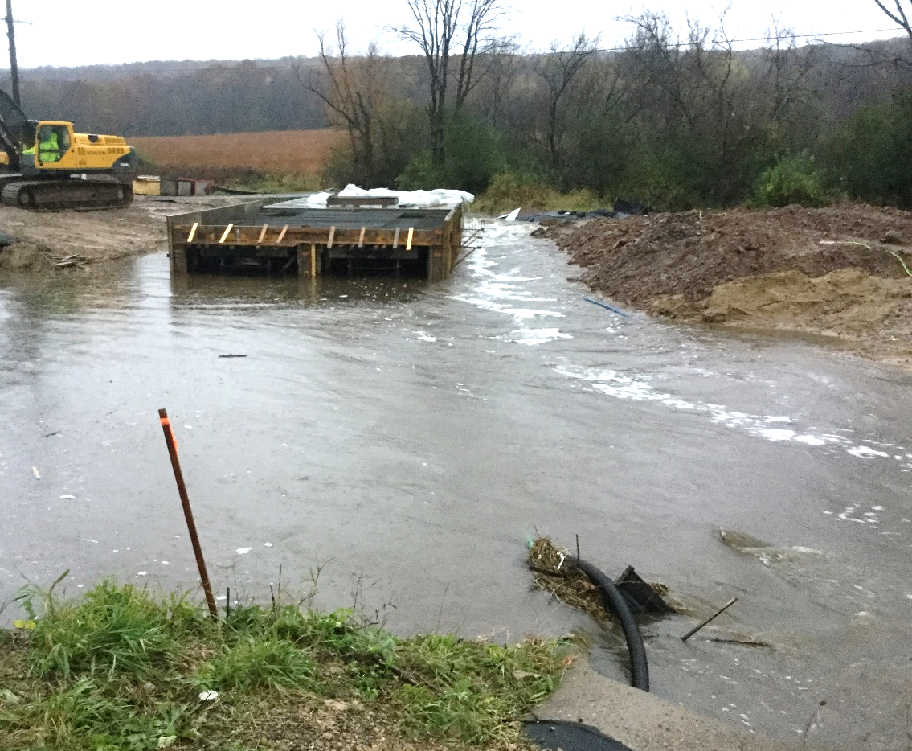
Contacting BOS – When & Why
ANYTHING STRUCTURAL
if in doubt, call BOS!
NE Region Liaison
Tim Borowski
608-266-4547
see Contact List handout
  consultant/in-house plans
Examples:
  standard specifications
  plan details
  questionable means and methods
  “But we’ve always done it this way.”
Notes:
BOS is able, available, and willing to answer any questions that you may have during the construction of your projects.
Any item that you may think involves structural aspects that you are not 100% comfortable answering, please don’t hesitate to contact us.
I am the NE Region Liaison, here is my number, please always feel comfortable to call or email me. Even if you think I’m not the right person to call I can get you in contact with who can help.
There is a hierarchy of people to call with questions… those numbers are listed on the Structures Contact list that you should have picked up.
first try calling the designer whose name is listed on the plans
Just as an example of some of the calls we get from construction staff and are happy to help work thru are listed here, anything from….
interpretation of the standard spec
when can we set girders after the abutments have been poured
can we let girders sit thru the winter with no deck
plan detail questions
what’s going on with this plan note? what does it mean?
is this really how the contractor should be doing this….
contractor is telling me they always do it this way… but should they be?

Slide 4
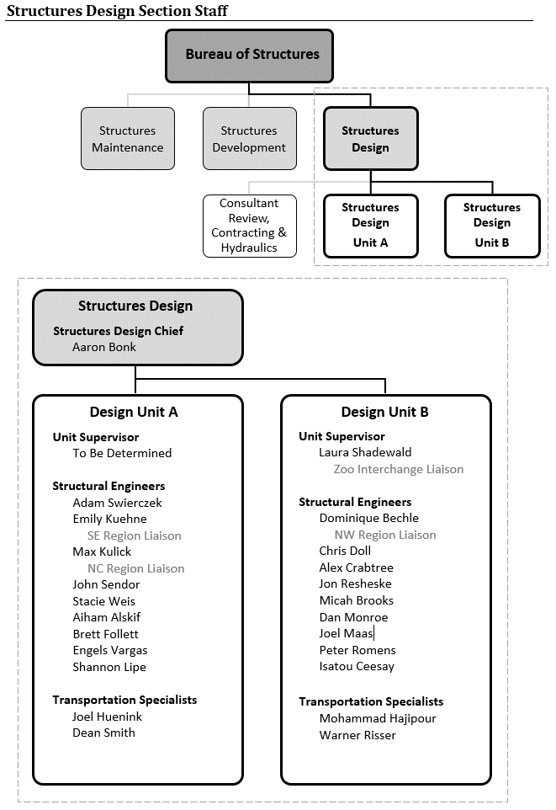
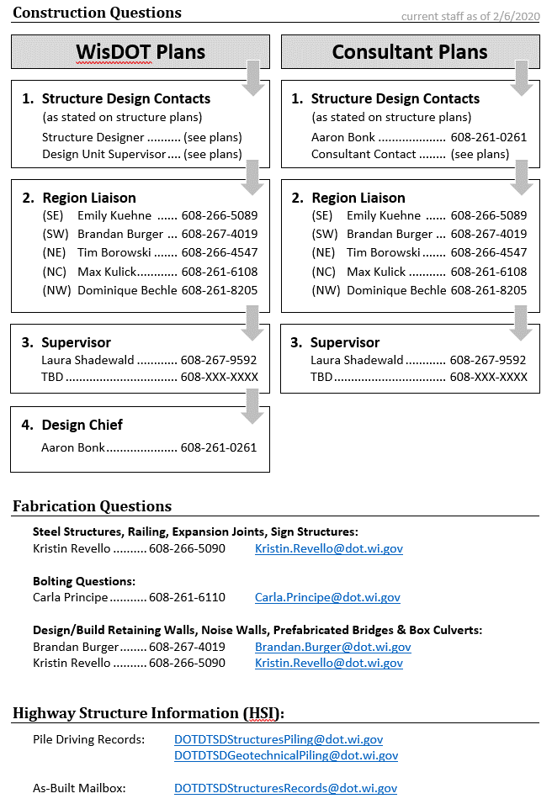
Contacting BOS – When & Why
Notes:
I have attached a contact list to this presentation for a reference on who to contact and for what situations.
Note that Aaron Bonk is the new Structures Design Chief. Bill Dreher’s name and number will still be on most consultant designed plans but Aaron should be contacted instead.

Slide 5
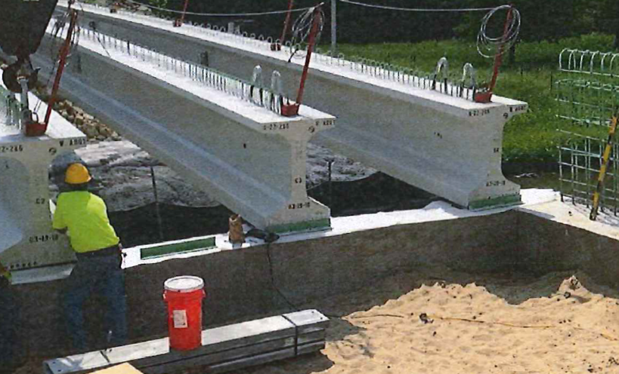
Contacting BOS – Structural Modification
Be aware of contractor means and methods
Alert BOS if permanent construction details deviate from plan details
Detail below changed abutment fixity – likely to create long term issues.
Notes:
In this case, contractor positively connected angles to beam seat of abutments, but abutment was designed as a semi expansion, so when diaphragm was poured, it would be connected to the abutment body, acting more as a fixed abutment than semi expansion.
Inspectors should be aware of how contractor’s means and methods might be affecting the functionality of the structure. If anything seems questionable, please contact BOS.

Slide 6
Structures Agenda
Contacting BOS – When & Why
Specification and Manual Updates & Reminders
Structures Construction Issues
Ancillary (Wind Loaded) Structure Issues

Slide 7
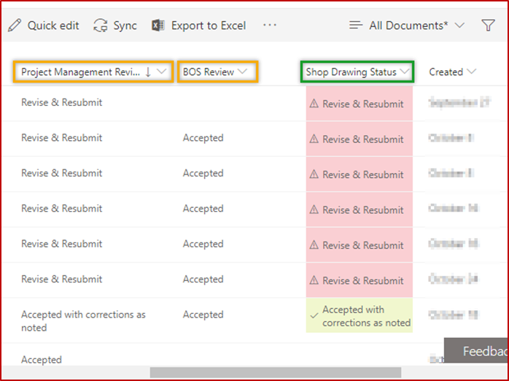
Standard Spec Reminder – Fabrication Library
Region and BOS Shop Drawing Acceptance
The Fabrication Library allows for Shop Drawing acceptance by both the Project Manager (Project Leader) and Bureau of Structures.
The Project Leader may have additional comments from their own QA reviews, so having a 2 party acceptance ensures any comments from both parties are addressed and the fabricator may proceed with fabrication.
Any comments from BOS or the PL should be added to the shop drawing in the Library.
Once both parties change the shop drawing status in Fabrication Library to “accepted”, the shop drawing will be formally accepted.
Notes:
A reminder about Fabrication Library shop drawing review and acceptance…
To ensure all comments are addressed from the PLs as well as BOS, and to clearly indicate to the fabricator that they can begin fabrication, the “Shop Drawing Status” is based on both the BOS review, and the PL review. BOS is not mandating PL review, but rather have provided a mechanism to facilitate such a review should you choose to do so. Often, the PL comments we see be materials related, but this is largely reviewer dependent. Any PL comments should be noted on the shop drawing itself. (Direction regarding how to do this is available on our website.) If you have no comments, please switch the Project Management Review Status” to “accepted” within the Library.
If you have questions, please contact the BOS Structural Metals and Fabrication QA Inspection Unit.

Slide 8
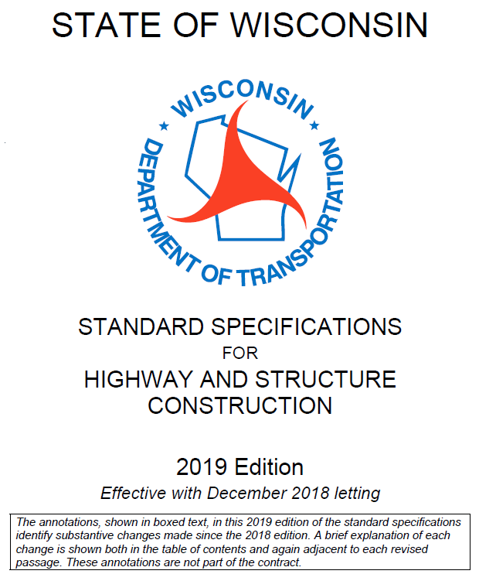
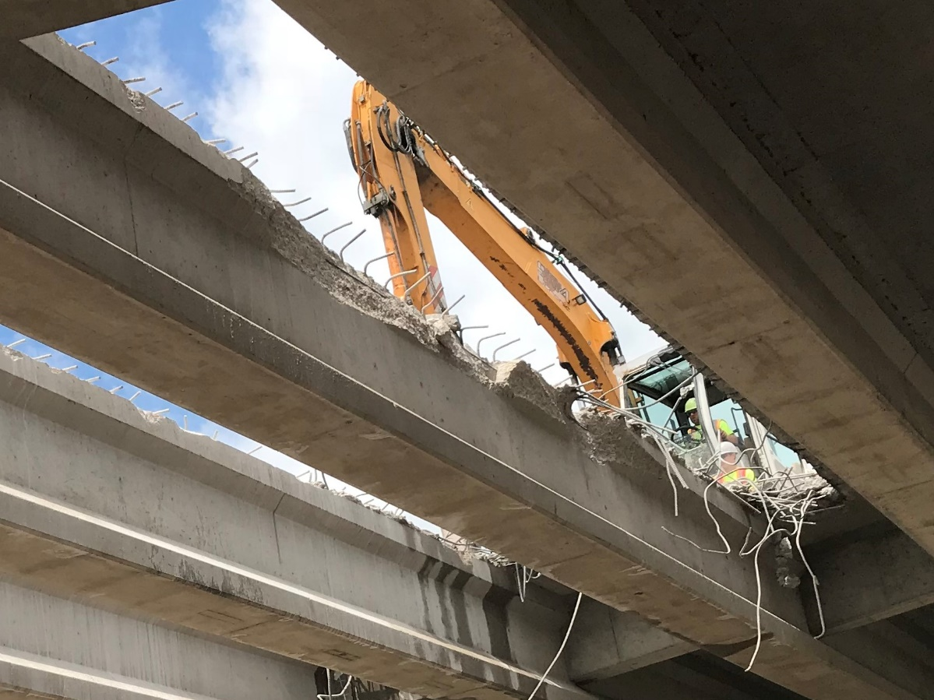
Standard Spec Reminder – Girder Damage
Assessment and approval for restoration of contractor-caused damage done during deck removal
Costs associated with contractor-caused damage are incidental
Notes:
REMINDER FOR PAST STANDARD SPEC UPDATES FROM 2019
Revise 203.3.2.2 to require department assessment of and written approval for restoration of contractor-caused damage done during deck removal.
After deck removal is complete, notify the engineer to request a damage survey. Point out damage to the engineer. Allow 1 business day for the engineer to complete the damage survey. If damage is identified, the department will determine if repairs or girder restoration will be allowed.
Revise 203.5.1(2) to clarify that all costs associated with contractor-caused damage are incidental. This change was implemented in ASP 6 effective with the December 2017 letting.

Slide 9
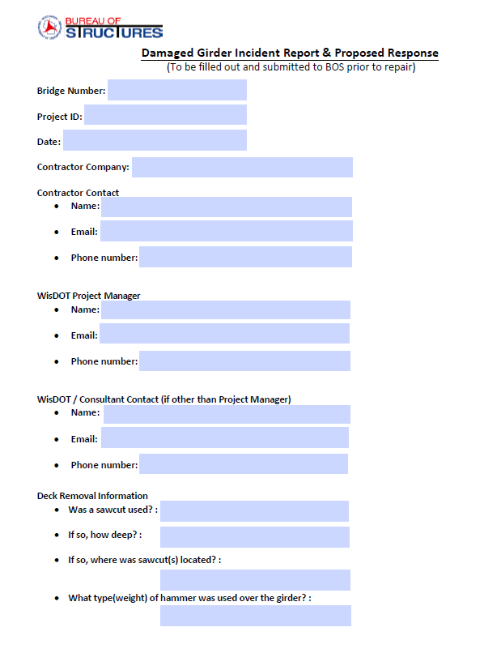
Standard Spec Reminder – Girder Damage
After deck removal, inspect girders for damage
Alert BOS if damage is found
Contractor to submit completed form
  Form found on BOS webpage (has been updated since last year)
  Provides pertinent info to BOS
  Contractor proposes remedy
BOS will review and provide acceptance/feedback
Notes:
Contact BOS when steel or prestressed girder damage is found after deck removals. BOS will send this form to inspection staff for contractor to complete and document damage locations and severity, and detail what their proposed fixes are. BOS will review and provide comments or acceptance. This helps us document historical information for the bridge, and provides consistency statewide with what girders are fixed and what are replaced.
There is a new form that should be used.

Slide 10
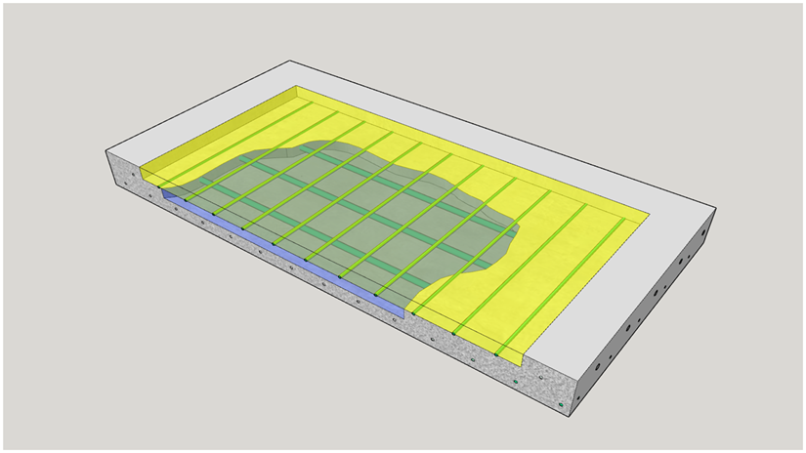
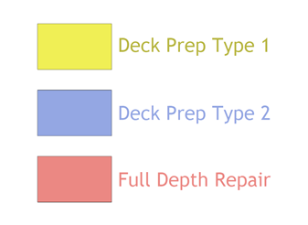
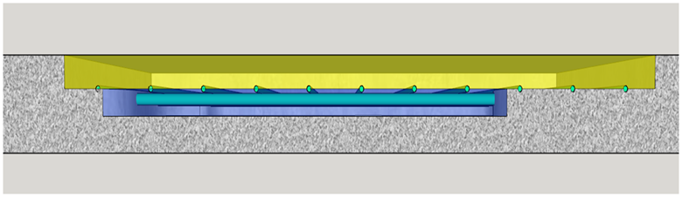
Standard Spec Reminder – Deck Prep
Preparation Decks Type 1, Type 2, Full-Depth Deck Repair
  Do not subtract areas of type 2 removal from areas of type 1 removal.
Notes:
Standard Spec 509:
Under the Preparation Decks Type 1 bid item, remove existing asphaltic patching and unsound bridge deck concrete only to a depth that exposes 1/2 of the peripheral area of the top or bottom bar steel in the top mat of reinforcement.
Under the Preparation Decks Type 2 bid item, remove existing unsound bridge deck concrete below the limit of the type 1 removal described above. One inch below the bottom of the top or bottom bar steel in the top mat of reinforcement is the minimum depth of type 2 removal. The engineer will direct any further removal.
Use air chippers or breakers that weigh no more than 35 pounds and are equipped with flat, chisel-type points with a cutting edge not less than 3/4 inch or greater than 3 inches wide.
After reaching the top of the reinforcing steel, do not use hammers heavier than 15 pounds within one inch of the steel.
Repair damage to existing epoxy-coated reinforcement remaining in place that is either uncovered by or damaged by the contractor's operations.
If damage occurs to anything designated for re-use in the new work, the contractor must repair, or replace it at no expense to the department.
The contractor must blast clean, realign, and retie the existing reinforcing steel to be re-used, as the engineer considers necessary.

Slide 11
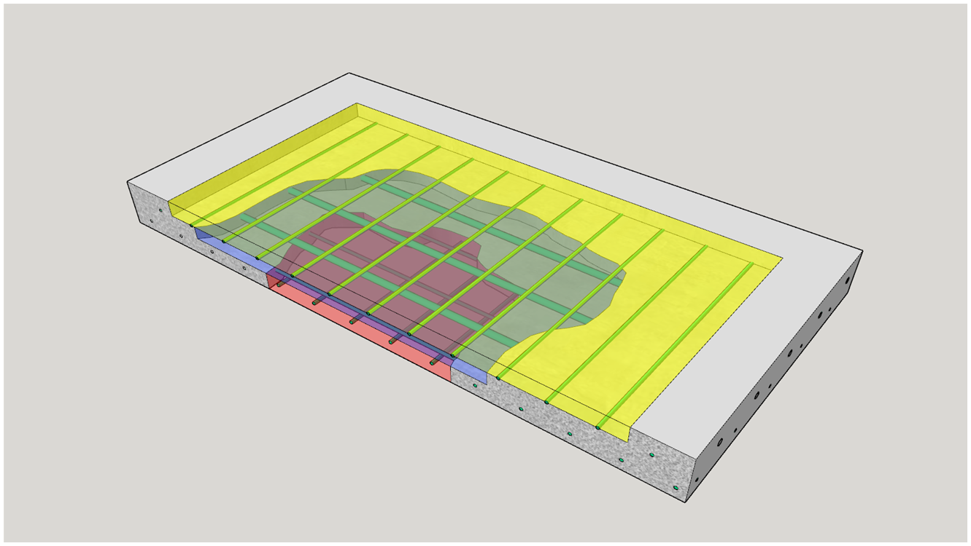
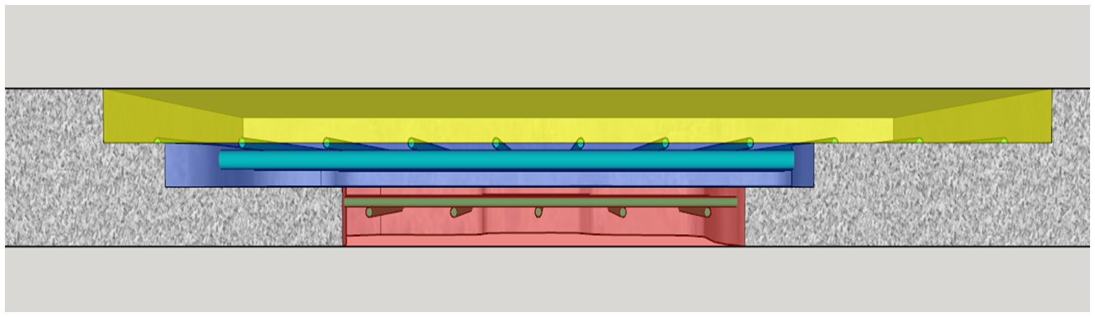
Standard Spec Reminder – Deck Prep
Preparation Decks Type 1, Type 2, Full-Depth Deck Repair
  Do not subtract areas of full-depth deck repair from the areas of the type 1 or type 2 removals if the engineer directs full-depth deck repair after type 1 or type 2 deck removals are underway.
Notes:
509.3.8:
If damage occurs to anything designated for re-use in the new work, the contractor must repair, or replace it at no expense to the department.
The contractor must blast clean, realign, and retie the existing reinforcing steel to be re-used, as the engineer considers necessary.

Slide 12
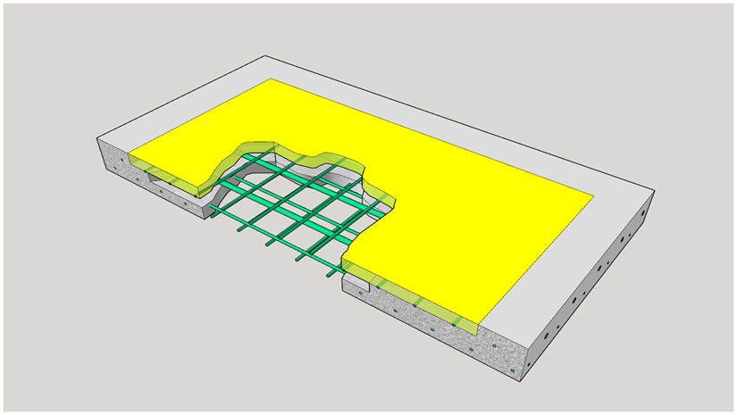
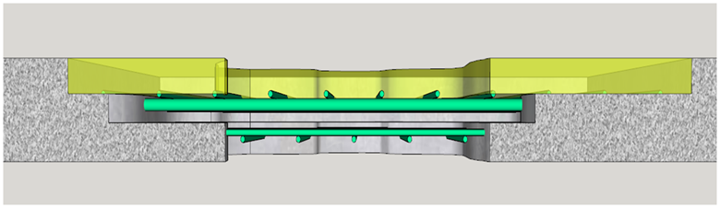
Standard Spec Reminder – Deck Prep
Preparation Decks Type 1, Type 2, Full-Depth Deck Repair
  Subtract areas of full-depth deck repair from the areas of the type 1 or type 2 removals if the engineer directs full-depth deck repair before beginning the type 1 or type 2 deck removals.

Slide 13
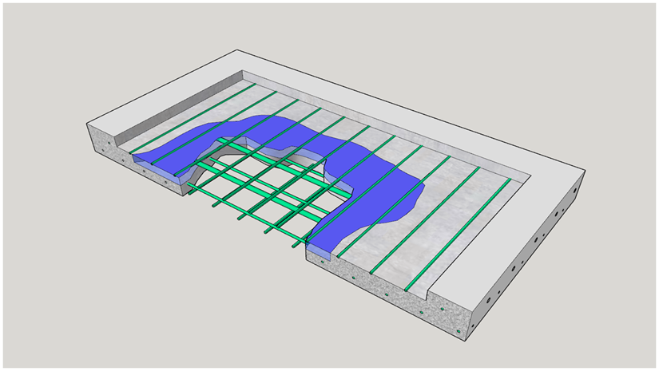
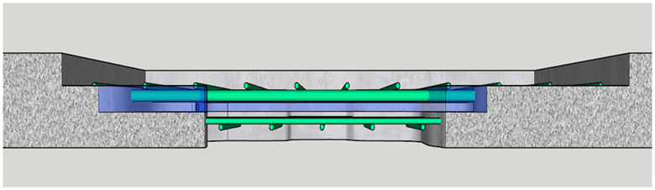
Standard Spec Reminder – Deck Prep
Preparation Decks Type 1, Type 2, Full-Depth Deck Repair
  Subtract areas of full-depth deck repair from the areas of the type 1 or type 2 removals if the engineer directs full-depth deck repair before beginning the type 1 or type 2 deck removals.

Slide 14
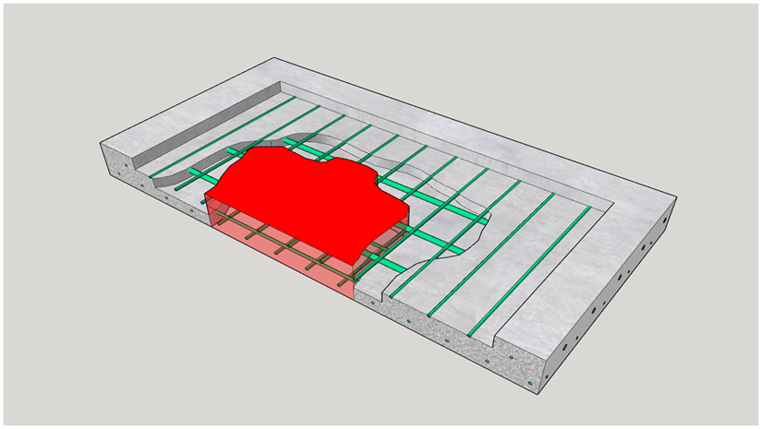
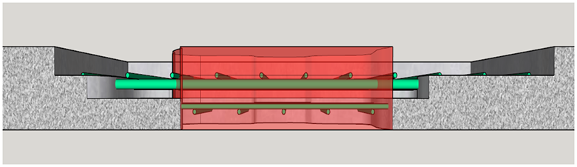
Standard Spec Reminder – Deck Prep
Preparation Decks Type 1, Type 2, Full-Depth Deck Repair
  Subtract areas of full-depth deck repair from the areas of the type 1 or type 2 removals if the engineer directs full-depth deck repair before beginning the type 1 or type 2 deck removals.

Slide 15
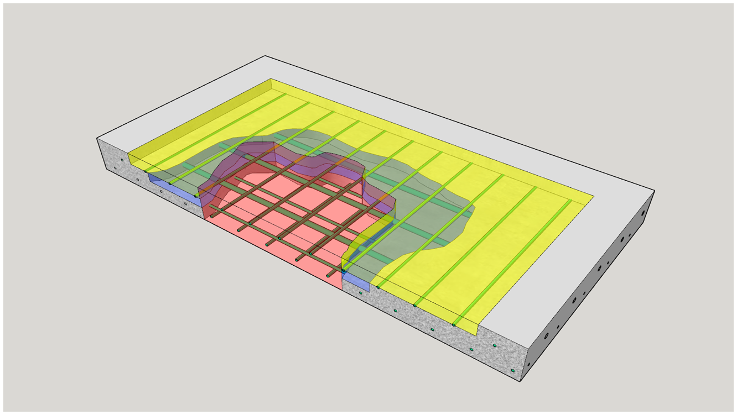
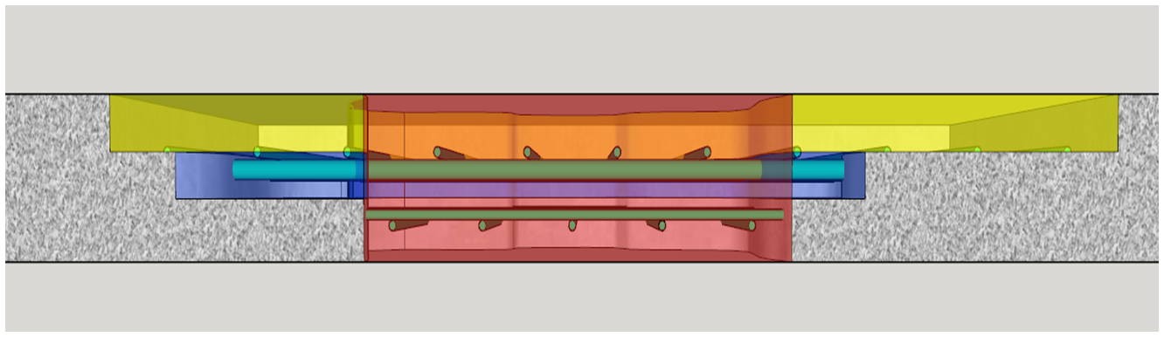
Standard Spec Reminder – Deck Prep
Preparation Decks Type 1, Type 2, Full-Depth Deck Repair
  Subtract areas of full-depth deck repair from the areas of the type 1 or type 2 removals if the engineer directs full-depth deck repair before beginning the type 1 or type 2 deck removals.

Slide 16
Standard Spec Reminder – Deck Prep
Removing Old Structure…
Over Waterway
  Structure type requires that it must be dropped into waterway for safe removal.
  The contractor may leave limited amounts of small concrete pieces scattered over the waterway floor or wetland only if the engineer allows.
Over Waterway With Minimal Debris
  Prevent all large pieces and minimize the number of small pieces from entering the waterway or wetland.
  The contractor may leave limited amounts of small concrete pieces scattered over the waterway floor or wetland only if the engineer allows.
Over Waterway With Minimal Debris Capture System
  Provide a debris capture and containment system that prevents all large pieces and virtually all other debris, including fine particles and slurry, from entering the sensitive waterway or wetland.
16
Notes:
SW Region in particular has had issues with field staff not being consistent on how they are enforcing the removing old structure over waterway bid items. These were updated a couple years back but wanted to have a slide to remind staff on the differences in removal… specifically what the contractor is allowed to leave behind in the waterway.
Over Waterway – least strict, contractors can drop portions of the structure into the waterway and then remove most items
With Minimal Debris – contractors need to prevent large pieces from entering the waterway and must remove anything that falls in except small fist sized pieces
With Debris Capture System – large pieces are not be dropped in waterway and virtually all small pieces that accidentally enter the waterway must be removed

Slide 17
Structures Agenda
Contacting BOS – When & Why
Specification and Manual Updates & Reminders
Structures Construction Issues
Ancillary (Wind Loaded) Structure Issues

Slide 18
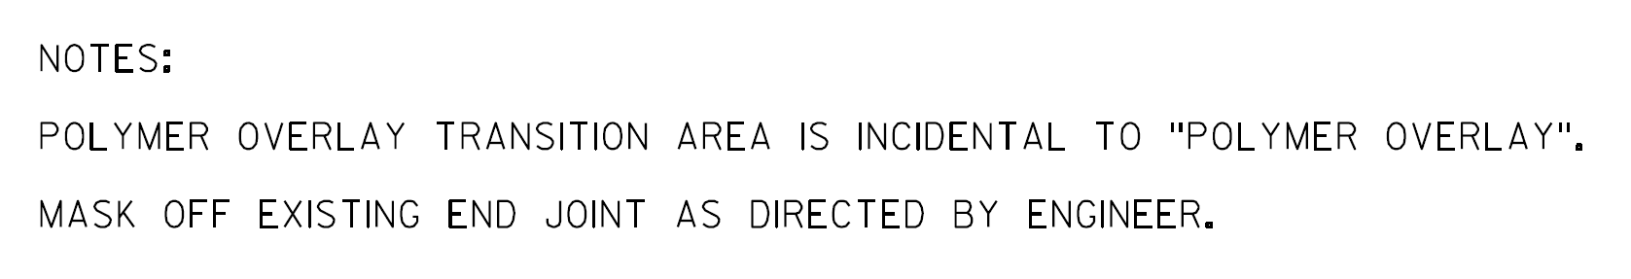
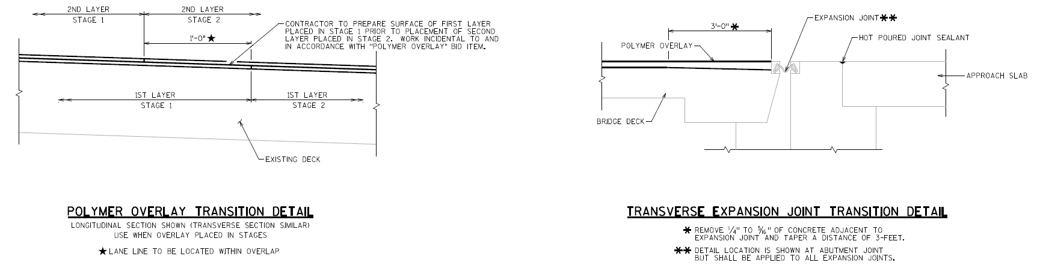
Thin Polymer Overlay Transition
Some plans will show transitions details
Removes a small bump at the end of the slab
Notes:
The department is moving in the direction of adding transition details to plans.
This will remove a small bump that can cause ride issues and durability issues from snow plows.
This can be completed with the equipment on site.
Without the detail you can ask the contractor to do it but there is nothing in the spec to enforce it.

Slide 19
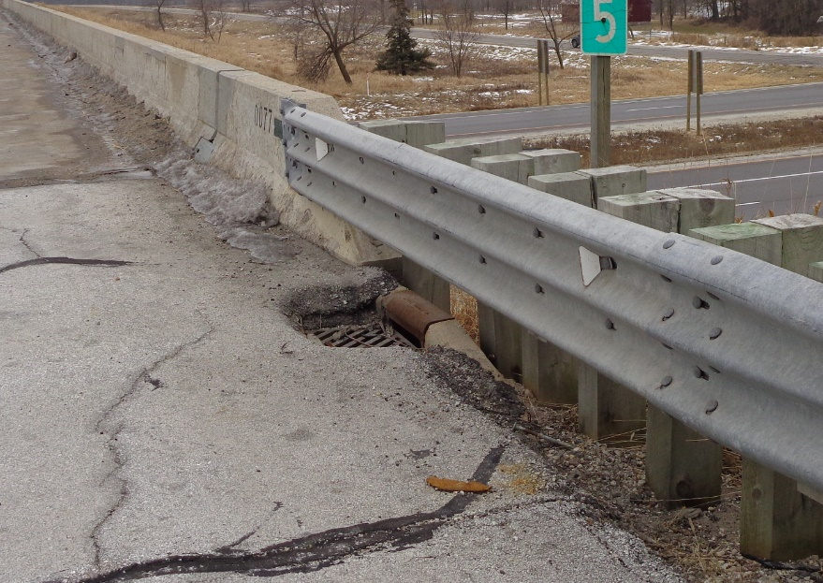
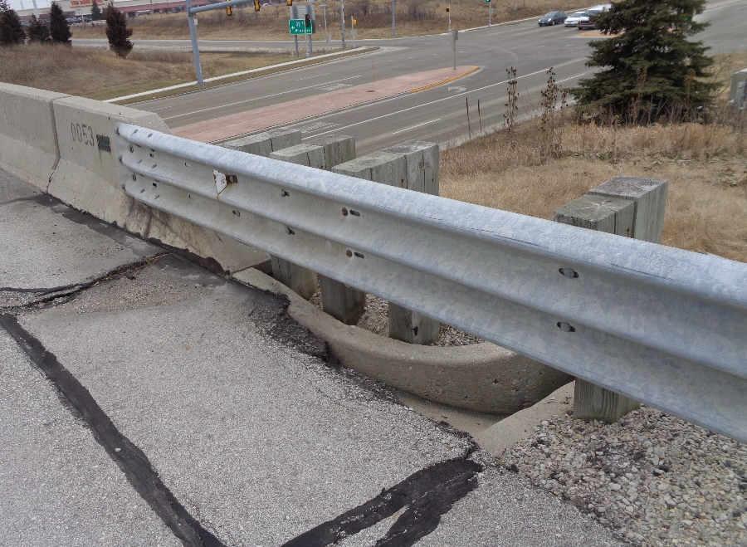
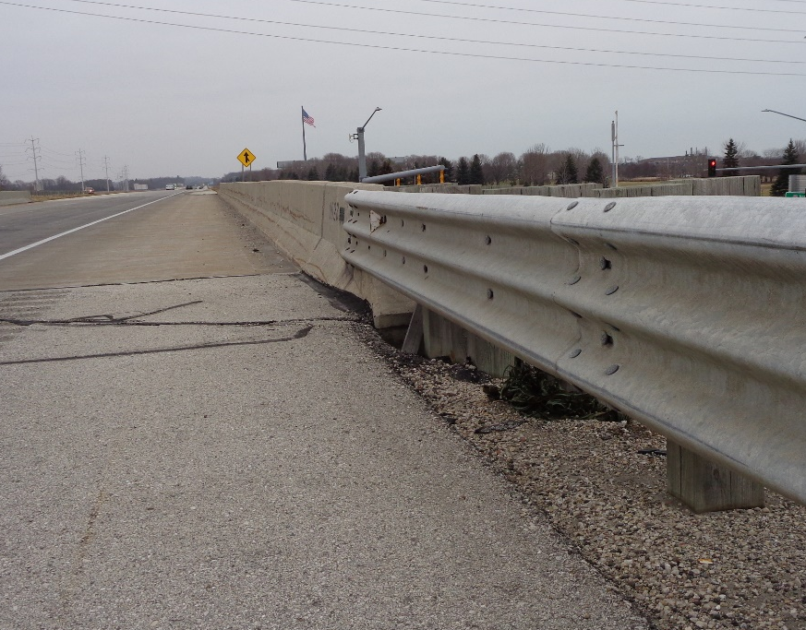
Wing Tip Erosion and Drainage
Often when overlaying a roadway as it approaches a bridge, the drainage isn’t considered.
Make adjustments in the field.
Notes:
In most cases the concrete inlets/flumes/curbs are not called for adjustment or replacement in the plans.
If an existing drain or flume exists, taper the overlay so that water properly flows to it.
Make sure drains are not paved over.
If no drain or flume exists, construct an asphalt flume to direct the drainage away from the wing.

Slide 20
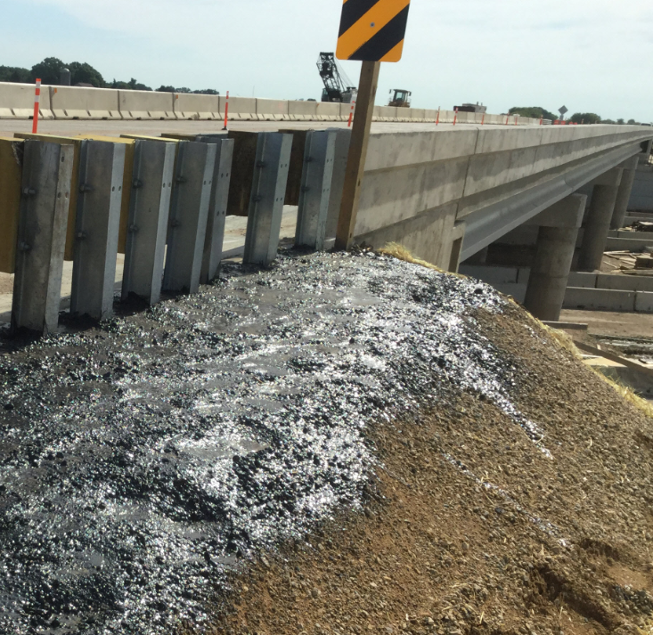
Wing Tip Erosion and Drainage
Be sure grading around wing tips promotes proper drainage.
Typically finished grade ends 6” above wing tip.
Do not allow bituminous sealant around wing tips.
  The end of the structural approach slab is not the end of wing.
Notes:
Erosion around wing tips continues to be a problem. Grading needs to be completed to the proper elevation at the wing tips. This does not always mean the finished ground should hit the wing tip, in many cases the finished grade needs to sit 6” above the wing tip.
While sealant around the wing tips may seem like a good idea to keep everything in place, it has also been known to worsen the issue. So please do not allow this.
Be careful the end of the structural approach slab is not confused with the end of wing. Next slide shows a good example of how not to complete grading with the structural approach slab extends beyond the wing.

Slide 21
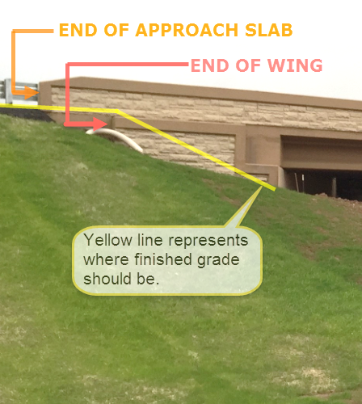
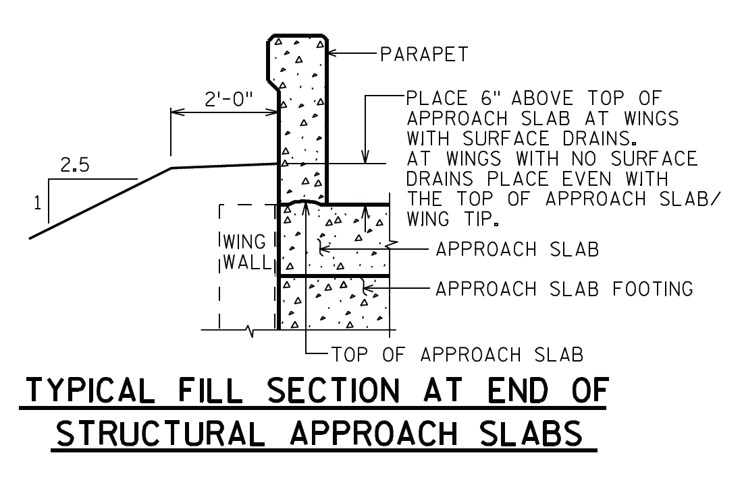
Wing Tip Erosion and Drainage
Notes:
- It is important to remember that with structural approach slabs the wing sits outside of the edge of deck and grading needs to come up to the end of wing, not where the parapet ends.
Northeast Region B-70-420/421
Past Issues:
Insufficient embankment fills
Insufficient beam guard embedment
Erosion around wing tips

Slide 22
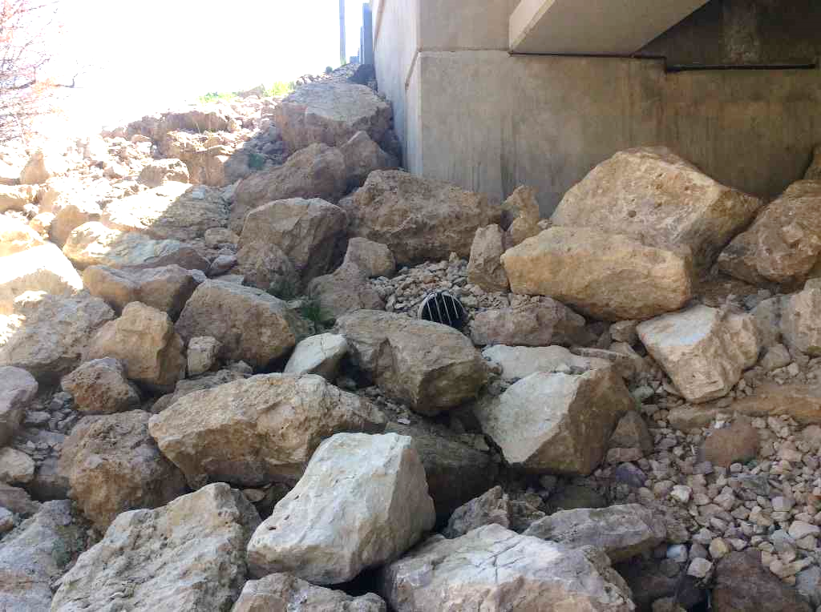
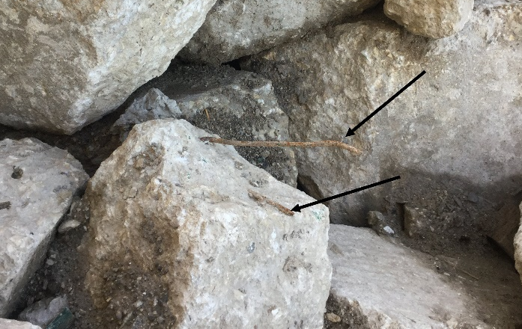
Riprap Spec. and Installation
Common problems with supplied riprap:
  Stone sizes too small
  Stone sizes poorly distributed
  Too many fines are included
  Protruding reinforcement
Ensure riprap complies with Specified grade- see CMM 6-45.7.7.1

Slide 23
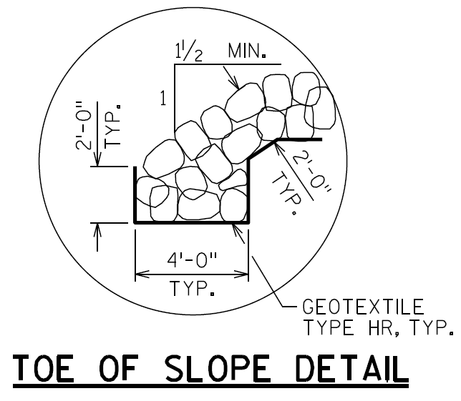
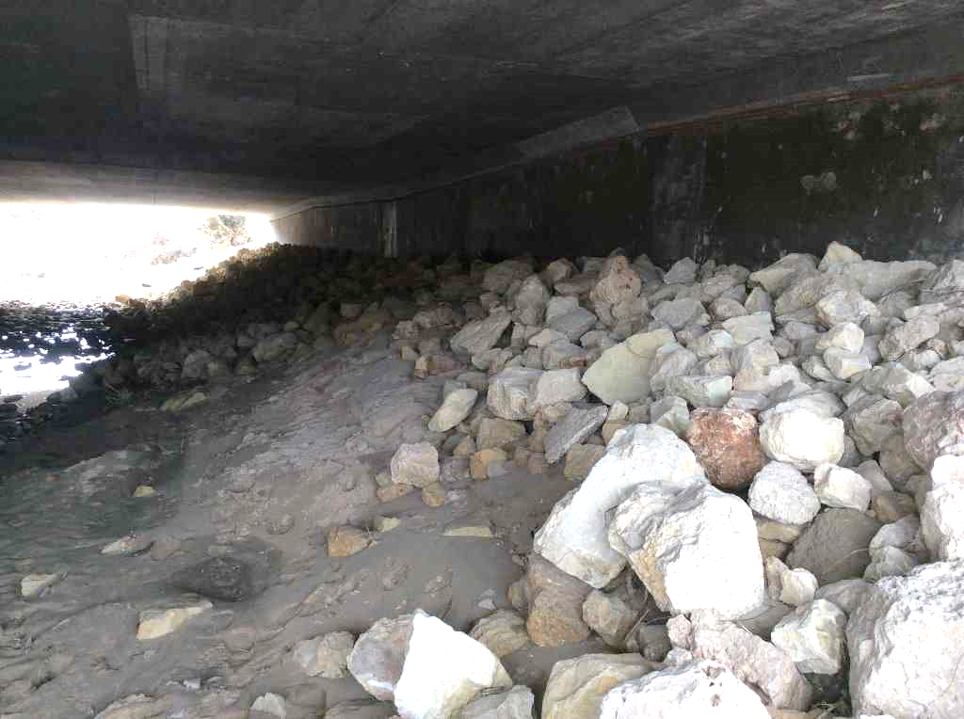
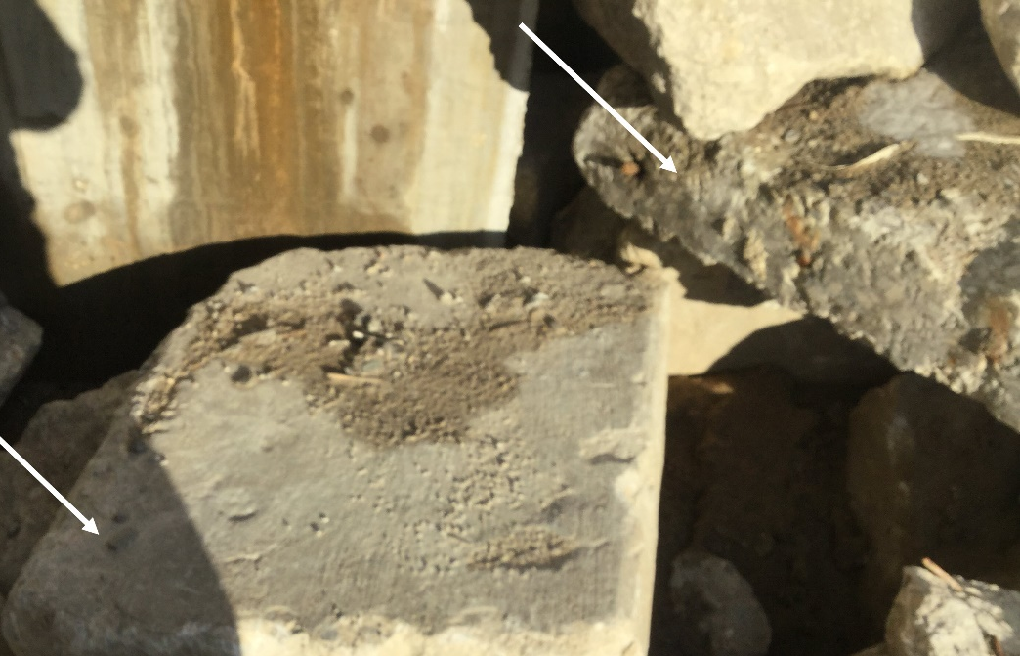
Riprap Spec. and Installation
Riprap should be installed per plan
Ensure toe of slope keyed in per plan detail
Do not omit geotextile fabric!

Slide 24
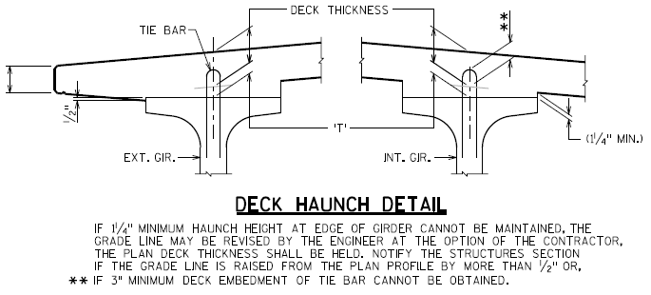
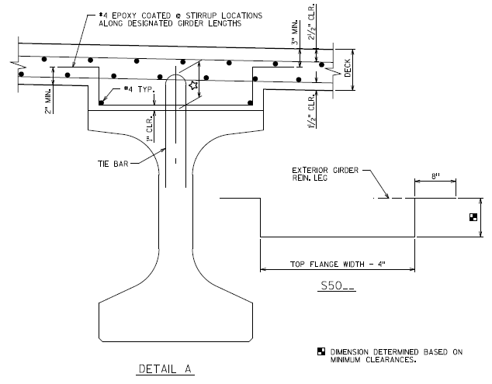
Excessive Haunch
The Contractor is responsible for providing supplemental concrete & reinforcing steel to accommodate higher than expected haunch depths due to variation in camber
This will be explicitly stated in the 2021 Standard Specifications
Construction & Materials Manual: Section 5-15-.5.7:
Notes:
This policy will be explicitly stated in the 2021 Standard Specifications, making this policy contractual, which would not go into effect until the 2021 construction season. However, this policy should still be upheld and implemented in the field during the 2020 construction season. (The Standard Specification edits will be incorporated into Section 502: Concrete Bridges, and Section 505: Steel Reinforcement).
In some recent cases, Contractors have requested that the Department cover the cost of extra haunch concrete and reinforcement due to a large variation in the expected camber. (beam seat elevations were within tolerance)
However, BOS has maintained a policy with Contractors for many years establishing the Contractors’ responsibility to pay for any required extra haunch concrete and/or reinforcing.
Study was done by BOS to establish the 1.4 residual camber factor, to predict camber growth as accurately as possible. However, more or less than expected camber still occurs in some cases, resulting in excessive haunch values.
BOS development plans to add supplemental haunch reinforcing details to standards, insert sheets, and/or the Bridge Manual to provide further guidance to Contractors’ in the event that they come across this in the field.
Extra concrete and reinforcing to be incidental to other bid items.
At the discretion of the Contractor, the Contractor can survey the tops of girders at the precast plant prior to forming/casting substructure units, such that excessive haunches can be avoided by making adjustments to the beam seat elevations. This measure is not required by BOS, and the Contractor maintains responsibility for excess haunch values.

Slide 25
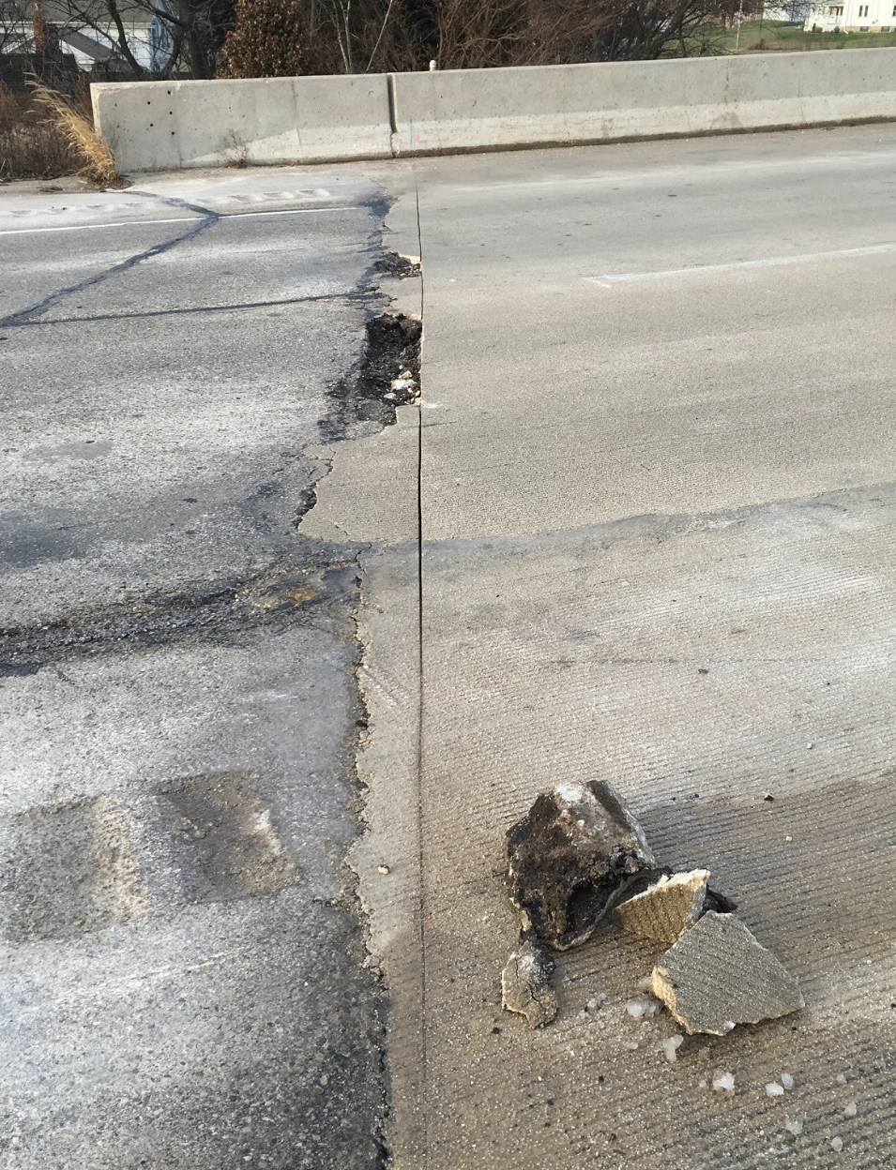
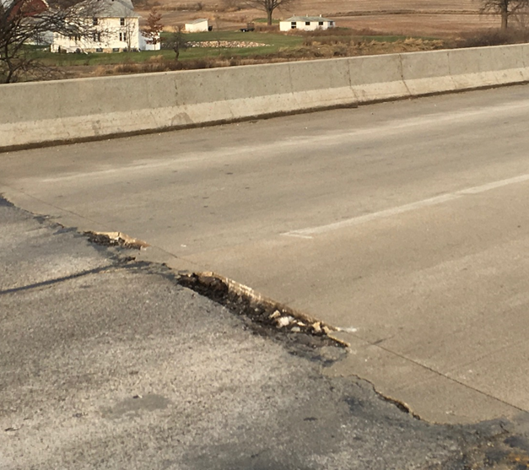
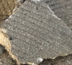
Overlay Placement and Approach
Concrete should not be used to repair roadway approach
  concrete will spall and become roadway hazard
Fill with HMA
Review project before construction, is approach work likely?
Notes:
In this picture, concrete was poured past the end of deck to fill the voids in the approach asphalt roadway.
This concrete is unreinforced and spalls quickly creating roadway hazards. Roadway approach spalls should be filled with HMA.
Typically roadway approach work is completed in conjunction with a concrete overlay and this situation is avoided.
If no roadway approach work is planned for your structure please be mindful of how they are patching the approach roadway.

Slide 26
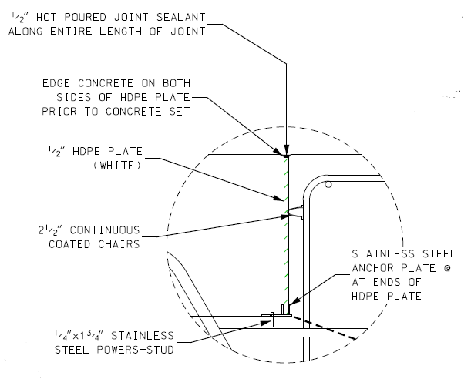
Structural Approach Slabs
Some contractors have requested to pour the structural approach slabs in conjunction with the bridge deck
The request is primarily made to compress the construction schedule
Example Detail:
If you receive this request, contact BOS for review & approval
  BOS will review contractor provided proposed details & notes
Notes:
Sometimes to expediate the schedule contractors request to pour the structure approach slabs with the bridge deck.
This is not common, only about a dozen bridges statewide per year, usually on mega projects.
If requested, contact BOS for review of contractors details and notes.
If approved, make sure that it is constructed with care.
Follow the detail
Keep the plate straight
Finish neatly
Background/Additional Information:
BOS requests the contractor to provide details including elevation views & notes, so that BOS is better able to determine if this detail is beneficial to the particular situation.
In some instances, Contractors have requested the use of a saw-cut in lieu of the HDPE plate, due to concerns over not being able to keep the HDPE straight before and after the concurrent pour.
This is not an acceptable method for the following reasons:
risk of cutting abutment rebar and stainless-steel rebar
• ensuring a straight and uniform joint at the proper location
• added responsibilities for the field staff and contractor after the deck pour (note: sawing is time-sensitive)
• interruptions to the curing process
• properly cleaning the saw-cut joint
• properly filling saw-cutting the joint
Other important details/notes BOS is looking for include:
Maximum timeframe between diaphragm and deck is 14 days; (some submittals have stated 21 days)
Hot pour sealant must be called out along the top of the HDPE plate; (this has been left out in some submittals)
When this is requested, BOS provides the following note as a condition for using this details:
The contractor may use the alternative pouring detail, with the engineer’s approval. The 1/2-inch HPDE joint shall be located per the contract plans, maintain strait alignments, and be free of defects. If the engineer orders, the contractor shall remove and replace defective and inferior joints at no expense to the department. A minor joint defect may be repairable if the engineer allows. A major defect will require joint replacement for the entire length and depth of the joint.

Slide 27
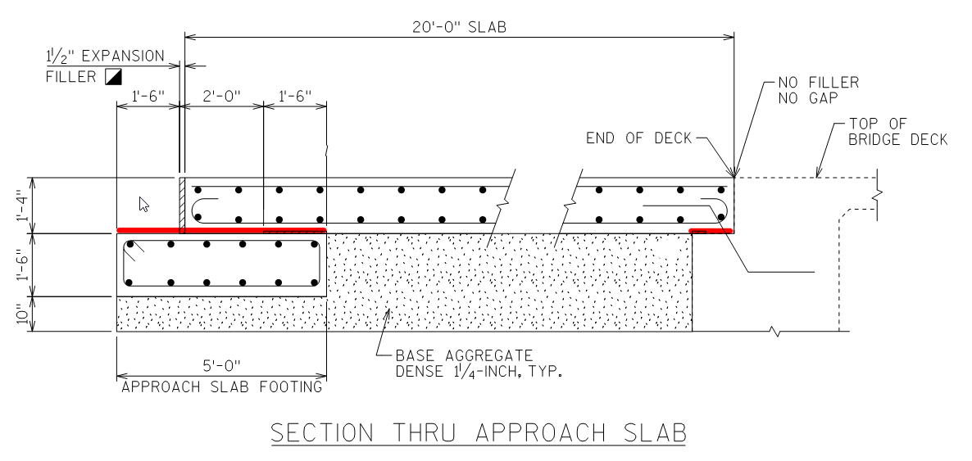
Structural Approach Slabs
Make sure that paving notches and sleeper slabs are free of aggregate before pouring structural approach slab.
If not clean, water that goes down the joints can wash stone from the top of the concrete and settlement may occur.
Notes:
A common issue that has been found is that paving notches and sleeper slabs are not free of aggregate.
If not bare, water that goes down the joints can wash stone from the top of the concrete and settlement may occur.

Slide 28
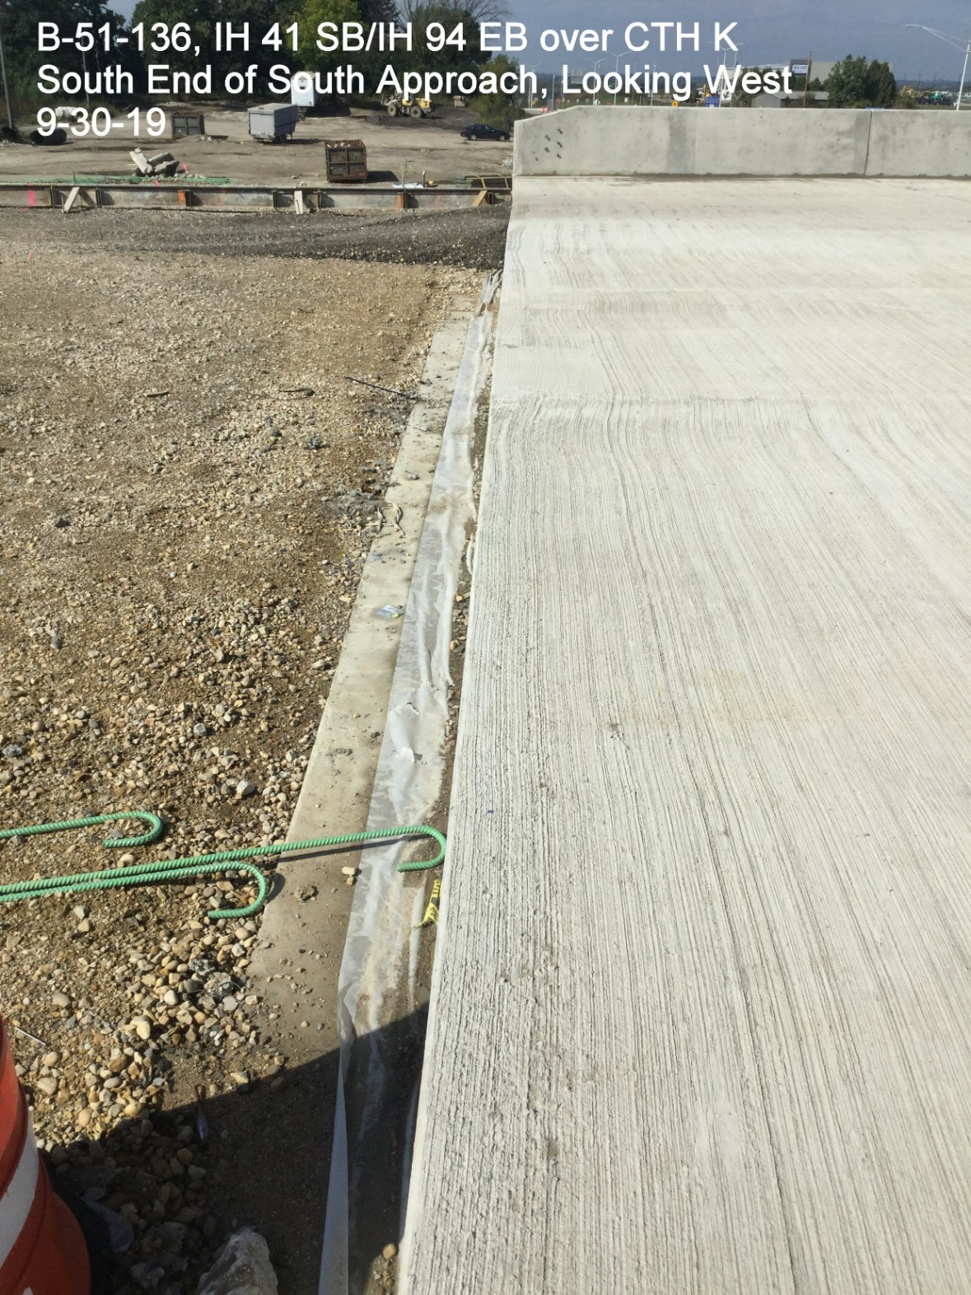
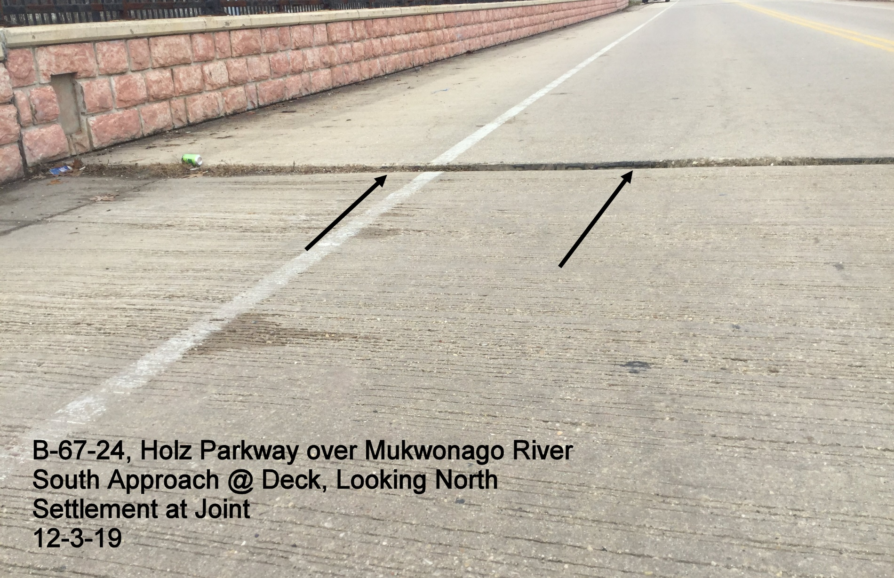
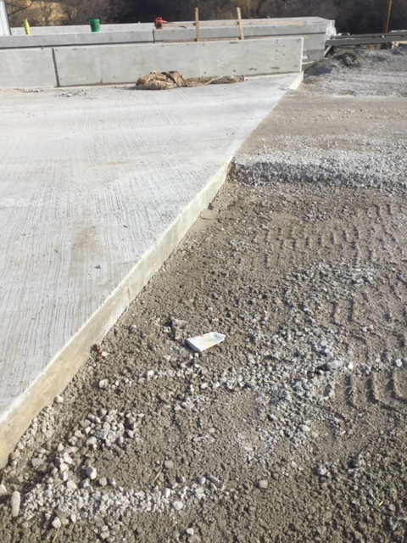
RESULT OF PLACING AGGREGATE BETWEEN STRUCTURAL APPROACH SLAB FOOTING AND ROADWAY PAVEMENT
DO NOT PLACE AGGREGATE ON TOP OF STRUCTURAL APPROACH SLAB FOOTING

Slide 29
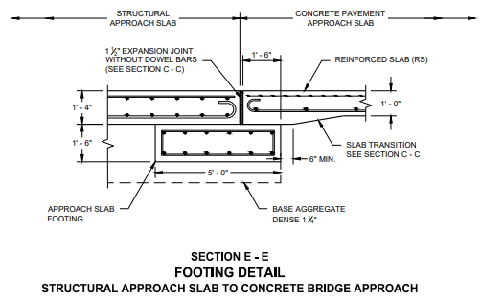
Concrete Pavement Approach Slabs
Ensure Concrete Pavement Approach Slab bears directly on the Approach Slab Footing. Do not allow for aggregate to be placed between the two.
  Reference SDD 13b2-9b: Structural Approach Slab and Concrete Pavement Approach Slab
Notes:
The forming of the notch of the header at the deck/approach joint is commonly done wrong.
Ensure that Joint sealant extends to the top of the paving notch.
Ensure that the expansion joints btw the roadway approach slab and adjacent pavement is constructed per the SDD
Without proper expansion joints, there is no mechanism to push the approach back after the structure expands and pushes the approach away from the bridge, resulting in 4”-5” gaps at the paving notch (unsealable)
These gaps allow water to stream in
This moisture results in frost and heave/loss of material, leading to settlement of the roadway and increased impact on the structure
The moisture also leads to saturation of the slopes, which then leads to slope failure

Slide 30


Concrete Pavement Approach Slabs
Ensure that the ½” wide x ¾” deep notch at deck/approach joints is formed and poured per the plans
  Reference SDD 13b2-9a: Concrete Pavement Approach Slab
Notes:
The forming of the notch of the header at the deck/approach joint is commonly done wrong.
Ensure that Joint sealant extends to the top of the paving notch.
Ensure that the expansion joints btw the roadway approach slab and adjacent pavement is constructed per the SDD
Without proper expansion joints, there is no mechanism to push the approach back after the structure expands and pushes the approach away from the bridge, resulting in 4”-5” gaps at the paving notch (unsealable)
These gaps allow water to stream in
This moisture results in frost and heave/loss of material, leading to settlement of the roadway and increased impact on the structure
The moisture also leads to saturation of the slopes, which then leads to slope failure

Slide 31

Concrete Cure Time
How long does the Contractor need to wait prior to…
  Setting girders on substructure units?
    Substructure units must cure for at least 48 hours prior to applying superstructure load or any dead load, per 502.3.10.1.2.2(2)
  Pouring the structural approach slab (on the approach slab footing)?
    This is not explicitly stated in the Standard Specifications, but apply section 502.3.10.1.2.2(1), concrete columns & walls may be poured after the footings have cured for at least 24 hours over 40° F.
Notes:
Several requests came in from NWR during the Summer 2019 construction season asking how long the Contractor needed to wait after pouring various substructure/approach concrete elements.
Reference standard spec section 502.3.10.1.2.2(2) for required cure time of substructure units.
Note that there is one exception to this: Per 502.3.10.1.2.2(1), the Contractor may place footing forms and pour footing concrete on a footing seal immediately after dewatering a cofferdam. Also, the Contractor may place column/wall forms on footings the day after pouring the footing, and they may pour the column/wall concrete once the footing has cured for at least 24 hours over 40 deg. F.

Slide 32


Concrete Cure Time
How long does the Contractor need to wait prior to…
  Placing riprap?
    If backfilling on both sides of the abutment, riprap may be placed up to the berm elevation immediately upon removing the forms. (Reference Standard Spec Section 206.3.13.2.3)
    If NOT backfilling on both sides of the abutment, the Contractor must wait 2 days before placing riprap. (206.3.13.2.2)
Notes:
Several requests came in from NWR during the Summer 2019 construction season asking how long the Contractor needed to wait after pouring various substructure/approach concrete elements.
Reference standard spec sections 206.3.13.2.2 & 3 for backfilling at abutments, and section 502.3.10.1.2.2 for required cure time of substructure units.

Slide 33
Structures Agenda
Contacting BOS – When & Why
Specification and Manual Updates & Reminders
Structures Construction Issues
Ancillary (Wind Loaded) Structure Issues

Slide 34
2020 Monotube Poles and Arm Update
Depending on your Region, you may see Contractor furnished or Department furnished monotube poles and arms on your project.
If there are Department furnished monotube poles and arms on your project, there will be a SPV indicating this.
REGION | WHO WILL FURNISH
SE | All Department Furnished Monotube poles and arms
SW | All Contractor Furnished Monotube poles and arms
NW | All Contractor Furnished Monotube poles and arms
NC | A combination, but primarily Contractor furnished.
NE | A combination, but primarily Contractor furnished.
Notes:
In the 2019 Standard Specification-
657.2 was revised to require contractor furnished monotube poles and arms from a manufacturer on the department's QPL
657.5 was revised to change install bid items to contractor-provided for poles, monotube arms, and steel luminaire arms.
In the 2020 construction season, depending on your region, you may see projects with contractor furnished or department furnished poles and arms. Projects that have department furnished poles and arms will include a SPV indicating this.

Slide 35

Ancillary (Wind Loaded) Structures
Foundation Construction – On Going Problem
  Contractor locate utilities
  Cave-ins / standing water
    Contract submit proposal
    Pumps
    Casing
    Tremie
  Rock / obstruction
    Contact designer, or BOS for revised design
Notes:
Foundation construction is an on going problem
Make sure contractor locate all utilities before excavation
For Cave-ins and standing water conditions:
Contractor to submit construction plans
Casing, pumps and tremie placement of concrete may be required
For rock and obstruction conditions:
Contact designer or BOS for design revision

Slide 36


Ancillary (Wind Loaded) Structures
Foundation Construction (continued)
  Anchor rod inspection
    Standoff
    Damages
    Centered, Clean, Straight
    Adequate stickouts
    Check anchor rods against base plate
Notes:
Anchor Rod Inspection:
-Be sure to check for all of these common concerns
-Standoff (bottom picture)- The distance between the top of the concrete and bottom of the base plate is specified in the plan details, exceeding this dimension may require refined analysis and possible future maintenance concerns
-Incorrect base plate hole configuration vs anchor rod layout
-(picture on right) Anchor rod/oversize hole issue, usually on monotubes, the washer interferes with the weld and the nut is too close to pole to get a socket on it, therefore probably not properly tensioned.
-construction staff make sure the contractor can at least get a standard socket on the nut of the anchor rod, also can use a single clipped washer if necessary

Slide 37


Ancillary (Wind Loaded) Structures
DT Form Submittal
  DT2322 – Ancillary Structures
  Pre-Installation Verification Test
  of High Strength Bolts
    Submit both pages
    Test all assemblies
    Webinar coming
Monotube Issues
  Weld Interference
    Prevents DTI from working
  Dampeners
    Type 9 & 10 Special Poles
Notes:
DT2322
-Be sure both pages of DT2322 are submitted.
-Test all assemblies, this means all combinations of bolt, nut, washer and DTI used on the structure, including the use of clipped washers AND combinations that use different “lots” of hardware.
That being said, BOS is working on a webinar based training for Ancillary structure bolting, available to everyone on the Learncenter.
Monotube Issues
-Weld Interference with DTI, cannot verify that bolt is tight
- Type 9&10 SPECIAL poles require dampeners to be supplied by the fabricator (unless SE REGION), having issues with these being installed without dampeners.
Connections:
-DTI’s (Direct Tension Indicators), make sure DTI’s are oriented correctly and meeting all the quality control requirements of DT2322
-Top right picture shows a DTI that is interfering with a weld, this DTI will not perform properly, this is something that construction staff can look out for when the sign structure and hardware is still on the ground.
DT Form Submittal:
-DT Forms need to be complete for each structure. The contractor needs to make sure they submit ALL the pages, especially of BOTH pages of DT2322 (DTI), of each DT Form accurately with all required information and signatures. If they do not, it delays in the final inspections because consultants need these forms to verify construction.
-Include any design plans and shop drawings with DT Forms to the consultant sign/signal/hml (high mast lighting) inspectors BEFORE the inspection so they have time to review and adjust inspection procedure accordingly. This reduces delays and provides a better quality product in the end

Slide 38
Conclusion
Call us!
BOS looks forward to another successful construction season –
THANK YOU!
Notes:
“We always do it that way” is not a substitution for what is shown on the plans – if the contractor is looking to do something different than the plans show, need to contact EOR/BOS

