Slide 1
WisDOT Erosion Control Updates – 2020 Construction
Tom Kobus
NE Region Stormwater and Erosion Control Engineer

Slide 2
2020 Standard Specification Updates
628.5.11/.12 – Failure to mobilize
Updated from $300 to $500 daily deduct
Added Administrative Item
630.0500 – Seed Water
Water required if rainfall not sufficient after seed germination
Order seed and communicate water expectation on order.
Corrective action if work not completed.
Notes:
2020 standard spec updates
Spec 628.5.11 and 628.5.12 were updated as the dollar amount for failure to mobilize for erosion control was updated. The deductions for the standard mobilization and emergency mobilization are now $500 per day.
-For DOT field staff – WS 1074 – erosion control order form updated with this new amount.
-Also, the form was converted to a DT form – DT 1074. Form will updated in pantry shortly and on the erosion control website. So use this new form if the project is utilizing the 2020 spec book.
-the other big spec update for erosion control - Seed Water is a new bid item in 2020 standard spec. Will help WisDOT get the vegetation we have planted to survive during historically dry months by requiring watering after seed has germinated if rainfall is not sufficient.

Slide 3
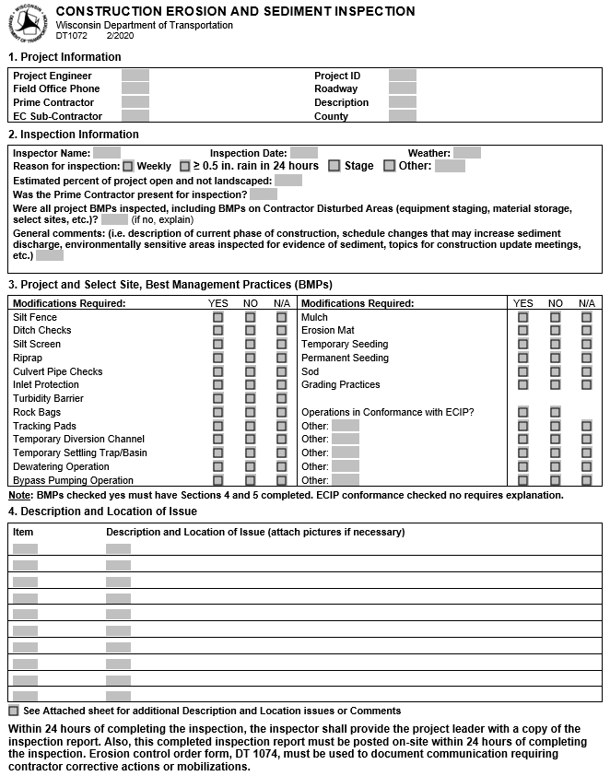
Inspection form update – DT 1072
Notes:
Inspection form was updated and should have replaced in all locations that you would get access to it. As you use the new form this summer on construction, please forward any suggestions to the PM for your project so that if we can make modifications that would make the form more user friendly to field staff we can consider that for next years construction.

Slide 4
ECIP form update – DT 1073
Electronic format
Sections A and B minor changes
New section for Pollution Prevention
Notes:
-moving on to the ECIP form update
-We updated the old form that was created for paper completion/submission
-The new form has expandable, fillable fields to aid in electronic completion
-We will quickly go over sections a and b
-then we will complete a more in depth review of section c as it is new

Slide 5
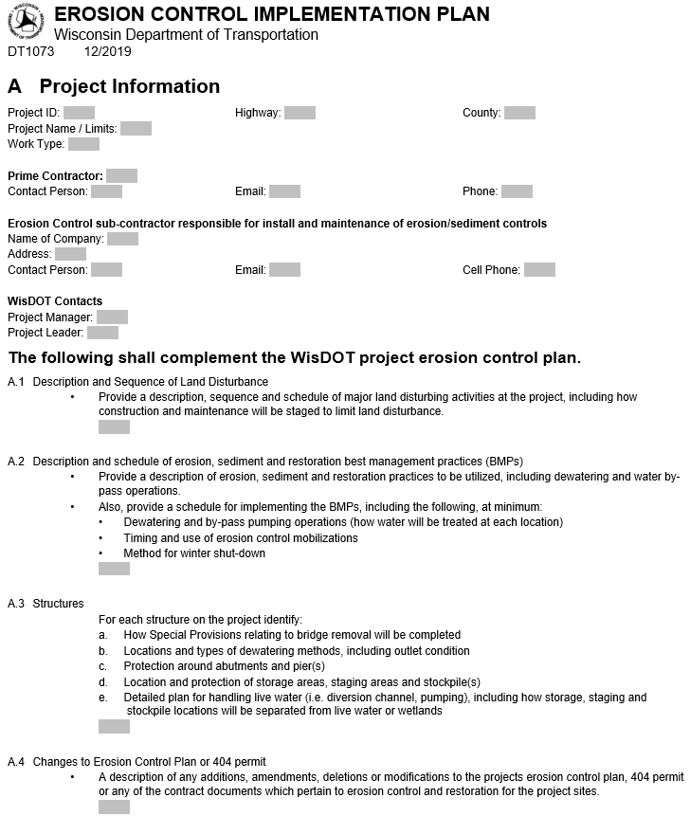
Section A
Numbering change – Old A1 is now project information
Dewatering and by-pass pumping called out in A2
Notes:
Section A
-first change, note the old A1, project contacts was moved to the top of form to project information. Now has fillable fields are expandable. Note this change updated all of the numbers in section A.
-second change, we specifically ask for Dewatering and Bypass pumping details in A2. These are critical details needed for ECIP approval but were not specifically listed previously. By listing we hope to eliminate some of the back and forth emails

Slide 6
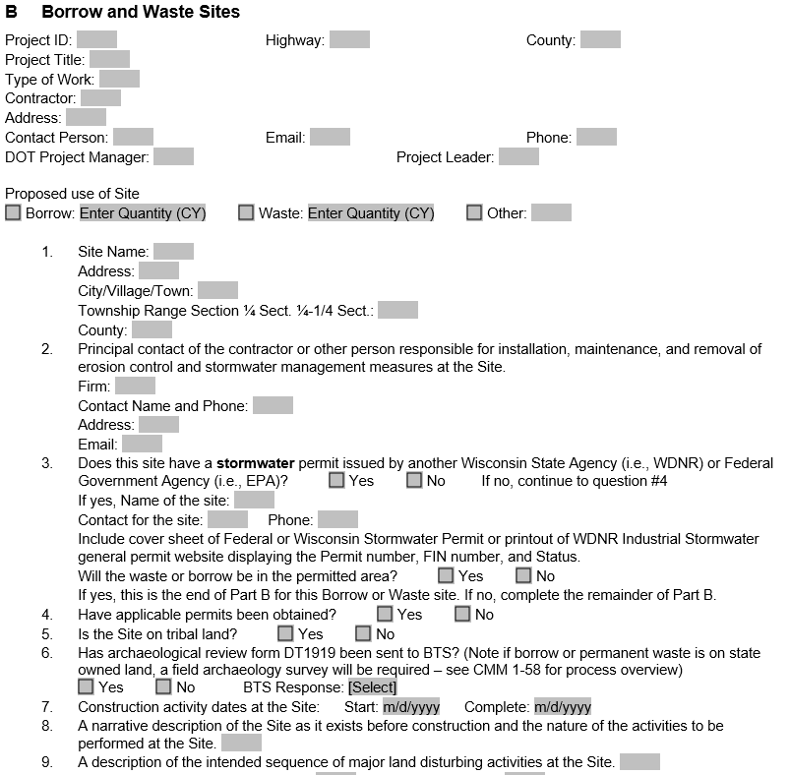
Section B
Proposed use
Quantity moved from question 8
Dropdowns match DT1919/ CMM 1-58 update
https://wisconsindot.gov/rdwy/cmm/cm-01-58.pdf
Notes:
Moving on to section B – borrow and waste sites
-Added “Proposed use” as this really helps stormwater engineer review the ECIP and understand site operations.
-Also now ask for quantity here (moved from old question 8.) again this helps the SWEC determine site operations.
-Question 6 - Lynn Cloud updated DT1919, which is the cultural resources review form, she also updated CMM 1-58 with clear overview of process. Question 6 was updated with dropdown boxes to match terminology used on the DT 1919 form.
-to all who have had questions regarding cultural resources review in the past, I encourage you to read CMM 1-58 for that helpful overview of cultural resource review process

Slide 7
Section B (cont.)
11 – remove mention of FEMA floodplain maps
12 – remove requirement for runoff coefficient table
13 – Add WDNR Surface Water Data Viewer option
“+” button for additional sites
Notes:
The remainder of changes to section b are to bring the form up to date and also add more functionality.
-old question 11 - eliminate need to attach FEMA floodplain maps - WDNR surface water data viewer layer is OK
-old question 12 - language requiring runoff coefficient table was removed from form, inconsistencies in region acceptances and WisDOT already has this in plan
-old question 13 - we encourage using the DNR surface water data viewer to show environmental layers but did not have this listed as an option, so we added it.
-Finally we added functionality to add additional borrow and waste sites by clicking a “+” symbol at the end of section B to help with formatting

Slide 8
Section C – Pollution Prevention
New section
Designed to meet TCGP
Straightforward Best Management Practice (BMP) checkboxes
Required on all projects with an ECIP
Erosion Control items
Selected Sites (Not in CMM)
Can be amended similar to other ECIP sections
Notes:
Section C – Pollution Prevention
-Brand new section, effective with December 2019 let
-This section was designed to meet requirements from our construction stormwater permit, commonly referred to as the TCGP
-we designed it to be straightforward utilizing clear BMPs with checkboxes
-this section is required on all projects with an ECIP
-Similar to other sections, amendments required if operations change

Slide 9
Section C – Pollution Prevention
Sources of pollution
BMPs
Material storage and disposal
Equipment fueling
Concrete truck washout
Spill control and reporting
Notes:
-Overview of the 3 parts to the new section.
we will go over the new parts in more detail in the following slides
-first part - sources of pollution
-second part – Best Management Practices (what will be done on the project to prevent pollution)
-third part - Spill control and reporting (BMPs to mitigate spills and procedure for what to do when a spill happens)

Slide 10
Section C – Pollution Prevention
Sources of pollution
Contractor should know!
Notes:
Breaking down the first part of section C - sources of pollution
-Contractor submits sources. Helps DOT determine what risks will be present.
-Contractor can pick from the 9 common items listed in checkboxes, or if not on list, insert in “other” box

Slide 11
Section C – Pollution Prevention
BMPs
Material storage and disposal
All boxes should be checked
Look at during inspections
Notes:
-Moving on to the second part of new section – identifying BMPs to prevent pollution
-Broken up into 3 categories to match our TCGP requirements
1. material storage
2. equipment fueling
3. concrete truck washout
-This slide shows the material storage category
-Four checkboxes are required to be checked. Common sense items, such as:
-not storing items in wetlands
-collecting and disposing of construction waste

Slide 12
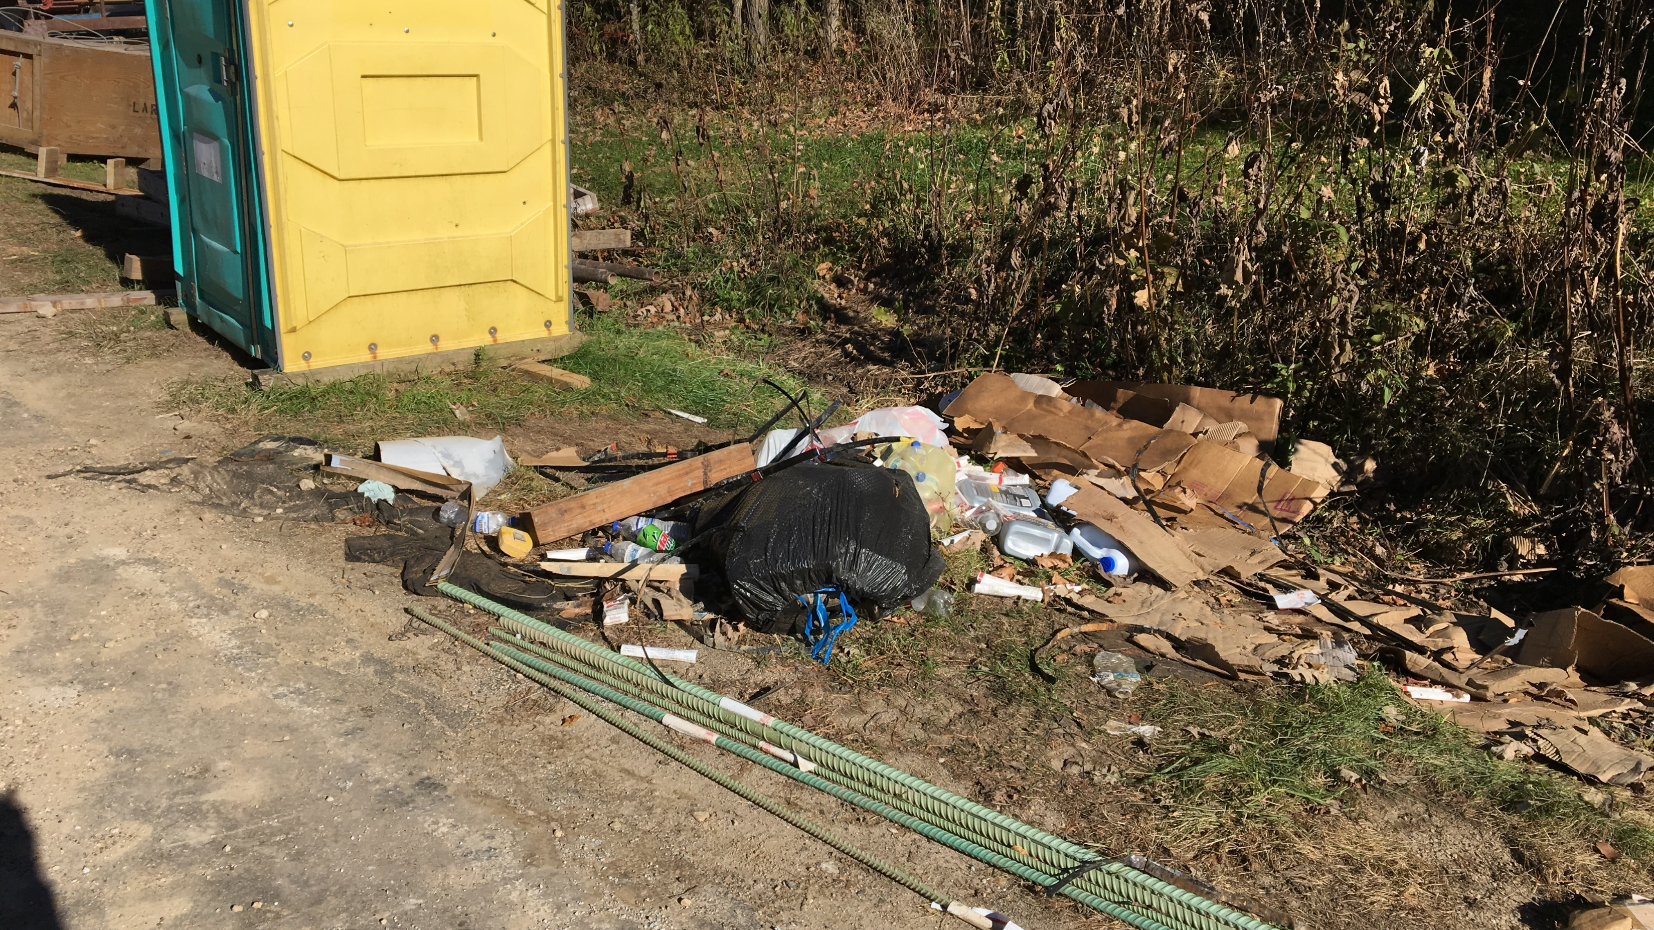
Example showing waste materials not disposed properly
Notes:
Example showing what we are trying to prevent
-construction waste not properly disposed of, possibly in wetland

Slide 13
Section C – Pollution Prevention
BMPs
Equipment fueling
Drip pans
Clean it up
Notes:
-Second BMP category is Equipment Fueling and maintenance
-For this category, two checkboxes are required to be checked. Again common sense type items
-the first is monitoring and fixing fluid leaks when discovered
-The second is using drip pans to prevent spills and using absorbent materials to cleanup spilled fluids

Slide 14
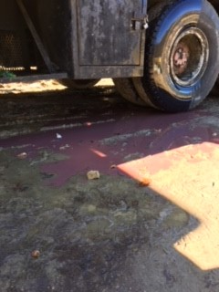
Fix leaks when discovered
Cleanup with absorbent materials
Fix it or remove it from Project.
Notes:
-Again example showing what we are trying to prevent
-fix fluids leaks when discovered
-use absorbent materials to cleanup
-if you notice equipment that has issues discuss with your Project Manager and during your weekly meetings.

Slide 15
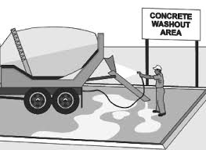
Section C – Pollution Prevention
BMPs
Concrete truck washout
Prevent washout from running off into:
Surface water
Wetlands
Drainage conveyances (inlets, ditches, curb flow lines)
Notes:
-Last category is concrete truck washout
-concrete truck washout water is caustic and corrosive with a pH around 12
-safe range of aquatic life is a pH around 6.5 to 9, so concrete truck washout water is harmful to aquatic life.
-We have always been required to prevent pollution from concrete truck washout, however now we will think about and plan concrete truck washout will be managed.
-Main idea here is to prevent concrete truck washout from running off into
-surface water
-wetlands
-drainage conveyances
(drainage conveyances are inlets, ditches and curb flow lines)

Slide 16
Section C – Pollution Prevention
Concrete truck washout (cont.)
Check only box that is being used on the project.
Notes:
-This slide lists common BMPs that can be used for concrete truck washout
-there are 4 common BMPs to manage concrete truck washout listed here. -Only one BMP is required to be checked.
-If you company has different options or practices for managing concrete truck washout, they can be proposed in “other” box.
-This category, and section, can be amended as the project progresses
-Note the link to a concrete truck washout document we created in consultation with Wisconsin DNR.
It is a10 page document that has photos of the common methods listed in section C of the ECIP.
So please check that guidance document out if you have any questions.

Slide 17
Poor concrete washout operations
Washout running into conveyance (ditch bottom)
Notes:
Example showing what we are trying to prevent.
In this example the concrete truck washout ran off into the ditch bottom

Slide 18
Section C – Pollution Prevention Discuss location of spill kits at preconstruction meeting and weekly project meetings. Contact your PM and Kathie Van Price (920) 492-7175
Notes:
-Last part to new section is hazardous spill control and reporting.
-Top portion of this part outlines BMPs that will be used in event of a spill. Two checkboxes are required to be checked.
-Remainder of this part details procedure for reporting spills – not a new requirement but more clearly spells out procedure to report spills
-Also lists what a spill is and when it needs to be reported
-that is the end of new section
-we went over fast and it may look like a lot, however we feel it is a pretty straightforward section, ECIP submittals using the form so far this year have gone over very well.
-I encourage you to check out the new form.

