Slide 1
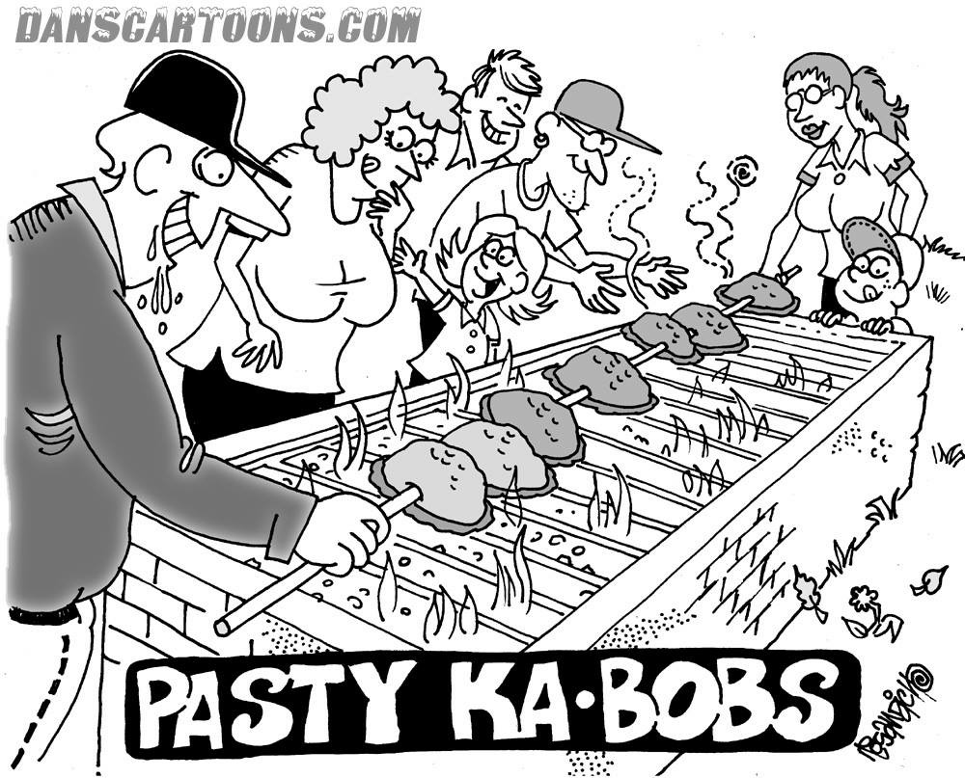
Contract Administration
NER Construction Training
March 6, 2019

Slide 2
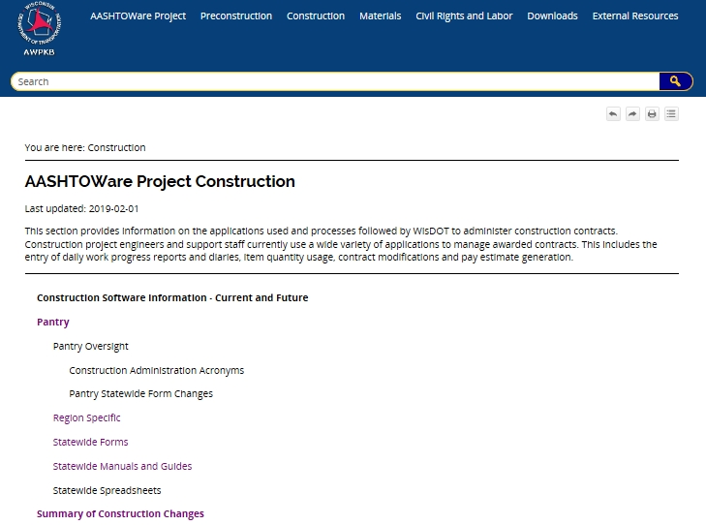
AWPKB
HOLYWAH, IT’S A CHANGE!
Notes:
AWPKB = AASHTOWare Project Knowledge Base
Pantry
Summary of Construction Changes (list of changes by month)

Slide 3
2019 NER Field Construction Administration and Field Software User’s Guide available in Pantry
Notes:
Only one regional guide for all projects (including Local Program and Workshare). 2018 is currently available in Pantry as we are making a few last minute updates for 2019. The statewide Field Software User’s Guide is also available in Pantry.

Slide 4
Local Program
Contract administration managed in-house
Most processes are same as state projects
Differences include:
Weekly Construction Update form (in Pantry)
Utility coordination and conflict
Municipality concurrence within CMJ
Notes:
We’re on our second year now of Local Program projects being administered in-house. For the most part, the goal is to streamline local program projects and administer them the same as state projects. There are a few key differences to mention.

Slide 5
Workshare Projects
NE Region is administering several projects for NC and SW Region
Follow all NE Region processes
PM will coordinate with other regions as necessary

Slide 6
Start of your projects
Project Binders
Pick up your plans, proposals, and labels from the PM’s
Project leader prints off Binder materials (including instructions) located in Pantry
All binder materials are in one document called 2019 NER Construction Binder
Empty 3-ring binders available at NE Region office
Notes:
Plans, proposals and labels can be picked up anytime from our regional office. They are no longer stored in the drawers but you can get them from your PM. You can also wait until the pre-construction conference to pick up your items, too. Like last year, print off the binder materials from Pantry.
We have 3-ring binders and you’re welcome to take as many as you need!

Slide 7
Initial Project Communication
Preconstruction Conference
Invite, Agenda, Minutes
Meeting Flow
Preconstruction Public Meetings/
Business Meetings
Property Owner Letters
Don’t use Pantry template
Notes:
Depends on consultant contract language. Usually PM creates and sends invite (via Outlook Calendar Appointment), PCL creates agenda and PM reviews. PM kicks off meeting but PCL runs it. PCL usually develops meeting minutes and PM reviews. PM should distribute minutes to all invitees.
Make the precon worthwhile. Use large displays or have plan available on Smartboard. Try to establish day/time of weekly meetings at precon or in the minutes.
PI Meetings: will depend on special provision and consultant contract responsibilities. May need to target large traffic volume generators outside the project limits.
Property owner letters: PCL will create, PM will review and sign. On DOT letterhead. Don’t use pantry template.

Slide 8
Cost to Complete Reports
Main data comes from FieldManager
Engineer inputs projected over/under for each bid item
Monthly updates April - November
Email reminders from Mark Higley
SharePoint site same as last year

Slide 9
Cost to Complete Reports
Notes:
Report given to the PM’s and Supervisors.
2018 NE region was even with overruns on reported projects

Slide 10
Finals Process Reminders
No need to print signed copies of CMJ’s or CCO’s
Organize back up documents
No need to print NTP, Final Accept. Letters, etc.
Guide Section 4: Documentation
Notes:
Don’t print these items. Will be stored in the digital files.

Slide 11
Finals Process Reminders
Emails/correspondence saved to a combined PDF. No hardcopies.
Reduce paper when practical
Only accept flash drives, no CD’s.
Notes:
The way the IHD binder is set up should be similar to the past.
But with MI or digital entries there will be less hardcopy paperwork.
Any hard copy source documents should go in IHD binder as in the past.
Do not print out emails. Save them to a combined PDF.
Don't make things harder for yourself and others trying to reduce paper. Be smart and stay organized.
Refer to checklist coming up later.

Slide 12
Finals Process Reminders
Finals Process Manual
Found under ‘Statewide Manuals and Guides’ in Pantry
Close out 180 days from Substantial Completion
81 days to submit records
Each project’s dates are tracked and reported out statewide – Performance Goals
55% Statewide Goal
Notes:
Document called Finals Process for Let Project Closeout
180 is the ultimate goal to achieve
It is divided up into milestones, float built in, don’t use up all the float.
PCL’s have 81 days from substantial completion to turn in records. 60 days is from CFA as the process assumes 15 days for punch list completion.
Each process goal date is tracked and reported out – 55% fiscal year
Projects past the goal date are given a reason code
Can turn them early….

Slide 13
Finals Process Reminders
Turn in your records as early as you can but with minimal outstanding issues
Discuss with PM when small issues remain but are ready to turn in
Reviews can occur even with a few outstanding items
Notes:
We don’t want to wait until day 81 for all projects
Discuss with PM to turn in records with outstanding issues. PM can discuss with Krissy and Eric if questions. Idea is not to fall behind on the process for small issues or paper work.
Examples: CCO negotiations, material credits, claims

Slide 14
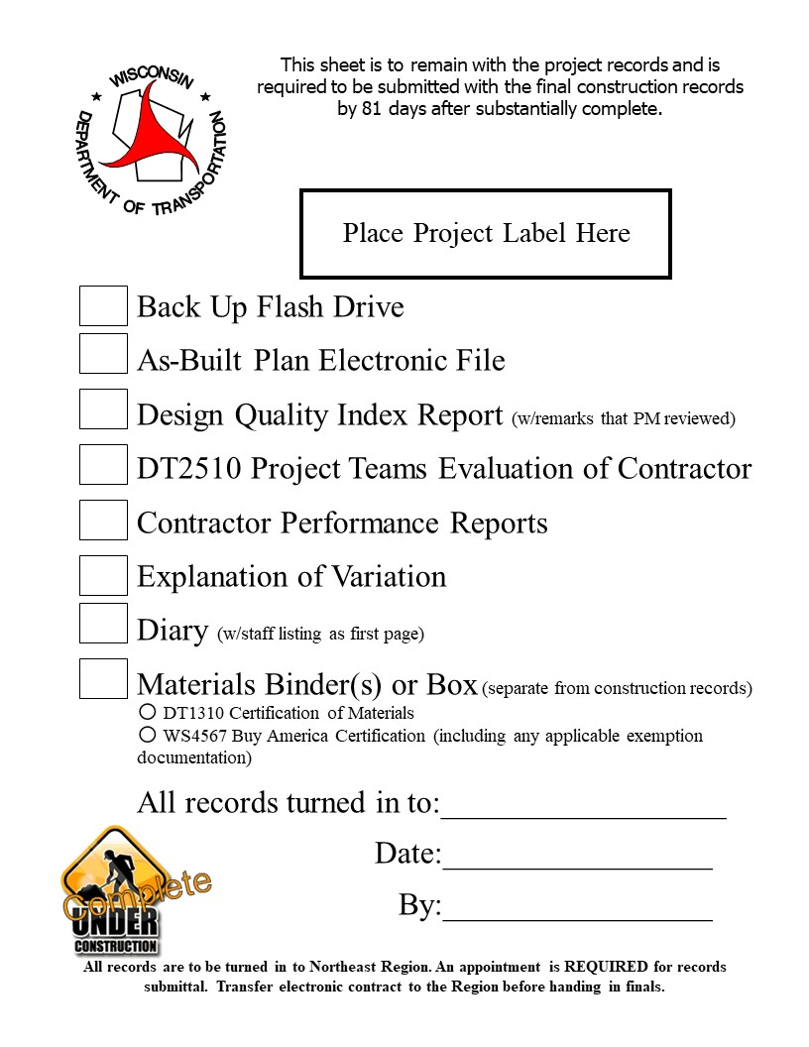
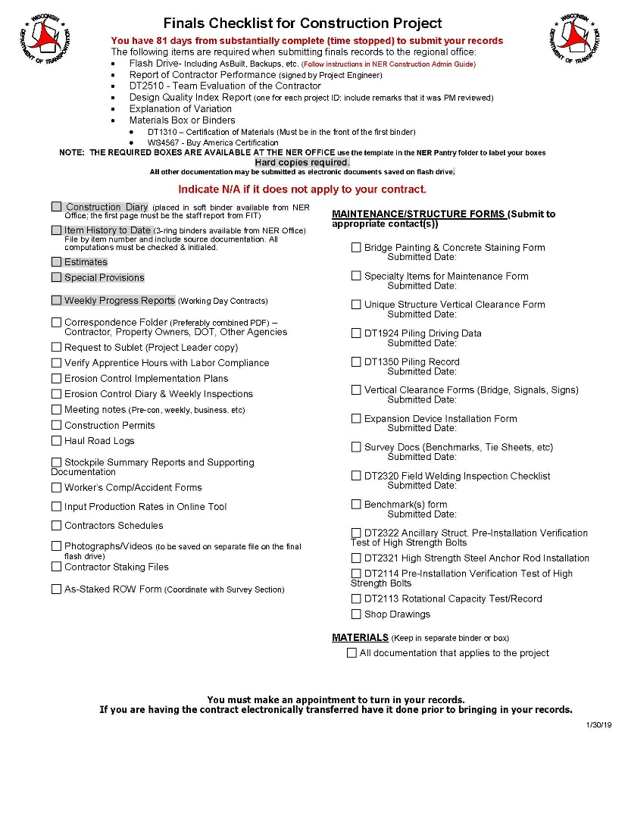
Finals Process Updates
NER Finals Checklist
Notes:
These documents need to be turned in with your final records. Fill out the finals checklist. These are included in the 2019 NE Construction Binder material in Pantry under NE region, Field Resources.
It now has submitted dates for DT maintenance forms.
Do not fill out the finals checklist that is under the statewide forms in Pantry. NE region is more specific.

Slide 15
Finals Process Updates
NER Finals Checklist

Slide 16
Finals Process Updates
Notes:
Small sample of the list

Slide 17
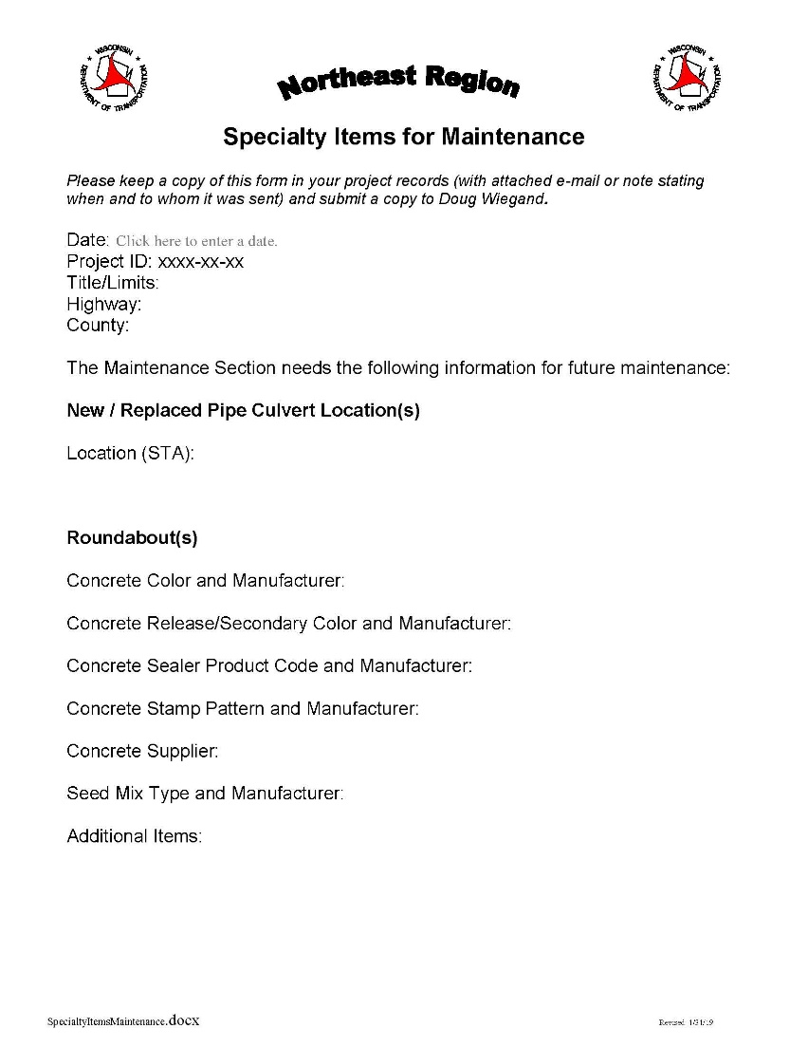
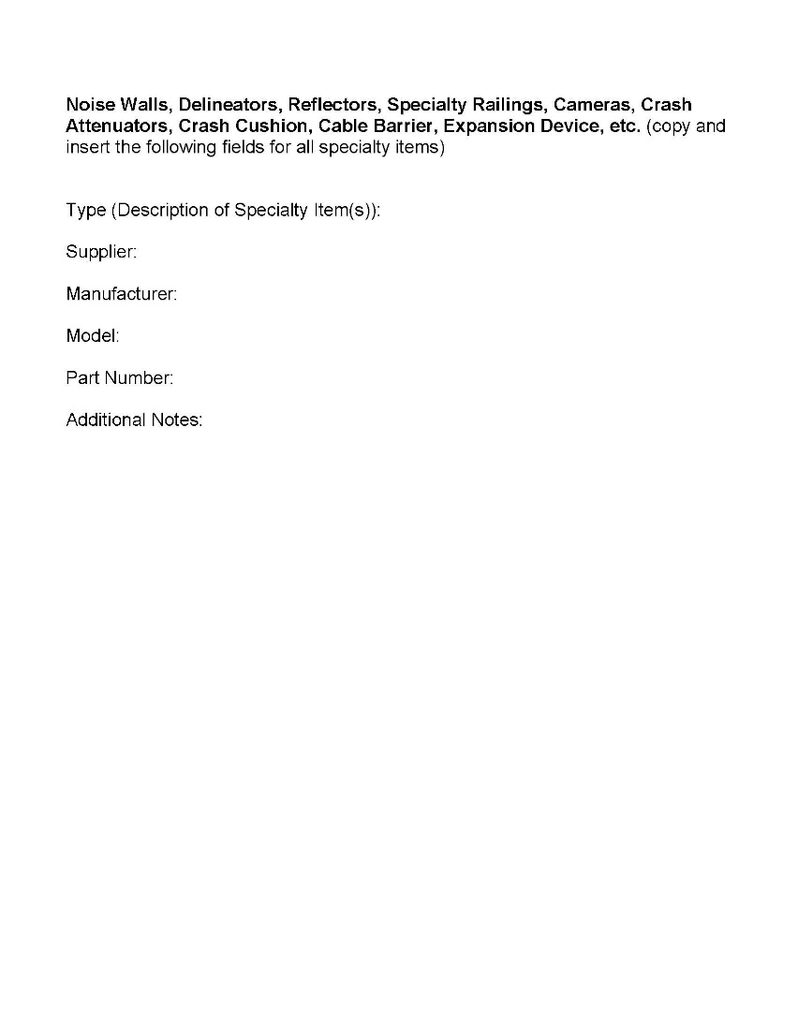
Finals Process Updates
NER Specialty Maintenance Form - NEW
Notes:
This new form combines many of the NE region maintenance forms into one.
Also a new request from NE Maintenance is the location of new or replaced pipe culverts. They have a new GIS database that needs updated once a project is complete. This will alert them to go to your as-built and update their information.
The only stand alone maintenance document remaining is the Bridge Staining and Painting and Unique Vertical Clearance form as these are used less frequently.
This does not include any DT forms.

Slide 18
Finals Process Updates
NER Specialty Maintenance Form - NEW

Slide 19
Finals Process Updates
NER Specialty Maintenance Form - NEW

Slide 20
Finals Process Updates
NER Specialty Maintenance Form - NEW

Slide 21
Finals Process Updates
As-builts (CMM 1-65.14)
Complete As-built
1 PDF per project
Structure As-built
1 PDF is to be submitted
>1 structure in your project, combine all the structure as-builts into 1 PDF document.
Notes:
One Complete As-built with all roadway and structure mark-ups plus one Structure As-built containing all structure sheets.

Slide 22
Ongoing Finals Issues
READ the Construction Guide!!
It is updated each year.
Notes:
Please READ the guide!!
Even the seasoned vets should reread.
It is very evident the people that don’t read it.

Slide 23
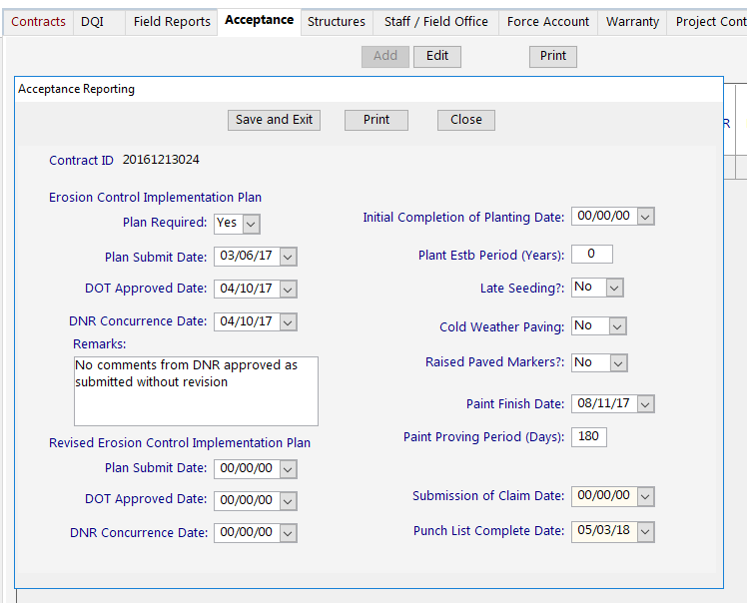
Ongoing Finals Issues
Entering Dates in FIT
Last Day of Painting
Enter 180 days for proving period. ALWAYS!
Punch List Complete Date
Cold Weather/Late Seeding Button

Slide 24
Ongoing Finals Issues
Requesting Conditional Final Acceptance
When punch list is complete
Can include exceptions (WPEDS Permit, Landscaping Proving Periods, etc)
Request with Krissy to send letter.
Spec allows acceptance to be revoked if issues are found

Slide 25
Ongoing Finals Issues
Must transfer contract before submitting final records.
All mail messages must be processed before transferring the contract.
Notes:
We will not start your review until we get your contract.
Major issues if mail messages are not processed before transferring the contract.

Slide 26
Contract Refresh mail needs to be received and processed.
May take up to 30 minutes to receive this message.
Notes:
The Contract Refresh message is being missed.

Slide 27
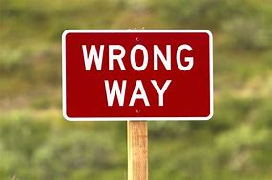
Ongoing Finals Issues
DO NOT change the format of the electronic field files. This makes finding documents easier.
Using ‘Direct Entry’ incorrectly
When source documents exist or measurements taken or when using Mobile Inspector or Mobile Devices
Notes:
Direct Entry is for LS items and Each Items that don’t require measurement. (Removing Structures, Finishing Roadway, etc)
No need to create a pay sheet for these entries.

Slide 28
Ongoing Finals Issues
Example: Mobile Inspector
Directly posting items in the field. If measurements are made directly into the mobile device then the posting/IHD is your source document.
Enter in the ‘Location’ or ‘Station’ fields: STA 1150+25 – 1200+00
Enter the measurements in the ‘Remarks’ field: 15’+28’+36’=79’ Direct Field Measured by initials
If the item is simply verified in the field enter Direct Field Verified by initials
Staff will check it for accuracy and type Checked by initials in the posting Remarks field.
Notes:
MI can change the your source documents. It can eliminate hard copy or handwritten versions.
Cannot call postings ‘Direct Entry’ when measurements have been taken.
Keep the terms separated

Slide 29
Ongoing Finals Issues
3.0+2.5+2.5= 8.0 LF
Direct Field Measured by SPM.
Checked by JRG
Notes:
Example….

Slide 30
Ongoing Finals Issues
Example: Digital spreadsheet from mobile device
If field measurement is made directly into a pantry spreadsheet from a mobile device, this is your source document.
Store file in the Source Documents folder and reference appropriately in the posting. Example: See Electronic Source Document Folder
State in ‘Remarks’ of spreadsheet, Direct Field Measured by initials. This will eliminate questions from finals checkers whether this is the actual source document.
Staff will post the quantity type Posted by initials xx/xx/xx in the spreadsheet ‘Remarks’ field.
After the posting, staff will check math and the posting, type Checked by initials in the spreadsheet ‘Remarks’ field.
NO need to print the spreadsheet at closeout
Notes:
No need to reference the exact computer file path (N:/2017252258….)
Name your word or excel file the bid item and sheet number as you would with a paper document.
All the source documents would be stored under the ‘source documents’ folder.
Cannot call ‘Direct Entry’ when there is a source document.

Slide 31
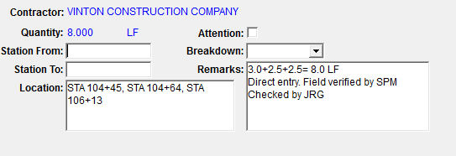
Ongoing Finals Issues
Example:
See Electronic Source Document Folder.

Slide 32
Ongoing Finals Issues
Same rules apply for source documents
Original document (a field book, handwritten spreadsheet, digital file, etc) is the source document and it must be referenced
Notes:
These new options do not change the rules on the original source documents.
Include in IHD binder or reference that original document in the IHD…..just as you have done in the past.
Use simplest method possible. Some bid items work better with different methods.

Slide 33
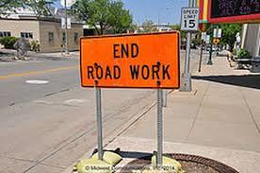
Ongoing Finals Issues
Working Day Contracts
Each day from Construction Start Date to Time Charges Stopped Date
Site times: Working Yes/No, controlling item, hours worked/available
Clearly explain when no time/half day is charged in ‘Reason for Delay’ field (Not ‘Comments’ Field)
Include ‘No Work – Contractors Choice’ in the delay field including weekends.
Completion Date Contracts
Same as above. Helps with
delay claims.
Notes:
Don’t place the delay reason in the Comments field as that field does not print when the Weekly Reports of Time Charges is generated.

Slide 34
Ongoing Finals Issues
Notes:
No column for the comments field.
Fill out site tab for Completion date contracts also

Slide 35
Ongoing Finals Issues
Notes:
This example is filled out for each day with reasoning.
This information is also displayed in the Daily Diary print out which is important for future retention.

Slide 36
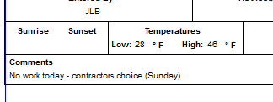
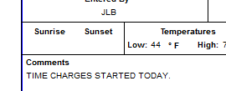
Ongoing Finals Issues
Daily Diary required for every day
No work today – Contractors choice (Saturday), or Holiday Restriction, or Adverse Weather
‘Postings Only’
All critical dates
Place in ALL CAPS
Notes:
Big problem is missing critical dates. We only retain the diary long term so we need them documented.

Slide 37
Ongoing Finals Issues
Daily Diary
Bring IDR comments into Diary before generating
Don’t print IDRs separately or edit within the Diary
‘Environmental Commitments Reviewed’ statement
NOTE: Approved Enviro. Document, TMP, Bid Inquires should be in placed in field files by PM.
Notes:
Don’t delete comments once brought in. Change IDR and merge back with Diary.
Krissy will talk about printing and binding…..

Slide 38
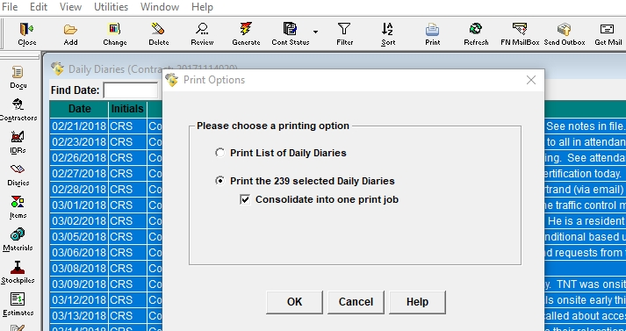
Print & bind earliest to current
No need to sign them
Cover should contain project label and Construction Diary __ of __ label

Slide 39
Ongoing Finals Issues
Staff not checking source document math or quantities
Example: Red check marks with initials, or stating Checked by initials.
Notes:
Either not occurring or not showing evidence of this. This reduced errors and helps save time in the long run.

Slide 40
Ongoing Finals Issues
CADD drawings
Calculations printout needed.
Reference CADD digital file location. (Source document)
Notes:
A lot of computers cannot open the CADD files, so a calculation printout is needed to show math.
That sheet should reference the CADD file location which is the source document.

Slide 41
Rounding Guidance (CMM 2-32)
Be consistent
Don’t change at a later date
Most items are paid 0.1
Notes:
CMM rounding guidance is not all inclusive. If you are getting tickets to 0.01 you can pay to that but be consistent. Don’t change mid project. Most items are paid to the 0.1 but there are exceptions. Don’t round at end. Rounding is meant to help you.

Slide 42
Plan Sheet Revisions
Language for Contract Modification:
The following plan sheets are attached and made part of the plans for this contract:
Revised: 51, 52, 256, and 625.
Added: 250A and 250B.
Make sure Contract Modification Attachments are labeled w/ Contract ID, Cont Mod #, sheet number
Notes:
Language similar to how addendum are written.
Otherwise it may be confusing to say “Remove and Replace Sheet XX” if you are adding and swapping out some pages.
Attachments may also be referenced within a SPV item (Attachments A.1-A.6).

Slide 43
Modifying Method of Measurement
Language for Contract Modification:
Amend subsection 205.4.1 by adding the following:
(12) The engineer may review accuracy of the contract quantity of Excavation Common and perform spot checks and random observations to verify that the contract quantity, as originally drawn or subsequently corrected or revised is in substantial agreement with the quantity of work acceptably completed. The method of measurement will be based on the quantity set forth in the contract without measurement.
Notes:
We don’t have PPQ or Supplemental Agreements anymore, but we can still agree to pay some quantities without field measuring by modifying the method of measurement in a contract modification.
Verify plan quantities with some sort of calculations. Make sure to remove undistributed quantities. Other measurement options in particular spec are still available for additions in the field. Best practice to increase/decrease quantity to reflect changes.
Other common items are Base Aggregate and Concrete Masonry Bridges (very common to say w/in 1%).
Amend subsection 305.4 by adding the following:
(3) The engineer may review accuracy of the contract quantity of Base Aggregate Dense bid items and perform spot checks and random observations to verify that the contract quantity, as originally drawn or subsequently corrected or revised is in substantial agreement with the quantity of work acceptably completed. The method of measurement will be based on the quantity set forth in the contract without measurement.
-------------------------------------------------------------------------------------------------------------------------------
Amend subsection 502.4.2 by adding the following:
(5) The engineer may review accuracy of the contract quantity of Concrete Masonry Bridges and perform spot checks and random observations to verify that the contract quantity, as originally drawn or subsequently corrected or revised is in substantial agreement with the quantity of work acceptably completed. The method of measurement will be based on the quantity set forth in the contract without measurement.

Slide 44
Materials Credits
Language for Contract Modification:
Add the following administrative items to the contract:
Non-Performance of QMP, Item 800.0005
Nonconforming QMP Base Aggregate Gradation, Item 803.0100
Nonconforming Thickness Concrete Pavement, Item 804.6005
Add the following items to the contract:
Concrete Masonry Bridges (Price Reduction – Nonconforming Material – Slump), Item 502.0100
Concrete Sidewalk 4-Inch (Nonconforming Material – Curing), Item 602.0405
Nonconforming Material - Granular Backfill for Storm Sewer, Item SPV.0055.XX

Slide 45
ITEM DESCRIPTION ITEM UNIT QTY UNIT TOTAL
NUMBER PRICE AMOUNT
CONCRETE PAVEMENT 10-INCH 415.0100 SY -42.67 13.07 -557.70
(PRICE REDUCTION –
NONCONFORMING MATERIAL –
AIR CONTENT)
Reason: SS – During slip-formed concrete pavement operations on 9/14/18, the random QC test for sublot 2-1 at Station 211+91 had an air content of 4.6% which is outside the allowable limits per standard spec 501.3.2.4.2 (7% +/- 1.5%). Because the concrete was being delivered in dump trucks the concrete had already been incorporated in the work prior to the nonconforming test results and it was impossible to add air entrainment to the concrete on site. An engineer directed test was conducted at Station 211+75 with a conforming test result of 5.9%. The nonconforming pavement will be allowed to remain in place in accordance with standard spec 106.5(2)2 with a 30% price reduction for air content 0.6% to 1.0% below spec as recommended in CMM 8-10.5.1.2.
Nonconforming qty = 16’ x 24’ lane width = 384 SF = 42.67 SY
Unit price reduction = 0.30 x $43.55/SY = $13.07/SY
Total Credit = $13.07/SY x 42.67 SY = $557.70
Notes:
Show the each step of the calculation so that rounding doesn’t become an issue.
The last few examples of contract modification language will be added to Pantry.

Slide 46
Contract Changes/Disputes
Treat every dispute as a claim
Entitlement
Impact
Cost
Document appropriately
Follow notice timelines in section 104
Notes:
Claims often revolve around delays so understanding project schedules and production rates is important.

Slide 47
Contract Change/Dispute Exercise

Slide 48
Change/Dispute #1: The DOT sends the contractor a letter indicating that the final estimated quantity of hot mix asphalt (HMA) paving is 26,000 tons instead of the 20,000 tons indicated in the bid schedule. The contractor’s request for payment for this change will be based on what contract clause? Same question for a final quantity reduced from 20,000 tons to 14,000 tons? How will the clause be applied to each change?

Slide 49
Change/Dispute #2: The DOT provides direction that the contractor will not be allowed to work within the ordinary high water (OHW) limits until all equipment is diapered and contains booms and clean-up materials in the event of operating fluid leakage as per the NPDES permit (which was not received until after the project was bid but before it was awarded). If the contractor requests payment for this direction, which clause would it be based on?

Slide 50
Change /Dispute #3: The DOT contract plans indicate that the drilled shaft construction should be able to proceed with limited water entering the shaft holes based on hydraulic monitoring. During shaft construction, the contractor runs into large volumes of water that necessitates the use of temporary casings to prevent the hole from caving in. The contractor’s request for additional compensation is based on what contract clause?

Slide 51
Change/Dispute #4: After a large, multi-vehicle fatal accident in the workzone on Tuesday (not the contractor’s responsibility), the DOT Resident Engineer shuts down all contract operations except for traffic control for the remainder of the week to allow OSHA inspectors and law enforcement officers to work the scene as part of a criminal investigation. Contractor believes additional contract time is warranted and additional compensation for the dedicated traffic control operations is due, what contract clause is used to request additional time and money?

Slide 52
Change/Dispute #5: The original DOT contract drawings for an urban area include curb inlets with a horizontal metal grate. After local bicyclists realize the grates represent a hazard to them, they protest to the DOT. A decision is made to change the horizontal grate inlets to a face-opening only inlet that will eliminate the bicycle hazard. Since only a few inlets have been installed, the amount of re-work is minimal. New drawings are provided to the contractor as well as a request for a price for the new inlet types. The contractor’s response to the drawings and the revised inlet pricing is based on what contract clause?

Slide 53
Change/Dispute #6: From the previous drilled shaft example, the contract documents indicate the contractor should expect to see shaft excavations filled with water. When the contractor does this work during an unusually warm and dry summer, the excavations are dry and the contractor avoids using either temporary steel casings or shaft slurry. If the DOT Resident Engineer believes that a credit might be due, what contract clause would he/she use to make such a contention? Is this an allowable use of the contract claim?

Slide 54
Change/Dispute #7: While excavating for a storm drain line, the contractor encounters what appears to be an underground storage tank surrounded by dark black soil. The inspector directs that all work stop in the area until the environmental consultant can mobilize to the site with a hazmat team to determine how to proceed. If the contractor believes additional compensation is due, what contract clause would he/she use to assert such entitlement? What contract clause would be used if a critical delay occurred?

Slide 55
Change/Dispute #8: The DOT sends a memo to the contractor directing that all paving operations be performed at night when the contractor has clearly indicated intent to pave during daylight hours as they are allowed by the Traffic Control special provision included in the contract. The contractor’s dispute with this direction and request for additional compensation is based on what contract clause?

Slide 56
Change/Dispute #9: While attempting to construct the cast-in-place concrete diaphragms at an interior bent, the contractor realizes that there is not enough room to form the diaphragms as shown in the contract plans. Furthermore, it is impossible to pre-construct the forms and lower them into place due to the fit around the individual girders. Also, even if the diaphragms could be formed, it would be impossible to strip the forms once the concrete has cured. The contractor requests clarification and guidance and puts the inspector on notice that this appears to be a constructability issue. What implicit concept or explicit clause will likely apply to this situation?

Slide 57
Change/Dispute #10: The lead inspector appears to be having personality issues with the contractor’s foreman. Recently during a concrete deck pour, the inspector waited until the first load of concrete was tested, accepted and ready to go into the pump truck before pointing out to the foreman that the specification requires 100% ties at all rebar intersections in the top mat and 50% ties in the bottom mat, and demands that all deficiencies are corrected before the deck pour proceeds. Over the foreman’s strenuous objections since there was a deck dry run the previous day that the inspector attended, the foreman sends away the first truck, calls up the plant and has them delay the next several loads for an hour and has his crew tie up the isolated areas that are not tied correctly. If the contractor believes that he/she is entitled to consideration for this incident, what reason might be cited?

Slide 58
Notes:
Experience affects contract interpretation.

Slide 59
Questions?

