Slide 1
Material World
Leslie Ashauer, PE
NE Region Materials Engineer
2019 Northeast Region Construction Training
NWTC, Green Bay, WI
March 6, 2019

Slide 2
Base Aggregates
Unique Identifier Number for Each Pit & Quarry
Approved Products List → Aggregate Report
QMP Base Aggregates – SS 730
DON’T FORGET: Contact BAD IA with placement schedule

Slide 3
Concrete Aggregate Testing
SS 701.3.3.2 QV Testing
The department will conduct a minimum of 1 verification test for each 5 contractor QC tests unless specific QMP provisions specify otherwise.
Concrete Aggregate Testing: 1 QV per 5 QC
Contractor tests aggregate during aggregate production
QV will test aggregate during concrete production

Slide 4
Concrete Class I
QV Test Result Notification – SS 715.3.1.3(2)
Report to contractor within 2 business days of sampling

Slide 5
Concrete Pavement
SS 715.2.3.1(6) SAM Number
New mix designs need to include SAM number with mix design submittal.
SAM Testing
QC required to test once per lot
SAM test entered into MRS

Slide 6
HMA Ignition Oven Correction Factor
1st Day of Production Sample
Mix Designs Prior to 12/1/2018
Provide to Region, Tested by BTS
Lab Batched Mix Sample
Mix Designs after 12/1/2018
Provide to Region 10 days prior to production

Slide 7
Asphalt Content
Department Will Test Asphalt Content
Acceptable content is within -0.3% of JMF
AC more than -0.5% below JMF – contact PM, ME & HMA IA for resolution

Slide 8
IRI Ride
SS 740
Provide As Much Notice As Possible – PLEASE!
Coordinate with Kim Heise

Slide 9
Nulcear Density Testing
Test Duration & Gauge Placement

Slide 10
Nuclear Density Random Numbers
Project Staff Determines Density Randoms
Provide QV Density Random Numbers to Appropriate IA

Slide 11
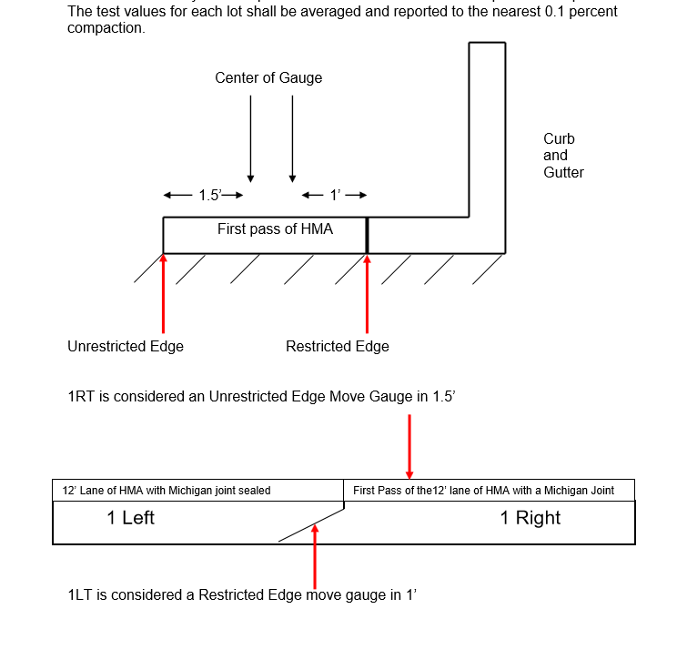
Longitudinal Joint Density
Confined? Unconfined?
Notes:
Pave Wider & Mill Out Later – Unconfined
No Cost to the Department (milling and extra material)
Qty of Extra Material is Calculated
Test at location according to CL NOT, the unconfined edge

Slide 12
MRS Entry
Contractor Must Enter ALL Contractual Tests
Structures
Pavement
PCC Thickness
HMA
IRI Ride
Soils & Aggregates

Slide 13
Documentation
NEW 2019 Process
Material Archive
Material documentation retained in long-term storage for future reference
Materials Project Records
Material documentation to be retained with the construction project records

Slide 14
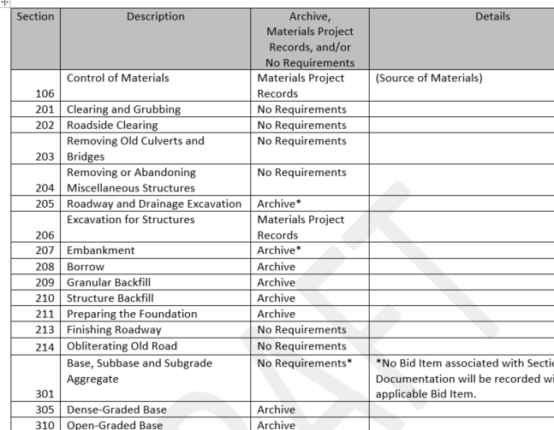
Proposed CMM 8-45 Table
Material User Group is updating CMM 8-45 and applicable sections to define the new department process for material finals.

Slide 15
E-Guide
Committee Rewriting ALL E-Guides
Anticipated end of March for update
Follow proposed documentation process

Slide 16
Certification of Materials – DT1310
Rewrite of CMM 8-45: May 2019
Non-Conforming Materials
Non-Performance of QMP (QC & QV)
Buy America Exemption
2019 Construction: DISINCENTIVES

Slide 17
Non-Performance / Nonconformance
Credit Consistency
Credits ≥ $5,000
Reviewed by Region / BPD / BTS
Credits < $5,000
Reviewed by Region
Notes:
33 Columns of information to enter

Slide 18
Credit Consistency
Submit Log of Credits Annually
Review for Commonalities
Contractor
Tester
Spec Issues

Slide 19
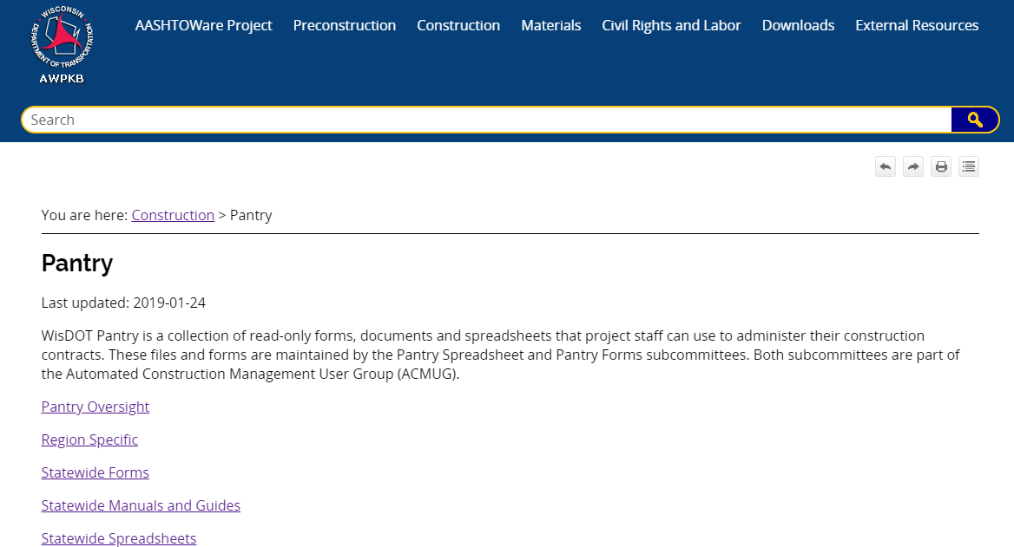
Pantry
Online

Slide 20
