Slide 1
WisDOT NE Region 2019 Construction Conference
Tim Borowski
Bureau of Structures
March 6, 2019
Notes:
Before
Be well prepared with content. Know facts and figures and your audience.
Everyone should be able to read the slides but if NOT, read it to them. Otherwise don’t include it.
Do a final check on microphone and other equipment well before the start time.
Practice the presentation aloud several times. Feel comfortable.
Drink fluids and do something to relax you.
During presentation
Smile and be confident.
Introduce yourself and the organization.
Speak with energy, clearly, and in a reasonable volume so everyone can hear you.
Do not read each line on the slide show – use your own wording and add in examples or additional information which will aid in comprehension.
Talk “friendly” and with the attitude that you are here to provide information and assistance. Have a “win/win” attitude.
If you make an error, politely clarify or correct it. Move on quickly and don’t dwell on it.
If you can’t answer a question, politely indicate you don’t have the information available. Indicate that you will follow-up individually with the requestor.
After presentation
Be available for follow up.
Be prepared for additional comments, questions or clarifications.
Maintain composure.
If you make a promise, be sure to follow up quickly or reassign if appropriate.

Slide 2
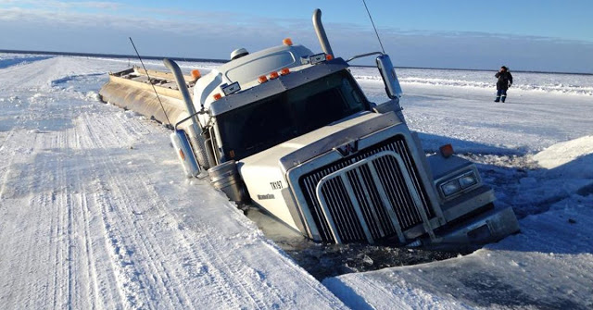

Slide 3
Structures Agenda
Contacting BOS – When & Why
Specification and Manual Updates
Structures Construction Issues
Ancillary (Wind Loaded) Structure Issues

Slide 4
Structures Agenda
Contacting BOS – When & Why
Specification and Manual Updates
Structures Construction Issues
Ancillary (Wind Loaded) Structure Issues

Slide 5
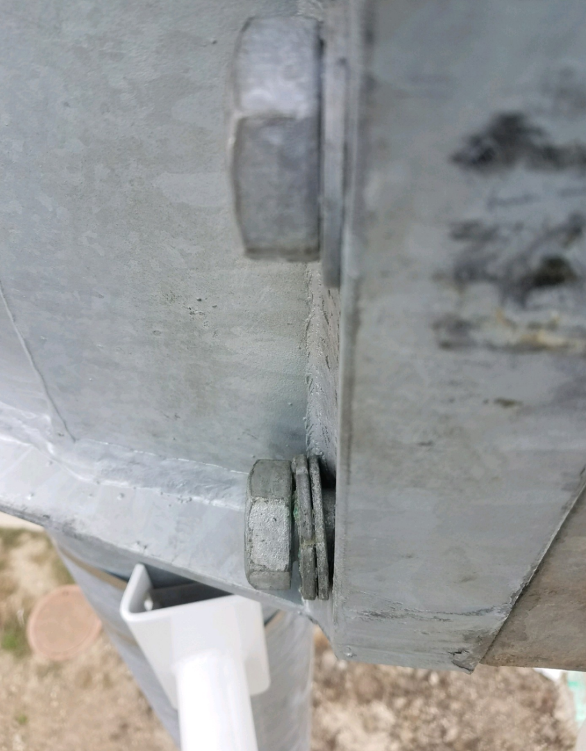
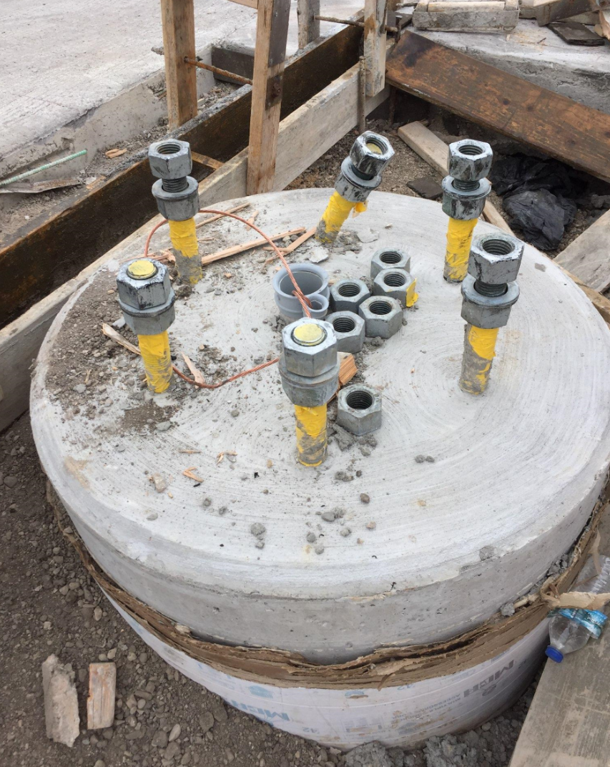
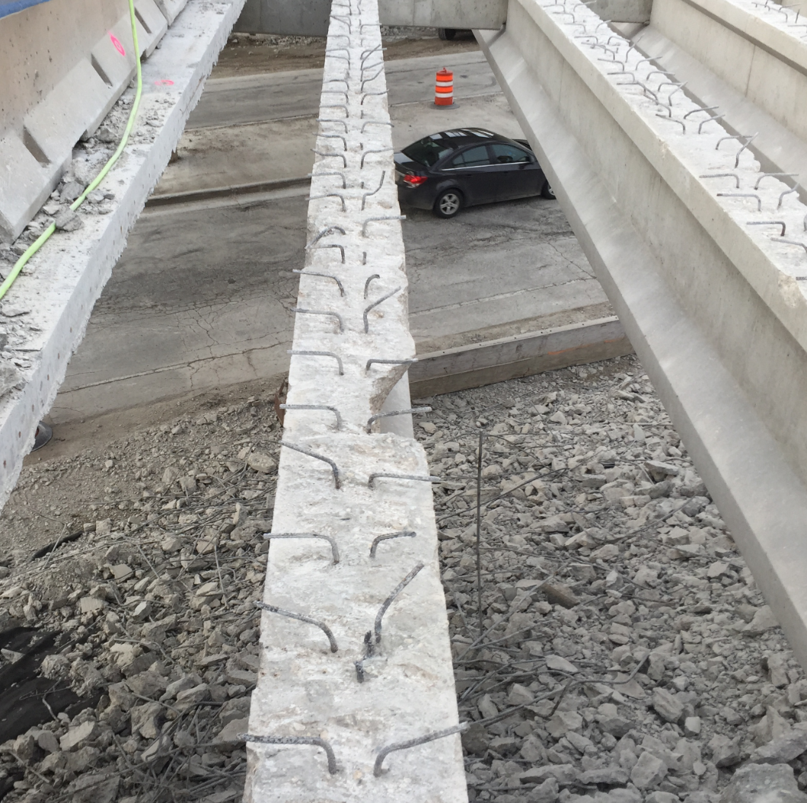
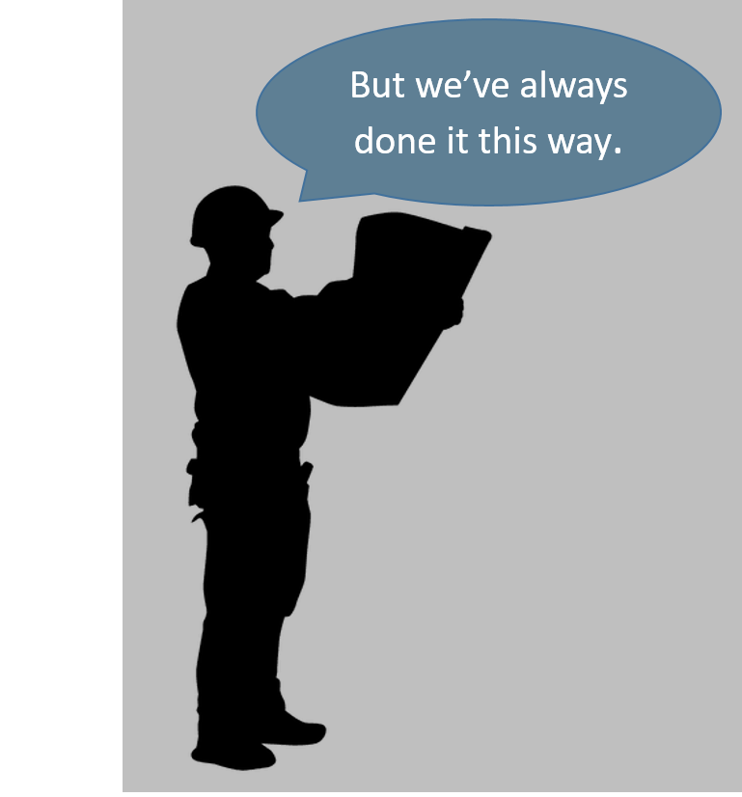
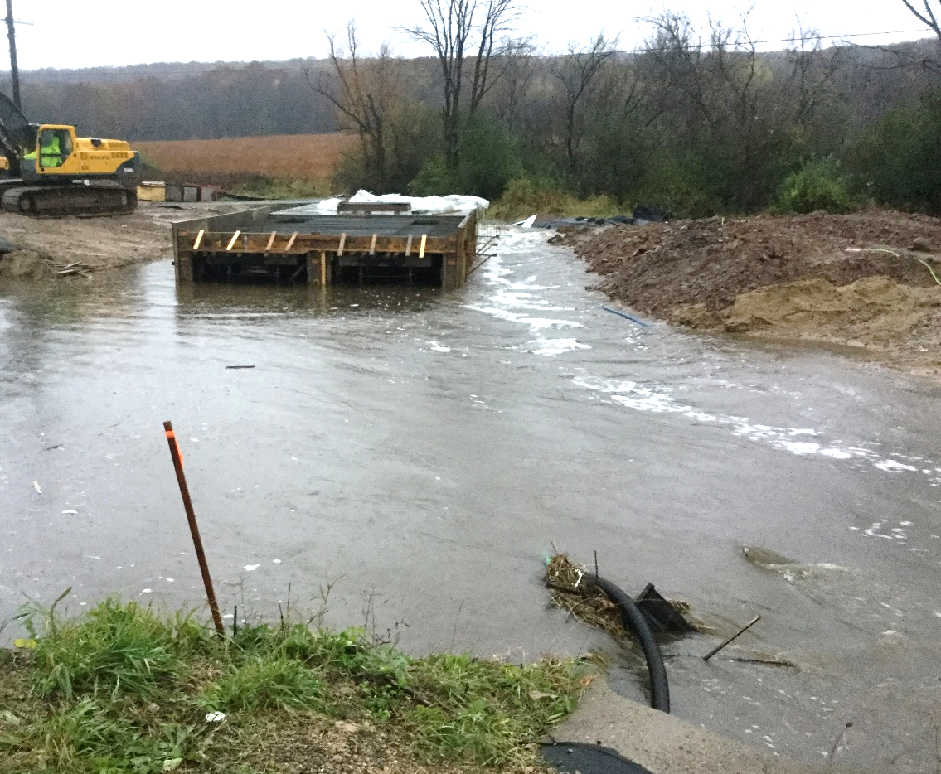
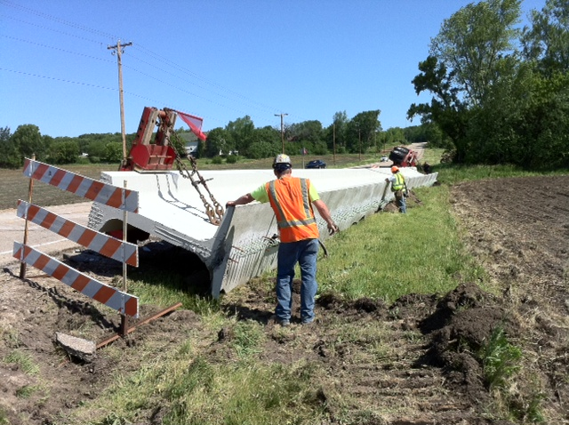
Contacting BOS – When & Why
Anything “structural”
  excessive construction loads
  structural capacity
  pile locations, etc.
If in doubt, call us!
  See Structures Contacts Handout
Bureau of Structures Contacts-General.doc
Notes:
If there is one thing that I would like for you to take away from my presentation here today, I hope that you know that BOS is able, available, and willing to answer any questions that you may have during the construction of your projects.
Any item that you may think involves structural aspects that you are not 100% comfortable answering, please don’t hesitate to contact us.
I have attached a contact list to this presentation for a reference on who to contact and for what situations.
One other reminder– is to push for contractor staff to work through the Region or Consultant construction staff for inquiries. Historically, the contractors have come directly through BOS and we have asked that they go back through project staff.

Slide 6
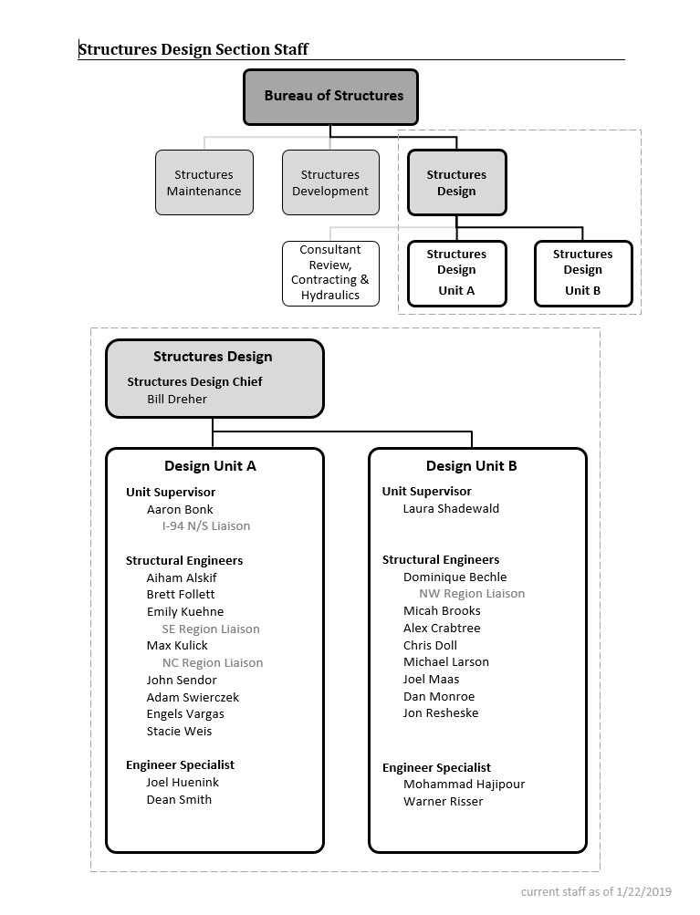
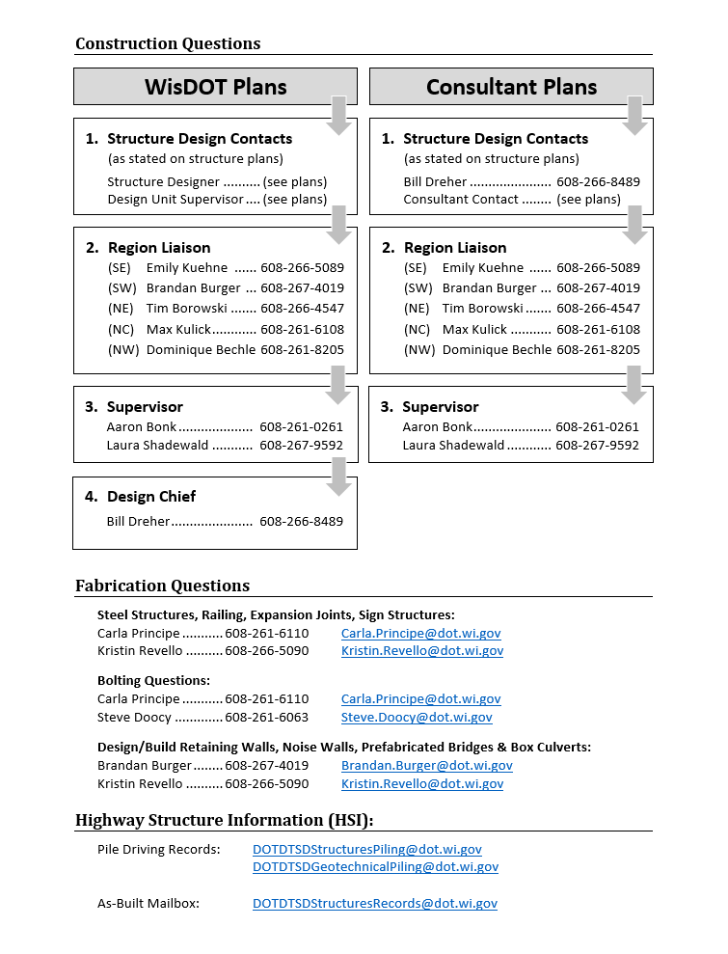
Contacting BOS – When & Why
Notes:
If there is one thing that I would like for you to take away from my presentation here today, I hope that you know that BOS is able, available, and willing to answer any questions that you may have during the construction of your projects.
Any item that you may think involves structural aspects that you are not 100% comfortable answering, please don’t hesitate to contact us.
I have attached a contact list to this presentation for a reference on who to contact and for what situations.
One other reminder– is to push for contractor staff to work through the Region or Consultant construction staff for inquiries. Historically, the contractors have come directly through BOS and we have asked that they go back through project staff.

Slide 7
Structures Agenda
Contacting BOS – When & Why
Specification and Manual Updates
Structures Construction Issues
Ancillary (Wind Loaded) Structure Issues

Slide 8
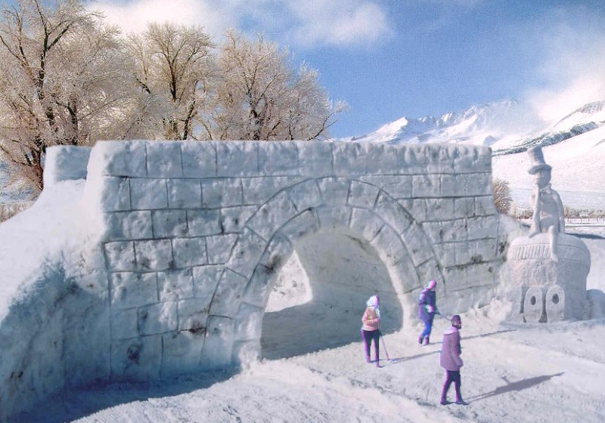

Slide 9
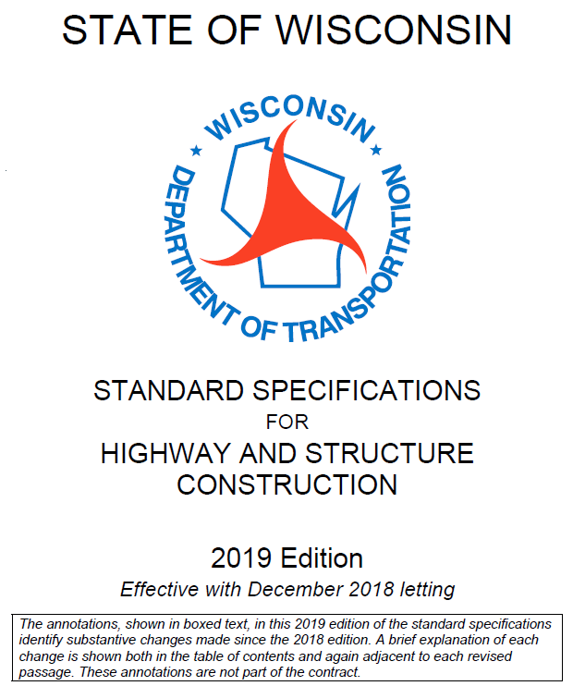
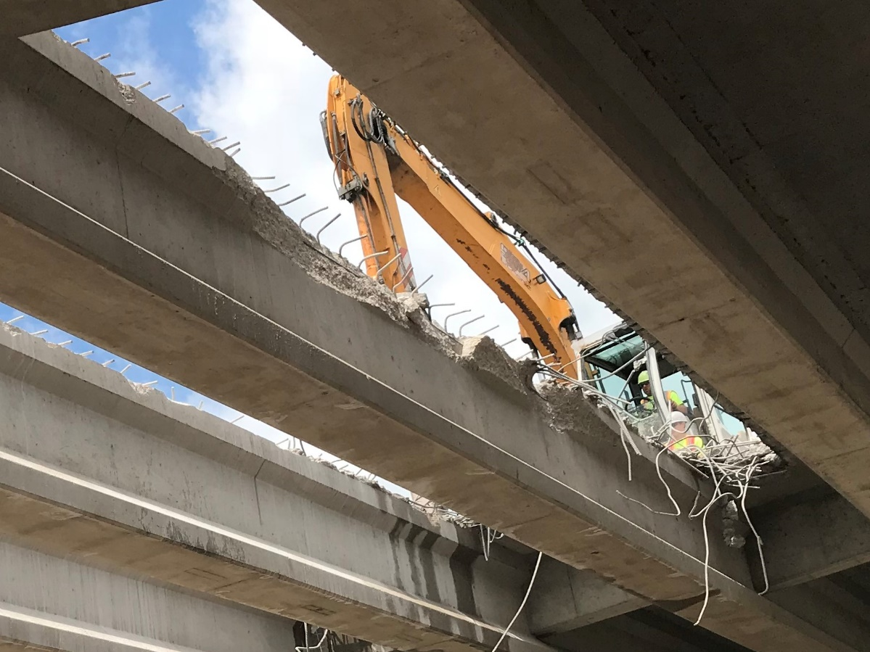
Standard Spec Updates
Assessment and approval for restoration of contractor-caused damage done during deck removal
Costs associated with contractor-caused damage are incidental
Notes:
Revise 203.3.2.2 to require department assessment of and written approval for restoration of contractor-caused damage done during deck removal. This change was implemented in ASP 6 effective with the December 2017 letting.
After deck removal is complete, notify the engineer to request a damage survey. Point out damage to the engineer. Allow 1 business day for the engineer to complete the damage survey. If damage is identified, the department will determine if repairs or girder restoration will be allowed.
Revise 203.5.1(2) to clarify that all costs associated with contractor-caused damage are incidental. This change was implemented in ASP 6 effective with the December 2017 letting.

Slide 10
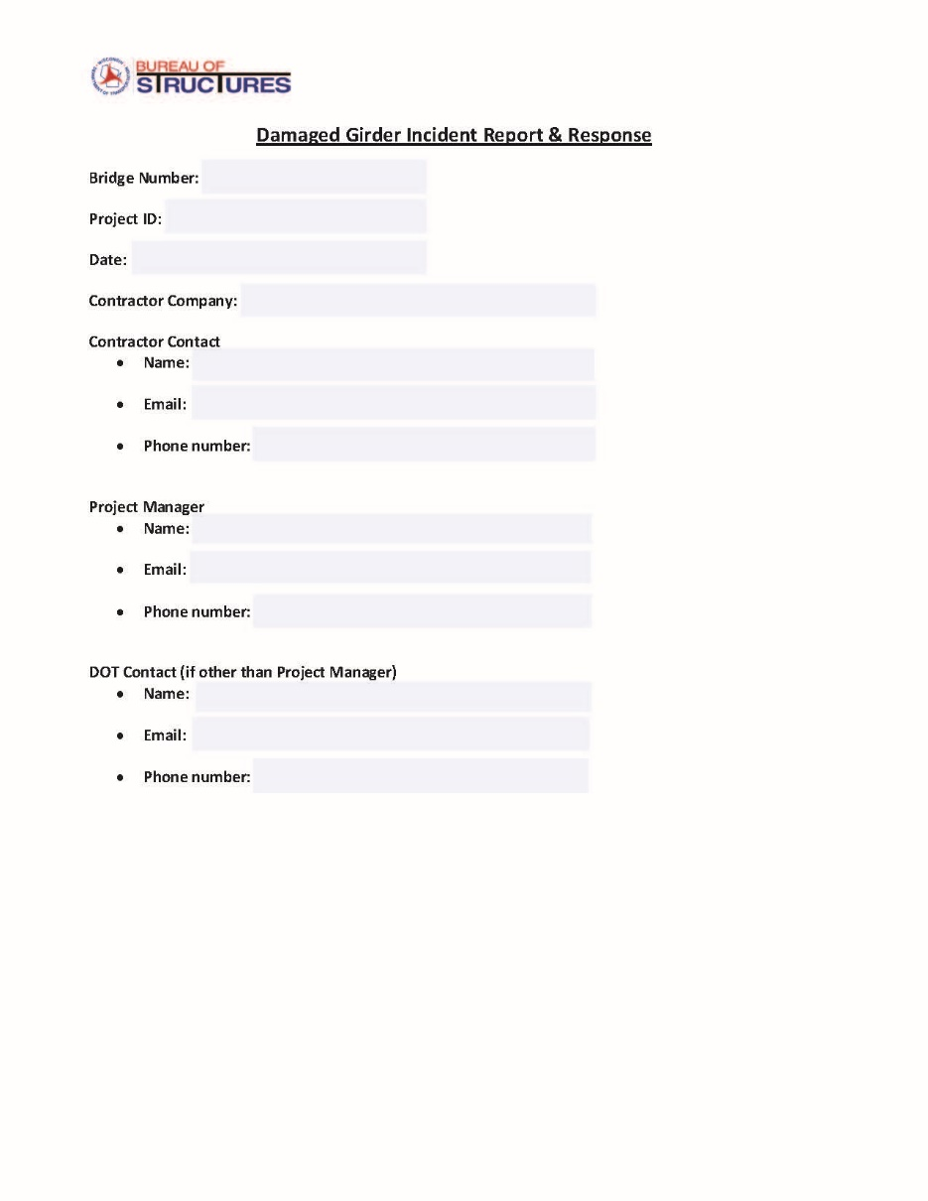
Girder Damage (Steel and Prestressed)
After deck removal, inspect girders for damage
Alert BOS if damage is found
BOS will provide a form for contractor to complete
  Provides pertinent info to BOS
  Contractor proposes remedy
BOS will review and provide acceptance/feedback
Notes:
Contact BOS when steel or prestressed girder damage is found after deck removals. BOS will send this form to inspection staff for contractor to complete and document damage locations and severity, and detail what their proposed fixes are. BOS will review and provide comments or acceptance. This helps us document historical information for the bridge, and provides consistency statewide with what girders are fixed and what are replaced.

Slide 11
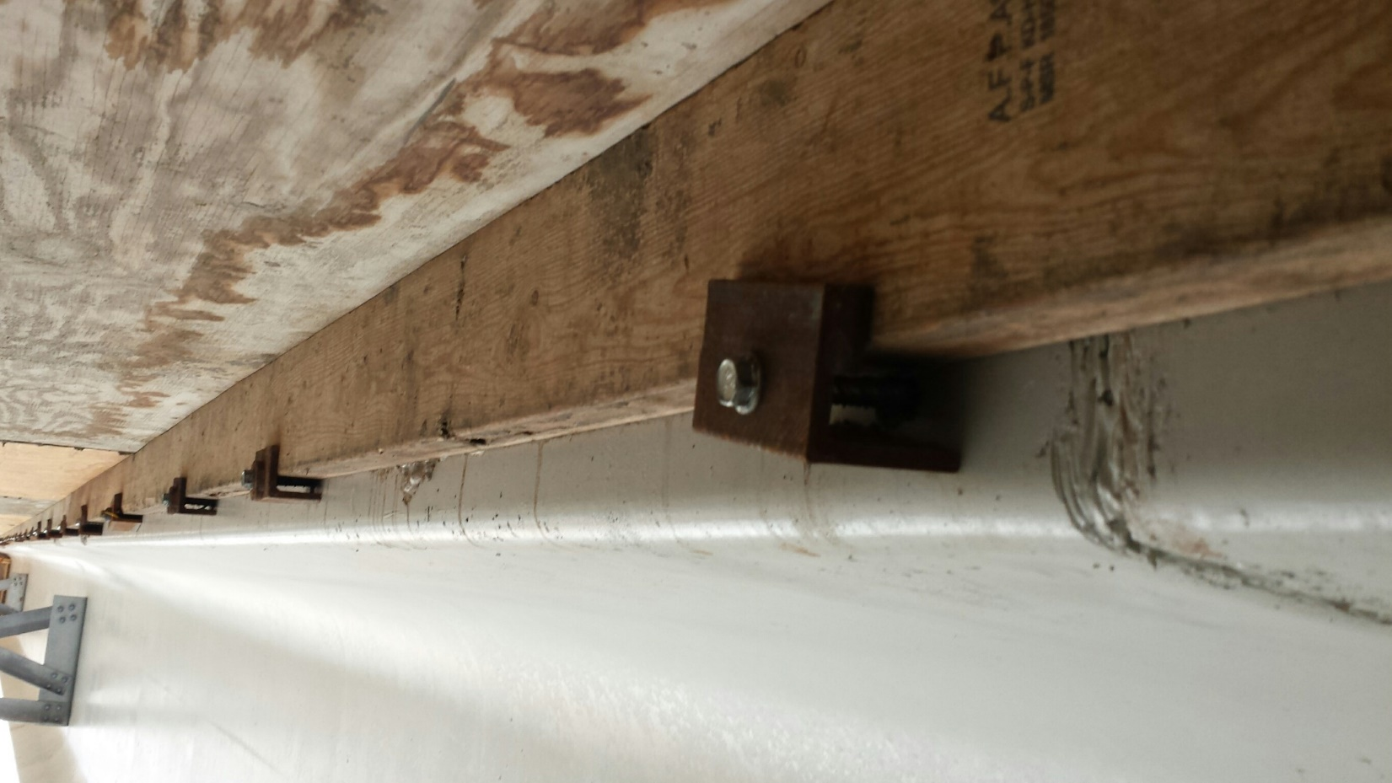
Standard Spec Updates
Fill voids created for prestressed girder transport, erection, or deck forming
Notes:
Add 503.3.3.4(5) to specify filling voids created for transport, erection, or deck forming.
Fill with an engineer-approved non-shrink grout
For voids with a surface opening greater than 2 inches in diameter, dry and uniformly coat void surfaces with an epoxy bonding agent

Slide 12
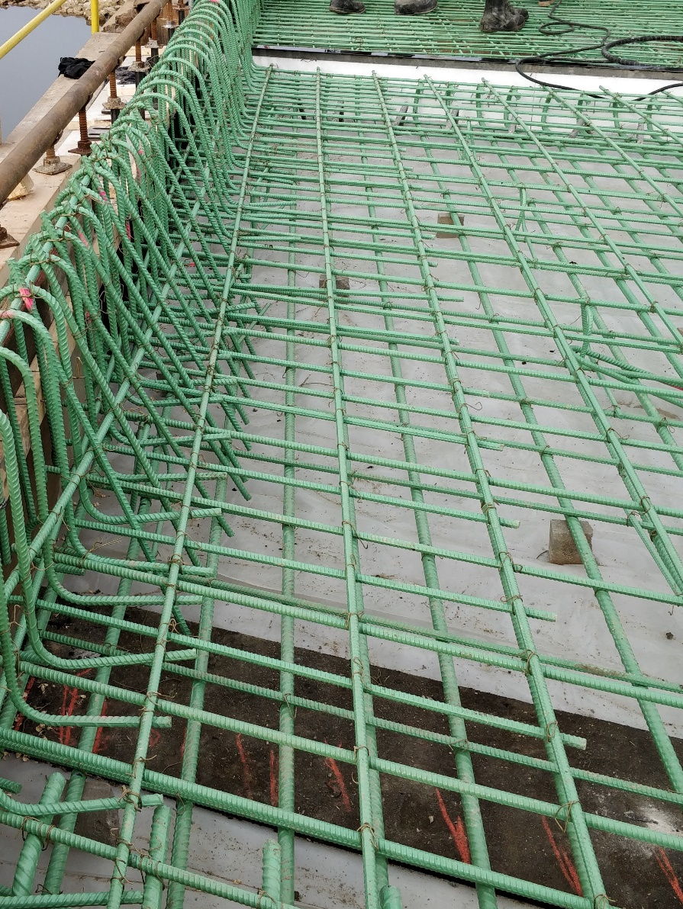
Standard Spec Updates
Cumulative exposure to sunlight for epoxy coated rebar is limited to 2 months
Notes:
Cover epoxy-coated bars in storage, or placed in a bridge deck mat, with an opaque engineer approved material to prevent cumulative exposure to sunlight for more than 2 months before being embedded in concrete. Include portions of partially embedded bars left exposed between construction stages.
The total maximum exposure is 60 days; should be covered as soon as possible if concrete embedment is not expected within 60 days.

Slide 13

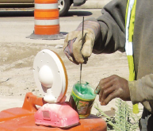
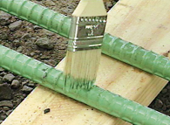
Standard Spec Reminder
Furnish a two-part epoxy resin for field repairs and patching – not spray.
Notes:
505.2.4.2(2) specifies a two-part epoxy resin for field repairs and patching of rebar. This spec was effective with the December 2015 letting, yet common field practice is still a one-part spray.
Use care to avoid getting the resin on concrete as it acts as a bond-breaker.

Slide 14
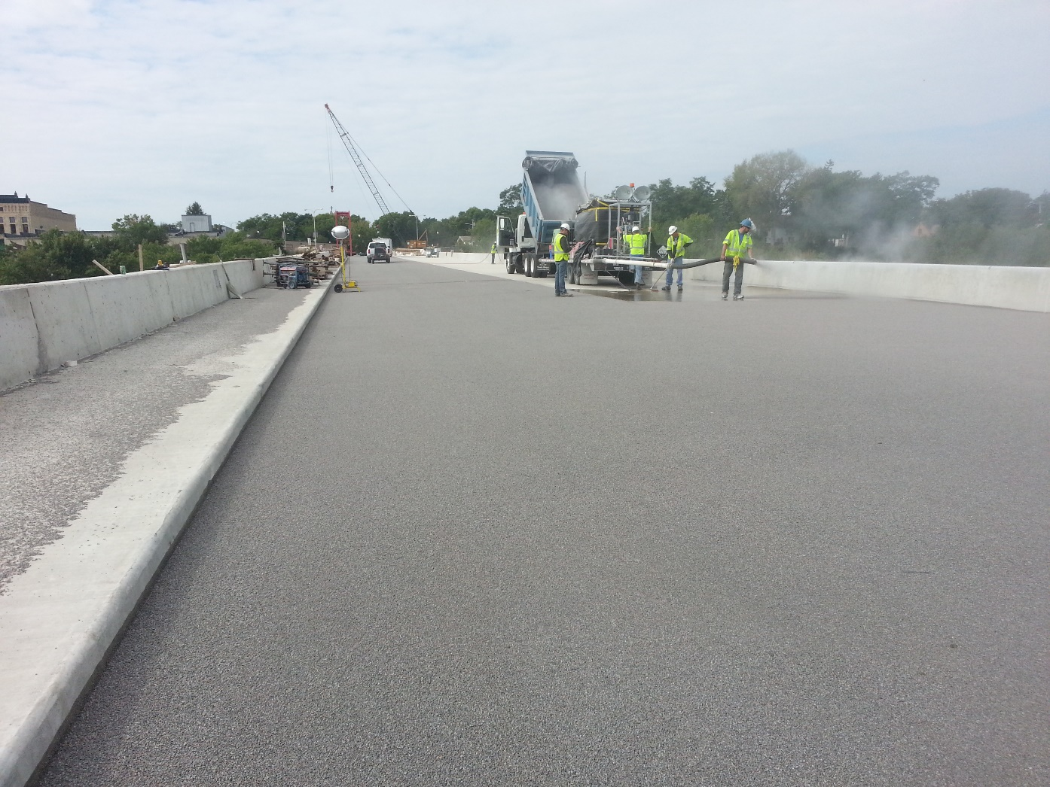
Standard Spec Updates
Do not remove polymer overlay materials in areas receiving pavement marking. Use only epoxy pavement marking where the contract requires marking placed on polymer overlays.
Notes:
Revise 646.3.1.1(1) to reinstate language that prohibits removing polymer overlay material to place pavement marking.
Use only epoxy pavement marking where the contract requires marking placed on polymer overlays.
This change was implemented in ASP 6 effective with the December 2017 letting.

Slide 15
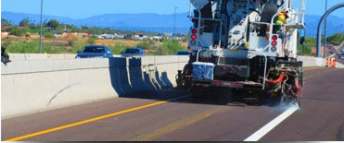
Standard Spec Updates
Mask over pavement marking when resealing bridge decks
Notes:
Revise 646.3.1.1(5) to require masking over pavement marking when resealing bridge decks. This change was implemented in ASP 6 effective with the December 2017 letting.
After newly applied pavement marking can sustain exposure to traffic, cover marking with a system that will not degrade the marking's retroreflectivity and re-apply clear protective surface treatment to deck where removed during marking surface preparation. Seal exposed concrete including grooves for tape.

Slide 16
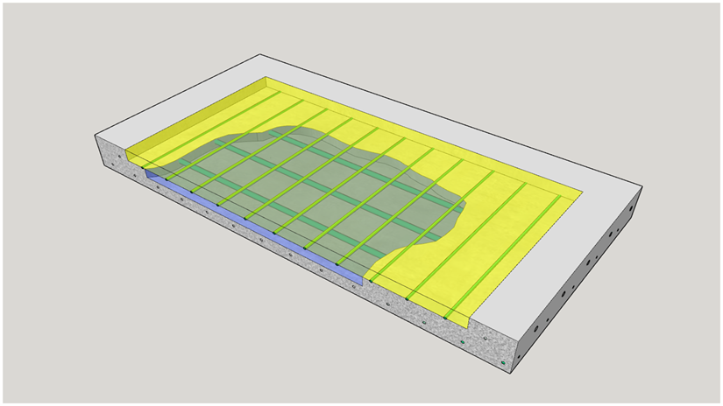
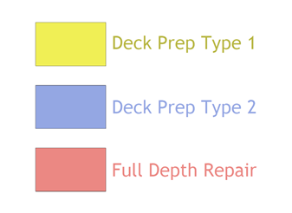
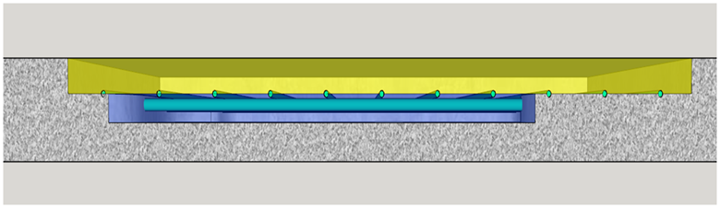
Standard Spec Reminder
Preparation Decks Type 1, Type 2, Full-Depth Deck Repair
  Do not subtract areas of type 2 removal from areas of type 1 removal.
Notes:
Standard Spec 509:
Under the Preparation Decks Type 1 bid item, remove existing asphaltic patching and unsound bridge deck concrete only to a depth that exposes 1/2 of the peripheral area of the top or bottom bar steel in the top mat of reinforcement.
Under the Preparation Decks Type 2 bid item, remove existing unsound bridge deck concrete below the limit of the type 1 removal described above. One inch below the bottom of the top or bottom bar steel in the top mat of reinforcement is the minimum depth of type 2 removal. The engineer will direct any further removal.
Use air chippers or breakers that weigh no more than 35 pounds and are equipped with flat, chisel-type points with a cutting edge not less than 3/4 inch or greater than 3 inches wide.
After reaching the top of the reinforcing steel, do not use hammers heavier than 15 pounds within one inch of the steel.
Repair damage to existing epoxy-coated reinforcement remaining in place that is either uncovered by or damaged by the contractor's operations.
If damage occurs to anything designated for re-use in the new work, the contractor must repair, or replace it at no expense to the department.
The contractor must blast clean, realign, and retie the existing reinforcing steel to be re-used, as the engineer considers necessary.

Slide 17
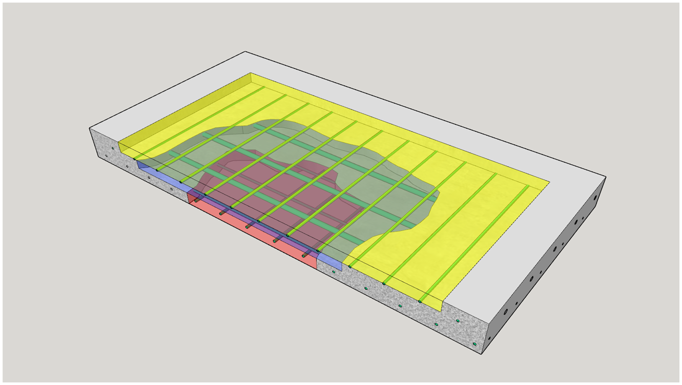
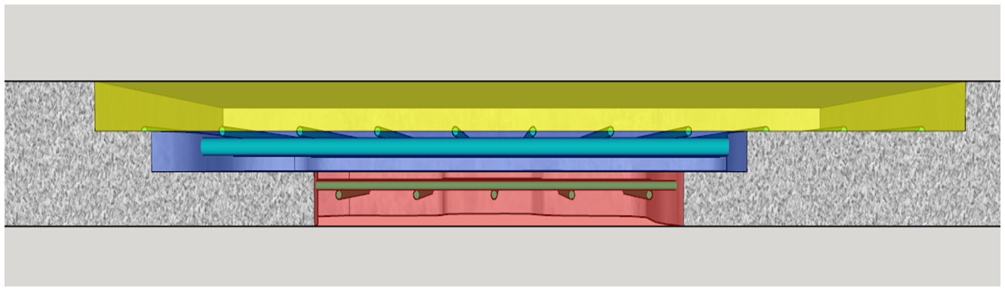
Standard Spec Reminder
Preparation Decks Type 1, Type 2, Full-Depth Deck Repair
  Do not subtract areas of full-depth deck repair from the areas of the type 1 or type 2 removals if the engineer directs full-depth deck repair after type 1 or type 2 deck removals are underway.
Notes:
509.3.8:
If damage occurs to anything designated for re-use in the new work, the contractor must repair, or replace it at no expense to the department.
The contractor must blast clean, realign, and retie the existing reinforcing steel to be re-used, as the engineer considers necessary.

Slide 18
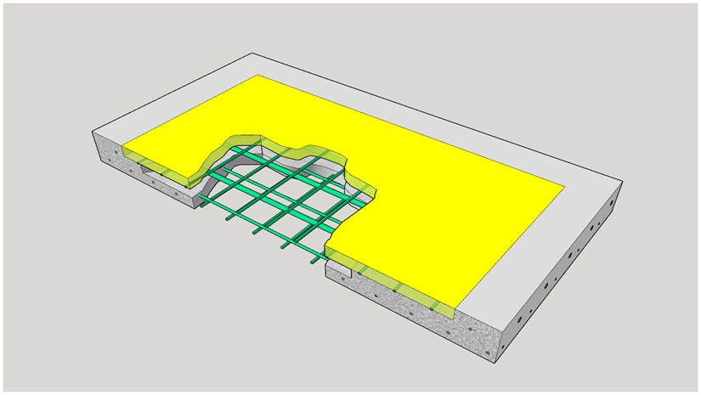
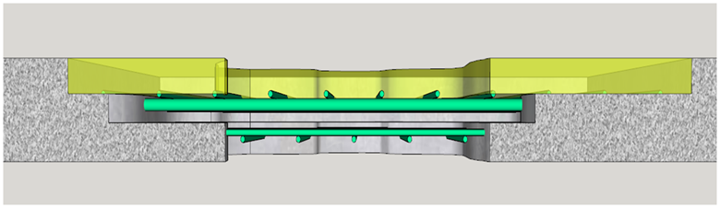
Standard Spec Reminder
Preparation Decks Type 1, Type 2, Full-Depth Deck Repair
  Subtract areas of full-depth deck repair from the areas of the type 1 or type 2 removals if the engineer directs fill-depth deck repair before beginning the type 1 or type 2 deck removals.

Slide 19
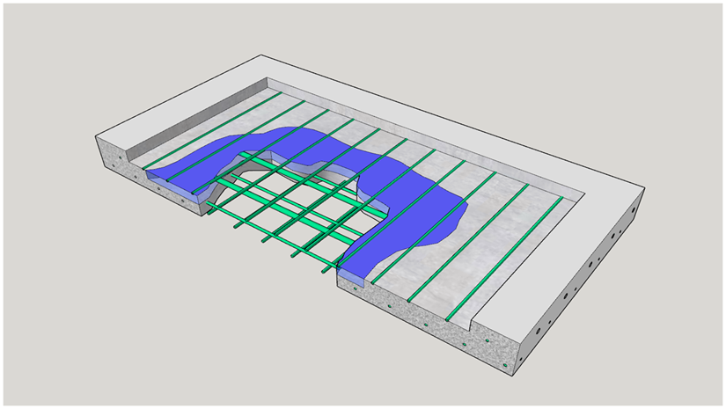
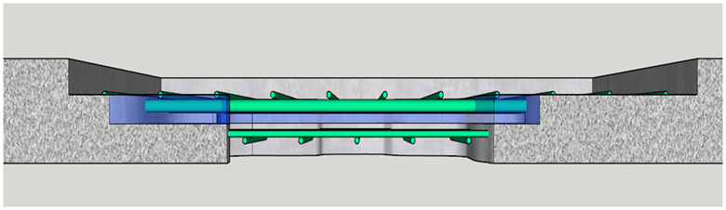
Standard Spec Reminder
Preparation Decks Type 1, Type 2, Full-Depth Deck Repair
  Subtract areas of full-depth deck repair from the areas of the type 1 or type 2 removals if the engineer directs fill-depth deck repair before beginning the type 1 or type 2 deck removals.

Slide 20
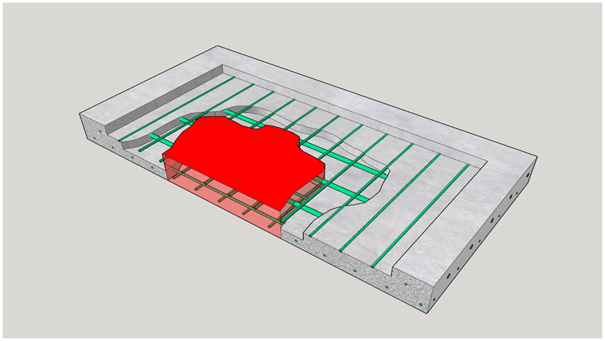
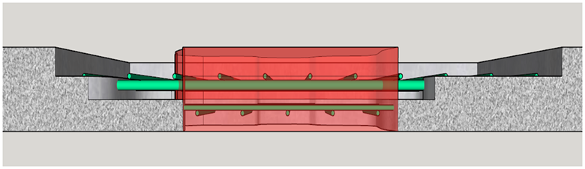
Standard Spec Reminder
Preparation Decks Type 1, Type 2, Full-Depth Deck Repair
  Subtract areas of full-depth deck repair from the areas of the type 1 or type 2 removals if the engineer directs full-depth deck repair before beginning the type 1 or type 2 deck removals.

Slide 21
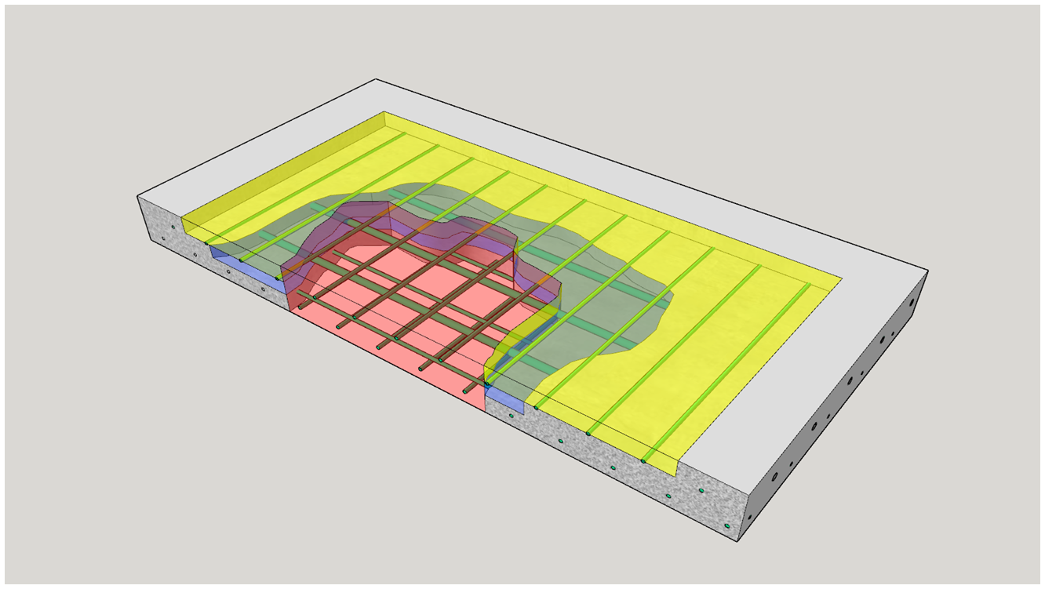
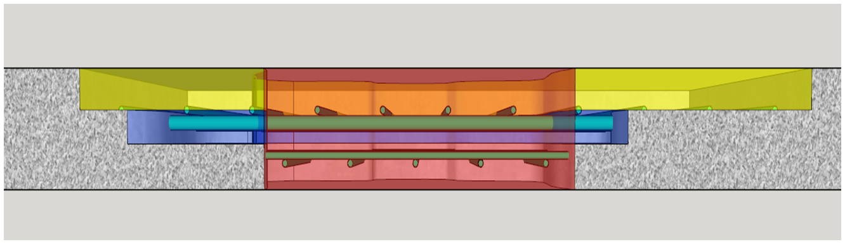
Standard Spec Reminder
Preparation Decks Type 1, Type 2, Full-Depth Deck Repair
  Subtract areas of full-depth deck repair from the areas of the type 1 or type 2 removals if the engineer directs fill-depth deck repair before beginning the type 1 or type 2 deck removals.

Slide 22
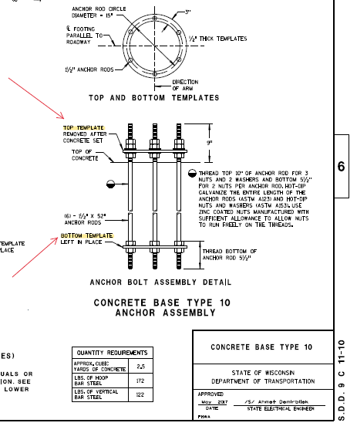
Standard Spec Updates
Top and bottom templates are required for anchor rod assemblies used with type 10 and 13 bases
Notes:
Revise 654.2(4) to include top and bottom templates for anchor rod assemblies used with type 10 and 13 bases.

Slide 23
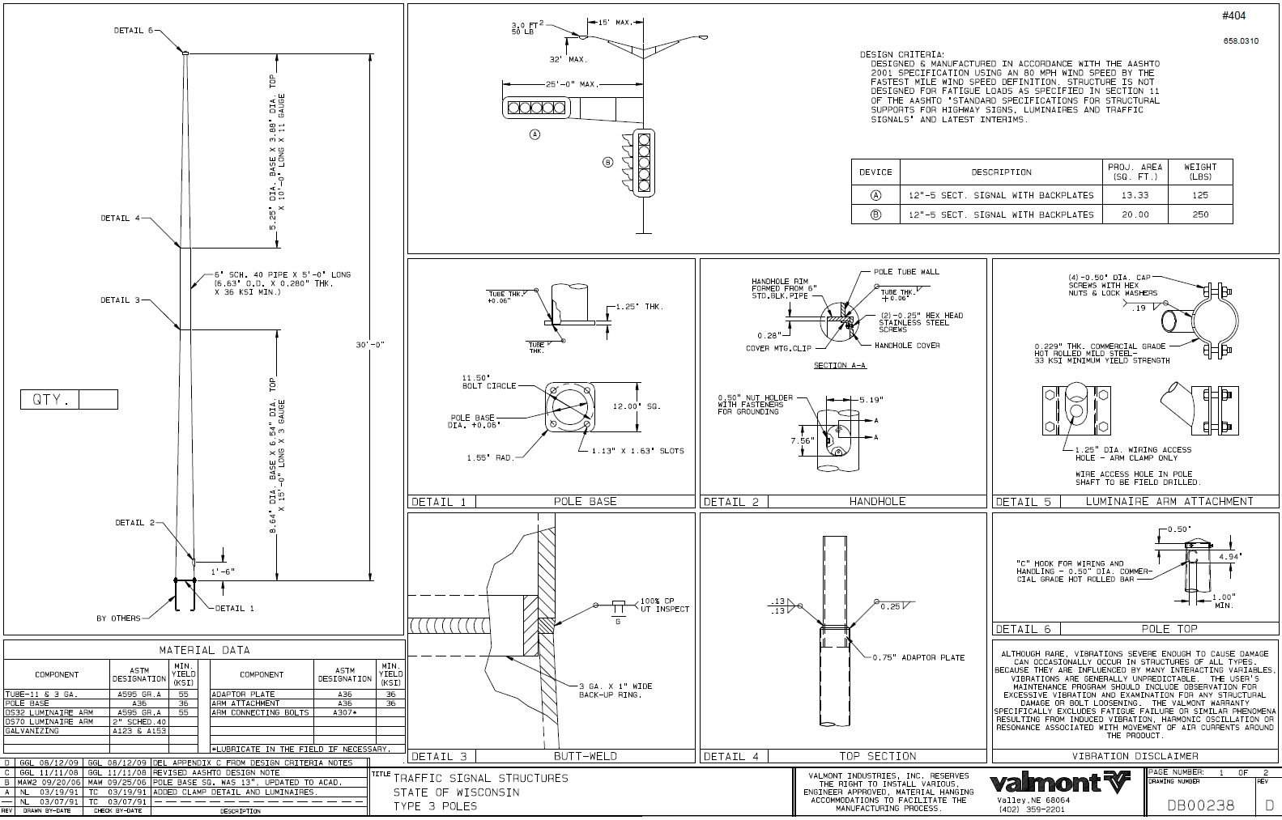
Standard Spec Updates
Contractor furnishes monotube poles and arms
Notes:
Revise 657.2 to require contractor furnished monotube poles and arms from a manufacturer on the department's QPL
Revise 657.5 to change install bid items to contractor-provided for poles, monotube arms, and steel luminaire arms.

Slide 24
Standard Spec Updates
Fabrication Requirement Changes
Key changes Include:
Required use of the WisDOT Fabrication Library for all fabrication document submittals
4 new Contractor Certificate of Shop Drawing QC forms
3 new Fabrication Status Reports that will need to be filled out by the fabricator on a weekly basis
2 new Approved Product Lists:
  Steel Bridge Primary Members, Steel Sign Bridges and Overhead Sign Supports

Slide 25
Standard Spec Updates
Fabrication Requirement Changes
Key changes Include:
4 new APL lists for Fabricated Bridge Components have replaced the prior Bridge Metal Secondary Fabrication Items (In order to fabricate these items, the fabricator must be on the appropriate list.)
  Railings
  Steel Bearings
  Diaphragms
  Expansion Devices
BOS no longer reviews 100% of all shop drawings.

Slide 26
Standard Spec Updates
Fabrication Updates & Field Welding Overview Videos
2019 WisDOT Standard Specification Fabrication Changes
WisDOT Fabrication Library Overview
WisDOT Field Welding Overview
To access these videos, please use the following Link:
https://wisconsindot.gov/Pages/doing-bus/eng-consultants/cnslt-rsrces/strct/fab-train.aspx
Notes:
Three New Videos Available Now

Slide 27
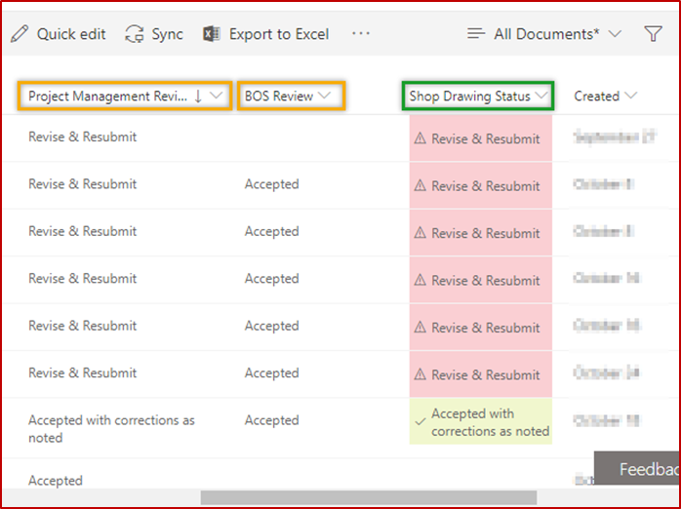
Standard Spec Updates
WisDOT Fabrication Library: Region and BOS Shop Drawing Acceptance
The Fabrication Library allows for Shop Drawing acceptance by both the Project Manager (Project Leader) and Bureau of Structures.
The Project Leader may have additional comments from their own QA reviews, so having a 2 party acceptance ensures any comments from both parties are addressed and the fabricator may proceed with fabrication.
Once both parties change the shop drawing status in Fabrication Library to “accepted”, the shop drawing will be formally accepted.
Notes:
Two New Videos Available Now

Slide 28
Structures Agenda
Contacting BOS – When & Why
Specification and Manual Updates
Structures Construction Issues
Ancillary (Wind Loaded) Structure Issues

Slide 29
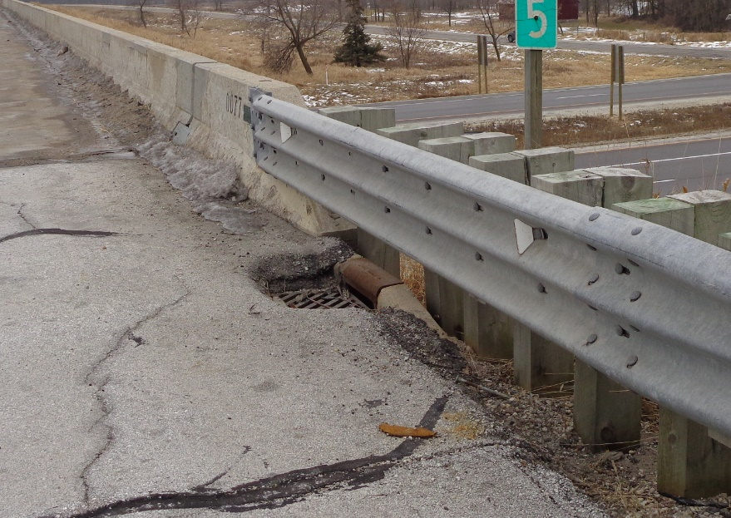
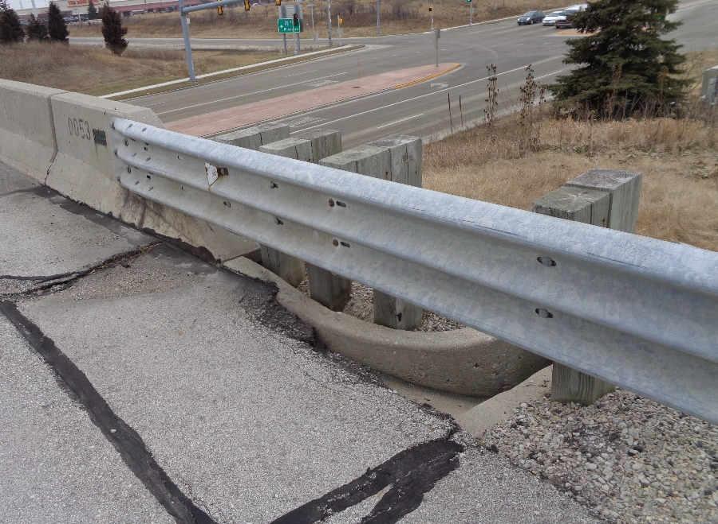
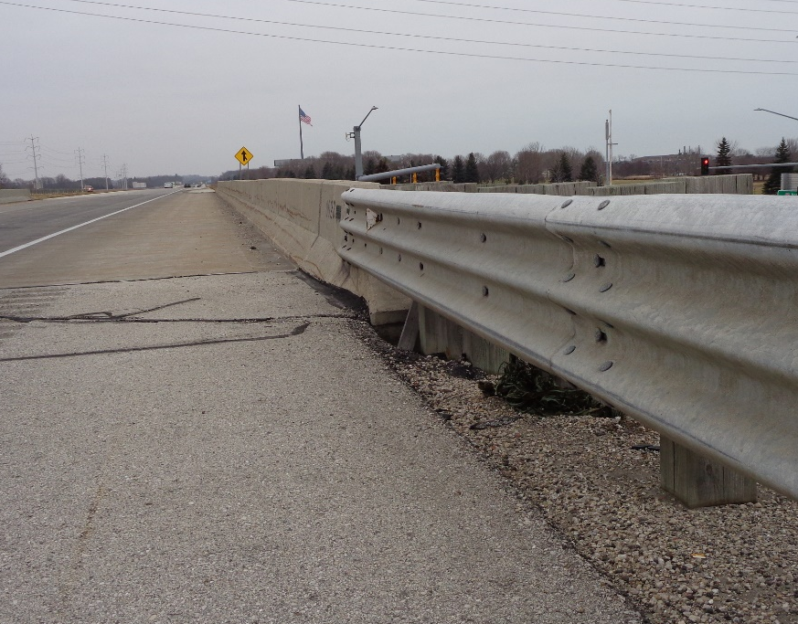
Wing Tip Erosion and Drainage
Often when overlaying a roadway as it approaches a bridge, the drainage isn’t considered.
Make adjustments in the field.
Notes:
In most cases the concrete inlets/flumes/curbs are not called for adjustment or replacement in the plans.
If an existing drain or flume exists, taper the overlay so that water properly flows to it.
Make sure drains are not paved over.
If no drain or flume exists, construct an asphalt flume to direct the drainage away from the wing.

Slide 30
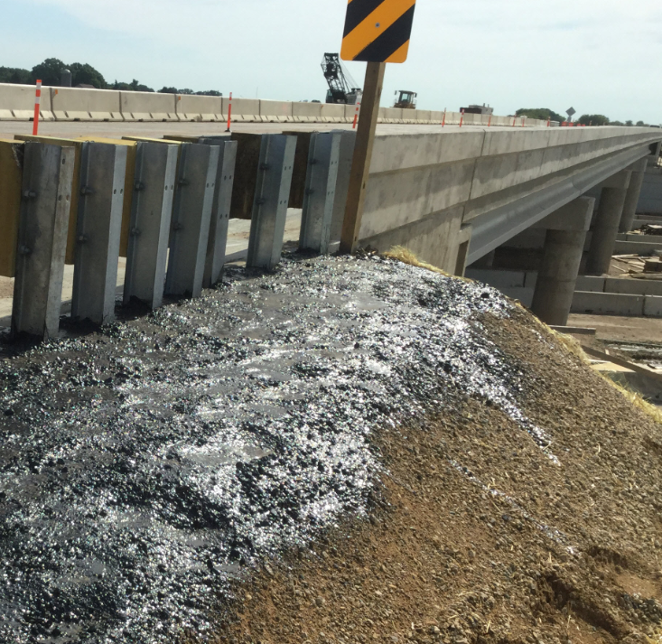
Wing Tip Erosion and Drainage
Be sure grading around wing tips promotes proper drainage.
Typically finished grade ends 6” above wing tip.
Do not allow bituminous sealant around wing tips.
  The end of the structural approach slab is not the end of wing.
Notes:
Erosion around wing tips continues to be a problem. Grading needs to be completed to the proper elevation at the wing tips. This does not always mean the finished ground should hit the wing tip, in many cases the finished grade needs to sit 6” above the wing tip.
While sealant around the wing tips may seem like a good idea to keep everything in place, it has also been known to worsen the issue. So please do not allow this.
Be careful the end of the structural approach slab is not confused with the end of wing. Next slide shows a good example of how not to complete grading with the structural approach slab extends beyond the wing.
Southeast Region

Slide 31
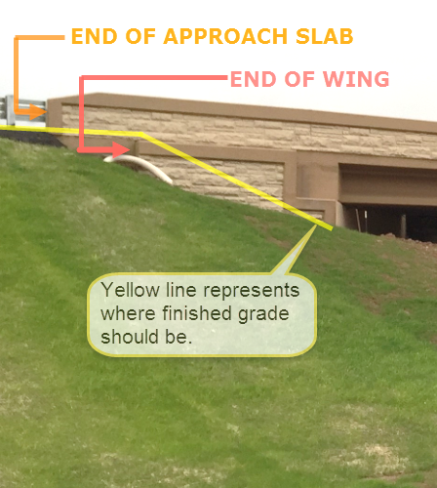
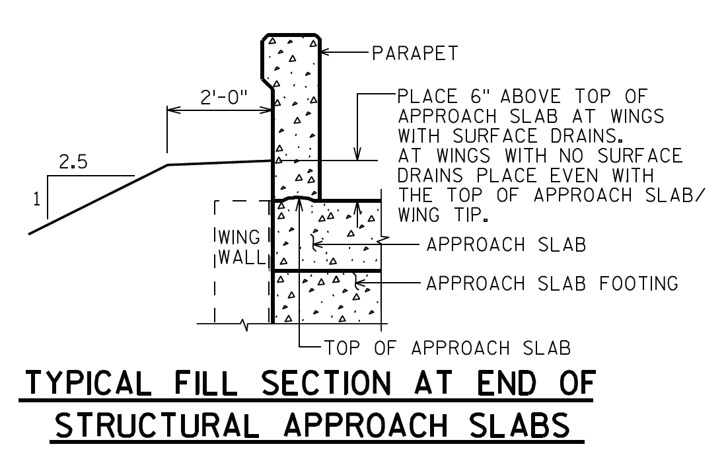
Wing Tip Erosion and Drainage
Notes:
- It is important to remember that with structural approach slabs the wing sits outside of the edge of deck and grading needs to come up to the end of wing, not where the parapet ends.
Northeast Region B-70-420/421
Past Issues:
Insufficient embankment fills
Insufficient beam guard embedment
Erosion around wing tips

Slide 32
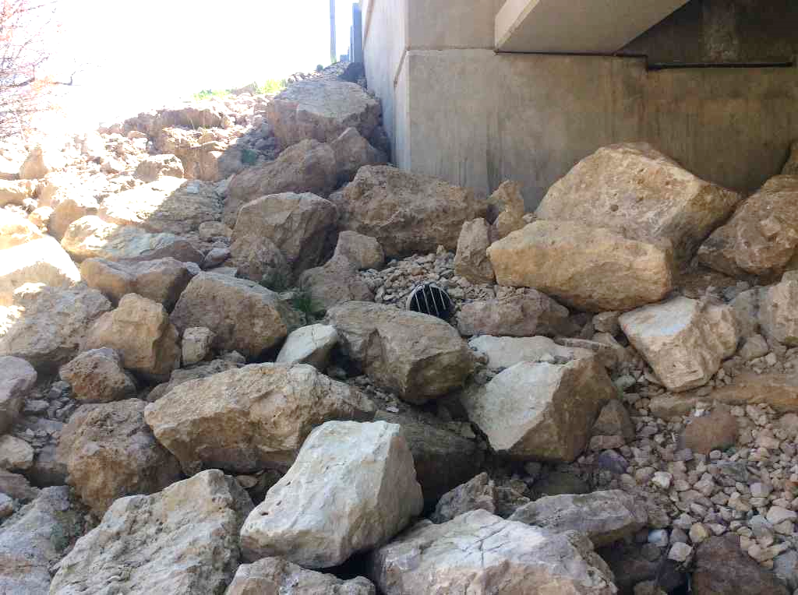
Riprap Spec. and Installation
Common problems with supplied riprap:
  Stone sizes too small
  Stone sizes poorly distributed
  Too many fines are included
Ensure riprap complies with Specified grade- see CMM 6-45.7.7.1

Slide 33
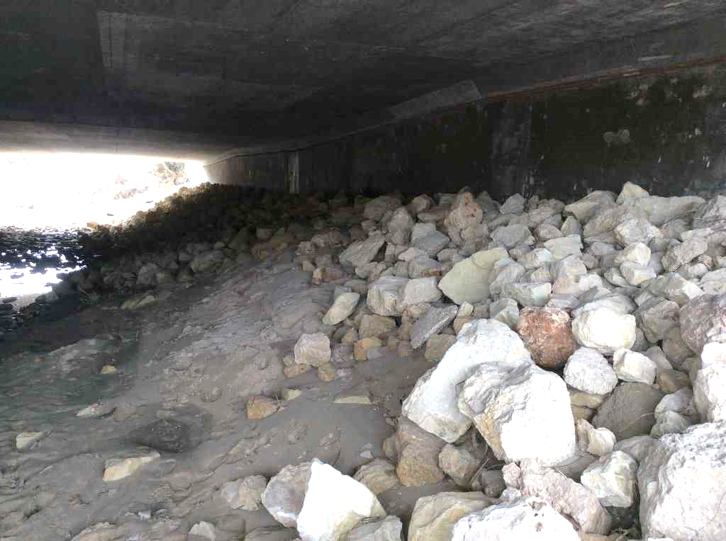
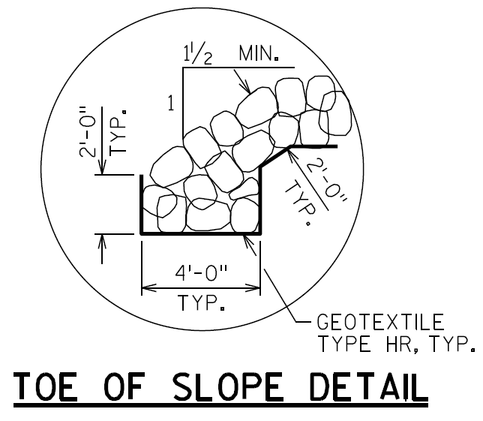
Riprap Spec. and Installation
Riprap should be installed per plan
Ensure toe of slope keyed in per plan detail
Do not omit geotextile fabric

Slide 34
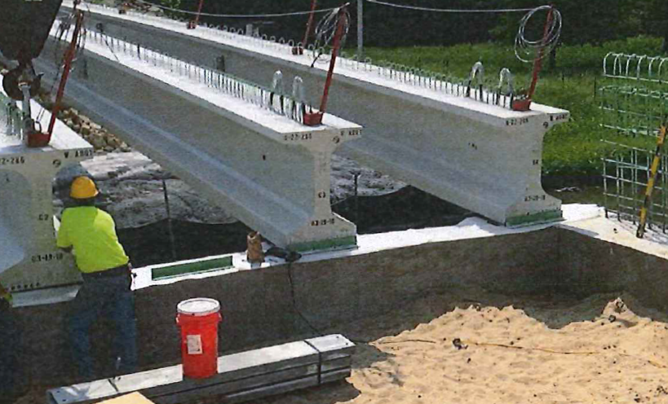
Structural Modifications
Be aware of contractor means and methods
Alert BOS if permanent construction details deviate from plan details
Detail below changed abutment fixity – likely to create long term issues.
Notes:
In this case, contractor positively connected angles to beam seat of abutments, but abutment was designed as a semi expansion, so when diaphragm was poured, it would be connected to the abutment body, acting more as a fixed abutment than semi expansion.
Inspectors should be aware of how contractor’s means and methods might be affecting the functionality of the structure. If anything seems questionable, please contact BOS.

Slide 35
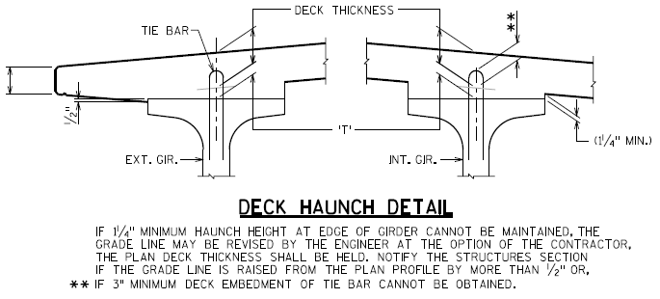
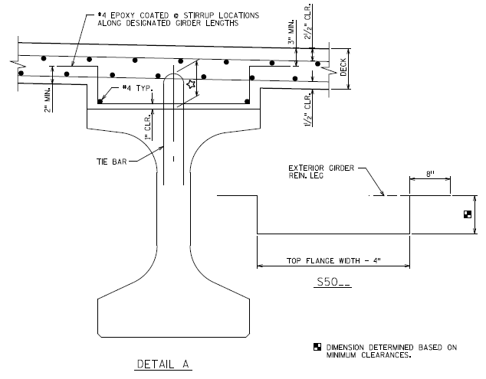
Excessive Haunch
The Contractor is responsible for providing supplemental concrete & reinforcing to accommodate higher than expected haunch depths due to variation in camber
Construction & Materials Manual: Section 5-15-.5.7:
Notes:
In some recent cases, Contractors have requested that the Department cover the cost of extra haunch concrete and reinforcement due to a large variation in the expected camber. (beam seat elevations were within tolerance)
However, BOS has maintained a policy with Contractors for many years establishing the Contractors’ responsibility to pay for any required extra haunch concrete and/or reinforcing.
Study was done by BOS to establish the 1.4 residual camber factor, to predict camber growth as accurately as possible. However, more or less than expected camber still occurs in some cases, resulting in excessive haunch values.
BOS development plans to add supplemental haunch reinforcing details to standards, insert sheets, and/or the Bridge Manual to provide further guidance to Contractors’ in the event that they come across this in the field.
Extra concrete and reinforcing to be incidental to other bid items.
At the discretion of the Contractor, the Contractor can survey the tops of girders at the precast plant prior to forming/casting substructure units, such that excessive haunches can be avoided by making adjustments to the beam seat elevations. This measure is not required by BOS, and the Contractor maintains responsibility for excess haunch values.

Slide 36
Construction Traffic on New Deck
Construction traffic is not allowed during wet cure
Notes:
502.3.10.1.2.1: “If the contract prescribes a specific wet curing period, do not open to service until after wet curing is complete and the strength or equivalent curing day requirements are met.” 7 days for normal concrete; 14 days for high performance concrete (HPC)
Concerns include:
Disruption of wet cure
Vehicle impact (bounce) because approaches are not in place
Vehicle weight is uncontrolled – could be off-road vehicles with weight greater than legal
Contact BOS if contractor requests an exception to this requirement (typically not granted)
Note: per 502.3.10.1.2.3, after the concrete cures sufficiently, the contractor may, with the engineer's approval, apply loads to decks that result from storing small articles, and operating concrete buggies and other necessary light equipment, if applied in a way that causes no injury to the concrete (i.e. parapet construction); the contractor may operate hauling equipment as necessary to perform subsequent pours on that structure.

Slide 37
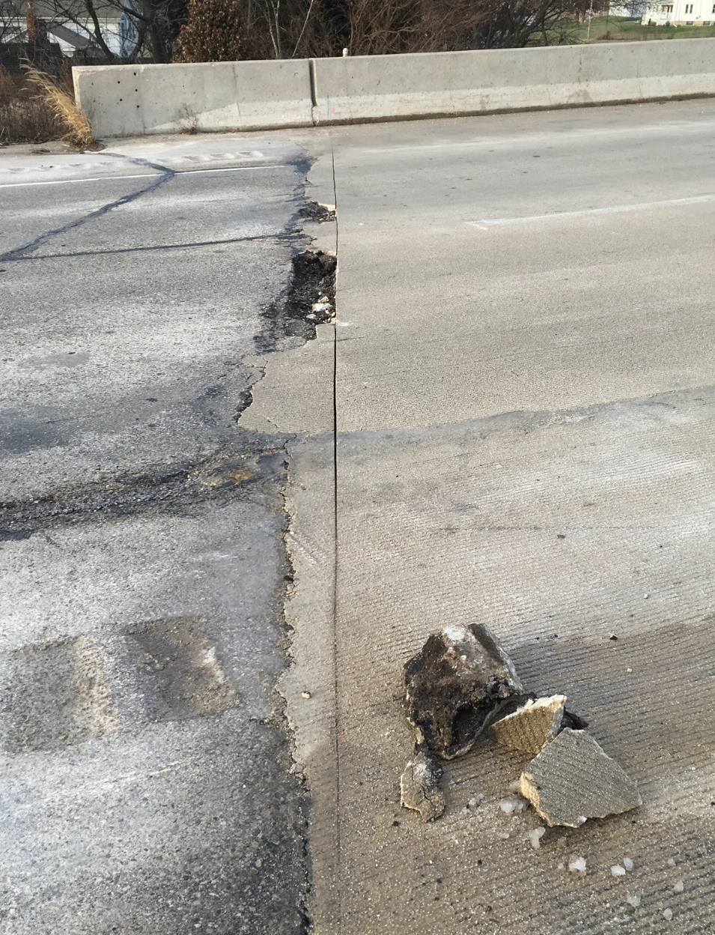
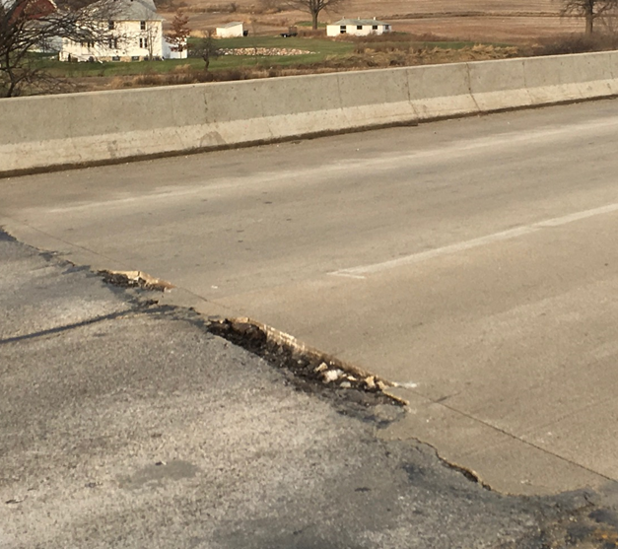
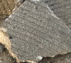
Overlay Placement and Approach
Concrete should not be used to repair roadway approach
  concrete will spall and become roadway hazard
Fill with HMA
Review project before construction, is approach work likely?
Notes:
In this picture, concrete was poured past the end of deck to fill the voids in the approach asphalt roadway.
This concrete is unreinforced and spalls quickly creating roadway hazards. Roadway approach spalls should be filled with HMA.
Typically roadway approach work is completed in conjunction with a concrete overlay and this situation is avoided.
If no roadway approach work is planned for your structure please be mindful of how they are patching the approach roadway.

Slide 38

Structural Approach Slabs
Some contractors have requested to pour the structural approach slabs in conjunction with the bridge deck
Potential benefits:
  Schedule
  Ride
  Durability
If you receive this request, contact BOS for review & approval
  to determine if it is right for your situation
  to review the Contractor’s proposed details & notes
Notes:
BOS requests the contractor to provide details including elevation views & notes, so that BOS is better able to determine if this detail is beneficial to the particular situation.
In some instances, Contractors have requested the use of a saw-cut in lieu of the HDPE plate, due to concerns over not being able to keep the HDPE straight before and after the concurrent pour.
This is not an acceptable method for the following reasons:
risk of cutting abutment rebar and stainless-steel rebar
• ensuring a straight and uniform joint at the proper location
• added responsibilities for the field staff and contractor after the deck pour (note: sawing is time-sensitive)
• interruptions to the curing process
• properly cleaning the saw-cut joint
• properly filling saw-cutting the joint
Other important details/notes BOS is looking for include:
Maximum timeframe between diaphragm and deck is 14 days; (some submittals have stated 21 days)
Hot pour sealant must be called out along the top of the HDPE plate; (this has been left out in some submittals)
When this is requested, BOS provides the following note as a condition for using this details:
The contractor may use the alternative pouring detail, with the engineer’s approval. The 1/2-inch HPDE joint shall be located per the contract plans, maintain strait alignments, and be free of defects. If the engineer orders, the contractor shall remove and replace defective and inferior joints at no expense to the department. A minor joint defect may be repairable if the engineer allows. A major defect will require joint replacement for the entire length and depth of the joint.

Slide 39


Concrete Pavement Approach Slabs
Ensure that the ½” wide x ¾” deep notch at deck/approach joints is formed and poured per the plans
  Reference SDD 13b2-9a: Concrete Pavement Approach Slab
Notes:
The forming of the notch of the header at the deck/approach joint is commonly done wrong.
Ensure that Joint sealant extends to the top of the paving notch.
Ensure that the expansion joints btw the roadway approach slab and adjacent pavement is constructed per the SDD
Without proper expansion joints, there is no mechanism to push the approach back after the structure expands and pushes the approach away from the bridge, resulting in 4”-5” gaps at the paving notch (unsealable)
These gaps allow water to stream in
This moisture results in frost and heave/loss of material, leading to settlement of the roadway and increased impact on the structure
The moisture also leads to saturation of the slopes, which then leads to slope failure

Slide 40
Structures Agenda
Contacting BOS – When & Why
Specification and Manual Updates
Structures Construction Issues
Ancillary (Wind Loaded) Structure Issues

Slide 41

Ancillary (Wind Loaded) Structures
Foundation Construction – On Going Problem
  Contractor locate utilities
  Cave-ins / standing water
    Contract submit proposal
    Pumps
    Casing
    Tremie
  Rock / obstruction
    Contact designer, or BOS for revised design
Notes:
Foundation construction is an on going problem
Make sure contractor locate all utilities before excavation
For Cave-ins and standing water conditions:
Contractor to submit construction plans
Casing, pumps and tremie placement of concrete may be required
For rock and obstruction conditions:
Contact designer or BOS for design revision

Slide 42


Ancillary (Wind Loaded) Structures
Foundation Construction (continued)
  Anchor rod inspection
    Standoff
    Damages
    Centered, Clean, Straight
    Adequate stickouts
    Check anchor rods against base plate (No. & location)
Sign Structure Lead Times
  Up to 6 months
Notes:
Anchor Rod Inspection:
-Be sure to check for all of these common concerns
-Standoff (top picture)- The distance between the top of the concrete and bottom of the base plate is specified in the plan details, exceeding this dimension may require refined analysis and possible future maintenance concerns
-Incorrect base plate hole configuration vs anchor rod layout (bottom picture)
Sign Structure Lead Times:
-Time in which the purchase order is issued to the contractor to the time the structure arrives on site has increased to as high as 6 months due to changes in the steel market, 6 months would be on the high side for what we know as of right now

Slide 43


Ancillary (Wind Loaded) Structures
Connections
  DTI’s
    Correct installation
    Meet DT2322 quality control
  Truss and Mast Arms
    Ensure no gap in faying surface
    Correct orientation
DT Form Submittal
  Complete and accurate
Notes:
Connections:
-DTI’s (Direct Tension Indicators), make sure DTI’s are oriented correctly and meeting all the quality control requirements of DT2322
-Ensure the splice (top picture) connections of trusses and mast arms are in FIRM contact, above picture is not adequate, the connection is not designed to have a gap
-Ensure that trusses delivered to the sight match the design plans and shop drawings and are installed in the correct orientation (bottom picture-incorrect orientation)
DT Form Submittal:
-DT Forms need to be complete for each structure. The contractor needs to make sure they submit ALL the pages of each DT Form accurately with all required information and signatures. If they do not, it delays in the final inspections because consultants need these forms to verify construction.
-Include any design plans and shop drawings with DT Forms to the consultant sign/signal/hml (high mast lighting) inspectors BEFORE the inspection so they have time to review and adjust inspection procedure accordingly. This reduces delays and provides a better quality product in the end

Slide 44
Conclusion
Call us!
BOS looks forward to another successful construction season – THANK YOU!
Notes:
SW Region
“We always do it that way” is not a substitution for what is shown on the plans – if the contractor is looking to do something different than the plans show, need to contact EOR/BOS

