Slide 1
WisDOT Traffic Updates
Andy Heidtke, PE
Statewide Work Zone Design Engineer
NE Region Construction Training
Northeast Wisconsin Technical College, Green Bay, WI
March 6th, 2019
Notes:
Read me notes regarding this WisDOT PowerPoint template: Wide screen size of 1920 by 1080, includes either blue or light gray backgrounds
This WisDOT PowerPoint template has a widescreen (16:9) aspect ratio (1920 x 1080).
Use if you will be doing one of the following:
showing your presentation on a large widescreen television.
showing your presentation using a display in widescreen format.
converting your presentation to video in the future.
Use the WisDOT PowerPoint template that has the standard (4:3) aspect ratio (1024 x 768) if you will be doing one of the following:
Presenting with a WisDOT projector that displays in standard (4:3) or 1024 x 768.
Presenting at a conference location which uses projectors that display in standard (4:3) or 1024 x 768.
Title slide
Slide 1 and slide 8 are layouts for the title slide of your WisDOT presentation. The title of your presentation goes at the top in the white text (for the light gray background) or blue text (for the gray background). The title may be one or two lines.
Managing placeholders
If your presentation does not need all the text placeholders, delete the placeholders you do not need and then you may need to lower or adjust the height between lines.
Various slide layouts
Slides 2 through 6 and 9 through 13 are examples of five slide layouts you may use in your presentation. The headline of each example describes which content placeholders are available in its layout. Review the slide layouts and decide which one best suits your content.
Blank slides
Slides 7 and 14 are blank slides for custom layouts in your presentation.
Ways to transfer a PowerPoint presentation from another design to this template.
The recommended way is to copy text line by line, slide by slide, from the other PowerPoint design. Then paste it into Notepad, copy from Notepad, then return to this template, select the text in the desired placeholder and copy. If you would like to get all your text out of the other design at once, choose file, save as .rtf, then copy all text from the .rtf, paste it into Notepad. Then use the Notepad file to copy the text line by line into this template by selecting the desired placeholder and copying. (Notepad will clear styles from the other PowerPoint design.)
How to paste text and keep template’s font styles and color
Select text in placeholder, then copy. If copying and pasting text into a slide layout does not preserve the template’s font styles, select text in placeholder and right click on the placeholder and select the first paste option: use destination theme. Doing so will keep your pasted text in the font style and color designed for WisDOT template.
How to add more slides with the layout you want
To add a new slide layout to your presentation: in normal view, on the home tab, select new slide. Slide layout options for the WisDOT template will appear. Select the slide layout you want.
Changing a current slide layout on to a different current slide layout is not recommended.
Changing a current slide layout on to a different current slide layout is not recommended, as sometimes this results in additions of unmatched text and placeholders. It’s best to add a new slide layout to your presentation: in normal view, on the home tab, select new slide. Slide layout options for the WisDOT template will appear. Select the slide layout you want and add new text to this slide layout.
When to choose the blue background
Slides 1 through 7 have a dark blue background. Use with its white and gold type styles. Use if you have reverse or negative versions of graphics and logos. Some experts say if you're presenting with most of the lights off in the room or in a darker presentation area, consider using the blue background color, then the background won't intrude on the message and the lighter components will stand out. Other experts say that if your copy is kept short and sweet, the lightness or darkness of the background is irrelevant, as viewers then have little to read.
When to choose the light gray background
Slides 1 through 7 have a light gray background. Use with its navy and red type styles. Use if you have positive versions of graphics and logos. Some experts say if you're presenting in a small room with most of the lights on, use a lighter gray background, then the background will tend to fade away while the other components will grab attention. Other experts say that if your copy is kept short and sweet, the lightness or darkness of the background is irrelevant, as viewers then have little to read.
Use these sizes and colors of fonts for template with LIGHT GRAY background and wide aspect ration (1920 x1080).
Font sizes may be adjusted either 2 points smaller or 2 points larger from sizes listed.
Slide 1 with GRAY background
Title text = Arial Narrow Bold, 63 point, Color: navy blue R0 G65 B106, Title text may be one or two lines. 3 or more lines are not recommended.
Name of Presenter = Arial Narrow Bold, 48 point, Color: red R164 G40 B76, Keep to 1 line
Title of Presenter = Arial Narrow, 40 point, Color: red R164 G40 B76, Keep to 1 line
Name of conference or event, Location, City, State = Arial Narrow, 28 point, Color: navy blue R0 G65 B106, Keep to 1 or 2 lines
Month, Day, Year = Arial Narrow Bold, 25 point, Color: red R164 G40 B76, Keep to 1 line
Slides 2, 3, 4, 5, 6 with GRAY background
Example heading = Arial Narrow Bold, 48 point, Color: navy blue R0 G65 B106, Heading may be one or two lines. 3 or more lines are not recommended.
Red subhead = Arial Narrow Bold, 39 point, Color: red R164 G40 B76, Keep to 1 line
Bullet 1 = Arial Narrow, 35 point, Color: navy blue R0 G65 B106
Bullet 2 = Arial Narrow, 32 point, Color: red R164 G40 B76
Paragraph text = Arial Narrow, 28 point, Color: navy blue R0 G65 B10
Use these sizes and colors of fonts for template with BLUE background and wide aspect ration (1920 x1080).
Font sizes may be adjusted either 2 points smaller or 2 points larger from sizes listed.
Slide 8 Title slide with BLUE background
Title text = Arial Narrow Bold, 63 point, Color: white R255 G255 B255, Title text may be one or two lines. 3 or more lines are not recommended.
Name of Presenter = Arial Narrow Bold, 48 point, Color: gold R216 G184 B70, Keep to 1 line
Title of Presenter = Arial Narrow, 40 point, Color: gold R216 G184 B70, Keep to 1 line
Name of conference or event, Location, City, State = Arial Narrow, 28 point, Color: white R255 G255 B255, Keep to 1 or 2 lines
Month, Day, Year = Arial Narrow Bold, 25 point, Color: gold R216 G184 B70, Keep to 1 line
Slides 9, 10, 11, 12, 13 with BLUE background
Example heading = Arial Narrow Bold, 48 point, Color: white R255 G255 B255, Heading may be one or two lines. 3 or more lines are not recommended
Red subhead = Arial Narrow Bold, 39 point, Color: gold R216 G184 B70, Keep to 1 line
Bullet 1 = Arial Narrow, 35 point, Color: white R255 G255 B255
Bullet 2 = Arial Narrow, 32 point, Color: gold R216 G184 B70
Paragraph text = Arial Narrow, 28 point, Color: white R255 G255 B255
Contact the WisDOT Learn Center for training in PowerPoint. A link to the WisDOT Learn Center may be found on the dotnet home page.

Slide 2
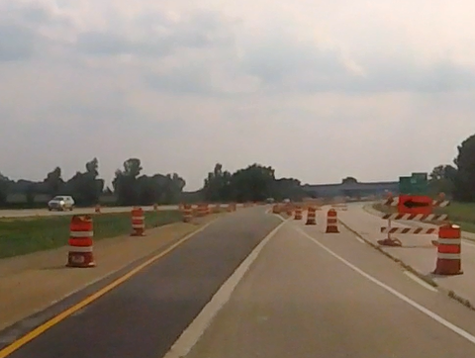
Overview
Work zone crashes
Work zone inspections
Lane Closure System

Slide 3
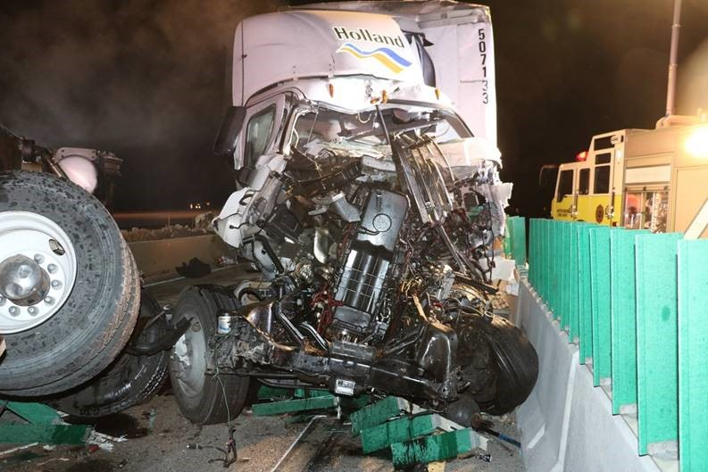
Crashes
Total Work Zone Crashes per year 2014-2018
Crash Severity per year 2014-2018
Crash Location 2017-2018
  Data began being collected in 2017 with updated crash report form
Crash Type 2014-2018
  All 2018 crash data is preliminary

Slide 4
Notes:
5 year total crashes – 2018 preliminary until finalized in middle of 2019
13,421 total work zone crashes documented over 5 years – 2014 to 2018

Slide 5
Crash Severity per Year 2014-2018

Slide 6
Crash Location 2017-2018
**Crashes are from January 1, 2017 to October 10, 2018
Notes:
Based on data input from DT4000 Crash Report – relies on officer knowledge of work zones
Data is from January 2017 to 10/18/2018.
WisTransportal has not yet been updated with the new work attributes

Slide 7
Crash Type 2014-2018
Notes:
5 year – crash type
2018 preliminary
SSOP – Side Swipe Opposite Direction
SSS – Side Swipe Same Direction
Percentages are based on 5 years – 13, 421 total work zone crashes documented

Slide 8
2018 Work Zone Inspections
144 work zone inspections completed
Survey the quality and effectiveness of the devices and strategies
ATSSA Quality Guidelines for device standards
Used SDDs and WisMUTCD for layout
Wisconsin Lane Closure System checked
Improvement, maintenance, and utility all reviewed

Slide 9
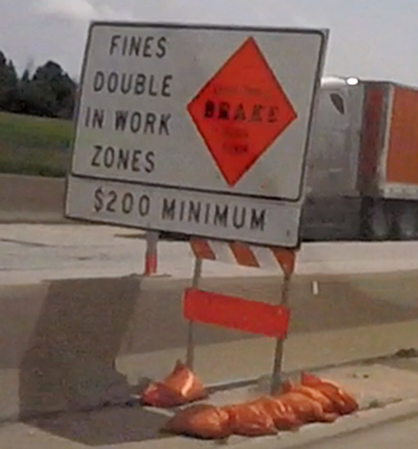
Advance Warning Area Issues
PCMS messaging
Sign supports
Poor sign condition

Slide 10
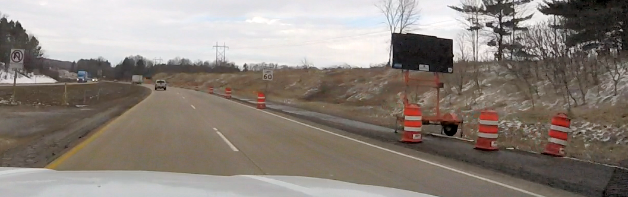
Transition Area Issues
Dim arrow boards
Non-fluorescent orange drums

Slide 11
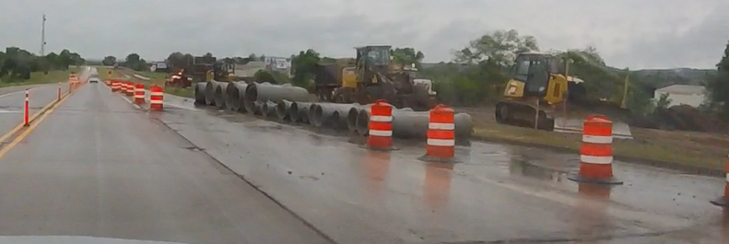
Activity Area Issues
Pavement Marking and Removal
Channelizing devices

Slide 12
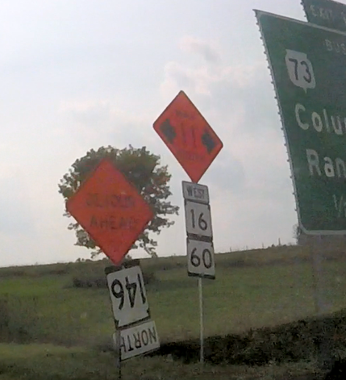
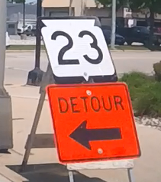
Termination Area, Detours, Crossroads Issues
Missing End Road Work sign
Detour sign mounting
Intersection drum spacing

Slide 13
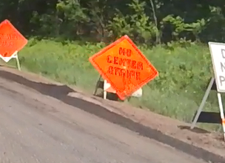
Flagging Issues
Temporary Portable Rumble Strip use and spacing
Advance warning area signing
Training

Slide 14
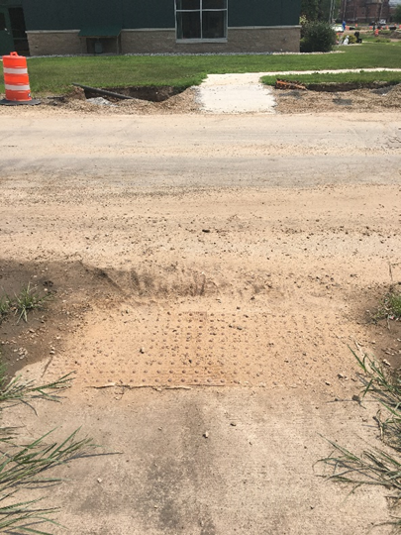
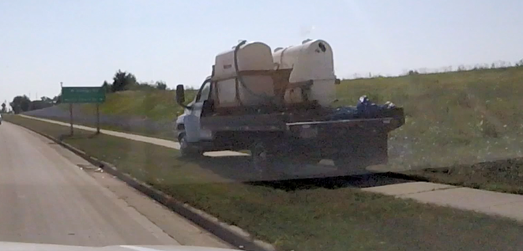
Pedestrian Accommodations
Maintenance of accommodations
Vehicles parking on open sidewalks

Slide 15
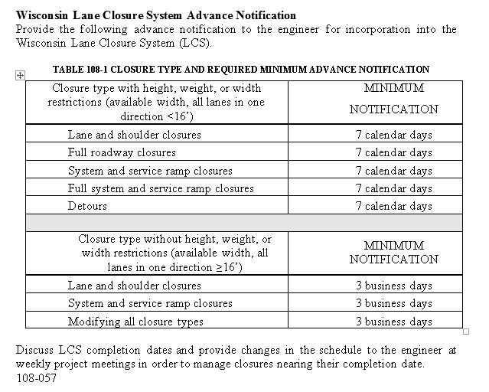
Lane Closure System Entries
STSP 108-057

Slide 16
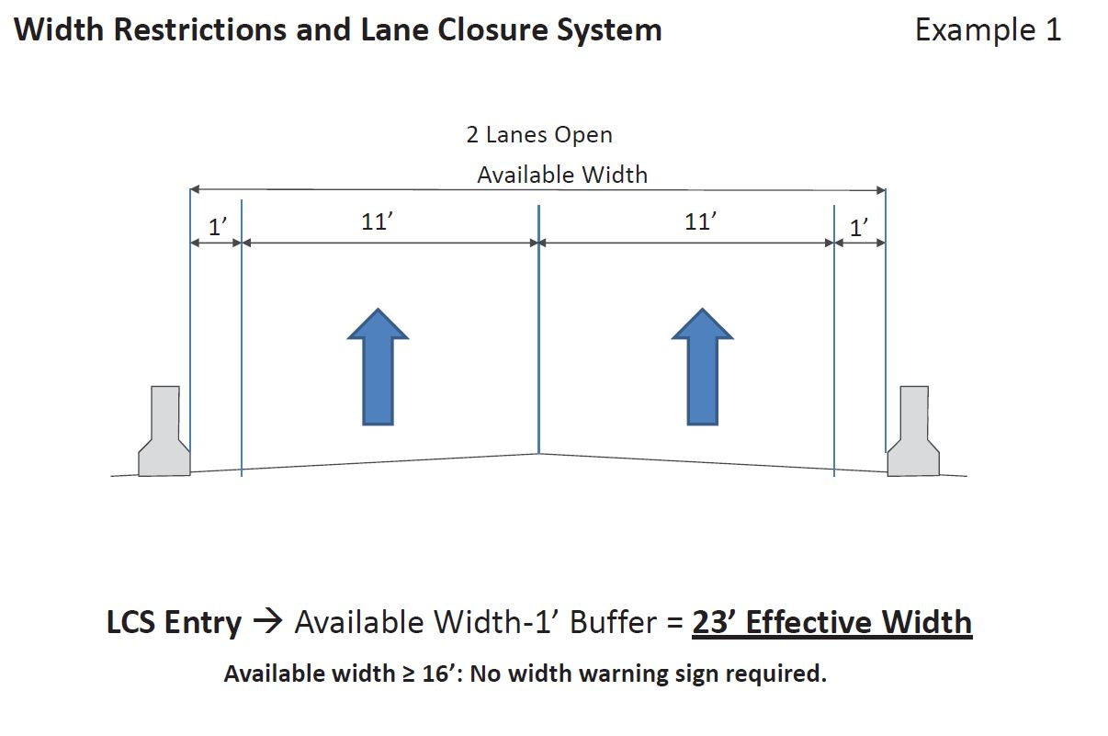
Lane Closure System Entries
Available Width Definition

Slide 17
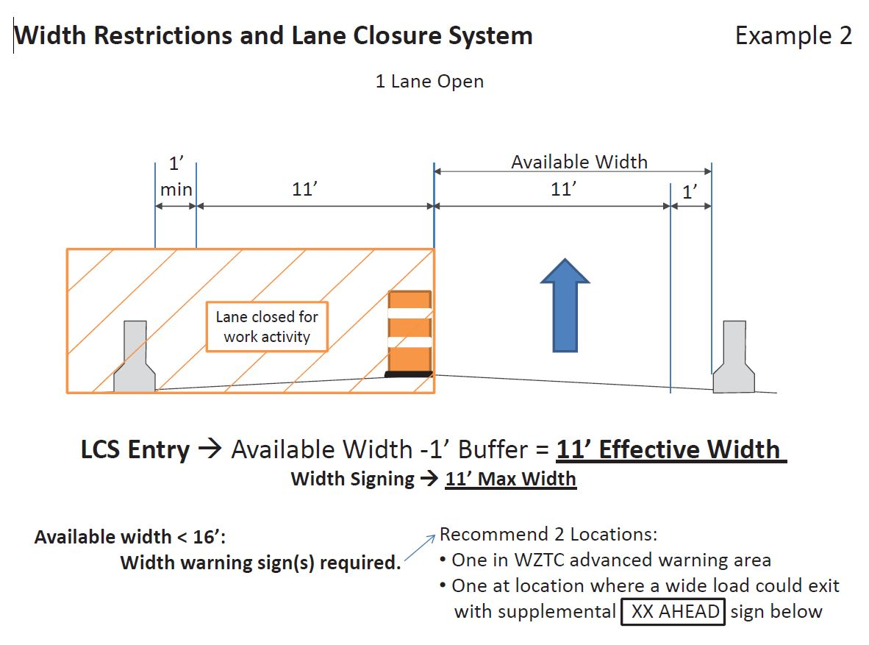
Lane Closure System Entries
Available Width Definition

Slide 18
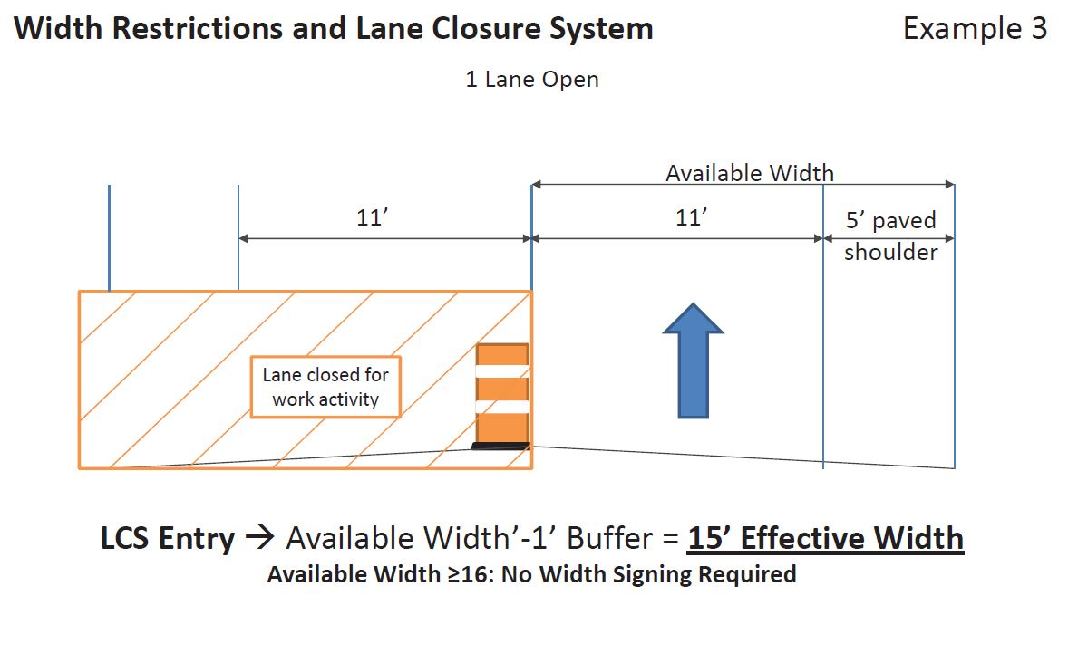
Lane Closure System Entries
Available Width Definition

Slide 19
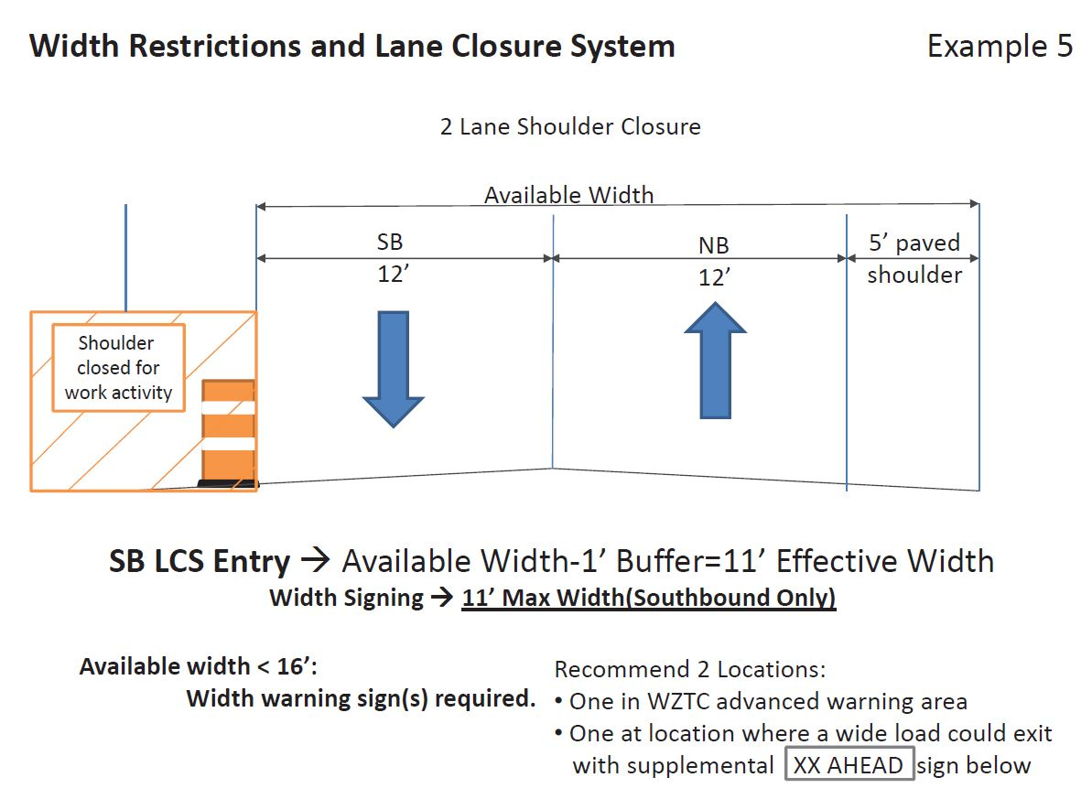
Lane Closure System Entries
Available Width Definition

Slide 20

Questions?
Contact Information
  Joshua Falk
  Work Zone/TC Engineer
  joshua.falk@dot.wi.gov
  920-366-8033
  Andy Heidtke
  Statewide Work Zone Design Engineer
  andrew.heidtke@dot.wi.gov
  414-322-4185

