Slide 1
SIGNALS, LIGHTING, ITS
A WisDOT Electrician will be assigned to each project as a primary point of contact. You will find out who that person is at the pre-con.
Notify Randy Asman when Electrical subcontractor is on–site via e-mail.
I will notify our electricians and they may stop by the same day to check the electrical subcontractors work.
Our electricians will touch base with construction staff if any direction needs to be given to the contractor
Read appropriate spec book articles and enforce (651-661).
Electrical punch list – invite our electricians
Underground punch list (pullboxes, conduit, concrete bases, pullbox drains)
Final punch list (electrical wiring, loose signal pole, detector tests, etc…)
Don’t pay for all electrical items until punch lists have been addressed.

Slide 2
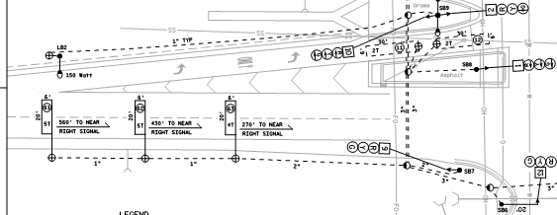
Notification / Verification
Cannot scale loop detector location off of plan or use the CADD drawing as a reference --- READ THE NOTES ON THE PLAN!!!

Slide 3
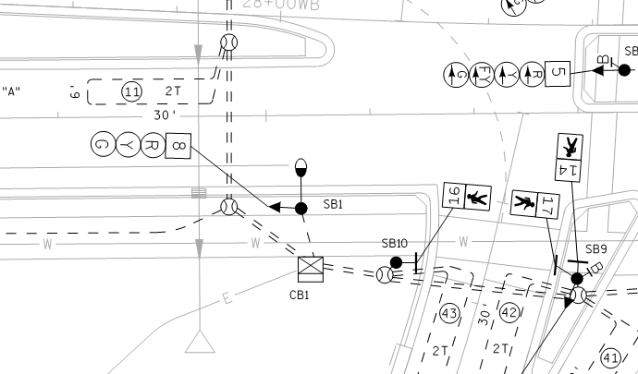
Loop Detector – Side Pull

Slide 4
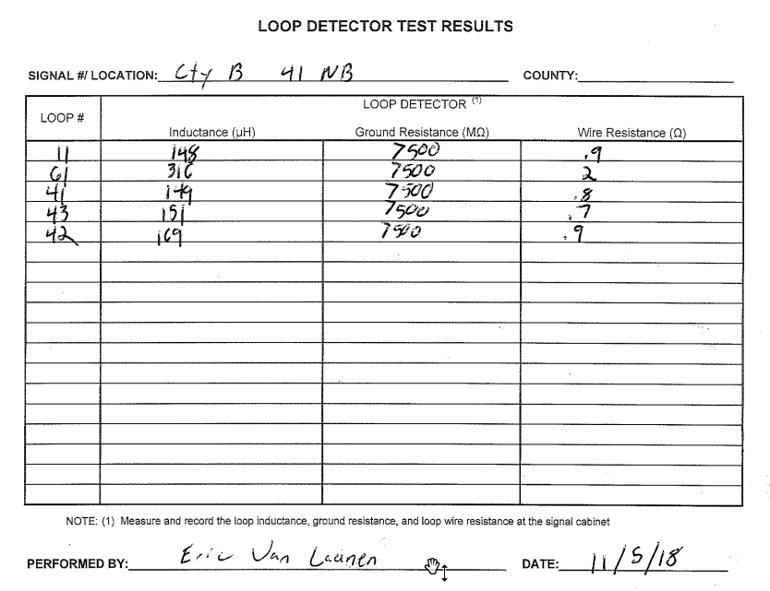

Slide 5
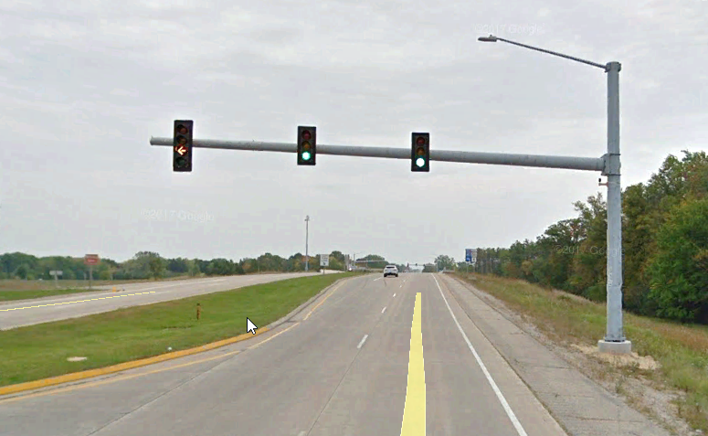
Monotube Signal Head Layout
1. Center the traffic signal heads over each lane.
2. Center the yellow solid ball or top yellow arrow on the monotube arm.
3. See S.D.D. for clearance heights to signals.

Slide 6
Loose signal poles…turned signal heads
This continues to be a big maintenance problem for our Electricians.
The contractor needs to tighten as far as possible, loosen ½ turn, and tighten a whole turn.

Slide 7
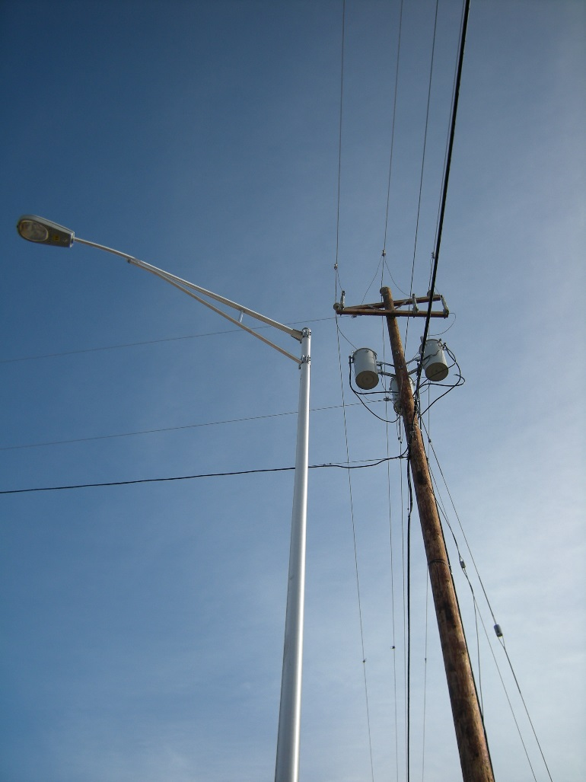
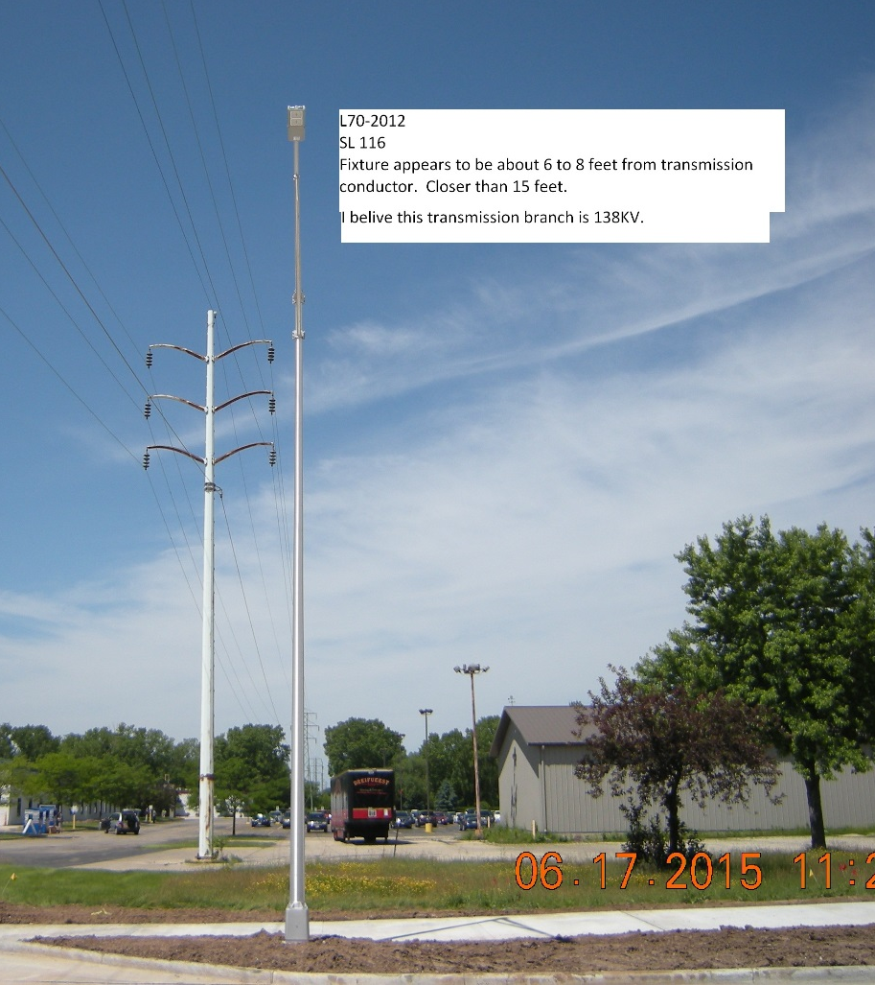
Utility Conflicts

Slide 8
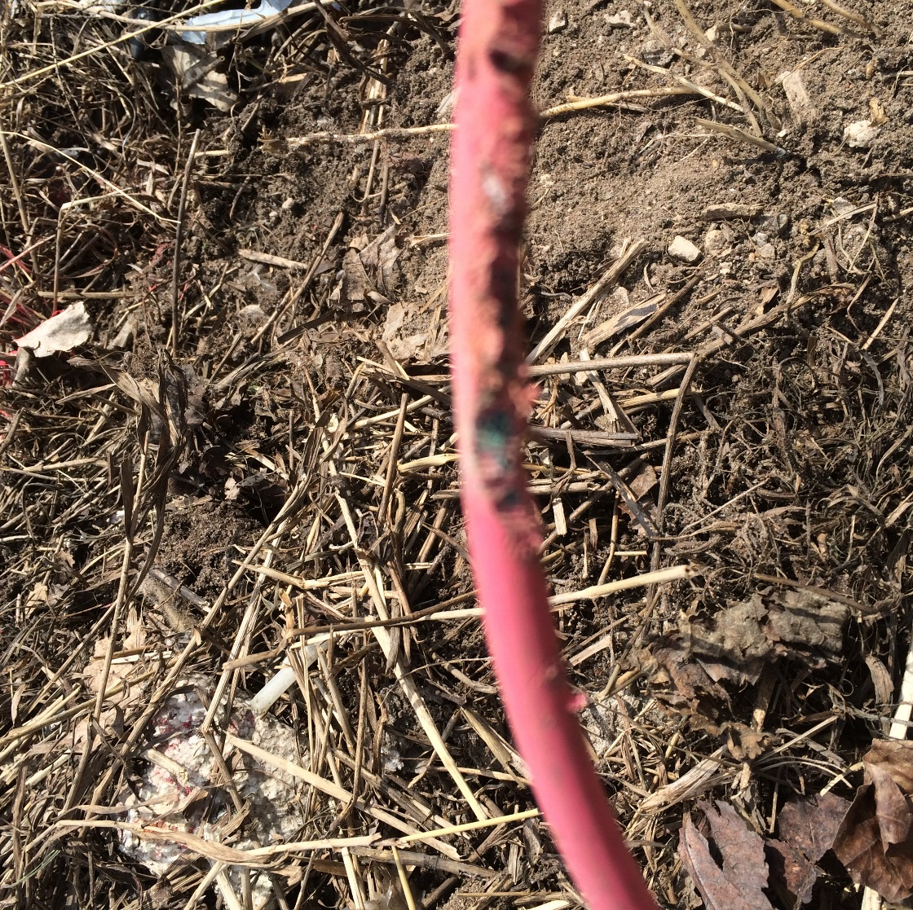
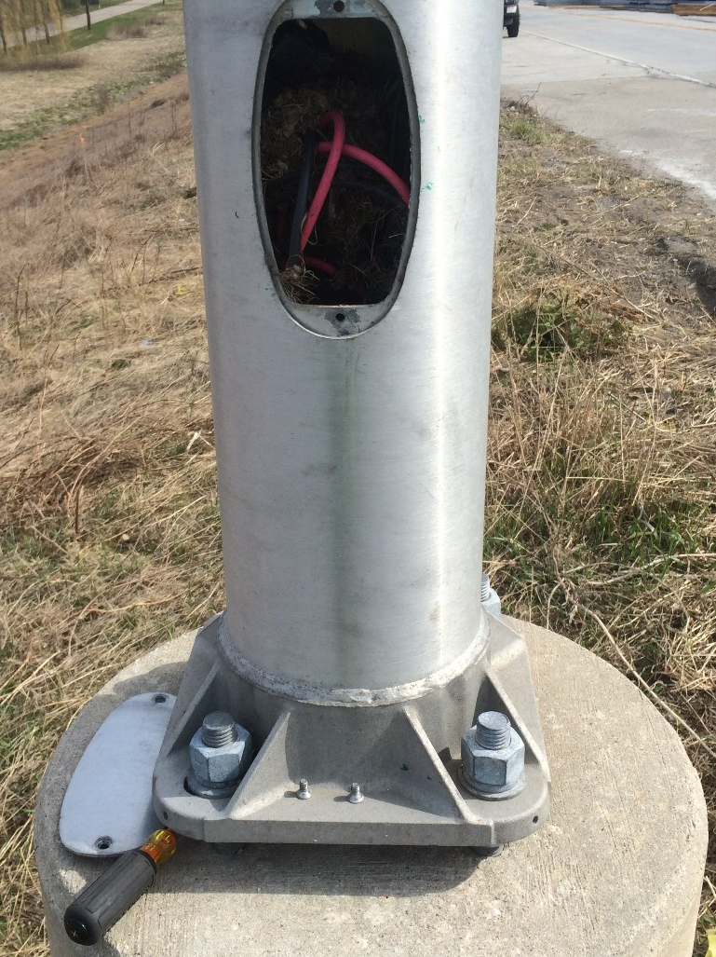
Rat Screens

Slide 9
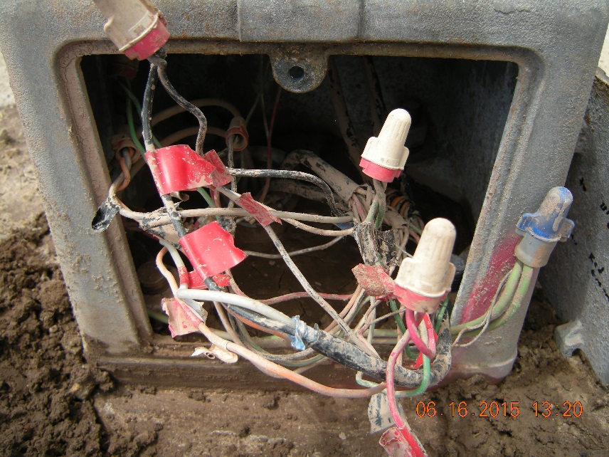
Landscaping

Slide 10
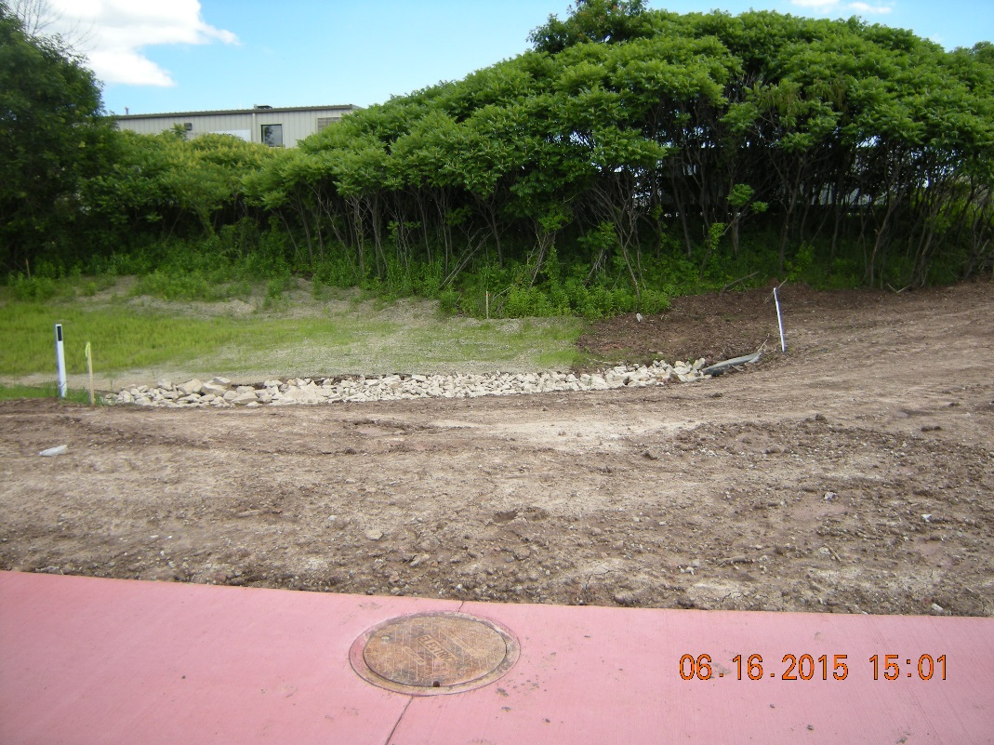
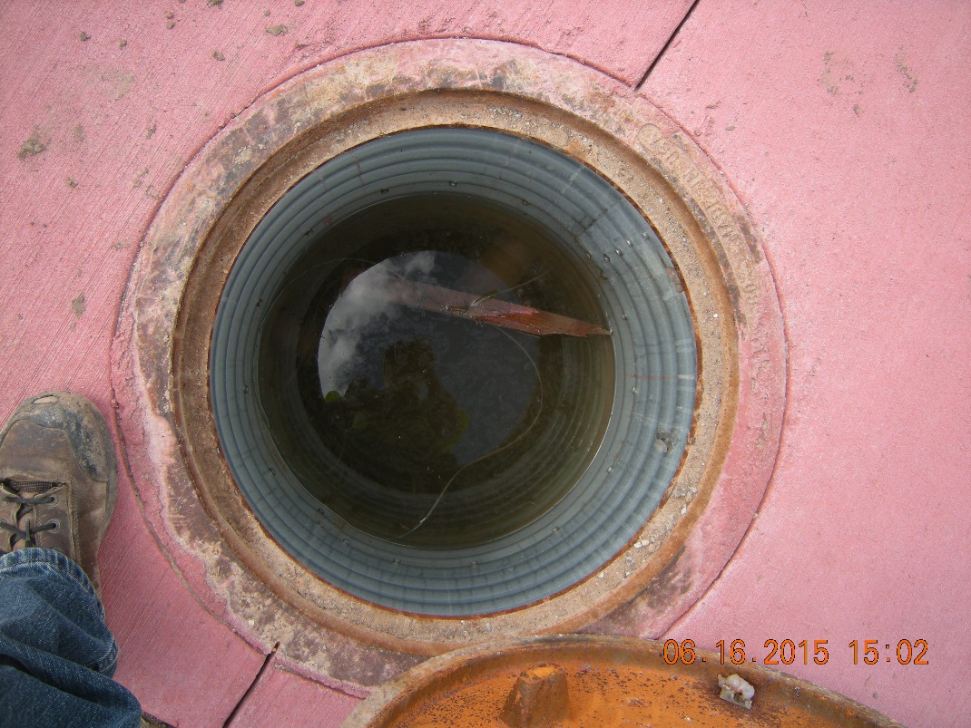
Pullbox Drains

Slide 11
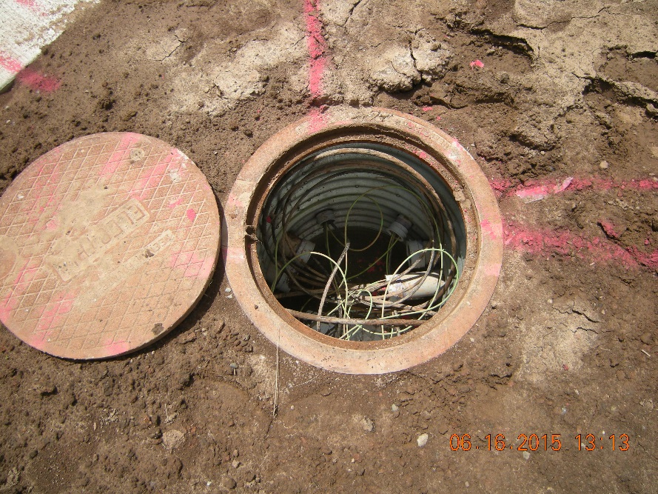
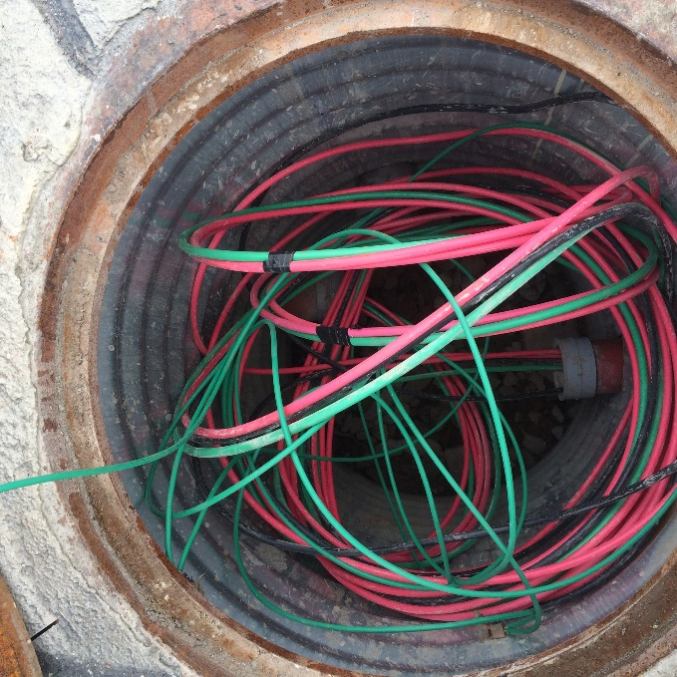
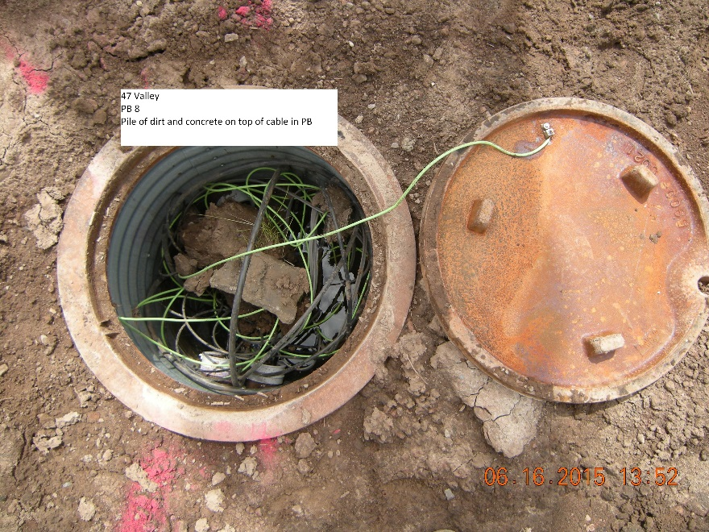
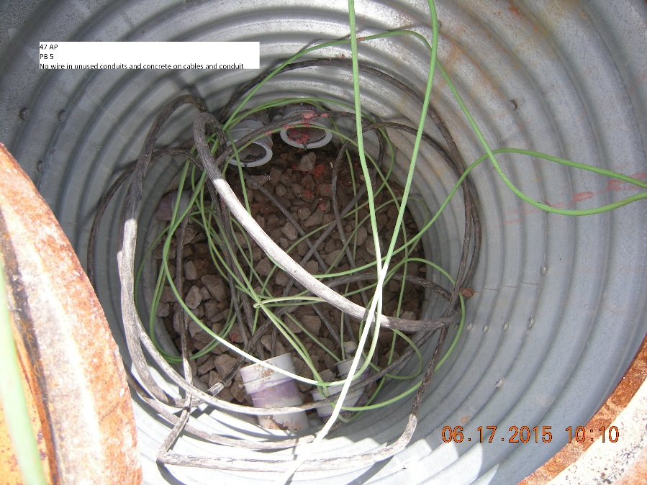
Pullbox

Slide 12
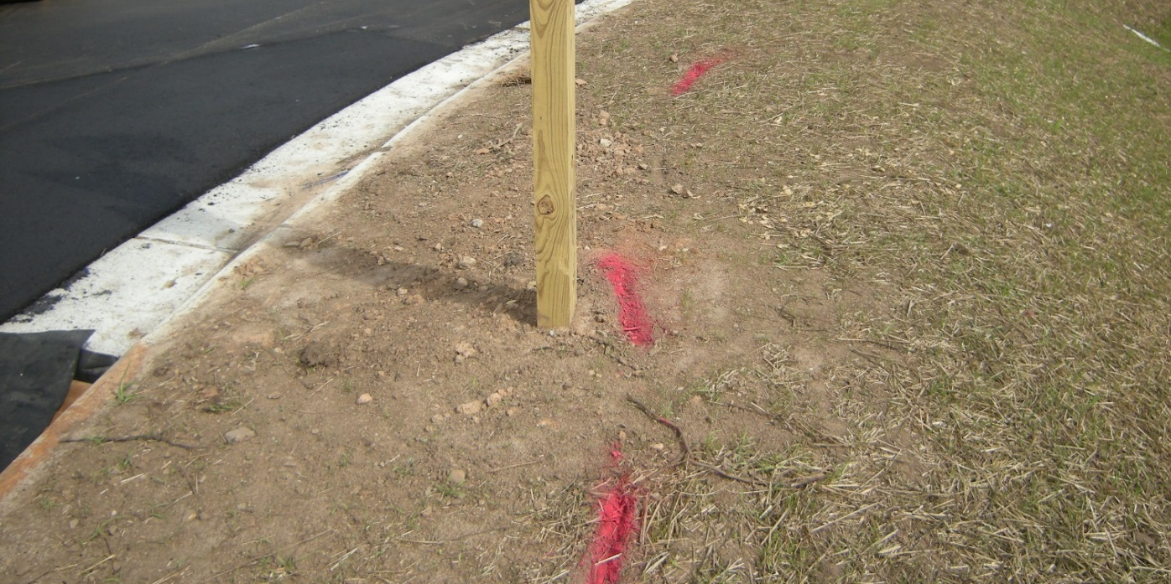
Digger’s Hotline Locating
WisDOT Electrical Facilities will be located by G4S (not USIC). If WisDOT facilities have not been located on your project, call Randy (920)360-3107 immediately.

Slide 13
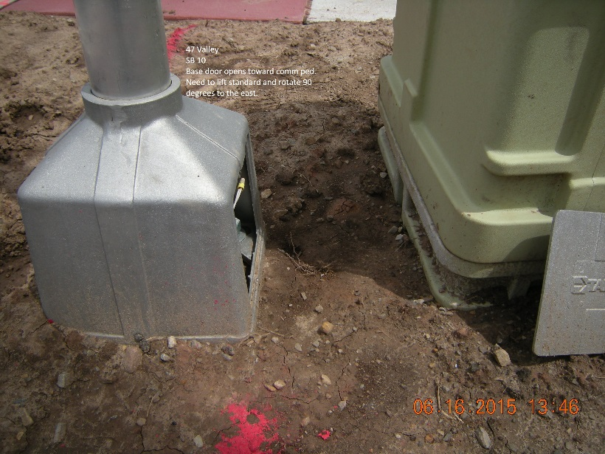
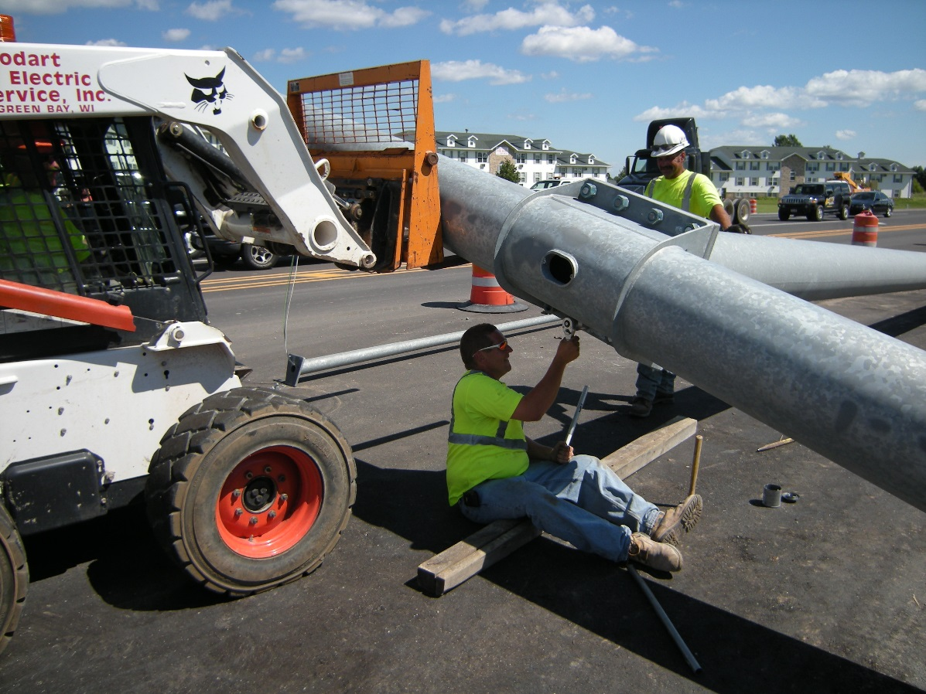
Really???

Slide 14
TRAFFIC
CONTACT INFORMATION
Randy Asman
(Signals & ITS)
(920) 360-3107
randy.asman@dot.wi.gov
Matt Talcott
(Lighting)
(920) 360-4749
matthew.talcott@dot.wi.gov

Slide 15
Randy Asman
Matt Talcott
Craig Settersten
Jeff O’Dell
Ryan Horkman
Matt Markiewicz
Jeff Rickert

Slide 16
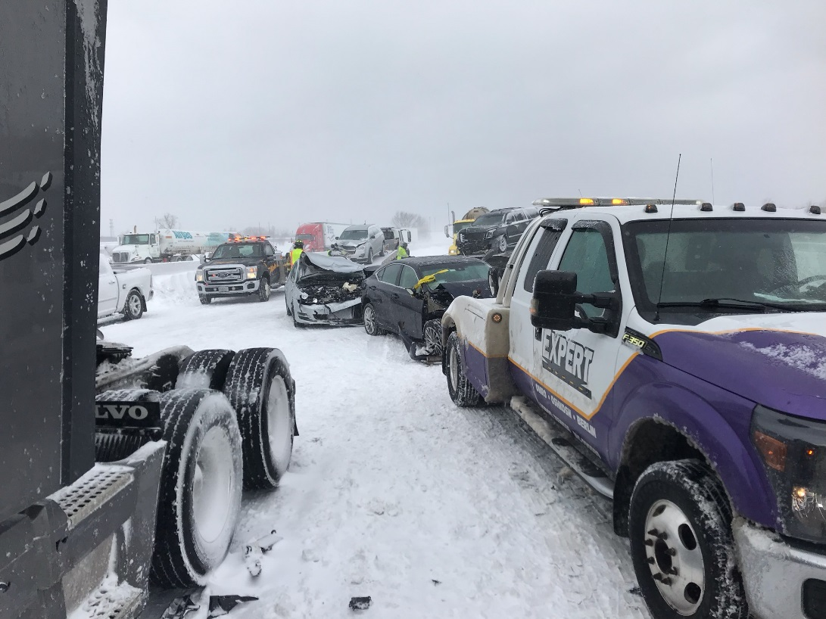
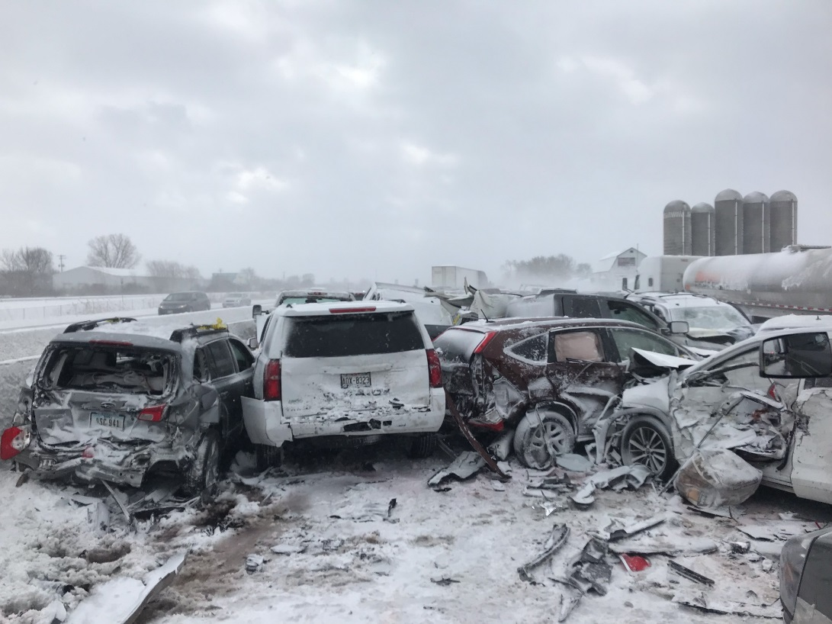
Buckle Up and Stay Buckled!!!

