Slide 1
Northeast Region Construction Training UTILITIES
Joseph Coughlin, P.E.
Utility Coordinator
March 6, 2019
Notes:
RELAX… LOOK UP… TALK SLOW
Good morning
My name is Joe
and I’m one of the utility coordinators in the region

Slide 2
AGENDA
Utility Coordination Staff
“Best Practices”
Utility Coordination Prior to Construction
Communicate with the Utilities during Construction
Resolve Utility Conflicts in the Field
Utility Problems During Construction Documentation Report
Local Program Projects
Notes:
I’d like to SHARE 3 topics with you today…
1. Utility Contact Map
2. Best Practices
3. Utility Problem Report
THEN Krissy is going to talk briefly about UTILITY COORDINATION at the Local Program LEVEL

Slide 3
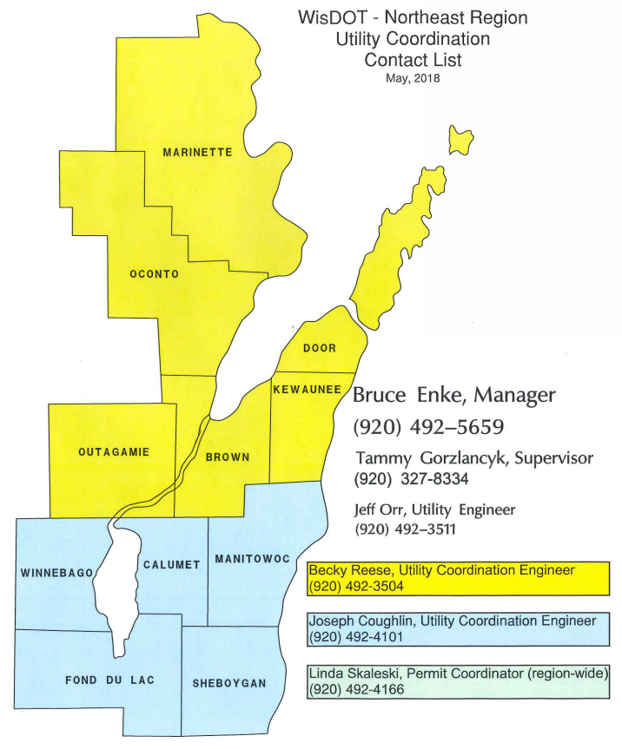
Notes:
The following is the Utility Contact Map…
BECKY is responsible for projects in the northern counties (yellow)
JOE is responsible for projects in the southern counties (blue)
JEFF is responsible for all the major projects in the region
LINDA is the utility permit coordinator for the region
TAMMY is our supervisor
BRUCE is our section chief

Slide 4
“BEST PRACTICES”
Utility Coordination Prior to Construction
Communicate with the Utilities during Construction
Resolve Utility Conflicts in the Field
Notes:
Utility Coordinators are a RESOURCE and CAN ASSIST you during construction HOWEVER…
We ENCOURAGE you to…
Understand the UTILITY FACILITIES within your project PRIOR to construction
Use the PLANS, UTILITY SPECIAL PROVISIONS and REACH OUT to the utilities before the pre-con
(Krissy chime in)
We ENCOURAGE you to…
Continue communication with utilities DURING construction
KNOW who the utility field contact is, REVIEW their schedule and INVITE them to the weekly meetings
We ENGOURAGE you to…
Be PROACTIVE and RESOLVE utility conflicts in the field

Slide 5
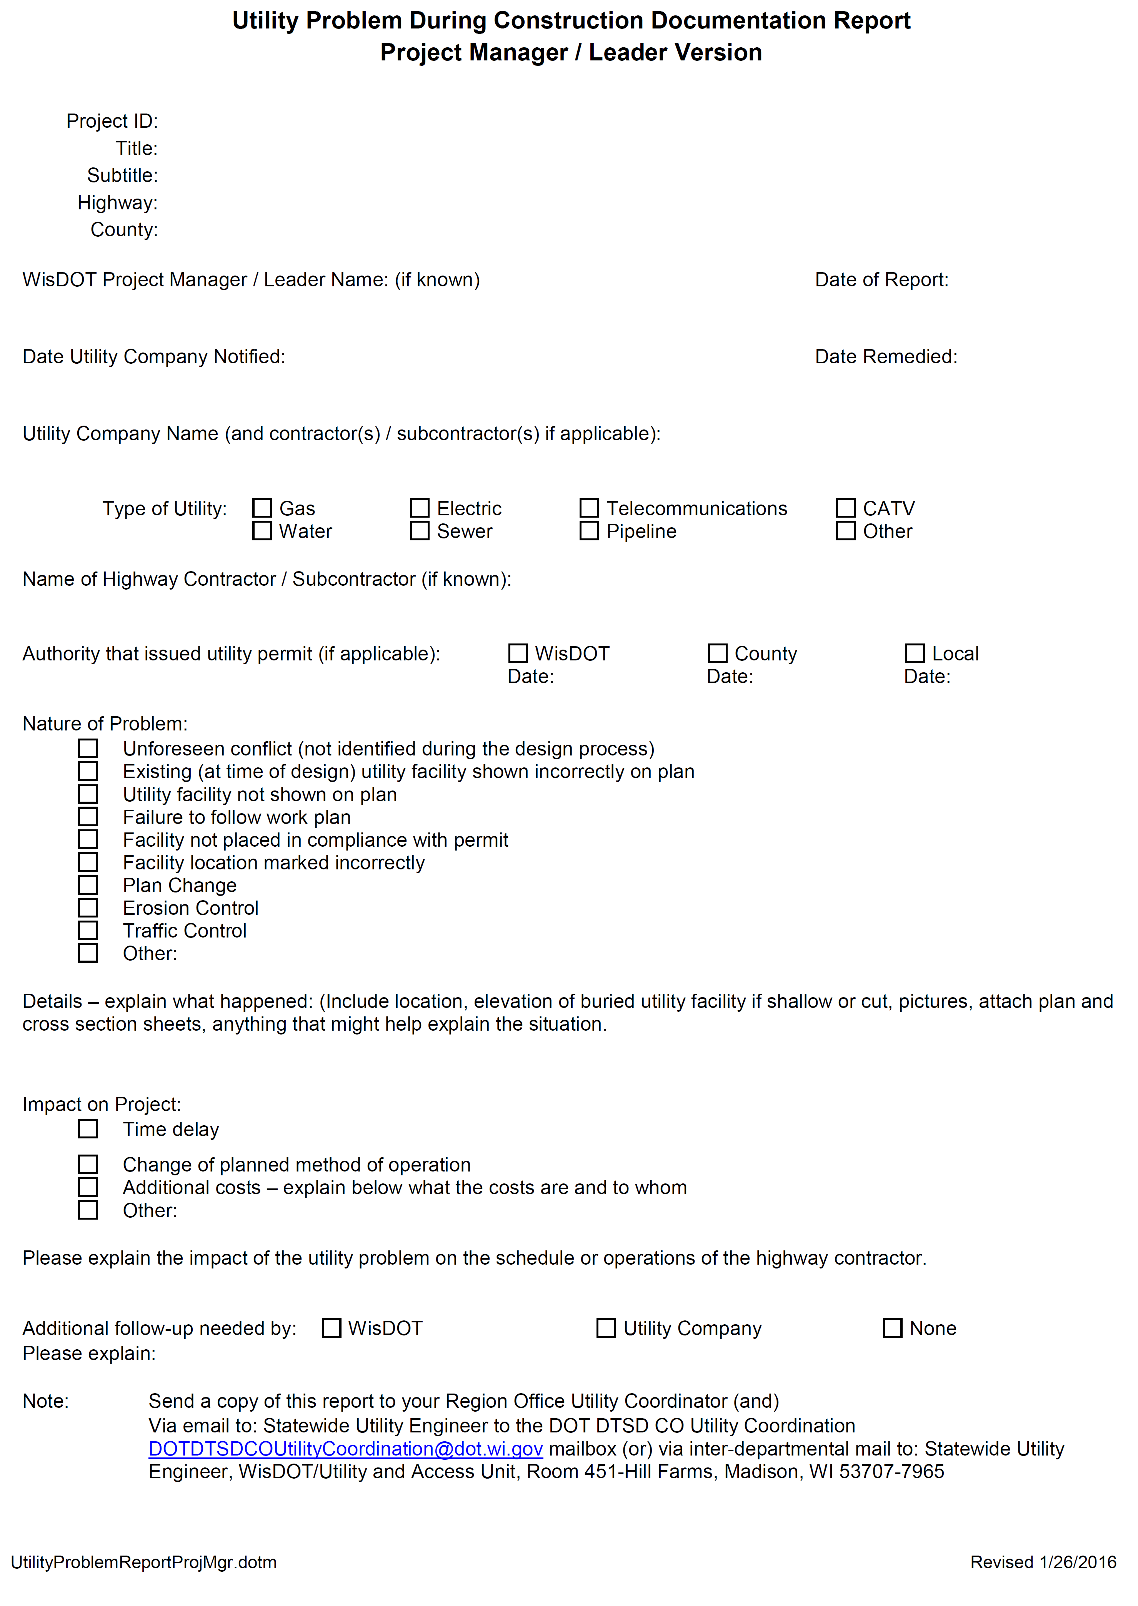
Select text to edit subhead
UTILITY PROBLEM REPORT
Notes:
With a show of hands…
… have you ever had a UTILITY CONFLICT during construction?
With a show of hands…
… have you ever SUBMITTED a Utility Problem Report?
<Hit button a second time>
This report is important because it…
DOCUMENTS problems in the field
… and RELAYS those problems to the utility coordinators in the office

Slide 6
LOCAL PROGRAM PROJECTS
Contact the sponsor immediately if utility conflicts or potential conflicts arise

Slide 7
RESOURCES
WisDOT Guide to Utility Coordination (UC Guide)
http://wisconsindot.gov/Pages/doing-bus/eng-consultants/cnslt-rsrces/util/ucguide.aspx
Utility Accommodation Policy / Highway Maintenance Manual http://wisconsindot.gov/Pages/doing-bus/real-estate/permits/utility-uap.aspx
Construction & Materials Manual (CMM)
http://wisconsindot.gov/Pages/doing-bus/eng-consultants/cnslt-rsrces/rdwy/cmm.aspx
Facilities Development Manual (FDM)
http://wisconsindot.gov/Pages/doing-bus/eng-consultants/cnslt-rsrces/rdwy/fdm.aspx

