Slide 1
Selected Sites
Tom Kobus
NE Region SWEC
NER Construction Training
NWTC
March 6, 2019

Slide 2
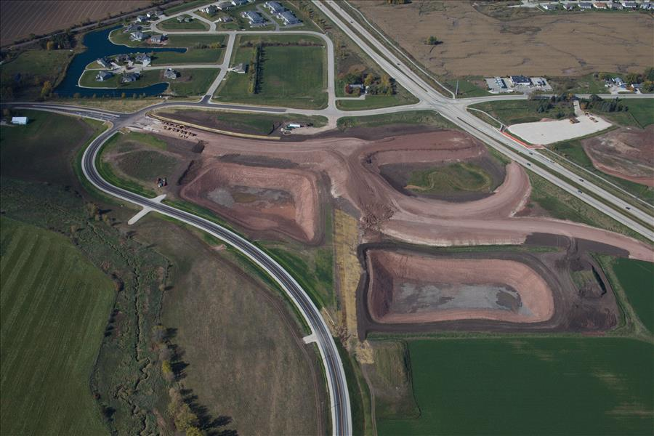

Slide 3
Open/Closed with the Project
Trans 401 “Selected Site” means any borrow site or material disposal site used exclusively for projects directed and supervised by the department.
85.193 2 (d) The site is used solely for the specified transportation project and solely during the period of construction of the specified transportation project.

Slide 4
Borrow TCGP
NR 135.02 (3) Exemption
(j) 1. nonmetallic mining conducted to obtain stone, soil, sand or gravel for construction, reconstruction, maintenance or repair of a highway, railroad, airport or other transportation facility, or part thereof, if the nonmetallic mining is subject to the requirements of the department of transportation concerning the restoration of the nonmetallic mining site.

Slide 5
Borrow TCGP
NR 135.02 (3) Exemption
(j) 2. The exemption provided is the paragraph only applies to a nonmetallic mining operation with limited purpose and duration where requirements and the operator reclaims the nonmetallic mining site in accordance with these requirements. The duration of the exemption shall be specific to the length of the department of transportation contract for construction of a specific transportation project.

Slide 6
Waste - Opened
Covered under Transportation Construction General Permit
≥1 Acre - NR 216 Construction Permit
Industrial Permit
≤1 – Local Permits may Apply

Slide 7
Restoration - Closed
Borrow/Waste area should be restored to the previous land cover
Farm fields are considered restored once farm operations resume
Property improvements would need applicable permits
Minor amount of impervious can remain on existing driveways

Slide 8
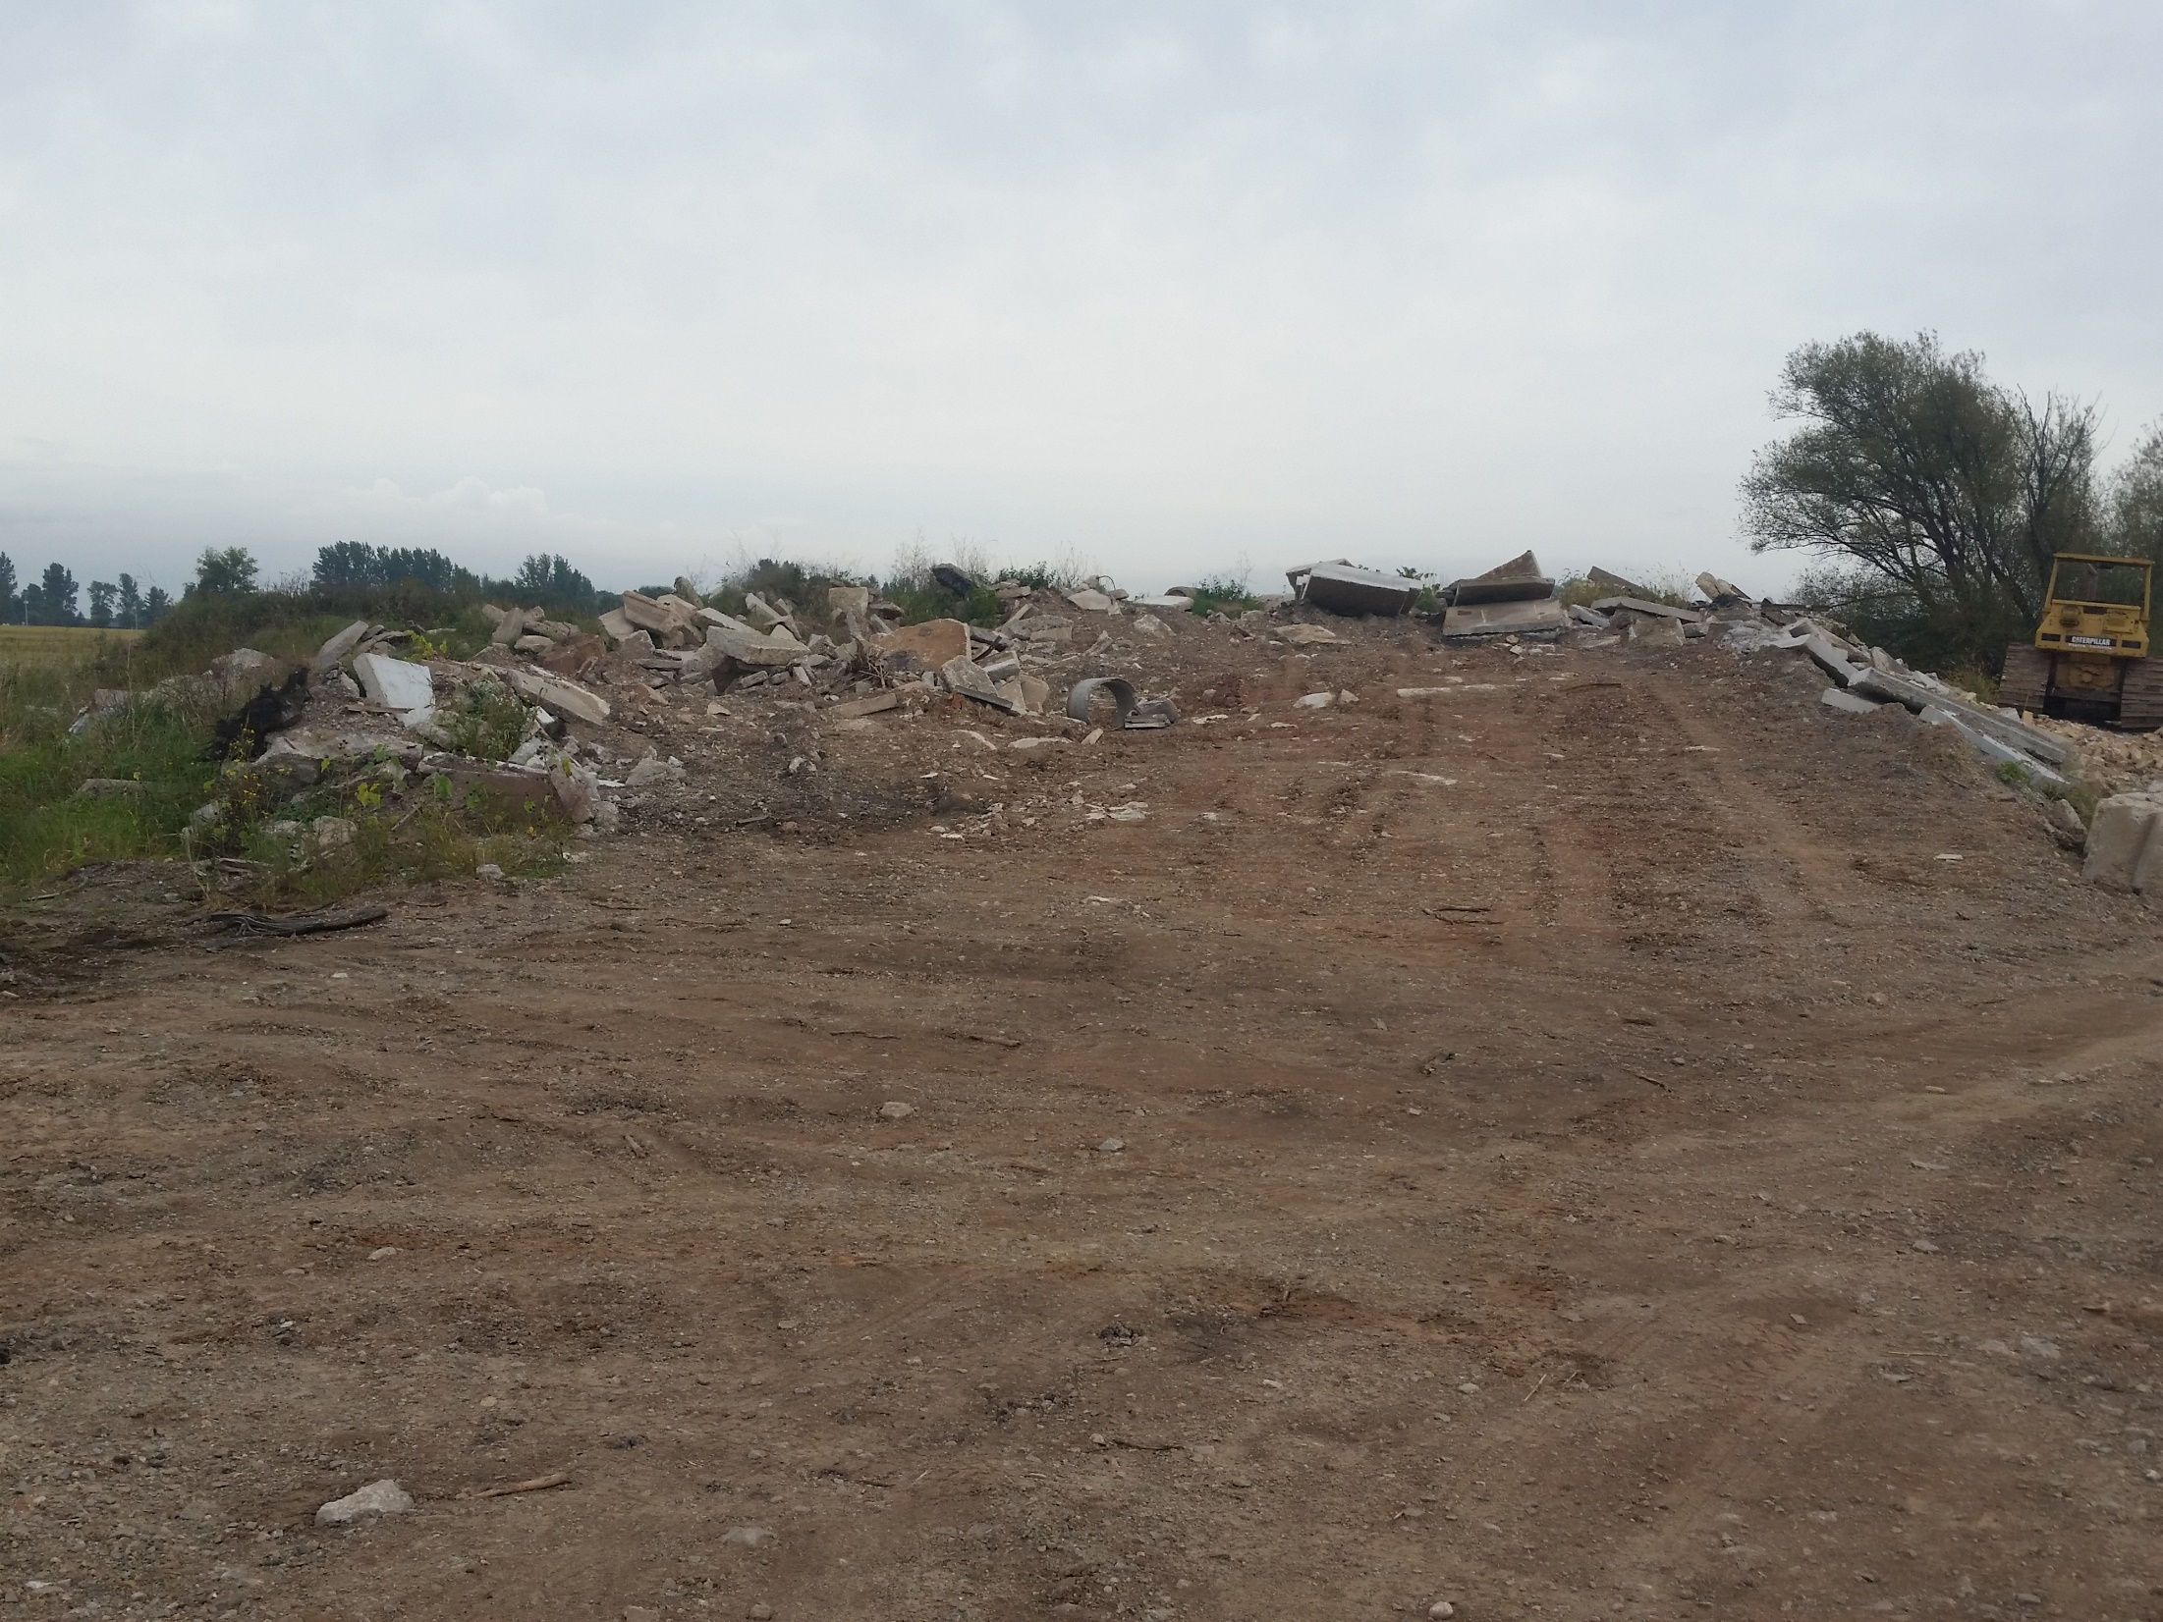

Slide 9
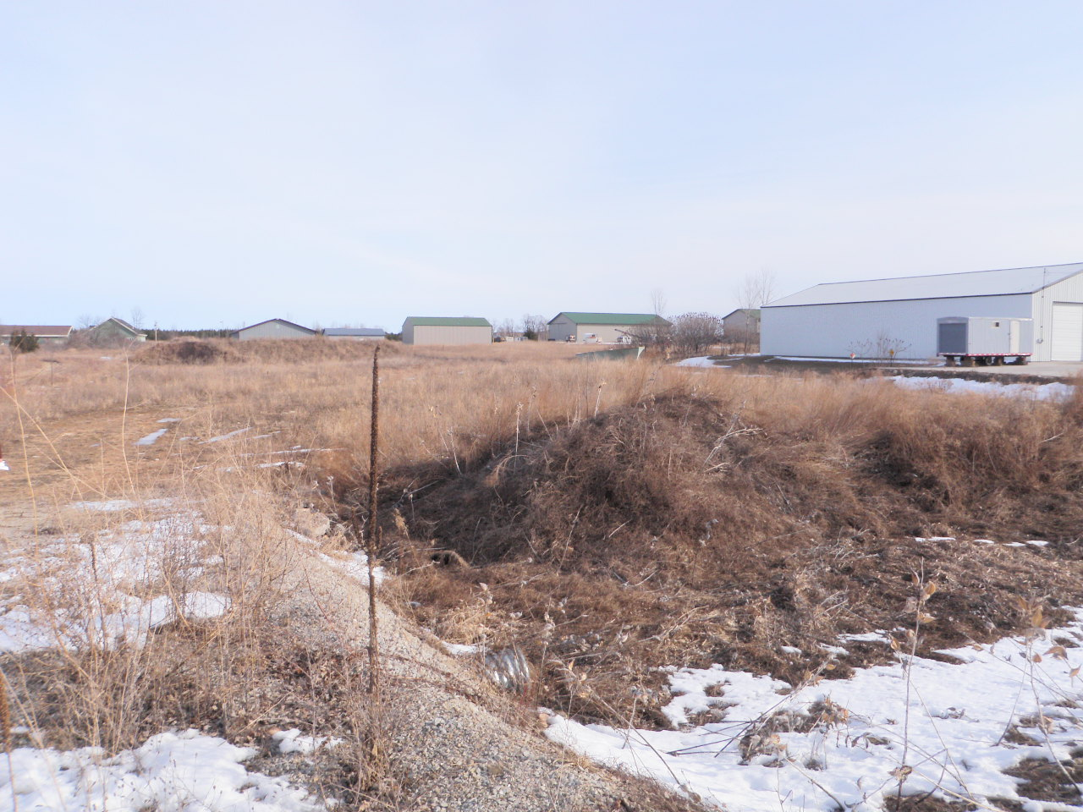

Slide 10
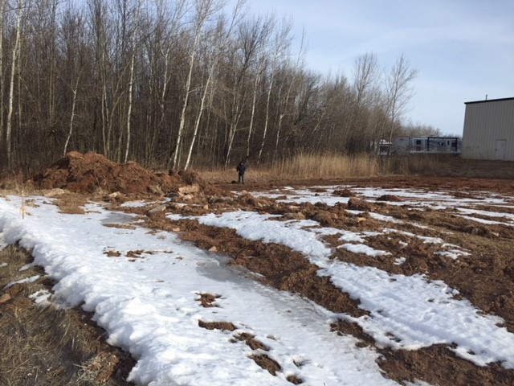

Slide 12
Sites Covered Under the TCGP
Archeological Review
ECIP Submittal and Review
WisDOT Review of Site
  Drainage
  Erosion Control
WDNR Review
  Wetlands
  Threatened and endangered resources
  Applicability of WDNR Permits
If project <1 Acre need to apply for permit
WisDOT pays for Erosion Control based on Std Spec
EC Inspection Requirements Apply
70% Vegetation Notice of Termination

Slide 13
Permitted Sites
Industrial – SIC Codes
Construction
  WisDOT Projects
  NR216
  Sites <1 Acre – Local Permits may Apply

Slide 16
Questions?

