Slide 1
Materials
Soils, Pavements & Materials Section
March 22, 2018 ▪▪▪ NWTC
Leslie Ashauer – NE Region Materials Engineer

Slide 2
Areas of Interest
Sampling & Testing
Base Aggregate
Asphalt
Concrete
General Material
Records

Slide 3
Concrete Aggregate Optimized Gradation - Backgroud
Contractor Option to use Optimized Gradation
Submit Optimized Gradation Job Mix Formula (JMF)
Submit Optimized Mixture after Optimized Gradation JMF approved
Aggregate will follow a tarantula curve.
If aggregate falls out of the tarantula curve, Contractor may:
Submit JMF modification
Return to regular spec
Concrete
Notes:
A little background on Optimized Gradation. This is an SPV that is being added to projects that require slip-form pavement. Even though the special is in your contract, it is completely optional for the CONTRACTOR to use.
If the special is not in your contract and a contractor requests to use it, the SPV can be change ordered into the project WITHOUT the 3% incentive.
Even without the 3% incentive, there are still benefits to the contractor. If the contractor also decides to use the Optimized Mixture, they are able to reduce up to 8% of cementitious material in the concrete mix. Cementitious material is the largest cost per lb in concrete. This can equate to a large savings for the contractor.
There are benefits to both the Contractor and the Department.
QV Testing of Concrete Aggregate is Required
CCO into job – no incentive
In specials – 3% incentive
Contractor option – optimized gradation first – then optimized mixture.
Contractor Benefit is ability to use less cement / and an option for 3% incentive (possible reduction of cementicious material from 565 lbs to 520 lbs. This is a large cost savings for the contractor – cementious materials are largest cost per lb.)
Department Benefit – better mixes – reducing voids – aggregate gradations will be well graded versus gap graded
Better durability – permeability will decrease – strengths should be comparable.
Contact ADAM as soon as we know which jobs are doing this.
All requirements are in SPV. Mix follow tarantula curve. Falls out of trantuala curve, can submit a JMF – Adam – Leslie backup.
Aiming for consistency in concrete.
Falls out and can’t adjust it – can always go back to regular spec.- if so that is a new mix design and lots/sublots start over.
Notify Adam (BAD IA)
If doing optimized – adam wants to do SAM testing during paving.
***SAM testing for pavement (handwork and slipform)
SAM number attached with a new mix design – 1 SAM test per pavement lot
Adam questions

Slide 4
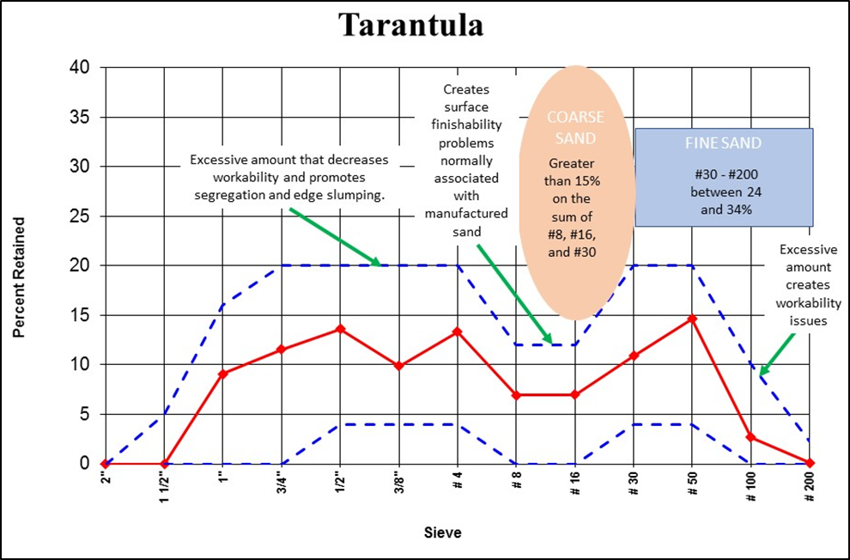
Concrete Aggregate Optimized Gradation - Backgroud
Contractor Option to use Optimized Gradation
Submit Optimized Gradation Job Mix Formula (JMF)
Submit Optimized Mixture after Optimized Gradation JMF approved
The
Notes:
A little background on Optimized Gradation. This is an SPV that is being added to projects that require slip-form pavement. Even though the special is in your contract, it is completely optional for the CONTRACTOR to use.
If the special is not in your contract and a contractor requests to use it, the SPV can be change ordered into the project WITHOUT the 3% incentive.
Even without the 3% incentive, there are still benefits to the contractor. If the contractor also decides to use the Optimized Mixture, they are able to reduce up to 8% of cementitious material in the concrete mix. Cementitious material is the largest cost per lb in concrete. This can equate to a large savings for the contractor.
There are benefits to both the Contractor and the Department.
QV Testing of Concrete Aggregate is Required
CCO into job – no incentive
In specials – 3% incentive
Contractor option – optimized gradation first – then optimized mixture.
Contractor Benefit is ability to use less cement / and an option for 3% incentive (possible reduction of cementicious material from 565 lbs to 520 lbs. This is a large cost savings for the contractor – cementious materials are largest cost per lb.)
Department Benefit – better mixes – reducing voids – aggregate gradations will be well graded versus gap graded
Better durability – permeability will decrease – strengths should be comparable.
Contact ADAM as soon as we know which jobs are doing this.
All requirements are in SPV. Mix follow tarantula curve. Falls out of trantuala curve, can submit a JMF – Adam – Leslie backup.
Aiming for consistency in concrete.
Falls out and can’t adjust it – can always go back to regular spec.- if so that is a new mix design and lots/sublots start over.
Notify Adam (BAD IA)
If doing optimized – adam wants to do SAM testing during paving.
***SAM testing for pavement (handwork and slipform)
SAM number attached with a new mix design – 1 SAM test per pavement lot
Adam questions

Slide 5
Concrete Aggregate Optimized Gradation Benefits
Contractor Benefits:
Up to 3% Incentive
Possible reduction of cementitious material from 565 lbs to 520 lbs.
Department Benefits:
Aggregate gradations are well graded versus gap graded (reducing amount of paste needed in the mix because voids are reduced
Better durability
Permeability will decrease
Strengths should remain comparable
Concrete
Notes:
A little background on Optimized Gradation. This is an SPV that is being added to projects that require slip-form pavement. Even though the special is in your contract, it is completely optional for the CONTRACTOR to use.
If the special is not in your contract and a contractor requests to use it, the SPV can be change ordered into the project WITHOUT the 3% incentive.
Even without the 3% incentive, there are still benefits to the contractor. If the contractor also decides to use the Optimized Mixture, they are able to reduce up to 8% of cementitious material in the concrete mix. Cementitious material is the largest cost per lb in concrete. This can equate to a large savings for the contractor.
There are benefits to both the Contractor and the Department.
QV Testing of Concrete Aggregate is Required
CCO into job – no incentive
In specials – 3% incentive
Contractor option – optimized gradation first – then optimized mixture.
Contractor Benefit is ability to use less cement / and an option for 3% incentive (possible reduction of cementicious material from 565 lbs to 520 lbs. This is a large cost savings for the contractor – cementious materials are largest cost per lb.)
Department Benefit – better mixes – reducing voids – aggregate gradations will be well graded versus gap graded
Better durability – permeability will decrease – strengths should be comparable.
Contact ADAM as soon as we know which jobs are doing this.
All requirements are in SPV. Mix follow tarantula curve. Falls out of trantuala curve, can submit a JMF – Adam – Leslie backup.
Aiming for consistency in concrete.
Falls out and can’t adjust it – can always go back to regular spec.- if so that is a new mix design and lots/sublots start over.
Notify Adam (BAD IA)
If doing optimized – adam wants to do SAM testing during paving.
***SAM testing for pavement (handwork and slipform)
SAM number attached with a new mix design – 1 SAM test per pavement lot
Adam questions

Slide 6
Concrete Aggregate Optimized Gradation – Project Staff
Notify Region Base Aggregate IA – Adam Johnson
QV testing of aggregate is required.
1 QV per 5 QC tests
JMF approval / modification
Submit to Region BAD IA & Region Material Engineer
Region will perform SAM testing during paving
Concrete
Notes:
A little background on Optimized Gradation. This is an SPV that is being added to projects that require slip-form pavement. Even though the special is in your contract, it is completely optional for the CONTRACTOR to use.
If the special is not in your contract and a contractor requests to use it, the SPV can be change ordered into the project WITHOUT the 3% incentive.
Even without the 3% incentive, there are still benefits to the contractor. If the contractor also decides to use the Optimized Mixture, they are able to reduce up to 8% of cementitious material in the concrete mix. Cementitious material is the largest cost per lb in concrete. This can equate to a large savings for the contractor.
All requirements are in SPV. Mix follow tarantula curve. Falls out of trantuala curve, can submit a JMF – Adam – Leslie backup.
Aiming for consistency in concrete.
Falls out and can’t adjust it – can always go back to regular spec.- if so that is a new mix design and lots/sublots start over.
Notify Adam (BAD IA)
If doing optimized – adam wants to do SAM testing during paving.
***SAM testing for pavement (handwork and slipform)
SAM number attached with a new mix design – 1 SAM test per pavement lot
Adam questions

Slide 7
Super Air Meter (SAM) Background
Measures both air void size and air volume of fresh concrete
10 Minute test
Small Air Bubbles increase:
Freeze-Thaw Durability
Strength of Concrete
Concrete
Notes:
Super Air Meter testing was discussed in the material presentation by Bureau of Technical Services a few weeks back.

Slide 8
Super Air Meter (SAM) ASP 6 Dec 2018 LET
715.2.3.1 Pavements
For new lab-qualified mixes, test the air void system of the proposed concrete mix conforming to AASHTO provisional standard TP 118. Include the SAM number as a part of the mix design submittal.
715.3.1.1 General
For pavement concrete, also test the air void system conforming to AASHTO provisional standard TP118 at least once per lot and enter the SAM number in the MRS for information only.
Concrete
Notes:
SAM testing needs to be completed on concrete pavement projects (both hand and slipform). The SAM number needs to be submitted with the mix design submittal. Ensure you are looking for this on your projects. The contractor will perform 1 SAM test for each lot of concrete and will enter the SAM number into MRS. The SAM number is being entered for information only.

Slide 9
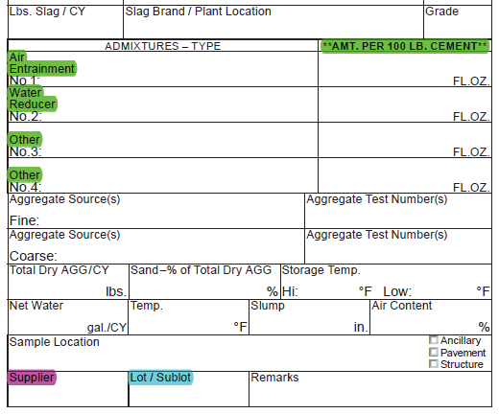
Concrete Cylinder Card DT 1308
3 Commonly Overlooked / Improperly Filled in Fields
Fluid Ounces in
**AMT per 100 LB Cement**
Supplier – Location
Suppliers have multiple locations.
Lot / Sublot
Concrete

Slide 10
Incentive / Disincentive
Need to pay individual Incentive & Disincentive separately
Administrative Item Numbers – CMM 2-38 Table 1
BTS Tracking of Incentive & Disincentive Dollars
Records
Notes:
List contact and resources to help get answers.
Refer to WisDOT project web site for detailed and ongoing information.
Include name and phone number/email for lead staff.
Take Q&A if time allows.
End the presentation on a positive note. Thank the audience for their time and attention.

Slide 11
Reference to Other Item (Entire)
Records

Slide 12
Reference to Other Item (Partial)
.A
- Pipe
.B
Records

Slide 13
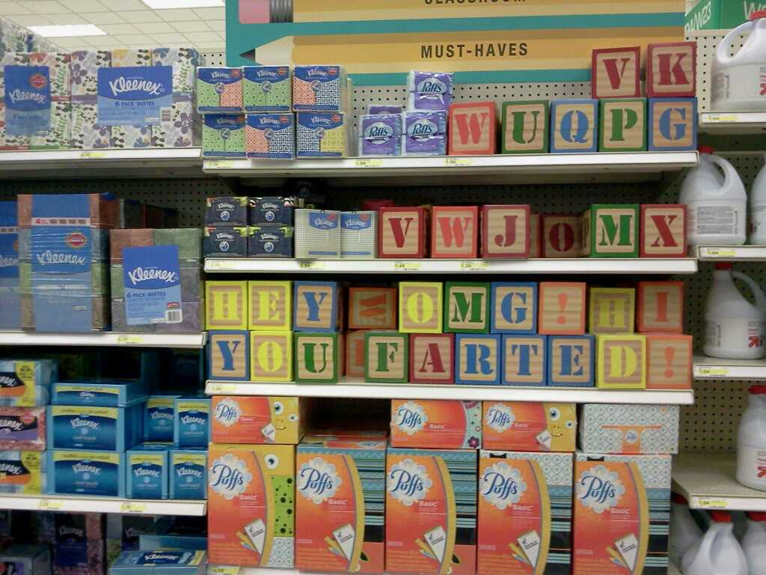
Product Name
Can you go to the store and get me some tissues?
Records

Slide 14
Product Name
UMM, what Manufacturer do you want?
Proctor & Gamble
What Kind? Puffs Plus, Puffs Ultra Soft & Strong, Puffs Plus Lotion?
PRODUCT NAME: PUFFS PLUS LOTION
Records

Slide 15
Non-Performance of QMP
Non-Performance Form
Located in Pantry under NE Region
Non-Performance Amounts > $5,000 get additional concurrence from BTS / BPD
Document on DT 1310
Include Non-Performance Form in Material Records
Records

Slide 16
DT 1310 Entries
Need Details
QV Random not reached – WHY?
Include:
Non-Conforming Material (test and spec)
Non-Performance of QMP (QC and QV)
Buy America Exemptions
Records

Slide 17
Buy America
CMM 2-28.5 Buy America Provision
Step Certification Process
1. Location steel/iron was melted/cast.
2. Location steel/iron was rolled/drawn.
3. Location steel/iron was fabricated.
4. Location steel/iron was coated/galvanized.
Records

Slide 18
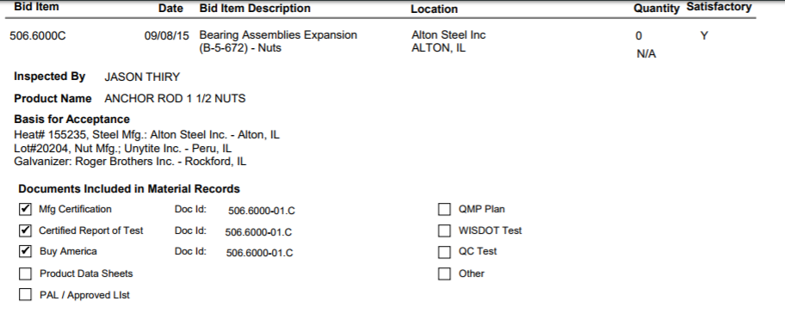
Buy America
Steel Mill – Material Came From Here
Unytite – Manufactuer (Need Buy America)
Roger Brothers – Galvanizer (Need Buy America)
Records

Slide 19
Geotextile Testing
ASTM D6421 (new) / ASTM D6432 (old)
DO NOT send samples to BTS for Testing
Entry on DT1310 allowing material (language)
Values coming in 2019 spec.
Sampling & Testing
Notes:
Cover topics not yet addressed in prior slides, include them as appropriate.
The amount of information should be relevant to allowable time and audience.

Slide 20
Sample Drop Off - Region
Sampling & Testing
Notes:
Cover topics not yet addressed in prior slides, include them as appropriate.
The amount of information should be relevant to allowable time and audience.

Slide 21
Sample Drop Off - Madison
Sampling & Testing

Slide 22
Sample Drop Off
Sampling & Testing

Slide 23
Samples for Madison / Truax
Delivery Truck comes every 2 weeks on a TUESDAY.
Truck schedule posted in Sample Drop Off Room
Copy Attached to Posted Presentation
Be mindful of truck when needing results – may take longer if need to wait 2 weeks for truck!
Sampling & Testing

Slide 24
Contractor Material Coordinator
Contractor Project Material Coordinator
Certification PRIOR to Preconstruction Meeting
Withhold NTP until certified.
CPMC is responsible to review submittals.
Be upfront with CPMC of expectations.
Highlighting or Initialing
General Material

Slide 25
ASTM / AASHTO
ASTM Compass
DOT Employees have access
NOT allowed to distribute externally
Allowed to come into Region Office and reference
If need ASTM / AASHTO information call:
DOT Project Manager
DOT Materials
General Material

Slide 26
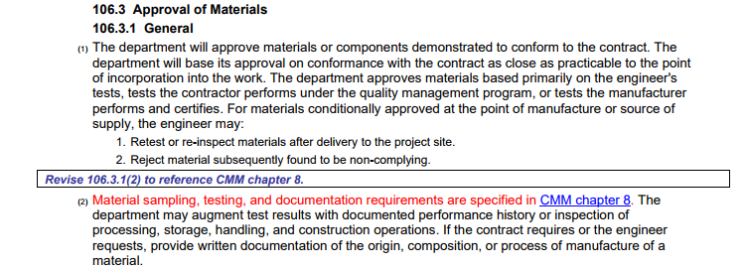
CMM Chapter 8 – Contractual?
General Material

Slide 27
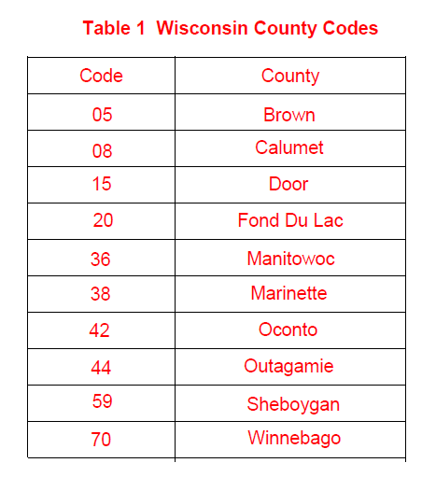
Aggregate Sources
CMM 8-60.2.1 Unique Source Identifier
Unique Identifiers will be
formatted as follows:
SS-CC-XXX-YYY
SS = state FIIPS code
CC = county number corresponding to the aggregate source location.
XXX = arbitrary number unique to each source within a county beginning with source 001.
YYY = source type; a three-letter description such as QRY for quarry, PIT for pit, or RCC for recycled
concrete.
Base Aggregate
Notes:
What will be happening after today?
List key next steps and perhaps a phrase or sentence about what the goal will be.
Be as clear as possible – if you don’t have an exact date, include general month/year.

Slide 28
Aggregate Sample Cards
Include:
Source Name
Project ID
Source Number
CMM 8-60: Table 1
Provide copy of SPV Article
State Accurate Material
Trench Backfill – ¾” BAD
Foundation Backfill – Stone Chips (>18” Pipe)
Base Aggregate

Slide 29
QMP BAD Stockpile Test
Intent is to do a side by side QC/QV
QC & QV stockpile tests valid for 60 Days
Contractor required to inform staff of valid stockpile sample from another project
List project ID & test number in 155 report
Base Aggregate

Slide 30
HMA Longitudinal Joint Density
Joint between 2 lanes
Not to be used with Joint Heaters
Ensuring compaction in Joint for longevity
Can be used on QMP HMA projects – Including HMA PWL
Asphalt
Notes:
Security Tape on QC Retained samples.

Slide 31
Tracking of HMA QV Mix Samples
QV sampling for NE Region in 2018 will be tracked by Project, not mix design.
Keep Region HMA IA in the loop on samples/tonnages
Asphalt
Notes:
Security Tape on QC Retained samples.

Slide 32
Region HMA Training
Staff on HMA projects
6 Sessions
Staff will be contacted from PDS
Discuss HMA, HMA PWL, CIR, and SMA
Asphalt
Notes:
Security Tape on QC Retained samples.

Slide 34
What is Acceptable Forms of Buy America Certification?
Step Certification (CMM 2-28.5) – Need to state where material came from or where process took place. Must be in the USA.
DOT follows 23 CFR.

Slide 35
Proprietary Items – Exempt from Buy America?
ALL Steel or Iron that is LET in our contract is subject to Buy America unless the provision is omitted from the specials.
Local items (non-participating funds) are not exempt from Buy America requirements.
Proprietary Items are not exempt from Buy America requirements.

Slide 36
Can Spec be updated to have all acceptable ASTM / AASHTO Std’s?
WisDOT uses AASHTO standards.
Spec references ASTM’s when an AASHTO does not exist.
If both were included it would entail a great detail of additional work to ensure all the “tentacles in the spec” are updated.

Slide 37
Why do Contractors tell us Every year “I never had to do this before?”
Human Nature to not do something that isn’t fun or desirable.
Other staff may not have held contractor accountable.

Slide 38
Why don’t Contractors/Suppliers/Mfgrs have In-Depth Training?
No contractual way to require a contractor to attend training
Invited to the Bureau spec and material training

Slide 39
There is Non-Performance of QMP, why not a Non-Performance of CDMP?
Spec does not have consequences for CDMP not performing tasks.
It starts with project staff informing the department of specific issues that are not being done.
Would a form to fill out be helpful?

