Slide 1
WisDOT NE Region 2018 Construction Conference
Tim Borowski – Bureau of Structures
March 22, 2018
Notes:
Before
Be well prepared with content. Know facts and figures and your audience.
Everyone should be able to read the slides but if NOT, read it to them. Otherwise don’t include it.
Do a final check on microphone and other equipment well before the start time.
Practice the presentation aloud several times. Feel comfortable.
Drink fluids and do something to relax you.
During presentation
Smile and be confident.
Introduce yourself and the organization.
Speak with energy, clearly, and in a reasonable volume so everyone can hear you.
Do not read each line on the slide show – use your own wording and add in examples or additional information which will aid in comprehension.
Talk “friendly” and with the attitude that you are here to provide information and assistance. Have a “win/win” attitude.
If you make an error, politely clarify or correct it. Move on quickly and don’t dwell on it.
If you can’t answer a question, politely indicate you don’t have the information available. Indicate that you will follow-up individually with the requestor.
After presentation
Be available for follow up.
Be prepared for additional comments, questions or clarifications.
Maintain composure.
If you make a promise, be sure to follow up quickly or reassign if appropriate.

Slide 2
Structures Agenda
Contacting BOS – When & Why
Specification and Manual Updates
Structures Construction Issues
Ancillary (Wind Loaded) Structures
Fabrication & Materials Issues

Slide 3
Structures Agenda
Contacting BOS – When & Why
Specification and Manual Updates
Structures Construction Issues
Ancillary (Wind Loaded) Structure Issues
Fabrication & Materials Issues

Slide 4
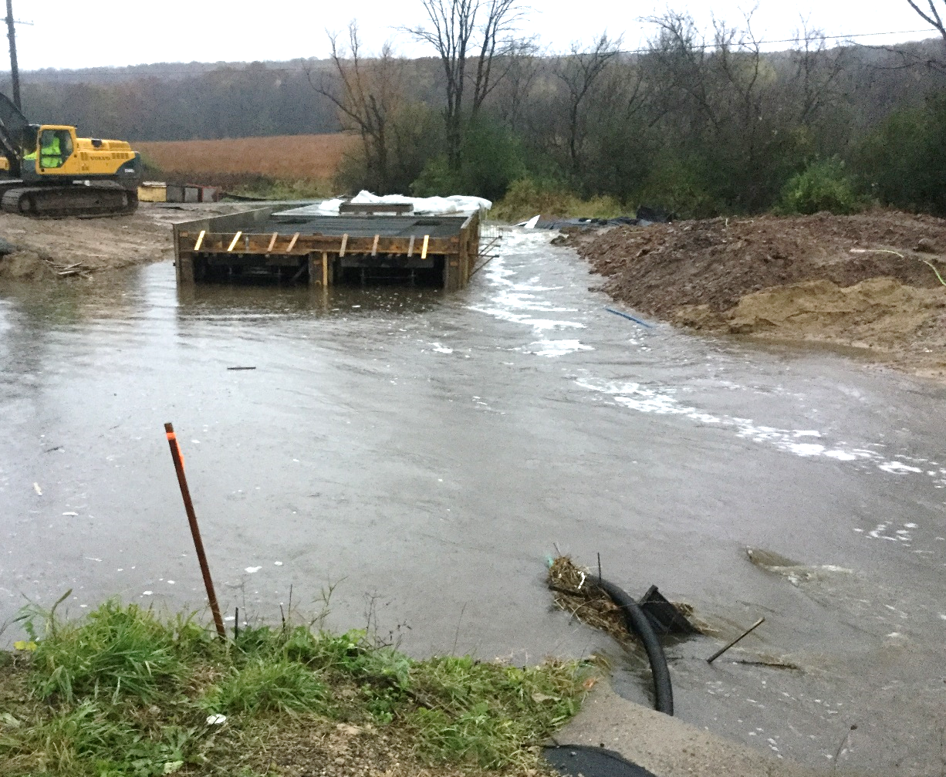
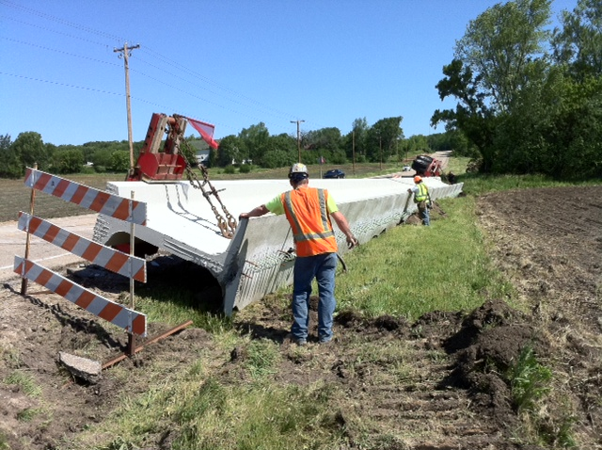
Contacting BOS – When & Why
Anything “structural”
  excessive construction loads
  structural capacity
  pile locations, etc.
If in doubt, call us!
  See Structures Contacts Handout
Notes:
If there is one thing that I would like for you to take away from my presentation here today, I hope that you know that BOS is able, available, and willing to answer any questions that you may have during the construction of your projects.
Any item that you may think involves structural aspects that you are not 100% comfortable answering, please don’t hesitate to contact us.
I have attached a contact list to this presentation for a reference on who to contact and for what situations.
One other reminder– is to push for contractor staff to work through the Region or Consultant construction staff for inquiries. Historically, the contractors have come directly through BOS and we have asked that they go back through project staff.

Slide 5
Structures Agenda
Contacting BOS – When & Why
Specification and Manual Updates
Structures Construction Issues
Ancillary (Wind Loaded) Structures
Fabrication & Materials Issues

Slide 6
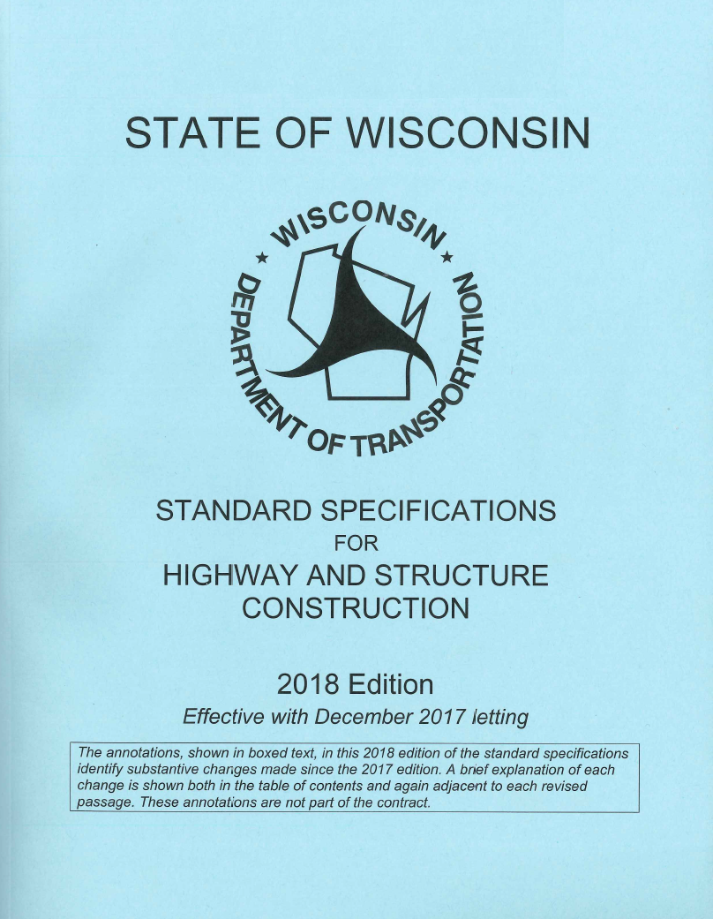
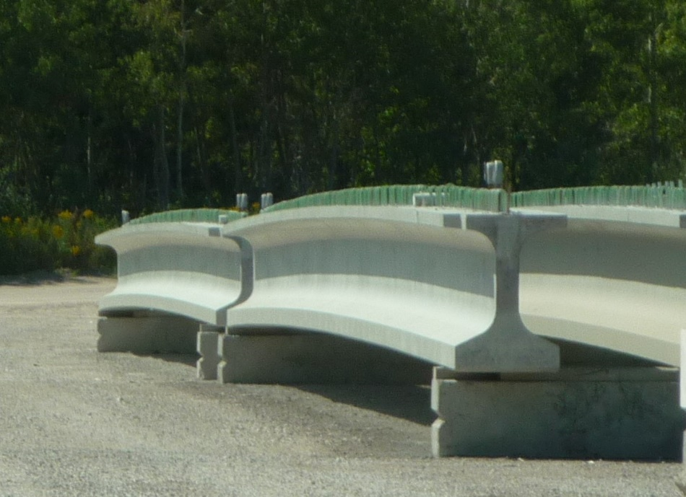
Standard Spec Updates
Prestressed Girder Length Tolerance
Laminated Elastomeric Bearings
Steel Fabrication
Notes:
Prestressed Girder Length Tolerance:
the length tolerance for prestressed concrete I-type girders is increased to a max. of 1 1/2“ (+/- 1/8" per 10', up to a max of +/- 1 1/2“).
Laminated Elastomeric Bearings
Furnish laminated bearings from the department's APL for laminated elastomeric bearings
APL for laminated elastomeric bearings is considerably smaller than in the past (must have an audit scheduled with NTPEP or have a completed audit on file)
Steel Fabrication:
Ensure that the fabricator submits quality management plan, proper DT forms, shop drawings, etc. per the roles and responsibilities document on the BOS website

Slide 7
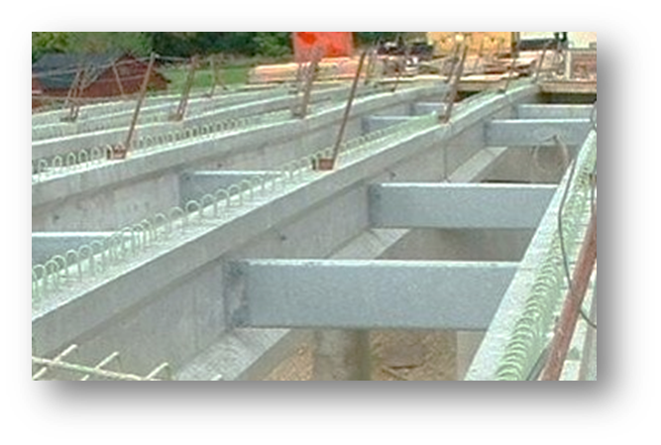
Standard Spec Updates
Bolting Procedures for Steel Diaphragms on Prestressed Concrete Girder Bridges
Concrete Masonry Overlay bid item
Steel Railings
Notes:
Bolting Procedures for Steel Diaphragms on Prestressed Concrete Girder Bridges:
For steel-to-steel connections within diaphragms:
No field rotational capacity testing is required.
Provide a certified report of test or analysis from the bolt supplier
The department may require field testing to determine inspection torque.
Re-lubricate bolt threads with a wax-based lubricant.
Tension by the turn-of-nut method.
For steel-to-concrete girder connections:
No testing is required.
Tighten as the plan details specify (typically snug-tight plus ¼ turn)
Concrete Masonry Overlay Decks bid item:
Clarifies that the item includes concrete for Preparation Decks, Joint Repair , Curb Repair, and Full-Depth Deck Repair bid items
Steel Railing:
Section 513 was rewritten, incorporating several railing special provisions.
Furnish railing from a department-approved fabricator. A list of approved fabricators is available on the department's APL for structures under bridge secondary metals.
If painting, use a two-coat paint system after galvanizing. Use a paint system from the department's APL for structure painting systems under paint - galvanized railing.

Slide 8
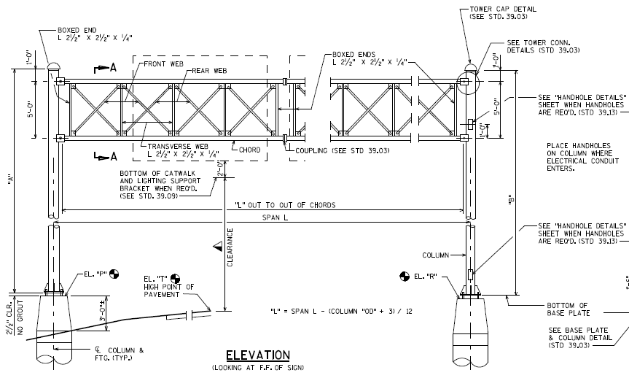
Standard Spec Updates
Ancillary (Wind Loaded) Structures
  641: Sign Bridges and Overhead Sign Supports
    Primary member shop fabrication to be conformed to 506.3.2
      Contractor submit sign bridges shop drawings electronically to department fabrication library at least 2 weeks prior to fabrication.
      Contractor submit overhead sign supports shop drawings, design computations and material spec to the engineer 2 weeks prior to fabrication.
    Shop inspection per 506.3.22
    Field inspection per 506.24
Notes:
Sign bridge and overhead sign support shop fabrications now conforming to same general requirements for bridges as in standard spec 506
Steel Sign Bridges and Overhead Sign Supports:
Ensure fabricator/contractor electronically submits shop drawings to the department's on-line fabrication library at least 2 weeks before beginning fabrication

Slide 9
Standard Spec Updates
Ancillary (Wind Loaded) Structures
  ASP6 (641.2.9(3)): Contractor may provide overhead sign support members with straight or tapered poles and mast arms, unless noted otherwise on the plans
  654: Department no longer supply anchor rods for type 10 and 13 concrete bases. Contractor will furnish these anchor rods going forward
  657: New bid items and articles added for Anchor Assemblies Light Poles on Structure
Notes:
ASP6 for 641.2.9(3) was implemented effective December 2017 LETTING allowing contractor to provide either straight or tapered poles and mast arms for overhead sign support when there is no tapered section requirement in the plans.
Going forward, contractors are required to furnish anchor rods, nuts and washers for traffic monotubes. This is in consistent with sign structures.
New bid item and standard spec are added for Anchor Assemblies Light Poles and mounted on bridges. This is typically type 5 light poles.

Slide 10
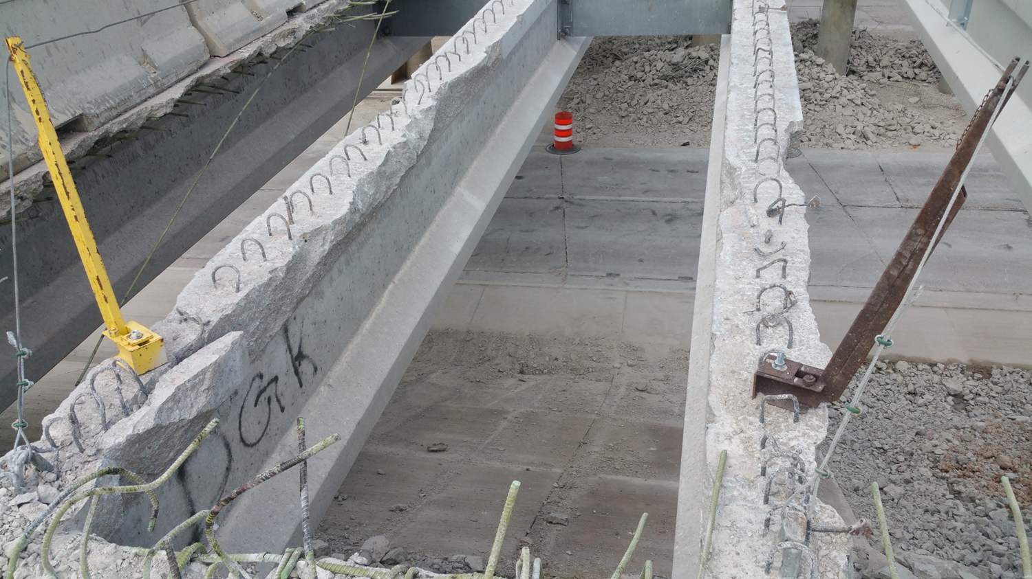
ASP 6
Revise 203.3.2.2: Restoration of contractor-caused damage
Notes:
ASP 6 effective with the December 2017 letting
Revise 203.3.2.2:
Requires department assessment of and written approval for restoration of contractor-caused damage done to girders during deck removal.
After deck removal is complete, notify the engineer to request a damage survey.
Goal is to AVOID DAMAGE!

Slide 11
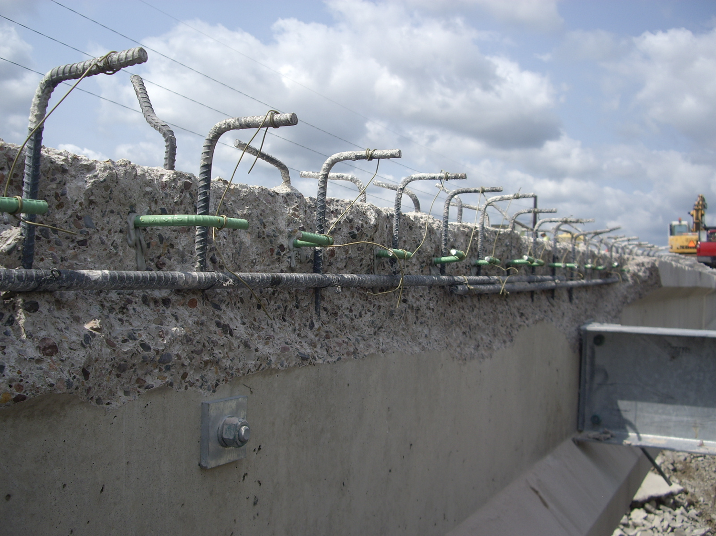
Const. & Mat’ls Manual Updates
Contact BOS Structures Design at 608-266-8489 if damage to steel or concrete girders occurs during deck removal.
Notes:
CMM 5-28 Concrete Deck Overlays and Structure Repairs:
Contact BOS Structures Design at 608-266-8489 (Bill Dreher) if damage to steel or concrete girders occurs during deck removal.

Slide 12
Structures Agenda
Contacting BOS – When & Why
Specification and Manual Updates
Structures Construction Issues
Ancillary (Wind Loaded) Structure Issues
Fabrication & Materials Issues

Slide 13
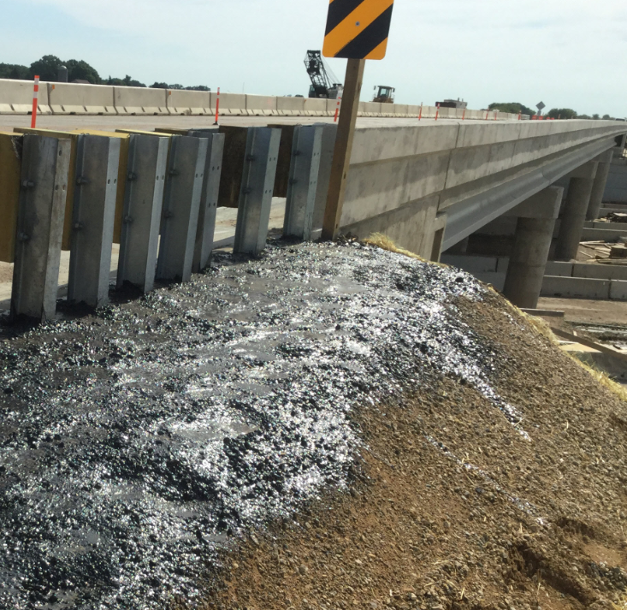
Wing Tip Erosion and Drainage
Be sure grading around wing tips promotes proper drainage.
Typically finished grade ends 6” above wing tip.
Do not allow bituminous sealant around wing tips.
The end of the structural approach slab is not the end of wing.
Notes:
Erosion around wing tips continues to be a problem. Grading needs to be completed to the proper elevation at the wing tips. This does not always mean the finished ground should hit the wing tip, in many cases the finished grade needs to sit 6” above the wing tip.
While sealant around the wing tips may seem like a good idea to keep everything in place, it has also been known to worsen the issue. So please do not allow this.
Be careful the end of the structural approach slab is not confused with the end of wing. Next slide shows a good example of how not to complete grading with the structural approach slab extends beyond the wing.
Southeast Region

Slide 14
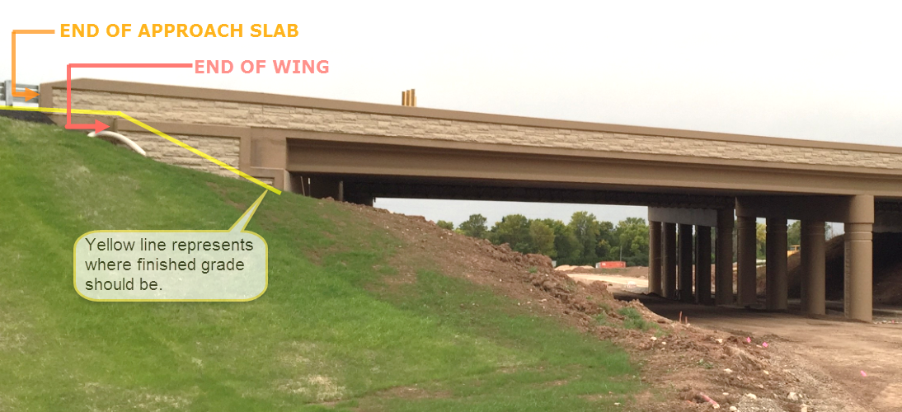
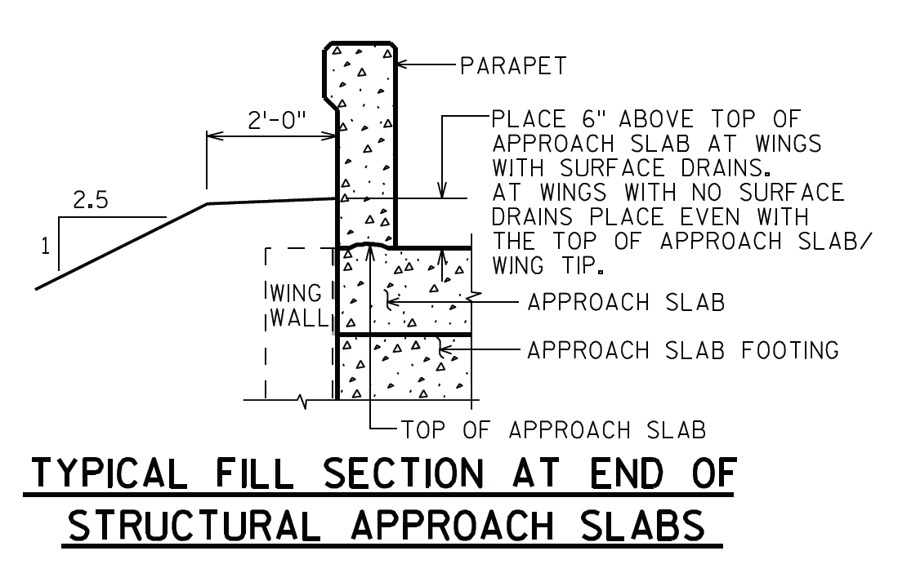
Wing Tip Erosion and Drainage
Notes:
- It is important to remember that with structural approach slabs the wing sits outside of the edge of deck and grading needs to come up to the end of wing, not where the parapet ends.
- Northeast Region B-70-420/421

Slide 15
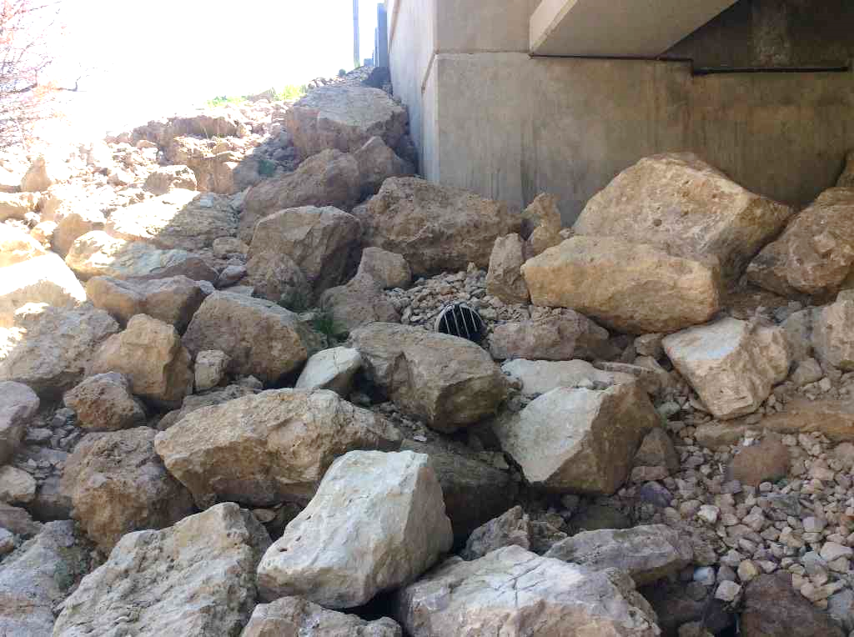
Riprap Spec. and Installation
Common problems with supplied riprap:
  Stone sizes too small
  Stone sizes poorly distributed
  Too many fines are included
Ensure riprap complies with Specified grade- see CMM 6-45.7.7.1

Slide 16
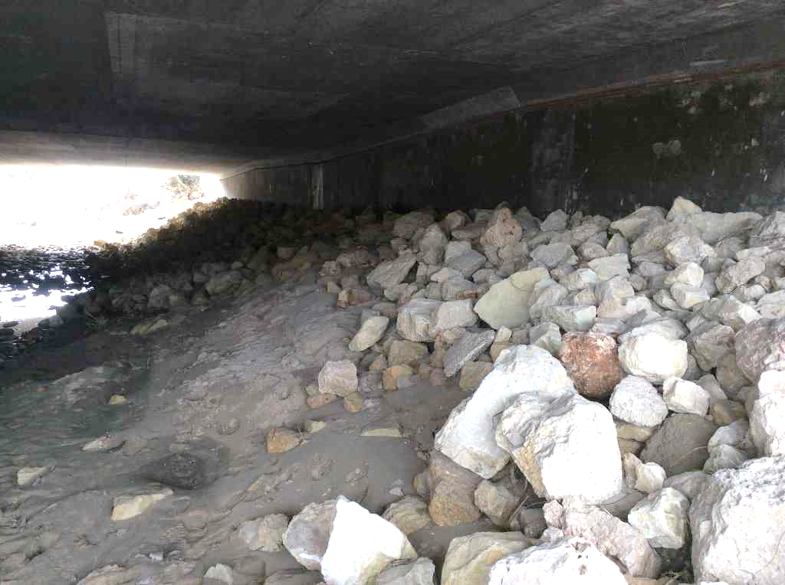
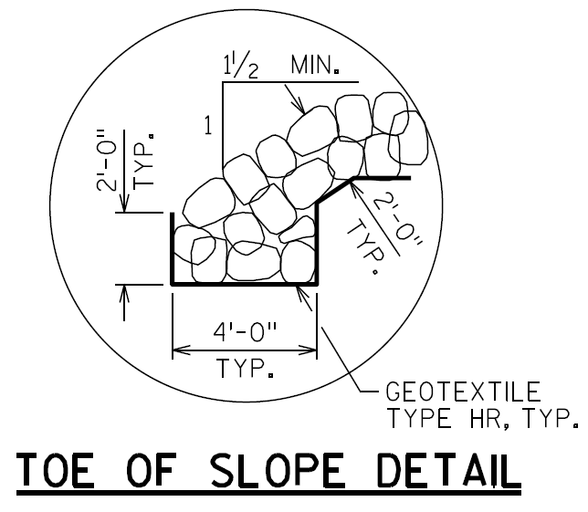
Riprap Spec. and Installation
Riprap should be installed per plan
Ensure toe of slope keyed in per plan detail
Do not omit geotextile fabric

Slide 17
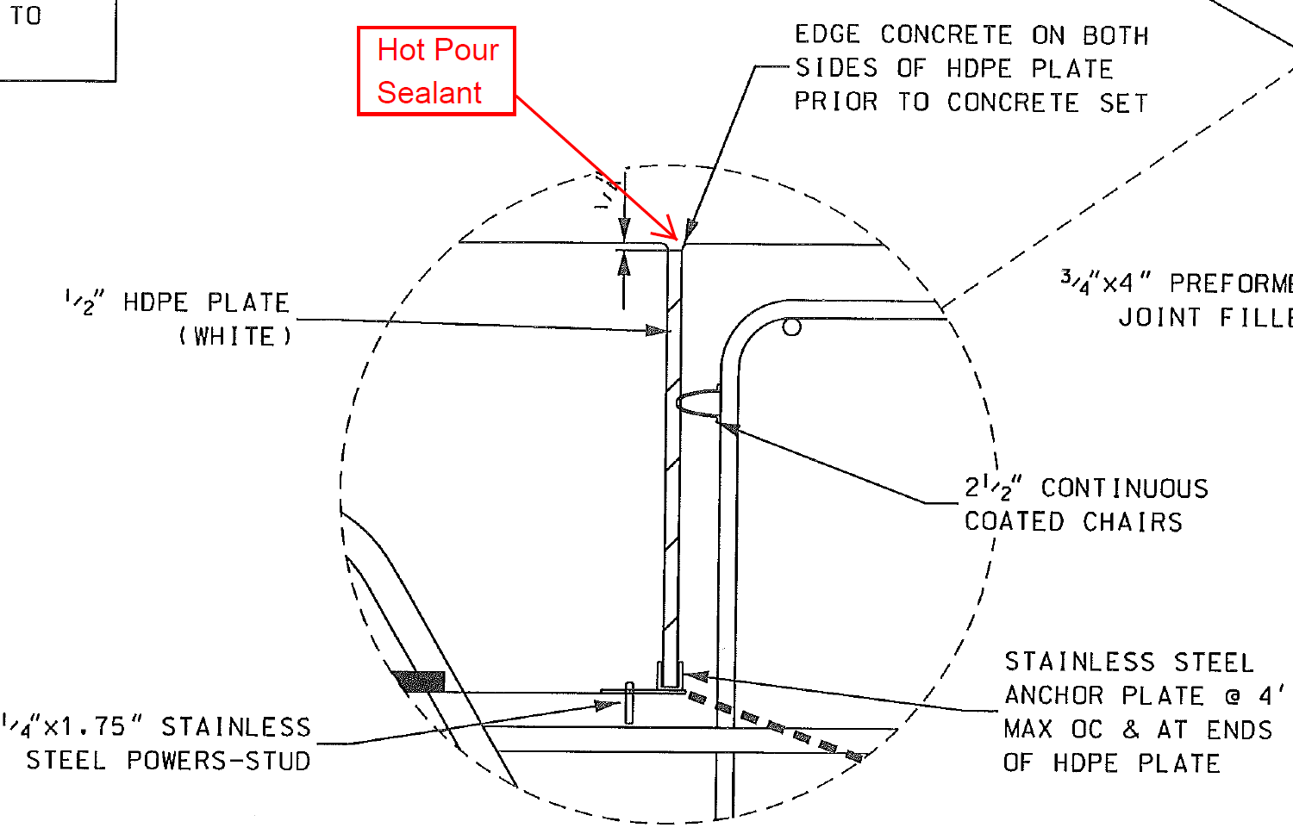
Structural Approach Slabs
Some contractors have requested to pour the structural approach slabs in conjunction with the bridge deck
Potential benefits:
  Schedule
  Ride
  Durability
If you get this request, contact BOS to see if it is right for your situation
Notes:
For future requests, BOS will be asking the contractor to provide more information such as elevation views, so that BOS is better able to determine if this detail is beneficial to the particular situation.

Slide 18
Proprietary Retaining Walls
Systems are pre-approved by WisDOT
MSE walls, modular block gravity walls, bin, crib walls
Minimum embedment (1’-6”)
  Embedment in contract plans is theoretical, sloped
  Shop drawings (by supplier/contractor) are as-built, stepped
Payment is per contract plans (theoretical) not shop drawings (as built)

Slide 19

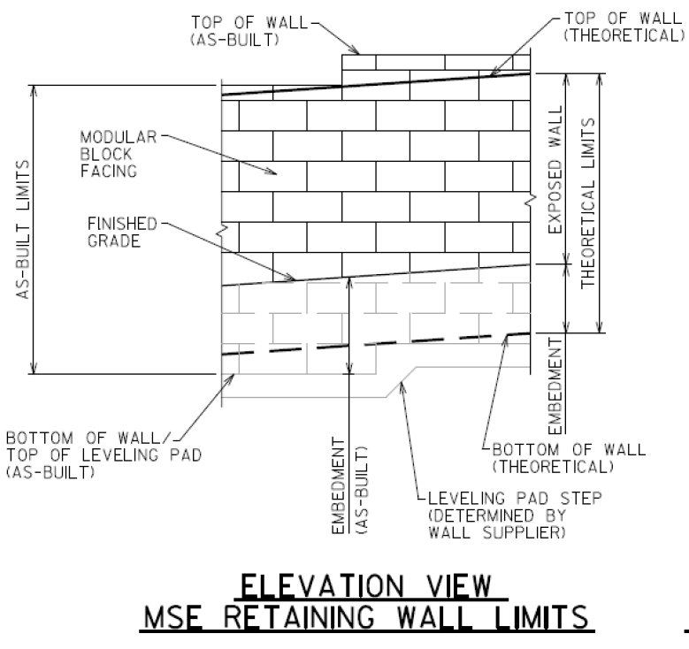

Proprietary Retaining Walls

Slide 20

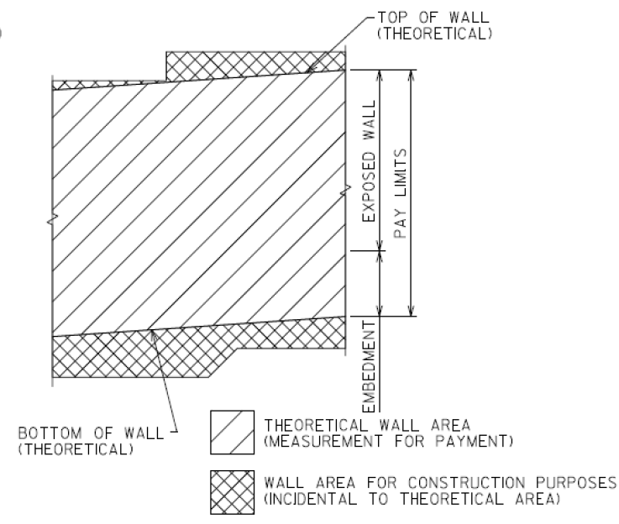
Proprietary Retaining Walls
$

Slide 21
Proprietary Retaining Walls
Spec’s:
D Measurement
The department will measure the Wall Concrete Panel Mechanically Stabilized Earth by the square foot acceptably completed, measured at the front face of wall as defined by the pay limits the contract plans show. Unless the Engineer directs in writing, a change to the limits indicated on the contract plan, wall area constructed above or below these limits will not be measured for payment.

Slide 22
Proprietary Retaining Walls
Spec’s:
E Payment
Payment limit for all walls is the line of minimum embedment per section B.2. No payment will be made for additional embedment detailed for construction purposes. Parapets, railings, abutment bodies and other items above the wall cap or coping will be paid for separately. Vehicle barrier and its support will be paid separately.

Slide 23
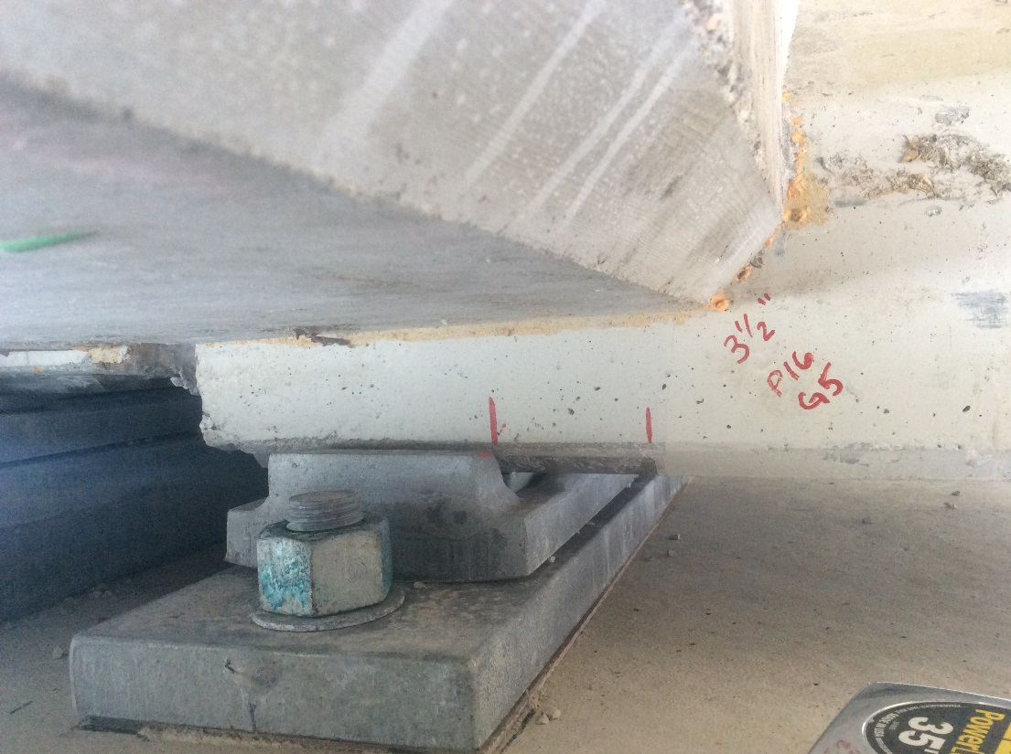
Steel Expansion Bearings Issues
Issues to watch for with Steel Expansion Bearings
  Girder anchor plate should be centered on plate B at the time of girder erection
  Bearing surfaces should be clean (proper storage is key!)
  Anchor plate finish (ANSI 8 -mirror finish)
Notes:
You will want to make sure that the girder anchor plate is set centered on the bearing assembly unless a temperature table is provided otherwise (steel girders only). The design of the steel bearings assumes that they are set centered at any temperature. If they are not centered, the girders may prematurely pull off of their bearings.
In order for the bearings to function as designed, the surface of the anchor plate needs to have a mirror finish and should be free of dirt, dust, debris, moisture, etc.

Slide 24
Structures Agenda
Contacting BOS – When & Why
Specification and Manual Updates
Structures Construction Issues
Ancillary (Wind Loaded) Structure Issues
Fabrication & Materials Issues

Slide 25
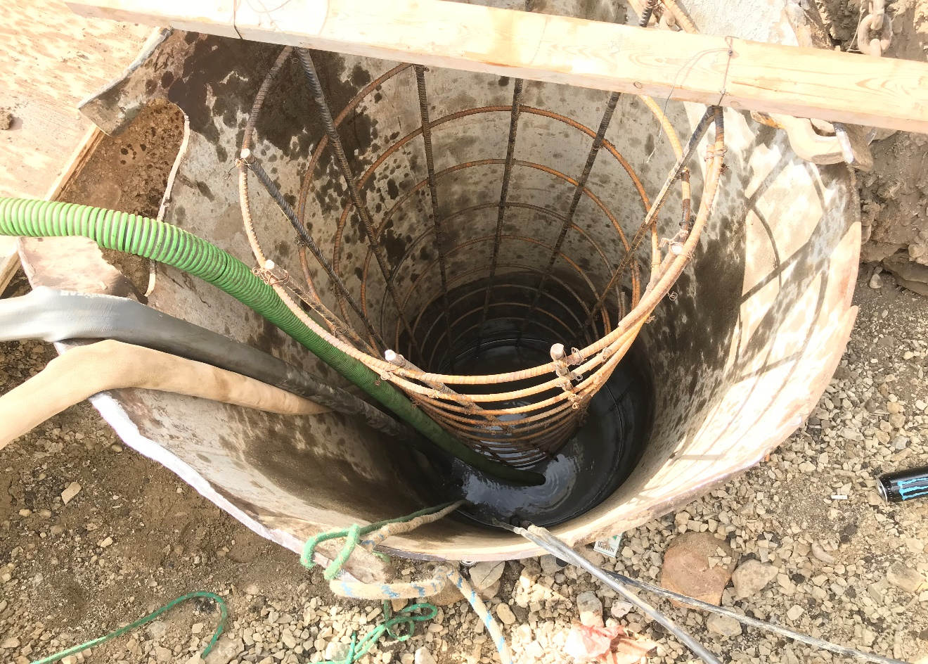
Ancillary (Wind Loaded) Structures
Foundation Construction – On Going Problem
  Contractor locate utilities
  Cave-ins / standing water
    Contract submit proposal
    Pumps
    Casing
    Tremie
  Rock / obstruction
    Contact designer, or BOS for revised design
Notes:
Foundation construction is an on going problem
Make sure contractor locate all utilities before excavation
For Cave-ins and standing water conditions:
Contractor to submit construction plans
Casing, pumps and tremie placement of concrete may be required
For rock and obstruction conditions:
Contact designer or BOS for design revision

Slide 26
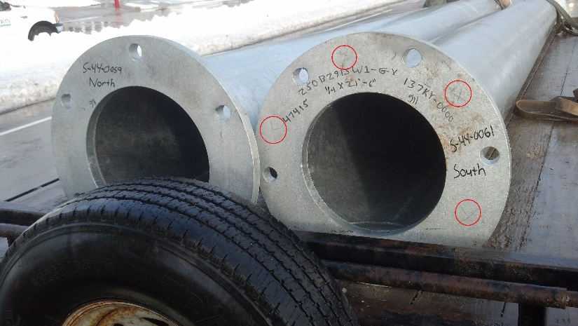
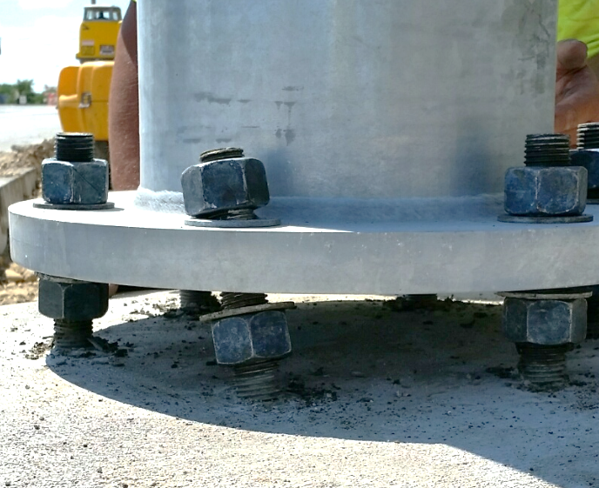
Ancillary (Wind Loaded) Structures
Foundation Construction (continue)
  Anchor rod inspection
    Centered
    Clean
    Straight
    Adequate stickouts
    Damages
    Check anchor rods against base plate (No & location)

Slide 27
Structures Agenda
Contacting BOS – When & Why
Specification and Manual Updates
Structures Construction Issues
Ancillary (Wind Loaded) Structure Issues
Fabrication & Materials Issues

Slide 28
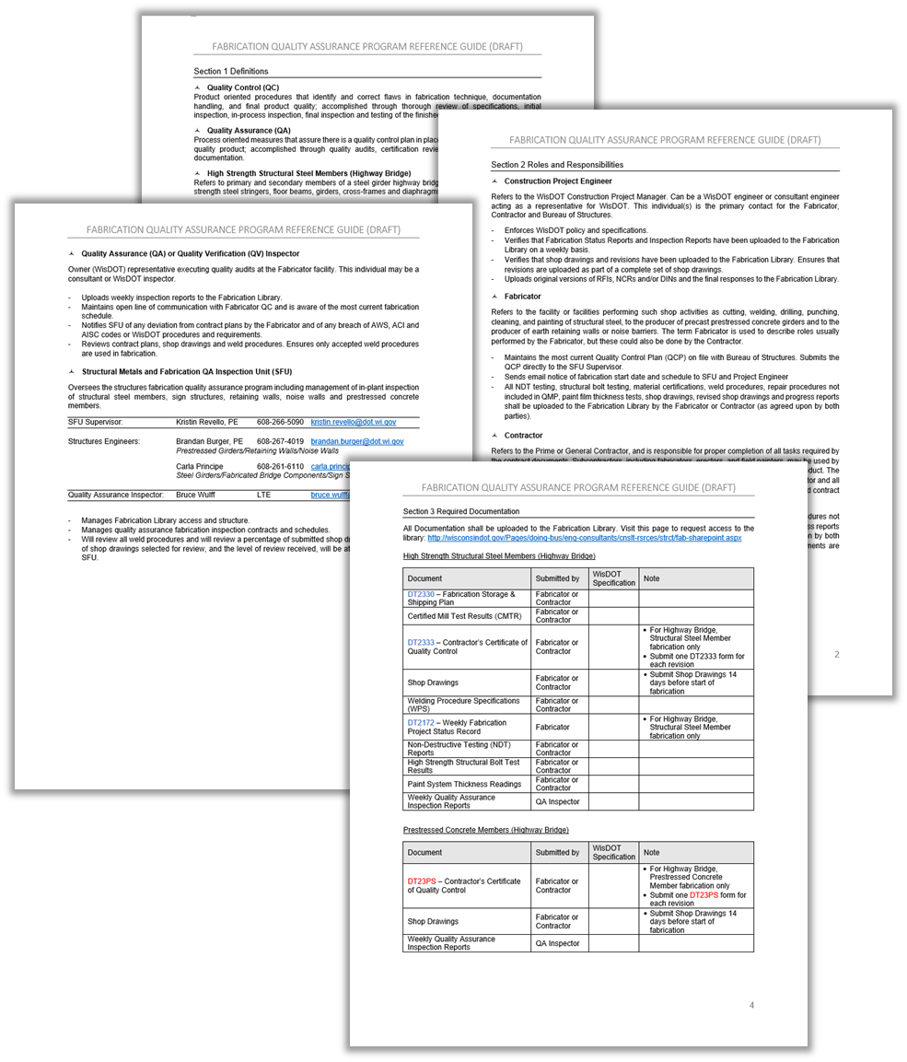
Fabrication & QA Reference Guide
Definitions
Roles & Responsibilities
SFU Contact Information
Required Documentation by Structure Type
Standard Specification References

Slide 29
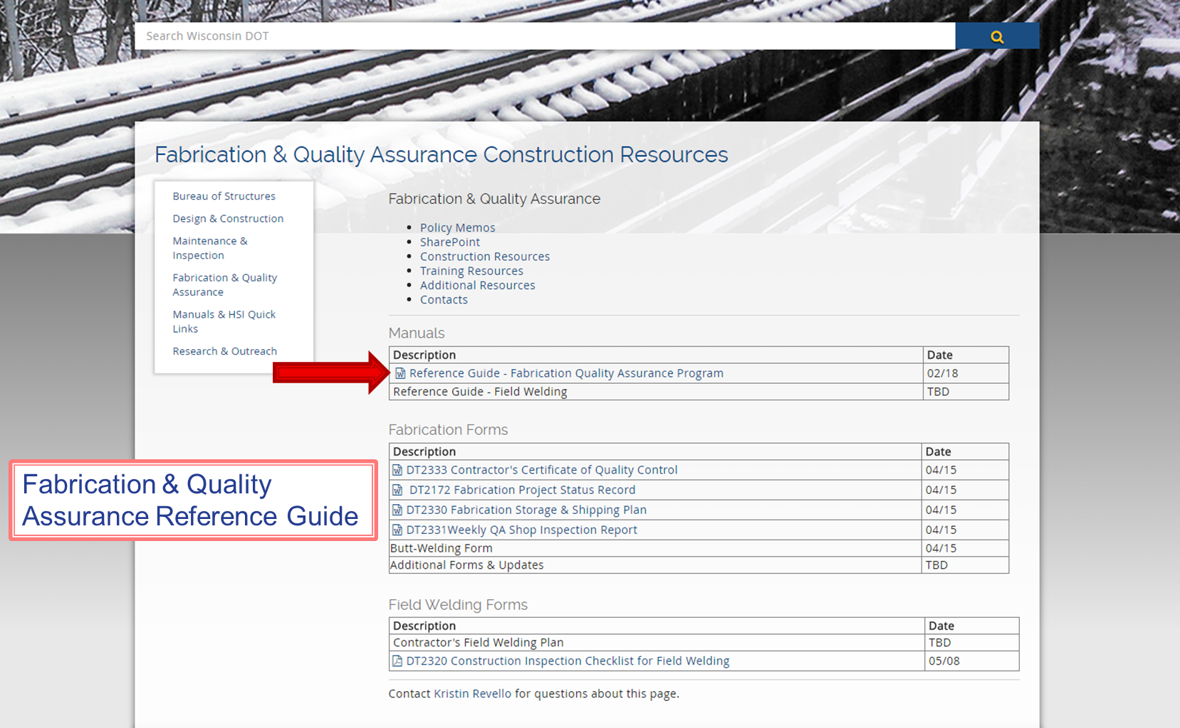
Fabrication & QA Reference Guide
http://wisconsindot.gov/Pages/doing-bus/eng-consultants/cnslt-rsrces/strct/fab-cnstr.aspx

Slide 30
Conclusion
Call us!
BOS looks forward to another successful construction season – THANK YOU!
Notes:
“We always do it that way” is not a substitution for what is shown on the plans – if the contractor is looking to do something different than the plans show, need to contact EOR/BOS

