Slide 1
2018 Spring Construction Training
Tom Kobus, WisDOT SWEC Engineer

Slide 2
Construction General Permit 2018 (TCGP)
Projects directed and supervised by the department with ≥1 acre of disturbance will require Coverage under the TCGP
TCGP Permit requirements that require changes to WisDOT contract will be developed and implemented over the next several construction seasons

Slide 3
Changes for 2018 Construction Season
Notice of Intent (NOI) - Certificate of Coverage
ECIP and Amendments Under TCGP
Transfer of Coverage
Projects < 1 acre of Disturbance
Notice of Termination (NOT)
Other TCGP Implications

Slide 4
Notice of Intent (NOI)
What is required to be submitted for projects to receive coverage under the TCGP
This years construction projects will be handled through a batch coverage.
Certificate of Coverage – will be provided by WDNR with concurrence/water quality certification.
Certificate of Coverage will need to be posted in the field office.

Slide 5
ECIP and Amendment Process
WDNR will still review and comment on ECIP and amendments based on previous guidance.
Once ECIP or amendments have been approved you should respond to concurrence e-mail from WDNR attaching the approved ECIP or amendment to amend the Certificate of Coverage.
WDNR should respond with an acceptance e-mail for your records.
WisDOT should send all ECIP amendments to WDNR for Comment
WDNR should be given appropriate time to review and comment based on the scope of the amendment

Slide 6
Transfer of Coverage

Slide 7
Projects < 1 Acre
Not covered under the TCGP
Get the area of disturbance from Designer/PM
Verify based on ECIP selected sites <1 Acre
If significant changes are made to the design, area of disturbance should be evaluated along with all other environmental impacts to determine if it will cause project to go over 1 Acre.
Submit NOI if disturbance increases to ≥ 1 Acre

Slide 8
Notice of Termination
70% vegetative cover will be required to terminate permit coverage for projects
Place more emphasis on timing for getting restoration completed
Place more emphasis on removing erosion control once vegetation has been established.
PD guidance on closing contracts

Slide 9
Other TCGP Implications
WDNR site reviews
24 hour routine maintenance of BMP’s
New Trackout Control Practices Technical Standard
Select sites covered under the TCGP
Manage dewatering activities
SWEC Engineer availability

Slide 10
Selected Sites under TCGP
Open and Closed with the project
Archaeological Review (Form DT1919)
WDNR must concur that Wetlands will be avoided
WDNR must complete Threatened and Endangered Species review

Slide 11
Selected Sites Under TCGP
If a selected site is used prior to WisDOT written approval, it is not covered under the Cooperative Agreement (TCGP) between WisDOT and WDNR; all applicable federal, tribal, state, and local permits need to be obtained for the selected site.

Slide 12
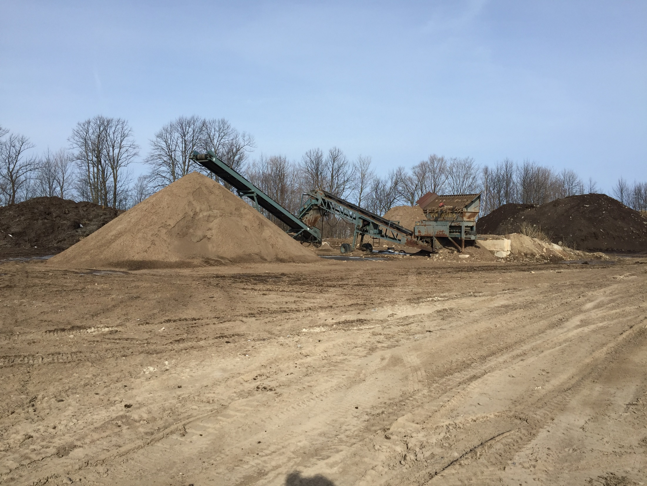

Slide 13
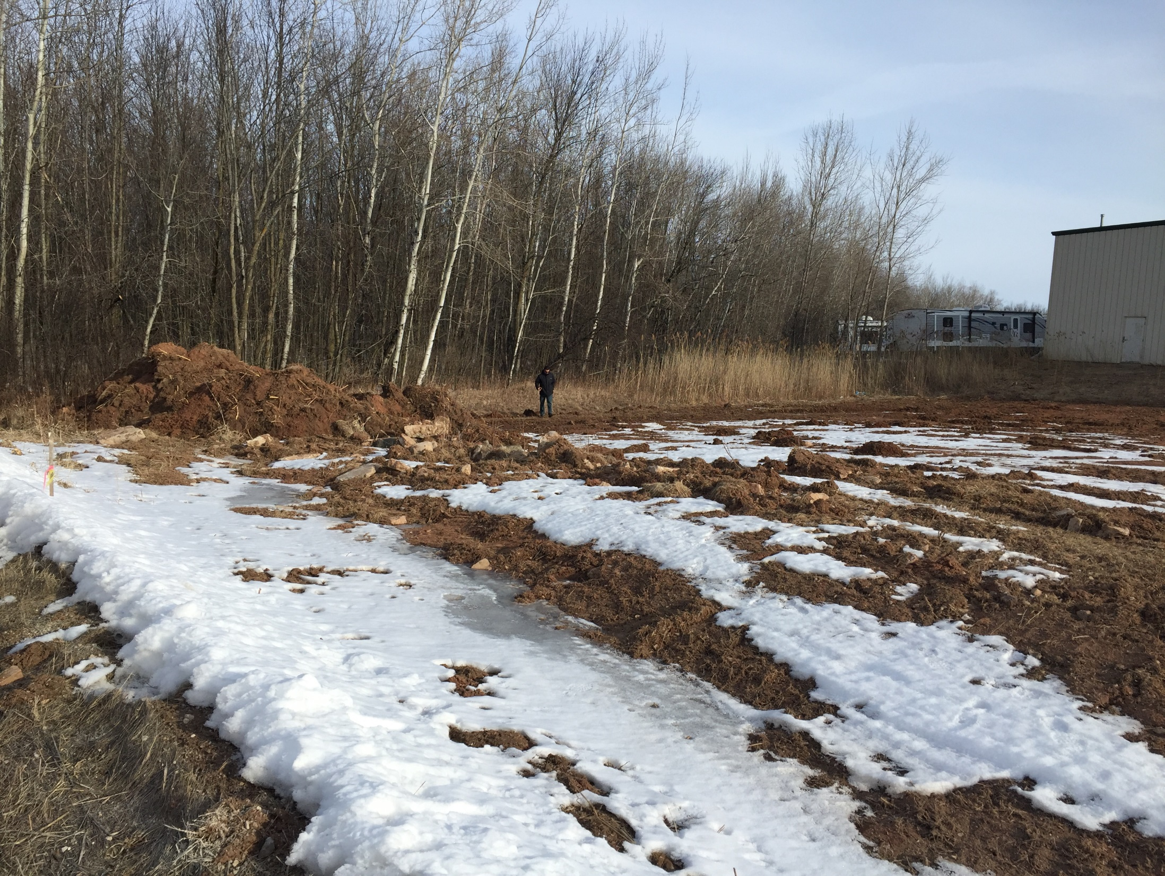

Slide 14
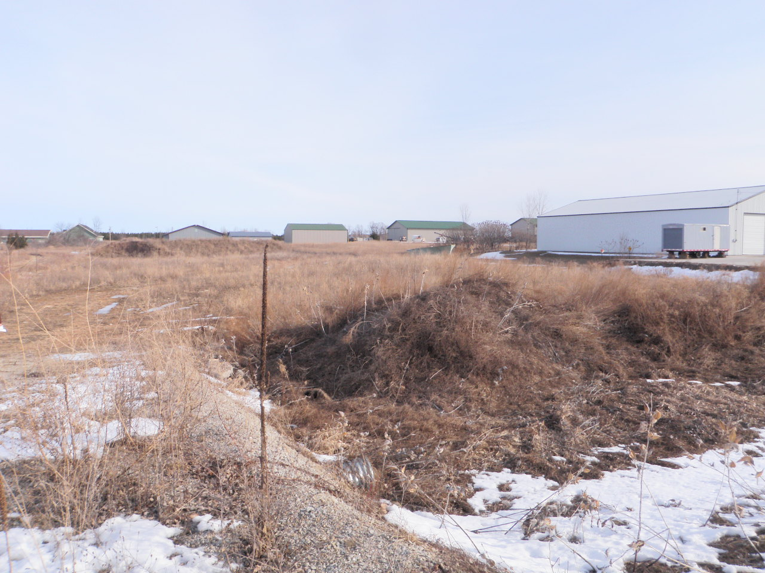

Slide 15
Questions?

