Slide 1
Northeast Region Construction Training
March 22, 2018
UTILITIES
DTSD NER TSS - Utilities
Jeff Orr, Utility Engineer

Slide 2
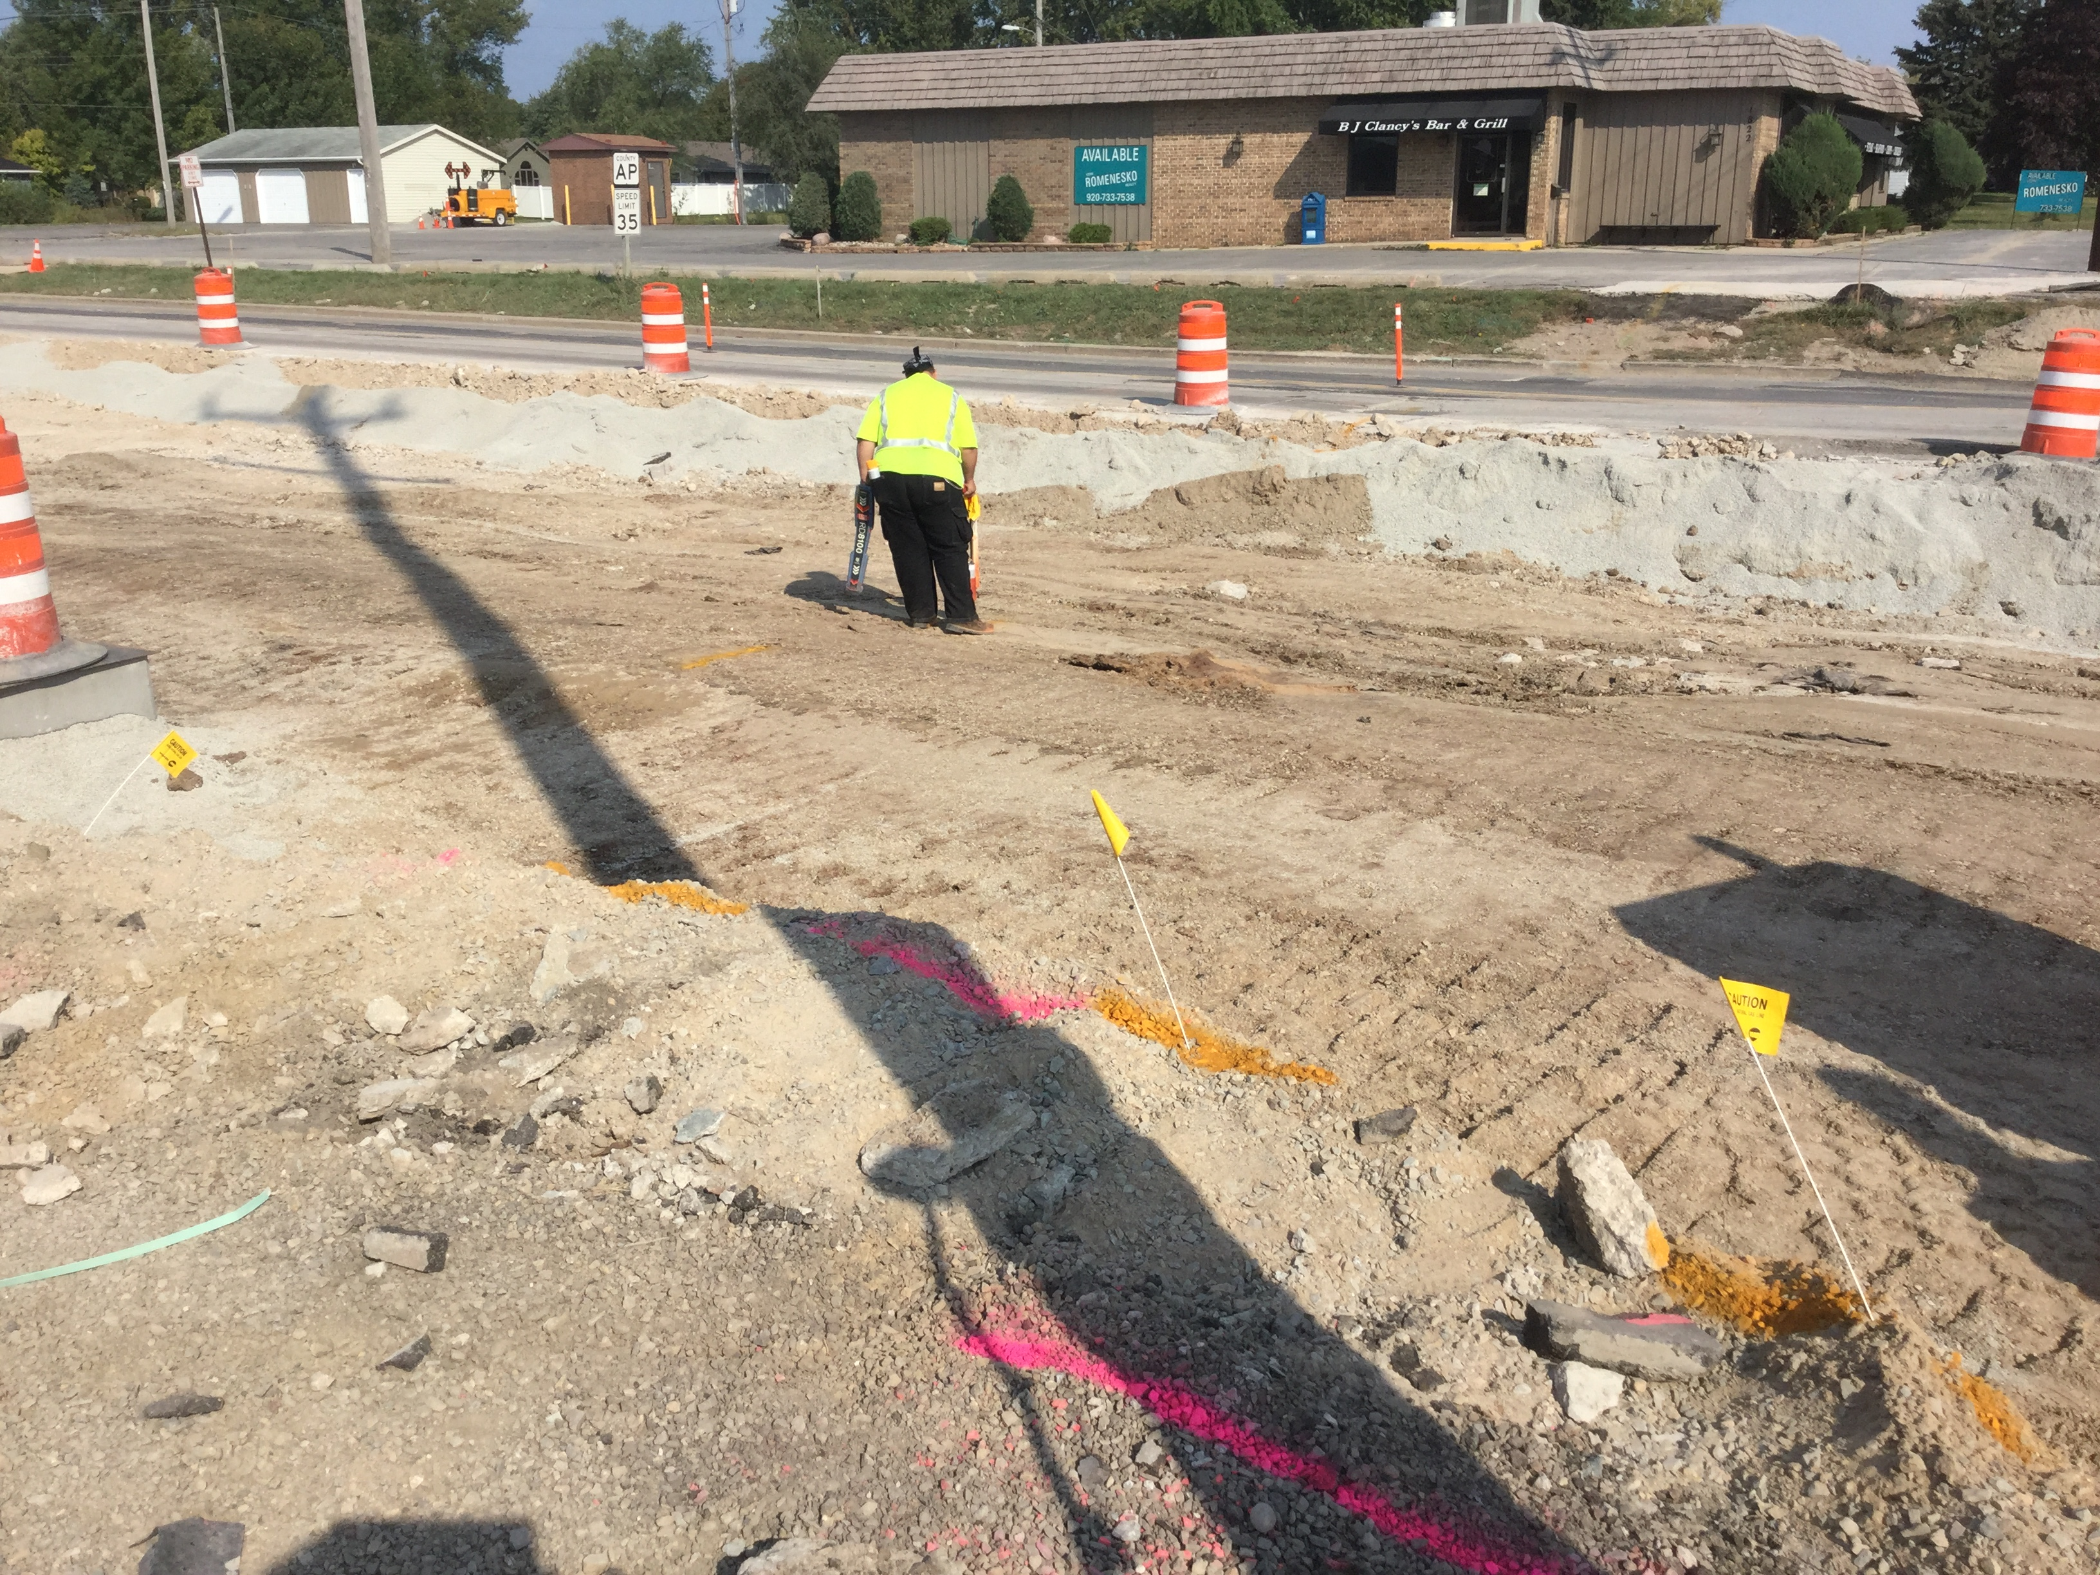
Northeast Region Construction Training (2018)
Agenda
Utility Coordination Goals (2018)
Pre-Construction Utility Meeting
Coordination During Construction
“lessons learned”

Slide 3
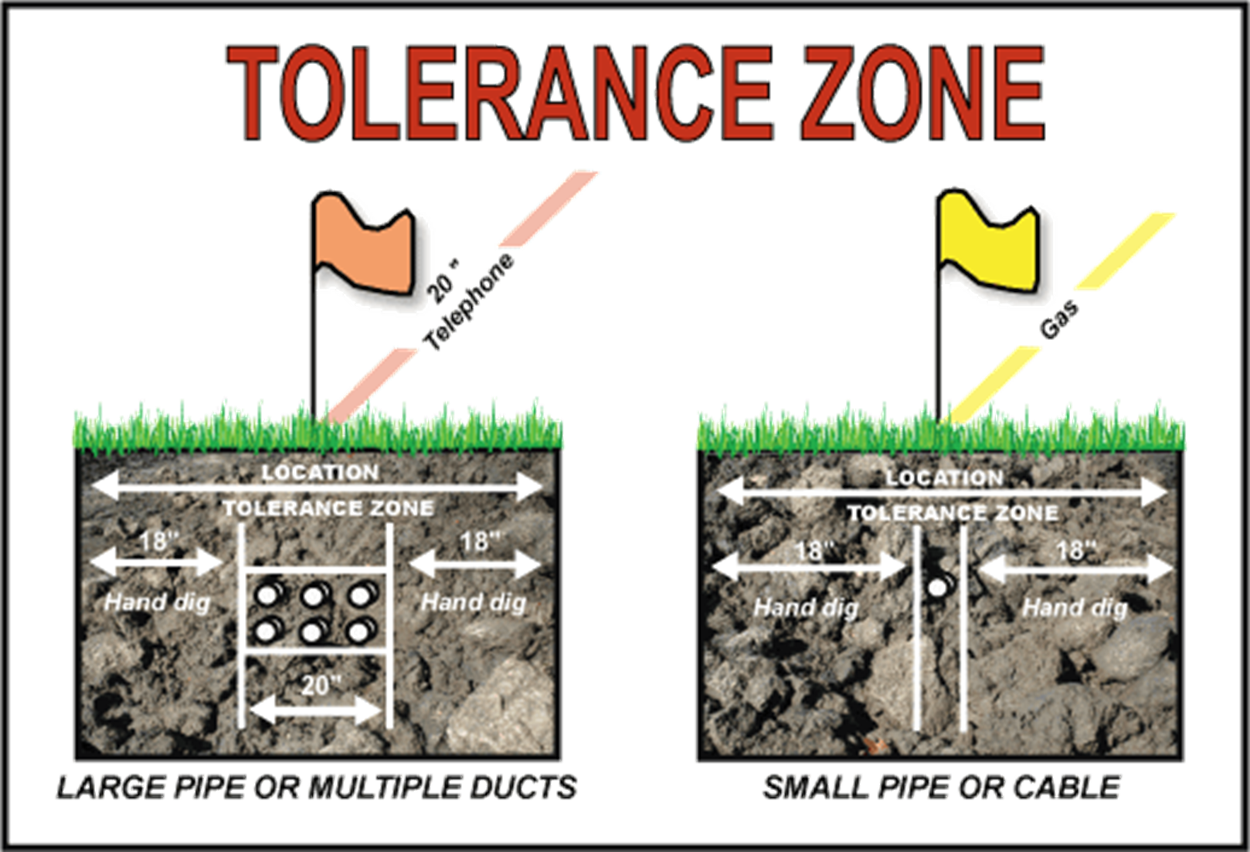
Northeast Region Construction Training (2018)
Utility Coordination GOALS
Safety
Prevent Damage to Utility Facilities
Prevent Delay to Construction projects

Slide 4
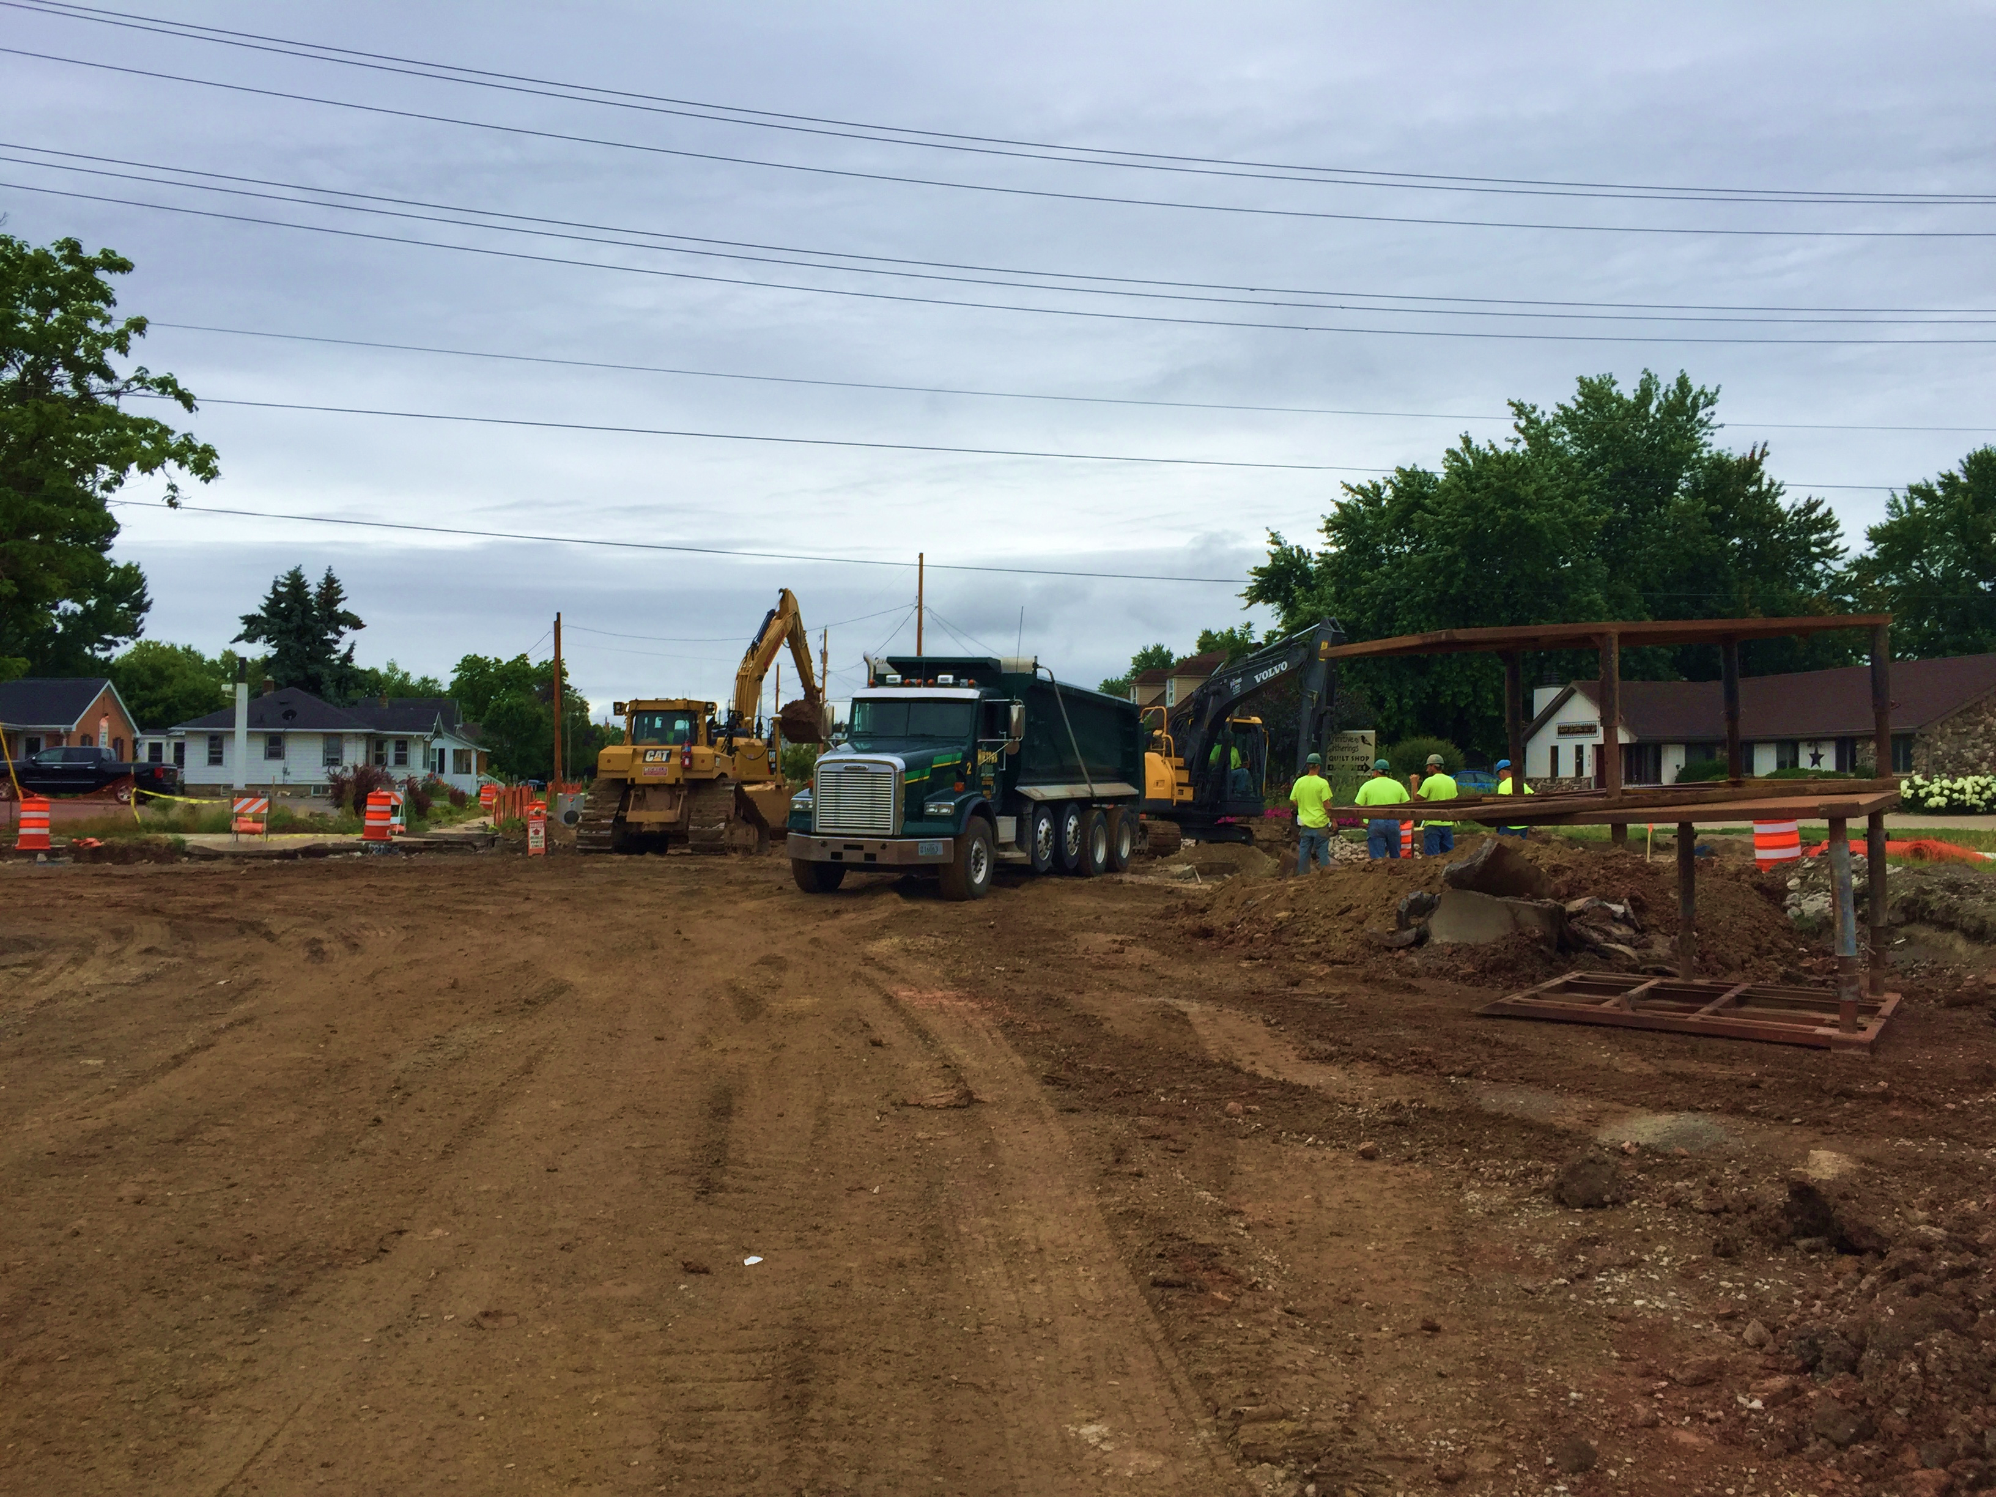
Northeast Region Construction Training (2018)
Pre-Construction Utility Meeting
Utility, Contractor, and WisDOT representatives
Special Provisions & Addendums
Discuss status of utility conflicts
Coordinate any concurrent relocations

Slide 5
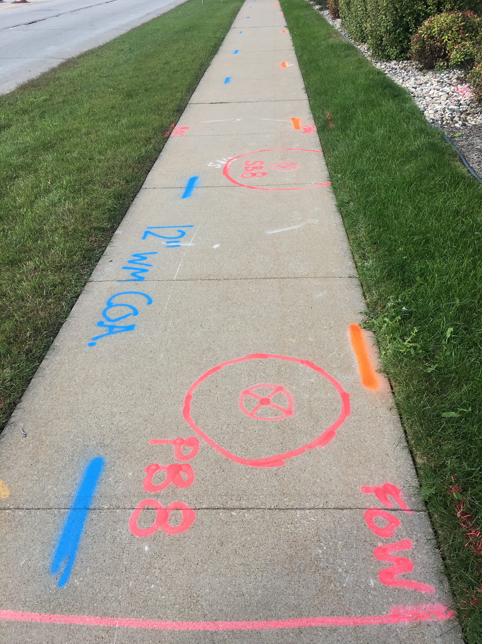
Northeast Region Construction Training (2018)
Lessons learned
Identify a single point of Contact
Become familiar with existing, proposed, and discontinued utility facilities
Establish and agree upon a relocation timeline with the Contractor and the Utility

Slide 6
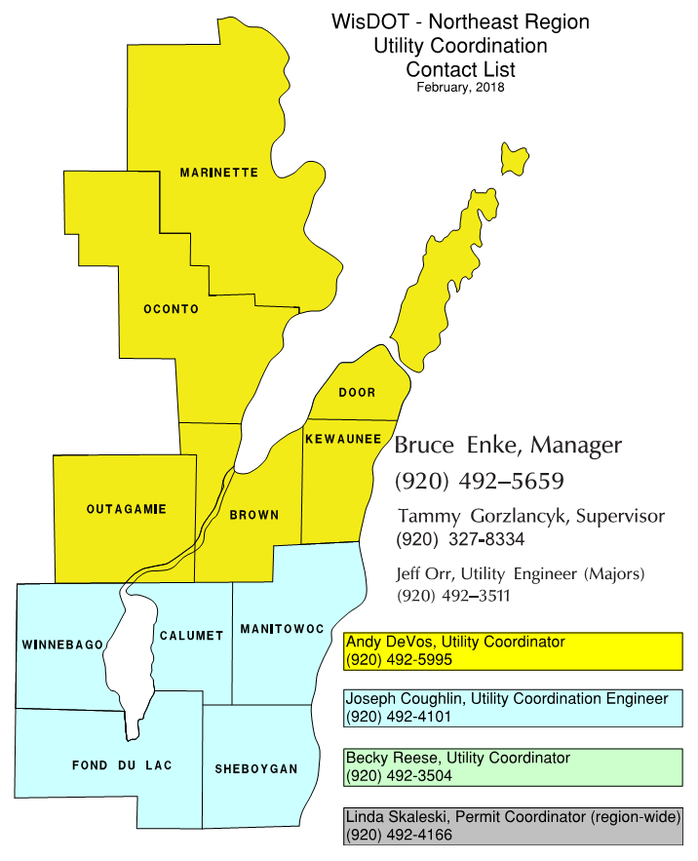
Northeast Region Construction Training (2018)
Northeast Region Utility Contacts
Presented by:
Jeff Orr, P.E.
Utility Engineer
(920) 492-3511
Jeffry.orr@dot.wi.gov

