Slide 1
Contract Administration
NER Construction Training
March 16, 2017

Slide 2
2017 Pantry Region Updates
REMINDER
Project Binders
Pick up your plans, proposals, and labels at the NE Region office
441 contact Mickey Jenks for plans and proposals
PCL prints off Binder materials (including instructions) located at:
Pantry2017\RegionSpecific\NE\NE\ProjBinder
Empty 3-ring binders available at NE Region office
REVISED
ECIP Review Checklist
Traffic Signal and Lighting Inspection Checklist

Slide 3
2017 Field Software User’s Guide for Construction staff will be available in Pantry 2017
Notes:
New statewide data entry guide for FM, FieldBook, FIT and MIT. Our region guide is more specific and should be referenced first. Hopefully we will be able to better combine or reference between the two in the future.
Stored in Pantry2017\StatewideManualsAndGuides with shortcut in WisDOT Shortcuts folder.

Slide 4
Northeast Region 2017 Field Construction Administration Guidelines also in Pantry 2017

Slide 5
New Look!
The 2017 Field Construction Admin Guidelines has new format
Sequencing follows: setting up contract, entering dates, ongoing documentation, submitting payments, specific sections (labor compliance, maintenance, materials, etc.), to final closeout
Notes:
Ongoing documentation = diaries, IDRs, postings, etc.
The new processes highlighted today are included in step-by-step instructions within the Guidelines.

Slide 6
Notice to Proceed Process
Notice to Proceed (NTP)
Only ONE NTP per contract, issued by the contract specialist (CS).
Time charges start 10 days after NTP or when controlling work begins (whichever is first).
May include restrictions (ECIP not approved, RR insurance not received, etc.)
Notes:
Want to clear up past confusion of NTP/conditional NTP
There may still be some unique situations such as early clearing for NELB that uses language other than the 10 days.

Slide 7
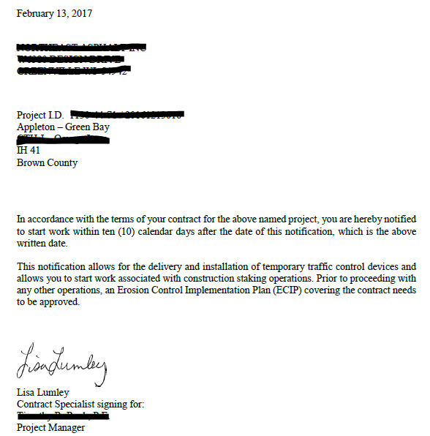
Example

Slide 8
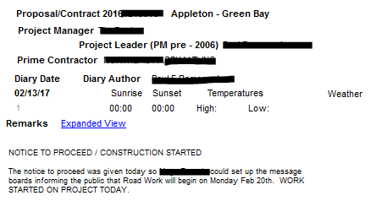
Document NTP and
Construction Start Date in Diary
Example
Notes:
Reminder to PCLs to document NTP issued date and construction start date in Diaries.
Include the type of work that began. Also mention any restrictions.

Slide 9
Restrictions Removed Notice
When restrictions can be removed, PM emails the Prime, PCL, and CS that all over work can begin.
PM saves email to: N:\pds\construction-services\Construction Projects\xxxx-xx-xx\Contractor.
PCL records in diary that ECIP approved, etc. and all contract work can begin.

Slide 10
Example
Notes:
PCL will follow up with diary entry that ECIP was approved on X date and all other contract work can begin.

Slide 11
Documenting Time – Important Reminders
Difference between “construction start date” and “time charges start date.”
Construction Start Date: Date contractor begins any onsite work, including staking, traffic control, etc.
Time Charges Start Date: 10 days after NTP or when controlling work starts, whichever first.
Notes:
Some confusion about construction start date and time charges start date.
In example earlier, the ECIP was NOT approved and at that point only construction start date entered.
Once ECIP approved and controlling work began, Time Charges start date entered.
PCLs must enter dates in diary entries for both construction start date and time charges start date.

Slide 12
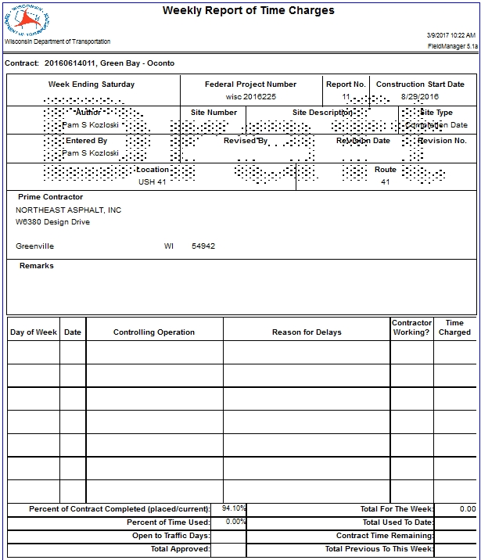
September 3, 2016
1
0
Traffic Control Signs PCMS
Construction started 8/29/16 with the installation of message boards. Time charges will start 10 days from the Notice to Proceed or when controlling work starts, whichever is first.
Sunday
8/28
Monday
8/29
Traffic Control Signs PCMS
Yes
0
Tuesday
8/30
No
0
Wednesday
Construction Staking
Yes
0
8/31
Thursday
9/1
Locating No Passing Zones
Yes
0
Friday
9/2
No
0
Saturday
9/3
No
0
Notes:
Weekly Report of Time Charges for Working Day Contracts should begin from the Construction Start Date. Remarks may be necessary about work starting on non controlling items.

Slide 13
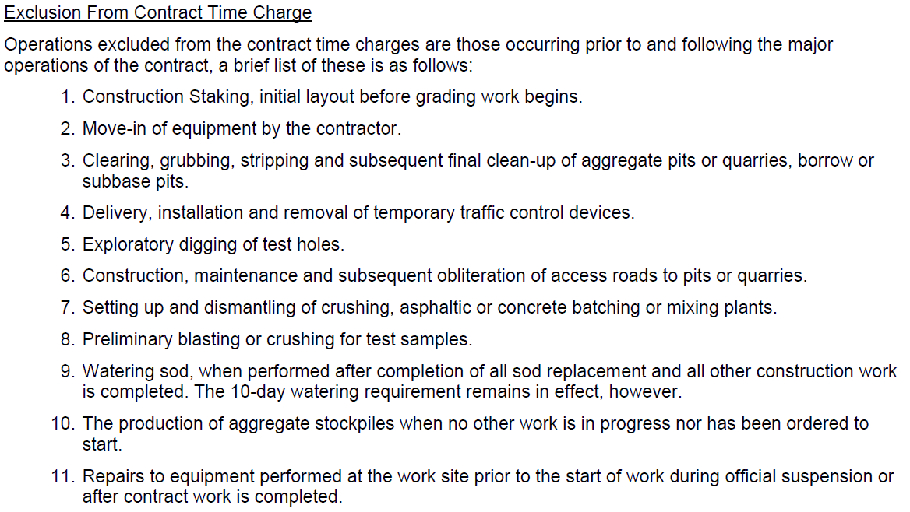
(FDM 19-10-30)
Notes:
List of exclusions from contract time charges from FDM 19-10-30
This is non-controlling work.

Slide 14
September 10, 2016
2
1
8
0
Removing Asphaltic Surface
Contractor’s Choice
Time charges started 9/5/16 since it was 10 days from the Notice to Proceed, however no time was charged due to the holiday work restriction.
Sunday
9/4
Monday
9/5
Removing Asphaltic Surface
Holiday Restriction
No
0
Tuesday
9/6
Removing Asphaltic Surface
Contractor’s Choice
No
1
Wednesday
9/7
Removing Asphaltic Surface
Adverse Weather – Heavy Rain
Yes
0.5
Thursday
9/8
HMA Pavement
Yes
1
Friday
9/9
HMA Pavement
Noon Traffic Restriction
Yes
0.5
Saturday
9/10
HMA Pavement
No
0
Notes:
Text in the Comments field does not show up on the Weekly Report of Time Charges, so comments should be made in the Reason for Delay field.

Slide 15
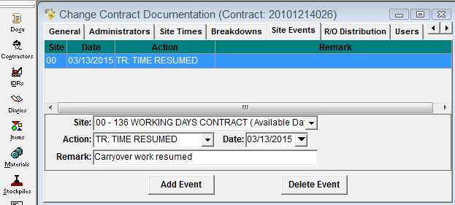
Documenting Time – Important Reminders
Time suspensions and resumptions (in Site Events tab) used in rare circumstances. If you want to suspend time, contact the PM and CS/Krissy first.
Notes:
Reminder that time suspensions and resumptions should be consulted with PM and contract specialist before enforcing.

Slide 16
Documenting Time - Important Reminders
Time Charges Stop Date: Date when work is done except for punch list and plant establishment period.
Triggers an automatic email for Substantially Complete and kicks off the finals process.
When in doubt, discuss with PM and CS/Krissy to determine if remaining work requires more time added to contract or is appropriate for punch list.
Notes:
A lot of cases where work appeared to be straightforward and minor, yet the work dragged on months past the punch list complete date. When this happens it creates headaches for everyone! It’s also reflected on our finals closeout process performance measure.

Slide 17
Documenting Time - Important Reminders
Punch List Complete Date: Date when required contract documentation, minor corrective work, and cleanup work are all complete.
When you enter the Punch List Complete Date in FIT, email the CS and PM to request the conditional final acceptance letter be issued to the Prime. Include any minor outstanding issues that are left for the Prime to complete.
Notes:
Must request Conditional Final Acceptance letter
Examples of outstanding issues: remove silt fence, plant establishment, etc.
In some instances, the PCL may find extra work after the punch list is given to the Prime or has been completed.
Discuss with PM and Krissy/Lisa to determine if more time should be added to the contract to complete remaining work.

Slide 18
ContMod Justification (CMJ)
One issue per CMJ
Refer to pertinent subsection of Spec 104
Independent Cost Analysis
Reasonable markup for OH and profit
Document Negotiation
Prior Approval
If it involves any local funding, include a statement of local government acceptance of price
Notes:
CMJ should include a complete explanation of the scope, schedule and budget impacts (including increase/decrease of existing items) related to one issue (may include multiple items).
Some administrative items don’t require a CMJ.
“…These differing site conditions allow for a revised unit price in accordance with spec 104.2.2.2.”

Slide 19
Example

Slide 20
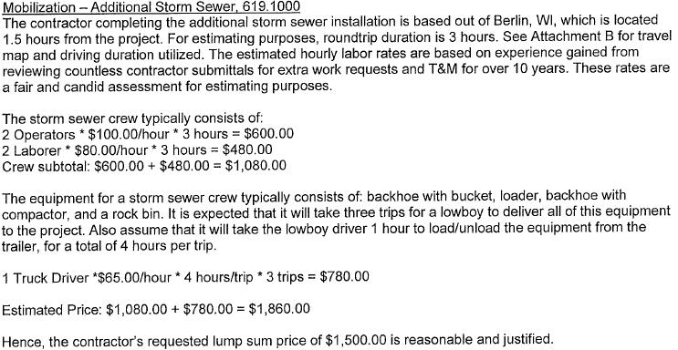
Example

Slide 21
Example

Slide 22
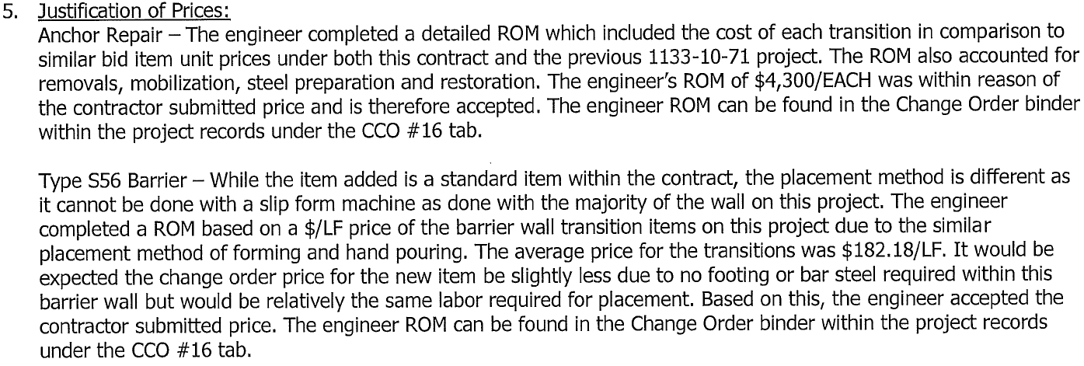
Example

Slide 23
Example

Slide 24
New CMJ Process
PCL writes CMJ, saves it as PDF with supporting documentation, and emails it to PM.
PM saves CMJ on local drive, makes comments, sends link to CS, Krissy, and Leslie for review.
PM emails CMJ with comments back to PCL.
PCL makes corrections, signs, and returns to PM for signatures.

Slide 25
New ContMod Process
PCL writes ContMod, leaves it in draft mode, saves it as PDF, and emails it to PM.
PM saves ContMod on local drive, makes comments, sends link to CS, Krissy, and Leslie for review.
PM emails draft ContMod with comments back to PCL for corrections.

Slide 26
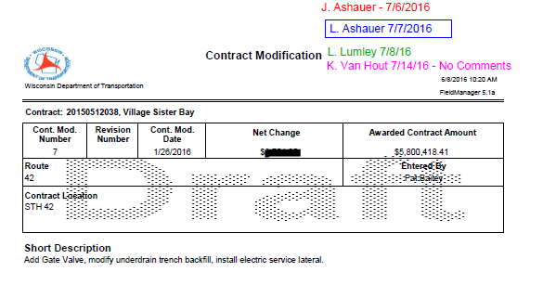

Slide 27
New ContMod Process
PCL makes corrections to ContMod in FieldManager.
Click Generate.
FieldManager prompts “Does this require supervisor approval?” Click NO.
Print ContMod and sign/date it on the “Prepared By” line.

Slide 28
New ContMod Process
Obtain Prime Contractor’s Signature
Scan and email ContMod to CS. CS will get signature from Prime, WisDOT, and continue processing.
OR
Scan and email ContMod directly to Prime for signature (cc: CS).
OR
Have Prime sign ContMod in the field. Scan and email signed ContMod to PM (cc: CS).
Notes:
No longer need two copies of CCO. No longer need cover letter.
Remind staff that this process is different for Local Program projects.

Slide 29
New ContMod Process
CS emails executed ContMod to Prime and PCL.
CS instructs PCL to approve ContMod in FieldManager.
PCL right clicks on the ContMod (should show “pending approval” status) and enters approval date.
PCL does FIT merge/send.
No need for the PCL to print executed ContMod for project records. CS will save to file.

Slide 30
ContMod Reminders
Always address time
Description of Changes should only contain contractual language
Standard items may be used with a supplemental description
Mobilization (Bodart Boring), Item 619.0100
Excavation Common (Rev. Price), Item 205.0100
Unit Price for DOL items is $1.00
Notes:
Contract revisions should be communicated via CCO. (Example: lighting plan routing – no new items)
# of CCO is not a performance measure
Add time if extra work is controlling
Will send examples of common CCO in Word format

Slide 31
No More Supplemental Agreements
Notes:
Still have the option to modify the method of measurement for individual items via CCO.

Slide 32
Stockpile Payments
Notes:
Very vague

Slide 33
Stockpile Payments
Notes:
Refers to invoices but not what component of pavement (aggregates?, dowel baskets?)

Slide 34
Stockpile Payments
Notes:
Tells who, what, where, and explains the conversion used

Slide 35
Stockpile Payments
Notes:
Detailed information on the invoices and originators

Slide 36
Stockpile Payments
Notes:
Doesn’t refer to specific invoices
Does mention that materials documentation was verified

Slide 37
Eliminated Items
Preparation Expenses
Restocking/Cancellation Charges
Markup for OH and Indirect Costs – 7%
Department take ownership of materials
Use on future projects
Maintenance on state highways
Wisconsin Surplus Online Auction
Dispose of material
Notes:
Spec 109.5
Document in CMJ what is being done with them.
Don’t pay full bid price since that usually includes installation.

Slide 38
Production Rates
Notes:
Reminder to collect production rates and submit data via web-based tool.

