Slide 1
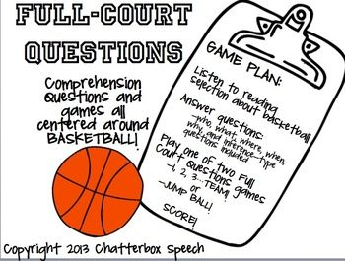
Bring YOUR questions centered around MATERIALS!
Listen to Leslie Talk about Materials
Answer Questions:
-who, what, why, where, when, how – types of questions
Post Presentation Highlights

