Slide 1
2017 Construction Conference
Electrical

Slide 2
Electrical Focus
Monotube Problems – Grades?
Monotube Changes – OSOH
20’ minimum clearance
Hwy 151 – Manitowoc
Hwy 42/57 – Sturgeon Bay (S of Bayview Br.)

Slide 3
Monotube Problems?
Bases
Soil Condition
Water Table
Bolts
Elevation

Slide 4
Monotube Problems?
Bases
Soil Condition – Concern but hasn’t been a problem
Water Table – Concern but hasn’t really been a problem
Bolts – Hasn’t really been a problem
Elevation – Lots of questions from the field. Can be a problem!

Slide 5
Monotube Problems
Bases
Elevation
Top of base Elevation not provided
Pavement grade changes
Sidewalk slope changes
Drainage changes that force curb changes
Follow through.
Compute after all is known
Try not to install prematurely (i.e. early unless grades are final)
Pay attention to clearance requirements (OSOH?)

Slide 6
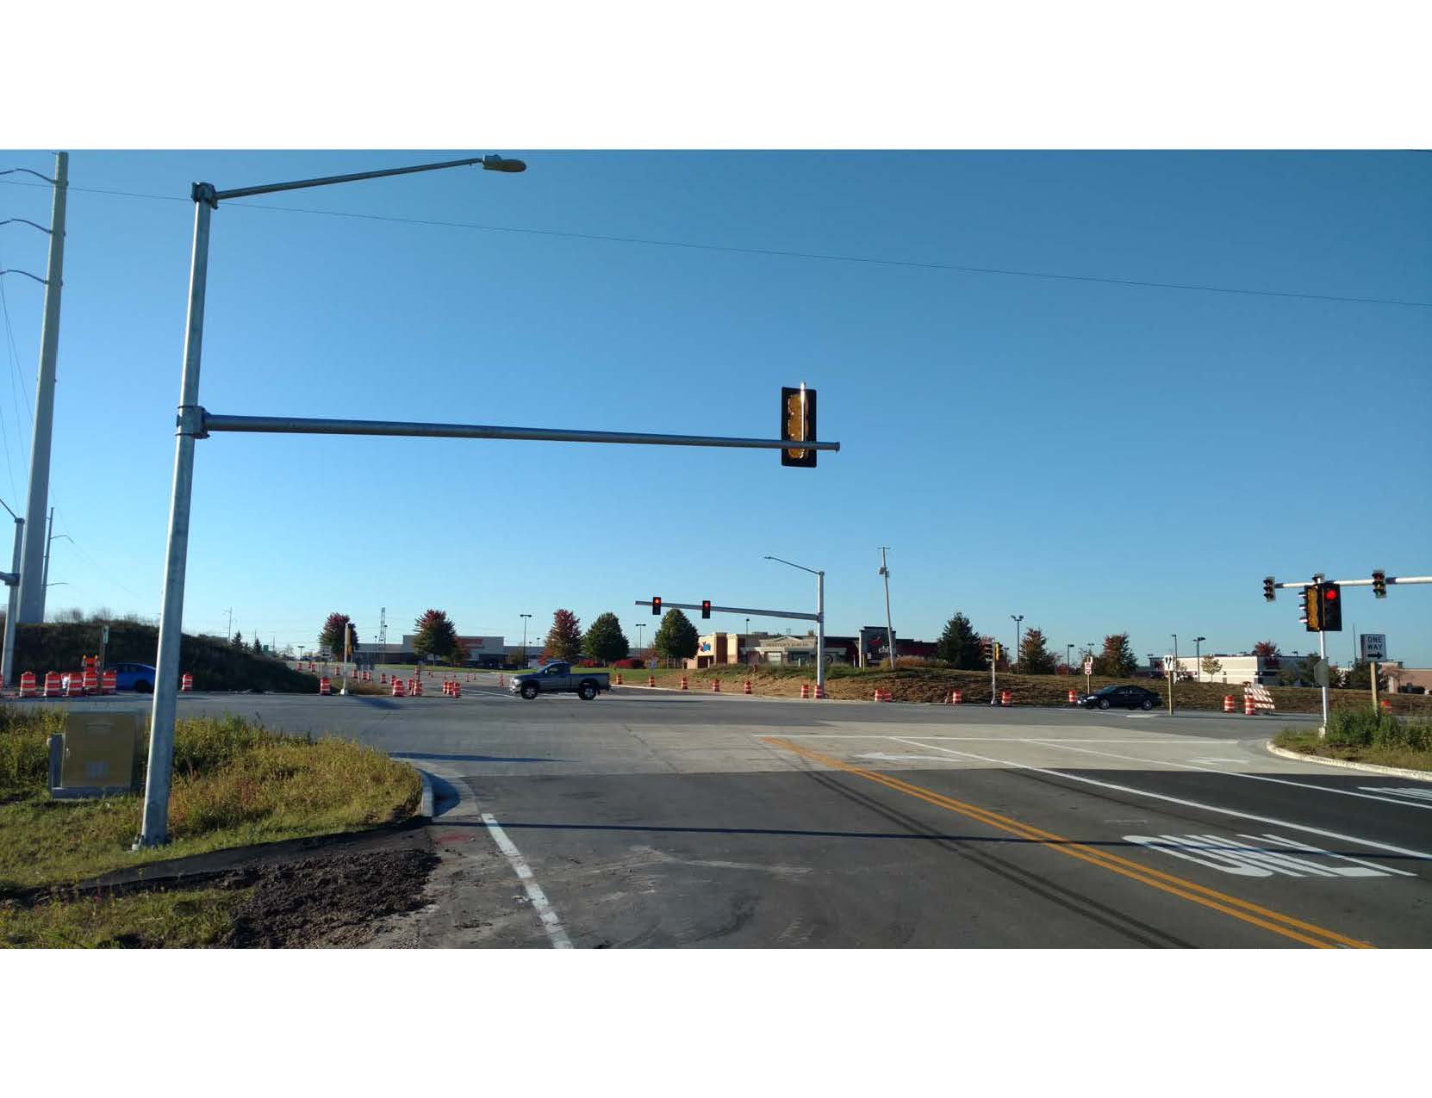

Slide 7
14.5’

Slide 8
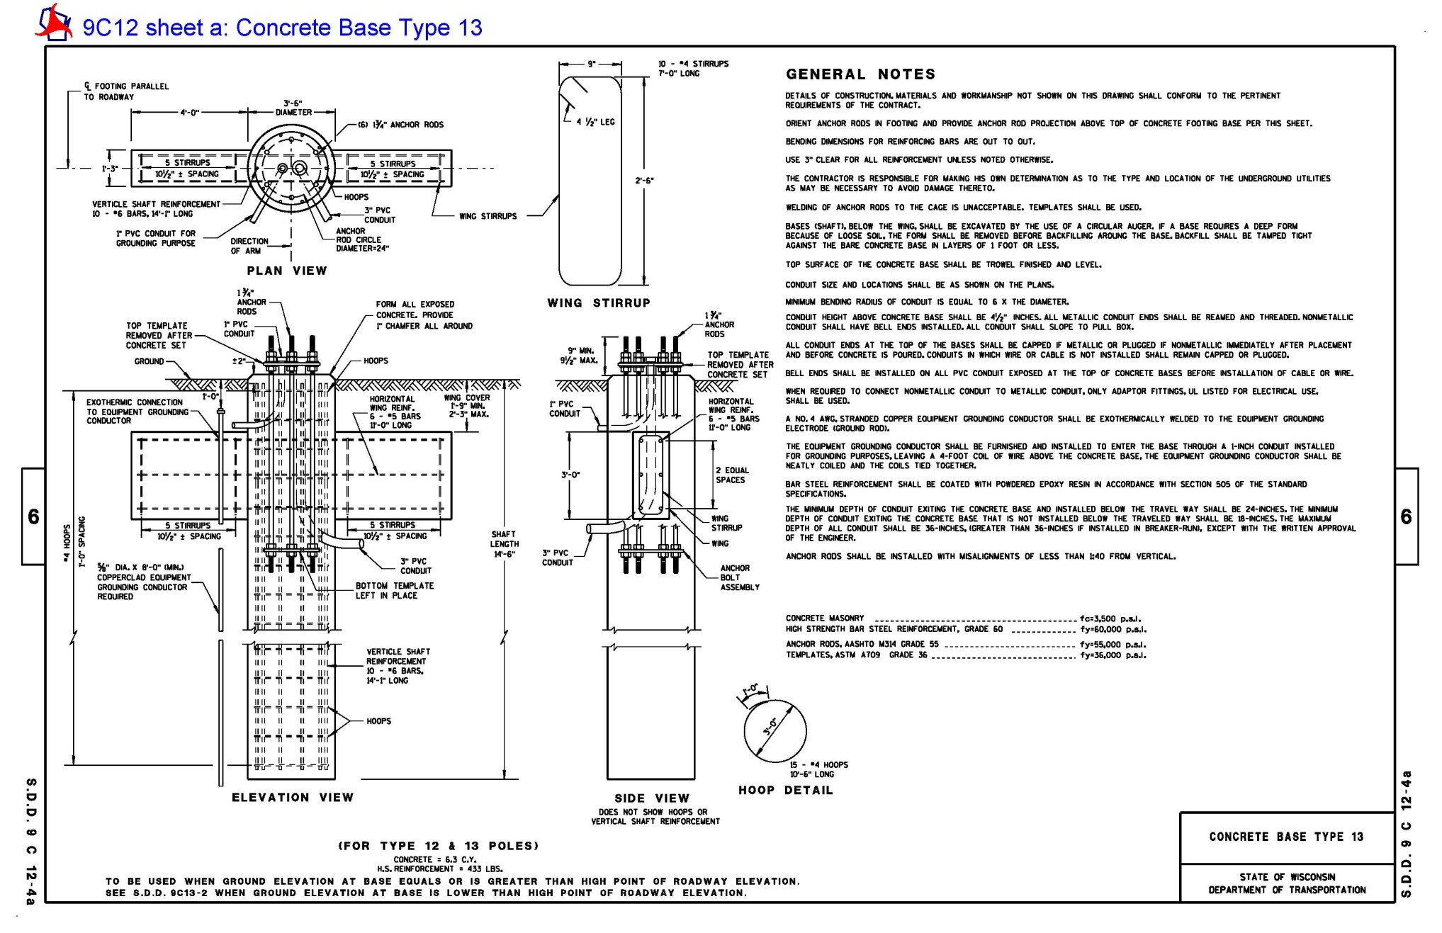

Slide 9
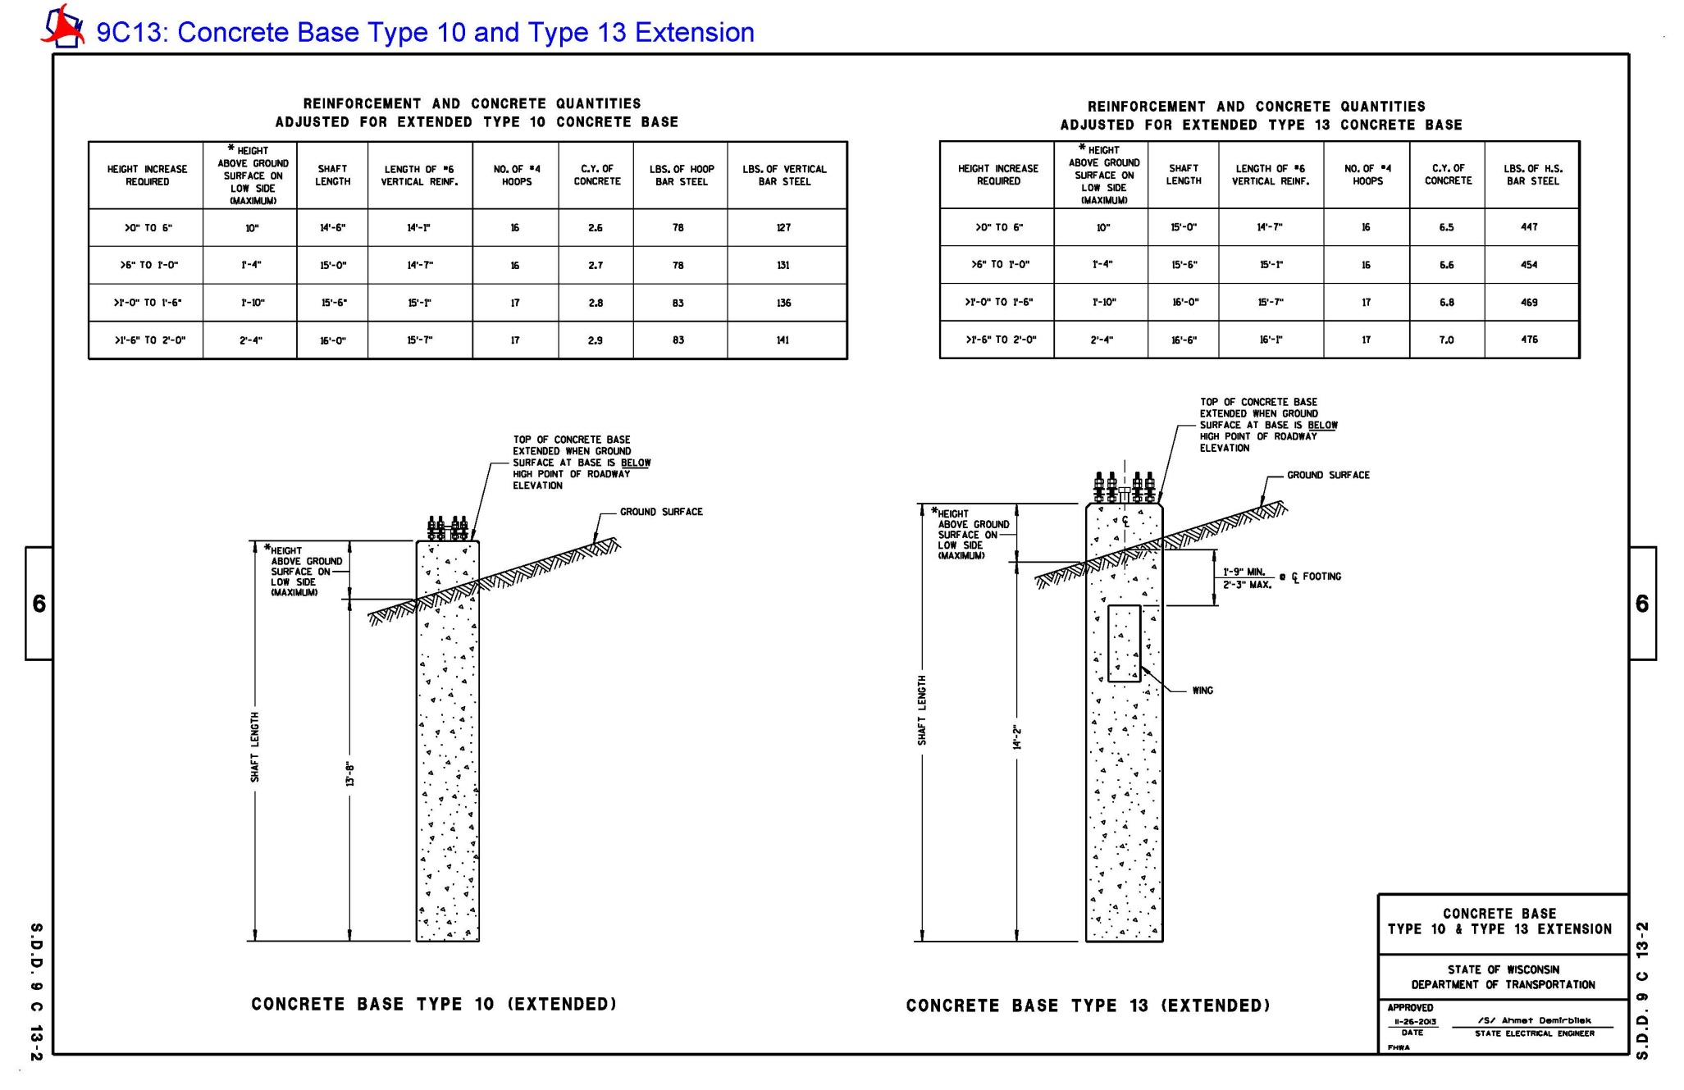

Slide 10
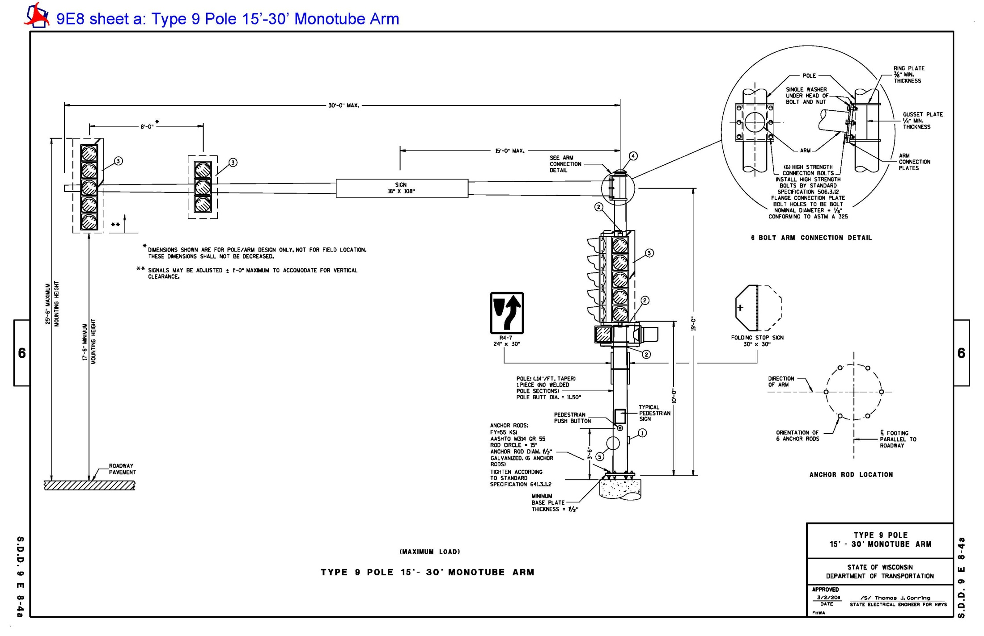

Slide 11
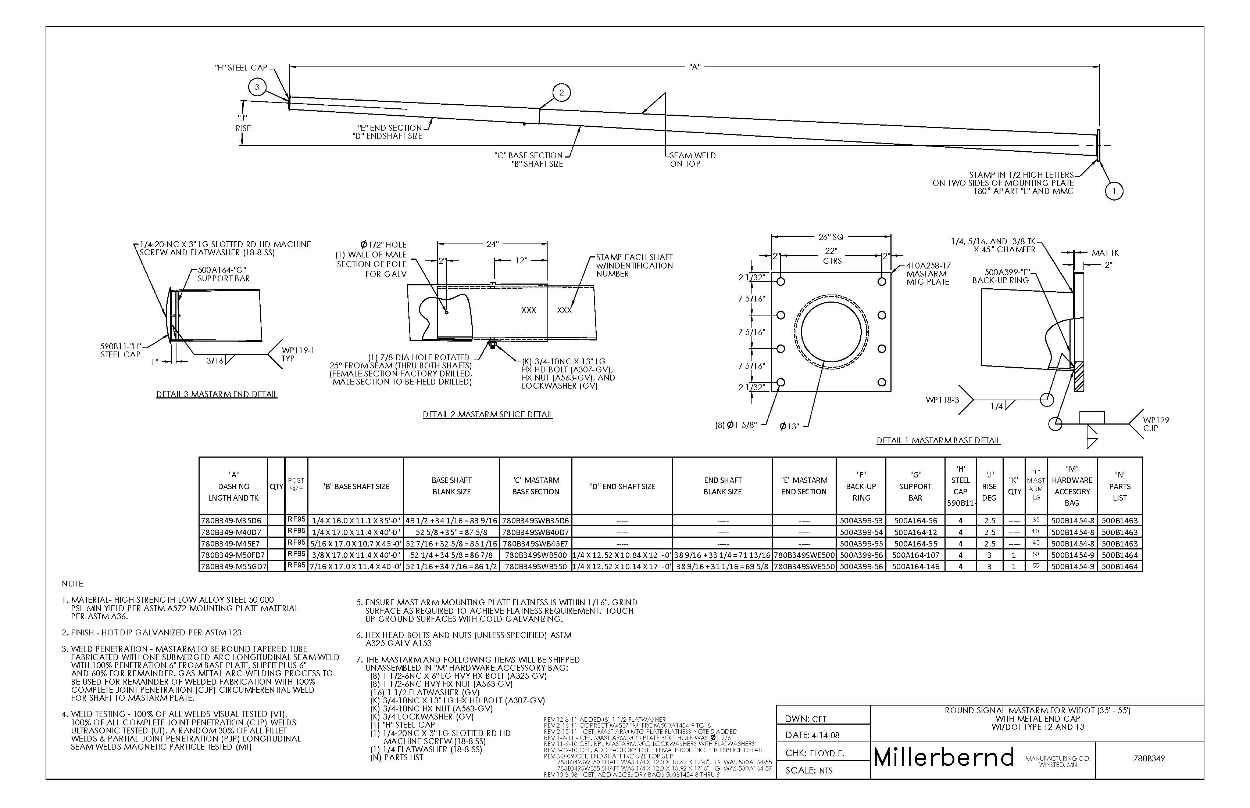

Slide 13
Electrical Services

Slide 14
Electrical Services
Types
Meter Breaker Pedestal – Common
Meter Socket – Fairly Rare
Main Lug Only – Line Voltages above 277

Slide 15
Electrical Services
Types
Meter Breaker Pedestal – Common
Meter Socket – Fairly Rare
Main Lug Only – Line Voltages above 277
Section 656
Process to get a lateral from the utility

Slide 16
Electrical Services
Types
Meter Breaker Pedestal – Common
Meter Socket – Fairly Rare
Main Lug Only – Line Voltages above 277
Section 656
Process
656.5(7)Coordinate with the engineer to determine how to handle.. If the utility bills the contractor directly, pay the utility promptly. Department will reimburse for INVOICE costs under the Electrical Service Lateral Administrative item.

Slide 17
Section 656 Elec Service Process
Special Provision would dictate responsibility. If none – Contractor
Not a Project Manager Responsibility
Make Application
Obtain Estimate for Lateral Cost from Utility
Pay for Estimate??
Install Service Device and Provide Wiring Affidavit
Utility Schedules Installation of Lateral
Utility Provides Invoice
Pay per Section 656
What should you pay
What if there is a credit?

Slide 18
Section 656 Elec Service Process
Make Application
Who?
Check SP’s
IF NOT DEFINED SPECIFICALLY
Contractor
Utility Needs Two Things
Where to send bill for lateral installation
Requestor/Applicant
Where to send monthly energy bill
Ultimate Owner

Slide 19
Section 656 Elec Service Process
Utility Provides an Estimate for Lateral Install
Utility performs a “design”
Applicant gets an estimate
Utility Needs One Thing Now
$$$
Cash/Check or PO
Contractors pay with Cash/Check
State uses PO due to State Purchase Law Requirements

Slide 20
Section 656 Elec Service Process
State Purchase Law
Includes State Administered Projects
Cannot pay for a service until that service is rendered
Cannot pay an “estimate”
How will you know?

Slide 24
Section 656 Process
State Purchase Law
State Administered Projects
Cannot pay for a service until that service is rendered
Cannot pay an “estimate”
Can we pay a contractor Invoice?
Yes and No

Slide 25
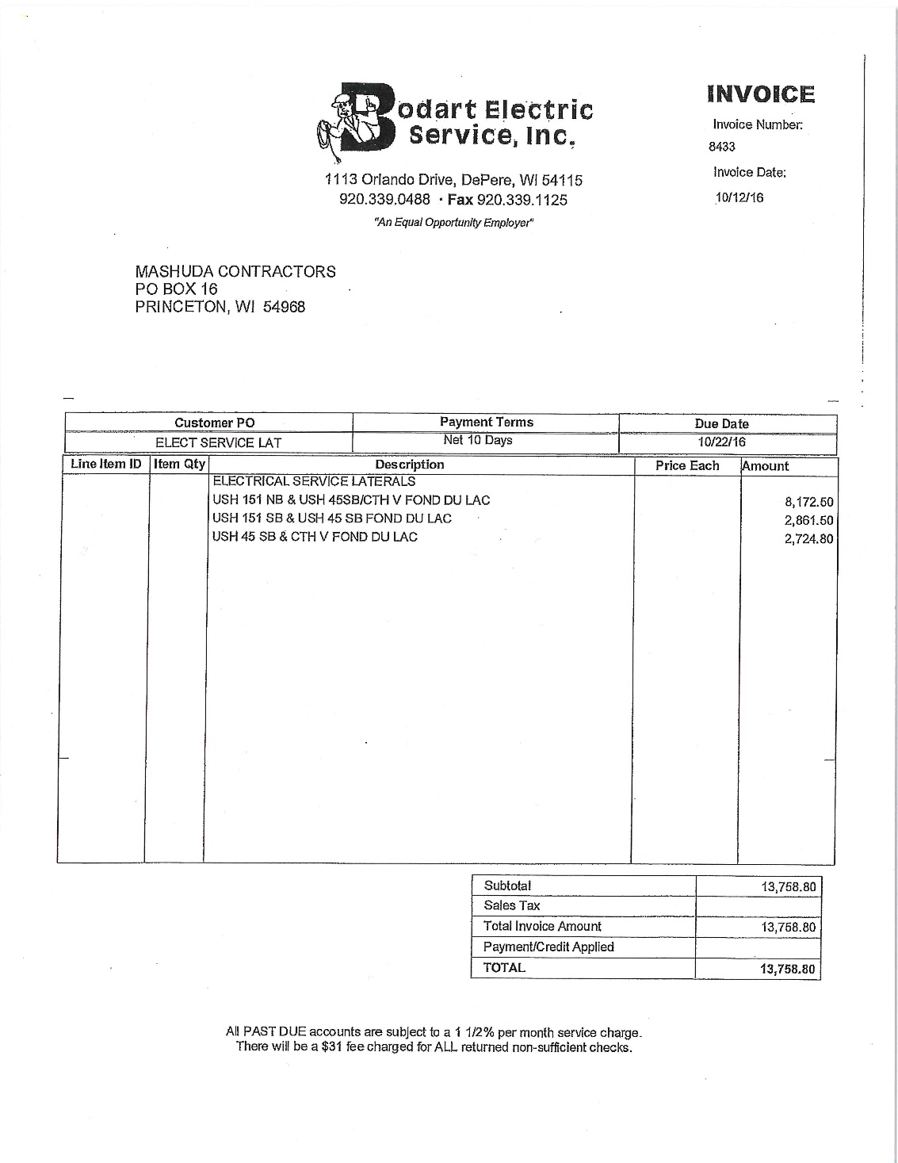

Slide 26
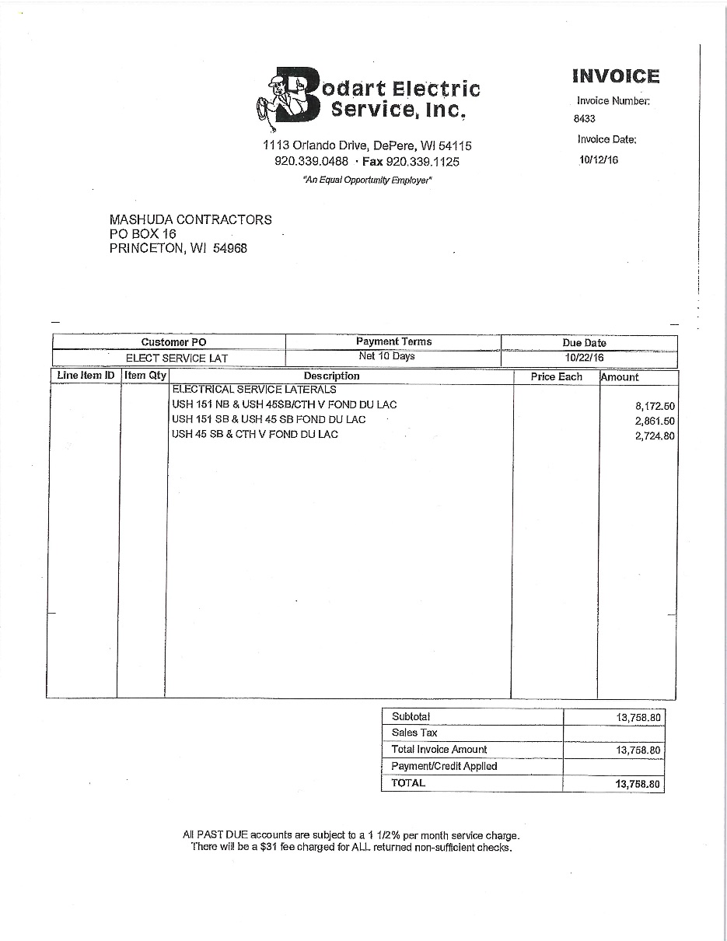
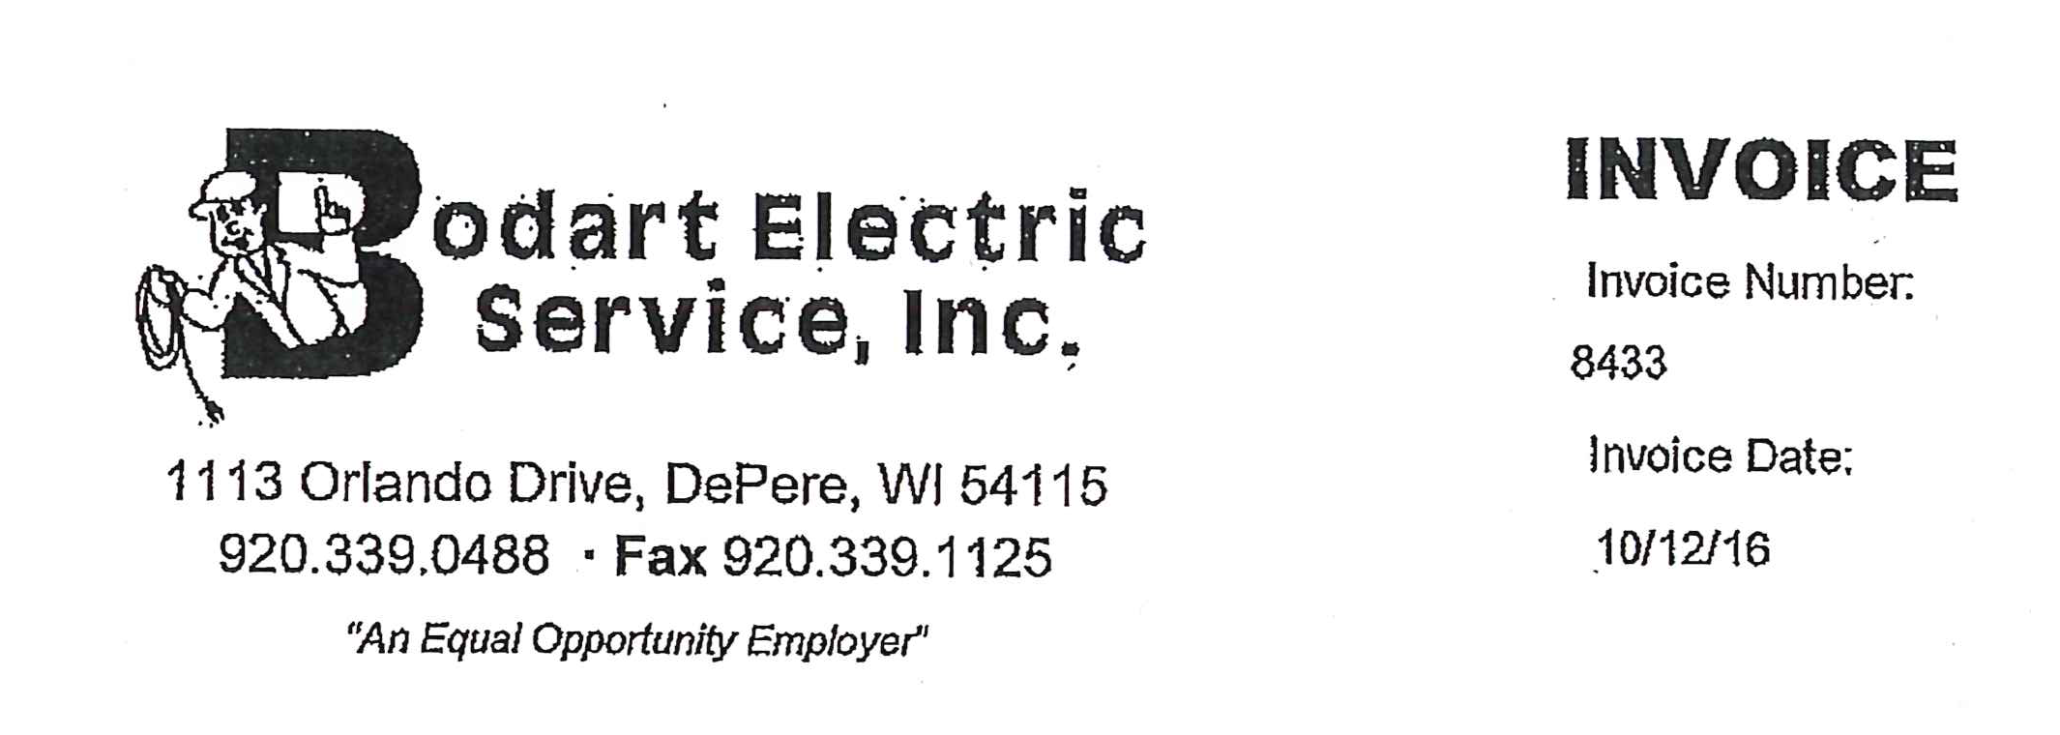
In this example the payment
Is the same as the “estimate”
From the utility

Slide 27
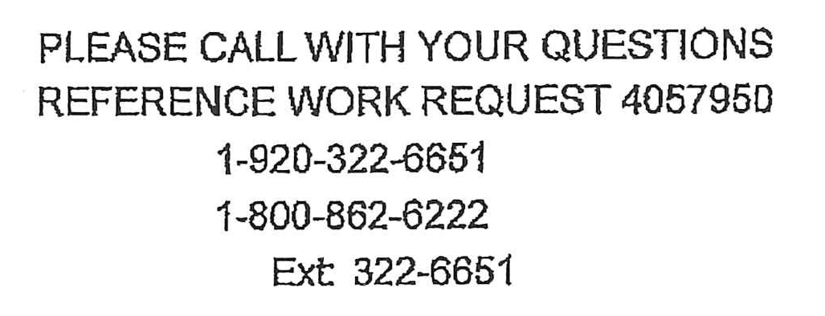
You may have to contact the
Utility to confirm

Slide 28
Section 656 Process
State Purchase Law
State Administered Projects
Cannot pay for a service until that service is rendered
Cannot pay an “estimate”
Can we pay a Contractor Invoice
Utility Accounting Policy
Must have payment before work gets scheduled
Cash/Check works – only for a contractor
PO works for Gov’t Agencies. Promise to pay.

Slide 29
Section 656 Process
Utility Schedules Lateral Installation
Many times we are at their mercy
Busy
Mother Nature
Project Staff, Contractor, NE Region Traffic – powerless
Start process early
Mention at Pre-Con if this is a controlling issue
It can become one if missed
Coordination of work
LD’s

Slide 30
Section 656 Process
Utility Provides Invoice for Lateral Installation
Contractor Submission
Proof of payment to utility
Copy of invoice from Utility
Now you can pay contractor per Section 656.5(7)
656.5(7)Coordinate with the engineer to determine how to handle.. If the utility bills the contractor directly, pay the utility promptly. Department will reimburse for INVOICE costs under the Electrical Service Lateral Administrative item.

Slide 31
Utility Invoice

Slide 32
Section 656 Process
Utility Provides Invoice for Lateral Installation
Credit or no credit? That is the question!
Should show on the invoice as a refund to the contractor
Who cares?
Nobody if you haven’t paid for this yet

Slide 33
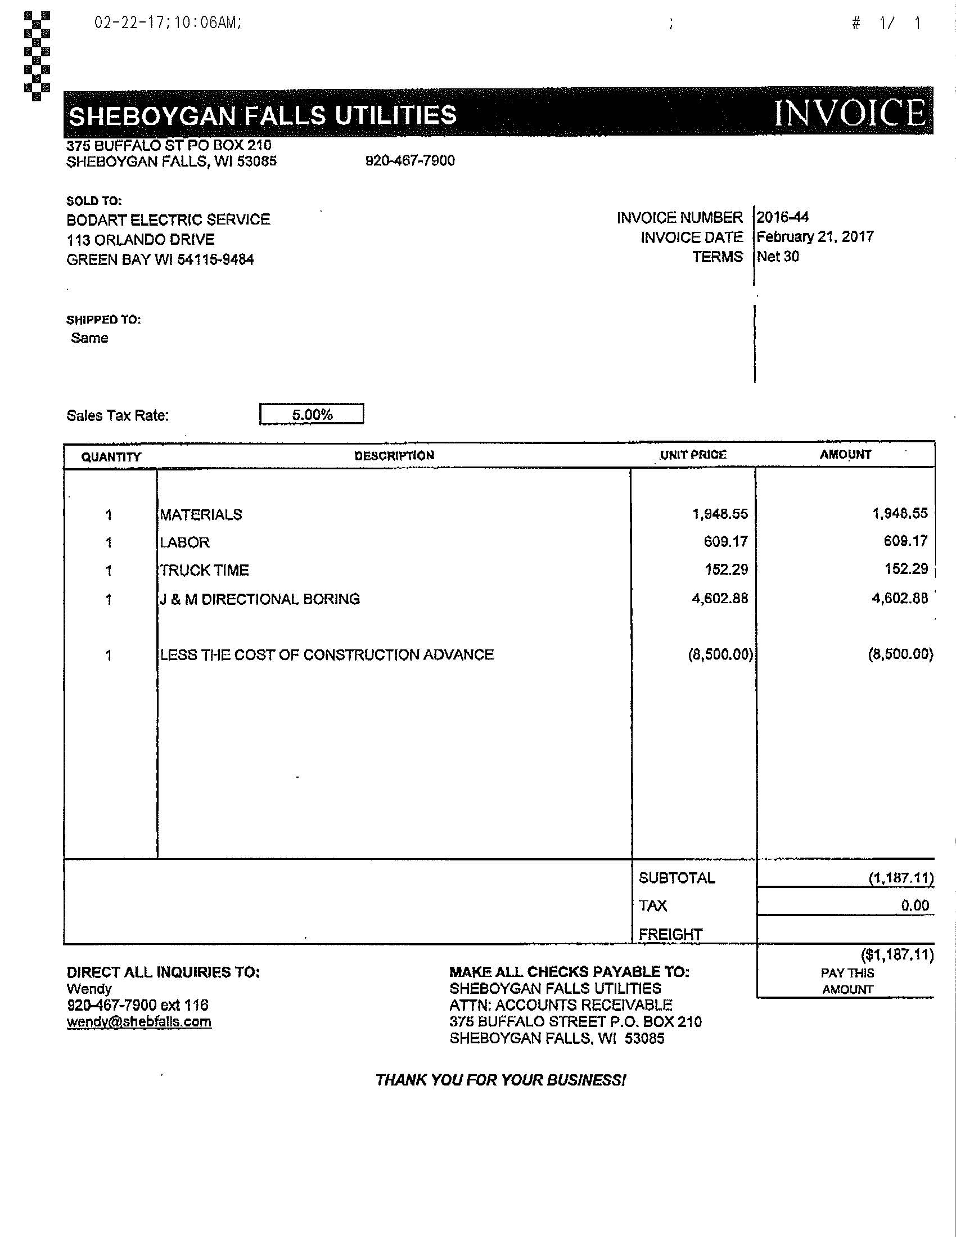
$7312.89
Costs
$8500
Payments
Credit
Owed to
Applicant
$1187.11

Slide 34
$7312.89
Costs
$8500
Payments
Credit
Owed to
Applicant
$1187.11

Slide 35
Section 656 Process
Credit???
Utility over-estimates
Credit comes back on INVOICE
If PM pays early the contractor gets overpaid
If we don’t get an invoice we may never know
Contractor may not reimburse
If we pay early AND we find out there is a credit
Document
Inform all parties
Withhold from estimate

Slide 36
Section 656 Process
This Whole Thing Can Slip Through the Cracks
Know it is in your plans
Only way to really remember
Contractor may forget to submit paperwork
Utility may be really late in providing invoice
Contractor forgets to submit real invoice from the utility

Slide 37
Section 656 Process
Questions
Contact NE Region Traffic Unit
Help getting paperwork
Contacting right people
Working through problems
Process not perfect
Only way to keep responsibility for coordination in the contractors hands.

