Slide 1
2017 Northeast Region Construction Training
UTILITIES
DTSD NER TSS-Utilities
Thursday, March 16, 2017

Slide 2
Overview
On-Site Utility Monitor
Utility Problems During Construction
Documentation Report
SPAR pilot project

Slide 3
On-Site Utility Monitor
ID 4085-42-71
STH 32, City of DePere
Outagamie County
ID 9670-09-71
STH 180
Marinette County
ID 6240-26-71
STH 47, City of Appleton
Outagamie County
Purpose: Monitor (not inspect) utility relocation
EXAMPLE
Notes:
NER has implemented 3 specific contracts for On-Site Utility Monitor in 2016 – which have been very successful.
These contracts are used for specific projects that have been identified as high-risk and high-cost.
The purpose of these contracts is to monitor (not inspect) utility relocations prior to and during construction, including: Schedule, Location, and Restoration.

Slide 4
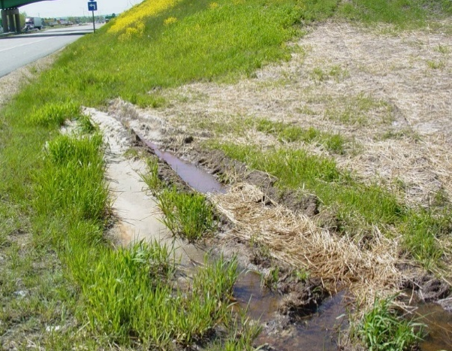
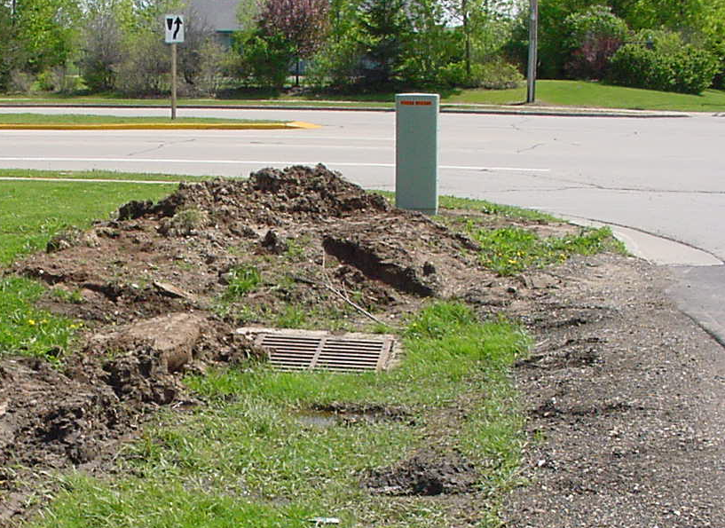
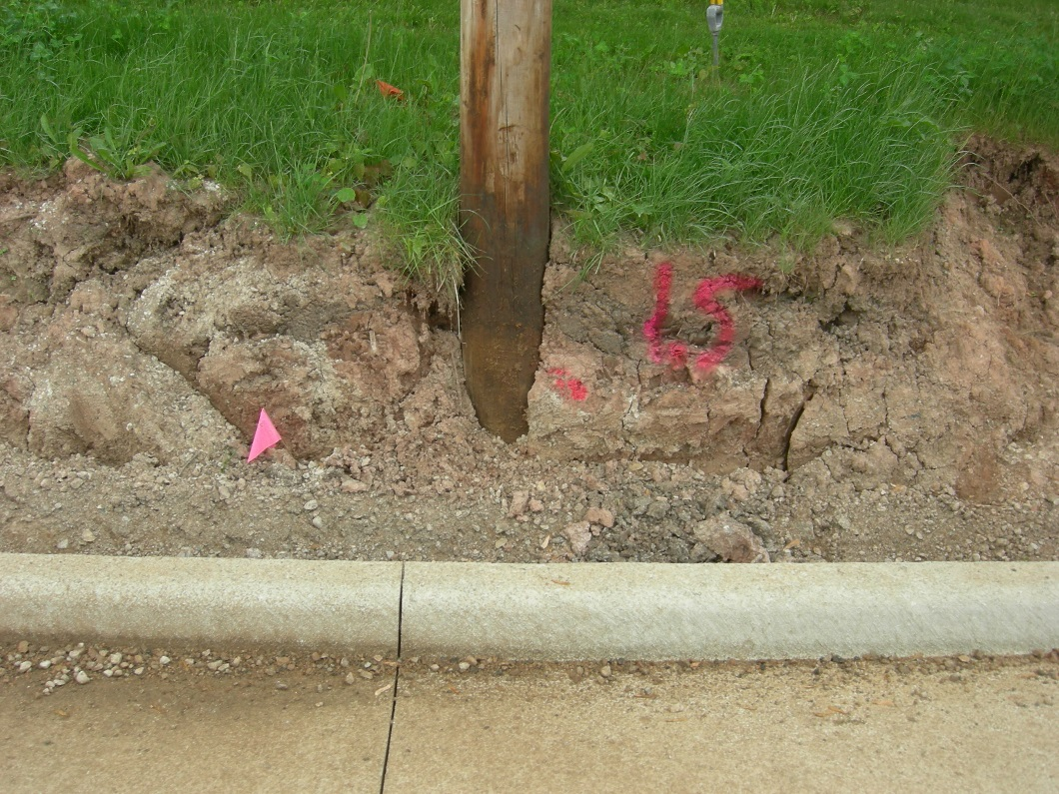
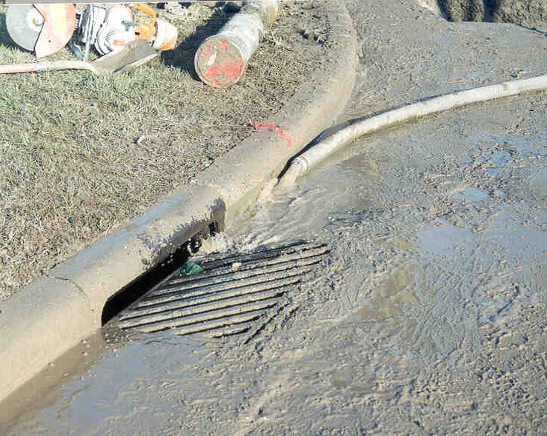
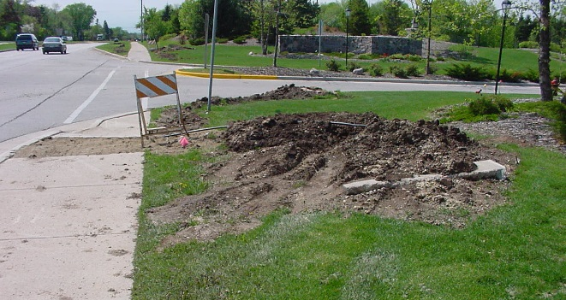
Notes:
poor LOCATION (center picture)
Poor RESTORATION (corner pictures) : erosion control , run-off, pedestrian access (and traffic control).

Slide 5
Utility Problem During Construction Documentation Report
Project Manager / Leader Version
Utility Company Version
WisDOT Guide to Utility Coordination
Chapter 20 Conflicts During Construction
Notes:
The goal of utility coordination is to not have any utility-related problems during construction, Unfortunately, as hard as we try, it is not always possible to accomplish that goal.
There are sever types of problems that typically occur during construction, which are identified in Chapter 20 of the UC Guide, along with the ways to handle each type of problem in the field.
Including how to document each problem.

Slide 6
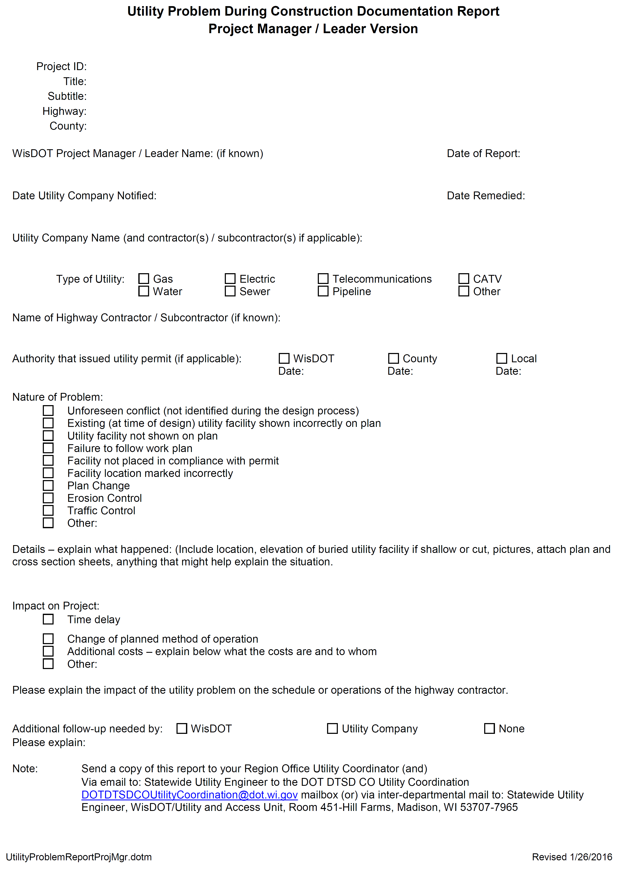
Notes:
Utility Problem During construction Documentation Report:
Project Manager / Leader Version
Utility Company Version
Not all problems are due to the negligence of the UTILITY, some are due to negligence of the CONTRACTOR / EXCAVATOR.
Nature of the Problem.
Details (and pictures) are important.
Send report to Region Utility Coordinator.

Slide 7
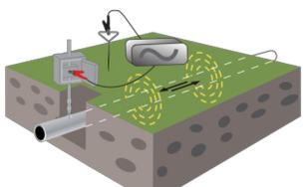
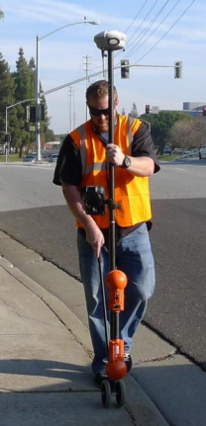
SPAR – pilot project
ID 4650-08-71
STH 55
Outagamie County
Subsurface utility mapping using SPAR
g Pressure as Main Relocate
  Objective: Save cost on hydro excavation
  Objective: Save time and avoid utility strikes
  Objective: Verify a difficult locate
  Objective: Document underground utility locations
Notes:
New technology!
The Northeast Region has identified one pilot project for subsurface utility mapping using SPAR.
The information gathered using SPAR will identify the approximate location of underground facilities that will be used and made available during construction.
Objectives:

Slide 8
Resources
WisDOT Guide to Utility Coordination (UC Guide)
  http://wisconsindot.gov/Pages/doing-bus/eng-consultants/cnslt-rsrces/util/ucguide.aspx
Utility Accommodation Policy / Highway Maintenance Manual
http://wisconsindot.gov/Pages/doing-bus/real-estate/permits/utility-uap.aspx
Construction & Materials Manual (CMM)
  http://wisconsindot.gov/Pages/doing-bus/eng-consultants/cnslt-rsrces/rdwy/cmm.aspx
Facilities Development Manual (FDM)
  http://wisconsindot.gov/Pages/doing-bus/eng-consultants/cnslt-rsrces/rdwy/fdm.aspx
Notes:
Resources . . . .

