Slide 1
FHWA-Required
DBE Program Responsibilities
2017 WisDOT Regions Construction Training
For
Construction Staff
Michele Carter, DBE Program Chief
Office of Business Opportunity & Equity Compliance
Northeast Wisconsin Technical College
March 21, 2017

Slide 2
Overview of presentation
Explain the chain of responsibility for the DBE Program
Demonstrate that DBE compliance and monitoring are interdisciplinary tasks shared by all of us
Explain FHWA expectations for DBE-related tasks to be performed by DOT construction staff
Remind you that we all work for WisDOT

Slide 3
USDOT Office of Inspector General
Issued an audit report titled:
Weaknesses in the Department’s Disadvantaged Enterprise Program Limit Achievement of its Objectives
Summary Findings
USDOT had no regulatory standard for measuring successful DBE utilization
USDOT has limited success in achieving its program objective to develop DBEs to succeed in the marketplace due to “misplaced emphasis”
Ineffective program management and oversight for the DBE program
Weak DBE certification and contract oversight practices
& Made 8 Recommendations

Slide 4
FHWA Civil Rights HQ responded
Conducted an in-depth study of FHWA division & state DOT practices
FHWA formally declared responsibility for the DBE program
  created a modal collaborative with FTA & FAA
Adopted Risk Based Stewardship and Oversight (RBSO) as a means to manage and mitigate identified risks to all aspects of their programs
  Civil Rights Program Administration is one
  of FHWA’s Top 10 Corporate Risks
  44% of FHWA Division Administrators stated that if the risk were not mitigated or eliminated it could have a major or catastrophic impact on the administration of the State’s Federal-aid Highway Program.

Slide 5
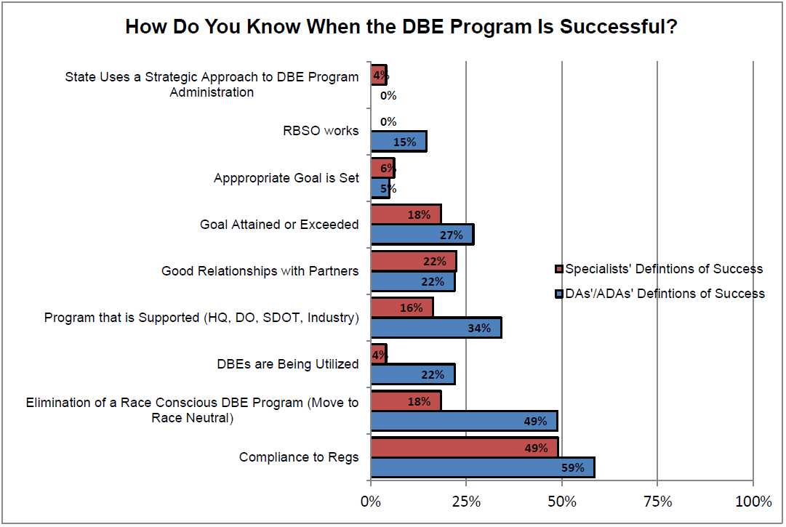
FHWA Perspective
Compliant vs Successful DBE Program

Slide 6
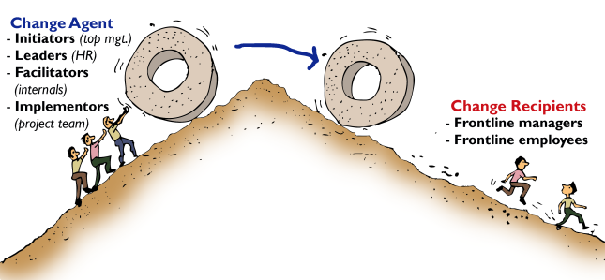

Slide 7
DBE Impact: National vs Wisconsin
35,840 Certified DBEs
2015 National DBE Utilization: 12%
Funds: $4.8 billion of $39.3 Billion
906 Certified DBEs
2015 Wisconsin DBE Utilization: 14.03%
Funds: $83.2 out of $696 million

Slide 8

What you need to know about the dbe program
DBE program is a requirement when federal funds are received/used
  Federal funds are 60-70% of WisDOT’s annual budget
DBE is in the Law
Title VI
Nondiscrimination not Minority
Transportation Bill
Reviewed & approved by Congress
Inclusion, Remedies
Guidance
Code of Federal Regulations, 49 CFR Part 26

Slide 9
Contract Provisions in all Federal Contracts
“Contractor’s failure to comply with any provision of the DBE regulations will be considered a material contract breach. This is non-negotiable.”
DOTs were to include a list of contractual sanctions that may be used in the event of a breach of contract on this basis.
DBE is a contract requirement at WisDOT
  FHWA 1273
  Executive Order 11246
    ASP1
    ASP3
    ASP4
    ASP7
    ASP9

Slide 10

The DBE Program needs you
DBE monitoring is in your job
Just Ask the Feds
  
49 CFR Part 26.37
What are a recipient's responsibilities for monitoring the performance of other program participants?
Your DBE program must also include a monitoring and enforcement mechanism to ensure that work committed to DBEs at contract award or subsequently (e.g., as the result of modification to the contract) is actually performed by the DBEs to which the work was committed. This mechanism must include a written certification that you have reviewed contracting records and monitored work sites in your state for this purpose. The monitoring to which this paragraph refers may be conducted in conjunction with monitoring of contract performance for other purposes (e.g., close-out reviews for a contract).

Slide 11
Monitoring DBE performance
Interdisciplinary staff responsibility
  DBE, LCS, project, audit, inspectors, area engineer
  Written confirmation required
  Where is the written confirmation certification stored?
  Remember . . .
  ARRA Audits
  FHWA Compliance Assessment Program Civil Rights Review
Who is responsible for monitoring and overseeing DBE performance?
WisDOT
Who monitors and oversees WisDOT performance?
FHWA
Stewardship & Oversight Agreement
Federal Reports

Slide 13
MONITORING Prompt Payment
Prompt Payment
Applicable to all subcontractors
  including DBEs
  all tiers of subcontractors
  contracts in any form: leases; work orders, task orders
Ensure that a prompt payment provision is included in every contract including subcontracts.
Addressed at pre-con and progress meetings
Procedures should follow WisDOT quality assurance measures
We need cooperative procedures to:
Track & Monitor when & how regions change contracts (DBE Goal Adjustments)
Examine contract/subcontract records
Monitor worksites
Keep running tally of payments
GET written confirmation that work committed to DBEs at contract award is actually performed by those DBEs.

Slide 14
Monitoring Questions
How regions determine whether to accept the primes pay estimate (inspection/quality measures/who);
How do regions confirm substantial completion of each sub-contracted portion of the work; (iterative payment/prompt payment)
Project Schedule tracking for subcontractors
Review Subcontracts for release of retainage (DBE Office)
OBOEC is responsible for affirmative monitoring and enforcement of prompt payment and return of retainage. Advice?

Slide 15
Safe, Efficient, On Time, Under Budget
Fraud = inefficiency,
lack of quality control by DOT

Slide 18
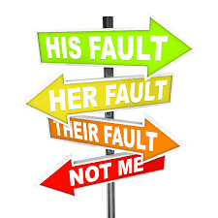
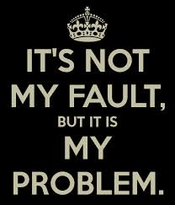

Whose fault is fraud?

Slide 19
Project Coordination Tasks & DBE
1) Replacing or Terminating a DBE
No payment to Primes if the approved DBE doesn’t do the assigned work
WisDOT must confirm/deny alleged efforts
Proof of effort is required from the prime
2) Reviewing CUF
What did field staff see/do?
Documentation: emails, project diaries,
3) Permitting primes to use joint checks
4) Coordinating Workforce Opportunity Sessions
5) Coordinating site visits w/DBE staff/consultants
6) Sharing construction progress with non-project staff
QUESTIONS
Who is the “authority” on the job site?
Criteria for approving pay estimates
Good cause for terminating a contractor/subcontractor

Slide 20

Region To Do
Standard Agendas
Pre Con Meetings Progress Meetings | Review ASPs Notification to email Subcontracts DBE utilization Labor utilization Payment tracking

Slide 21
Region To Do
Commercially useful function review
Form DT1011 Written Certification | 1 DBE per Project Entry in Project Engineer Diary Red Flag Reporting

Slide 22
Region To Do
Region To Do
alerts to dbe staff
Email Alerts System Access Joint Check Policy | 50-60% Completion DBE Performance Red Flags

Slide 23



INTERACTIve communication
Project Engineer Diaries IS & Software Interfaces | Annual Event Change Orders Project Meetings Project Schedules

Slide 24

Anticipate follow-up from DBE Staff regarding . . .
CUF Review Form
Joint Check Policy
Utilization of Project Diaries
On site visit protocols
Accessing Project Schedules
Alerts upon 50% completion
Who does pay inspections
Prime’s requests to replace or terminate DBE firms

