Slide 1
2017
Labor Compliance Reminders

Slide 2
Entering Dates in Project Tracking
Important to enter correct dates
Labor Compliance relies on dates for our finals
Substantially Complete date triggers automated email to me to start the finals process
WisDOT performance team measures the time it takes to enter a payroll clear date from the substantially complete date
Please don’t back date any of the dates
Timely payroll clear dates entered by Labor Compliance helps the close out projects in a timely fashion which gets contractors paid
Notes:
Intros – LCSs and Contractors (Co, name, and what you do).
- Housekeeping – Restrooms, silence phones, restaurants for lunch
- Statewide training – can still catch trainings statewide
- Training materials – will be available online soon
Q&A – we’ll be compiling questions from all trainings and will share answers by phone
Feedback appreciated, will improve training and materials to be posted online
Why are we here today? Strengthen knowledge, communication, network, partnering to complete and close projects timely and efficiently.

Slide 3
Daily Diary
Important resource for Labor Compliance
Allows us to match up days, equipment and companies for payroll discrepancies, incorrect classifications and most importantly, Wage Complaints
Please enter the name of the of the trucking company and number on the truck
It is a tremendous help if you do that
Notes:
Changed Agenda to match what was in the slides – moved apprentices and took off resources since there are two separate resource areas

Slide 4
Example of Entering Trucking Firms
2016 Wage Complaint
No trucking names were entered in Diary
Had to work with prime and sort through 781 truck tickets with prime to match 2,751 hours trucked between 2010 -2016
$90,969.00 back wages owed to 1 truck employee
Notes:
Labor Compliance is enforced by law

Slide 5
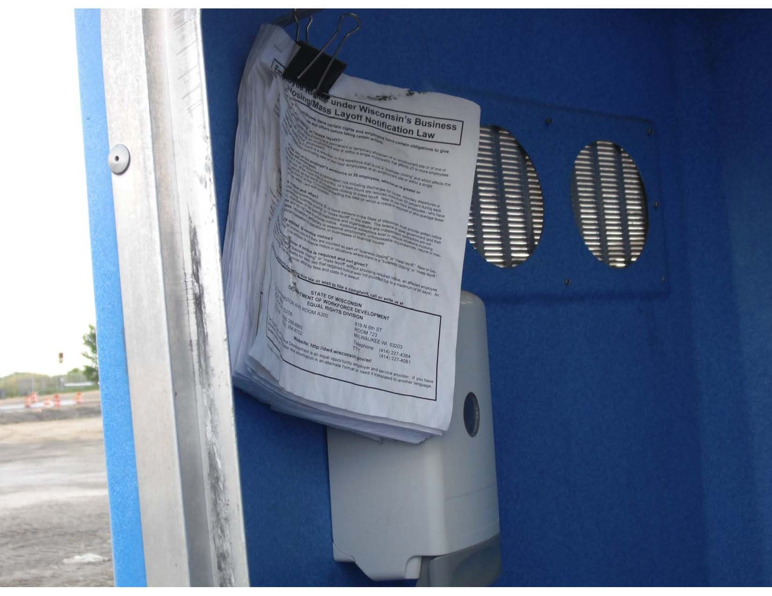
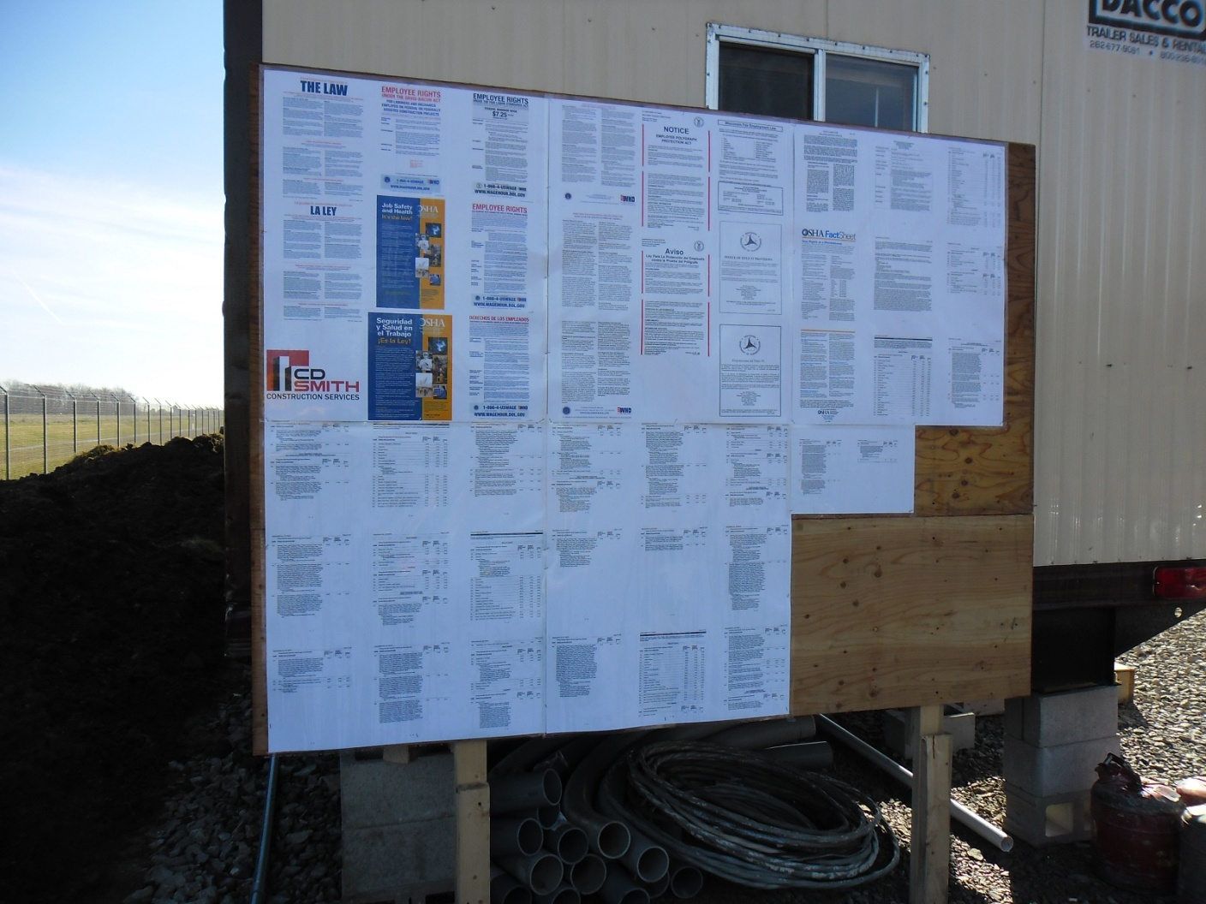
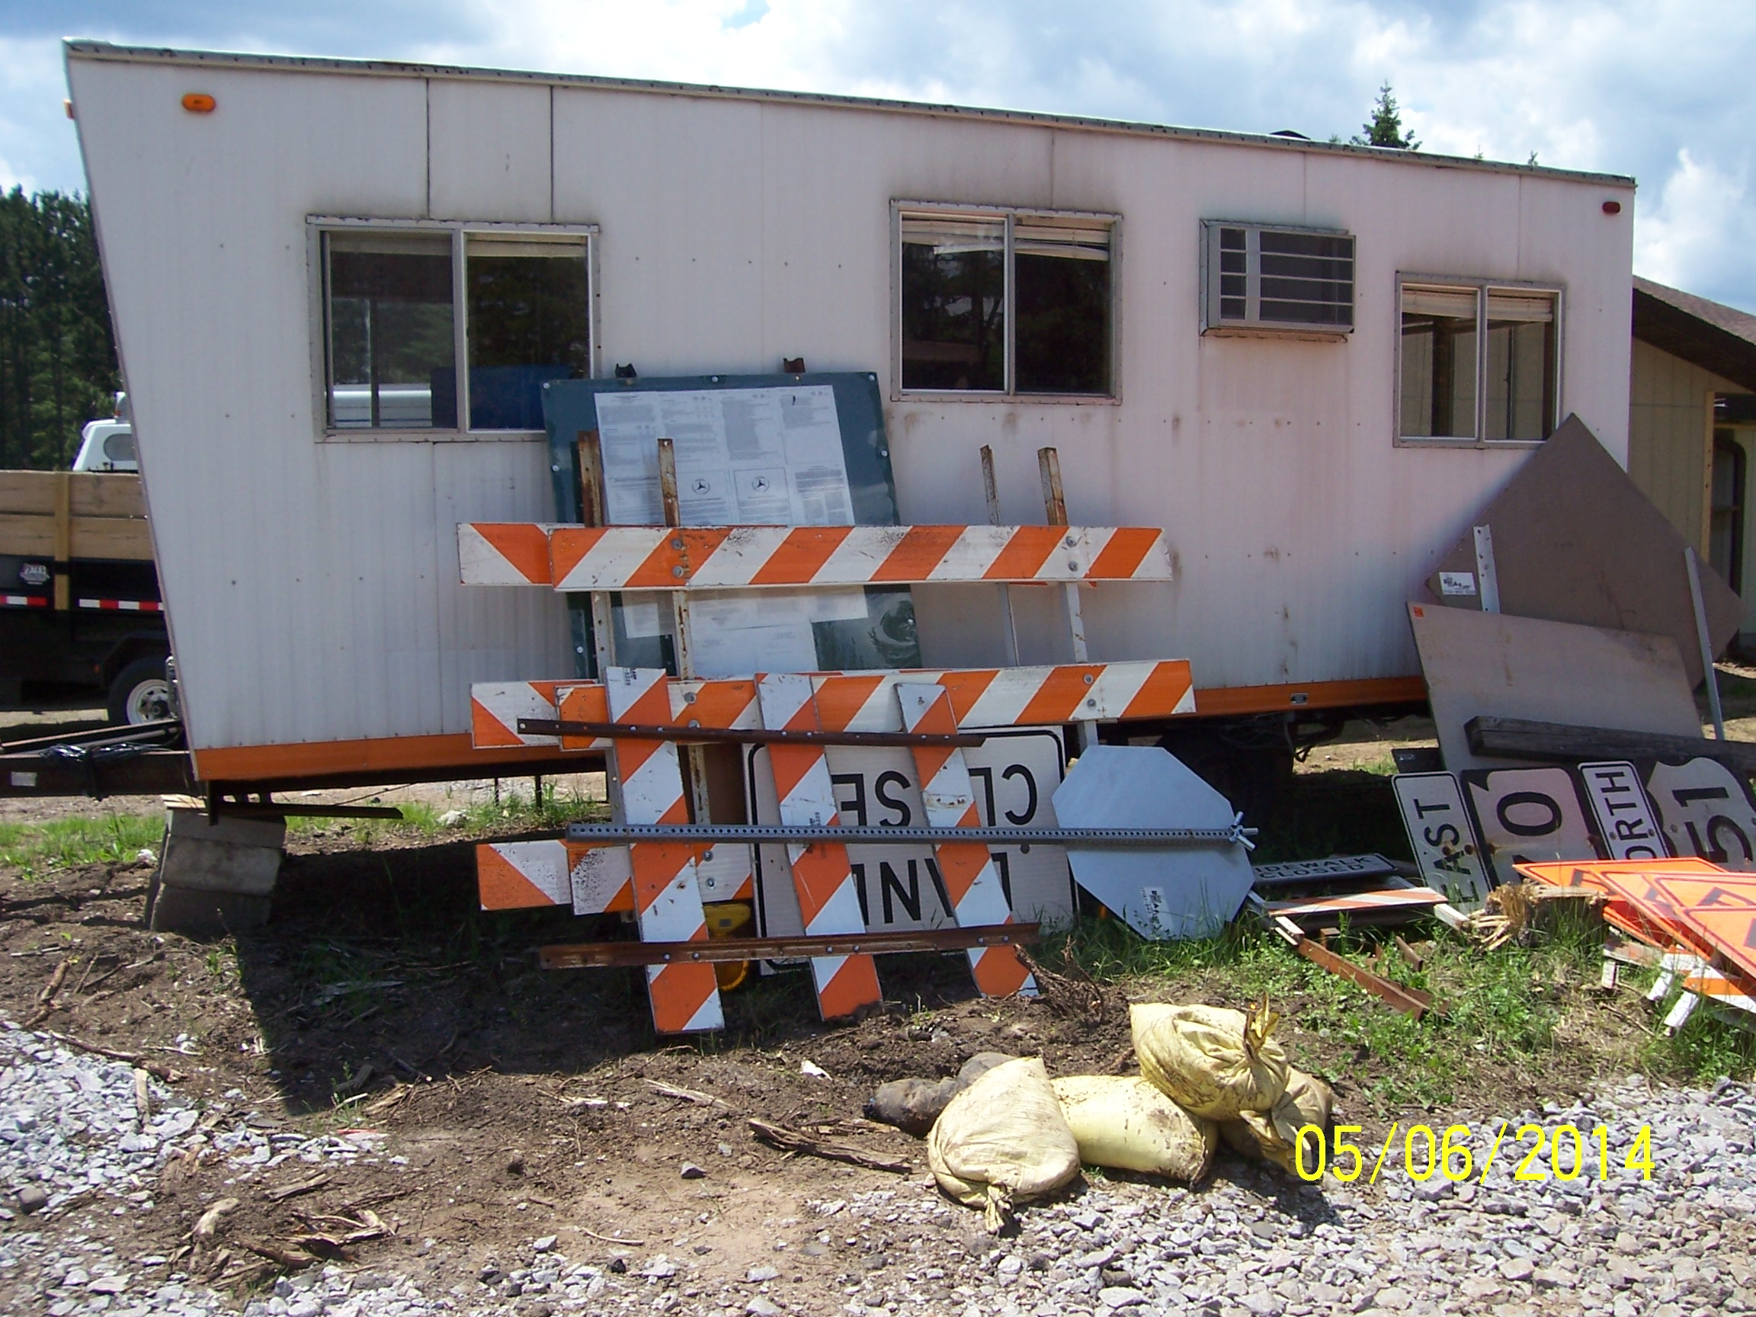
Construction Bulletin Board
NOT ACCEPTABLE
PERFECT
NOT ACCEPTABLE
Prime contractor must maintain.
Must be weatherproof, readable, accessible, complete and accurate.
WisDOT provides a courtesy copy of the posters.
All employees need to know the location of the board.
Notes:
- AKA wage board, but not just for wages. Federal requirement, must be up and accurate before work starts.
- Boards are to be maintained, all of your workers must know where this board is.
Later in the presentation, new PW laws will be affect (posting all pages of the Fed. Wages rates). Expect boards to be bigger in size etc.
Made changes

