Slide 1
2017 NER Const. Training
Survey Issues
Cormac McInnis
NER Survey Coordinator
920-492-5638
Cormac.mcinnis@dot.wi.gov

Slide 2
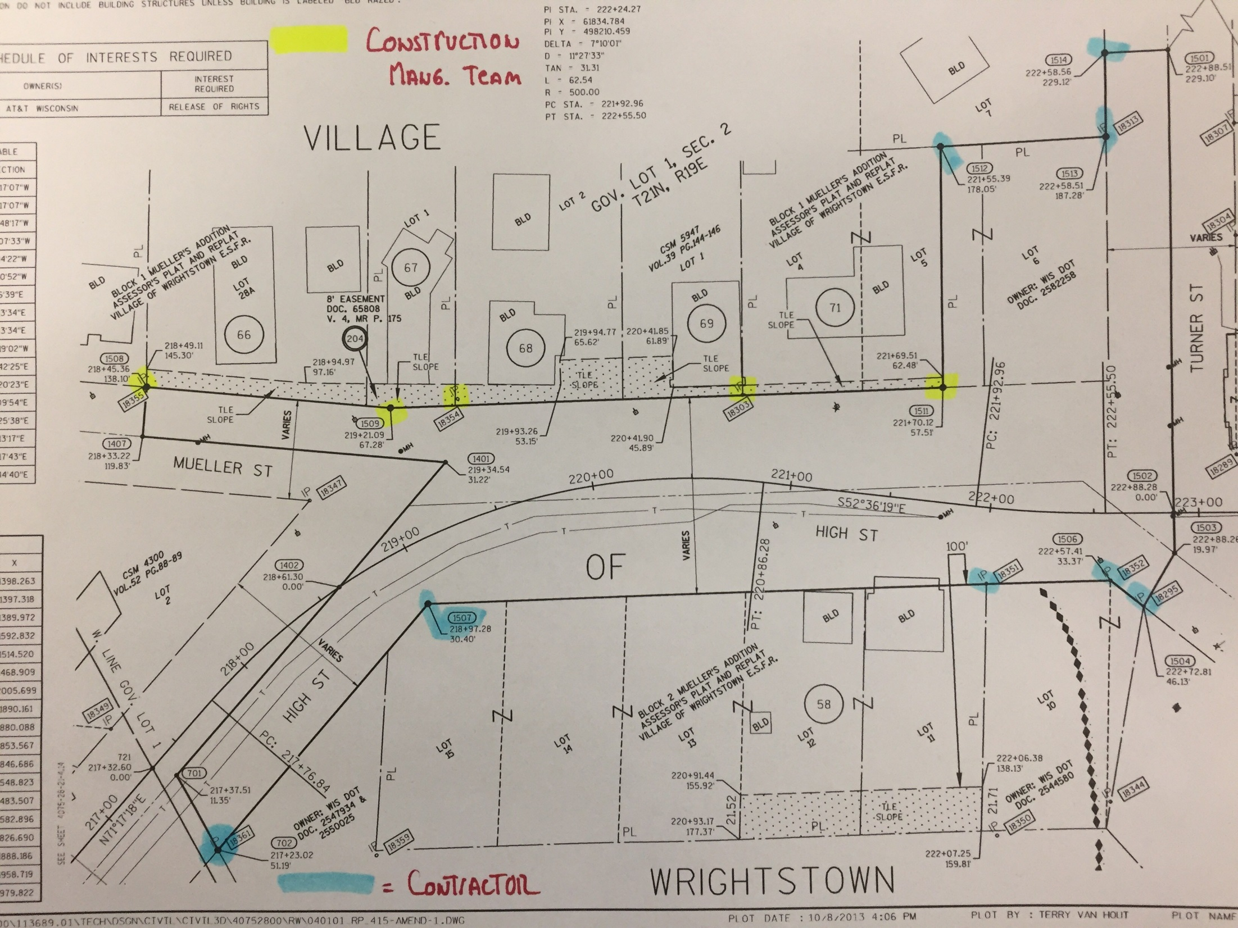
ROW & Property Monument Responsibilities

Slide 3
Bench Marks – Location & Elevation Form

Slide 4
2017 NER Const. Training
Survey Issues
Cormac McInnis
NER Survey Coordinator
920-492-5638
Cormac.mcinnis@dot.wi.gov

