Slide 1
Work Zone Traffic Control Presentation
2017 NE Construction Training
March 16th

Slide 2
Work Zone Topics
Temporary Portable Rumble Strips (TPRS)
WisTMP
Work Zone Crashes
Temporary Work Zone Speed Limit Covering
SDD Changes for 2017
Lane Closure System Entries

Slide 3
Temporary Portable Rumble Strips
Required for all Flagging Operations, effective with February 1, 2017 PS&E
SDD 15C12 – Flagging Operations
Piloting TPRS for Freeway Lane Closures, BTO studying effectiveness for future guidance and policy
Notes:
An array is 3 strips, 2 sets of arrays on each end of a flagging operation
TRPS are bid as a lump sum
Piloting TPRS on a weekly closure on I-43 in Sheboygan County
3 arrays are used for Lane Closure set-up, 2 in the lane that will be closed and 1 in the adjacent lane.
BTO is completing a study of 5 locations to determine future policy and guidance.
Only allow Road Quake 2 or 2F, proprietary product.
Should see TPRS on many milling/paving projects this summer throughout the region

Slide 4
WisTMP
Attaching Project Amendments to the WisTMP
FDM 11-50-5.7.5 - Monitor TMP
FDM 11-50-5.7.6 Post Construction Project Evaluation
Did queue exceed what was approximated in the analysis of the TMP?
Did the mitigation strategies work?
What changes were made during construction that impacted the TMP? (allowable lane closure hours, work hours, etc)
Total number if incidents/crashes that occurred?
Any complaints from public?
Project Close out at the end of the project
Notes:
Attach amendments (after 90% approval) to the WisTMP so we have better documentation
Construction Staff needs to be monitoring the TMP to make sure mitigation strategies are effective, the queue and delay is what was predicted in the TMP analysis, lane closure hours are acceptable (could they be extended or do they need to be shortened), documented complaints from the traveling public, incidents occurring in the work zone.
Attach Post Evaluation summary document to WisTMP that includes information provided in 11-50.5.7.6 (there is a bulleted list of information that should be documented)
Reminder to PM’s to change project from 90% to marked as completed for Project Close Out in the TMP System

Slide 5
Work Zone Crashes
Report any Work Zone crashes to WisDOT BTO mailbox: DOTWorkZoneCrashes@wisconsin.gov
FDM 11-50-5.7.5, CMM 1-45.8.2
BTO is working on a crash report form to be filled out by construction staff
Information to provided:
Project ID and Location
Crash Severity (PDO, Injury A/B/C, Fatal)
Crash Type (Rear-end, Head-On, ROR, SSS, Fixed, etc)
Time of Day
End of Queue
Did the crash occur due to a work zone set-up?
Notes:
BTO is looking to better track work zone crashes since not all crashes are captured in the DT 4000 crash report forms
BTO is planning to start doing field reviews of crashes in work zones depending on severity, especially work zone fatality crashes (many other states do work zone field reviews after a crash has occurred)
We understand that some crashes may occur when you are not on site, but try to get some information pertaining to the crash and send it over.
BTO set up a separate mailbox that the information can be sent to, a form will be distributed this Spring for field staff to fill out.

Slide 6
Temporary Work Zone Speed Limit Covering and Uncovering
Make sure contractors are removing the speed reduction per approved temporary speed declaration language
WisDOT is working towards better statewide consistency and driver compliance in work zones
TGM 13-5-6 covers the instances for reestablishing the permanent speed limit and when to keep it lowered all the time
Notes:
-There have been issues with contractors not removing the temporary speed reduction and leaving it up 24/7.
-This starts to reduce compliance with motorists who actively see a lower speed limit without workers present.
-Some regions do a very good job with this and some do not, so we would like to see better statewide consistency so we can achieve better speed reduction compliance when warranted.
-Instances for keeping reduced speed limit in place all the time:
-Counter-directional traffic
-Lane shift onto shoulder/temp pavement
-Temp barrier block wall in place

Slide 7
SDD Updates
SDD 15D15 - Lane Closures at Ramps (Revised)
Entrance and Exit Ramps within Left and Right Lane Closures
SDD 15D39 - Drop-offs (New)
SDD 15C12 - Flagging Operations (Revised)
All should be published by April
Notes:
-Drop-off’s SDD covers when and where “Uneven Lanes” signage needs to applied, as well as “Low Shoulder” and “Shoulder Drop-off” signs for any work on the shoulders

Slide 8
SDD Updates
Notes:
-Drop-off’s SDD covers when and where “Uneven Lanes” signage needs to applied, as well as “Low Shoulder” and “Shoulder Drop-off” signs for any work on the shoulders

Slide 9
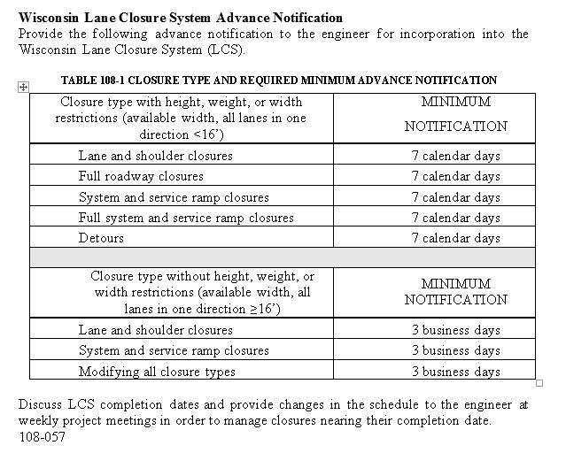
Lane Closure System Entries
STSP 108-057

Slide 10
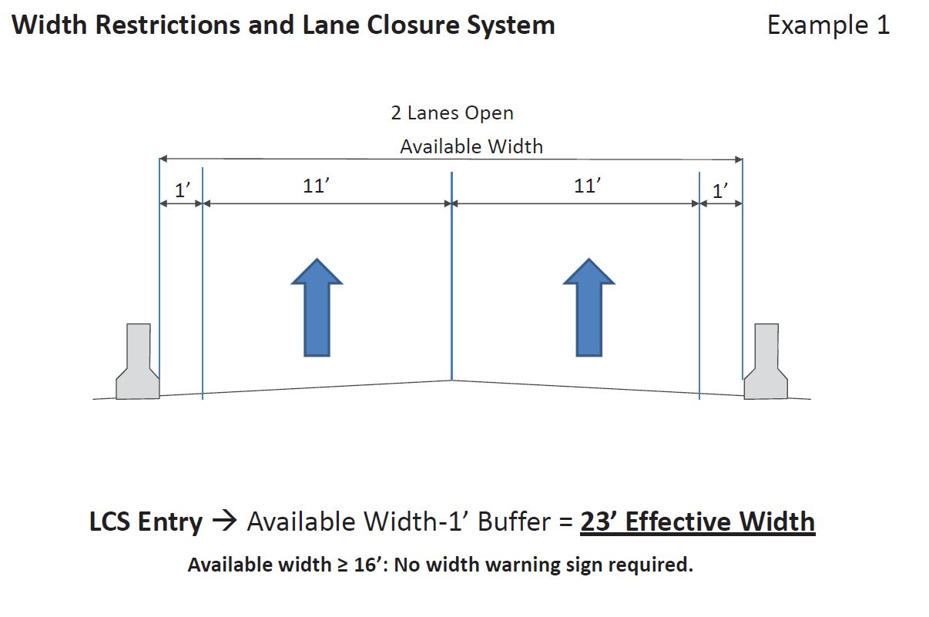
Lane Closure System Entries
Available Width Definition

Slide 11
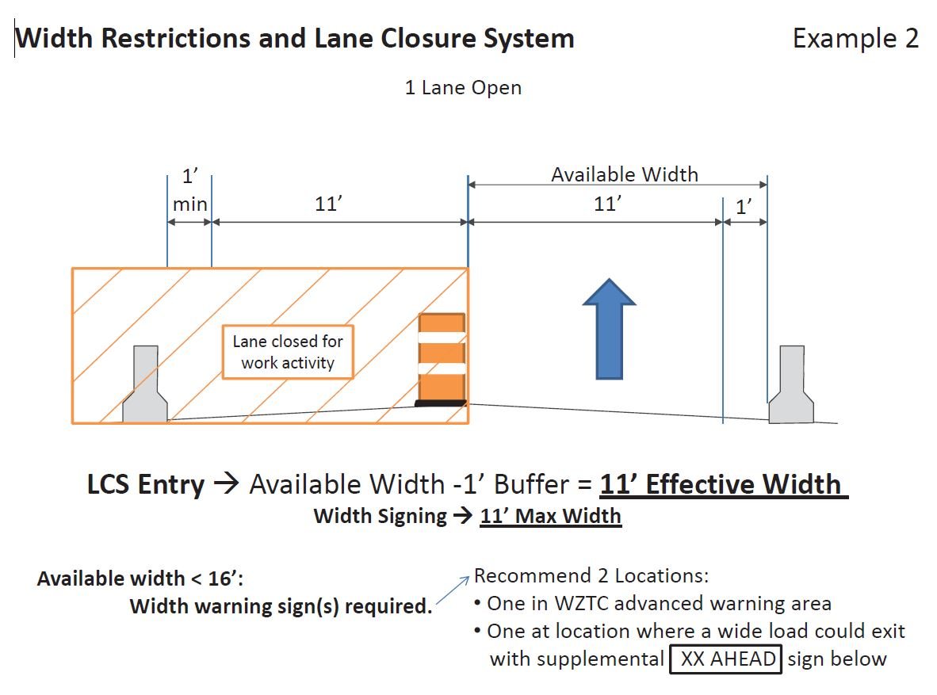
Lane Closure System Entries
Available Width Definition

Slide 12
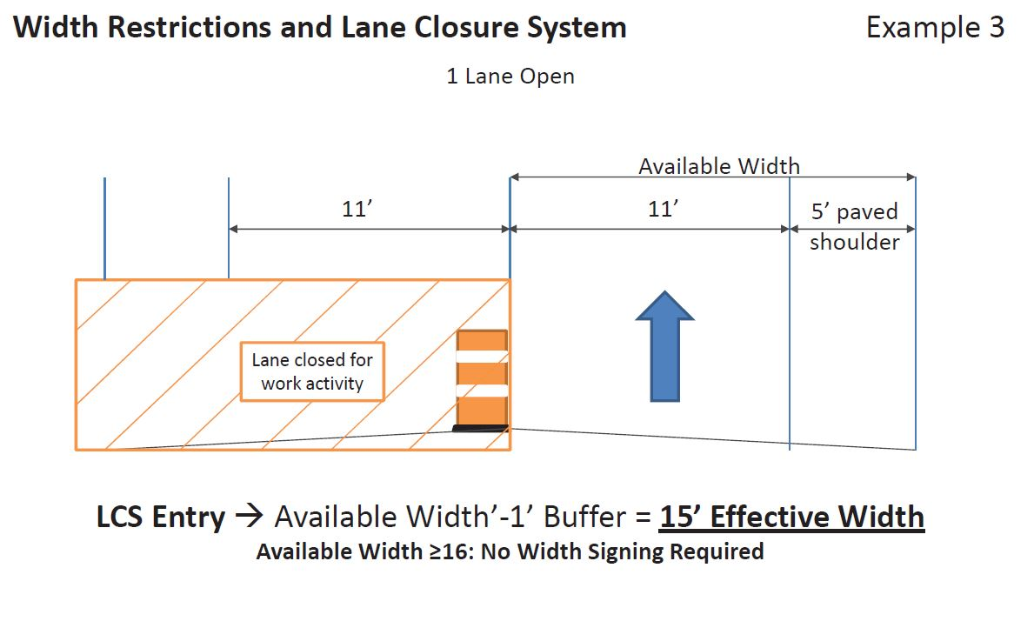
Lane Closure System Entries
Available Width Definition

Slide 13
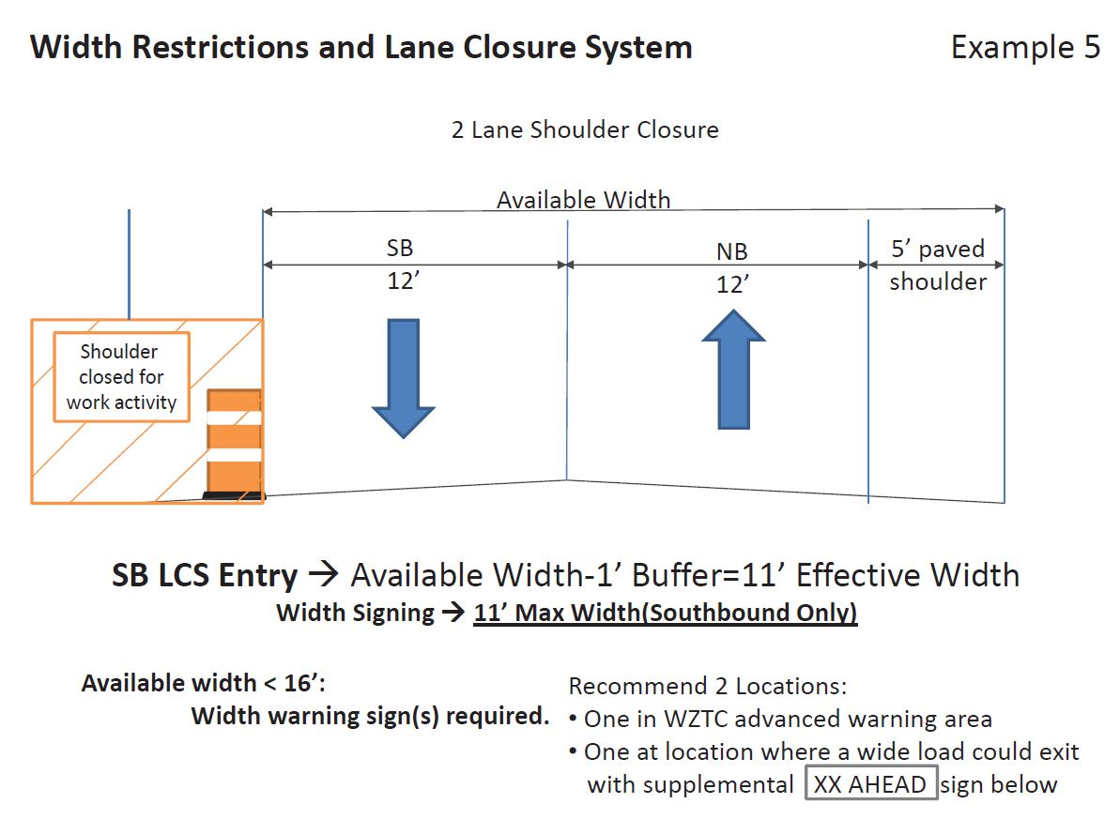
Lane Closure System Entries
Available Width Definition

Slide 14
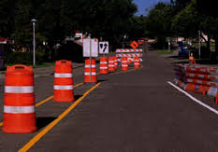
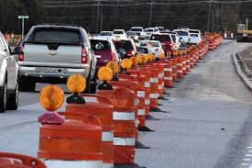
Questions?
Contact Information
Joshua Falk
Work Zone/TC Engineer
joshua.falk@dot.wi.gov
920-366-8033

